Slide 1

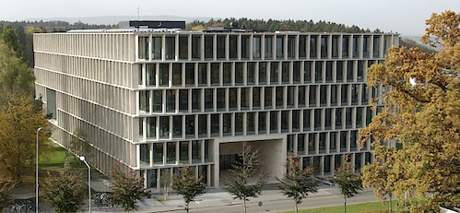
Quantum metrology with a Single Qubit
Andrey Lebedev
(S.Danilin, G.Lesovik, G.S. Paraoanu, G.Blatter)
Institute fur Theoretische Physik, ETH Zurich

Slide 2
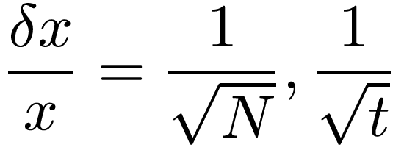
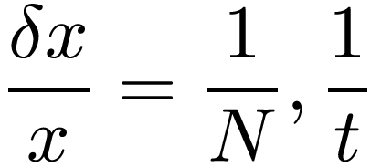
Outline
1) Introduction
2) Ramsey Intterferometry and measurement of the characteristic function of a
stochastic process.
3) Phase estimation algorithms. Kitaev and Fourier procedure in ideal situation.
4) Experiment.

Slide 3




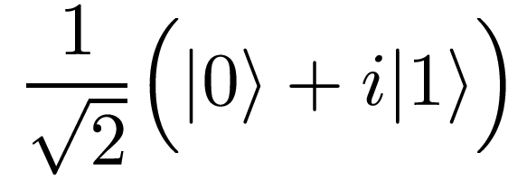



Ramsey sequence with a single spin
rotation with
an unknown angle
Probability of the excited state:

Slide 4


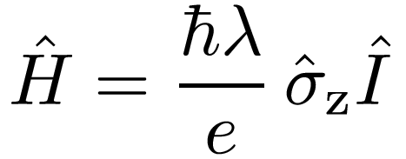


FCS measurement
Rotation angle is proportional to a
number of transmitted electrons
random process
Characteristic function
of the stochastic process
FCS
Observed probability:

Slide 5





A more general view:
Quantum point contact at fixed voltage:
Non-fluctuating current:
White noise:
signal
noise

Slide 6




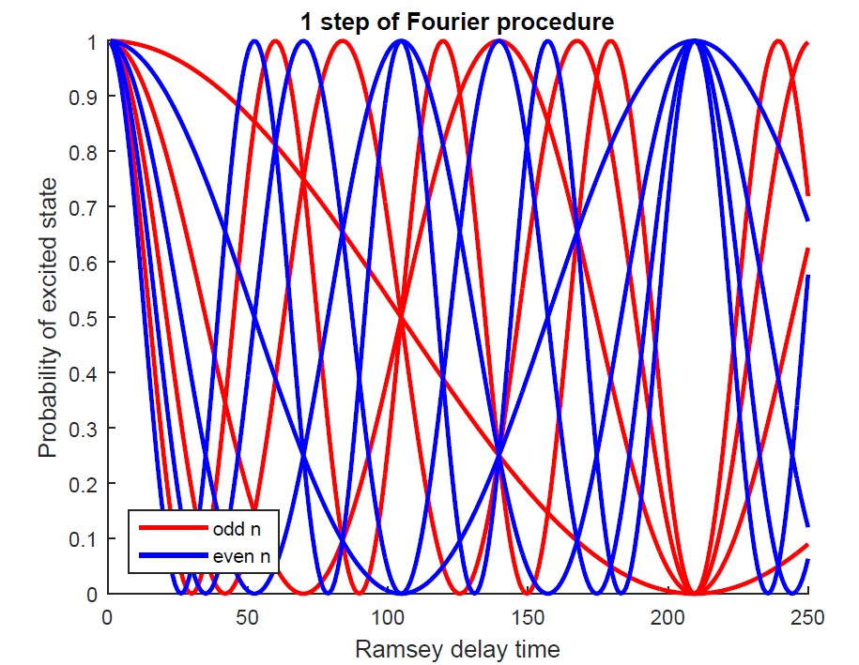

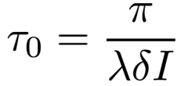
Fourier procedure for a phase estimation
Let current can get one of eight discrete values:
least significant bit
most significant bit

Slide 7



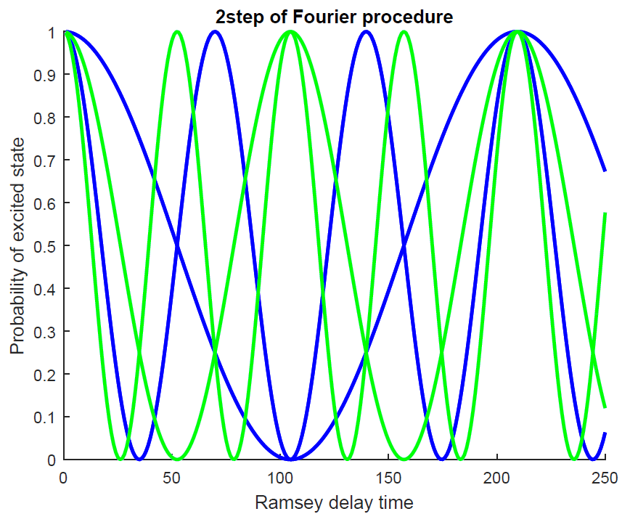
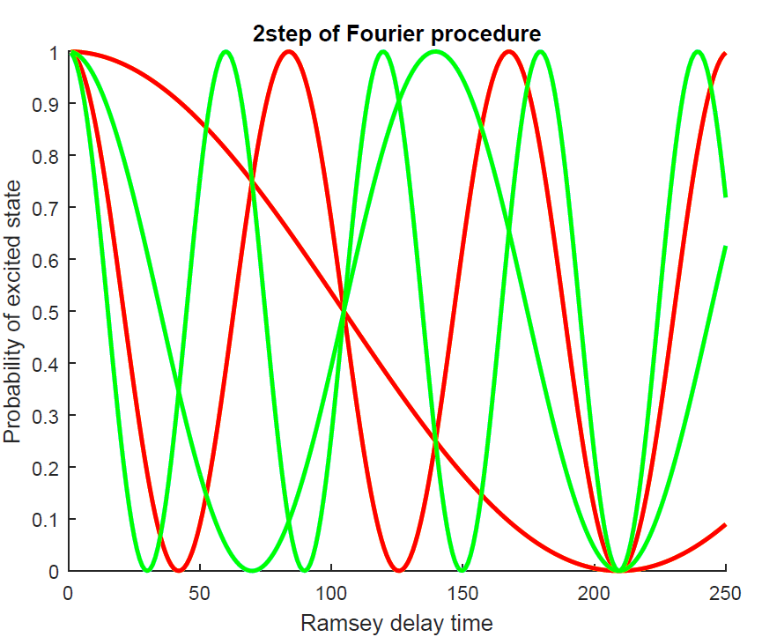
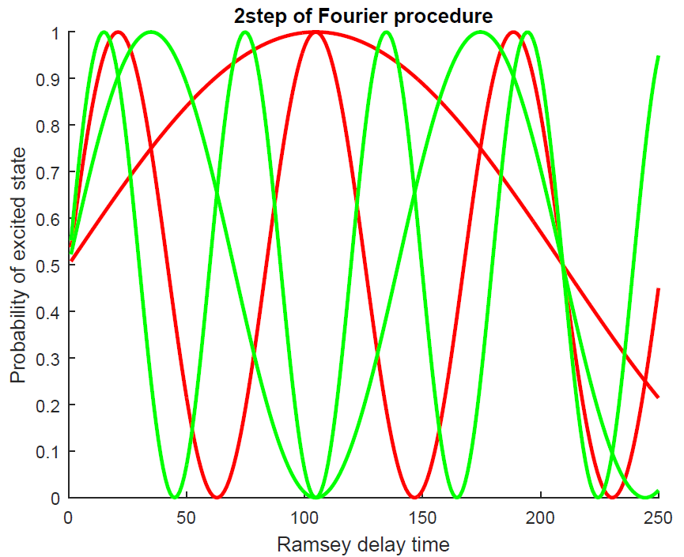
Next step of the Fourier procedure

Slide 8

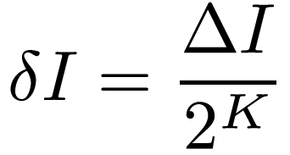

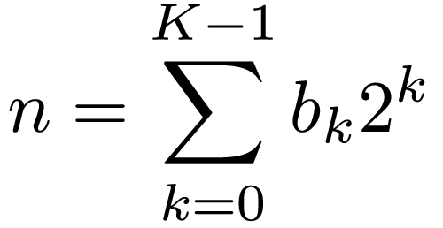




Fourier procedure. Summary.
discrete current values
precision
Fourier procedure learns K bits of unknown index n within K single qubit measurement.
Time resources spent:

Slide 9
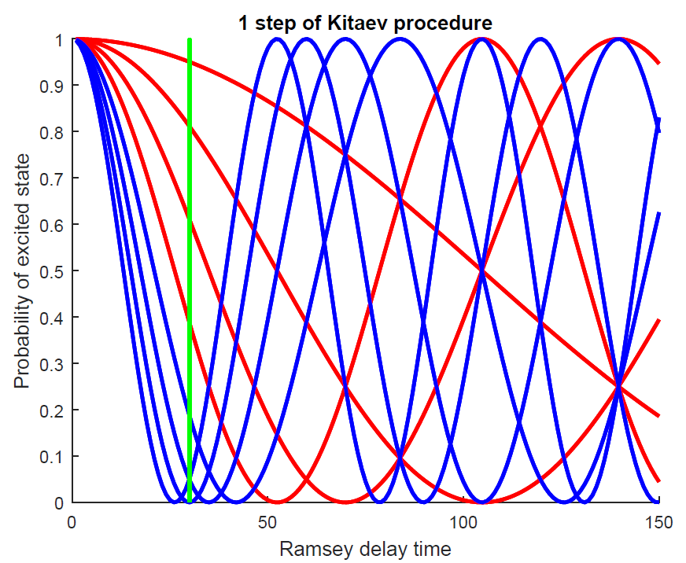
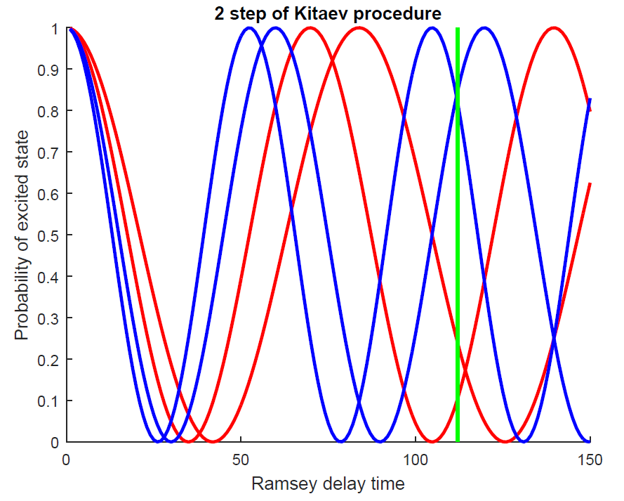

Kitaev phase estimation algorithm

Slide 10
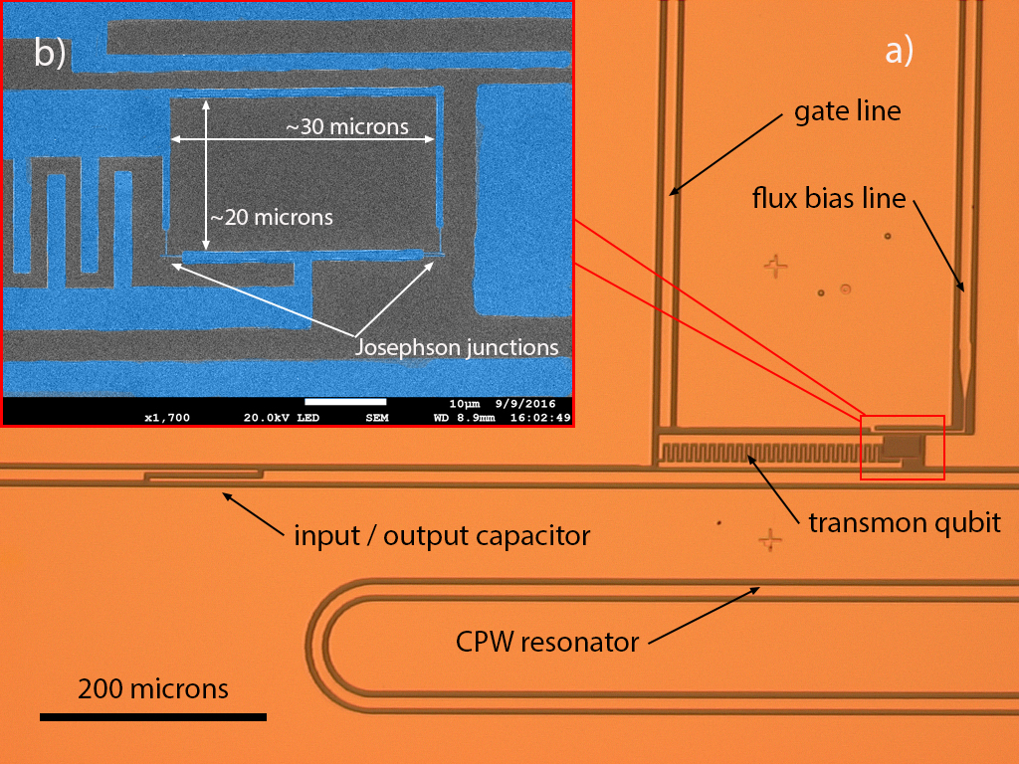
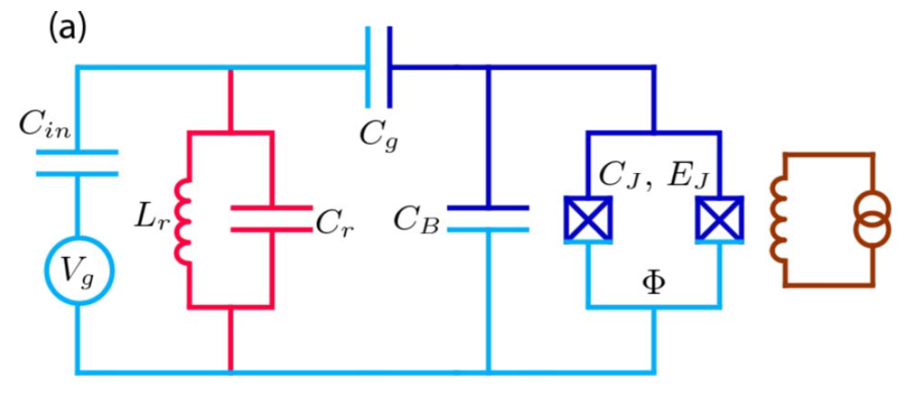
Superconducting transmon qubit

Slide 11
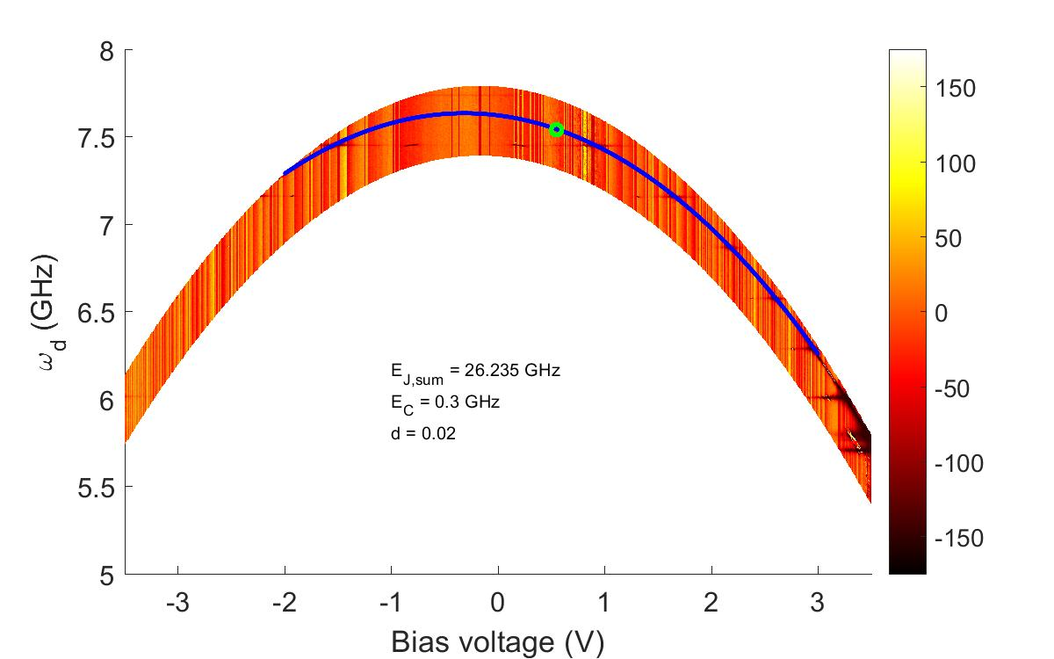




Spectrum of transmon

Slide 12
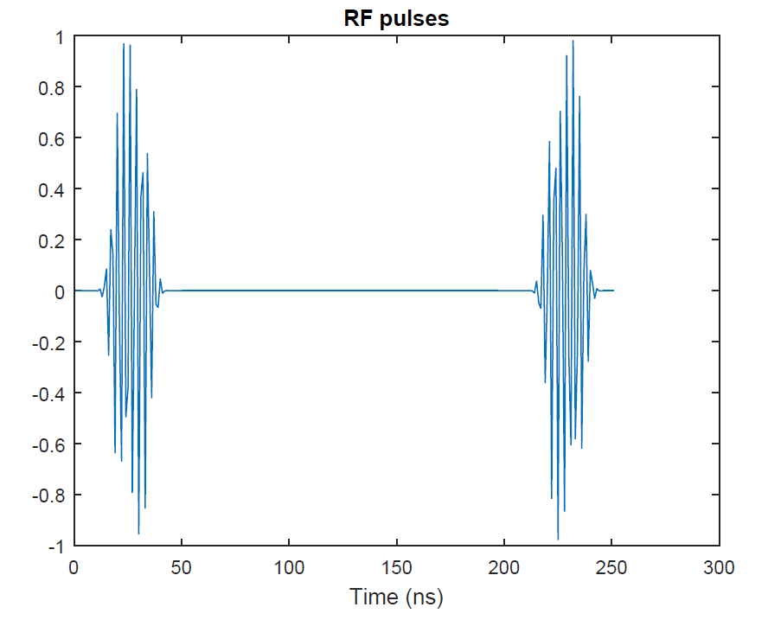

Ramsey Interferometry
pi/2 pulse
pi/2 pulse

Slide 13
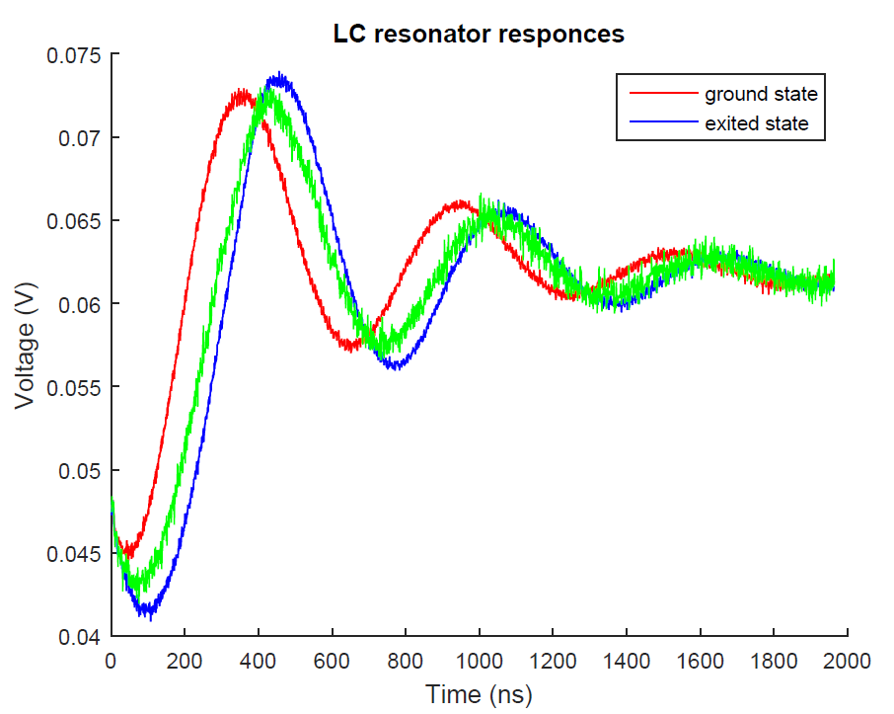
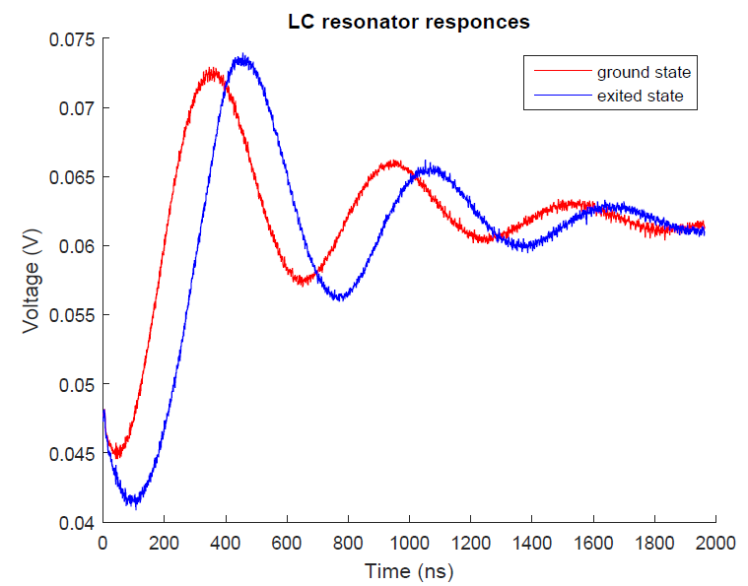

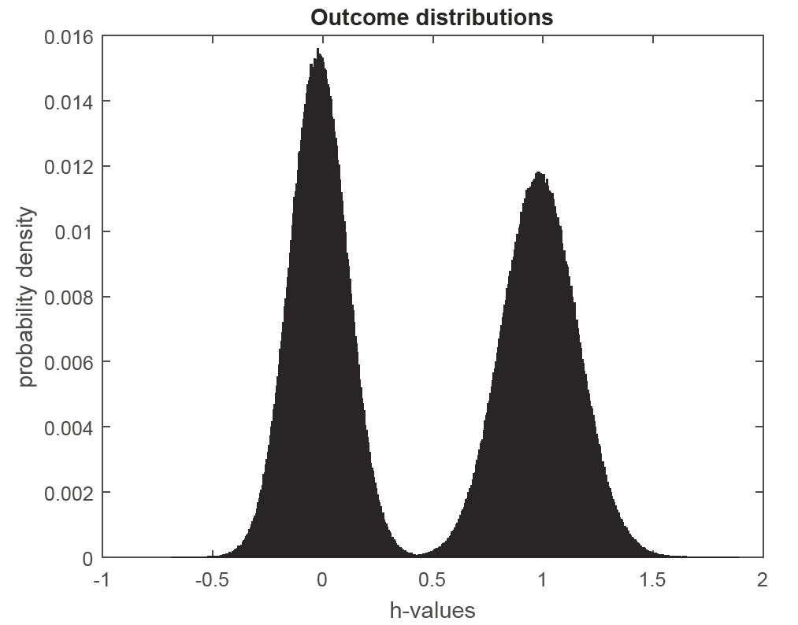





Single Shot Measurement

Slide 14

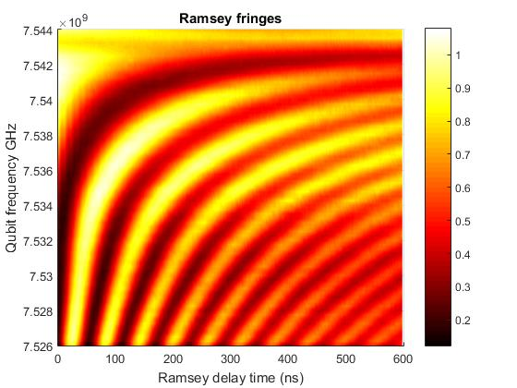
``Passport ‘’ of the device
(empirically measured probability of the excited state)

Slide 15
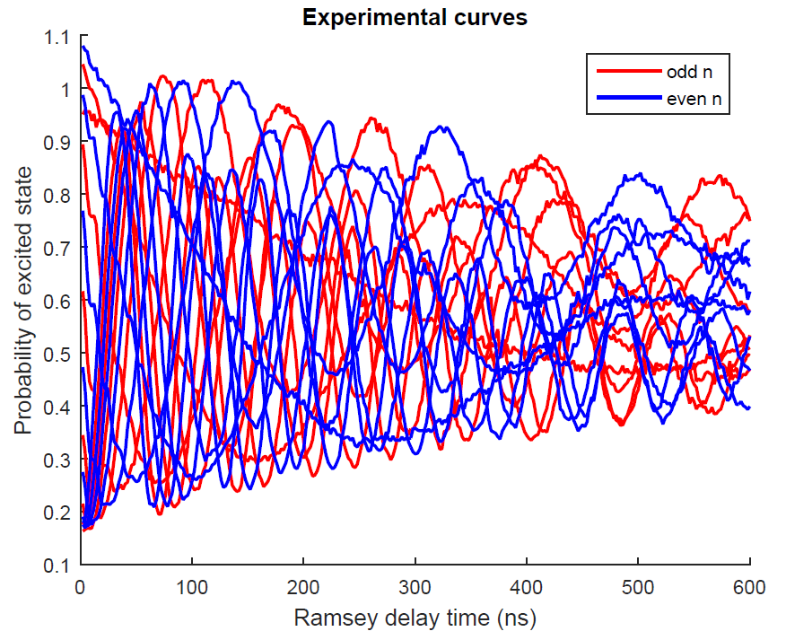
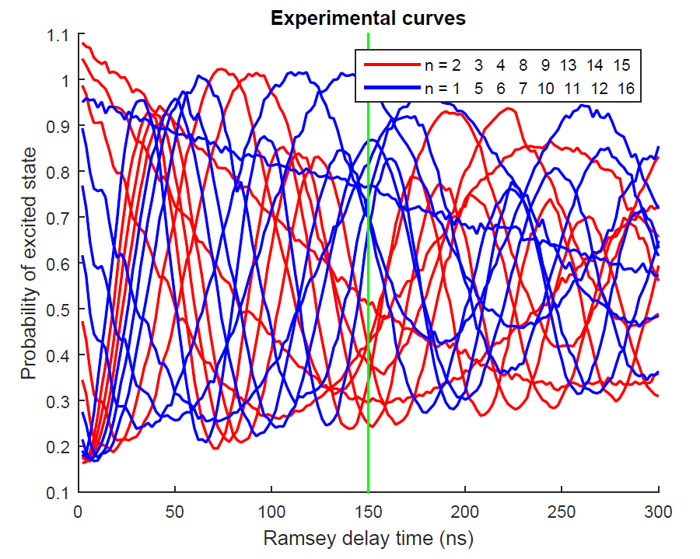
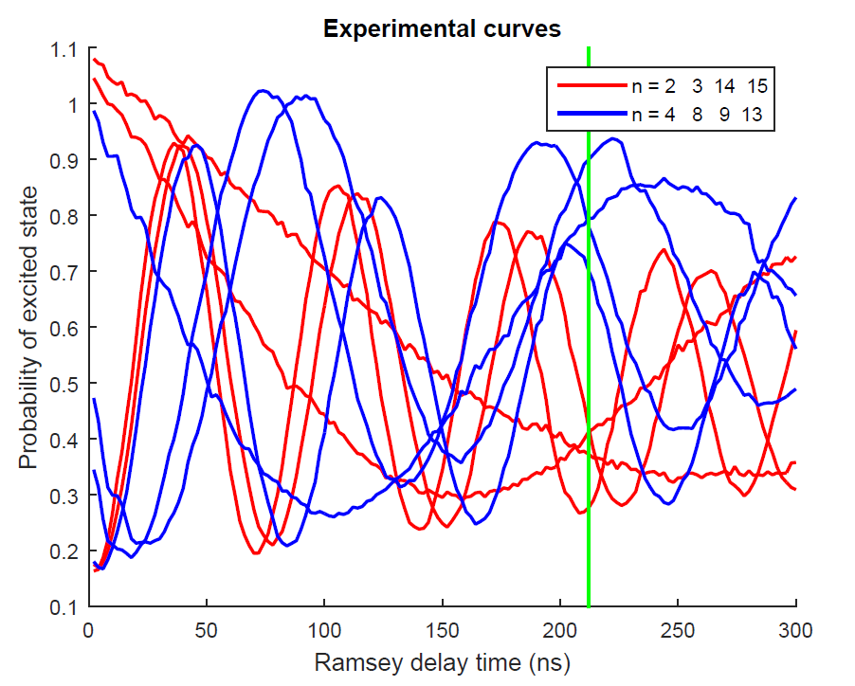
Modified Fourier Procedure

Slide 16
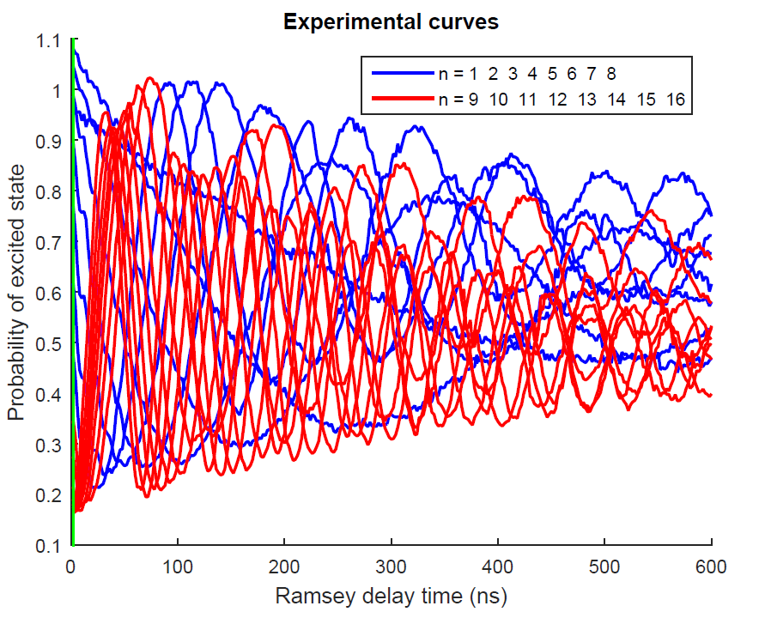
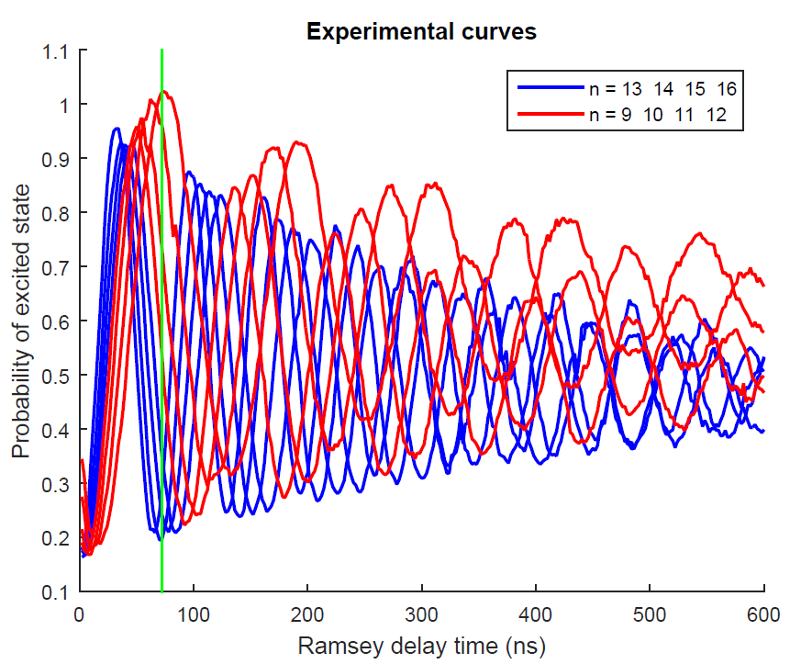
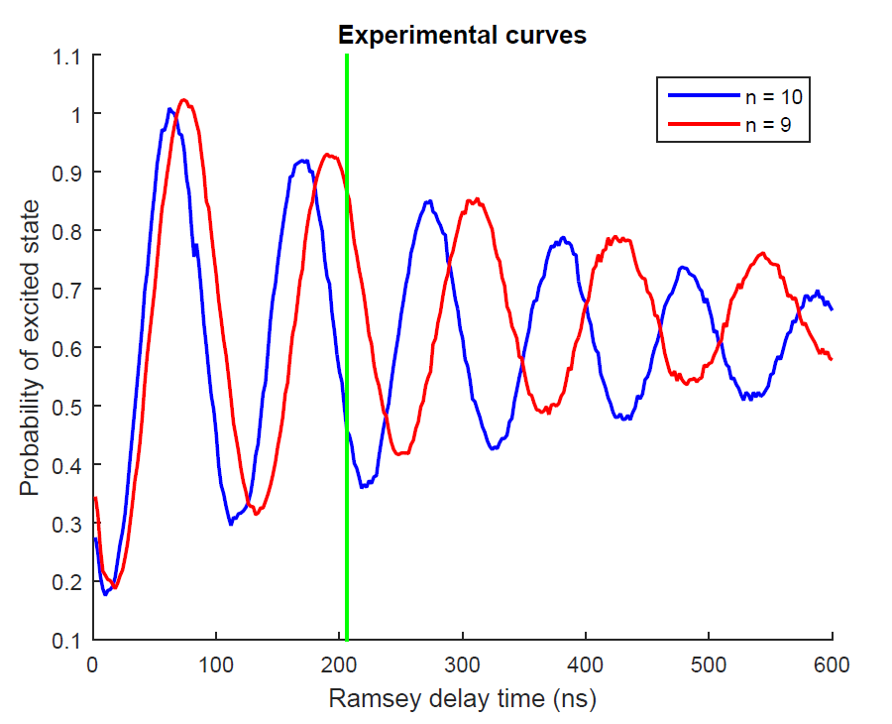
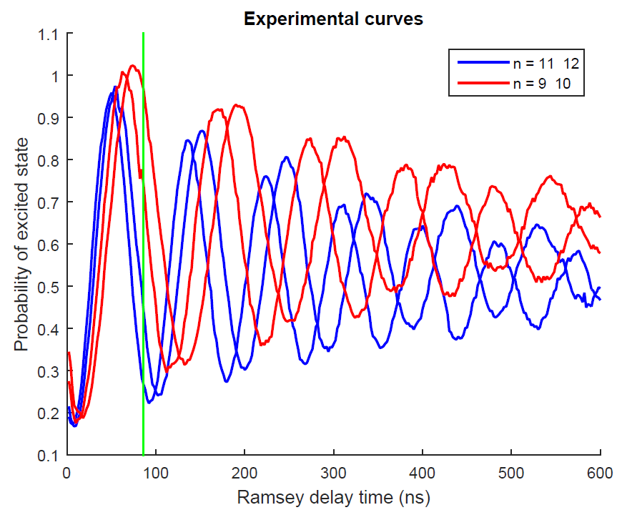
Modified Kitaev Procedure

Slide 17
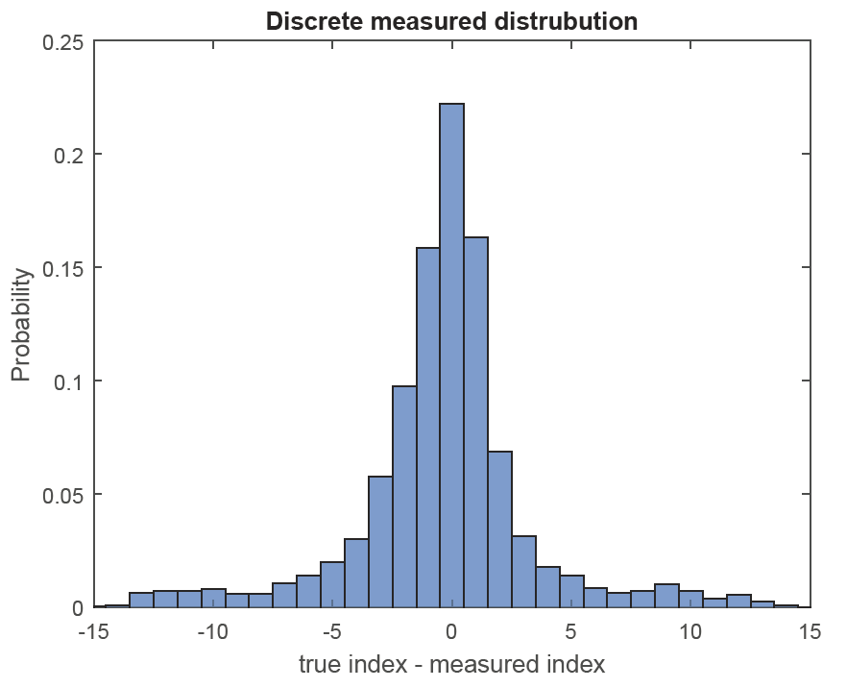
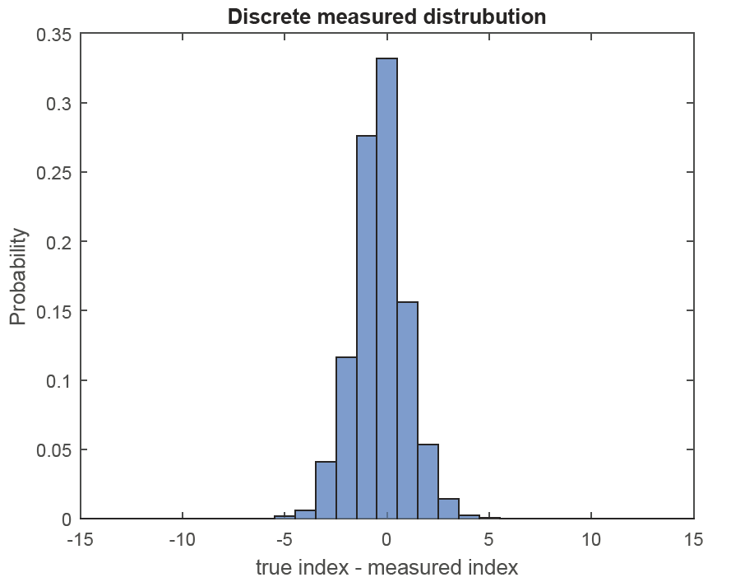


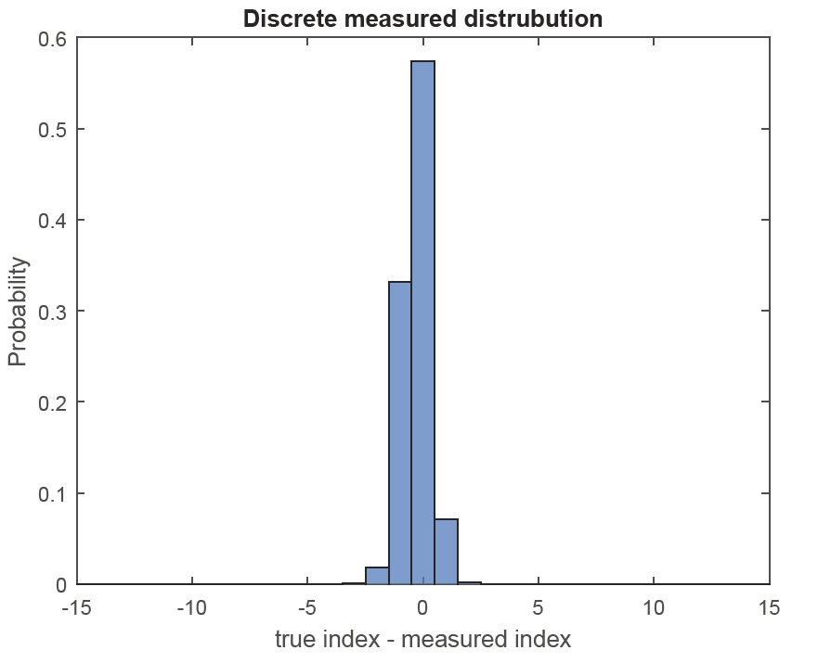
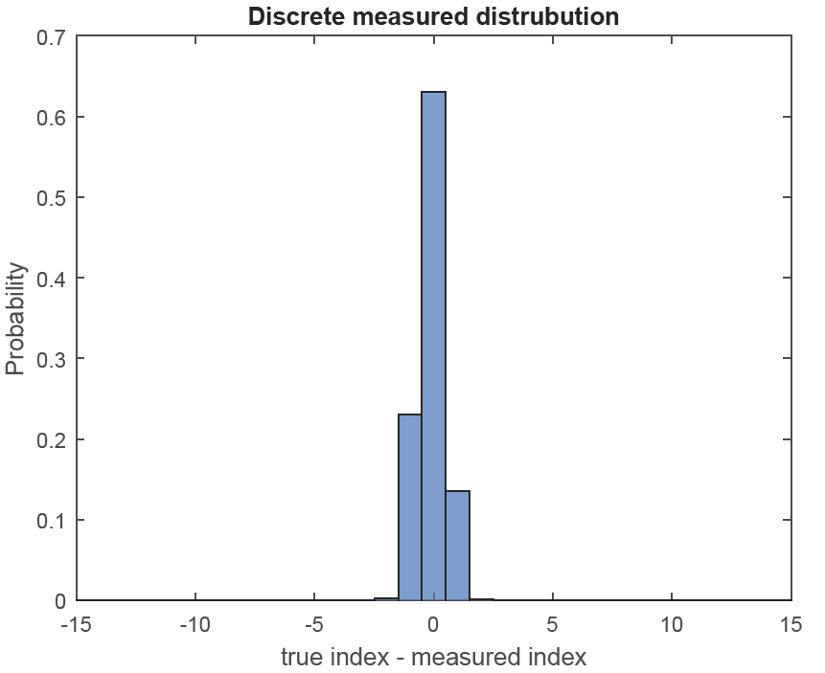


Experimental results

Slide 18
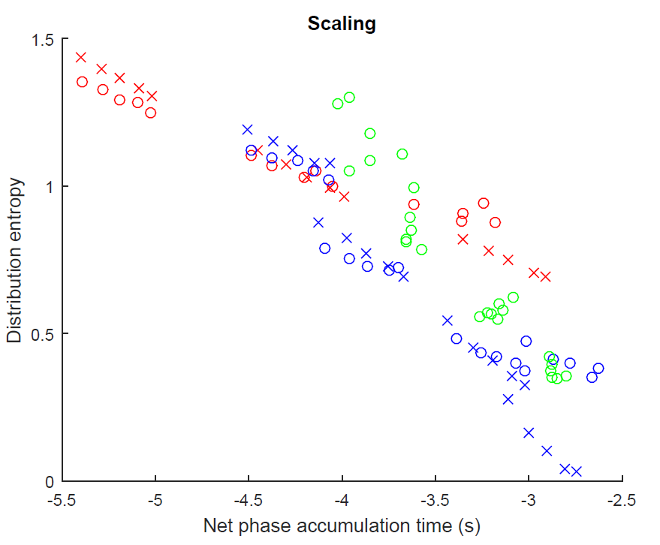
Scaling diagrams

Slide 19
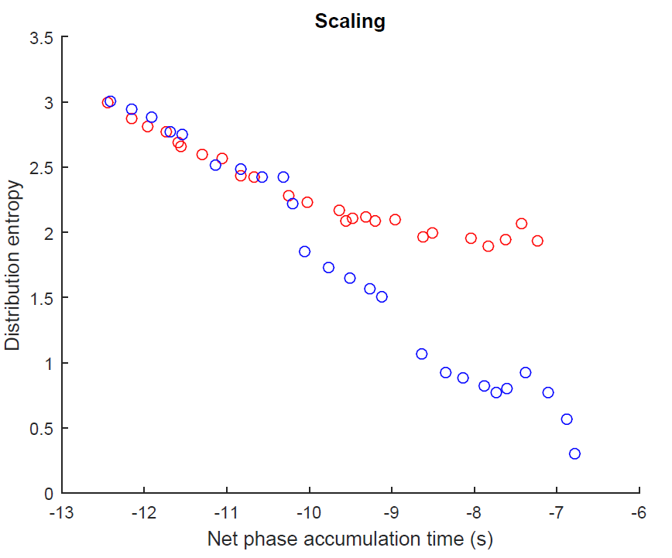

Slide 20
Why Kitaev overperforms Fourier?

Slide 21
Conclusions

