Slide 1
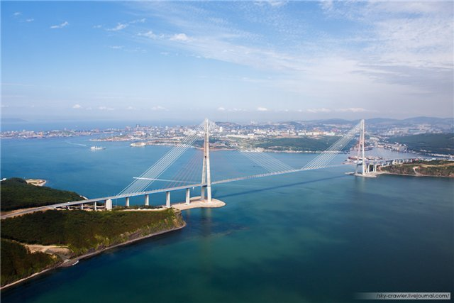
International conference « Dynamics in Siberia » , February 26 — March 4, 2018 , Russia
On Fourier's law for linear chain of particles
Mikhail A. Guzev
Institute for Applied Mathematics
Far Eastern Branch of Russian Academy Sciences, Vladivostok
Notes:
1

Slide 2
OUTLINE
1. Background
2. Schrodinger, Ornstein-Uhlenbeck, Prigogine, and others
3. Different forms presentation of the solution
4. Generalization of the solution for an inhomogeneous chain
5. Temperature distribution in 1D harmonic crystal
6. Heat flux in 1D harmonic crystal

Slide 3
Background

Slide 4
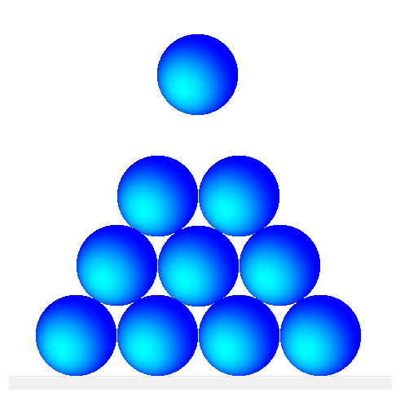
Advances in nanotechnologies
Each atom can be put on its place:
Ultrapure materials
100% defect free

Slide 5

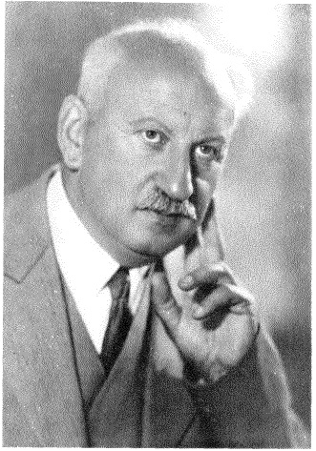
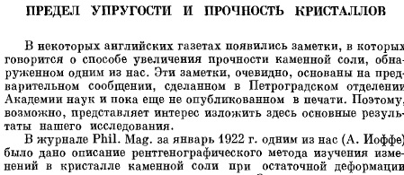
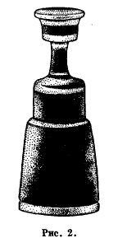


Strength

Slide 6
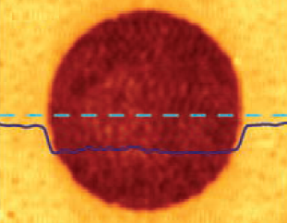
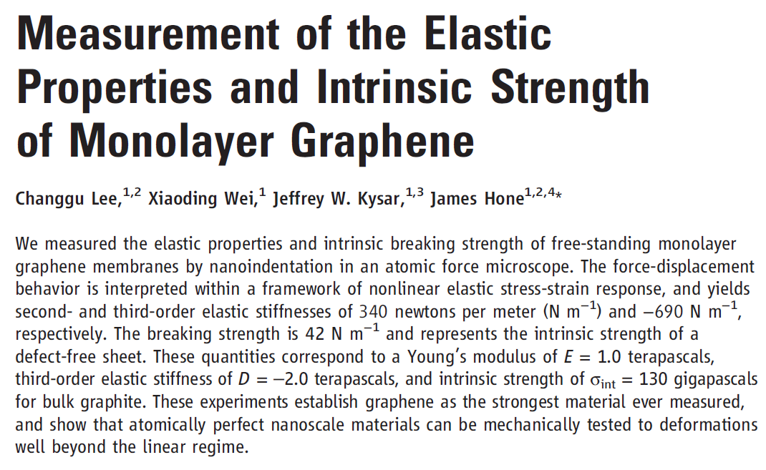
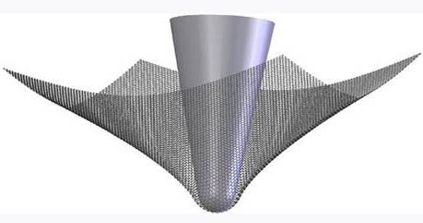
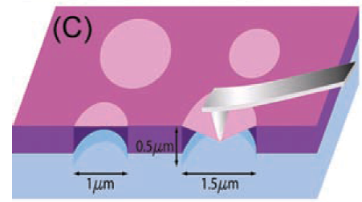
Strength
Ultrahigh strength and stiffness
Approaching theoretical strength

Slide 8
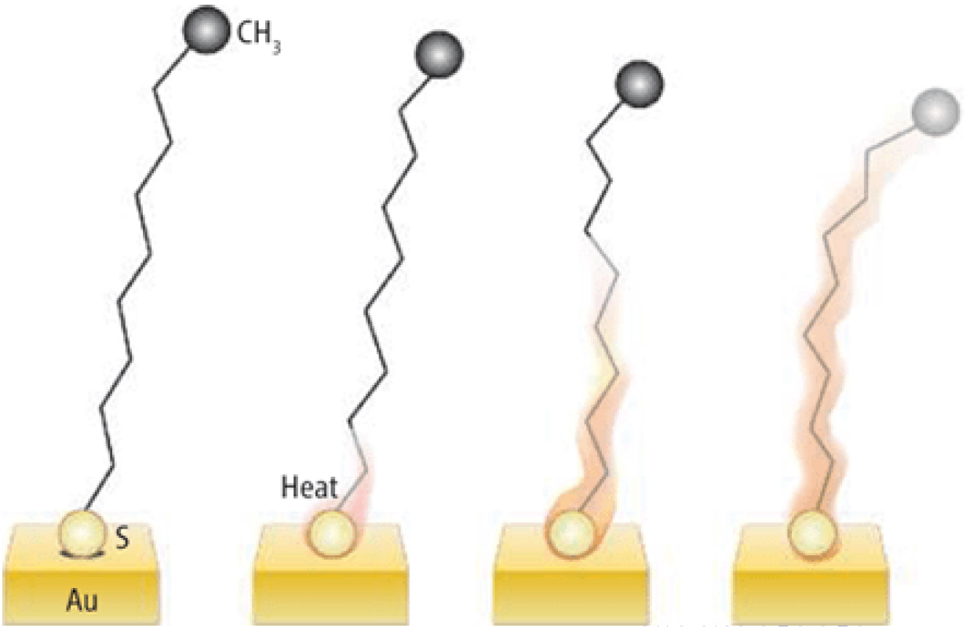
Ultrafast heat transfer
1 km/s

Slide 9
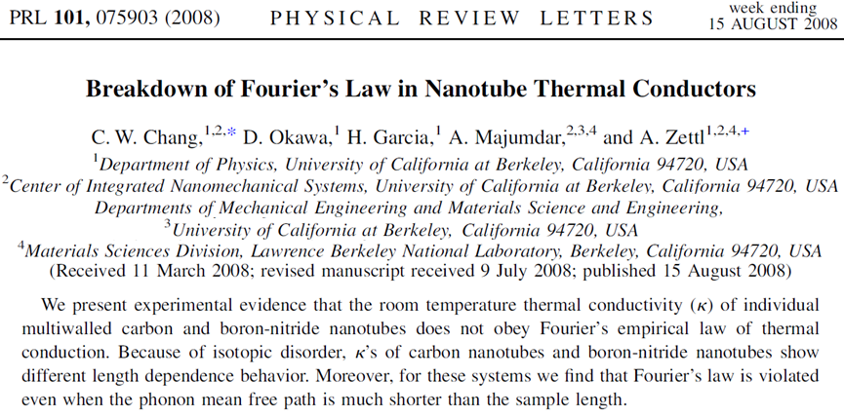
Breakdown of Fourier's law: experimental confirmation

Slide 12
Model for one-dimensional heat transport

Slide 13
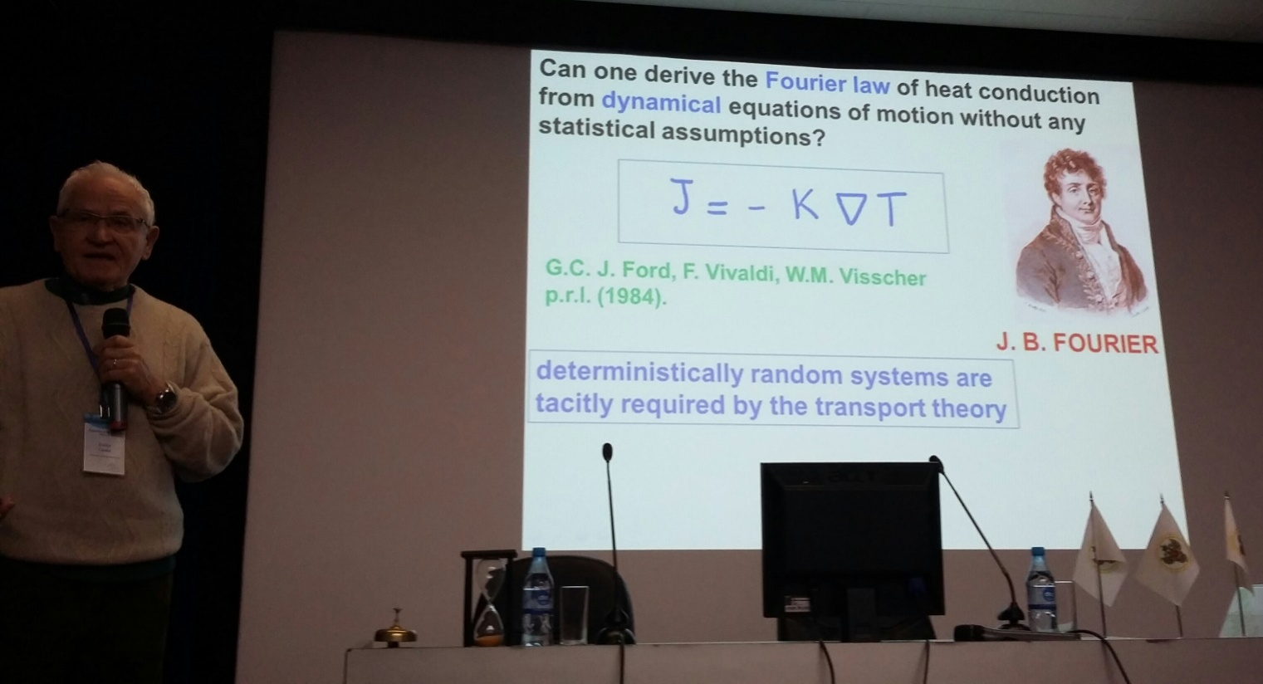
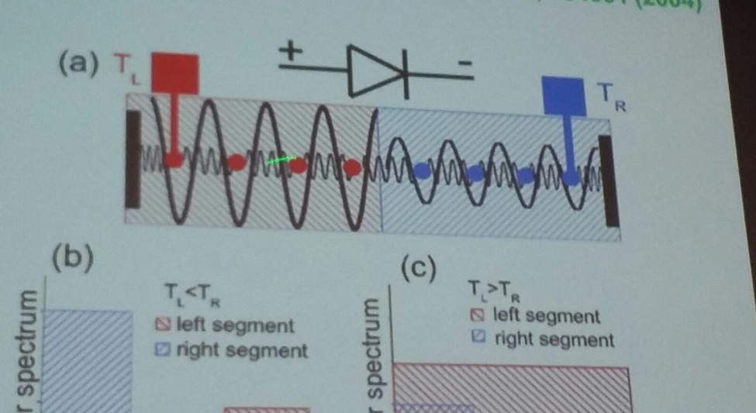

Slide 14
Schrodinger, Ornstein- Uhlenbeck, Prigogine,
and others

Slide 15
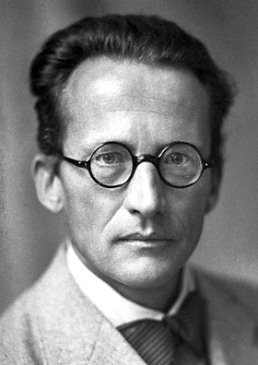

Schrodinger solution
Schrodinger
coordinates

Slide 16
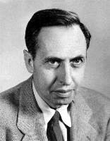
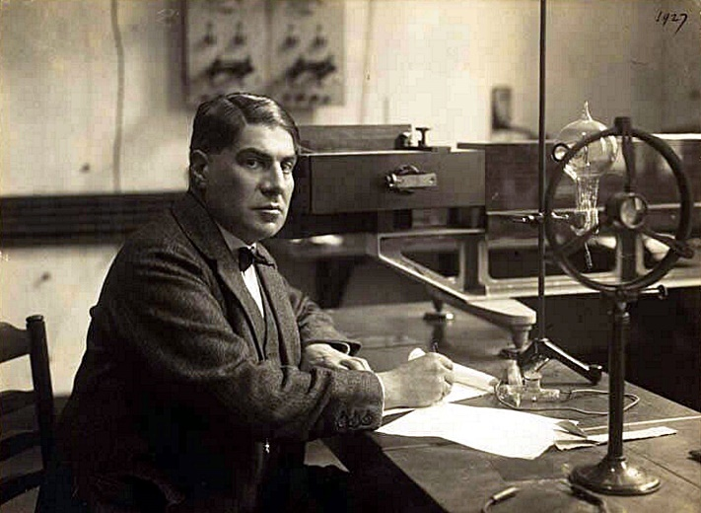

Thermal fluctuations of harmonic oscillators
George Eugene
Uhlenbeck
The stochastic differential equation
of an Ornstein–Uhlenbeck process
is rewritten as a Langevin equation
Leonard Ornstein

Slide 17
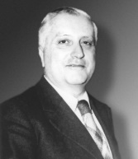
Linear assembly of harmonic oscillator
Ilya Romanovich Prigogine

Slide 19
Different forms
presentation of the solution

Slide 20
Standard approach for construction of solution
Link with the Chebyshev polynomials
Exclusion of spectral information from the fundamental solution
D. Integral presentation of the fundamental solution
E. Laplace transformation

Slide 21
A. Standard Approach for Construction of Solution in homogeneous chain
is an eigenvalue of

Slide 22
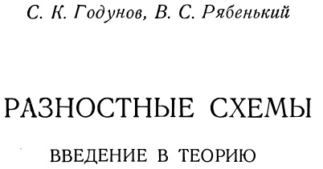
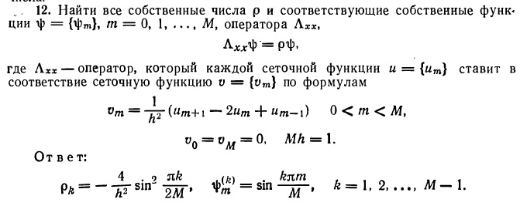
Homogeneous chain: eigenvalues and eigenvectors of

Slide 23
B. Link with the Chebyshev polynomials
We obtain the following representation for

Slide 24
Eigenvalues of

Slide 25
Eigenvectors of
Components of eigenvectors

Slide 26
Final presentation
(FS)
fundamental solution

Slide 27
C. Exclusion of spectral information from the fundamental solution
We expand
in
Let’s use the relation
Than

Slide 28
Change indices in summation
Because of
let’s introduce
Than the expression for the fundamental solution is reduced to

Slide 29
The formula (FS) contains indices of the Chebyshev polynomial restricted by n so
we use the periodic properties and obtain generalization of Schrodinger solution
(K)
since there is the orthogonality property

Slide 30
D. Integral presentation of the fundamental solution
It is known that
Than
(Phi)
The quantity
coincides with
and there is an equality
at
It allows to write (Phi) in the form

Slide 31
We sum with respect to index l in (K) and obtain

Slide 32
E. Laplace transformation
System of equations
Solution
The inverse Laplace transformation is given by the formula

Slide 33
Final formulae

Slide 34
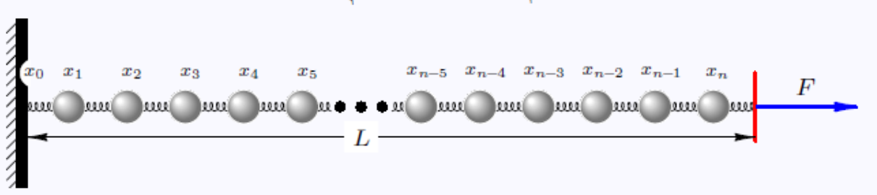
Generalization of the solution for an inhomogeneous chain
Laplace transformation results in
We find
and

Slide 35
Because of
It follows
Given
we write
Than

Slide 36
Slide №10
The aim is to analyze behavior of temperature and heat flux in the terms of the dynamical model in 1D harmonic crystal

Slide 37
Temperature distribution in 1D
harmonic crystal

Slide 39
There is a probability distribution
Local definition of temperature
is given through the kinetic energy of a particle
Dynamical model of a free crystal
Solution
Hibbs distribution

Slide 40
Kinetic energy of a particle:
Hibbs distribution results in
The quantity
characterizes the internal stresses.
We exclude the internal stresses from consideration.
The quantity of interest:

Slide 41
Steps of calculations
Standard formulae:
Exact formulae:

Slide 42
Final expression for temperature
We consider then
and

Slide 43
Heat flux in 1D
harmonic crystal

Slide 44
We consider the quantity

Slide 45
Steps of calculations
Solution for the displacement:
Velocity:
Differences:
Heat flux:
The quantity of interest:

Slide 46
Final expression for heat flux and Fourier's law
We consider then and
Difference of temperatures:
Breakdown of Fourier's law:

Slide 47
Acknowledgements
Dmitriev A.A , Institute for Applied Mathematics, FEBRAS,
Vladivostok
Scientific group headed by Krivtsov A.M.

Slide 48


