Slide 1
БЛУЖДАНИЯ ОСВОБОЖДЕННОГО РАЗУМА: О НАУЧНОЙ РЕВОЛЮЦИИ НАЧАЛА НОВОГО ВРЕМЕНИ
THE WANDERINGS OF THE LIBERATED MIND: THE SCIENTIFIC REVOLUTION OF THE EARLY MODERN ERA

Slide 2
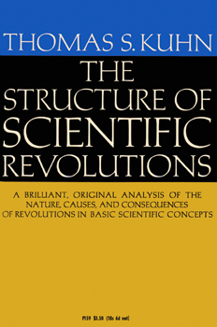
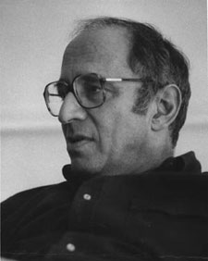
THOMAS SAMUEL KUHN (1922 – 1996)

Slide 3
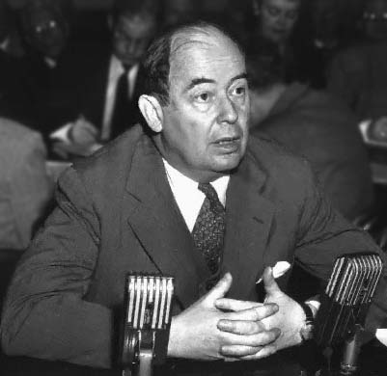
JOHANN VON NEUMANN (1903 – 1957)

Slide 4
DRAMATIC CHANGES IN EUROPE
The Economic Expansion of Europe
Revolution and Reformation in the Church
Voyages of Exploration
The New Warfare (The Military Revolution)
The Invention of Printing
Revolution in Music
Revolution in the fine arts
New Philosophy
Scientific Revolution

Slide 5
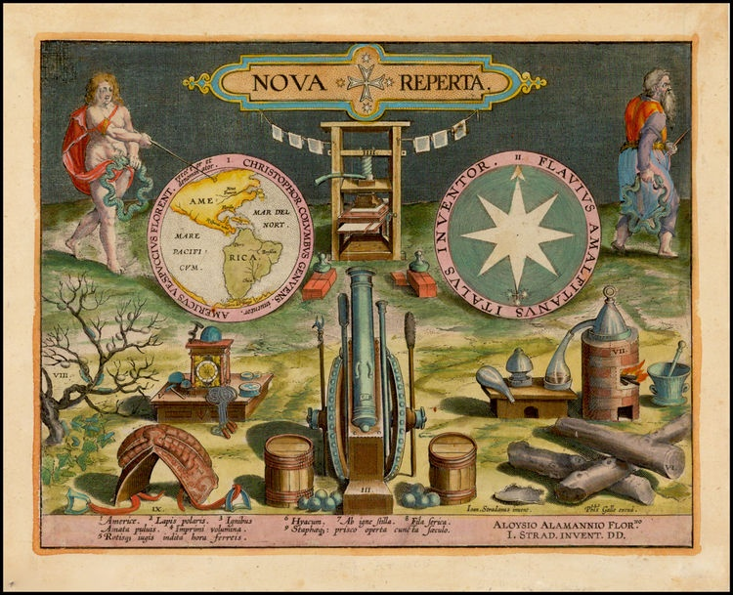
NEW DISCOVERIES (new lands, gunpowder, compass, the clock, printing; Jan van Straet, ca. 1600)

Slide 6
ABOUT NATURAL PHILOSOPHY
In a larger sense, there was no such thing as „science‟ in the sense of a single, unified discipline whose object was the study of nature. The closest term we have for the modern term „science‟ is „natural philosophy.‟ Natural philosophy, otherwise known under the names of physics or physiology, dealt first with the general truths about natural things (matter, form, privation, cause, etc.), then with the more specific truths about more specific things, including the cosmos as a whole, the elements, the make up of individual kinds of bodies, including all kinds of living bodies, plant, animal, and human.

Slide 7
Aristotelianism (and indeed all systems that came to contest its hegemony) rested on four structural elements:
1. A theory of substance (material and immaterial), concerning what the cosmos consists in, what kinds of bodies or entities it contains;
2. A cosmology, an account of the macroscopic organization of those bodies;
3. A theory of causation, an account of how and why change and motion occur;
4. An epistemology and doctrine of method which purported to show how the discourses under (1), (2) and (3) were arrived at and/or how they could be justified, and how they constitute a system.

Slide 8
NATURAL PHILOSOPHY
MATHEMATICS

Slide 9


ENTOURAGE:
MATHEMATICA MIXTA
(The ‘mixed’, or ‘subordinate’, mathematical sciences, such as optics, astronomy and mechanics, the study of the simple machines).
BIO-MEDICAL DISCIPLINES: anatomy, physiological theory, medical theory
ESPECIALLY DISPUTED DISCIPLINES: astrology, alchemy, other branches of natural magick etc.

Slide 10
FRANCIS BACON’S TREE OF KNOWLEDGE

Slide 11
PERIODIZATION
I. THE SCIENTIFIC RENAISSANCE, 1500 – 1600.
II. THE CRITICAL PERIOD (OR NATURAL PHILOSOPHICAL WARS), 1590 – 1660.
III. NEWTONIAN PRAGMATIC COUNTERREVOLUTION, 1660 – 1720.

Slide 12
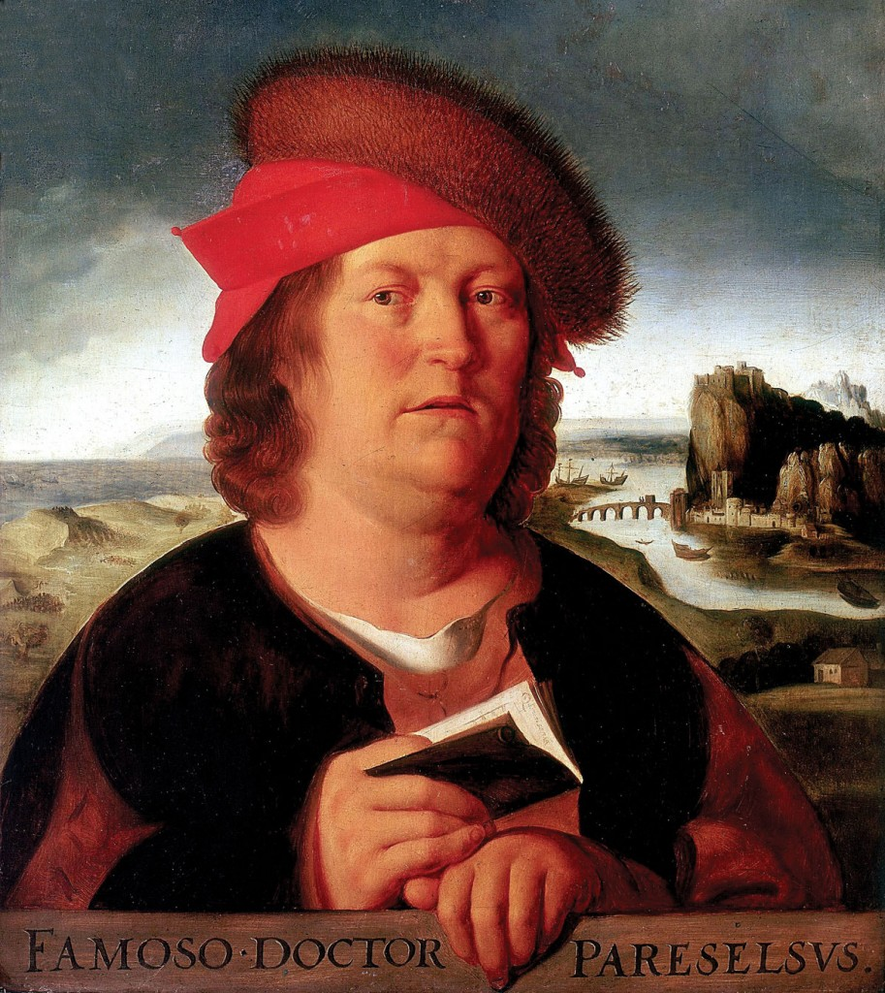
PARACELSUS (1493 – 1541)
Each part of the heavens in Paracelsus's geocentric universe was deemed to have its correlate in the human body.
Paracelsus's use of astrological ideas and categories went along, however, with an explicit repudiation of astrology itself: where astrology as Paracelsus understood it spoke of the causal influence of the heavens on terrestrial affairs, he himself, in what he called his "astrosophy”, saw only correlations or correspondences between these parts of nature.

Slide 13
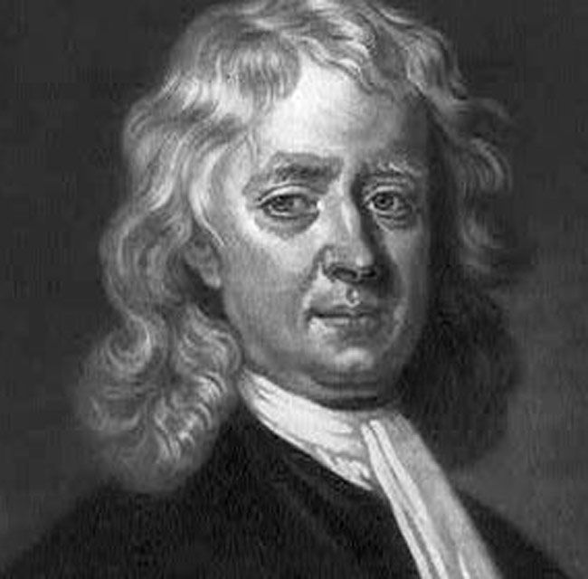
ISAAC NEWTON (1642 – 1627)

Slide 14
NEWTONIAN TURN
Newton brought in natural philosophy (or, more precisely, in a certain, but its important part) is a kind of formal universal and universalizing order, which was based on four mathematically expressed laws. And this “new order” was very far from vague reasoning of the creators of mechanical philosophy.
Moreover, it was Newtonian natural philosophy, which acquired “mathematical principles", became the basis (along with other factors) to create science. Sir Isaac sought the answer to the question, organically alien to supporters of mechanical philosophy: the action of which intangible factor (spiritual causal agency) can be explained body movements (earthly and celestial)?

Slide 15
CHARACTERISTICS OF NEWTON’S THOUGHT
1. Failure and imperfection of mechanical picture of the world. Newton treated his mechanical and non-mechanical agents in a comparable format during the ensuing decade and even combine their functions in the economy of nature;
2. Three interrelated types of reasoning: physical, theological and historical ones;
3. All Newtonian doctrines are the various projections and contexts of his idea of God.

Slide 16
CONCLUSION
The diversity of alternative anti-Aristotelian programs that blossomed in the late sixteenth and early seventeenth centuries never completely sorted itself out into a single alternative to the Aristotelian program, nothing that could be called the new science.

