Slide 1
Baby Universes and Black Hole Information
Don Marolf April 30, 2020 Based on arxiv:2002.08950 with Henry Maxfield

Slide 2

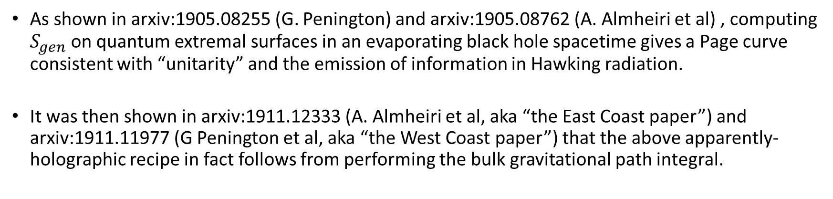
Motivation: Recent progress on black hole information
As shown in arxiv:1905.08255 (G. Penington) and arxiv:1905.08762 (A. Almheiri et al) , computing $S_{gen}$ on quantum extremal surfaces in an evaporating black hole spacetime gives a Page curve consistent with “unitarity” and the emission of information in Hawking radiation.
It was then shown in arxiv:1911.12333 (A. Almheiri et al, aka “the East Coast paper”) and arxiv:1911.11977 (G Penington et al, aka “the West Coast paper”) that the above apparently-holographic recipe in fact follows from performing the bulk gravitational path integral.
A lamp post in the dark: This suggests that non-perturbative – but still geometric! -- effects in the gravitational path integral are responsible for getting information out of black holes.
Our goal: Tear open the above calculation to understand better how it works, and what it means.
At least within a simple model, we will indeed be able to do so.

Slide 3
Spacetime (Euclidean) Wormholes
Connected geometries with a disconnected boundary (need not be a solution!)
Critical role in recent study of JT-gravity/random matrix dualities by Stanford group (including features related to BH info)
Also played a prominent role in West Coast BH info paper.
Ensemble story from 1980’s (Coleman, Giddings & Strominger, etc.)
Our work returns to such issues, addressing them in general and in a simple exactly-solvable model.
Motto: Do the gravitational path integral. Sum over all topologies (including disconnected spacetimes)!
This talk: The simple, solvable model with brief comments
about general arguments.

Slide 4

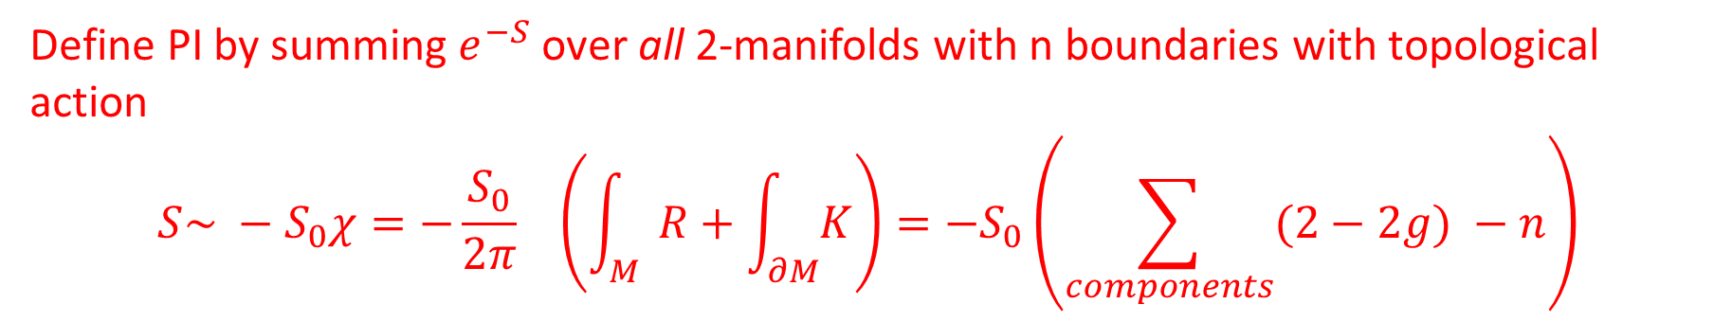
Background for model:
Intended to model Euclidean 2d asymptotically-AdS gravity (i.e., a JT-like system, perhaps with EOW branes)
Reduce to topology only; remove metric from model.
Take our grav path integral to compute the inner product.
This is precisely the way one treats a field theory path integral, but is *not* the way one treats a “worldline path integral” associated with Feynmann diagrams.
Path Integral: Boundary conditions → $ℂ$
$$n circles= Z^{n}$$
Example: Z
Simplest “Z-only” Model allowed BCs: …
Define PI by summing $e^{−S}$over all 2-manifolds with n boundaries with topological action $$S\sim −S_{0}χ=−{\frac{S_{0}}{2π}}_{}\left(\int_{M}{R}+\int_{∂M}{K}\right)={−S}_{0}\left(\sum_{components}{(2−2g)} −n\right)$$

Slide 5
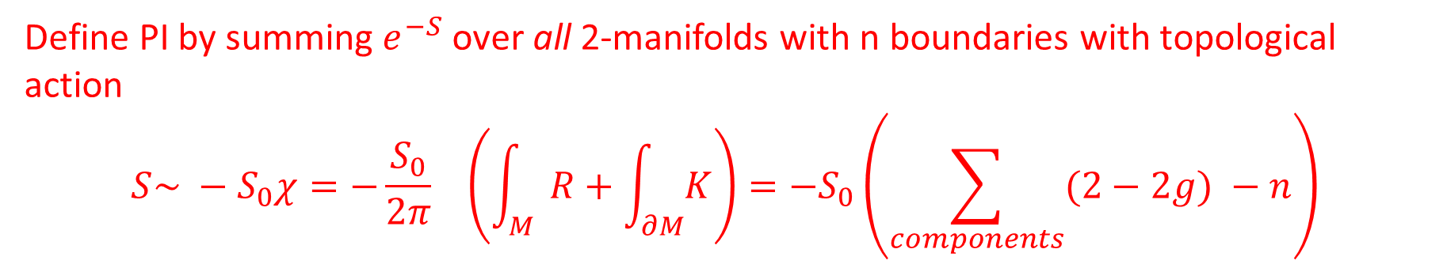


Fine Points:
Define PI by summing $e^{−S}$over all 2-manifolds with n boundaries with topological action $$S\sim −S_{0}χ=−{\frac{S_{0}}{2π}}_{}\left(\int_{M}{R}+\int_{∂M}{K}\right)={−S}_{0}\left(\sum_{components}{(2−2g)} −n\right)$$
where M has components of genus g.
Also, choose $$S= −S_{0}\tilde{χ}={−S}_{0}\left(χ+n\right)={−S}_{0}\left(\sum_{components}{(2−2g)}\right)$$
Could have given n-term an arbitrary coefficient $S_{∂}$, but take${ S}_{∂}=S_{0}$for simplicity and later convenience. Corresponds to coupling the more naïve model to an additional “boundary sector” (and perhaps integrating out the boundary sector). Note: effectively rescales Z by $e^{S_{∂}}.$

Slide 6
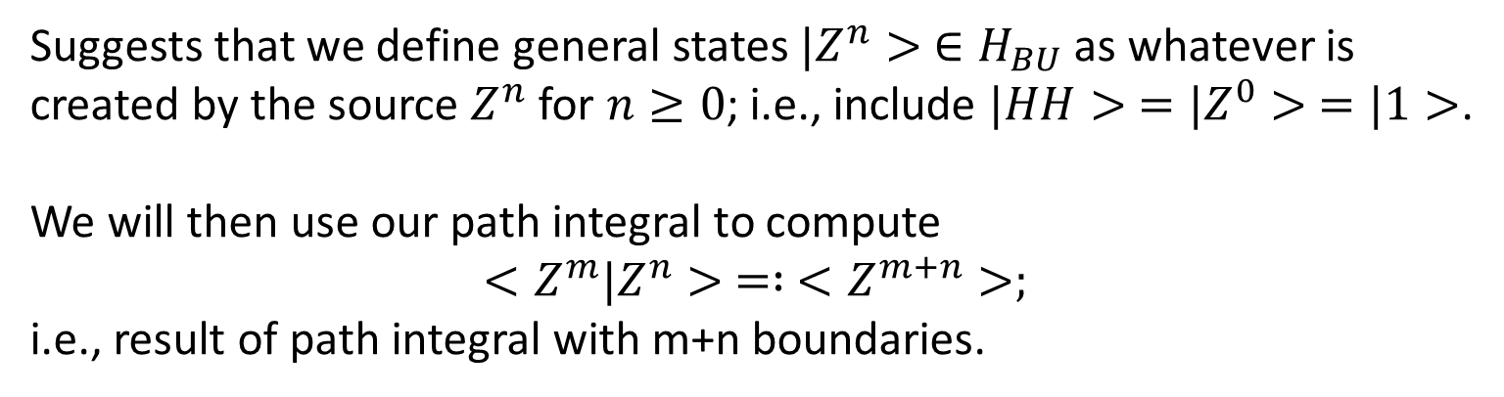
What physics will we study?
As previously advertised, we will be interested in Euclidean wormholes:
Z
Z
Alternate Interpretation: A Euclidean Cosmology!
Z
So Z is also a “source” that creates a closed universe (aka “baby universe”) state.
Suggests that we define general states $|Z^{n}> ∈H_{BU}$ as whatever is created by the source $Z^{n}$ for $n≥0$; i.e., include $|HH> =|Z^{0}> =|1>$.
We will then use our path integral to compute
$$<Z^{m}|Z^{n}> = : <Z^{m+n}>;$$
i.e., result of path integral with m+n boundaries.
Z

Slide 7
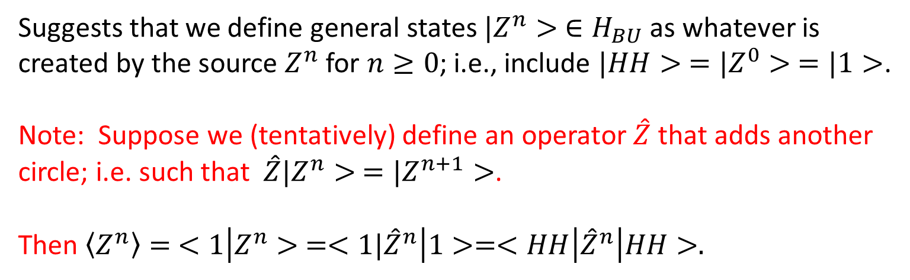
What physics will we study?
As previously advertised, we will be interested in Euclidean wormholes:
Z
Z
Alternate Interpretation: A Euclidean Cosmology!
Z
So Z is also a “source” that creates a closed universe (aka “baby universe”) state.
Suggests that we define general states $|Z^{n}> ∈H_{BU}$ as whatever is created by the source $Z^{n}$ for $n≥0$; i.e., include $|HH> =|Z^{0}> =|1>$.
Note: Suppose we (tentatively) define an operator $\hat{Z}$ that adds another circle; i.e. such that $\hat{Z}|Z^{n}> =|Z^{n+1}>$.
Then $\left\langle Z^{n}\right\rangle = <1\left|Z^{n}> =<1|{\hat{Z}}^{n}\right|1>=<HH\left|{\hat{Z}}^{n}\right|HH>.$
Z

Slide 8
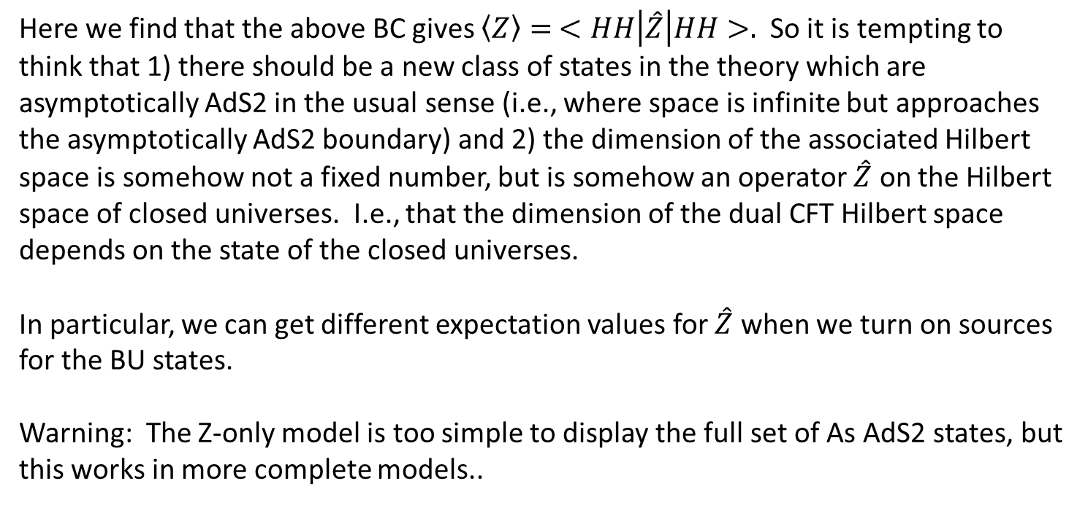

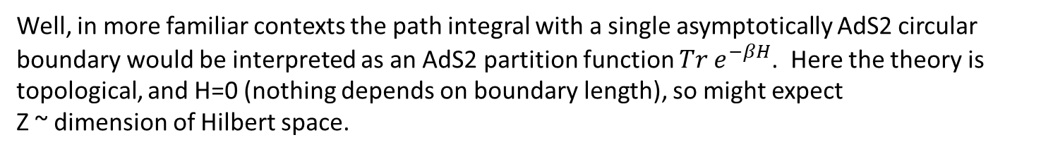
What physics does the operator $\hat{Z}$ encode? (heuristics)
Well, in more familiar contexts the path integral with a single asymptotically AdS2 circular boundary would be interpreted as an AdS2 partition function $Tr e^{−βH}$. Here the theory is topological, and H=0 (nothing depends on boundary length), so might expect Z ~ dimension of Hilbert space.
Here we find that the above BC gives $\left\langle Z\right\rangle = <HH\left|\hat{Z}\right|HH>.$ So it is tempting to think that 1) there should be a new class of states in the theory which are asymptotically AdS2 in the usual sense (i.e., where space is infinite but approaches the asymptotically AdS2 boundary) and 2) the dimension of the associated Hilbert space is somehow not a fixed number, but is somehow an operator $\hat{Z}$ on the Hilbert space of closed universes. I.e., that the dimension of the dual CFT Hilbert space depends on the state of the closed universes.
In particular, we can get different expectation values for $\hat{Z}$ when we turn on sources for the BU states.
Warning: The Z-only model is too simple to display the full set of As AdS2 states, but this works in more complete models..
Source for <BU|
Operator $\hat{Z}$
Source for |BU>

Slide 9
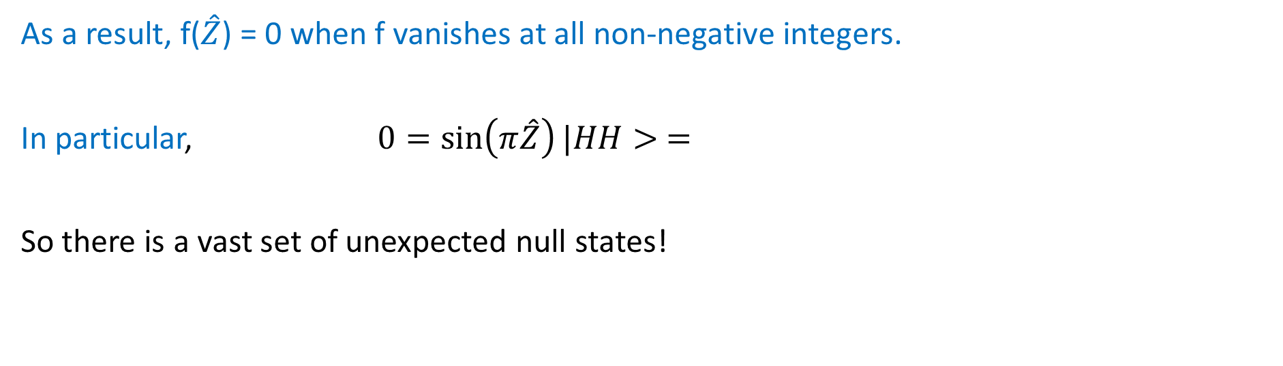

Solution:
It is possible to fully solve for all moments of Z. One finds:
$\frac{\left\langle Z^{n}\right\rangle }{\left\langle 1\right\rangle }= \sum_{d=0}^{∞}{d^{n}p_{d}\left(λ\right)}$, w/ ${ p}_{d}\left(λ\right)=e^{−λ} \frac{λ^{d}}{d!}$
Poisson distribution with mean $λ!$
Supported on positive integers!
Thus $\hat{Z}$ is a self-adjoint operator with spectrum {0,1,2,….}
As a result, f($\hat{Z}$) = 0 when f vanishes at all non-negative integers.
In particular, $0=\sin\left(π\hat{Z}\right)|HH> =$
So there is a vast set of unexpected null states!

Slide 10
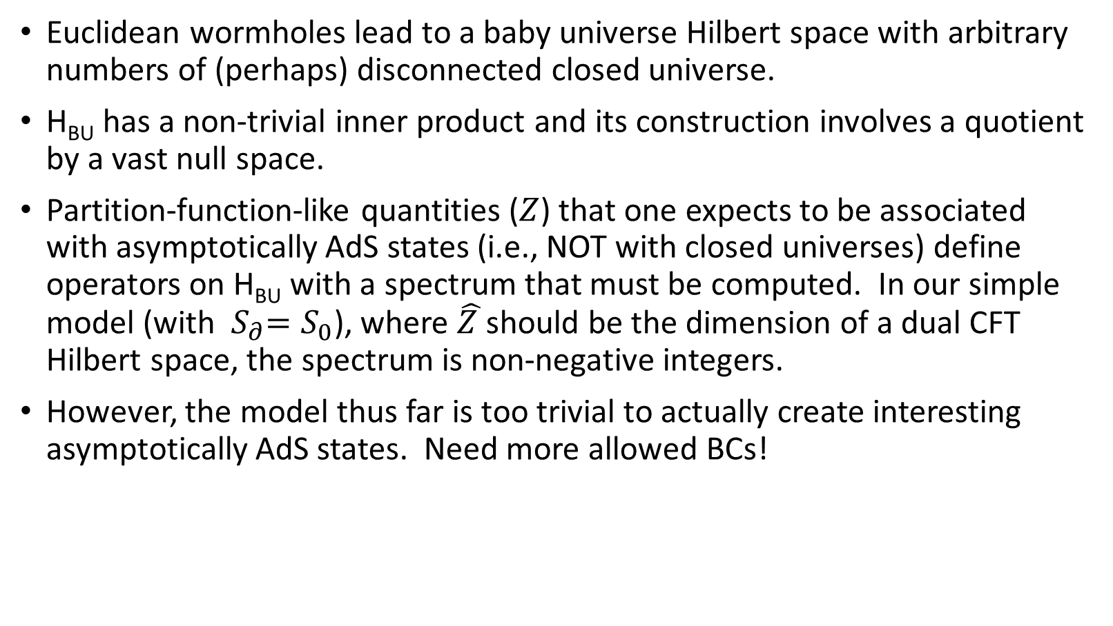
Summary thus far
Euclidean wormholes lead to a baby universe Hilbert space with arbitrary numbers of (perhaps) disconnected closed universe.
H_{BU} has a non-trivial inner product and its construction involves a quotient by a vast null space.
Partition-function-like quantities ($Z$) that one expects to be associated with asymptotically AdS states (i.e., NOT with closed universes) define operators on H_{BU} with a spectrum that must be computed. In our simple model (with ${ S}_{∂}=S_{0}$), where $\hat{Z }$should be the dimension of a dual CFT Hilbert space, the spectrum is non-negative integers.
However, the model thus far is too trivial to actually create interesting asymptotically AdS states. Need more allowed BCs!

Slide 11
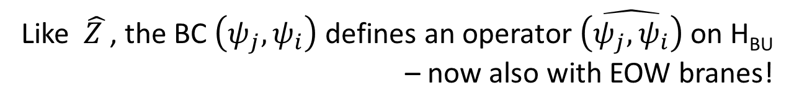

EOW branes
Introduce new BCs with sources for EOW branes
j
Asymptotically Euclidean AdS2 BCs:
i
In a dual CFT, this would be an inner product. So write it as $\left(ψ_{j},ψ_{i}\right)$. Cutting open such path integrals will define new asymptotically AdS2 states w/ EOW branes.
But note: When cutting open the PI, there is implicitly a choice of baby universe state as well!
j
I.e., this inner product depends on BU state.
Like $\hat{Z }$, the BC $\left(ψ_{j},ψ_{i}\right)$ defines an operator $\hat{\left(ψ_{j},ψ_{i}\right)}$ on H_{BU} – now also with EOW branes!
i

Slide 12
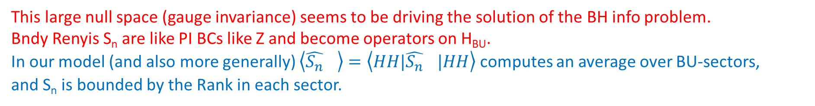
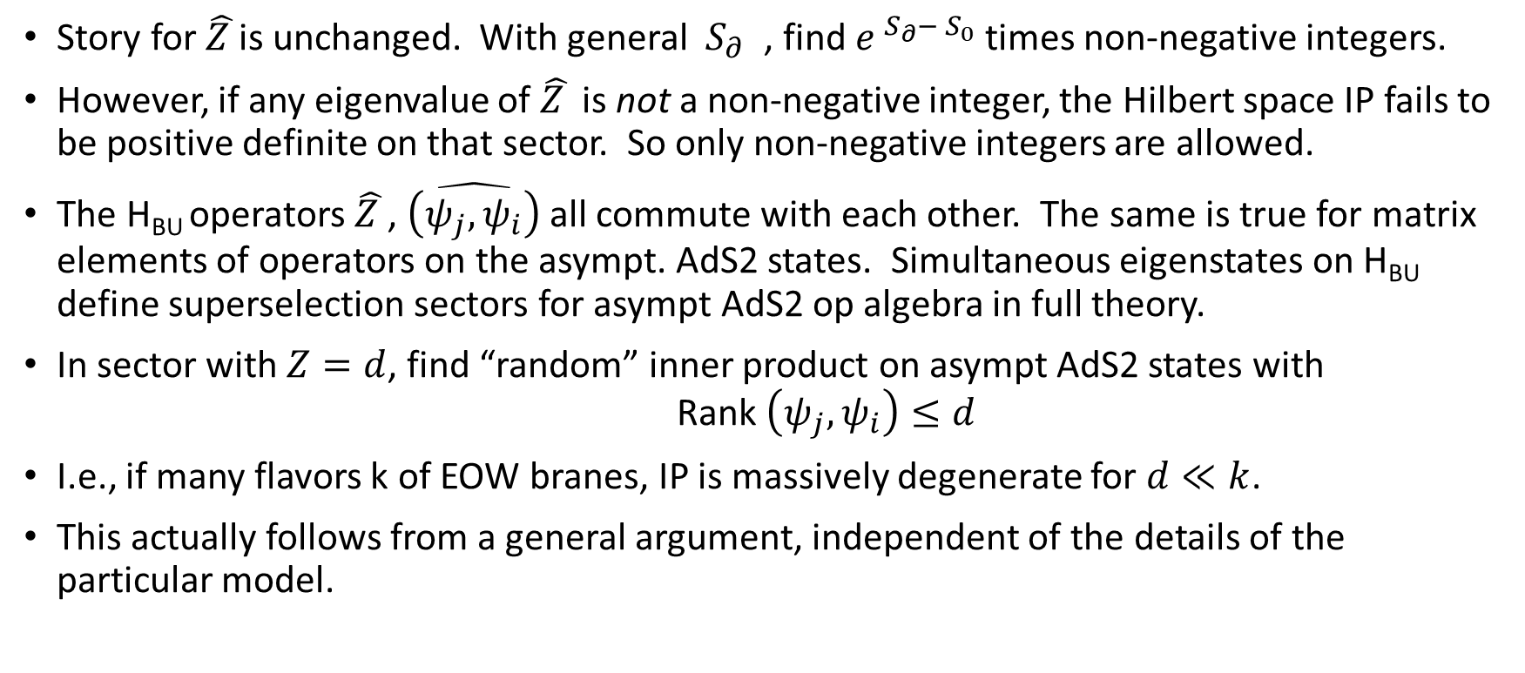
Results
Story for $\hat{Z }$is unchanged. With general ${ S}_{∂}$ , find $e^{{ S}_{∂}−{ S}_{0}}$times non-negative integers.
However, if any eigenvalue of $\hat{Z }$ is not a non-negative integer, the Hilbert space IP fails to be positive definite on that sector. So only non-negative integers are allowed.
The H_{BU} operators $\hat{Z }$, $\hat{\left(ψ_{j},ψ_{i}\right)}$ all commute with each other. The same is true for matrix elements of operators on the asympt. AdS2 states. Simultaneous eigenstates on H_{BU} define superselection sectors for asympt AdS2 op algebra in full theory.
In sector with $Z=d$, find “random” inner product on asympt AdS2 states with Rank $\left(ψ_{j},ψ_{i}\right)≤d$
I.e., if many flavors k of EOW branes, IP is massively degenerate for $d≪k$.
This actually follows from a general argument, independent of the details of the particular model.
This large null space (gauge invariance) seems to be driving the solution of the BH info problem. Bndy Renyis S_{n} are like PI BCs like Z and become operators on H_{BU}. In our model (and also more generally) $\left\langle {\hat{S_{n}}}_{}\right\rangle =\left\langle HH|{\hat{S_{n}}}_{}|HH\right\rangle$ computes an average over BU-sectors, and S_{n} is bounded by the Rank in each sector.

Slide 13
Summary of full results:
Even with e.g. asymptotically AdS BCs, bulk gravity theories naturally include a description of arbitrarily many disconnected closed universes (“baby universes”, BUs) --- and this makes sense!!!!!
The operator algebra associated with asymptotically AdS states has superselection sectors associated with the BUs. As a result, asymptotically AdS physics with a given BU initial state is equivalent to that of an ensemble of asymptotically AdS theories without BUs. One might thus say that the bulk is naturally dual to an ensemble of CFTs.
Summing over topologies leads to a vast set of null states. This follows from a general argument and can be seen explicitly in simple models. This appears to be responsible for the Page curve in evaporating black holes.

Slide 14
Open questions and outlook
To what extent does this all go through in more complete theories where the bulk path integral is not a-priori well-defined? (And where the sum over topologies is more difficult?) Similarlity to SSS → Probably works more or less the same in full JT-gravity, but higher dimensions?
In particular, we expect N=4 SYM to be the unique maximally SUSY local theory. Does this leave room for IIB SUGRA to define an ensemble of dual theories? (Note possibility that ensemble corresponds to bulk field-redefinitions, and perhaps non-local ones.)
Implications for cosmology?
Details of BH info story? Note that integrating out BUs should induce new interactions --- now non-local on the scale of the (horizon-scale) QES.
Further exploration of infalling observers and implications of null states? E.g., firewalls may be gauge equivalent to smooth horizons! This should allow one to incorporate some level of “state-dependence” into standard QM by interpreting it as gauge-dependence.

Slide 15


Appendix: Positivity implies the inner product to have bounded rank
Consider BC
In a given sup. Sel. sector $α$, expect this to create TFD-like entangled state of two asymptotically AdS2 universes.
I.e., compare with
$$|i,j,α>$$
j
i
j
$<i,j;α \sim$ ~ ~ $\left(ψ_{j},ψ_{i}\right)= {<i|j>}_{1−bndy}$
j
i
i
So, choose O.N. basis $|J>$ in 1-bndy theory: ${<I|J>}_{1−bndy}= δ_{I,J}$ and find
$<I,I;α =1,$ w/ $<I,I;α|J,J;α> = δ_{I,J}$ number set by R = Rank of 1-bndy I.P.
But ~ $=d (eigenvalue of \hat{Z})$

Slide 16
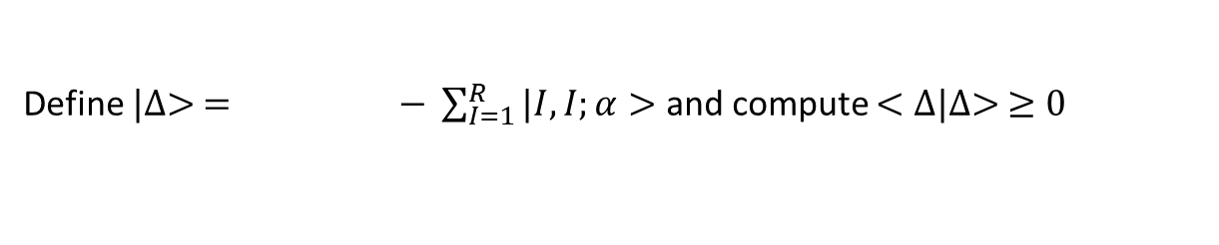
Appendix: Positivity implies the inner product to have bounded rank
Define $|∆> = − \sum_{I=1}^{R}{|I,I;α>}$ and compute $<∆|∆> ≥0$
$$<∆|∆> = − \sum_{J=1}^{R}{<J, J;α −\sum_{I=1}^{R}{ I,I;α> +\sum_{J=1}^{R}{<J,J;α|}\sum_{I=1}^{R}{|I,I;α>}}}$$
$$=d −2R+R=d−R$$
Rank of IP $≤d ‼‼!$
$<I,I;α =1,$ w/ $<I,I;α|J,J;α> = δ_{I,J}$ number set by R = Rank of 1-bndy I.P.
But ~ $=d (eigenvalue of \hat{Z})$

