Slide 1
The Cauchy-Bunyakovsky inequality and its mathematical interpretations

Slide 2
Позвольте мне прежде всего поблагодарить профессора Галину Ивановну Синкевич за любезное приглашение и за предоставленную мне возможность изучить один из аспектов истории Санкт-Петербургской математической школы. Я также благодарен Галине Ивановне за то, что она предоставила вам возможность прочитать текст презентации моего выступления на русском языке.

Slide 3
Приношу свои извинения, что не делаю доклад по-русски, поскольку моих знаний явно недостаточно для этой цели.
Позвольте мне перейти на английский язык.

Slide 4
Objectives
Examine why the Cauchy-Bunyakovsky inequality for integrals was obtained by Bunyakovsky but missed by other authors of the same period.
Show that the « Cauchy-Bunyakovsky-Schwarz » inequality is not a single result, but the conflation of several results with different mathematical meanings : projection (C.S.), consequence of convexity (Hölder, Jensen), least squares approximation (Gram), identity in disguise (Cauchy-Binet) etc.
General point, also useful in other problems in the History of Mathematics : one cannot dissociate a theorem from its proof, or from the mathematical discourse in which it is embedded.

Slide 5
Modern Russian usage
Modern Russian usage distinguishes the Cauchy-Bunyakovsky inequality for integrals, and the abstract Cauchy-Schwarz inequality.
(Example : L. D. Kudyavstev, Course in Math. Analysis, T. 3, (2006) p.195 and 188-9)
We suggest that the difference in terminology reflects a mathematical fact : the same integral inequality may be embedded in several, conceptually different discourses, leading to different proofs and different generalizations.
Notes:
Examples:

Slide 6
Modern Russian usage
While V. Ya. Bunyakovsky’s priority has been recognized clearly by G. H. Hardy, J.L. Littlewood and G. Pólya (1934/1952), they still call his inequality « the inequality of Schwarz » (cf. title of section 6.5, p. 135), even though they give two entirely different proofs. And others have been given.
We therefore try and understand the coherence of V. Ya. Bunyakovsky’s and others’ discourses.
The outline of the talk is as follows.

Slide 7
Outline of the talk
1. The problem : what does the C.-B. inequality mean ?
2. What A. Cauchy (1821), J. Liouville (1836) and H. Grassmann (1862) did, and did not do.
3. V. Ya. Bunyakovsky’s paper : a systematic investigation of means.
4. J. P. Gram (1882) and H. A. Schwarz (1885): least squares and quadratic forms.
5. Later interpretations and generalizations.
6. Conclusion : the result cannot be divorced from the discourse in which it is embedded.

Slide 8
1. The problem: The meaning of the Cauchy-Bunyakovsky inequality.

Slide 9
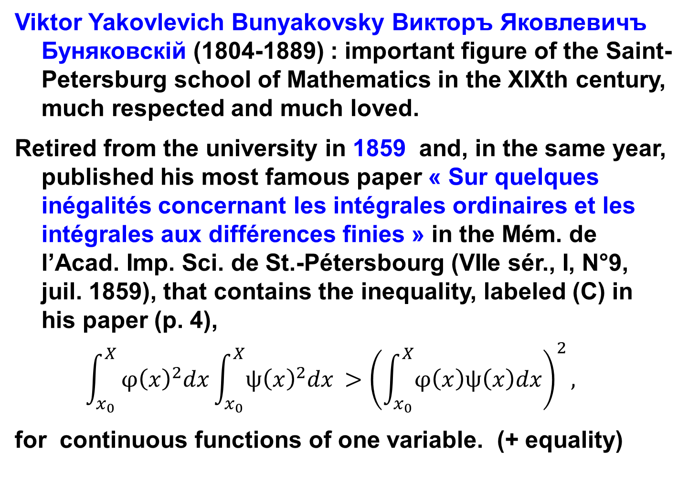
Viktor Yakovlevich Bunyakovsky Викторъ Яковлевичъ Буняковскiй (1804-1889) : important figure of the Saint-Petersburg school of Mathematics in the XIXth century, much respected and much loved.
Retired from the university in 1859 and, in the same year, published his most famous paper « Sur quelques inégalités concernant les intégrales ordinaires et les intégrales aux différences finies » in the Mém. de l’Acad. Imp. Sci. de St.-Pétersbourg (VIIe sér., I, N°9, juil. 1859), that contains the inequality, labeled (C) in his paper (p. 4),
$$\int_{x_{0}}^{X}{φ{\left(x\right)}^{2}dx\int_{x_{0}}^{X}{ψ{\left(x\right)}^{2}dx }>{\left(\int_{x_{0}}^{X}{φ\left(x\right)ψ\left(x\right)dx}\right)}^{2}},$$
for continuous functions of one variable. (+ equality)

Slide 10
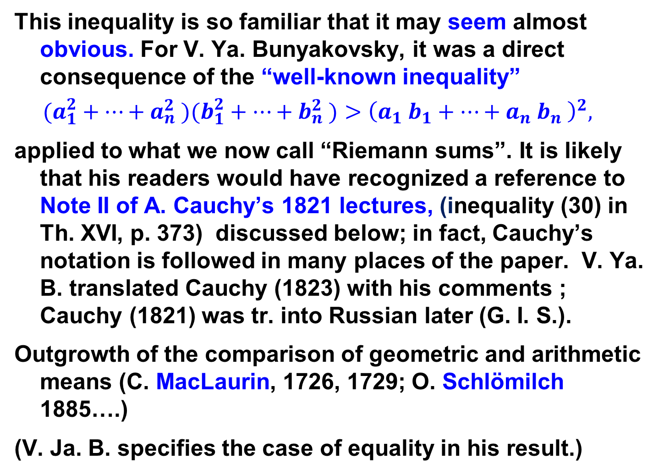
This inequality is so familiar that it may seem almost obvious. For V. Ya. Bunyakovsky, it was a direct consequence of the “well-known inequality”
$$(a_{1}^{2}+⋯+a_{n}^{2} )(b_{1}^{2}+⋯+b_{n}^{2} )>{\left(a_{1} b_{1}+⋯+a_{n} b_{n} \right)}^{2},$$
applied to what we now call “Riemann sums”. It is likely that his readers would have recognized a reference to Note II of A. Cauchy’s 1821 lectures, (inequality (30) in Th. XVI, p. 373) discussed below; in fact, Cauchy’s notation is followed in many places of the paper. V. Ya. B. translated Cauchy (1823) with his comments ; Cauchy (1821) was tr. into Russian later (G. I. S.).
Outgrowth of the comparison of geometric and arithmetic means (C. MacLaurin, 1726, 1729; O. Schlömilch 1885….)
(V. Ja. B. specifies the case of equality in his result.)

Slide 11
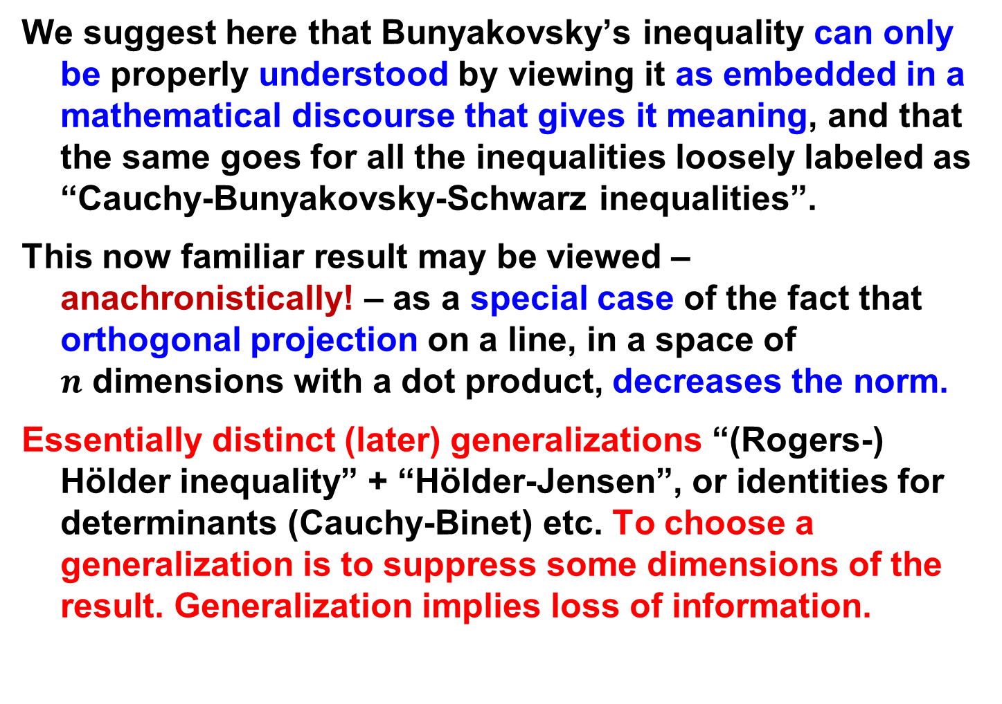
We suggest here that Bunyakovsky’s inequality can only be properly understood by viewing it as embedded in a mathematical discourse that gives it meaning, and that the same goes for all the inequalities loosely labeled as “Cauchy-Bunyakovsky-Schwarz inequalities”.
This now familiar result may be viewed – anachronistically! – as a special case of the fact that orthogonal projection on a line, in a space of $n$ dimensions with a dot product, decreases the norm.
Essentially distinct (later) generalizations “(Rogers-) Hölder inequality” + “Hölder-Jensen”, or identities for determinants (Cauchy-Binet) etc. To choose a generalization is to suppress some dimensions of the result. Generalization implies loss of information.

Slide 12
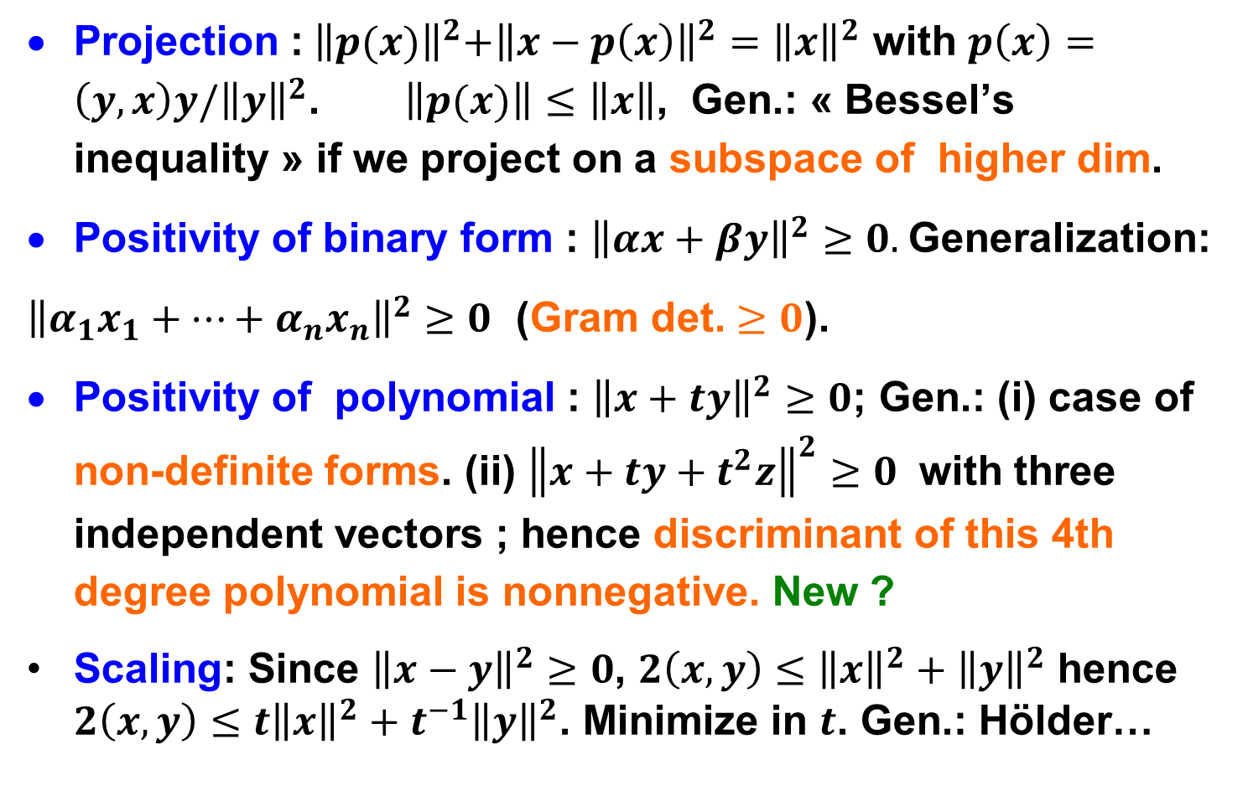
Proofs with different meanings
Projection :${ \left\|p(x)\right\|}^{2}+{\left\|x−p\left(x\right)\right\|}^{2}={\left\|x\right\|}^{2}$ with $p\left(x\right)=\left(y,x\right)y/{\left\|y\right\|}^{2}$. $\left\|p(x)\right\|≤\left\|x\right\|$, Gen.: « Bessel’s inequality » if we project on a subspace of higher dim.
Positivity of binary form : ${\left\|αx+βy\right\|}^{2}≥0.$Generalization:
${\left\|α_{1}x_{1}+⋯+α_{n}x_{n}\right\|}^{2}≥0$ (Gram det. $≥0$).
Positivity of polynomial : ${\left\|x+ty\right\|}^{2}≥0$; Gen.: (i) case of non-definite forms. (ii) ${\left\|x+ty+t^{2}z\right\|}^{2}≥0$ with three independent vectors ; hence discriminant of this 4th degree polynomial is nonnegative. New ?
Scaling: Since ${\left\|x−y\right\|}^{2}≥0$, $2\left(x,y\right)≤{\left\|x\right\|}^{2}+{\left\|y\right\|}^{2}$ hence $2\left(x,y\right)≤{t\left\|x\right\|}^{2}+t^{−1}{\left\|y\right\|}^{2}$. Minimize in $t$. Gen.: Hölder…

Slide 13
We also show that some essential elements in V. Ya. Bunyakovsky’s discourse, such as proofs, are not spelled out, but are implied by his discourse. That makes it what we call an apodictic discourse, or a discourse that contains proofs (apodeixis) encoded in part by the discursive structure itself : if the motivation is clear, proofs need not be spelled out.

Slide 14
2. What A. Cauchy, J. Liouville, H. Grassmann… diD ― and didn’t do

Slide 15
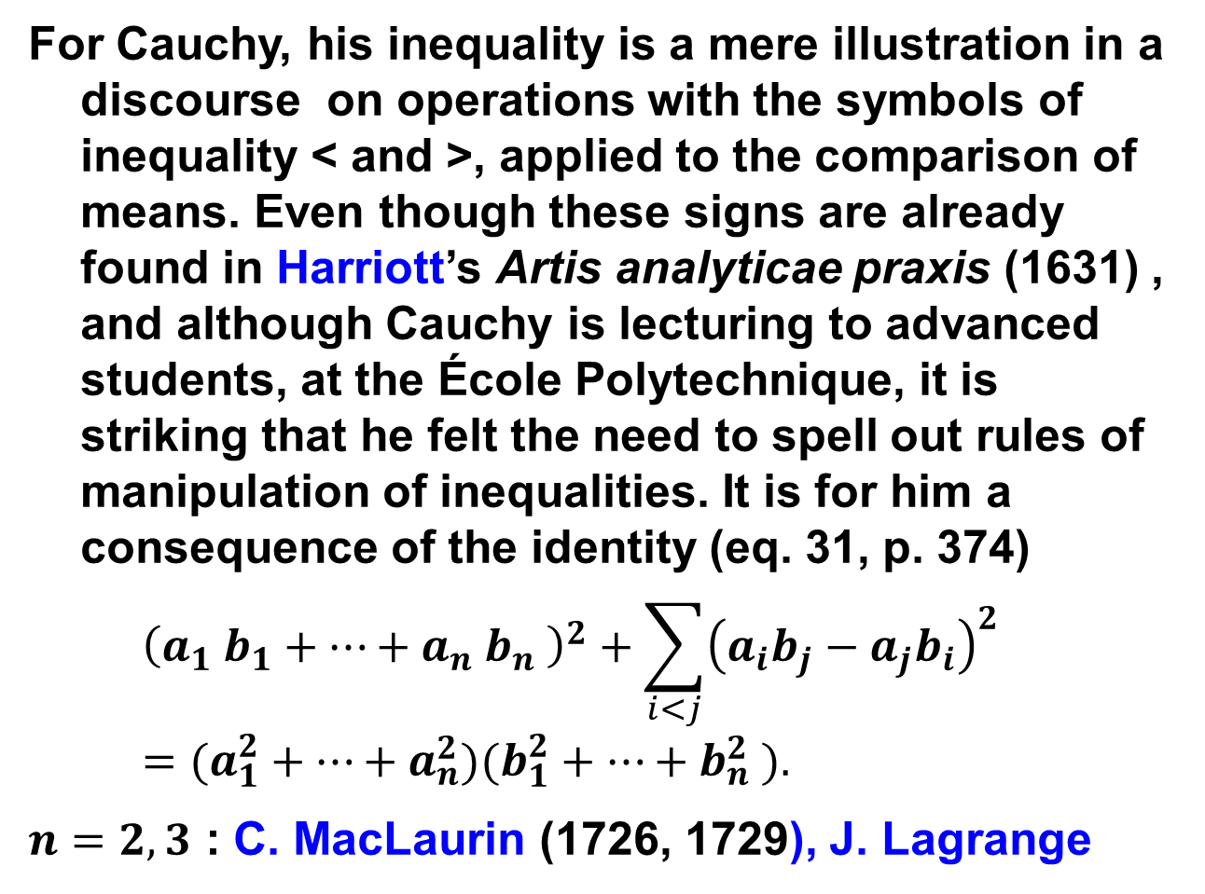
A. L. Cauchy (1821)
For Cauchy, his inequality is a mere illustration in a discourse on operations with the symbols of inequality < and >, applied to the comparison of means. Even though these signs are already found in Harriott’s Artis analyticae praxis (1631) , and although Cauchy is lecturing to advanced students, at the École Polytechnique, it is striking that he felt the need to spell out rules of manipulation of inequalities. It is for him a consequence of the identity (eq. 31, p. 374)
$${\left(a_{1} b_{1}+⋯+a_{n} b_{n} \right)}^{2}+\sum_{i<j}{{\left(a_{i}b_{j}−a_{j}b_{i}\right)}^{2}}=(a_{1}^{2}+⋯+a_{n}^{2})(b_{1}^{2}+⋯+b_{n}^{2} ).$$
$n=2, 3$ : C. MacLaurin (1726, 1729), J. Lagrange

Slide 16
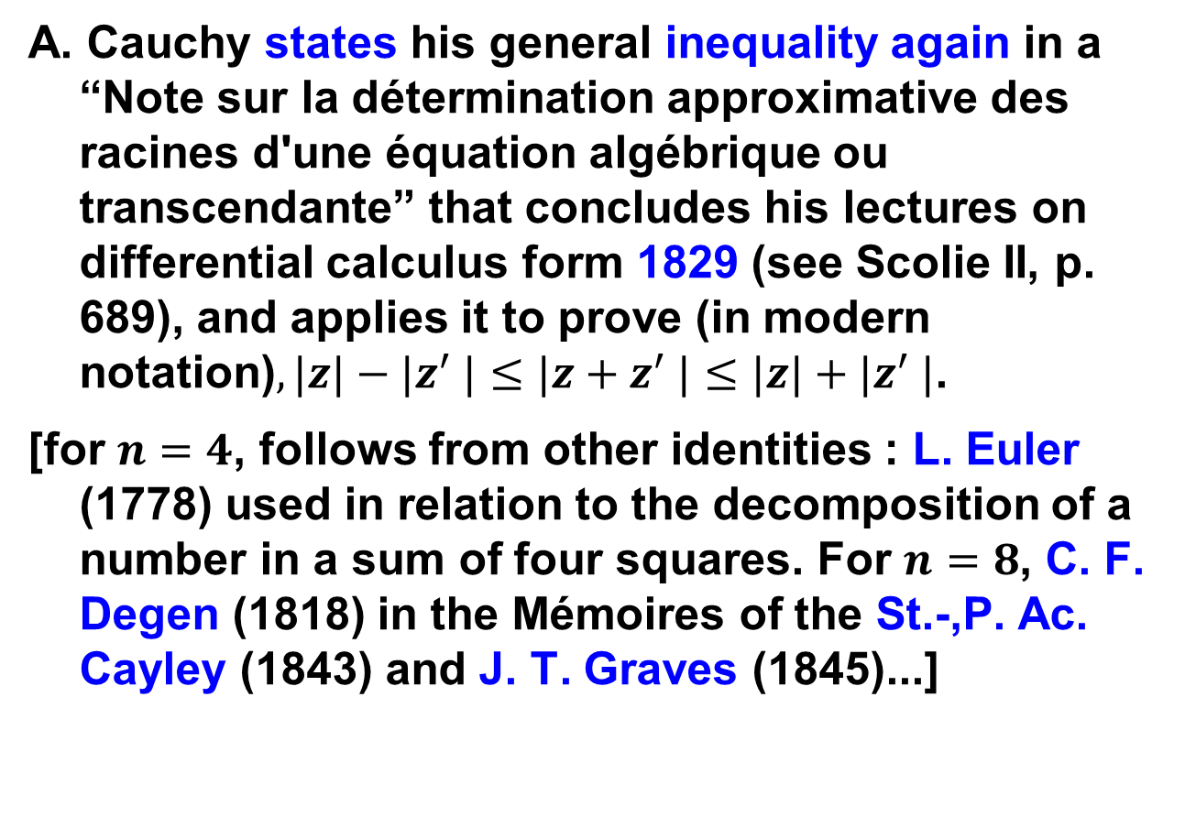
A. L. Cauchy’s motivation
A. Cauchy states his general inequality again in a “Note sur la détermination approximative des racines d'une équation algébrique ou transcendante” that concludes his lectures on differential calculus form 1829 (see Scolie II, p. 689), and applies it to prove (in modern notation)$, |z|−|z^{′} |≤|z+z^{′} |≤|z|+|z^{′} |$.
[for $n=4$, follows from other identities : L. Euler (1778) used in relation to the decomposition of a number in a sum of four squares. For $n=8$, C. F. Degen (1818) in the Mémoires of the St.-,P. Ac. Cayley (1843) and J. T. Graves (1845)...]

Slide 17
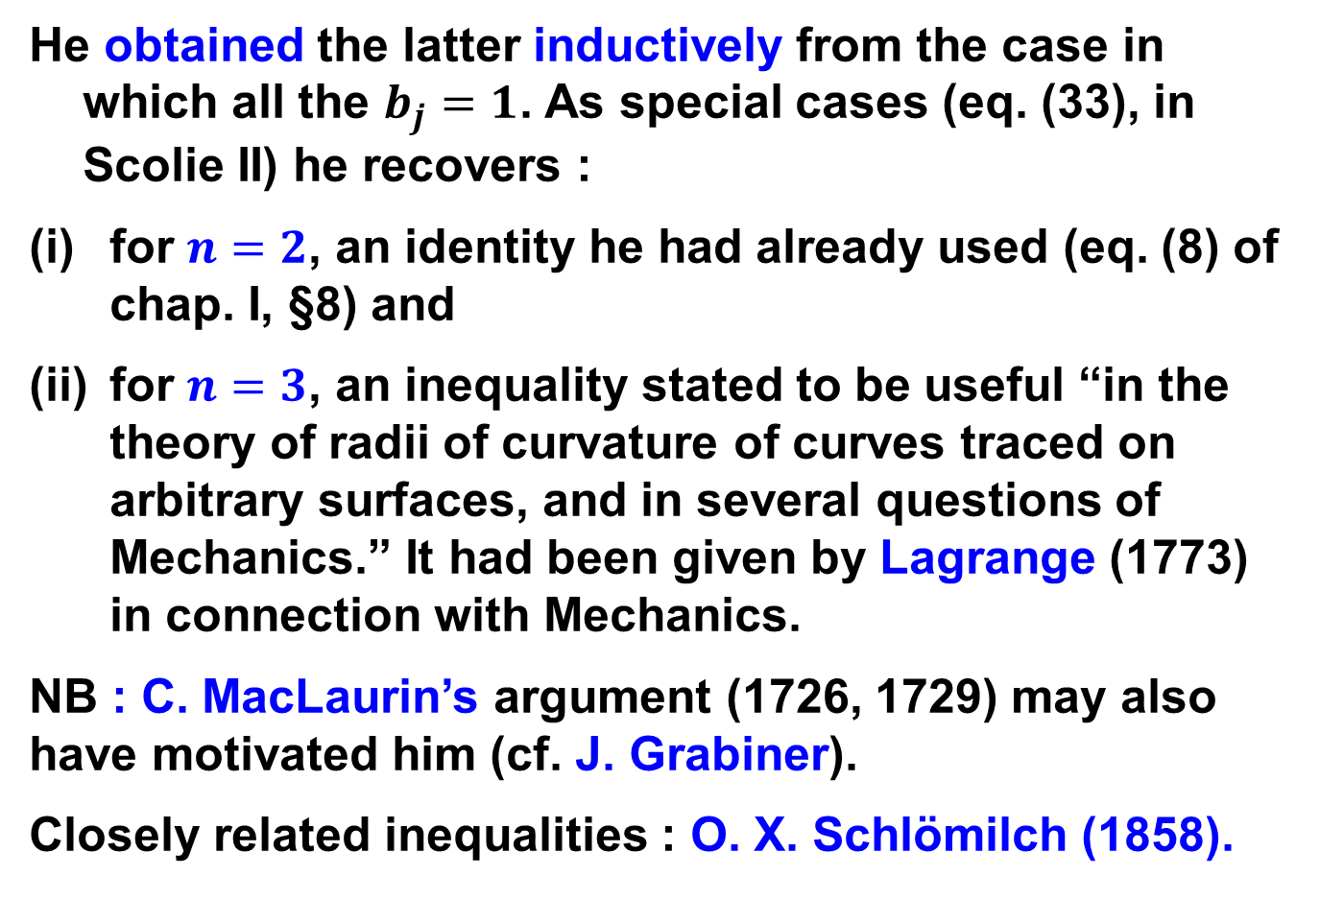
A. L. Cauchy (1821)
He obtained the latter inductively from the case in which all the $b_{j}=1$. As special cases (eq. (33), in Scolie II) he recovers :
for $n=2$, an identity he had already used (eq. (8) of chap. I, §8) and
for $n=3$, an inequality stated to be useful “in the theory of radii of curvature of curves traced on arbitrary surfaces, and in several questions of Mechanics.” It had been given by Lagrange (1773) in connection with Mechanics.
NB : C. MacLaurin’s argument (1726, 1729) may also have motivated him (cf. J. Grabiner).
Closely related inequalities : O. X. Schlömilch (1858).

Slide 18
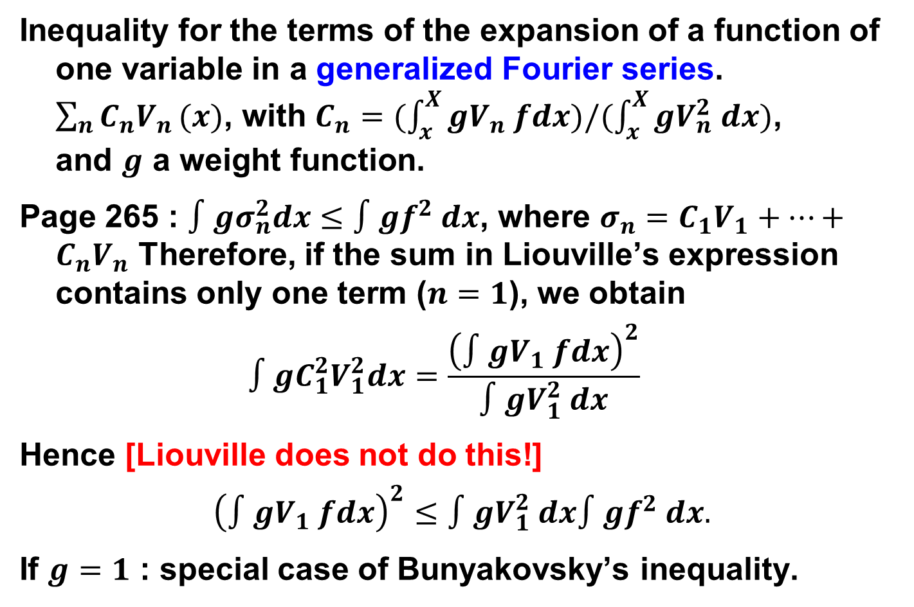
J. Liouville (1836)
Inequality for the terms of the expansion of a function of one variable in a generalized Fourier series. $\sum_{n}{C_{n}V_{n}}(x)$, with $C_{n}=(\int_{x}^{X}{gV_{n} fdx})/(\int_{x}^{X}{gV_{n}^{2} dx})\text{,} \text{and} g \text{a} \text{weight} \text{function}$.
Page 265 : $∫gσ_{n}^{2}dx≤∫gf^{2} dx$, where $σ_{n}=C_{1}V_{1}+⋯+C_{n}V_{n}$ Therefore, if the sum in Liouville’s expression contains only one term ($n=1$), we obtain
$$∫{gC}_{1}^{2}V_{1}^{2}dx=\frac{{\left(∫gV_{1} fdx\right)}^{2}}{∫gV_{1}^{2} dx}$$
Hence [Liouville does not do this!]
$${\left(∫gV_{1} fdx\right)}^{2}≤∫gV_{1}^{2} dx∫gf^{2} dx.$$
If $g=1$ : special case of Bunyakovsky’s inequality.

Slide 19
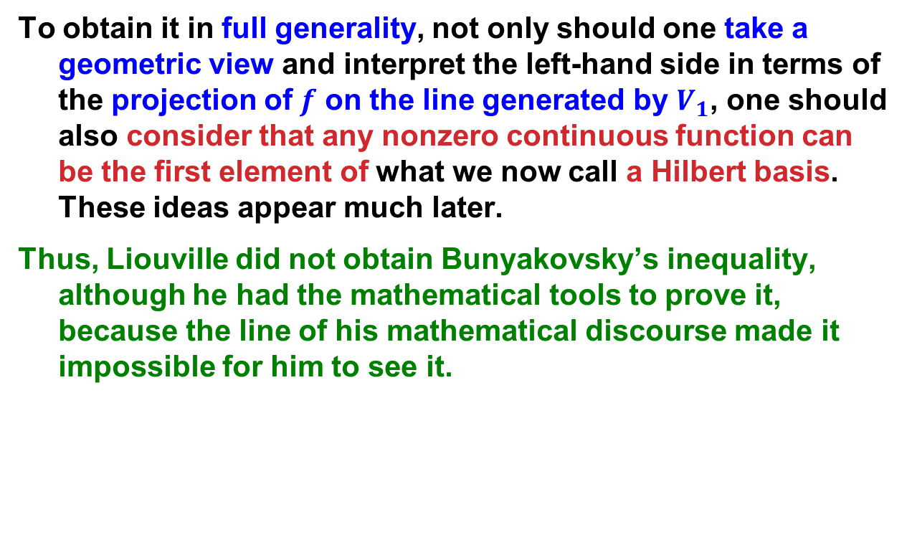
J. Liouville (1836)
To obtain it in full generality, not only should one take a geometric view and interpret the left-hand side in terms of the projection of $f$ on the line generated by $V_{1}$, one should also consider that any nonzero continuous function can be the first element of what we now call a Hilbert basis. These ideas appear much later.
Thus, Liouville did not obtain Bunyakovsky’s inequality, although he had the mathematical tools to prove it, because the line of his mathematical discourse made it impossible for him to see it.

Slide 20
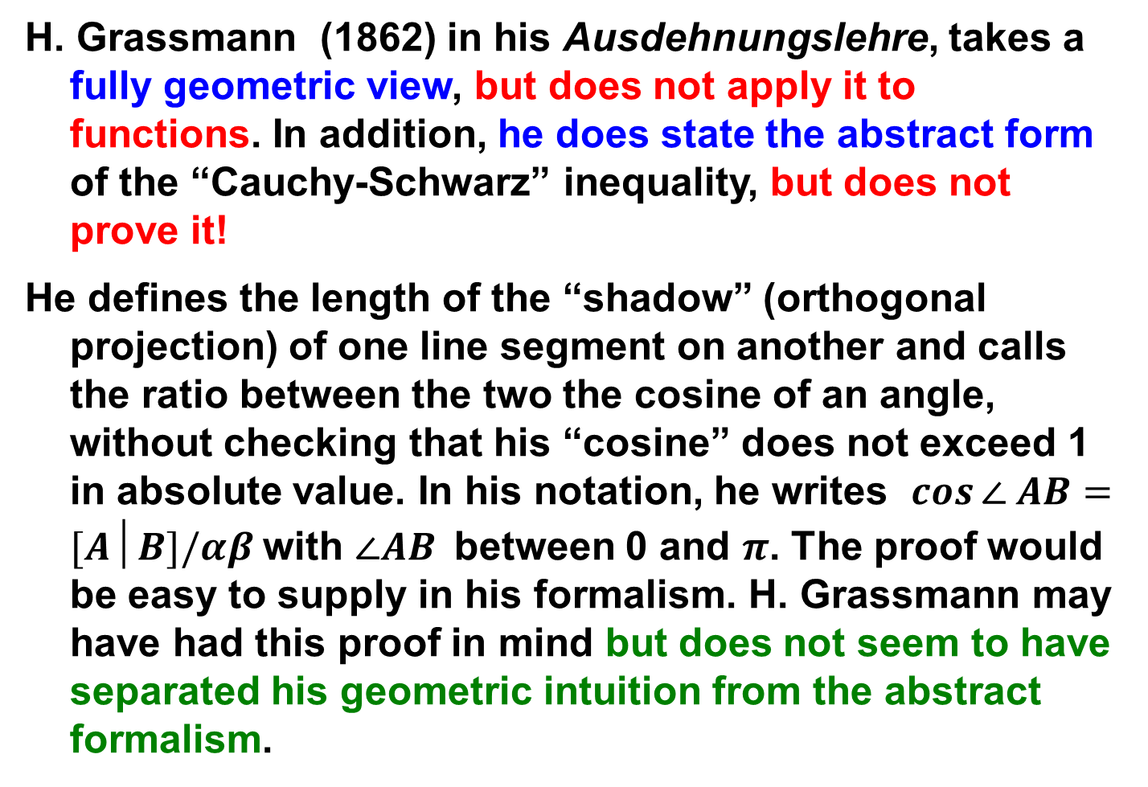
H. Grassmann (1862)
H. Grassmann (1862) in his Ausdehnungslehre, takes a fully geometric view, but does not apply it to functions. In addition, he does state the abstract form of the “Cauchy-Schwarz” inequality, but does not prove it!
He defines the length of the “shadow” (orthogonal projection) of one line segment on another and calls the ratio between the two the cosine of an angle, without checking that his “cosine” does not exceed 1 in absolute value. In his notation, he writes $cos⁡∠ AB=[A│B]/αβ$with $∠AB$between 0 and $π$. The proof would be easy to supply in his formalism. H. Grassmann may have had this proof in mind but does not seem to have separated his geometric intuition from the abstract formalism.

Slide 21
3. V. Ya. Bunyakovsky’s paper : a systematic investigation of means.

Slide 22
V. Ya. Bunyakovsky opens his 1859 paper by proposing that the notion of arithmetic mean is the concept that, when applied to “functions of one or several variables that change by imperceptible steps leads to Integral Calculus, in the most natural, the most elegant and the most satisfactory way from the point of view of clarity.”
In retrospect, his point of view is very close to that of Hardy et al., who will similarly explore many years later the various types of means, and their relations. By contrast, modern courses would rather appeal to notions of length or area, that are less general, since they are limited to special types of magnitudes.

Slide 23
V. Bunyakovsky continues: “In a large number of applications of transcendental Analysis, this point of view greatly facilitates the conception of the relations that exist between the data in the question [at hand], as in many examples that could be mentioned, in the Theory of Probability among others.” A footnote gives the only reference of the paper: “See my Traité du Calcul des Probabilités (Основанія Математической Теорія Вѣроятностей [Foundations of the Mathematical Theory of Probability], 1846 г.)”. “Continuous means” : p. 446 sq. of this treatise; discrete means on p. 153, and the convergence rules of Duhamel and Raabe, mentioned in §4, of the paper appear on p. 397 of his book.

Slide 24
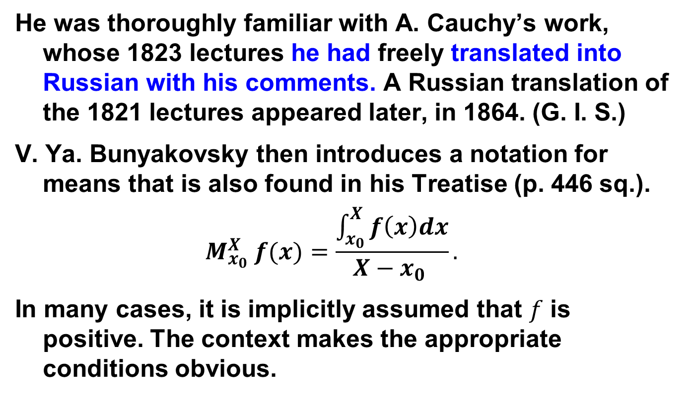
He was thoroughly familiar with A. Cauchy’s work, whose 1823 lectures he had freely translated into Russian with his comments. A Russian translation of the 1821 lectures appeared later, in 1864. (G. I. S.)
V. Ya. Bunyakovsky then introduces a notation for means that is also found in his Treatise (p. 446 sq.).
$$M_{x_{0}}^{X} f(x)=\frac{\int_{x_{0}}^{X}{f\left(x\right)dx}}{X−x_{0} }.$$
In many cases, it is implicitly assumed that $f$ is positive. The context makes the appropriate conditions obvious.

Slide 25
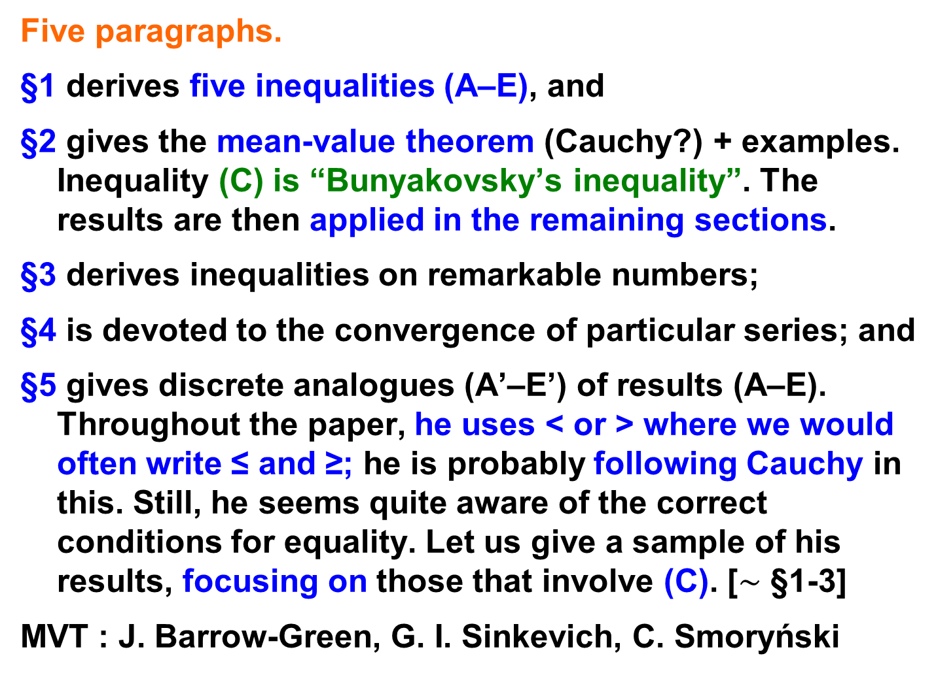
Five paragraphs.
§1 derives five inequalities (A–E), and
§2 gives the mean-value theorem (Cauchy?) + examples. Inequality (C) is “Bunyakovsky’s inequality”. The results are then applied in the remaining sections.
§3 derives inequalities on remarkable numbers;
§4 is devoted to the convergence of particular series; and
§5 gives discrete analogues (A’–E’) of results (A–E). Throughout the paper, he uses < or > where we would often write ≤ and ≥; he is probably following Cauchy in this. Still, he seems quite aware of the correct conditions for equality. Let us give a sample of his results, focusing on those that involve (C). [$∼$ §1-3]
MVT : J. Barrow-Green, G. I. Sinkevich, C. Smoryński

Slide 26
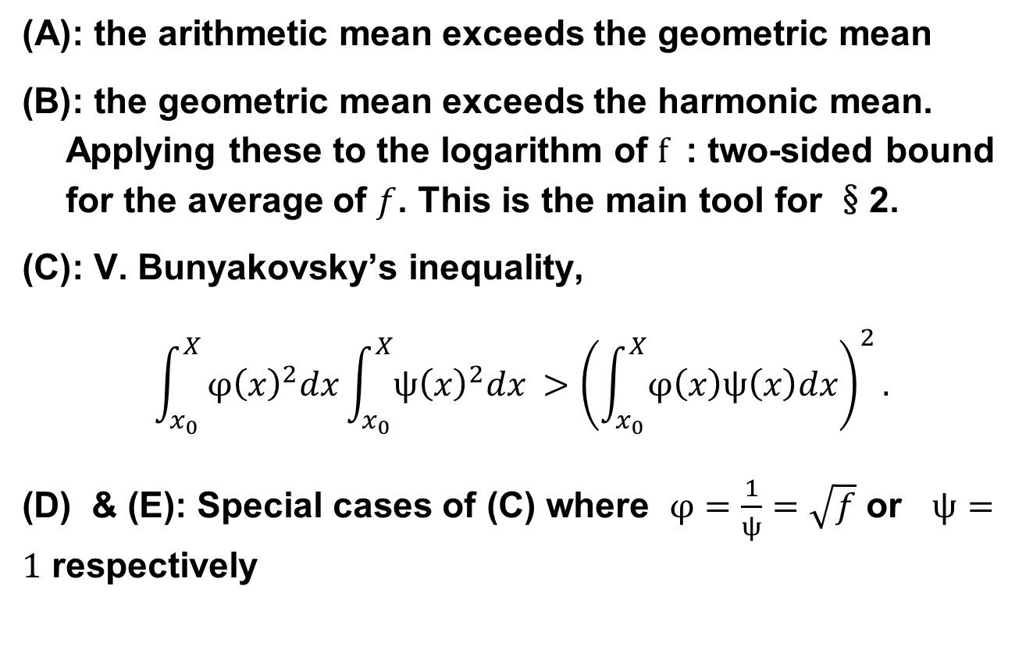
§1. V. JA. Bunyakovsky extends geometric and harmonic means to the continuous case
: the arithmetic mean exceeds the geometric mean
: the geometric mean exceeds the harmonic mean. Applying these to the logarithm of $f$ : two-sided bound for the average of $f$. This is the main tool for §2.
: V. Bunyakovsky’s inequality,
$$\int_{x_{0}}^{X}{φ{\left(x\right)}^{2}dx\int_{x_{0}}^{X}{ψ{\left(x\right)}^{2}dx }>{\left(\int_{x_{0}}^{X}{φ\left(x\right)ψ\left(x\right)dx}\right)}^{2}}.$$
(D) & (E): Special cases of (C) where $φ=\frac{1}{ψ}=\sqrt{f}$ or $ψ=1$ respectively

Slide 27
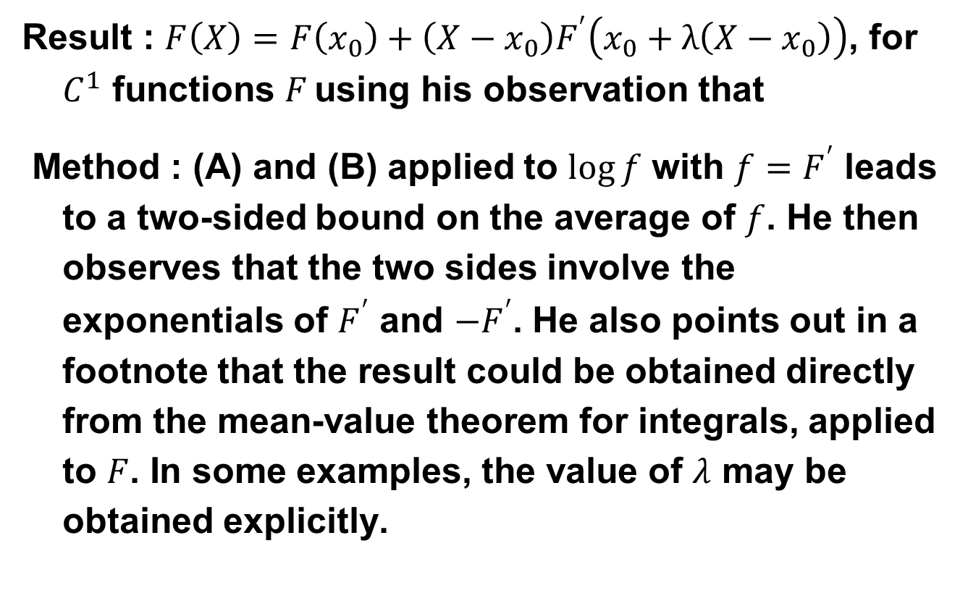
§2. V. JA. B, obtains the mean-value thm. For functions from the MVT for integrals
Result : $F\left(X\right)=F\left(x_{0}\right)+\left(X−x_{0}\right)F^{′}\left(x_{0}+λ\left(X−x_{0}\right)\right)$, for $C^{1}$ functions $F$using his observation that
Method : (A) and (B) applied to $\log{f}$ with $f=F^{′}$ leads to a two-sided bound on the average of $f$. He then observes that the two sides involve the exponentials of $F^{′}$ and $−F^{′}$. He also points out in a footnote that the result could be obtained directly from the mean-value theorem for integrals, applied to $F$. In some examples, the value of $λ$ may be obtained explicitly.

Slide 28
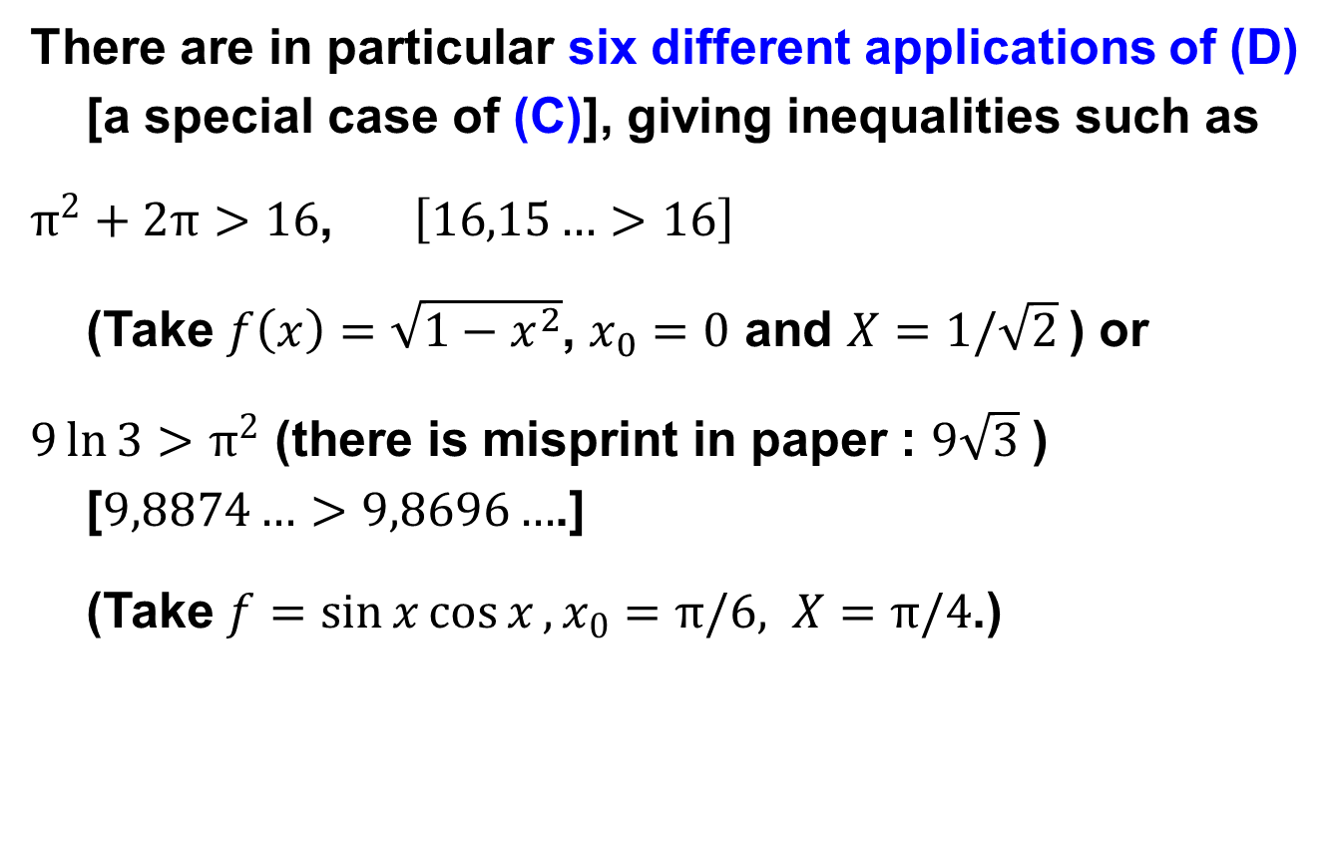
§3. Applications of (A-D)
There are in particular six different applications of (D) [a special case of (C)], giving inequalities such as
$π^{2}+2π>16$, $\left[16,15…>16\right]$
(Take $f\left(x\right)=\sqrt{1−x^{2}}$, $x_{0}=0$ and $X=1/\sqrt{2}$) or
$9\ln{3}>π^{2}$ (there is misprint in paper : $9\sqrt{3}$ ) [$9,8874…>9,8696…$.]
(Take $f=\sin{x}\cos{x},x_{0}=π/6, X=π/4$.)

Slide 29
4. J. P. Gram and H. A. Schwarz : least squares and quadratic forms.

Slide 30
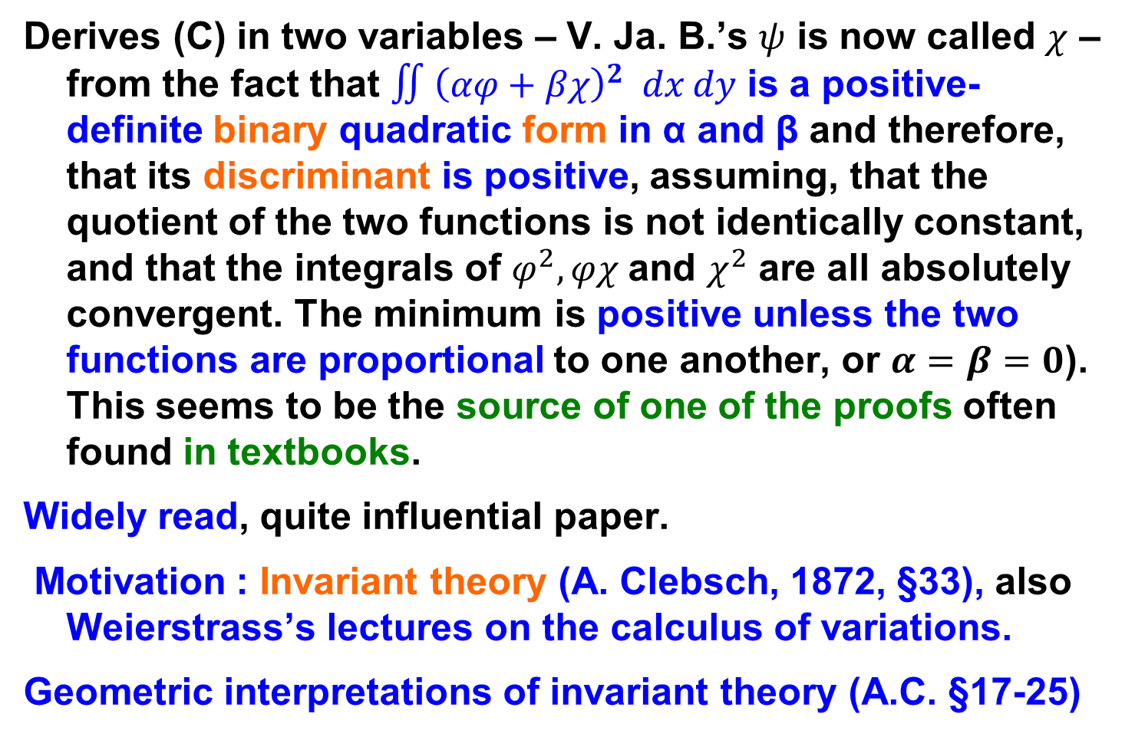
Schwarz (1885) §15, p. 344
Derives (C) in two variables – V. Ja. B.’s $ψ$ is now called $χ$ – from the fact that $∬{\left(αφ+βχ\right)}^{2} dx dy$ is a positive-definite binary quadratic form in α and β and therefore, that its discriminant is positive, assuming, that the quotient of the two functions is not identically constant, and that the integrals of $φ^{2},φχ$and $χ^{2}$ are all absolutely convergent. The minimum is positive unless the two functions are proportional to one another, or $α=β=0$). This seems to be the source of one of the proofs often found in textbooks.
Widely read, quite influential paper.
Motivation : Invariant theory (A. Clebsch, 1872, §33), also Weierstrass’s lectures on the calculus of variations.
Geometric interpretations of invariant theory (A.C. §17-25)

Slide 31
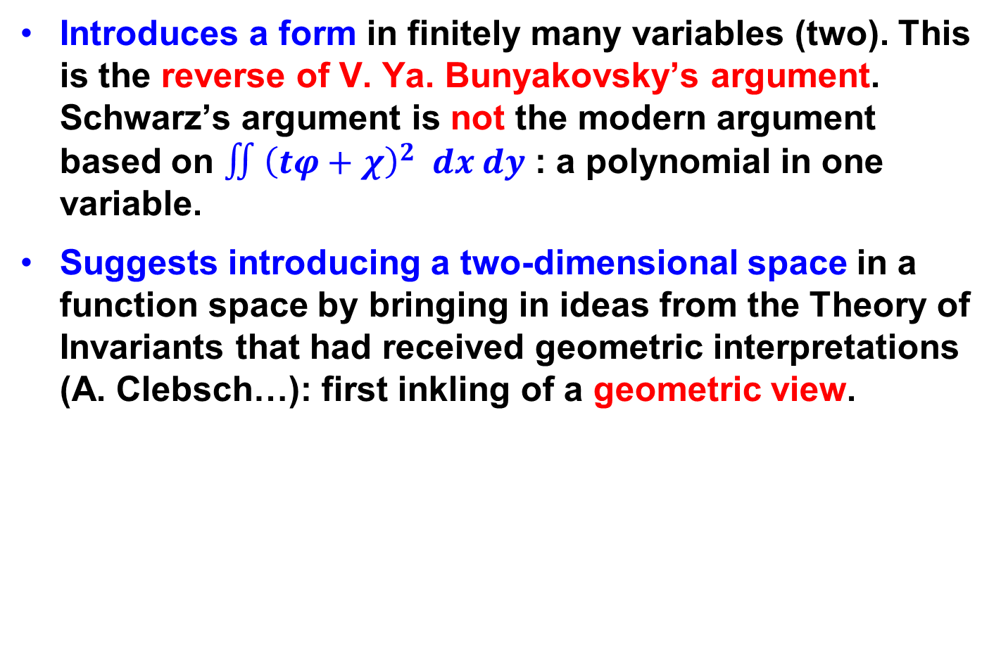
Change of viewpoint
Introduces a form in finitely many variables (two). This is the reverse of V. Ya. Bunyakovsky’s argument. Schwarz’s argument is not the modern argument based on $∬{\left(tφ+χ\right)}^{2} dx dy$ : a polynomial in one variable.
Suggests introducing a two-dimensional space in a function space by bringing in ideas from the Theory of Invariants that had received geometric interpretations (A. Clebsch…): first inkling of a geometric view.

Slide 32
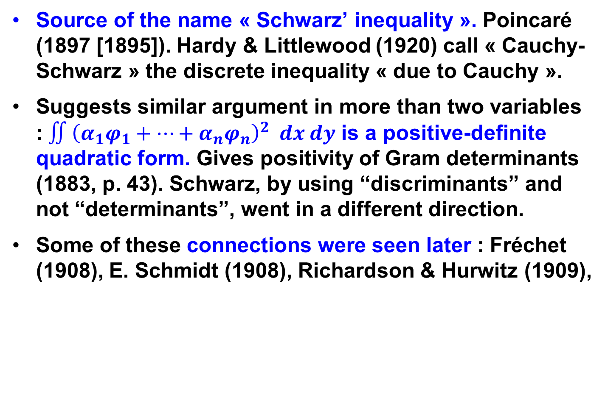
Later impact
Source of the name « Schwarz’ inequality ». Poincaré (1897 [1895]). Hardy & Littlewood (1920) call « Cauchy-Schwarz » the discrete inequality « due to Cauchy ».
Suggests similar argument in more than two variables :$∬{\left(α_{1}φ_{1}+⋯+α_{n}φ_{n}\right)}^{2} dx dy$ is a positive-definite quadratic form. Gives positivity of Gram determinants (1883, p. 43). Schwarz, by using “discriminants” and not “determinants”, went in a different direction.
Some of these connections were seen later : Fréchet (1908), E. Schmidt (1908), Richardson & Hurwitz (1909),

Slide 33
5. Later interpretations and generalizations.

Slide 34
The geometric interpretation of such integrals seems to have been stated clearly by Fréchet (1907) and Schmidt (1908). Once this step had been taken, the interpretation of the inequality in terms of the contraction property of orthogonal projection becomes natural.
There are countless generalizations of Cauchy’s and Bunyakovsky’s identities that apparently cannot be subsumed under a single “master theorem” (despite E. H. Zarantonello (1976) 133-137). (Some recent papers : S. M. Sitnik (2010); unusual ones in A. Ibrahim & S. S. Dragomir (2018)
Modern formulation : G. H. Hardy et al. (1920), H. Weyl (1918), J. von Neumann (Foundations of Q. M., p. 21-22).

Slide 35
The very useful fact that the inequality remains valid for Hermitian forms q(x,y), nonnegative but not necessarily positive definite, seems to have been folklore in the 1930s and possibly earlier. It is proved in a special setting by von Neumann , and by Riesz and Nagy , who do not seem to consider it as new. It is this general form that Bourbaki calls the “Cauchy-Schwarz inequality” (EVT, V.3, Prop. 2).

Slide 36
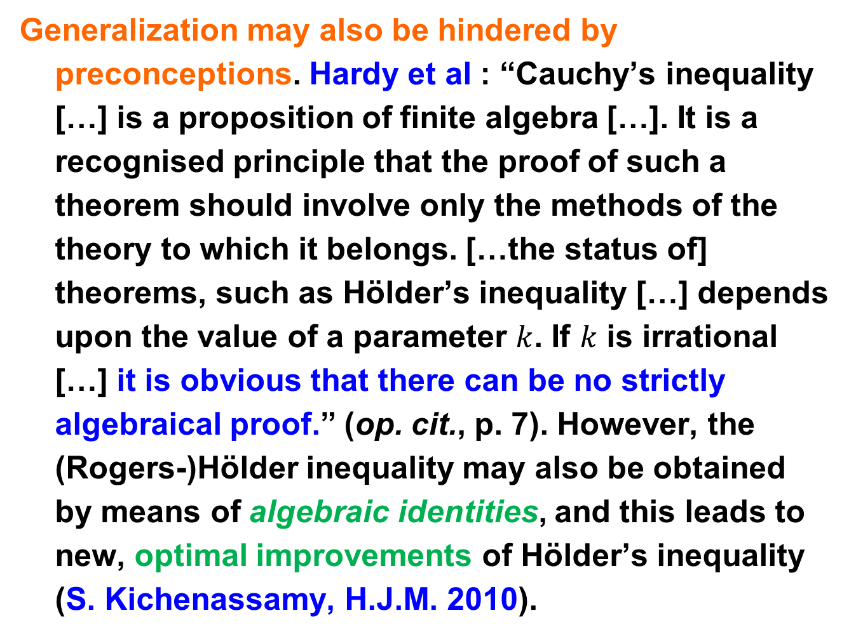
Generalization may also be hindered by preconceptions. Hardy et al : “Cauchy’s inequality […] is a proposition of finite algebra […]. It is a recognised principle that the proof of such a theorem should involve only the methods of the theory to which it belongs. […the status of] theorems, such as Hölder’s inequality […] depends upon the value of a parameter $k$. If $k$ is irrational […] it is obvious that there can be no strictly algebraical proof.” (op. cit., p. 7). However, the (Rogers-)Hölder inequality may also be obtained by means of algebraic identities, and this leads to new, optimal improvements of Hölder’s inequality (S. Kichenassamy, H.J.M. 2010).

Slide 37
6. CONclusion

Slide 38
We have seen that :
Bunyakovsky found his identity because he was interested in means that occur in Statistics and Probability, ….
… from a mathematical perspective inherited from Cauchy. Apparently unique combination at the time.
The various proofs of the modern inequality betray that we deal with several related results, but with quite different mathematical meanings.
Each interpretation makes some generalizations natural and makes other generalizations difficult to guess.

Slide 39
This suggests that:
Mathematics, when communicated, is a discourse.
Theorems receive meaning from the particular apodictic discourse in which they arise.
In teaching, it seems advisable to label theorems by their meaning, to attach names if necessary to proofs or discourses only. Give several proofs of the “same” theorem.

Slide 40
Conclusion
The various interpretations of V. Ya. Bunyakowsky’s inequality are therefore not developments of a single idea, like nested Matryoshka dolls, each of which is a copy of the next one, only smaller, but rather resemble Fabergé eggs Яйца Фаберже́ each with a “surprise ”: the outer (newer) layer does not indicate what the interior (the past) contains.
That is why historical investigation provides a deeper understanding of modern mathematics that cannot be inferred from the modern stage alone.
See for instance the recently recovered Third Imperial egg from 1887, the Diamond Treillis from 1892, or the Lilies of the Valley from 1898, that illustrate different types of « surprises ».

Slide 41
THANK YOU
FOR
YOUR ATTENTION

Slide 42
Notes and references
C. A. Andréieff, Викторъ Яковлевичъ Буняковскiй. Некрологическiй очеркъ, Communications de la Société mathématique de Kharkow. 2ème série, (1889), 2:1-2, 149–161. К.А. Андреевъ. Викторъ Яковлевичъ Буняковскiй. Некрологическiй очеркъ, Сообщ. Харьков. матем. общ. Вторая сер., 2:1-2 (1889), 149–161. Среди других аналитических статей назовём Мельников И.Г. Работы Буняковского по теории чисел. Труды Института истории естествознания и техники АН СССР, 17 (1957), стр. 270–286; «Описание празднования докторского юбилея вице-президента Академии наук академика Буняковского. 19 мая 1875 г.», Санкт-Петербург, Россия, 1876;.
J. Barrow-Green (2009). « From cascades to calculus: Rolle’s Theorem. » The Oxford Handbook of the History of Mathematics (eds. Eleanor Robson, Jacqueline Stedall), Oxford University Press, 737- 754.

Slide 43
N. S. Barnett, S. S. Dragomir, I. Gomm (2010). On some integral inequalities related to the Cauchy-Bunyakovsky-Schwarz inequality, Applied Mathematics Letters 23, (2010) 1008-1012
E. F. Beckenbach and R. Bellman (1961). Inequalities, Springer.
V. Bouniakowksy [В. Я. Буняковскiй] « Sur quelques inégalités concernant les intégrales ordinaires et les intégrales aux différences finies » in the Mém. de l’Acad. Imp. Sci. de St.-Pétersbourg (VIIe sér., I, N°9, juil. 1859), 1-18.
Викторъ Яковлевичъ Буняковскiй, (1846). Основанія Математической Теорія Вѣроятностей [Foundations of the Mathematical Theory of Probability], 1846.

Slide 44
Florian Cajori, A History of Mathematical Notations (vol. 1, Open Court, London, 1928), For the signs of inequality, see §188, p. 199 ; see also his A History of Mathematics (AMS, 2000 [First ed., 1893]), p. 157 : « The signs [of inequality in the wide sense] were first used about a century later [than Harriott] by the Parisian hydrographer Pierre Bouguer » with a reference to P. H. Fuss, Corresp. Math. Phys., I, 1843, p. 304 ;Encyclopédie des sc. math., T. I, vol. I, 1904, p. 23. [«Знаки [неравенства в широком смысле] были впервые использованы примерно на столетие позже [чем у Харриота] парижским гидрографом Пьером Бугером» со ссылкой на P.H. Fuss, Corresp. Математика. Phys., I, 1843, с. 304; Encyclopédie des sc. math., Т. I, vol. I, 1904, с. 23.]

Slide 45
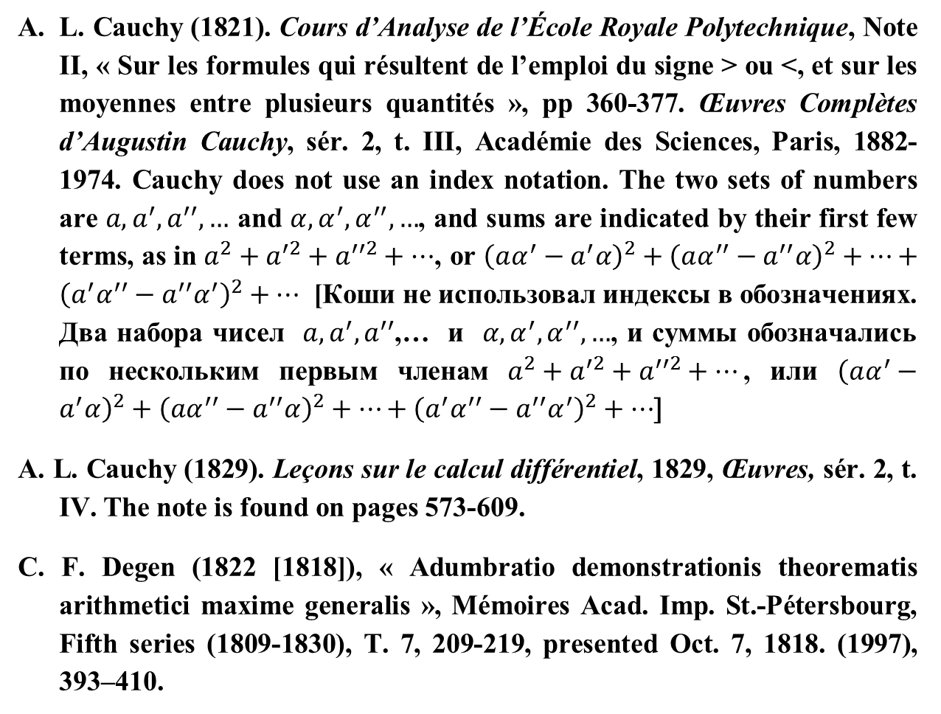
L. Cauchy (1821). Cours d’Analyse de l’École Royale Polytechnique, Note II, « Sur les formules qui résultent de l’emploi du signe > ou <, et sur les moyennes entre plusieurs quantités », pp 360-377. Œuvres Complètes d’Augustin Cauchy, sér. 2, t. III, Académie des Sciences, Paris, 1882-1974. Cauchy does not use an index notation. The two sets of numbers are $a, a^{′}, a^{′′},…$ and $α,α^{′},α^{′′},…$, and sums are indicated by their first few terms, as in $a^{2}+a^{′2}+a^{′′2}+⋯$, or ${\left(aα^{′}−a^{′}α\right)}^{2}+{\left(aα^{′′}−a^{′′}α\right)}^{2}+⋯+{\left(a^{′}α^{′′}−a^{′′}α^{′}\right)}^{2}+…$ [Коши не использовал индексы в обозначениях. Два набора чисел $a,a^{′},a^{′′}$,… и $α,α^{′},α^{′′},…$, и суммы обозначались по нескольким первым членам $a^{2}+a^{′2}+a^{′′2}+⋯$, или ${\left(aα^{′}−a^{′}α\right)}^{2}+{\left(aα^{′′}−a^{′′}α\right)}^{2}+⋯+{\left(a^{′}α^{′′}−a^{′′}α^{′}\right)}^{2}+⋯$]
A. L. Cauchy (1829). Leçons sur le calcul différentiel, 1829, Œuvres, sér. 2, t. IV. The note is found on pages 573-609.
C. F. Degen (1822 [1818]), « Adumbratio demonstrationis theorematis arithmetici maxime generalis », Mémoires Acad. Imp. St.-Pétersbourg, Fifth series (1809-1830), T. 7, 209-219, presented Oct. 7, 1818. (1997), 393–410.

Slide 46
J. V. Grabiner (1997). Was Newton’s calculus a dead end? The continental influence of Maclaurin’s treatise of fluxions, Amer. Math. Monthly 104 104 (1997), 393–410.
J. P. Gram, « Ueber die Entwickelung reeller Functionen in Reihen mittelst der Methode der kleinsten Quadrate », Journal für die reine und angewandte Mathematik, 94(1) (1883), 41–73.
Hermann Grassmann (2000 [1862]), Extension Theory, (Lloyd C. Kannenberg tr.), AMS. See Part I, Ch. 4 (Inner Product), §5 : Introduction of the angle, see p. 117.
G. H. Hardy, J. E. Littlewood and G. Pólya (1952). Inequalities, Cambridge, 1934, 2nd ed., 1952, see th. 7, note a, p. 16, and th. 181, pp. 132-4. Hardy and Littlewood had previously called the discrete inequality the “familiar inequality of Cauchy and Schwarz”, see p. 38 of their paper from 1920 (reference below).

Slide 47
G. H. Hardy & J. E. Littlewood “Some problems of ‘Partitio Numerorum’, I : A new solution of Waring’s problem” , Nachrichten von der Gesellschaft der Wissenschaften zu Göttingen, Mathematisch-Physikalische Klasse, 1920, Heft 1, presented by E. Landau January 30, 1920, 33-54.
Alawiah Ibrahim and Silvestru Sever Dragomir (2014), « A survey of Cauchy-Bunyakovky-Schwarz inequalities for power series », in G.V. Milovanović and M.Th. Rassias (eds.), Analytic Number Theory, Approximation Theory, and Special Functions. In honor of Hari M. Srivastava, Springer, 2014, p. 244-295, and its references.
S. Kichenassamy (2010), “Improving Hölder’s inequality”, Houston Journal of Mathematics, 36 (1) (2010) 303-312.
Лев Дмитриевич Кудрявцев (2006). Курс Математического Анализа, (2006) T. 3, p. 192 and pp. 188-9. Кудрявцев, Л.Д. Курс Математического Анализа, М.: Дрофа (2006).

Slide 48
J. L. Lagrange (1773) « Nouvelle solution du problème du mouvement de rotation d’un corps de figure quelconque qui n’est animé par aucune force accélératrice ». Nouv. Mem. de L’Acad. Roy. de Berlin) 85-128. [Œuvres, iii. pp. 577-616]
J. Liouville (1836), Mémoire sur le développement des fonctions ou parties de fonctions en séries dont les divers termes sont assujettis à satisfaire à une même équation différentielle du second ordre, contenant un paramètre variable. Journal de Mathématiques Pures et Appliquées, sér. 1, vol. 1, (1836) 253-265 [1835]. Lützen (Дж. Лютцен) points out that this is a forerunner of what we now call Bessel’s inequality, although not quite equivalent to it because it only involves a finite number of terms. It is similar to what Bessel actually proved in 1828, for the trigonometric system only, though. Bessel was interested in the method of least squares for approximating the oscillation periods of pendula. [J. Lützen (Дж. Лютцен) отмечает, что это предшествовало тому, что мы сейчас называем неравенством Бесселя, хотя и не полностью эквивалентно ему, поскольку содержит только конечное число членов. На самом деле это похоже на то, что Бессель фактически доказал в 1828 году, но только для тригонометрической системы. Бесселя интересовал метод наименьших квадратов для аппроксимации периода маятника.]

Slide 49
D. S. Mitrinović, J. E. Pečarić, and A. M. Fink, “Classical and New Inequalities in Analysis,” Kluwer, Dordrecht, 1993. See also D. S. Mitrinović (1970). Analytic Inequalities, Springer and P. S. Bullen, D. S. Mitrinović, and P. M. Vasić (1988) Means and Their Inequalities, Kluwer.
H. Poincaré (1897). « La méthode de Neumann et le problème de Dirichlet », Acta Mathematica 20 (1897) 59-142 (printed Nov. 11, 1895), calls p. 72 “inégalité de Lagrange” Cauchy’s inequality, from which he derives (as if the argument was new) p. 73 what he calls the “inégalité de Schwarz”, namely Buniakovsky’s, with strict inequality (not an obvious consequence of the limiting procedure). He gives no reference. [Он звонит c. 72 «inégalité de Lagrange» Неравенство Коши, из которого он выводит (как если бы аргумент был новым) с. 73 то, что он называет «inégalité de Schwarz», а именно Буняковского, со строгим неравенством (что не является очевидным следствием процедуры ограничения). Он не дает никаких ссылок.]

Slide 50
V. E. Prudnikov. V Y. Bunyakovsky, ucheny i pedagog (“V. Y. Bunyakovsky, Scientist and Teacher”; Moscow, 1954); see the comments by Gaïduk (Ю. М. Гайдук, B. Е. Прудников, “В.Я. Буняковский – учёный и педагог” (рецензия), УМН, 1956, том 11, выпуск 2(68), 245–248). В. Е. Прудников. В. Я. Буняковский − учёный и педагог. М.: Учпедгиз, 1954; см. комментарии Ю.М. Гайдук, “B.Е. Прудников, “В.Я. Буняковский – учёный и педагог” (рецензия)”, УМН, 11:2(68) (1956), 245–248.
R. G. D. Richardson, W. A. Hurwitz (1909). « Note on determinants whose terms are certain integrals », Bull. Amer. Math. Soc. 16(1): 14-19 (October 1909).
Frédéric Riesz and Béla Sz.-Nagy (1953). Leçons d’Analyse Fonctionnelle, 2e éd., Akadémiai Kiadó, Budapest, 1953, §104, p. 260
H. A. Schwarz (1885). « Über ein die Flächen kleinsten Flächeninhalts betreffendes Problem der Variationsrechnung », Acta Societatis Scientiarum Fennicæ, T. 15 (1885) 315-362 Presented to Karl Weierstrass on Oct. 31, 1885 [Werke, I, 224-269].

Slide 51
H. and N. Sedrakyan (2018). “The Cauchy–Bunyakovsky–Schwarz Inequality.” In: Algebraic Inequalities. Problem Books in Mathematics.
Seneta, Eugene, (1998). Early influences on probability and statistics in the Russian Empire. Arch. Hist. Exact Sci. 53, 201–213.
O. B. Sheynin (1991). On V. Ya. Buniakovsky's Work in the Theory of Probability, Arch. Hist. Exact Sciences (1991) 199-223. For the history of Probability and Statistics in Russia, see also E. Seneta’s papers, such as Seneta (1998).
S. M. Sitnik (2010), Generalized Young and Cauchy-Bunyakovsky inequalities : A survey. In: Advances in Modern Analysis (Yu. F. Korobeinik and A.G.Kusraev eds.), South Mathematical Institute of the Vladikavkaz Scientific Center of the Russian Acad. Sci, and the Government of Republic of North Ossetia–Alania, Vladikavkaz, 2009, pp. 221–266. https://arxiv.org/abs/1012.3864 See also P. Agarwal, A.A.Korenovskii and S. M. Sitnik, “A Generalization of Cauchy-Bunyakovsky Integral Inequality Via Means with Max and Min Values.” In: Trends in Mathematics. Advances in Mathematical Inequalities and Applications (eds. P. Agarwal, S.S. Dragomir, M. Jleli, B. Samet), Birkhäuser/Springer), 2018. Chapter 18, 333-349.

Slide 52
G. I. Sinkevich (2016), « Rolle’s theorem and Bolzano-Cauchy theorem : A view from the end of the 17th century until K. Weierstrass’ epoch», Gaṇita Bhāratī, 38:1 ; 31-53. Синкевич, Г. И. История понятия числа и непрерывности в математическом анализе XVII–XIX вв. Санкт-Петербург: СПбГАСУ, 2016.
G. I. Sinkevich and A. I. Nazarov (eds.) (2018). Математический Петербург : История, наука, достопримечательности : Справочник-путеводитель. Санкт-Петербург : Образовательные проекты. English translation forthcoming.
C. Smoryński (2017). MVT : A Most Valuable Theorem, Springer.
W. Stekloff (V. Steklov) (1916). « Sur la théorie de fermeture », Bulletin de l’Académie Impériale des Sciences de St.-Pétersbourg, VIe série, 1916, vol. 10(4), 219–226) uses « Bouniakovski’s well-known inequality » on p. 225. Five years later, he calls it « l'inégalité de Schwarz-Bouniakowsky » (« Une contribution nouvelle au problème du développement des fonctions arbitraires en séries de polynômes de Tchébychef », Bulletin de l’Académie des Sciences de Russie, VIe série, 1921, vol. 15, 267–280, see p. 275). (Continued on next slide)

Slide 53
(Previous note continued). N. M. Kryloff (Krylov), « Application of the method of W. Ritz to a system of differential equations », Bulletin de l’Académie des Sciences, 11(8) (1917), 521–534) prefers « Bouniakowsky-Schwarz » (p. 530). [В.А. Стеклов («Sur la théorie de fermeture», Bulletin de l'Académie Impériale des Sciences de Saint-Pétersbourg, VI-e série, 1916, vol. 10 (4), 219–226) использует название «известное неравенство Буняковского» (с. 225). Пять лет спустя он называет его «Неравенством Шварца-Буняковского» («Новое дополнение к задаче о разложении произвольных функций в ряды по полиномам Чебышева», Извѣстія Россiйской Академіи Наукъ. VI серiя, 1921, том 15, с. 267–280, см. с. 275). Н.М. Крылов в работе «Применение метода В. Ритца к системе дифференциальных уравнений», Извѣстія Академіи Наукъ, 11:8 (1917), 521–534) предпочитает название «неравенство Буняковского-Шварца» (с.530)]

Slide 54
J. von Neumann (1946 [1932]). Les fondements mathématiques de la Mécanique quantique, (tr. A. Proca), Félix Alcan, Paris, 1946, Th. 19 in §5 of chapter II, p.74 (German : Mathematische Grundlagen der Quantenmechanik, Springer, 1932, p. 53). See also p. 41.
A. P. Youschkevitch. Istoria matematiki v Rossii do 1917 goda (“History of Mathematics in Russia Before 1917”; Moscow, 1968), pp. 296–302. А.П. Юшкевич, «История математики в России до 1917 года», с. 296– 302, Москва, 1968
Eduardo H. Zarantonello, The meaning of the Cauchy-Schwarz Buniakovsky inequality, Proc. AMS, 59 :1 (1976) 133-137.

