Slide 1
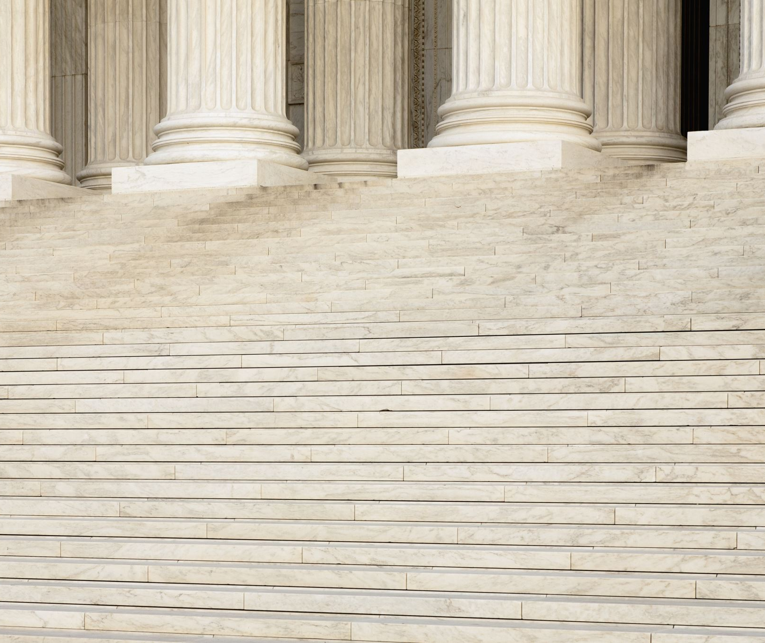
William Frederick Friedman (1891-1969)
Maryam Vulis, New York
Email: maryam@vulis.net

Slide 2
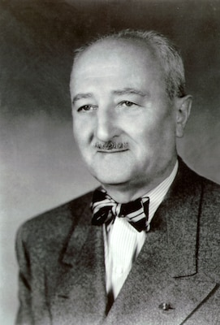
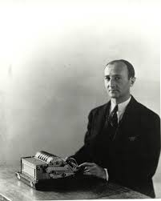
William Frederick Friedman (1891-1969)

Slide 3
William Frederick Friedman
William Friedman is often called the father of American Cryptology
Pioneer in the field
Hard working and ethical man. Herman Wouk: “His effect on world history was incalculable, greater than kings and captains. Yet what a modest man.”
Great contributions to cryptanalysis
First to use a statistical formula to aid deciphering
Wife Elisebeth Friedman: “Next to his passionate devotion to his country, the ruling precept of his life was KNOWLEDGE IS POWER.”

Slide 4
Before Cryptography
Born in Kishinev (Russian empire) in 1891, father spoke 9 languages
Family fled to the US, settled in Pittsburg
Change in economic status, William could not afford his dream- electrical engineering, switched to genetics (free education)
Started pursuing a degree in Genetics at the Cornell Uiversity Graduate School in 1915

Slide 5
Riverbank Laboratory
His research mentor got a request from George Fabyan for a Genetics Lab Director at Riverbank.
Riverbank Laboratories, a think tank
Friedman met his wife Elisebeth there in the cryptology group and figured out the futility of “deciphering” Shakespeare
‘The Index of Coincidence” was printed without Friedman’s name on the title page and moreover the result was attributed to the General Cartier , the head of French Cryptological Services and printed in Paris - Cartier apparently received the manuscript with no name. Was rectified later but Friedmans knew they had to get away from Riverbank

Slide 6
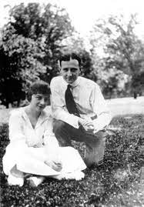
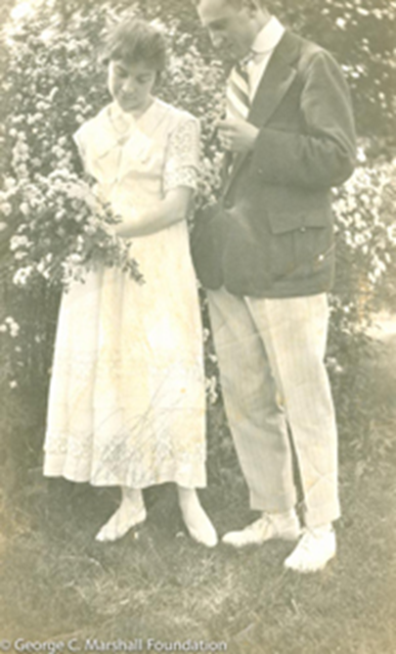
Newlyweds

Slide 7
The Start
As the US entered WWI in 1917, the Government asked Fabyan to help with deciphering, and thus WFF was recruited to decipher codes, worked in France
Returned to Riverbank shortly and eventually started with the US Government (1921 – 1955)
Head of the SIS ( Signals Intelligence Services) Cryptologic Division
Taught Military Cryptanalysis at Fort Monmouth, NJ
Before WWII started working on the Japanese diplomatic code Purple
Started decrypting messages, insufficient to prevent Pearl Harbor

Slide 8
The Japanese Diplomatic Code Purple
The Japanese diplomatic code Purple was broken in 1940 by the Friedman’s group working in Washington, DC in secrecy, first decrypts came in 1937
Rumor: K Umansky, the Soviet ambassador to the US tipped off Germany about breaking Purple
Leo Rosen built the machine, turned out to have the same stepping switches
The Japanese destroyed most of the Purple machines by the end of WWII
Communications went silent right before the Pearl Harbor attack on Dec 7, 1941
Rumor: the USSP also broke Purple
1946 Congressional Hearings n Pearl Harbor – breaking of Purple became public knowledge

Slide 9
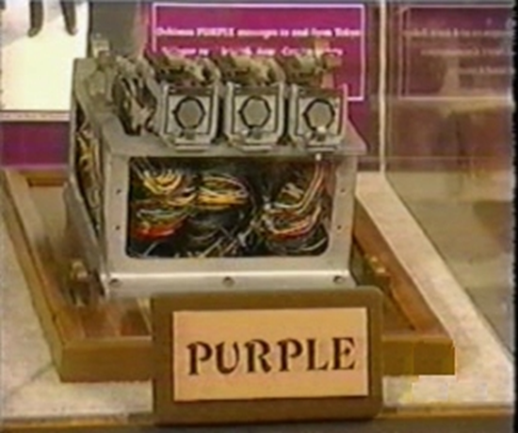
The Purple Machine, Japanese Embassy, Berlin, 1945
A 6 x 25 substitution table was used, 6 used for daily “sixes” indicating letter positions
The machine itself had 6-level 25-point stepping switches with an intricate plugboard

Slide 10
Japanese Diplomatic Code Purple
The Purple machine was built by Leo Rosen to aid deciphering, it was a switch, not a rotor machine. The Japanese destroyed all the machines, but some parts found at the Japanese Embassy in Berlin indicated the close similarity of the reconstructed and the actual Purple machines
As WWII progressed, Friedman and his group were able to read Japanese diplomatic communications
At this point, the Navy got involved in the JN 25 decrypts

Slide 11
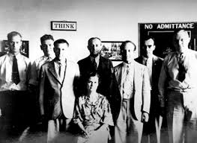
CIS People

Slide 12
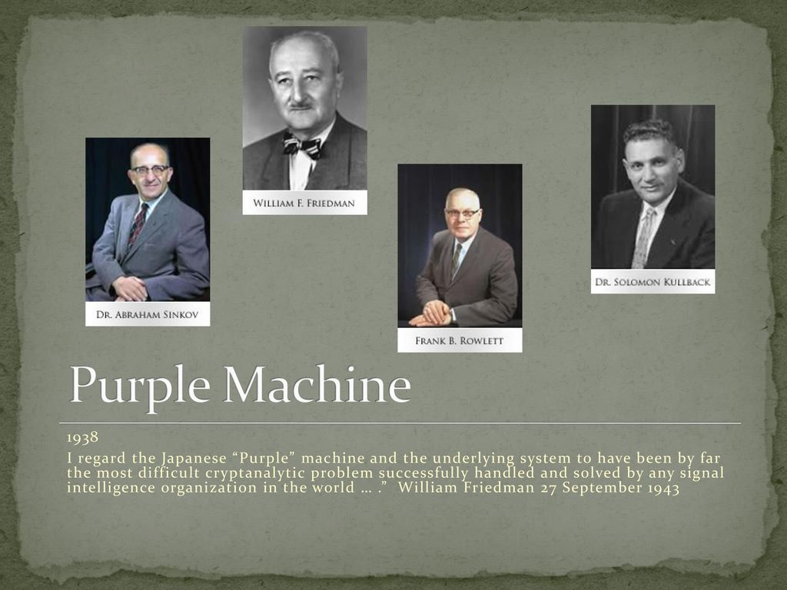
People of “Magic”

Slide 13
The Battle of Midway
The feat of cryptology
The decrypts of the Japanese Navy Communications prevented another victory by Japan
The Navy Code JN -25 was broken by the US Navy Cryptological Services
The “AF” story – the unsecured message about lack of fresh water on AF, the coordinates AF were confirmed in decrypts

Slide 14
Head of Cryptanalytic Section of SIS
As the war ended, Friedman’s group continued to provide cryptological services for the Government
WFF was not a “military man” and did not even have the proper clearance as he failed the medical test to join the Army
1952 – Creation of the NSA – the National Security Agency (aka “no such agency)
Not revealed to the public
“William Frederick Friedman (24 September 1891 - 12 November 1969) was a United Status Army cryptographer, codebreaker, cipher machine developer and case officer. In the 1930s he worked for the Army's Signals Intelligence Service (SIS), and in 1949 he became head of the cryptographic division of the newly established Armed Forces Security Agency (AFSA). In 1952, when the AFSA was succeeded by the National Security Agency (NSA), he became chief cryptologist of the NSA”

Slide 19
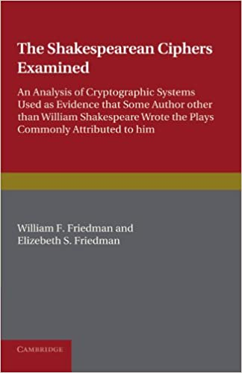
1955 - Retirement
Debunked Francis Bacon – Shakespeare connection

Slide 20
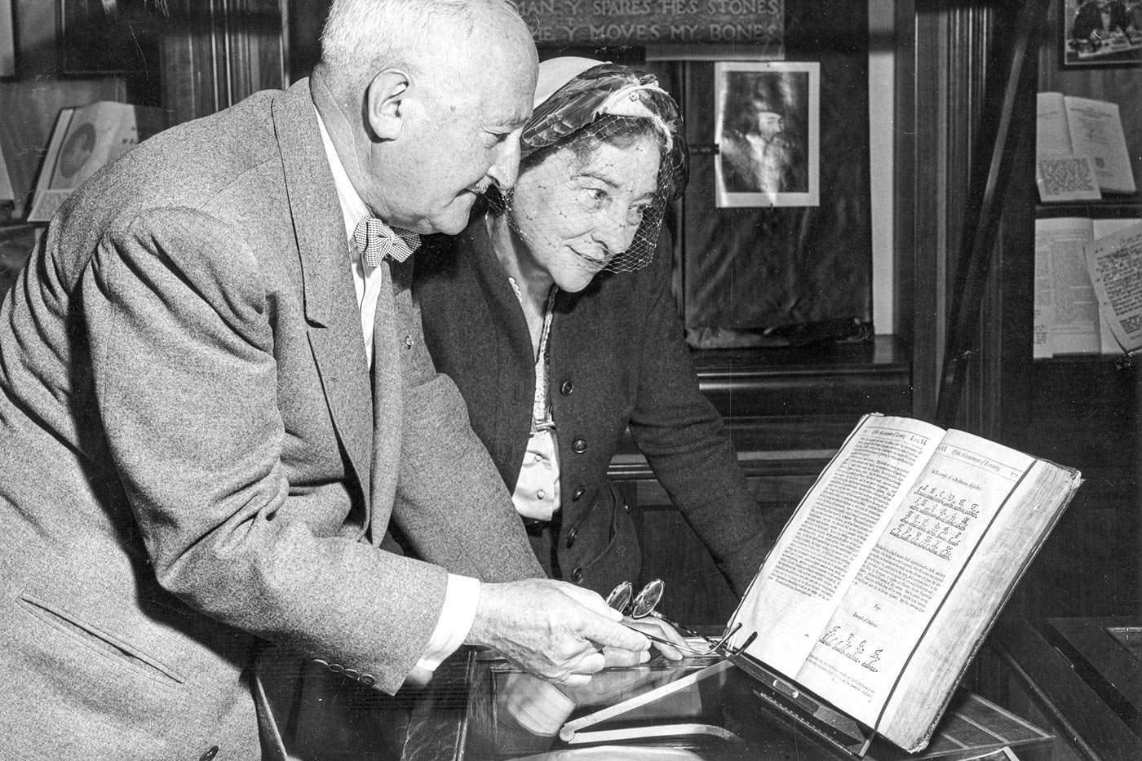

Slide 21
Unexpected Developments
1958 – with a knock on the door, the Government confiscated his writings, notes, and books
Huge blow and health crisis
Possible reasons: a) McCarthyism b) was not happy with the NSA eavesdropping on his own citizens
Virginia Military Institute (VMI) “rescued” works for the Marshall Foundation
Again removed, classified, finally declassified in 2015

Slide 22
Friedman and the NSA , the aftermath
Military historian Rose Mary Sheldon(VMI): “WFF had a falling out with the NSA. His heart sickened over the new order to spy on allies, the world of tricks and the CIA. WFF was disgusted when NSA started using lie detectors “
Ronald Clark, biographer: “a clearer picture of the significance of the secret missions of 1957 and 1958 is now emerging. These were the operations which appear to have turned WFF against the NSA. The NSA turned sour, impounded his papers and harassed him with petty humiliations. He found himself directed by “officials who were either so obsessed with security that they would hardly let him talk to his own wife” (herself an expert cryptologist) “or so pig-headed that they failed to use the priceless intelligence he provided”
Friedman did not take it lightly, for example he could not understand why notes on obsolete WWI codes were confiscated

Slide 23
Finally: Public Recognition
The National Archives: “On Monday, April 20, 2015, NSA released over 50,000 pages (or 7,000 records) of Friedman’s official papers to the public. These newly declassified records are now available at the National Archives and Records Administration. NSA also posted digital copies of the entire collection to its website and provided electronic copies to NARA and to the Marshall Foundation, which holds Friedman’s personal papers. On Thursday, April 23, 2015, the Foundation hosted a symposium marking the public release and featuring speakers from both government and academia. It also opened an excellent exhibit on the life and work of William Friedman and his wife Elizebeth – a renowned codebreaker in her own right – with numerous photographs, papers, and artifacts from its collections. Five days later, the National Cryptologic Museum, located on NSA’s Fort Meade campus, cut the ribbon on its own exhibit honoring the Friedmans.”

Slide 24
Legacy(The National Archives)
“Friedman served in almost every one of the signals intelligence agencies which preceded NSA and at NSA itself. He is remembered to have brought the discipline of a scientist to the making and breaking of codes and ciphers, or cryptology, a field previously left mostly to inspired amateurs and some less than noble dilettantes. After the first U.S. codebreaking organization, the American Black Chamber, was shut down in the 1920s, Friedman carried on as the Army’s lone cryptologist. Then, in the early 1930s, he founded the Signals Intelligence Service…with an initial staff, including Friedman himself, of six! The SIS grew slowly throughout the 1930s, but its small size did not keep it from achieving one of the most significant feats in the history of cryptanalysis: the breaking of Japan’s “Purple” cipher, which that nation used to protect its most sensitive diplomatic communications. But Friedman and his team were not just codebreakers. They also were code makers, devising an encryption machine – SIGABA – which, unlike the German Enigma or the Japanese Purple systems, protected Allied communications through World War II and beyond without ever having been cracked…at least not that we know of.”

Slide 25
Elizebeth Smith Friedman
One cannot talk about WF without mentioning his wife Elisebeth Smith Friedman
With the degree in English literature, Elisebeth Friedman became one of the finest cryptologist of the time
Prohibition era, involved in smuggling investigations, US Coast Guard
ESF was the driving force behind WF’s heritage

Slide 26
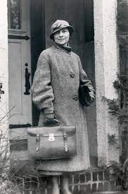
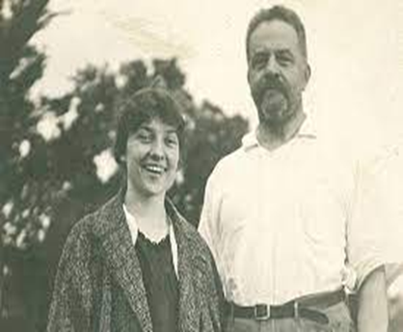
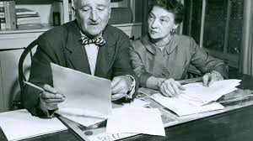
The Friedmans

Slide 27
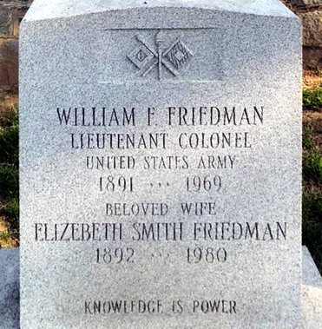
Honor

Slide 28
Legacy
Military historian Rose Mary Sheldon : “His knowledge of the history of cryptology was so immense and his collection so replete with materials, that when the NSA commissioned him to write the history of cryptology in six lectures, he found it immensely difficult”
“He knew his work was classified and he intended to keep it that way. Even when asked by his own son, he would shake his head “no” and say: “I gave my word.” One immediately notices there is no mention of the Enigma machine or the Japanese Purple code, except that which had gone into print by 1964. There are only a handful of mentions to Arlington Hall but nothing about what went on there. Bletchley Park is never mentioned at all. And yet it was Friedman’s work, in effect, that directed the course of the naval battle at Midway, the most decisive of WWII. WFF seems to have exonerated both Roosevelt and George Marshall of any duplicity in respect to the Purple warnings received before Pearl Harbor. It is clear he was not a fan of the revisionists.”
. “He was truly a giant in his field and a hero whose work saved the lives of countless Americans and their allies. He should be remembered for “his unflagging dedication to his country’s welfare and his unshakeable integrity.”
Died on November 12, 1969 and buried in Arlington National Cemetery

Slide 29

Index of Coincidence
WFF thought of really a brilliant idea of creating the methods of deciphering without guessing a single letter of the cyphertext
In 1920, he thought of using the product and sum for the probabilities in the following way
Used the product and addition rules for probabilities:
Assuming each letter has the frequency an the next chosen
Define IC = $\sum_{i=0}^{25}{\frac{f_{i }(f_{i}−1)}{n(n−1)}},$

Slide 30
Expected number of Coincidence in Random Text
Assume each letter is random with probability p_{i,} IC_{random} as the sum of probabilities for each pair of letters:
Friedman pointed out that IC _{random} = IC_{r} = .0385 corresponds to polyalphabetic deciphering, when a random letters used for encoding, for example in a “look up table”

Slide 31
Expected Frequencies in English Text
In the meantime, monoalphabetic encipherment results in
IC_{p} = fr_{a} fr_{a +} fr_{b} fr_{b} +… + fr_{z} fr_{z} = .0667 – the expected number of coincidence in English text
where fr_{a} = .0812 is the known relative frequency of “a” , fr_{b} = .0149, and so on

Slide 32
Frequencies Distribution based on 40000 words
Letter | Count |  | Letter | Frequency
E | 21912 |  | E | 12.02
T | 16587 |  | T | 9.10
A | 14810 |  | A | 8.12
O | 14003 |  | O | 7.68
I | 13318 |  | I | 7.31
N | 12666 |  | N | 6.95
S | 11450 |  | S | 6.28
R | 10977 |  | R | 6.02
H | 10795 |  | H | 5.92
D | 7874 |  | D | 4.32
L | 7253 |  | L | 3.98
U | 5246 |  | U | 2.88
C | 4943 |  | C | 2.71
M | 4761 |  | M | 2.61
F | 4200 |  | F | 2.30
Y | 3853 |  | Y | 2.11
W | 3819 |  | W | 2.09
G | 3693 |  | G | 2.03
P | 3316 |  | P | 1.82
B | 2715 |  | B | 1.49
V | 2019 |  | V | 1.11
K | 1257 |  | K | 0.69
X | 315 |  | X | 0.17
Q | 205 |  | Q | 0.11
J | 188 |  | J | 0.10
Z | 128 |  | Z | 0.07

Slide 33
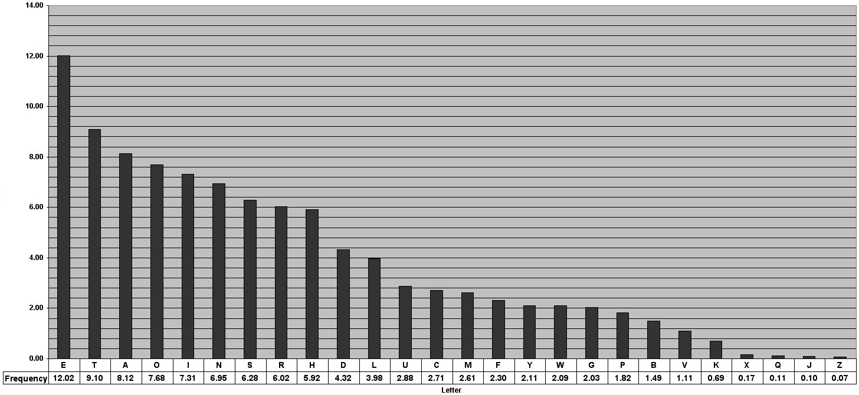
Bar Diagram

Slide 34
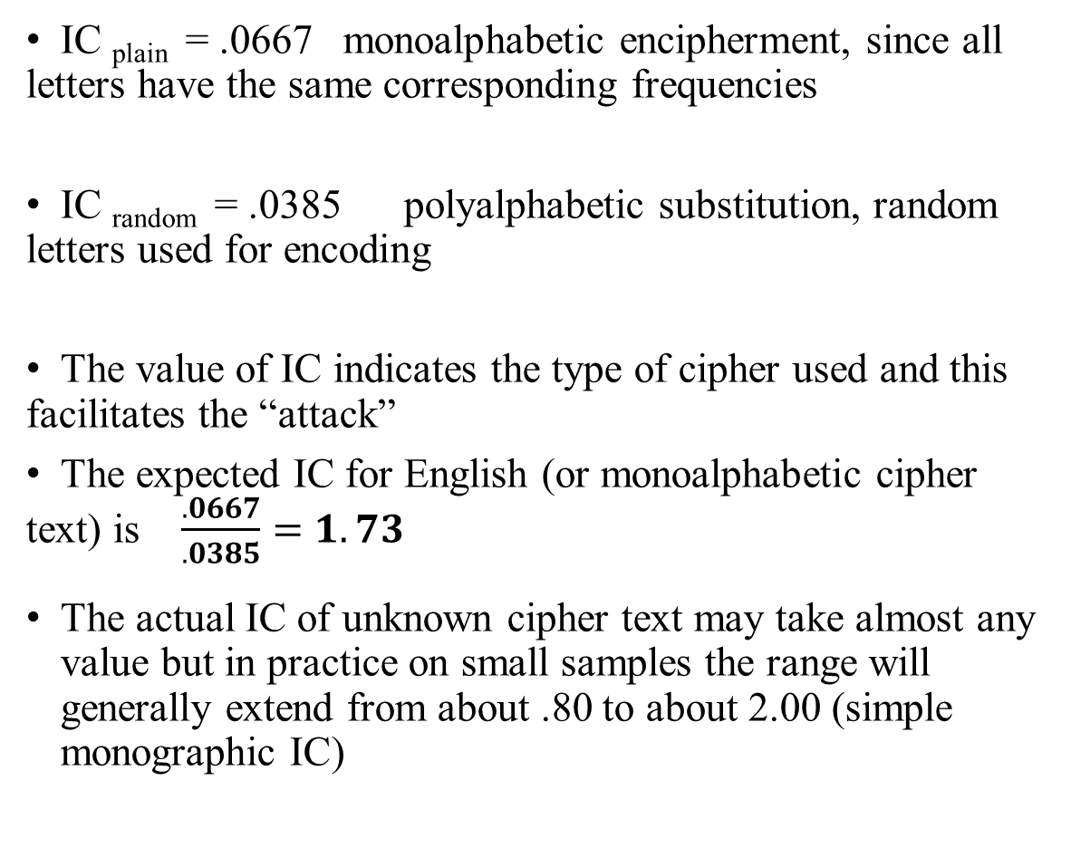
Index of Coincidence
IC _{plain} = .0667 monoalphabetic encipherment, since all letters have the same corresponding frequencies
IC _{random} = .0385 polyalphabetic substitution, random letters used for encoding
The value of IC indicates the type of cipher used and this facilitates the “attack”
The expected IC for English (or monoalphabetic cipher text) is $\frac{.0667}{.0385}=1.73$
The actual IC of unknown cipher text may take almost any value but in practice on small samples the range will generally extend from about .80 to about 2.00 (simple monographic IC)

Slide 37
The Phi Test
φ_{o =} phi observed φ_{r} = phi random φ_{p} = phi plain
φ_{r} = .0385N(N-1) φ_{p} = .0667N(N-1)

Slide 39
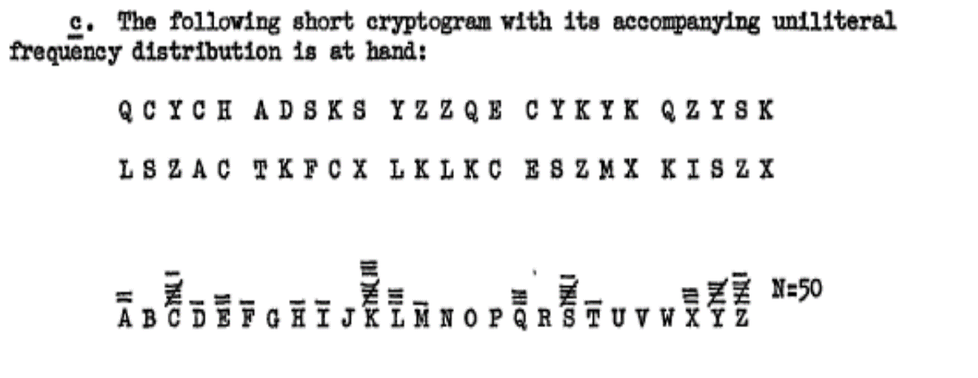

Slide 43
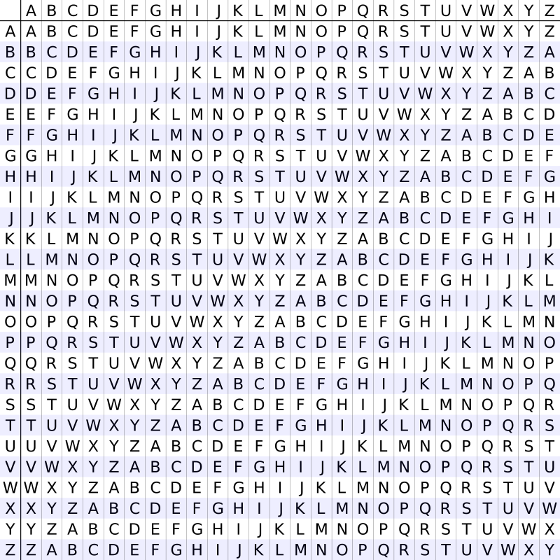
Vigenere Cipher (Polyalphabetic)
Key: stormstorm
Plaintext: evening
Ciphertext: woseufz
For IC = .0385

Slide 44

Using IC value to determine the key length in Vigenere Cipher
Working in opposite direction: assume the key length m is known in the ciphertext of size n, find the
index of coincidence for the given text using the key length m
Rearrange the text in a table with m columns and n/m rows and select 2 letters from the text:
P (second in the same column) =( $\frac{\frac{n}{m} −1}{n−1})(.0667)$ , P(second in different column) = $\left(\frac{n− \frac{n}{m} }{n−1}\right)(.0385)$
Ultimately, I(IC) = ( $\frac{\frac{n}{m} −1}{n−1})(.0667)$ + $\left(\frac{n− \frac{n}{m} }{n−1}\right)\left(.0385\right)$
m = $\frac{.0282n}{\left(n−1\right)I−0.0385n+ .0667}$

Slide 45
Breaking the Polyalphabetic Cipher
Knowing the key length of the Vigenere cipher, one will use be able to decrypt the message by breaking the text in m columns.
After this is done, check the value of I , should be close to IC_{p} = .0667 ; if not manipulate m to get the result closer to .0667
Maryam Vulis, New York
Email: maryam@vulis.net

