Slide 1
Mathematical rigour, mathematical creativity, and the transgression of limits
Eberhard Knobloch, Berlin
St. Petersburg December 2, 2021

Slide 2
Introduction
Archimedes as a model of
(1) mathematical inventiveness and
(2) mathematical rigour

Slide 3
Vitruvius on Archimedes
Though there were indeed many wonderful and various inventions of Archimedes this invention I shall describe seems to have come about by infinite skill among all inventions.
Exsiluit gaudio motus de solio et nudus vadens domum versus significabat clara voce invenisse, quod quaereret; nam currens identidem Graece clamabat eu[rhka( eu[rhka.
He sprang with joy out of the bath-tube and went naked at home and loudly declared that he has found what he had looked for. Since running he repeatedly cried in Greek „I have found, I have found.

Slide 4
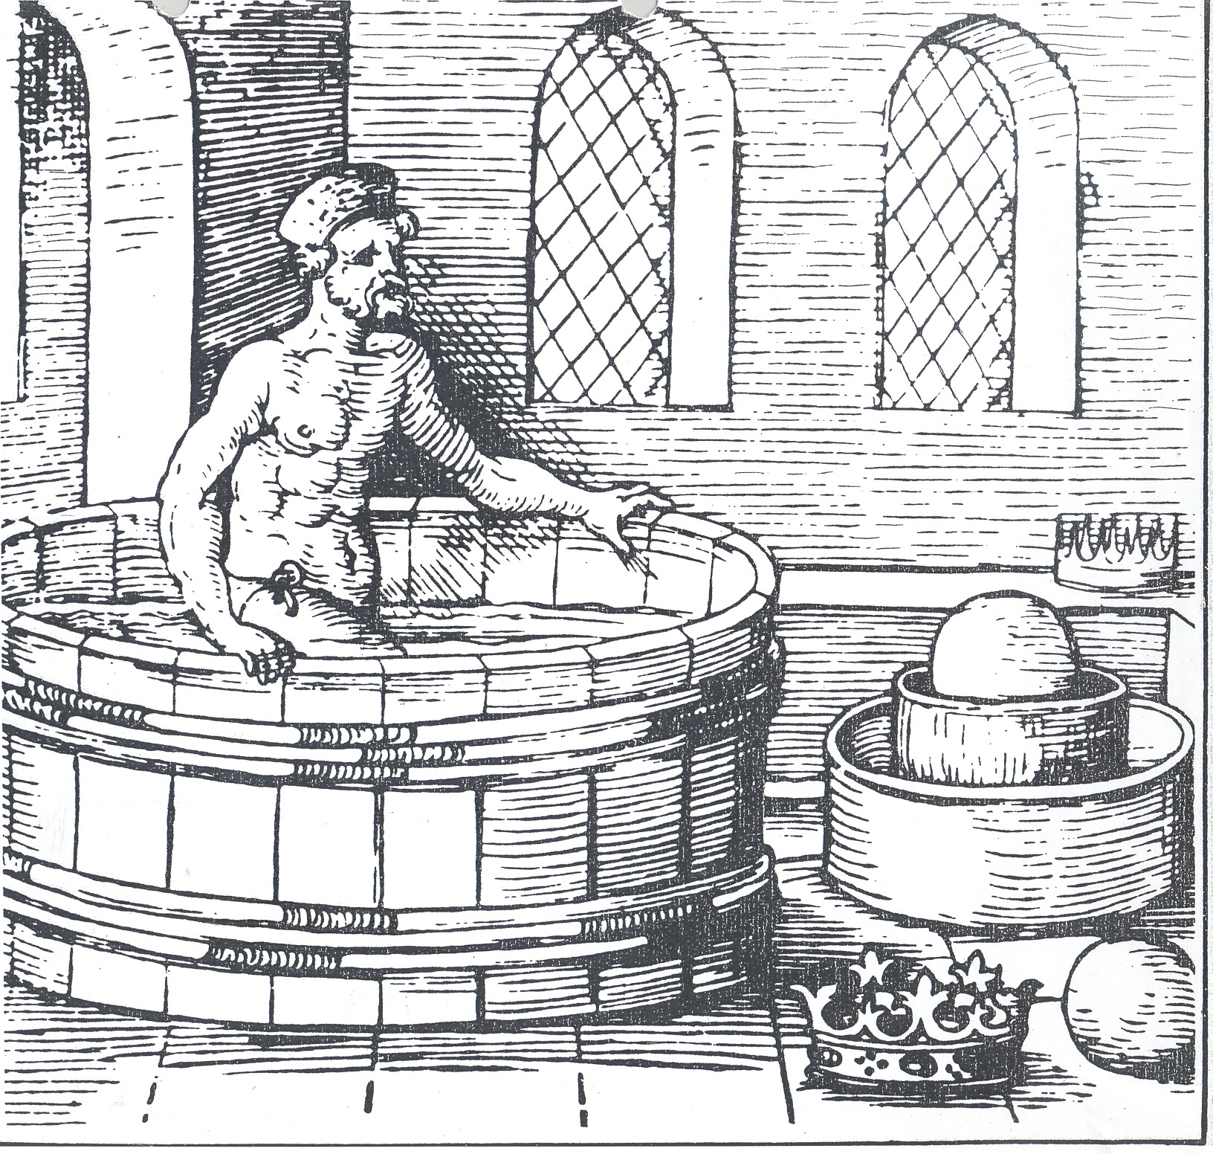
Walter Ryff, Architectur 1547

Slide 5
Introduction
(2) Mathematical rigour:
Criticism: Difficulty, obscurity, indirect proofs
Acceptance of A‘s proof methods
Quadrature of the parabola: „It suffices that the theorems which are published by us are pursued to a confidence (pistis), similar to that of these theorems (which are proved by means of the lemma).“

Slide 6
Introduction
Joseph Scaliger: Cyclometrica elementa 1594
In quo Archimedes adeo creber est, ut non regnum in Geometria obtinere, sed tyrannidem exercere videatur.
David Rivault de Flurance (1615):
Deum aliquem in ea (Geometria) fuisse Archimedem, nemo sanae mentis inficiari poterit.

Slide 7
Program
1. Archimedes: Perì tôn mechanikôn theoremáton éphodos 3rd c. BC
2. Kepler‘s New stereometry 1615
3. Guldin‘s Centrobaryca 1635-1641
4. Leibniz‘s On the arithmetical quadrature etc. 1675/1676 (1993)
Epilogue

Slide 8
1. Archimedes: Perì tôn mechanikôn theoremáton éphodos
Measurement of the circle:
The area of any circle is equal to a right-angled triangle in which one of the sides about the right angle is equal to the radius, and the other to the circumference of the circle:

Slide 9
Perì tôn mechanikôn theoremáton éphodos
Analogous theorem by increasing the dimension by 1:
Sphere instead of circle
Cone instead of triangle
Surface of the sphere (boundary) instead of circumference of the circle (boundary)
The volume of a sphere is equal to the volume of a cone with base equal to the surface of the sphere and height equal to the radius:V_{sphere}=V_{cone} ₁

Slide 10
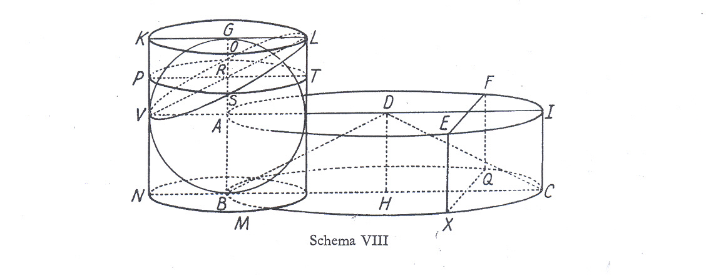
Sphere and cylinder

Slide 11
Theorem about sphere and cone
The volume of a sphere is four times as great as the cone with base equal to a great circle of the sphere and height equal to its radius:
V_{sphere} = 4 x V_{cone 2}

Slide 12
Problem: surface of a sphere
If the analogous theorem holds the surface of the sphere must be equal to four great circles in it.
Analogies in the context of discovery
Demonstration: 13 theorems

Slide 13
Archimedean trópos of the éphodos
Transfer of the structure of quantities to non-quantities (indivisibles)
Sections of areas (straight lines) or bodies (circles) are weighed by means of the doctrine of centres of gravity and statics:
Triangles consist of (synésteke) straight lines
Circles fill (sympleroûn) the cylinder
No infinitesimals, no summations: transfer from the finite to the infinite (measure axiom)

Slide 14
Archimedes transgressed limits
1. He violated methodological prescriptions
2. He used non-mathematical objects (non-quantities)
3. He violated the axiom named after him: Let a and b be two arbitrary real numbers. Then there is always a natural number n, such that na is larger than b.
He replaced the mode of possibility by an action really carried out

Slide 15
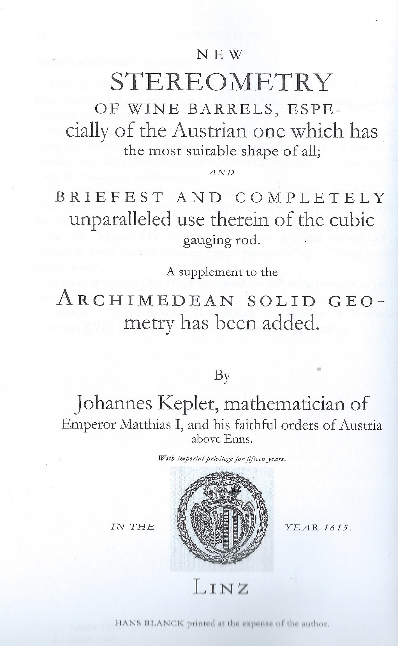
2. Kepler‘s New stereometry 1615

Slide 16
Kepler: Preamble on the reason for the figure of a wine barrel
Absolute and in every respect perfect demonstrations have to be taken from the Archimedean booklets themselves if one has not been deterred from their thorny lecture (spinosa lectione).

Slide 17
Kepler‘s method
1. Replacement of Archimedes‘s indirect proofs by direct argumentation
2. indivisibles, infinitely small quantities
3. geometrical transformations
4. analogies
5. probabilistic thinking
Aim: To reveal the meaning of Archimedes‘s procedures and results

Slide 18
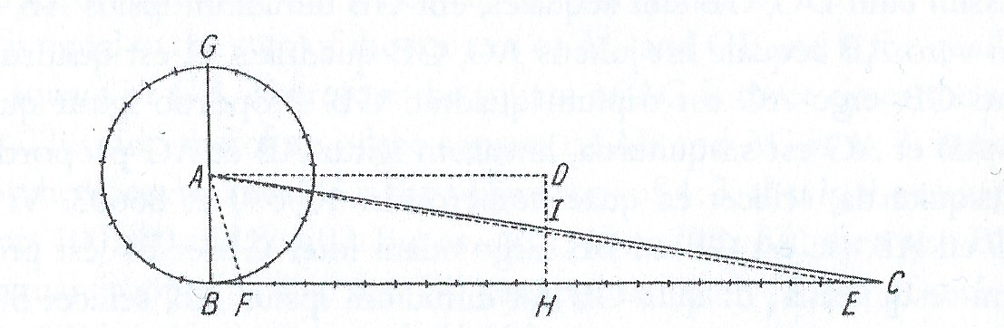
(1) Area of the circle

Slide 19
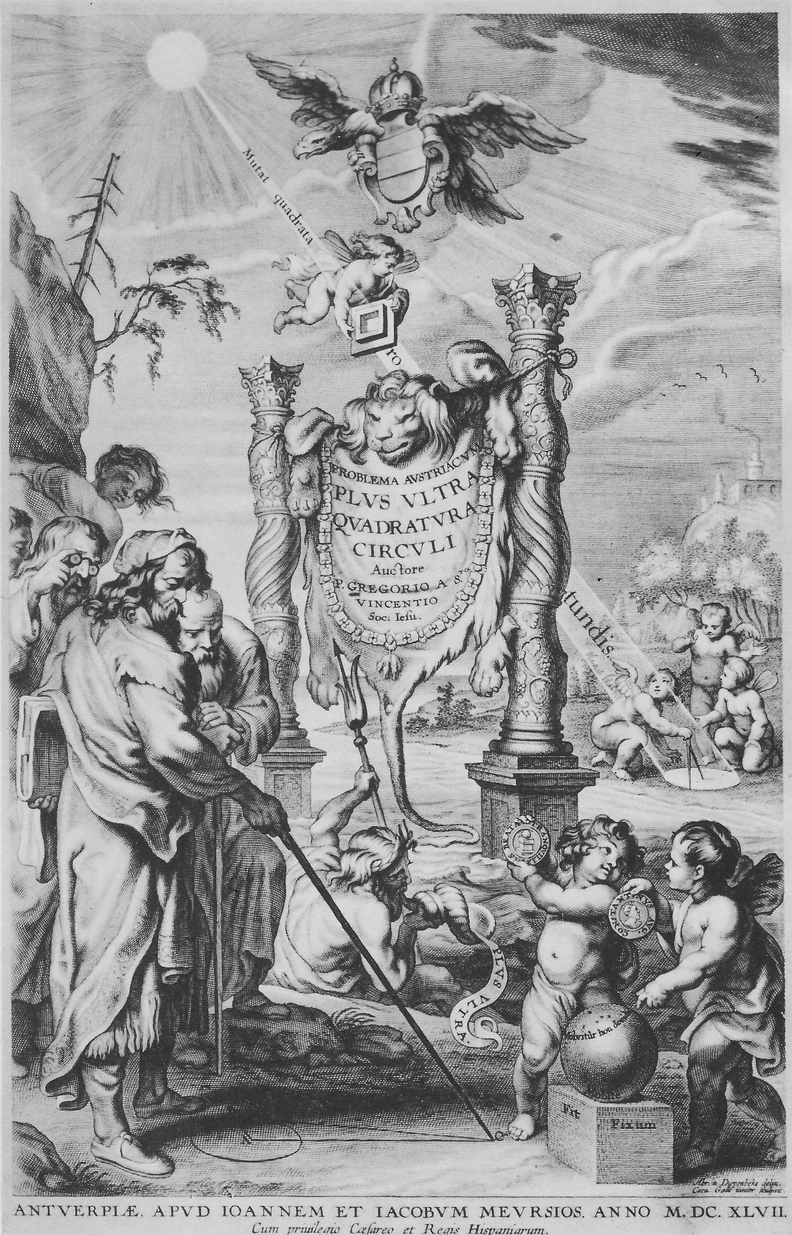
Grégoire de St. Vincent 1647

Slide 20
Area of the circle
For me the meaning seems to be this.
The circumference of the circle has as many parts as points, namely infinitely many. Each of these is regarded as the base of any isosceles triangle with the sides AB so that there are infinitely many triangles in the area of the circle...Let the circumference be straightened (extendatur) out into a straight line BC.
A base BF is arbitrarily small (quantulacunque).

Slide 21
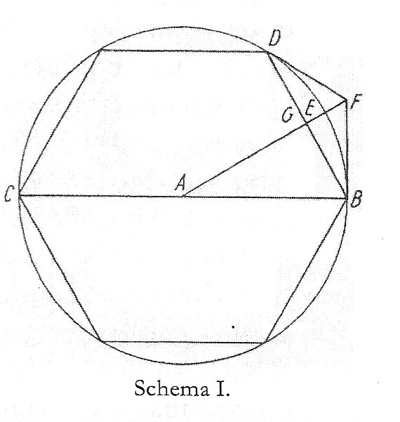
Ratio of the circumference to the diameter
AEB,FEB anguli sunt aequipollentes recto, cum EFB sit acutus.
Hence EB < FB
Licet argumentari de EB ut de recta, quia vis demonstrationis secat circulum in arcus minimos, qui aequiparantur rectis.

Slide 22
Sphere and cone
Transfer from the two-dimensional to the three-dimensional case:
Archimedes: instead of triangle cone (global)
Kepler: instead of infinitesimal triangles inf. cones (local); main idea: transformation
Corpus enim sphaerae ad analogiam eorum, quae dicta sunt theor. II. potestate in se continet infinitos velut conos, verticibus in centro sphaerae coeuntes, basibus, quarum vicem sustinent puncta, in superficie stantibus.

Slide 23
Sphere and cylinder

Slide 24
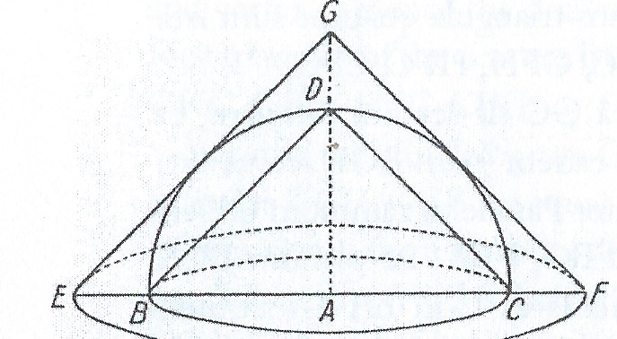
(2) The surface of the sphere surface of a cone = πrs

Slide 25
The cones
The smaller cone:
r₁= BA, s₁=
surface = πr₁
The larger cone:
r₂= AF = , s₂ = 2r₁
surface = π( )2r₁

Slide 26
The surface of the sphere
It is probable (verisimile est) that the surface of the hemisphere is the mean proportional between the surfaces of both cones.
The smaller conical surface is x area of the plane base (great circle), the larger conical surface is x area of the plane base
The geometric mean of and is 2:1.

Slide 27
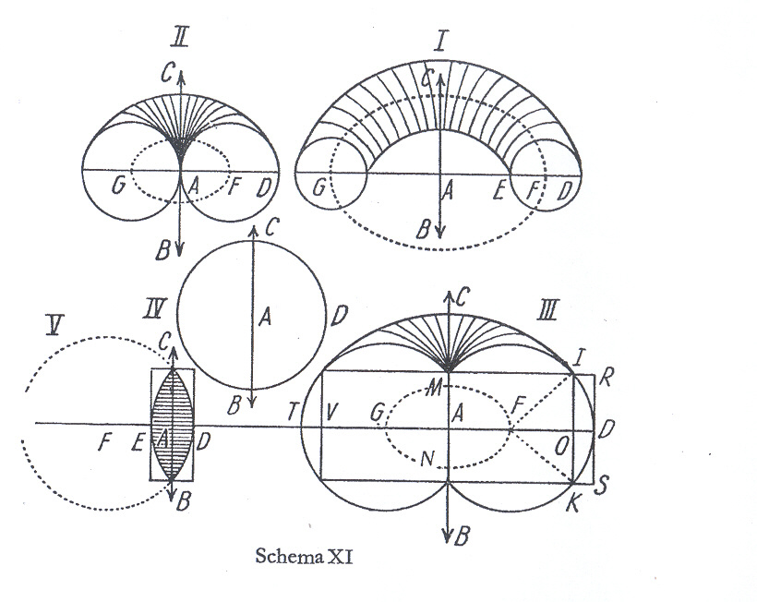
(3) Kepler: „Supplement“ to the Archimedean solid geometry

Slide 28
Theorem 18
Any ring with a circular or elliptical cross-section is equal to a cylinder whose height is equal to the circumference of the circle described by the centre of the turned around figure. The base is the same as the cross-section of the ring.
The bodies thus produced by rotation are cognate with each other.

Slide 29
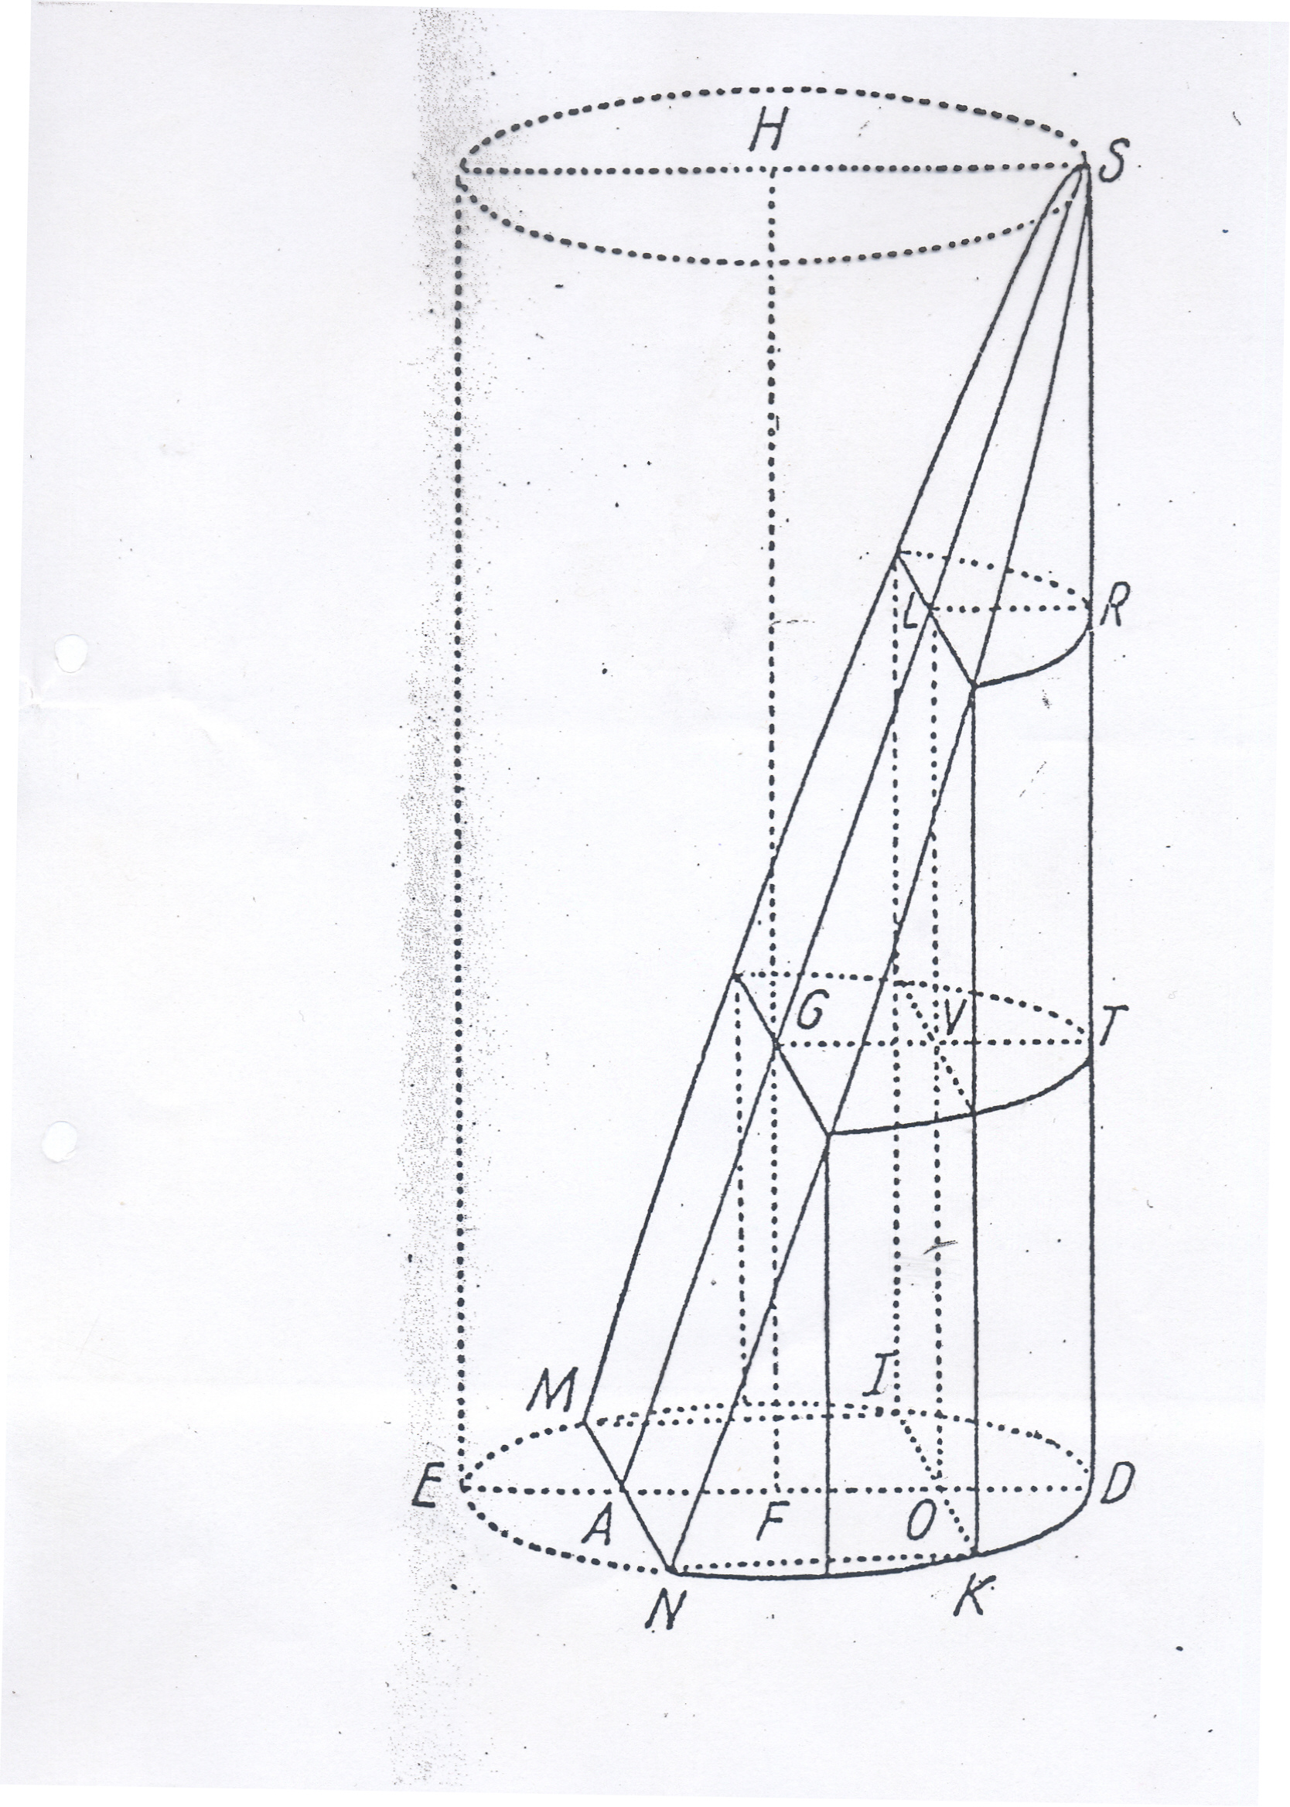
Kepler‘s apple
Main ideas:
1. Generation of the apple
2. Composition
3. Expansion
4. Transformation into a cylindrical hoof
5. Decomposition into calculable parts:
Cylinder +apple ring

Slide 30
Apple
Let the body of the apple be expanded into a cylindrical segment by the same laws (legibus) by which Archimedes expanded the area of a circle into a rectangular triangle.
Explicetur corpus Mali iisdem legibus in cylindricum segmentum, quibus Archimedes Theorema II explicavit circuli aream in triangulum rectangulum.

Slide 31
Kepler, Nova stereometria, Th. 20
Secetur area MDN lineis parallelis ipsi MN in aliquot segmenta aequelata minima, quasi linearia.
Let the area MDN cut by lines that are parallel to MN into smallest, quasi linear segments of equal breadth.
There are as many segments as points of AD.

Slide 32
Kepler, Nova stereometria, Th. 20
Hence when the figure is turned about MN, the small area MN creates nearly nothing because it is moved least of all.
Cum igitur figura circa MN circumagitur, nihil fere creat areola MN, quia minimum movetur.
There are as many segments as points of AD.

Slide 33
Construction of the cylindrical hoof
1. Apple: hollow, coaxial, cylindrical sheets (tunicae)
Hoof: rectangles erected on the circular segment
2. Expansion of the sheets into rectangles
3. Transformation of the volumes of apple and sphere into cylindrical hoofs
Vis transformationis

Slide 34
Theorem 20: Apple ring
An apple ring is composed of the belt of the spherical ring (VTSL) and the straight segment (ODTV) of the cylinder whose base is the (circular ) segment (IKD) lacking that figure which produces the apple, while its height (FG) is equal to (the circumference of) the circle which is described by the centre (F) of the greater (circular) segment (MIKN).

Slide 35
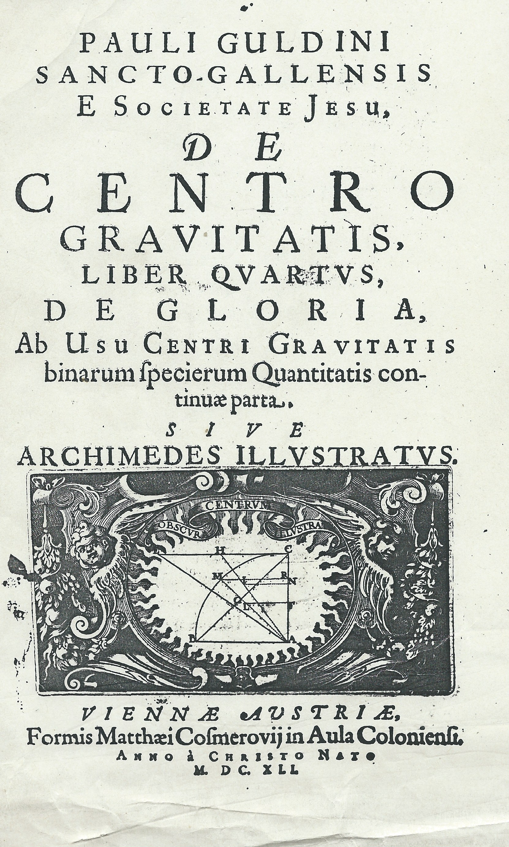
3. Guldin‘s Centrobaryca 1635-1641

Slide 36
Guldin on Archimedes IV, 289, 291
Concludendum ergo videtur Archimedi principia nostra (rotation, centre of gravity) fuisse quidem perspectissima, quae tamen ne vulgata vilescerent, ipsum data opera ea obscurare voluisse.
Archimedes...methodo...et tota docendi via perobscurus...libris tamen ipsis obscuritas arguitur.

Slide 37
The Pappus-Guldin theorems
Book II:
Suppose that a plane curve is rotating about an axis external to the curve. Then
1. the resulting surface area of revolution is equal to the product of the length of the curve and the displacement of the centre of gravity;
2. in the case of a closed curve, the resulting volume of revolution is equal to the product of the plane area enclosed by the curve and the displacement of the c. of gr. of this area.

Slide 38
Guldin‘s own claim
Ostensive
concisa brevitate
Demonstratio clara ac perspicua
Affirmative et ostensive
Ostensive et brevius
Ex solis nostris principiis vel longe faciliori modo
Loco enim istorum omnium substituo nostrum de centro gravitatis inventum, quod omnia per media Geometriae synceriori minime adversantia ostendet, modo nactum sit perfectum demonstratorem, qualem me ut inventorem pronuncio. (IV, 331)

Slide 39
Five chapters
IV,1 Archimedes: Measurement of the circle; first book of „On the sphere and cylinder“ (11 theorems)
IV,2 Archimedes: On conoids and spheroids (6 theorems)
IV,3 Euclid: Elements XII (7 theorems)
IV,4 Kepler: New solid geometry of wine barrels
IV,5 Cavalieri: New geometry (Geometria indivisibilibus continuorum nova quadam ratione promota)

Slide 40
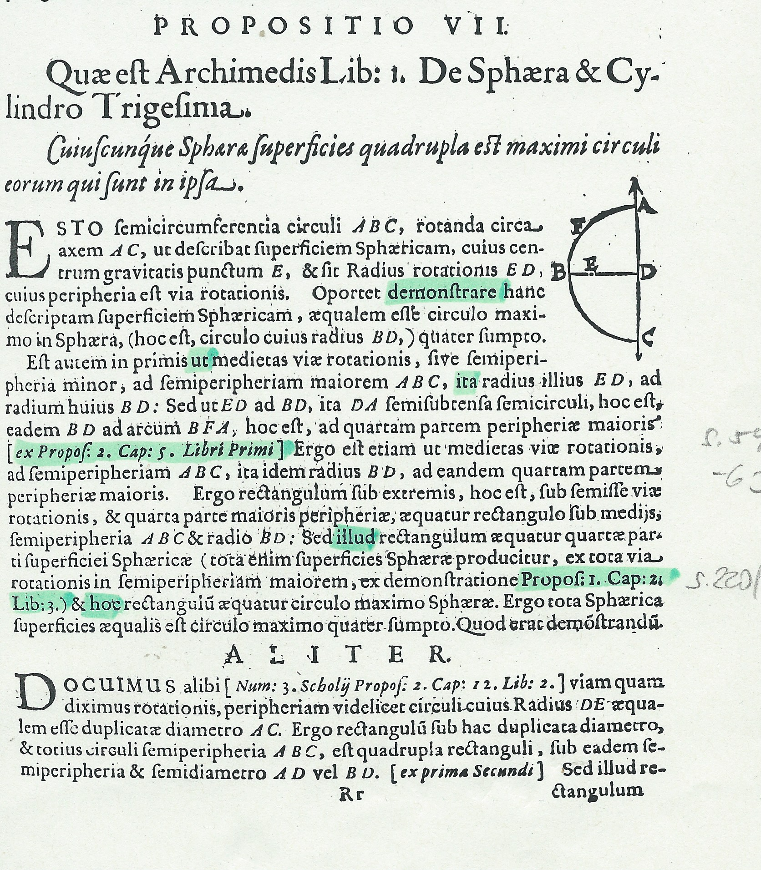
Archimedes, On the sphere and cyl. I,33 (I,21-33 rotating polygons)

Slide 41
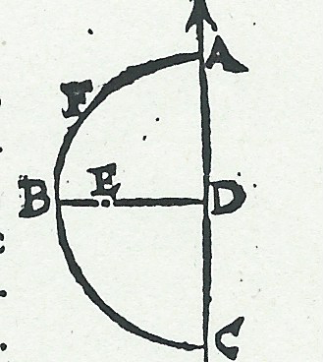
Guldin IV,1 prop. VII
1. smaller semicirc. : greater semic. ABC = ED:BD
2. ED:BD=DA(BD):arc BFA (I,5 prop. 2)
3. smaller semicirc.: greater semic. ABC=BD:arc BFA
4. smaller semicirc. x arc BFA =ABC x BD
5. ¼ of the surf. of the sphere = area of great circle
(III,22 prop. 1)

Slide 42
Guldin on Kepler (IV, 322)
The essential reproach was that he had not looked in the least after the purity and exactness of geometry, that he had assigned much to analogies and conjectures, that he had not always scientifically concluded and that moreover had obscurely presented all his results.

Slide 43
Guldin on Kepler‘s apple calculation
IV, 331:
Non...omnino contemnenda est Kepleri nova inventio, aut vilipendenda haec figurarum transmutatio.
Licet illud non demonstret ea demonstratione quae recipi statim ab omnibus possit...inde tamen eruit praxim, qua mensurat id corpus mali.
Mihi certe ut penitius penetrarem, frangere, quod aiunt caput aut cerebrum nolui.

Slide 44
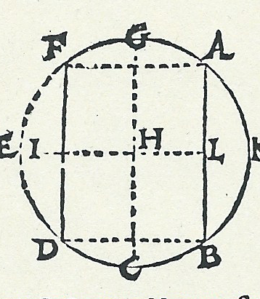
Guldin‘s calculation of the volume
1. AB axis of rotation
2. H centre of gravity of AGFDCB
3. I centre of gravity of FED=AKB
4. Two parts of the apple
Area of AGFDCB x circumference of the circle whose radius is HL
Area of FED x circumference of the circle whose radius is IL

Slide 45
Guldin, De centro gravitatis 1641
Hoc enim sibi invicem praestant scientiae huius cultores: nulla nimirum ut sit lis inter illos, aut diversarum sententiarum contra veritatem conspiratio; quae in Mathematicis inter veros Mathematicos maxime si puras spectemus scientias Arithmeticam et Geometricam, nulla esse potest. Semper enim illa in puncto, et indivisibili consistit, a quo sive ad levam sive ad dextram abieris, antrorsum retrorsumve, sive in omnem circuitum pedem contuleris, semper tamen a vero te discessisse invenies.

Slide 46
Point and indivisible
For the admirers of this science concede each other that indeed there should not be any quarrel between them nor any conspiracy of divers opinions against truth which is not possible in mathematics between true mathematicians, most of all when we look at the pure sciences, the arithmetical and the geometrical. For that quarrel always consists in point and indivisible. You will always find however that you have deviated from the truth whenever you have left it to the left or to the right, forward or backwords, or moving in a whole circle.

Slide 47
4. Leibniz‘s On the arithmetical quadrature etc. 1675/76 (1993)
The treatise (th. 6) serves to lay the foundations of the whole method of indivisibles in the soundest way possible (firmissime).

Slide 48
A VII,4, N. 16,1 (Spring 1673)
Nota: Indivisibilia definienda sunt infinite parva, seu quorum ratio ad quantitatem sensibilem (vel differentia) infinita est.
finite:infinitely small = infinite
infinitely small = smaller than any given (assigned) quantity
non-punctiform infinitesimals
infinitely large (infinite) = larger than any given (assigned) quantity

Slide 49
Theorem 6
Proposition 6 is most thorny (spinosissima). Therein it is overly carefully demonstrated that the procedure of constructing certain linear step spaces and in equal fashion polygons can be continued to such a degree, that they differ from each other or from curves by a quantity which is smaller than any arbitrary given quantity. This is usually assumed by others in most cases.
(...who declare to give rigorous (severas) demonstrations.)

Slide 50
Warning of the reader
The reading of this proposition can be omitted if somebody does not want supreme rigour in demonstrating proposition 7. And it will be better that it be disregarded at the beginning and that it be read only after the whole subject has been understood, in order that its excessive exactness does not discourage the mind from the other, much more agreeable things by making it become weary prematurely.

Slide 51
Warning (cont.)
For it brings about only this: that two spaces, of which one passes into the other if we progress infinitely, have a difference which is smaller than any arbitrary assigned difference, even when the number of inscriptions remains finite.

Slide 52
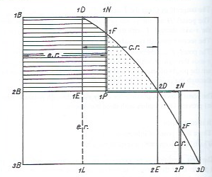
Theorem 6
The points F
No lower or upper sums, no inscriptions or circumscriptions

Slide 53
3 important characteristics
1. Generality: it is related to Riemann‘s integral for continuous functions
2. Rigour: Archimedes serves as a model for the rigour
3. Use of well defined notions of infinitely small and infinite: these notions are related to Weierstrass‘s epsilontics

Slide 54
Justification of the principle of linearization
Theorem 6: The difference between two areas under certain straight step polygons and under certain curves can be made smaller than any arbitrary given quantity that is infinitely small.
The polygons and the curves are „equivalent“.

Slide 55
Definition of this equivalence
Two curves are equivalent (aequipollentes) if they define the same areas or - except an (integer) factor - result in the same quadrature.
Hence: The equivalence of curves is based on the notion of quadrature and for that reason on the 6th theorem of the „Arithmetical quadrature of the circle etc.“

Slide 56
De quadratura arithmetica circuli ellipseos et hyperbolae 1676 (1993, 69; 2016, 130)
Principle of linearization:
Sentient autem (lectores) quantus inveniendi campus pateat, ubi hoc unum recte perceperint, figuram curvilineam omnem nihil aliud quam polygonum laterum numero infinitorum, magnitudine infinite parvorum esse.

Slide 57
Nova methodus October 1684 LMG V, 223
Patet etiam methodum nostram porrigi ad lineas transcendentes..modo teneatur in genere tangentem invenire esse rectam ducere..seu latus productum polygoni infinitanguli, quod nobis curvae equivalet.
Infinitely many angles → sides

Slide 58
Obscurity, fruitfulness (1993, 69)
Quae de infinitis atque infinite parvis huc usque diximus, obscura quibusdam videbuntur, ut omnia nova; sed mediocri meditatione ab unoquoque facile percipientur: qui vero perceperit, fructum agnoscet...sufficit enim fictione introduci, cum loquendi cogitandique, ac proinde inveniendi pariter ac demonstrandi compendia praebeant, ne semper inscriptis vel circumscriptis uti, et ad absurdum ducere, et errorem assignabili quovis minorem ostendere necesse sit.

Slide 59
Ostensive demonstrations
Imo si quidem possibile est directas de his rebus exhiberi demonstrationes, ausim asserere, non posse eas dari, nisi his quantitatibus fictitiis, infinite parvis, aut infinitis admissis.

Slide 60
Mémoire touchant son sentiment sur le calcul différentiel 1701
Au lieu de l‘infini ou de l‘infiniment petit, on prend des quantités aussi grandes et aussi petites qu‘il faut pour que l‘erreur soit moindre que l‘erreur donnée, de sorte qu‘on ne diffère du stile d‘Archimède que dans les expressions, qui sont plus directes dans notre méthode et plus conformes à l‘art d‘inventer.

Slide 61
Creativity
All three mathematicians (A., K., L.) transgressed limits.
All three were extremely creative.
Godfrey Harold Hardy (1969):
Archimedes will be remembered when Aeschylos is forgotten, because languages die and mathematical ideas do not. ‚Immortality‘ may be a silly word, but probably a mathematician has the best chances of achieving it whatever it may mean.

Slide 62
Epilogue
Euler: Institutiones calculi differentialis 1755
Sed quantitas infinite parva nil aliud est nisi quantitas evanescens ideoque revera erit = 0. Consentit quoque ea infinite parvorum definitio, qua dicuntur omni quantitate assignabili minora; si enim quantitas tam fuerit parva, ut omni quantitate assignabili sit minor, ea certe non poterit non esse nulla.

Slide 63
Epilogue
Hence that objection collapses by itself by which the analysis of infinites is accused of neglecting geometrical rigour, because nothing else is omitted but what is in truth nothing. And for that reason one can justly claim that in this more elaborated science the highest geometrical rigour (rigorem geometricum summum) which occurs in the books of the ancients is equally diligently observed.

