Slide 1
The Euler-Poisson Darboux equations in the development of the theory of partial differential equations

Slide 2
Позвольте мне прежде всего поблагодарить профессора Галину Ивановну Синкевич за любезное приглашение. Я также благодарен Галине Ивановне за то, что она предоставила вам возможность прочитать текст презентации моего выступления на русском языке.
Приношу свои извинения, что не делаю доклад по-русски.
Позвольте мне перейти на английский язык.

Slide 3
Conclusion of my earlier talk on Bunyakovsky
The various interpretations of V. Ya. Bunyakovsky’s inequality are not developments of a single idea, like nested Matryoshka dolls, each of which is a copy of the next one, only smaller, but rather resemble Fabergé eggs Яйца Фаберже́ each with a “surprise”: the outer (newer) layer does not indicate what the interior (the past) contains. Accounts for innovation.
That is why historical investigation provides a deeper understanding of modern mathematics that cannot be inferred from the modern stage alone.
See for instance the recently recovered Third Imperial egg from 1887, the Diamond Treillis from 1892, or the Lilies of the Valley from 1898, that illustrate different types of « surprises ».

Slide 4

матRyoshkа
Attribution: 0x010C, CC BY-SA 4.0 <https://creativecommons.org/licenses/by-sa/4.0>, via Wikimedia Commons
URL: https://commons.wikimedia.org/wiki/File:Poup%C3%A9es_russes.JPG

Slide 5
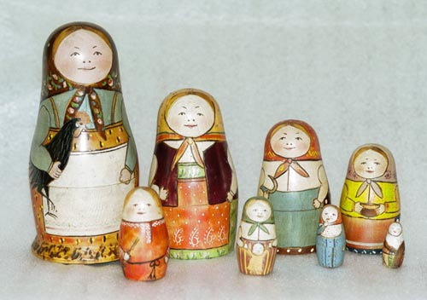
Matryoshka
The first original matryoshka
Sergiev Posad Museum of Toys, Russia
Date : 2000 (photo), 1892 (dolls)
Attribution: Photo: RK812, Doll carved by Zvezdochkin, painted by Malyutin, Public domain, via Wikimedia Commons
URL: https://commons.wikimedia.org/wiki/File:First_matryoshka_museum_doll_open.jpg

Slide 6
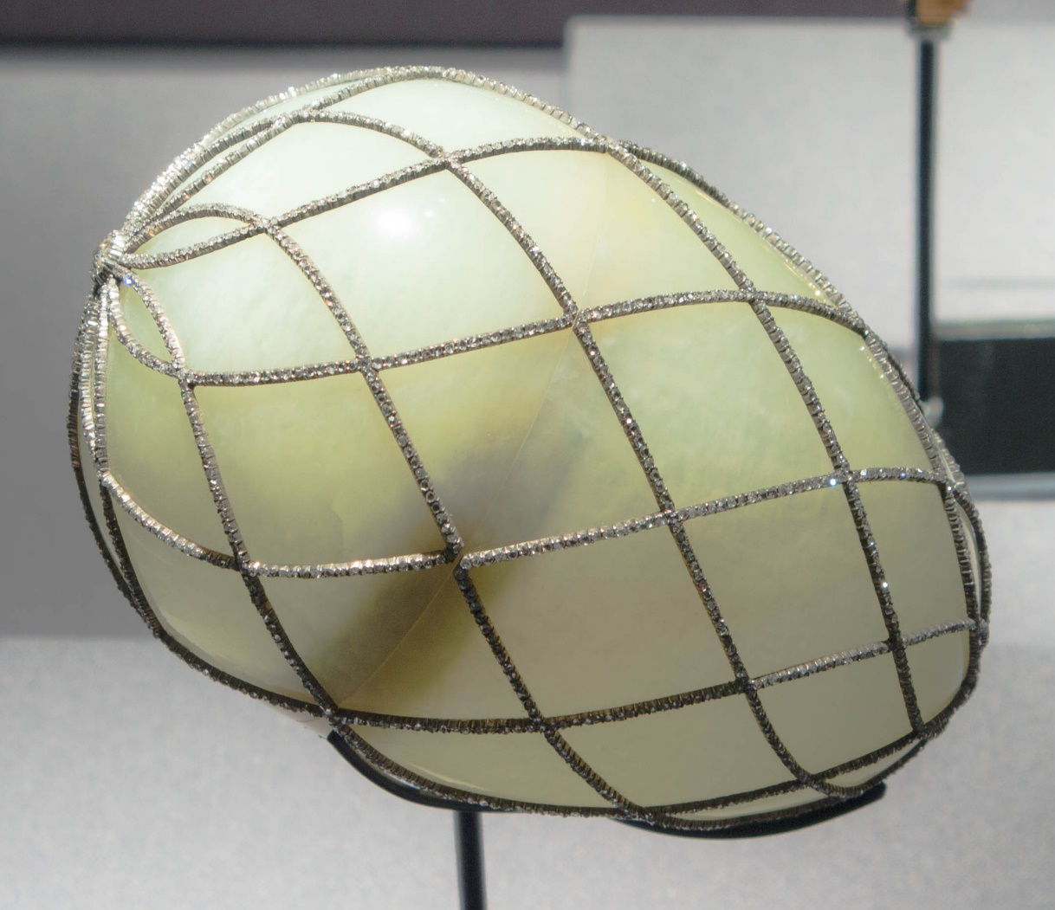
DIAMOND TREILLIS (1892)
Attribution : Randall Pugh from Houston, United States, CC BY 2.0 <https://creativecommons.org/licenses/by/2.0>, via Wikimedia Commons
URL: https://commons.wikimedia.org/wiki/File:Diamond_Trellis_Egg.jpg

Slide 7
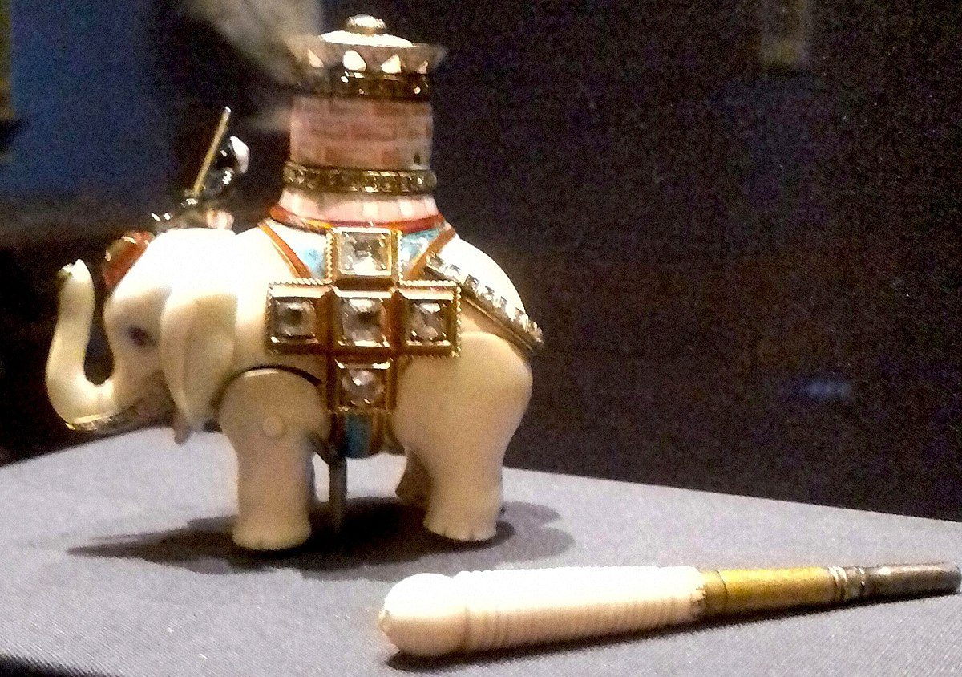
Diamond Treillis – Surprise (Elephant Automaton)
Attribution: Jafd88, CC BY-SA 4.0 <https://creativecommons.org/licenses/by-sa/4.0>, via Wikimedia Commons
URL:https://commons.wikimedia.org/wiki/File:Surprise_Faberg%C3%A9_Diamond_Trellis_Egg_(1892).jpg

Slide 8
MAin points
The Fabergé model applies to the EPD equation : its modern form(s) do not represent correctly its place in the theory of PDEs,
The EPD or Euler-Tricomi equation is not a PDE but a family of PDEs, partially related by transmutations.
One of them is equivalent to the first PDE ever analyzed as a PDE, but this fact was unnoticed.
3. Ceased to be central until recently because : not well-analyzed by contemporary theories (hyperbolic/ elliptic/mixed etc.). But is central in the theory of Fuchsian reduction.

Slide 9
Outline of the talk
1. Definitions & examples: EPD, Euler-Tricomi, Fuchsian ODEs, Fuchsian Reduction
2. The facts: (i) the first PDE is reducible to an EPD eq. (ii) EPD used to be considered as central in PDE theory until around 1930. (iii) Later treated as “singular” or “degenerate”.
3. Accounting for these facts.
4. Conclusion : an equation such as EPD is not a well-defined mathematical object. Its assigned (mathematical) meaning depends on the discourse in which it is embedded, and this discourse changes in time.

Slide 10
1. Definitions & examples

Slide 11
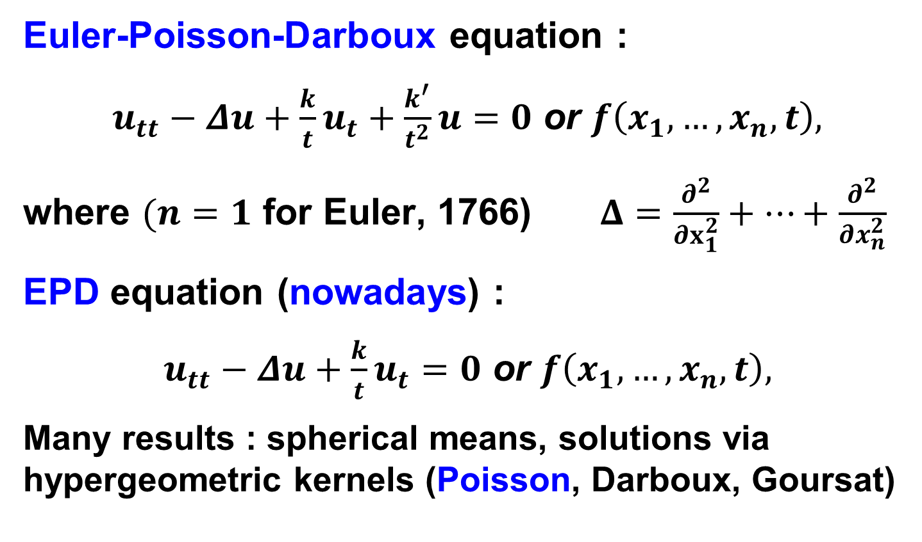
1. DEFinitions: EPD is a family of equations
Euler-Poisson-Darboux equation :
$u_{tt}−Δu+\frac{k}{t}u_{t}+\frac{k^{′}}{t^{2}}u=0$ or $f\left(x_{1},…,x_{n},t\right),$
where $(n=1$ for Euler, 1766) $Δ=\frac{∂^{2}}{∂x_{1}^{2}}+⋯+\frac{∂^{2}}{∂x_{n}^{2}}$
EPD equation (nowadays) :
$u_{tt}−Δu+\frac{k}{t}u_{t}=0$ or $f\left(x_{1},…,x_{n},t\right),$
Many results : spherical means, solutions via hypergeometric kernels (Poisson, Darboux, Goursat)
Notes:
Examples:

Slide 12
L. Euler, E319 (1766) & Institutiones calculi integralis (1770), sect. 2, ch. III, IV, V. For him, the wave eq. Is a special case!
S.D. Poisson, J. Ec. Poly. XII, (19e cahier) (1823) p. 215 ~transmutation
B. Riemann, Abh. Göttingen, VIII, 1960 (Œuvres, p. 177)
G. Darboux, Leçons sur la théorie générale des surfaces, 2e partie, chapitre III, p. 54-70, IV (§360-364) (1888/1915). Case of variable coefficients: §436, §460.
F. Tricomi, Atti Lincei, Ser. V, v. 14, 133-247 (1923); F. Frankl’ (1944), S.A. Chaplygin (1945), Landau-Lifshitz,…
Weinstein, Bull. Ac. Roy. Belgique (5) 37 (1951) 348-358, CPAM 7 (1954) 105-116….
On transmutation: J. Delsarte (1938), J.-L. Lions (1961), E.L. Shishkina-S.M. Sitnik (2017) (does not generalize well to variable coefficients).

Slide 13
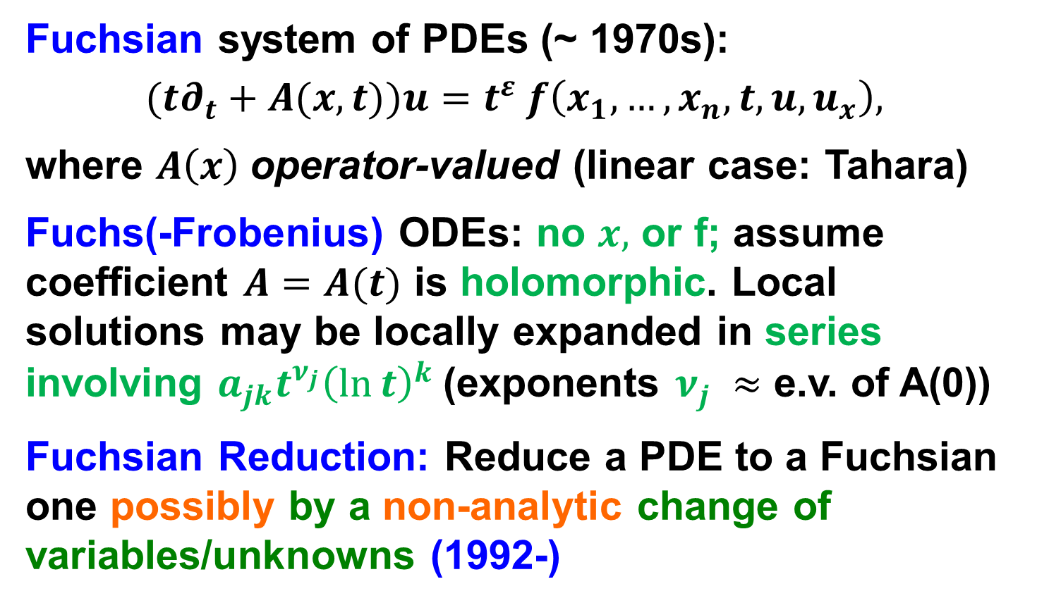
1. DEFinitions: Fuchsian Eqs. & Fuchsian Reduction
Fuchsian system of PDEs (~ 1970s):
$$(t∂_{t}+A(x,t))u=t^{ε} f\left(x_{1},…,x_{n},t, u, u_{x}\right),$$
where $A\left(x\right)$operator-valued (linear case: Tahara)
Fuchs(-Frobenius) ODEs: no $x,$ or f; assume coefficient $A=A(t)$ is holomorphic. Local solutions may be locally expanded in series involving $a_{jk}t^{ν_{j}}{\left(\ln{t}\right)}^{k}$(exponents $ν_{j} ≈$ e.v. of A(0))
Fuchsian Reduction: Reduce a PDE to a Fuchsian one possibly by a non-analytic change of variables/unknowns (1992-)
Notes:
Examples:

Slide 14
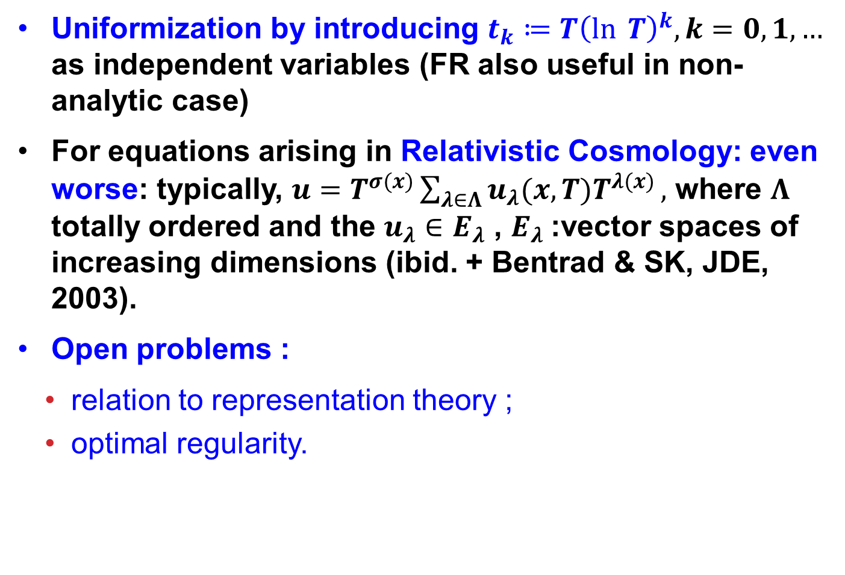
Uniformization by introducing $t_{k}≔T{\left(\ln{ T}\right)}^{k}, k=0, 1, …$ as independent variables (FR also useful in non-analytic case)
For equations arising in Relativistic Cosmology: even worse: typically, $u=T^{σ(x)}\sum_{λ∈Λ}{u_{λ}(x,T)T^{λ(x)}},$ where $Λ$ totally ordered and the $u_{λ}∈E_{λ}$ , $E_{λ}$:vector spaces of increasing dimensions (ibid. + Bentrad & SK, JDE, 2003).
Open problems :
relation to representation theory ;
optimal regularity.

Slide 15
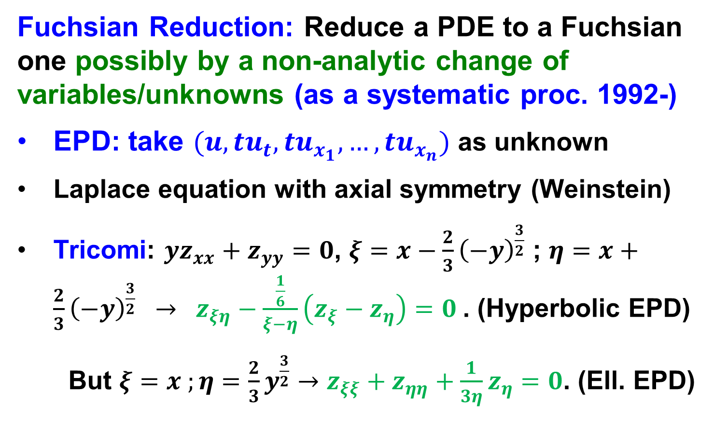
1. DEFinitions: Fuchsian Eqs. & Fuchsian Reduction
Fuchsian Reduction: Reduce a PDE to a Fuchsian one possibly by a non-analytic change of variables/unknowns (as a systematic proc. 1992-)
EPD: take $(u,tu_{t}, tu_{x_{1}},…,tu_{x_{n}})$ as unknown
Laplace equation with axial symmetry (Weinstein)
Tricomi: $yz_{xx}+z_{yy}=0$, $ξ=x−\frac{2}{3}{\left(−y\right)}^{\frac{3}{2}}$ ; $η=x+\frac{2}{3}{\left(−y\right)}^{\frac{3}{2}} → z_{ξη}−\frac{\frac{1}{6}}{ξ−η}\left(z_{ξ}−z_{η}\right)=0$. (Hyperbolic EPD)
But $ξ=x ;η=\frac{2}{3}y^{\frac{3}{2}}→z_{ξξ}+z_{ηη}+\frac{1}{3η}z_{η}=0$. (Ell. EPD)
Notes:
Examples:

Slide 16
1. DEFinitions: Fuchsian Eqs. & Fuchsian Reduction
Fuchsian Reduction: Reduce a PDE to a Fuchsian one possibly by a non-analytic change of variables/unknowns (see our monograph (2007))
EPD, Laplace equation,Tricomi:
Non-Fuchsian ODEs (SK & L. Jager, 2001)
Uniformization of solutions with logarithms (SK & Littman, 1992-3), Einstein’s equations (SK & Rendall, 1998)
Regularity of conformal radius (SK, 2003-2005) Fefferman’s conjecture (SK, 2003),
Weak detonation problem (SK, 2021),…
Notes:
Examples:

Slide 17
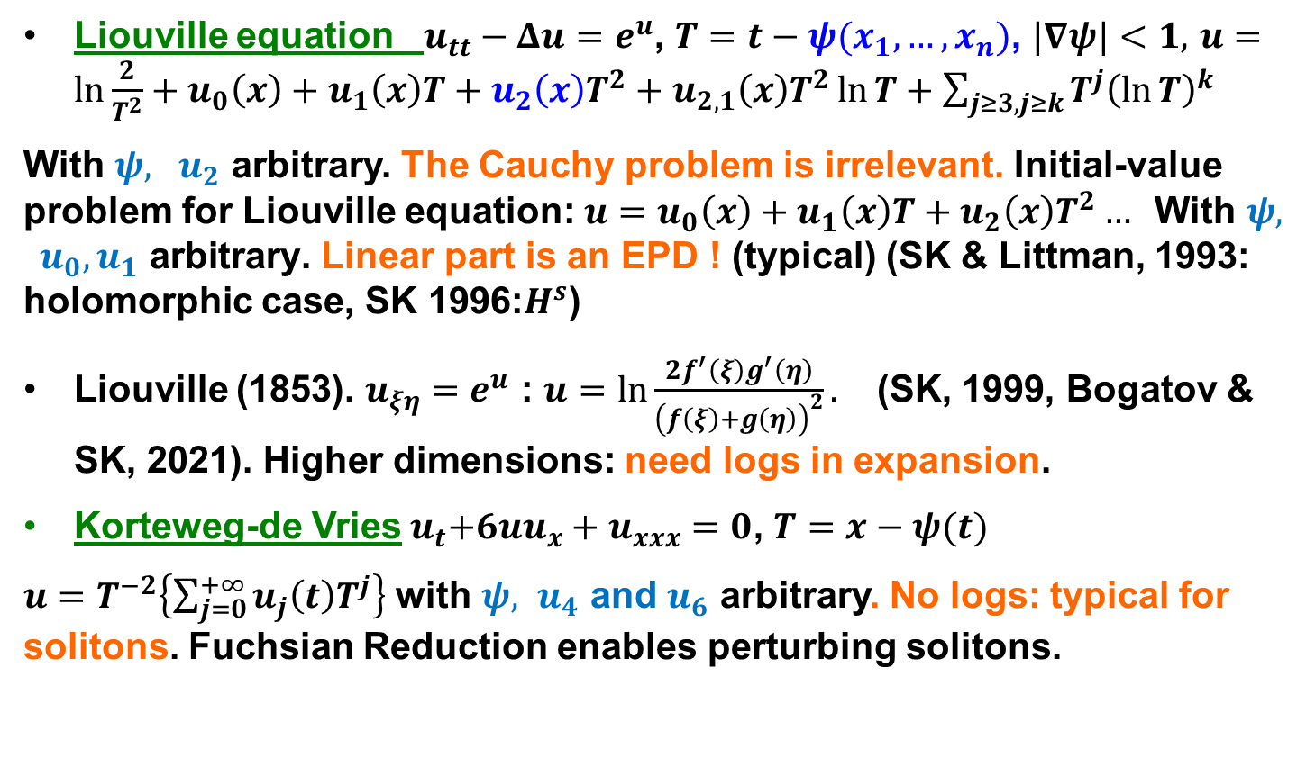
What Fuchsian reduction brings: EPD & Fuchsian PDEs are ubiquitous and necessary
Liouville equation $u_{tt}−Δu=e^{u}$, $T=t−ψ(x_{1},…,x_{n})$, $|∇ψ|<1,$ $u=\ln{\frac{2}{T^{2}}+u_{0}\left(x\right)+u_{1}\left(x\right)T+u_{2}\left(x\right)T^{2}+u_{2,1}\left(x\right)T^{2}\ln{T+\sum_{j≥3, j≥k}{T^{j}{\left(\ln{T}\right)}^{k}}}}$
With $ψ, u_{2}$ arbitrary. The Cauchy problem is irrelevant. Initial-value problem for Liouville equation: ${u=u}_{0}\left(x\right)+u_{1}\left(x\right)T+u_{2}\left(x\right)T^{2}… \text{With} ψ, { u}_{0}, u_{1} \text{arbitrary}\text{.}$ Linear part is an EPD ! (typical) (SK & Littman, 1993: holomorphic case, SK 1996:$H^{s}$)
Liouville (1853). $u_{ξη}=e^{u}$ : $u=\ln{\frac{2f^{′}\left(ξ\right)g^{′}\left(η\right)}{{\left(f\left(ξ\right)+g\left(η\right)\right)}^{2}}}.$ (SK, 1999, Bogatov & SK, 2021). Higher dimensions: need logs in expansion.
Korteweg-de Vries${ u}_{t}+6uu_{x}+u_{xxx}=0$, $T=x−ψ(t)$
$u=T^{−2}\left\{\sum_{j=0}^{+∞}{u_{j}\left(t\right)T^{j}}\right\}$ with ${ψ, u}_{4}$ and $u_{6}$ arbitrary. No logs: typical for solitons. Fuchsian Reduction enables perturbing solitons.

Slide 18
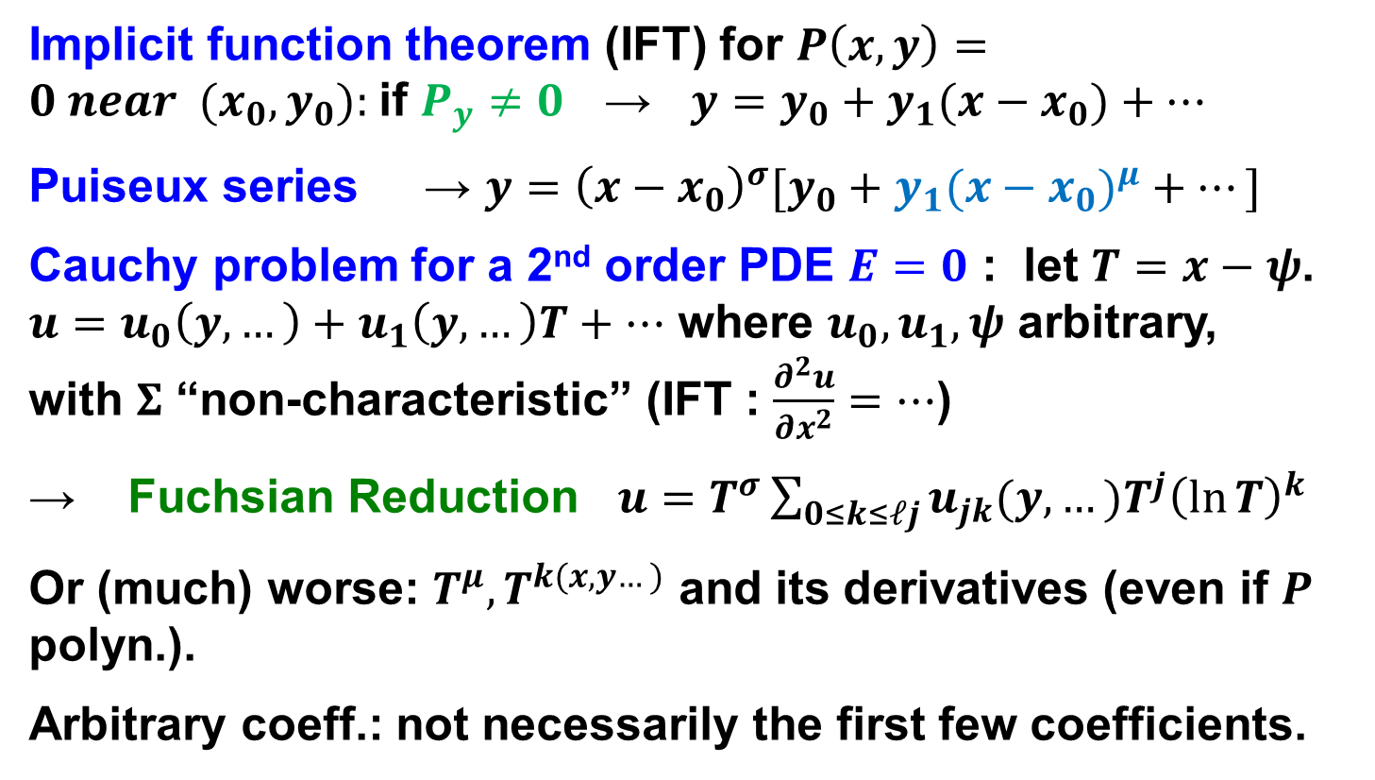
Comparison with other theories
Implicit function theorem (IFT) for $P\left(x,y\right)=0 near (x_{0}, y_{0}):$if $P_{y}≠0$ → $y=y_{0}+y_{1}(x−x_{0})+⋯$
Puiseux series → $y={\left(x−x_{0}\right)}^{σ}[y_{0}+y_{1}({x−x_{0})}^{μ}+⋯]$
Cauchy problem for a 2nd order PDE $E=0$ : let $T=x−ψ$. $u=u_{0}\left(y,…\right)+u_{1}\left(y,…\right)T+…$ where $u_{0}, u_{1}, ψ$ arbitrary, with $Σ$ “non-characteristic” (IFT : $\frac{∂^{2}u}{∂x^{2}}=…$)
→ Fuchsian Reduction $u=T^{σ}\sum_{0≤k≤ℓj}{u_{jk}(y,…)T^{j}{\left(\ln{T}\right)}^{k}}$
Or (much) worse: ${T^{μ}, T}^{k(x,y…)}$ and its derivatives (even if $P$ polyn.).
Arbitrary coeff.: not necessarily the first few coefficients.

Slide 19
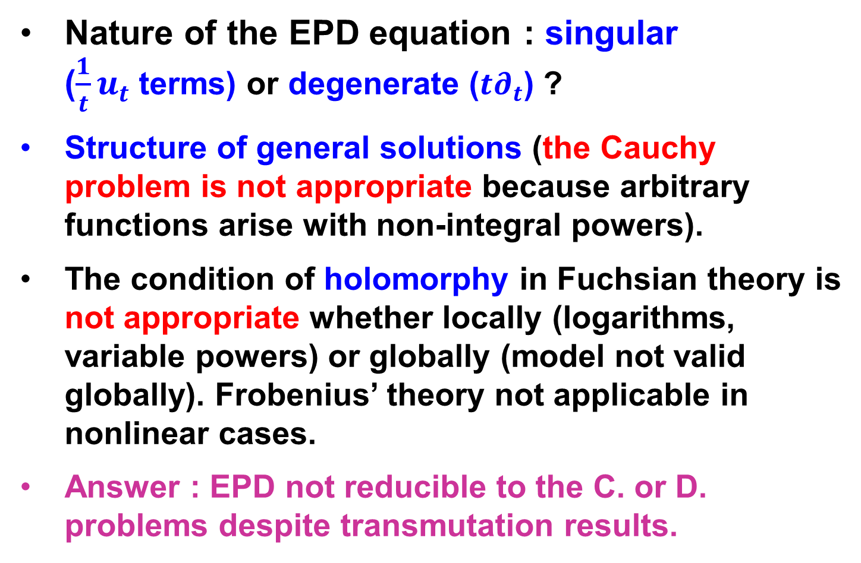
1. DEFinitions & issues
Nature of the EPD equation : singular ($\frac{1}{t}u_{t}$terms) or degenerate ($t∂_{t}$) ?
Structure of general solutions (the Cauchy problem is not appropriate because arbitrary functions arise with non-integral powers).
The condition of holomorphy in Fuchsian theory is not appropriate whether locally (logarithms, variable powers) or globally (model not valid globally). Frobenius’ theory not applicable in nonlinear cases.
Answer : EPD not reducible to the C. or D. problems despite transmutation results.
Notes:
Examples:

Slide 20
2. Facts that require explanation

Slide 21
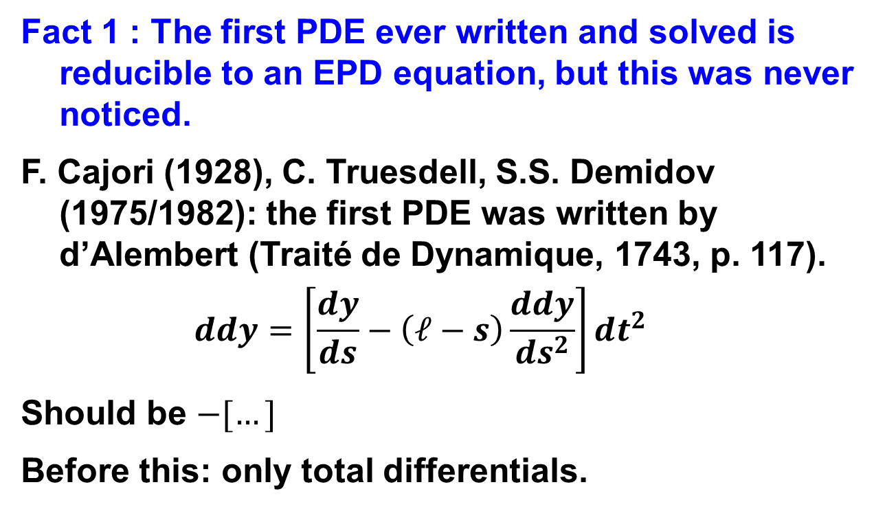
2. Facts
Fact 1 : The first PDE ever written and solved is reducible to an EPD equation, but this was never noticed.
F. Cajori (1928), C. Truesdell, S.S. Demidov (1975/1982): the first PDE was written by d’Alembert (Traité de Dynamique, 1743, p. 117).
$$ddy=\left[\frac{dy}{ds}−\left(ℓ−s\right)\frac{ddy}{ds^{2}}\right]dt^{2}$$
Should be $−[…]$
Before this: only total differentials.

Slide 22
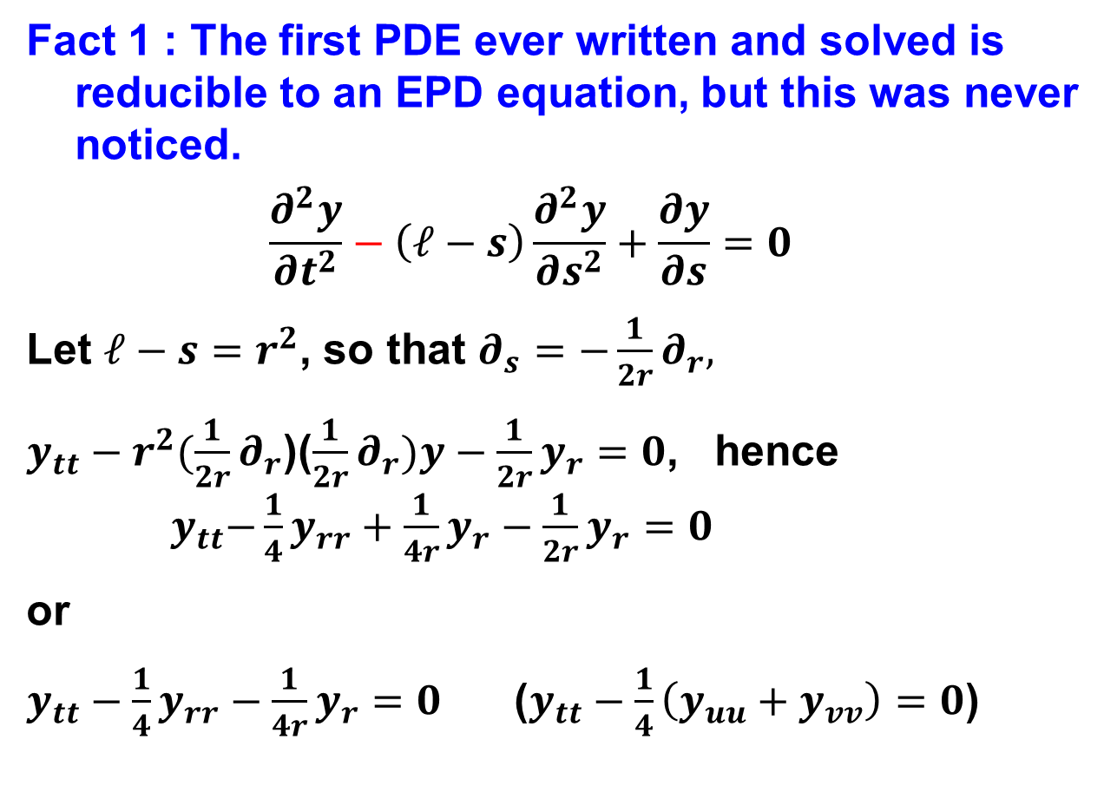
2. Facts
Fact 1 : The first PDE ever written and solved is reducible to an EPD equation, but this was never noticed.
$$\frac{∂^{2}y}{∂t^{2}}−\left(ℓ−s\right)\frac{∂^{2}y}{∂s^{2}}+\frac{∂y}{∂s}=0$$
Let $ℓ−s=r^{2}$, so that $∂_{s}=−\frac{1}{2r}∂_{r},$
$y_{tt}−r^{2}(\frac{1}{2r}∂_{r}$)($\frac{1}{2r}∂_{r})y−\frac{1}{2r}y_{r}=0$, hence ${ y}_{tt}−\frac{1}{4}y_{rr}+\frac{1}{4r}y_{r}−\frac{1}{2r}y_{r}=0$
or
$y_{tt}−\frac{1}{4}y_{rr}−\frac{1}{4r}y_{r}=0$ ($y_{tt}−\frac{1}{4}\left(y_{uu}+y_{vv}\right)=0$)

Slide 23
2. Facts
Fact 2 : The EPD eq. used to be central to PDE theory
Darboux (1915) : §344 « De toutes les équations que nous aurions pu choisir, il n’est est aucune dont l’étude présente plus d’intérêt et puisse fournir autant d’indications précieuses sur l’intégration des équations linéaires les plus générales. »
The solution of the wave equation rests on the EPD equation satisfied by spherical means (see e.g. C.H.).
Axial/spherical symmetry leads to EPD eqs. (A. Weinstein)

Slide 24
2. Facts
Fact 3 : The EPD eq. used to be central to PDE theory
Darboux (1915) : §344 « De toutes les équations que nous aurions pu choisir, il n’est est aucune dont l’étude présente plus d’intérêt et puisse fournir autant d’indications précieuses sur l’intégration des équations linéaires les plus générales. »
The solution of the wave equation rests on the EPD equation satisfied by spherical means (see e.g. C.H.).
Axial/spherical symmetry leads to EPD eqs. (A. Weinstein)

Slide 25
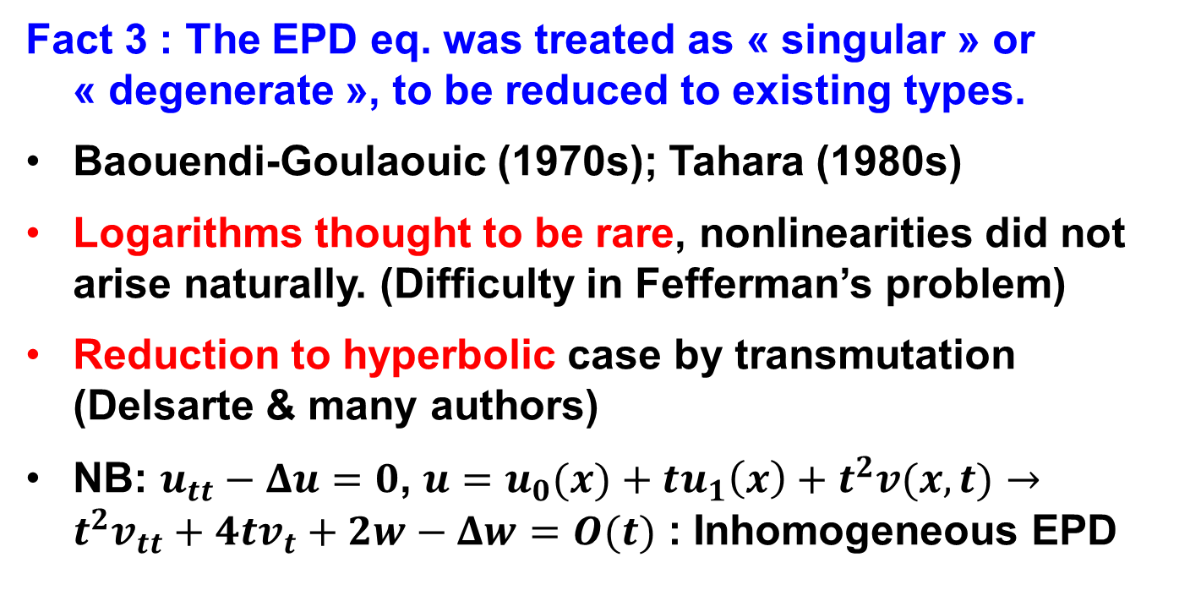
2. Facts
Fact 3 : The EPD eq. was treated as « singular » or « degenerate », to be reduced to existing types.
Baouendi-Goulaouic (1970s); Tahara (1980s)
Logarithms thought to be rare, nonlinearities did not arise naturally. (Difficulty in Fefferman’s problem)
Reduction to hyperbolic case by transmutation (Delsarte & many authors)
NB: $u_{tt}−Δu=0$, $u=u_{0}(x)+tu_{1}\left(x\right)+t^{2}v(x,t)→$ $t^{2}v_{tt}+4tv_{t}+2w−Δw=O(t)$ : Inhomogeneous EPD

Slide 26
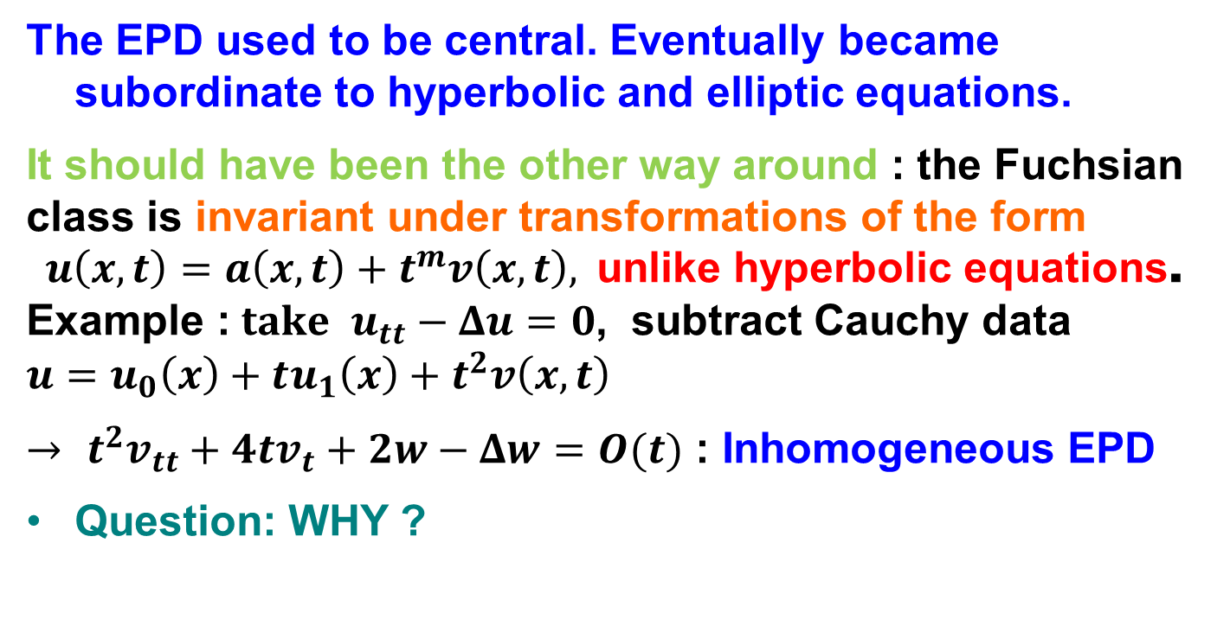
2. Facts : conclusion of part 2
The EPD used to be central. Eventually became subordinate to hyperbolic and elliptic equations.
It should have been the other way around : the Fuchsian class is invariant under transformations of the form $u\left(x,t\right)=a\left(x,t\right)+t^{m}v\left(x,t\right),$ unlike hyperbolic equations. Example :$take u_{tt}−Δu=0$, subtract Cauchy data $u=u_{0}\left(x\right)+tu_{1}\left(x\right)+t^{2}v\left(x,t\right)$
$→$ $t^{2}v_{tt}+4tv_{t}+2w−Δw=O(t)$ : Inhomogeneous EPD
Question: WHY ?

Slide 27
3. How do you account for these facts ?

Slide 28
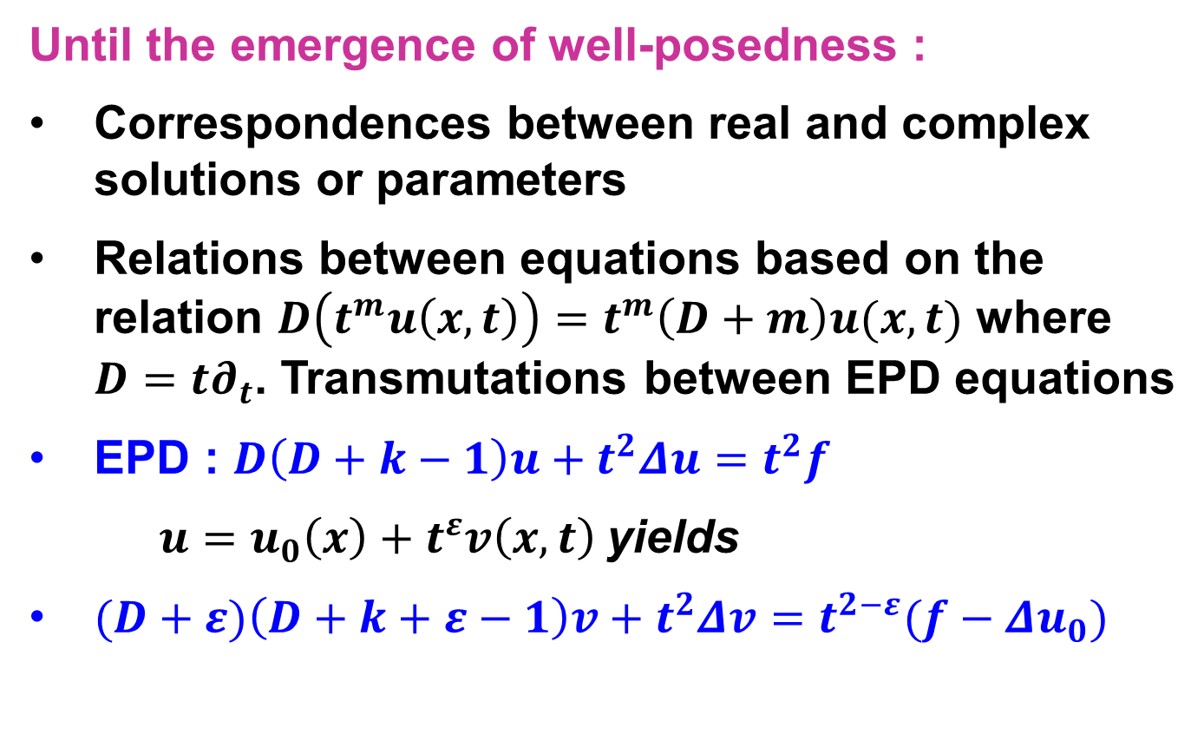
3. How do you account for these facts ?
Until the emergence of well-posedness :
Correspondences between real and complex solutions or parameters
Relations between equations based on the relation $D\left(t^{m}u\left(x,t\right)\right)=t^{m}\left(D+m\right)u(x,t)$ where $D=t∂_{t}$. Transmutations between EPD equations
EPD : $D\left(D+k−1\right)u+t^{2}Δu=t^{2}f$
$u=u_{0}\left(x\right)+t^{ε}v\left(x,t\right)$yields
$(D+ε)\left(D+k+ε−1\right)v+t^{2}Δv=t^{2−ε}(f−Δu_{0})$
Notes:
Examples:

Slide 29
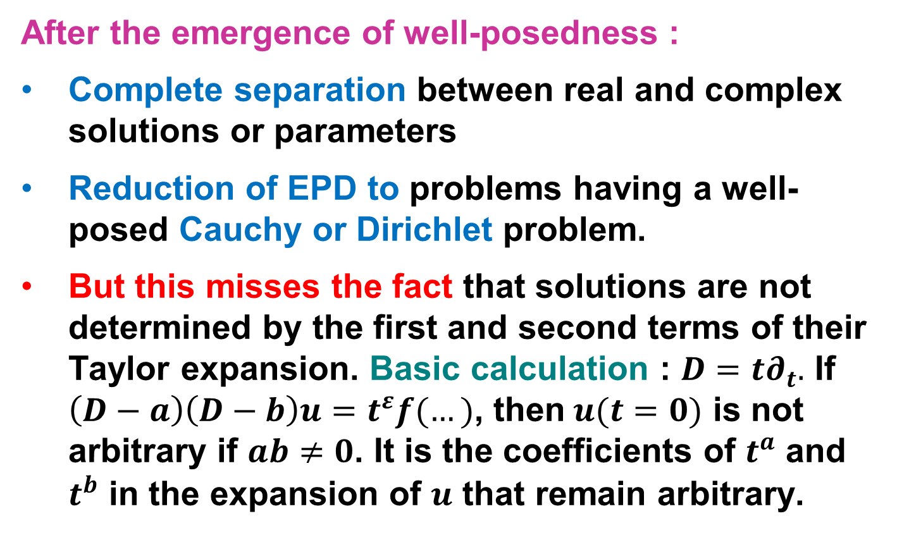
3. How do you account for these facts ?
After the emergence of well-posedness :
Complete separation between real and complex solutions or parameters
Reduction of EPD to problems having a well-posed Cauchy or Dirichlet problem.
But this misses the fact that solutions are not determined by the first and second terms of their Taylor expansion. Basic calculation : $D=t∂_{t}.$ If $\left(D−a\right)\left(D−b\right)u=t^{ε}f(…)$, then$u(t=0)$ is not arbitrary if $ab≠0$. It is the coefficients of $t^{a}$ and $t^{b}$ in the expansion of $u$ that remain arbitrary.
Notes:
Examples:

Slide 30
3. How do you account for these facts ?
After the emergence of well-posedness :
…But this misses the fact that solutions are not determined by the first and second terms of their Taylor expansion.
It became necessary is to view hyperbolic and elliptic problems as special cases of EPD-like problems.
Integral and non-integral powers, as well as logarithms, are the rule, not an exception.
Notes:
Examples:

Slide 31
3. How do you account for these facts ?
EPD-like equations (= Fuchsian PDEs) are more general than hyperbolic equations, that are a special case of them. They cannot be avoided because
The theory of solitons led to expansions in which arbitrary functions are not the first terms in the Taylor expansion.
Failure of L^{p} estimates for wave equations (Littman), except in 1D. Suggests symmetric-hyperbolic theory incomplete.
Blow-up problem requires Fuchsian Reduction.
General theory [elliptic : Fichera, Oleinik-Radkevich, SK ; hyperbolic : Tahara, Baouendi-Goulaouic, SK-Littman]. Open problems: optimal regularity in terms of coefficients (SK, J. Differential Equations, 1996)

Slide 32
Conclusion of Part 3
The theory of well-posedness (Hadamard) led to the impression that the Cauchy and Dirichlet problems should be the focus of PDE theory, just because they could be solved in a convenient framework.
The theory of the hyperbolic Cauchy problem & elliptic Dirichlet problems became a “paradigm”.
Paradigm failed because of soliton theory,

Slide 33
CONclusion

Slide 34
We have seen that :
The EPD was the first PDE to be written, but was forgotten.
It played a central rôle in PDEs until the theory of well-posedness that suggested the Cauchy and Dirichlet problems should be central. But C. & D. problems are not adapted to EPD eqs
EPD came back because the blow-up problem leads naturally to nonlinear EPD equations via Fuchsian Reduction. Many open problems remain.
A PDE may change meaning depending on its context and interpretation. Further example of the relevance of the Fabergé egg model in history.

Slide 35
Conclusion
The various interpretations of the EPD equation are therefore not developments of a single idea, like nested Matryoshka dolls, each of which is a copy of the next one, only smaller, but rather resemble Fabergé eggs Яйца Фаберже́ each with a “surprise ”: the outer (newer) layer does not indicate what the interior (the past) contains.
That is why historical investigation provides a deeper understanding of modern mathematics that cannot be inferred from the modern stage alone.
See for instance the recently recovered Third Imperial egg from 1887, the Diamond Treillis from 1892, or the Lilies of the Valley from 1898, that illustrate different types of « surprises ».

Slide 36
THANK YOU
FOR
YOUR ATTENTION

