Slide 1
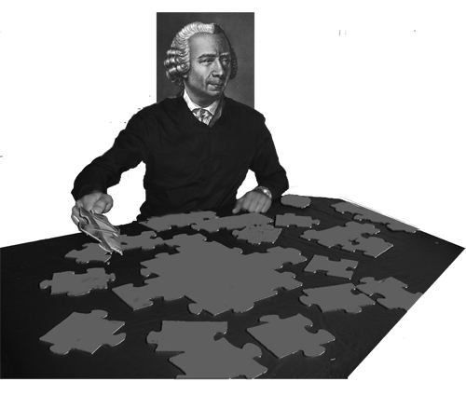
Next Generation DNA Sequencing:
Does the Read Length Matter?
Pavel A. Pevzner
Department of Computer Science and Engineering,
University of California at San Diego

Slide 2
Fragment Assembly
reads
atgcaatgcatgcatggatgcaatgcatgcaatgcatgcatggatgcaatgcatgcaatgcatgcatggatgcaatgcatgcaatgcatgcatggatgcaatgcatgcatgggg
Cover region with (overlapping) reads
Overlap reads and extend to reconstruct the original genomic region

Slide 3
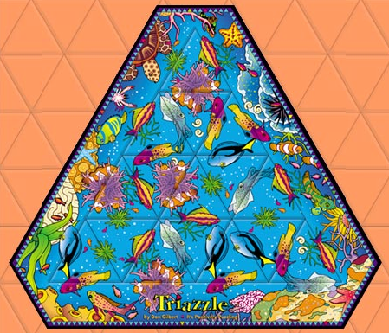
Some puzzles are more difficult than other...
The puzzle has only 16 pieces and looks simple
BUT there are repeats!!!
The repeats make it very difficult.

Slide 4

Does the Read Length Matter?
Mark Chaisson
(now at Pacific Biosciences)
Dima Brinza
(now at Life Technologies)

Slide 5
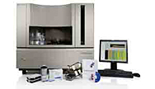

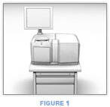


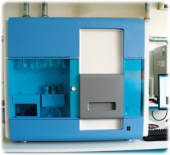
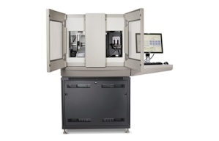
What are short reads?
800 bases
DO NOT SEEM
TO WORK WITH
CONVENTIONAL ASSEMBLERS
3730xl
200
454 GSFlx
500
50
Illumina
30
AB Solid

Slide 6
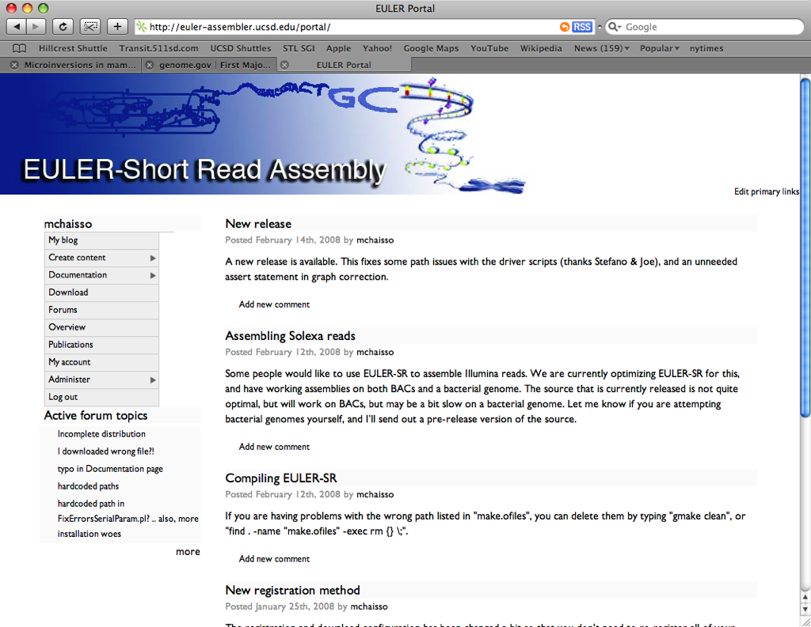
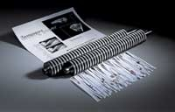

EULER Short Reads assembler
(Chaisson et al, Bioinformatics 2004, Genome Res., 2008, 2009)

Slide 8
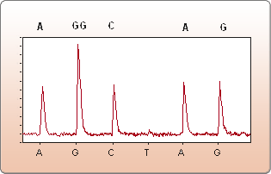
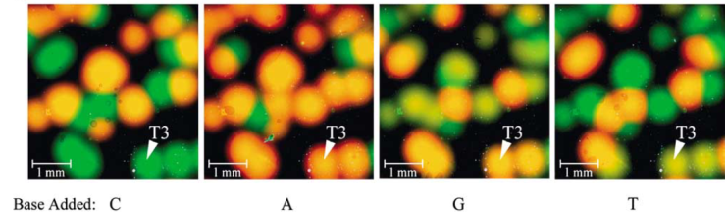
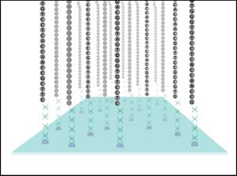
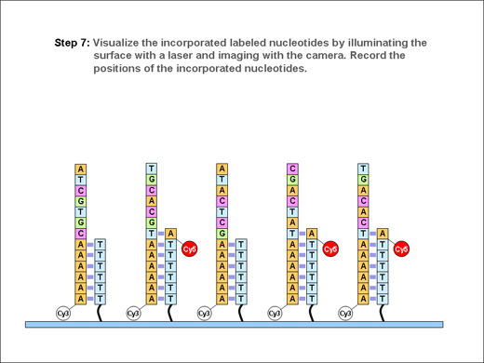
Emerging short read technologies
454 Life Sciences
ABI
Illumina/Solexa
Helicos

Slide 9
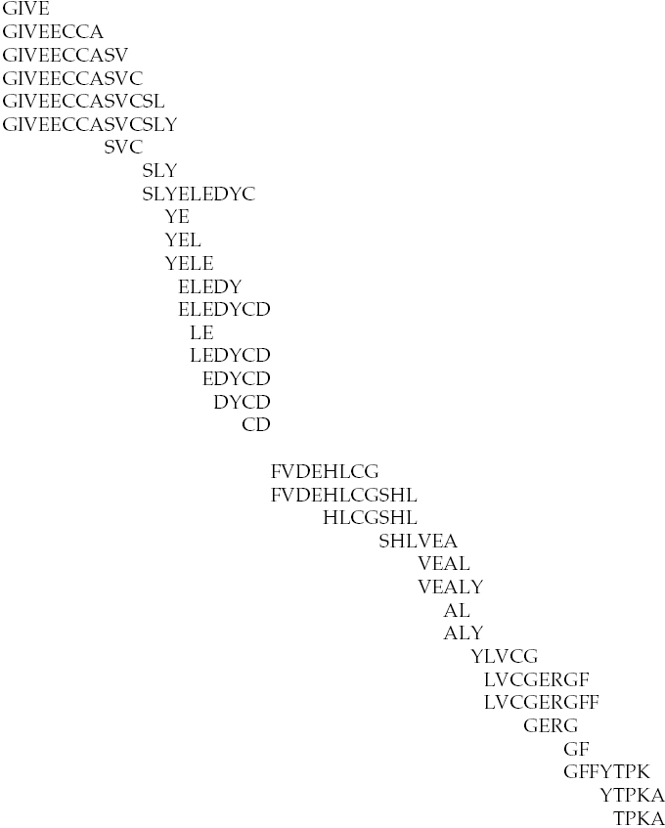
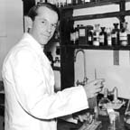
...history repeats itself: sequencing insulin
Fred Sanger
1958 (!) Nobel prize for sequencing insulin by Edman degradation
Average read length = 5 aa!

Slide 10
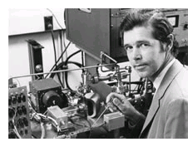

Mass Spectrometry Based Protein Sequencing
In 1988 Klaus Biemann sequenced purified rabbit glutaredoxin using tandem mass spectrometry:
MCP, July, 2008
collaboration with Karl Clauser@Broad

Slide 11
Shotgun Protein Sequencing: Mass Spectrometry vs. Edman degradation
Novel proteins are still determined by laborious Edman degradation.
Integrilin, a blood clot prevention drug derived from rattlesnake venom.
Ziconotide, 20x more potent than morphine and has no addiction side effects, derived from cone snail venom
Many important proteins are not inscribed in genomes
Fusion proteins in tumors
Antibodies (collaboration with Genentech)
Non-ribosomal peptides and other natural products represent 9 out of top 20 bestselling drugs (collaborations with Pieter Dorrestein at UCSD School of Pharmacy)
Challenge: Substitute slow Edman degradation by a fast protein sequencing technique
Bandeira et al, MCP 2007
Bandeira et al, PNAS 2007

Slide 12
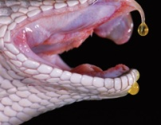

Shotgun Protein Sequencing by MS vs. Edman degradation
Novel proteins are still determined by laborious Edman degradation.
Integrillin (Millennium Pharma), a blood clot prevention drug derived from snake venom.
Ziconotide (Elan), 20x more potent than morphine and has no addiction side effects, derived from snail venom
Many important proteins are not inscribed in genomes
Fusion proteins in tumors
Antibodies (collaboration with Genentech)
Non-ribosomal peptides and other natural products represent 9 out of top 20 bestselling drugs (collaboration with UCSD School of Pharmacy)
Challenge: Substitute slow and inefficient Edman degradation by a fast protein sequencing technique
Bandeira et al, 2007

Slide 13
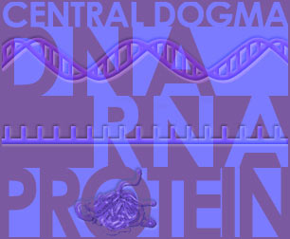
De Novo Protein/Peptide Sequencing by MS
All proteins are encoded in DNA: would it be easier to sequence DNA and infer amino acid sequences?
DNA makes RNA makes PROTEIN
transcription translation
Notes:
Elevator pitch: We are going to form a mass spec software company that will revolutionize the application of mass spectrometry to proteomics and life sciences. It will enable new applications that will significantly advance the research … in industry..

Slide 14

De Novo Protein Sequencing
Without any RNA template!
DNA makes RNA makes PROTEIN makes … PEPTIDE
transcription translation non-ribosomal peptide synthesis
Non-Ribosomal Peptides (NRPs) are excellent compounds for the development of novel pharmaceutical agents:
antibiotics (penicillin, vancomicine, etc.),
immunosuppressors (cyclosporin),
antiviral agents (luzopeptin A),
antitumor agents (bleomycin),
…
Notes:
Elevator pitch: We are going to form a mass spec software company that will revolutionize the application of mass spectrometry to proteomics and life sciences. It will enable new applications that will significantly advance the research … in industry..

Slide 15
De Novo Protein/Peptide Sequencing
Sequencing with SHORT (10-15 aa) and ERROR-PRONE reads (roughly equivalent 30% error rate)!
MCP 07, PNAS 07, Nat. Biotech 08 Nat. Methods 09
DNA makes RNA makes PROTEIN makes … PEPTIDE
transcription translation non-ribosomal peptide synthesis
Non-Ribosomal Peptides (NRPs) are excellent compounds for the development of novel pharmaceutical agents:
antibiotics (penicillin, vancomicine, etc.),
immunosuppressors (cyclosporin),
antiviral agents (luzopeptin A),
antitumor agents (bleomycin),
…
Notes:
Elevator pitch: We are going to form a mass spec software company that will revolutionize the application of mass spectrometry to proteomics and life sciences. It will enable new applications that will significantly advance the research … in industry..

Slide 16

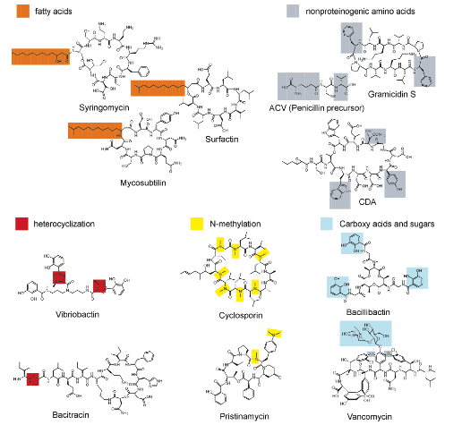
Why NRPs (e.g., Antibiotics) are Important Again: Emerging Diseases
NRPs display superior "druggability" but high identification cost
Where combinatorial chemistry has stalled, could untapped natural products usher in a second Golden Age of antibiotics?
Rapid sequencing of antibiotics is critical factor for market delivery – no computational technology for NRP sequencing exists today (Li and Vederas. Antibiotics discovery: end of an era or an endless frontier? (Science, July 09)
Notes:
Elevator pitch: We are going to form a mass spec software company that will revolutionize the application of mass spectrometry to proteomics and life sciences. It will enable new applications that will significantly advance the research … in industry..

Slide 17
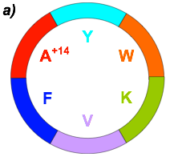
De Novo Sequencing of Nonribosomal Peptides
NRPs differ from ribosomal peptides in many respects:
non-linear structures, e.g., cyclic
they often contain non-standard amino acids increasing the number of possible building blocks from 20 to 100+
they are extensively modified
Each of these complications renders traditional MS-based de novo peptide sequencing approaches useless.
Seglitide
Notes:
Elevator pitch: We are going to form a mass spec software company that will revolutionize the application of mass spectrometry to proteomics and life sciences. It will enable new applications that will significantly advance the research … in industry..

Slide 18
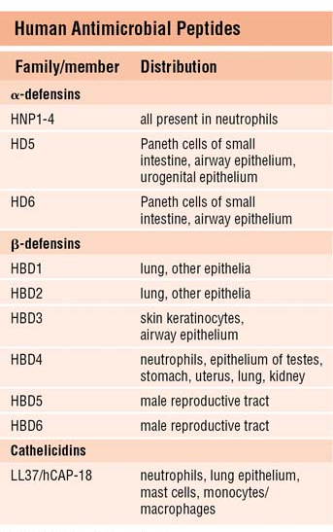
Primate Innate Immunity: Antimicrobial Peptides
theta-defensin
(cyclic peptide in primates)

Slide 19
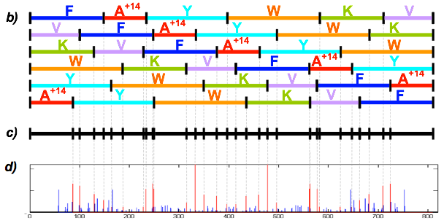
Sequencing Cyclic Peptides by MS and the Beltway Problem
Seglitide: somatostatin receptor antagonist, used experimentally to treat Alzheimer’s disease
Collaboration with Pieter Dorrestein, UCSD School of Pharmacy (Nature Methods 09)

Slide 20
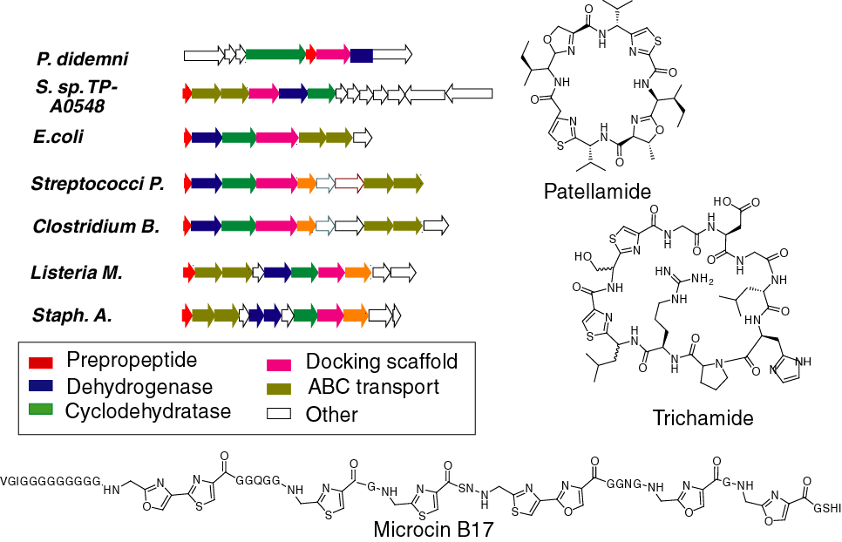
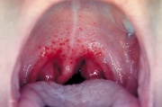
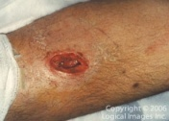
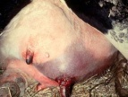
Ribosomal Peptides May Be Equally Elusive

Slide 21

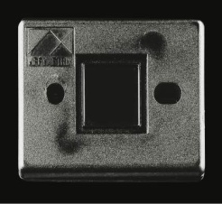
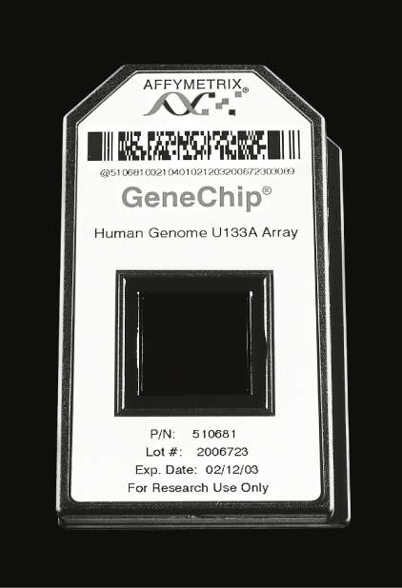
Short Read Sequencing and SBH
Short read sequencing was first proposed in 1988 under the name Sequencing by Hybridization (SBH)
1988: SBH suggested as an alternative to Sanger sequencing. Nobody believed it will ever work
1991: Light directed polymer synthesis developed
1994: Affymetrix develops first 64-kb DNA microarray
First microarray
prototype (1989)
First commercial
DNA microarray
prototype w/16,000
features (1994)
500,000 features
per chip (2002)

Slide 22
Fragment Assembly with Short Reads (k-mers)
P.P. (1989) k-mer DNA sequencing.
Result: An optimal Eulerian fragment assembly algorithm for SBH.

Slide 23
Fragment Assembly with (very) Short Reads (k-mers)
P.P. (1989) k-mer DNA sequencing.
Result: An optimal Eulerian fragment assembly algorithm for SBH.
Idury and Waterman (1995) Mimicking Sanger sequencing as SBH reconstruction (first Eulerian algorithm for fragment assembly)

Slide 24
Fragment Assembly with (very) Short Reads (k-mers)
P.P. (1989) k-mer DNA sequencing.
Result: An optimal and fast Eulerian fragment assembly algorithm for SBH.
Idury and Waterman (1995) Mimicking Sanger sequencing as SBH reconstruction (first Eulerian algorithm for fragment assembly)
De novo assembly with short reads is not unlike assembly with virtual universal DNA array

Slide 25
Fragment Assembly with (very) Short Reads (l-mers)
Pevzner (1989) l-mer DNA sequencing.
Result: An optimal and fast Eulerian fragment assembly algorithm for SBH.
Limits of SBH (Lipshutz and Pevzner, 1993): The Eulerian approach solves SBH
BUT…
the resolving power of DNA arrays with l-mers is only 2^{l}.
Random 3 billion base long genome: l ≥32.

Slide 26
Short Reads Assembly: Computational Challenge
Difficult using current assemblers
Number of read overlaps grows dramatically as compared with the conventional reads.
Phrap failed to assemble a bacterial genome with simulated short reads (50 bp reads and 20X coverage) even with error-free reads.

Slide 27
Fragment Assembly with Short Reads is not Unlike Assembly with Virtual Universal DNA Array
Chaisson, Tang, P.P (Bioinformatics 2004) Fragment assembly with short reads.
Result: While it is feasible to assemble short reads, the resulting contigs will require significant (if not prohibitive) finishing efforts.
Chaisson and P.P. (Genome Research 2008) Short reads assembly of bacterial genomes
Result: Practical EULER-SR assembler for (semi)-short 454 reads but the number of contigs explodes for Illumina reads.
Read length matters!

Slide 28
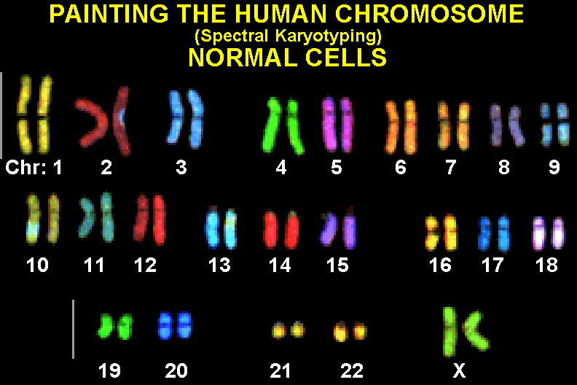
Chromosome Painting: Normal Cells
Human chromosomes
visualized with FISH
chromosome painting

Slide 29
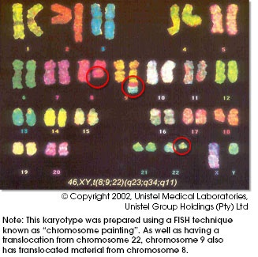
Tumor Cells
Tumor cells often exhibit chromosomal aberrations:

Slide 30
Tumor Genomes
Rearrangements may disrupt genes and alter gene regulation.
Example: translocation in leukemia yields “Philadelphia” chromosome:
Chr 9
promoter
ABL gene
promoter
BCR gene
Chr 22
promoter
BCR gene
promoter
c-ab1 oncogene
Thousands of individual rearrangements known for different tumors.

Slide 31
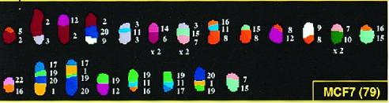
Breast Cancer Tumor Genome
MCF7 is human breast cancer cell line.
Cytogenetic analysis suggests complex architecture:
What is the detailed architecture of MCF7 tumor genome?
What sequence of rearrangements produced MCF7?

Slide 32
End Sequence Profiling (ESP) Collins et al. (UCSF Cancer Center)
Tumor DNA
Pieces of tumor genome: clones (100-250kb).
2) Sequence ends of clones (500bp).
3) Map end sequences to human genome.
x
y
Human DNA
Each clone corresponds to a pair of end sequences (ES pair) (x,y).

Slide 33
Tumor Genome Reconstruction Puzzle
Human genome
(known)
A
B
C
D
E
Unknown sequence of
rearrangements
Tumor genome
(unknown)
A
-C
-D
B
E
Map ES pairs to
human genome.
Reconstruct tumor
genome
Location of ES pairs
in human genome.
(known)
x₁
x₂
x₃
x₄
y₁
y₂
x₅
y₅
y₄
y₃

Slide 34
Tumor Genome Reconstruction
E
B
Tumor
-D
-C
A
A
B
C
D
E
Human

Slide 35
Tumor Genome Reconstruction
E
B
Tumor
-D
-C
A
A
B
C
D
E
Human

Slide 36
Human vs Tumor Comparison
E
(x₃,y₃)
B
Tumor
(x₂,y₂)
-D
(x₄,y₄)
-C
(x₁,y₁)
A
A
B
C
D
E
x₁ x₂
x₃ x₄
y₁ y₂
y₄ y₃

Slide 37
Human vs Human Comparison
E
(x₃,y₃)
(x₄,y₄)
D
(x₂,y₂)
Human
2D Representation of ESP Data
Each point is ES pair.
Can we reconstruct the tumor genome from the positions of the ES pairs?
C
(x₁,y₁)
B
A
A
B
C
D
E
Human

Slide 38
E
D
Human
2D Representation of ESP Data
Each point is ES pair.
Can we reconstruct the tumor genome from the positions of the ES pairs?
C
B
A
A
B
C
D
E
Human

Slide 39
E
D
Human
2D Representation of ESP Data
Each point is ES pair.
Can we reconstruct the tumor genome from the positions of the ES pairs?
C
B
A
A
B
C
D
E
Human

Slide 40
E
D
Human
2D Representation of ESP Data
Each point is ES pair.
Can we reconstruct the tumor genome from the positions of the ES pairs?
C
B
A
A
B
C
D
E
Human

Slide 41
E
D
Human
2D Representation of ESP Data
Each point is ES pair.
Can we reconstruct the tumor genome from the positions of the ES pairs?
C
B
A
A
B
C
D
E
Human

Slide 42
E
D
Human
2D Representation of ESP Data
Each point is ES pair.
Can we reconstruct the tumor genome from the positions of the ES pairs?
C
B
A
A
B
C
D
E
Human

Slide 43
E
D
Human
2D Representation of ESP Data
Each point is ES pair.
Can we reconstruct the tumor genome from the positions of the ES pairs?
C
B
A
A
B
C
D
E
Human

Slide 44
E
D
Human
2D Representation of ESP Data
Each point is ES pair.
Can we reconstruct the tumor genome from the positions of the ES pairs?
C
B
A
A
B
C
D
E
Human

Slide 45
E
D
Human
2D Representation of ESP Data
Each point is ES pair.
Can we reconstruct the tumor genome from the positions of the ES pairs?
C
B
A
A
B
C
D
E
Human

Slide 46
E
E
D
-D
Human
C
-C
B
B
A
A
A
B
C
D
E
Human
Reconstructed
Tumor Genome
A
-C
-D
B
E

Slide 47
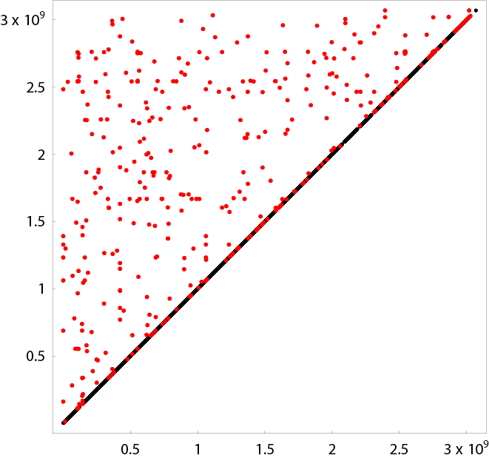
Real cancer data noisy and incomplete!

Slide 48
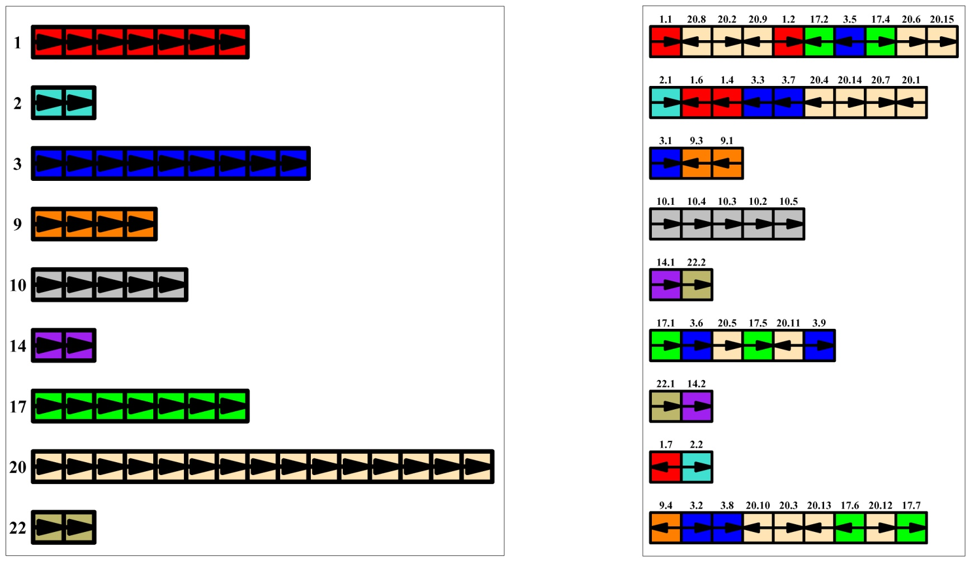
Breast Cancer MCF7 Cell Line
Human chromosomes
MCF7 chromosomes
Raphael, Volik, Collins, Pevzner. 2003.
Notes:
Provides model for experimental verification
Rearrangement centric

Slide 49
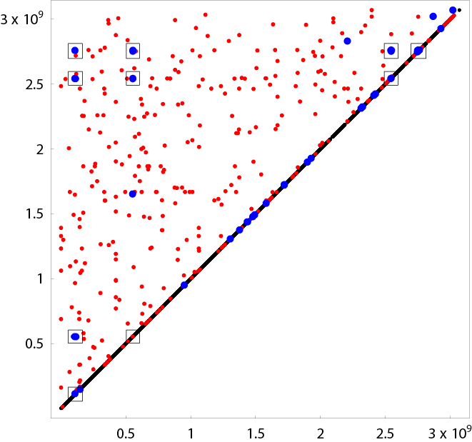
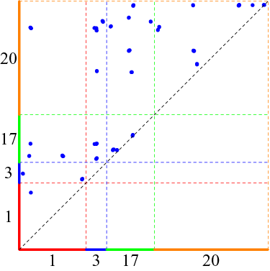
Complications with MCF7: Chromosomes 1,3,17, 20
33/70 clusters
Total length: 31Mb

Slide 50
Rearrangement Signatures
Human
Tumor
A
B
C
inversion
A
-B
C
s
t
s
t
A
B
C
D
translocation
A
-C
-B
D
s
t
s
t
duplication/
transposition
A
B
C
D
E
A
D
B
C
D
E
u
v
w
u
v
w
A
B
C
E
????
u
v
w

Slide 51
Complex Tumor Genomes

Slide 52
Structure of Duplications in Tumors?
Duplicated segments may co-localize
(Guan et al. Nat.Gen.1994)
Human genome
Tumor genome
Mechanisms not well understood.

Slide 53
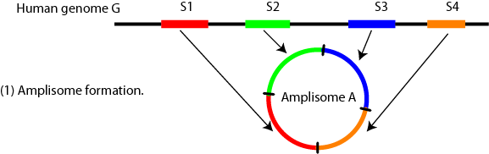
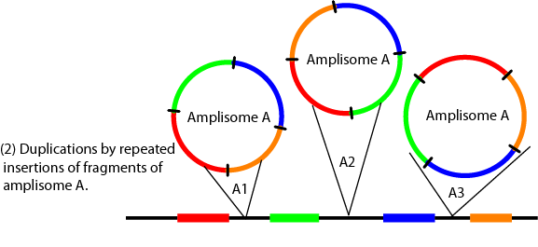
Tumor Amplisomes

Slide 54
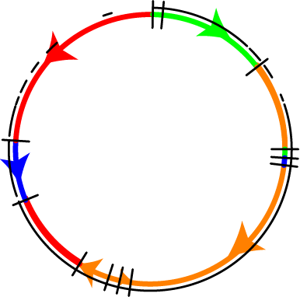
Reconstructed MCF7 amplisome
33 clusters
Total length: 31Mb
Chromosome
colors
1
3
17
20
Explains 24/33 invalid clusters.
Raphael and Pevzner, 2004.

Slide 55
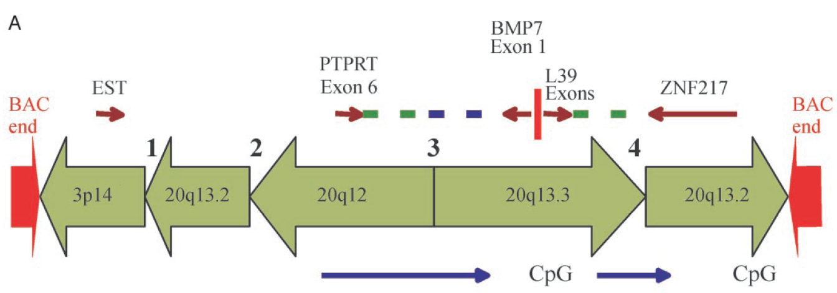
Sequencing Tumor Clones Confirms
Complex Mosaic Structure
Volik et al., 2006 Decoding the fine-scale structure of breast cancer genome and transcriptome: Implications for Tumor Genome Project, Genome Research
Raphael et al., 2006 Reconstructing Genomic Architectures of Solid Tumors (in preparation)

Slide 56
Tumor Genomes Projects
Mutation, selection
Human genome
Tumor genome
Tumor genome 2
Tumor genome 3
Tumor genome 4
Identify recurrent aberrations
Identify temporal sequence of aberrations
Use these data for tumor diagnostics and therapeutics

Slide 57

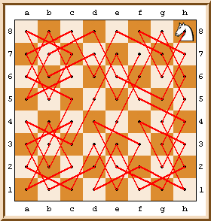
Knight Tours (Baghdad, 10th century)
Knight Tour Problem: Find a knight path on a chessboard that visits every square exactly once.

Slide 58
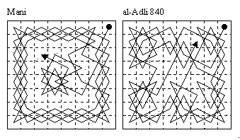
Knight’s Tour Problem: Solutions
1759: Berlin Academy of Sciences proposed a 4000 francs prize for the solution of the NxN Knight’s Tour problem
NxN problem was solved in 1766 by Leonhard Euler
The prize was never awarded since Euler was ineligible as Director of Mathematics at Berlin Academy at that time.
Even after he resigned in favor of Lagrange

Slide 59
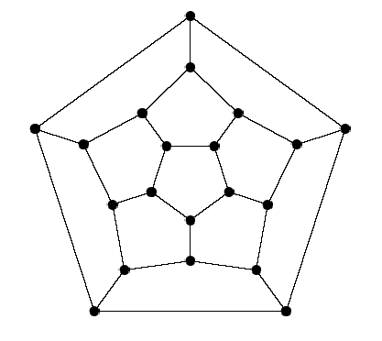
Hamiltonian Cycle Problem
Find a cycle that visits every vertex exactly once
NP – complete

Slide 60
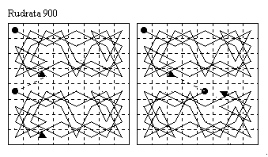
Knight Tour Problem: Solutions

Slide 61
Hamiltonian Cycle Problem
Find a walk (cycle) in a network (graph) that visits every NODE exactly once
Intractable problem (NP – complete)

Slide 62
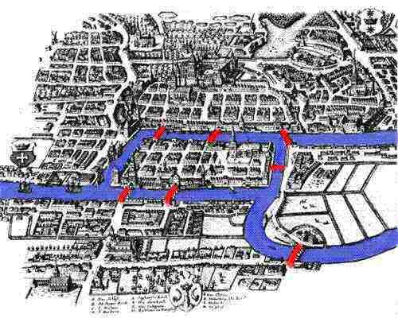
The Bridges of Konigsberg Problem
Find a path crossing every bridge just once
Leonhard Euler, 1735
Bridges of Königsberg

Slide 63
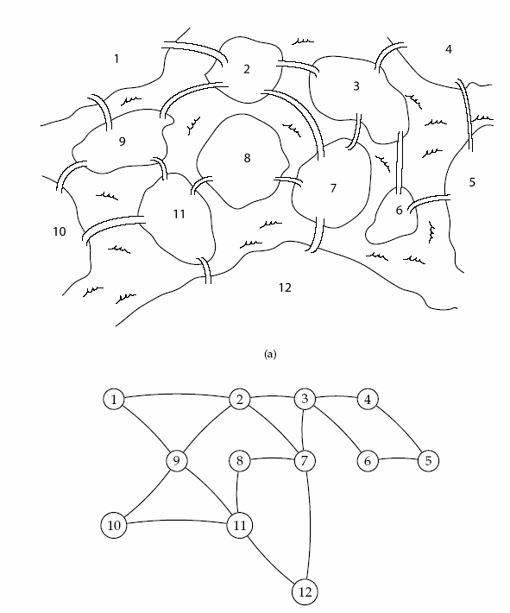
Eulerian Cycle Problem
Find a cycle that visits every edge exactly once
Linear time algorithm
More complicated Königsberg

Slide 64
Eulerian Cycle Problem
Find a cycle that visits every edge in the network (graph) exactly once
Easy to solve problem (linear time algorithm)
More complicated Königsberg

Slide 65
Eulerian Cycle Problem
Find a walk (cycle) that visits every EDGE exactly once
Linear time algorithm!
More complicated version of Königsberg

Slide 66
Eulerian Cycle Problem
Find a walk (cycle) that visits every edge exactly once
Linear time algorithm
Hamiltonian cycle exists Eulerian cycle does not exist
More complicated Königsberg

Slide 67
Fragment Assembly via the Overlap-Layout-Consensus
Assemblers: ARACHNE, PHRAP, CAP, TIGR, CELERA
Overlap: find potentially overlapping reads
Layout: merge reads into contigs and
contigs into supercontigs
Consensus: derive the DNA sequence and correct read errors
..ACGATTACAATAGGTT..

Slide 68
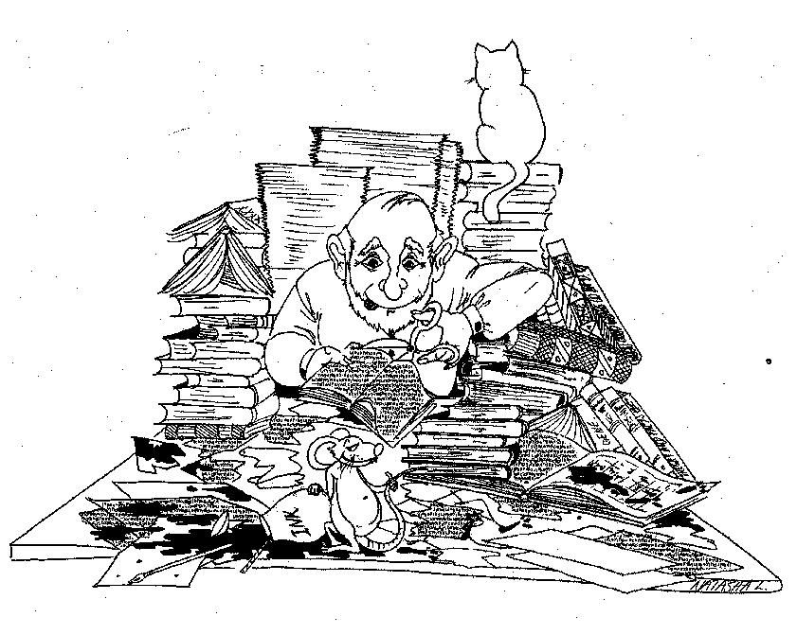
DNA Sequencing

Slide 69
OVERLAP GRAPH
Repeat
Repeat
Repeat
Finding a path visiting every NODE exactly once: Hamiltonian path problem

Slide 70
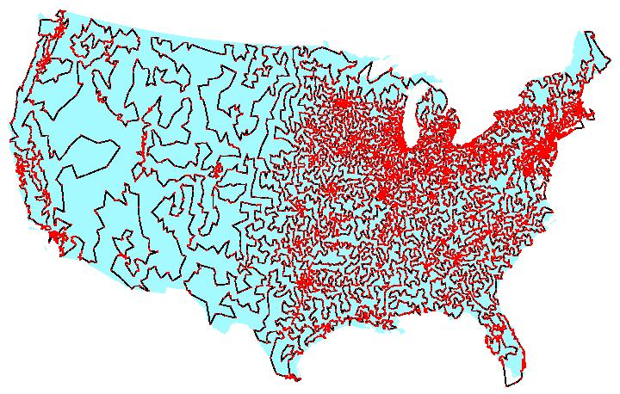
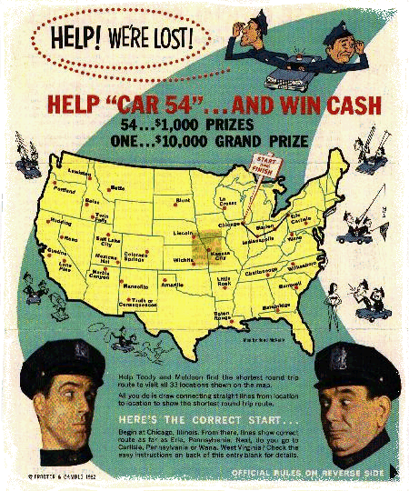
Traveling Salesman/Hamiltonian Cycle Problem

Slide 72
REPEAT GRAPH versus OVERLAP GRAPH
Repeat
Repeat
Repeat
Find a path visiting every EDGE exactly once:
Eulerian path problem (taking into account multiplicity of edges – red edge is visited 3 times)

Slide 73
REPEAT GRAPH
Repeat1
Repeat2
Repeat1
Repeat2

Slide 74
Fragment assembly: two approaches
Finding a path visiting every NODE exactly once in the OVERLAP graph:
Hamiltonian path problem (intractable)
Find a path visiting every EDGE exactly once in the REPEAT graph:
Eulerian path problem
Easy to Solve!

Slide 75
N. meningitidis: repeat graph

Slide 76
N. meningitidis: repeat graph

Slide 77
Repeat Graph vs. Unordered Contigs Generated by Traditional Assemblers
Notes:
Are you sure this is what you want to show?

Slide 78
P.P. et al., PNAS 2001, Genome Res., 2004

Slide 79
P.P. et al., PNAS 2001, Genome Res., 2004

Slide 80
P.P. et al., Proc. National Academy of Sciences 2001, Genome Res., 2004

Slide 81
NEWBLER (454 Life Sci.,06)
ALLPATHS, Genome Res.08 (Broad Inst.)
VELVET, Genome Res.08 (EBI)
ABySS, Genome Res.08
(UBC)
P.P. et al., PNAS 2001, Genome Res., 2004

Slide 82
The Eulerian approach works well for very accurate (nearly error free) reads but deteriorates for inaccurate reads

Slide 83
Overlap-Layout-Consensus: Major Challenge
Do two aligned reads really overlap, or are they from two copies of a repeat?
Solution: repeat masking – hide the repeats!!!

Slide 84
Overlap-Layout-Consensus: Major Challenge
Do two aligned reads really overlap, or are they from two copies of a repeat?
Solution: repeat masking – hide the repeats!!!

Slide 85
Repeat Graph: Major Challenge
If the DNA sequence is given, then construction of the repeat graph is a simple exercise.
Repeat1
Repeat2
Repeat1
Repeat2
?
However, we don’t have DNA sequence – we only have reads!
Problem: Construct the repeat graph from a collection of reads.
Notes:
Some de-bruijn info here

Slide 86
Overlapping Reads and Repeats
A k-mer that appears N times, initiates N² comparisons
For an Alu that appears 10⁶ times → 10¹² comparisons – too much
Solution:
Discard all k-mers that appear more than
t × Coverage, (t ~ 10)

Slide 87
Overlap-Layout-Consensus: Major Challenge
Do two aligned reads really overlap, or are they from two copies of a repeat?
Solution: repeat masking – hide the repeats???
More contigs, more work at the finishing step

Slide 88
Why the Overlap-Layout-Consensus Approach May Not Work for Short Reads.
Repeats shorter than read length are OK, repeats longer that read length should be masked
For read length 260 bp, 50% of the human genome may be masked (to deal with Alu and other repeats)
For read length below 100 bp, most of the genome will be masked
Short reads → short contigs → difficult to assemble

Slide 90
N. meningitidis sequencing project
Neisseria meningitidis genome
2.1 Mb long
Over 50,000 sequencing reads
Notes:
What does this wheel mean?

Slide 91
N. meningitidis: repeat graph

Slide 92
Repeat graph vs. unordered contigs
Notes:
Are you sure this is what you want to show?

Slide 93
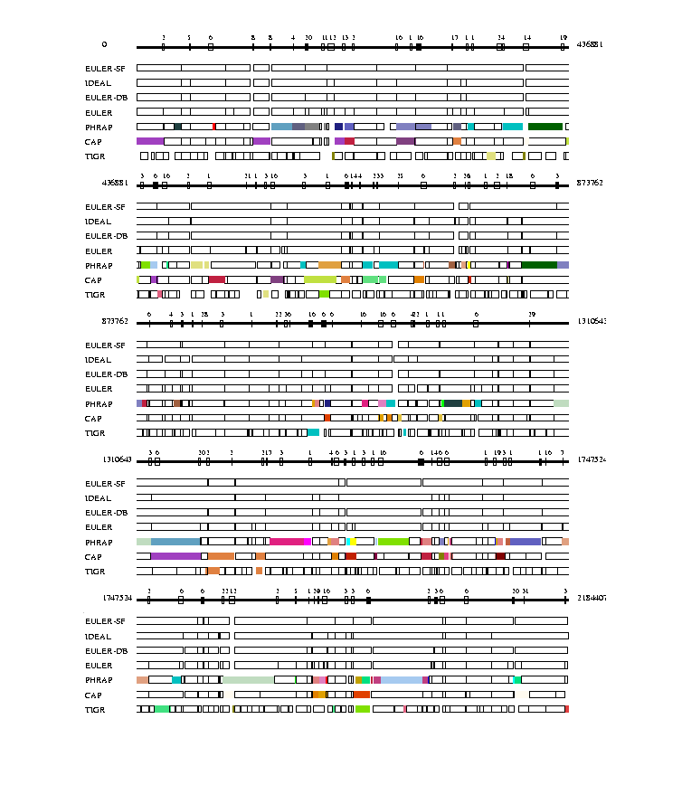
Comparative analysis of
EULER-SF, EULER-DB, EULER, Phrap, CAP and
TIGR assembler (Neisseria
Meningitidis).

Slide 94
Benchmarking of EULER, Phrap, CAP3, and TIGR assemblers (C. jejuni, N. meningitidis, and L. lactis sequencing projects)
 |  | IDEAL | EULER | Phrap | CAP | TIGR assembler
CJ | # of contigs | 24 | 29 | 33 | 54 | >300
 | # of misassembled contigs | - | 0 | 3 | 3 | 90.0%
 | Coverage of contigs | 99.5% | 96.7% | 94.0% | 92.4% | 1.2%
 | Coverage by misassembled contigs | - | 0.0% | 16.1% | 13.6% | 1.2%
NM | # of contigs | 79 | 149 | 160 | 163 | >300
 | # of misassembled contigs | - | 0 | 17 | 14 | 9
 | Coverage of contigs | 99.8% | 99.1% | 98.6% | 97.2% | 87.4%
 | Coverage by misassembled contigs | - | 0.0% | 10.5% | 9.2% | 1.3%
LL | # of contigs | 6 | 58 | 62 | 85 | 245
 | # of misassembled contigs | - | 0 | 10 | 8 | 2
 | Coverage of contigs | 99.9% | 99.1% | 97.6% | 97.0% | 90.4%
 | Coverage by misassembled contigs | - | 0.0% | 19.0% | 11.4% | 0.7%

Slide 95
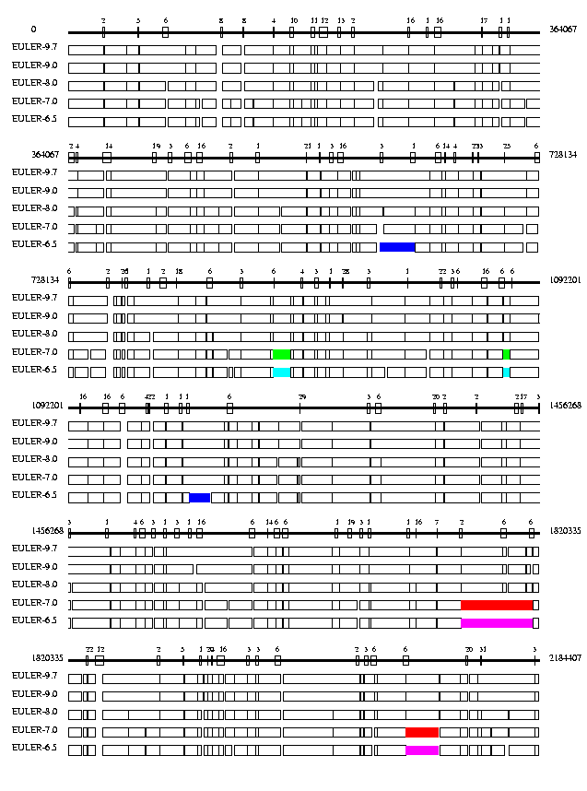
EULER’s performance with reduced coverage (NM sequencing project)

Slide 96
A Brief History of the Eulerian Approach to Fragment Assembly
Pevzner, 1989 – Eulerian approach for SBH - sequencing with very short reads (JBSD)
Idury and Waterman, 1995: Applied SBH to fragment assembly by transforming sequencing data into virtual DNA array data (JCB)
Pevzner, Tang, Waterman, 2001: Error correction idea results in the first practical Eulerian assembler (PNAS)
Pevzner, Tang, Tesler, 2004: EULER+ shown to outperform ARACHNE, Phrap, and Celera assemblers for BACS/bacterial genomes (Genome Research)
Chaisson, Tang, Pevzner, 2004 Short reads Eulerian assembler. (Bioinformatics)
Myers, 2005 Berkeley Open Assembler (BOA) is being developed as an Eulerian assembler (Bioinformatics)
Medvedev, Georgiou, Myers, Brudno, 2007 Decomposing Eulerian graph in direct and reverse strands (WABI)
Sundquist, Ronaghi, Tang, Pevzner, Batzoglou, 2007 Human genome can be assembled with short reads for $100,000 (PLOS 1)

Slide 97
Construction of the repeat graph: four ideas
Construction of the repeat graph from k-mers
Breaking reads into k-mers: transforming shotgun sequencing data into virtual DNA array data.
Error correction in reads: make reads (almost) error-free BEFORE the assembly even started.
Eulerian Superpath Problem: using reads and mate-pairs to simplify the repeat graph.
Pevzner. Tang, Waterman, PNAS 2001

Slide 98
Error Correction on 454 GS20 Reads
61.3
61.3
99.0
68.7
68.0
99.6
`

Slide 99
Comparison of Euler and Newbler Assemblies
Genome | Assembler | No. contigs | N50 | Misassembled | Coverage | Net size
E. coli | Euler | 199 | 468876 | 3 | 94.7 | 4277
 | Newbler | 141 | 60757 | 0 | 99.1 | 4531
 | Repeat graph | 94 | 125693 | - | 92.1 | 4560
S. pneumoniae | Euler | 127 | 32619 | 1 | 96.8 | 2001
 | Newbler | 253 | 11905 | 0 | 95.0 | 2000
 | Repeat graph | 136 | 36004 | - | 97.5 | 2091

Slide 100
454 Reads+Sanger Reads
Sanger coverage

Slide 101
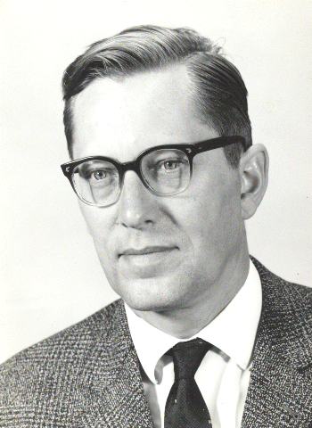
Eulerian Approach to Fragment Assembly: de Bruijn Graphs
Set of k-mers = {ATG TGG TGC GTG GGC GCA GCG CGT}
ATG
TGG
TGC
GTG
GGC
GCA
GCG
CGT
(k-1)-mers: {AT TG GT GG GC CA GT}
GT
CG
AT
TG
GC
CA
GG
Vertices: (k-1)-mers
Edges: k-mers

Slide 102
Eulerian Approach to Fragment Assembly: de Bruijn Graphs
Set of k-mers:= {ATG TGG TGC GTG GGC GCA GCG CGT}
Vertices: (k-1)-mers
Edges: k-mers from the spectrum
GT
CG
AT
TG
GC
CA
GT
CG
GG
GT
CG
AT
TG
GC
AT
TG
GC
CA
CA
GG
GG
ATGGCGTGCA
ATGCGTGGCA
Paths visiting ALL EDGES correspond to sequence reconstruction

Slide 103
Construction of the repeat graph: four ideas
Construction of the repeat graph from k-mers
Breaking reads into k-mers: transforming shotgun sequencing data into virtual DNA array data.
Error correction in reads: make reads (almost) error-free BEFORE the assembly even started.
Eulerian Superpath Problem: using reads and mate-pairs to simplify the repeat graph.

Slide 104
SBH approach to fragment assembly (Idury & Waterman 1995)
De Bruijn graph
Vertices: (k-1)-mers in each read
Edges: k-mers in each read

Slide 105
Breaking puzzle into smaller pieces: advantages
At the first glance breaking puzzle into smaller pieces is a very short-sighted procedure since information about the sequencing reads is lost.
However, the loss of information is minimal and is well paid for by the computational advantages of the Eulerian path approach.
Not to mention that the lost information can be easily restored at the later stages.

Slide 106
Construction of the repeat graph: four ideas
Construction of the repeat graph from k-mers
Breaking reads into k-mers: transforming shotgun sequencing data into virtual DNA array data.
Error correction in reads: make reads (almost) error-free BEFORE the assembly even started.
Eulerian Superpath Problem: using reads and mate-pairs to simplify the repeat graph.

Slide 107
Breaking puzzle into smaller pieces: problems
The SBH approach to the construction of the repeat graph works for error-free data but fails for data with errors.
The sequencing errors transform the repeat graph into a tangle of erroneous edges.

Slide 108

Error correction in reads: catch-22
The Eulerian approach works well for error-free reads but quickly deteriorates even for reads with low error rates (1%).
To assemble a genome we need to correct errors in reads first.
But to correct errors in reads one has to assemble the genome first!
Can we correct sequencing errors if the genome is unknown, before the assembly started?
Result: 50 fold reduction in sequencing errors PRIOR TO ASSEMBLY makes reads almost as accurate as the finished sequence (P.P. et al., PNAS 2001).
Similar Spectrum Alignment approach (in a different context) was proposed in Peer&Shamir, RECOMB 01,PNAS 02. It is now used in nearly all assembly tools.

Slide 109
Error correction in reads: bypassing catch-22
Problem: Given a read with sequencing errors, correct errors in the read before
assembly starts.
Pevzner, Tang, Waterman (PNAS 2001): 50 fold reduction in
sequencing errors even before the assembly started (makes
reads almost as accurate as the finished sequence).

Slide 110
Error correction
A
assembled DNA sequence
read
T
Do we need the entire DNA sequence to correct a single AT sequencing error?
A
read
T
A
A
A
A
read
T
A

Slide 111
Error Correction Problem
Given a collection of reads S and a parameter δ, introduce up to δ corrections in each read in S with the goal to minimize the number of different l-mers in S.

Slide 112
Comparison of the performance of different software tools plus EULER error correction (NM sequencing project)
 |  | Phrap | CAP | TIGR assembler
Without EULER | # of contigs | 160 | 163 | >300
 | # of misassembled contigs | 17 | 14 | 9
 | Coverage of contigs | 98.6% | 97.2% | 87.4%
 | Coverage by misassembled contigs | 10.5% | 9.2% | 1.3%
With EULER | # of contigs | 145 | 151 | 191
 | # of misassembled contigs | 7 | 4 | 2
 | Coverage of contigs | 97.9% | 95.5% | 94.5%
 | Coverage by misassembled contigs | 4.2% | 2.9% | 0.8%

Slide 113
Construction of the repeat graph: four ideas
Construction of the repeat graph from k-mers
Breaking reads into k-mers: transforming shotgun sequencing data into virtual DNA array data.
Error correction in reads: make reads (almost) error-free BEFORE the assembly even started.
Eulerian Superpath Problem: using reads and mate-pairs to simplify the repeat graph.

Slide 114
Assembling Error-Free Reads
EULER assembler faces an easy-to-solve Eulerian Path Problem with the following complication:
Algorithmic complication: restore read information that was lost after the puzzle was broken into pieces.

Slide 115
Eulerian Superpath Problem
Repeat
Repeat
Repeat
reads

Slide 116
Eulerian Superpath Problem
Given an Eulerian graph and a collection of (read) paths in the graph, find an Eulerian path that contains all these paths as subpaths.

Slide 117
Solving Eulerian Superpath Problem: Equivalent Transformations
Simplify the system of paths with the goal of transforming the Eulerian Superpath Problem into the Eulerian Path Problem.
Equivalent transformation of the repeat graph: there exists a one-to-one correspondence between Eulerian superpaths before and after the transformation
Make a series of equivalent transformations
that reduce every read path in the repeat graph to a single edge in the transformed graph

Slide 118
Eulerian assembly with mate-pairs
EULER does not mask repeats and analyzes mate-pairs with an approach that is very different from the conventional approach.
EULER transforms MATE-PAIRS:
“read1 - GAP of length d - read2”
into MATE-READS:
“read1 - DNA SEQUENCE of length d – read2”

Slide 119
Transforming mate-pairs into mate-reads
A
R
B
R
A’
B’
R
R
R

Slide 120
EULER: Increasing the effective read length.
EULER provides an algorithmic shortcut for the still unsolved experimental problem of increasing read length.
Assuming that the insert length in 5000 bp, EULER provides a tenfold increase in the effective length of reads (from 500 to 5000 bp).
Since EULER does not mask repeats, a significantly larger portion of mate-pairs can be transformed into mate-reads as compared to other assemblers.

Slide 121

Repeat graph before and after Euler-DB: N. Meningitidis sequencing project

Slide 122
Transforming mate-pairs into mate- paths: 3 cases
Clone length does not match the length of any path between the two ends.
Clone length matches the length of exactly one path between the two ends.
Clone length matches the length of more than one paths between the two ends.
A
A’
R₁
B
B’
R₂
C
C’

Slide 123
EULER-SF scaffolds gapped edges in the repeat graph
Notes:
Euler-SF title

Slide 124
EULER’s utilization of DB data
R₁
R₂
R₁
R₂
R₂
R₁
Notes:
Euler usage of DB data

Slide 125
N. meningitidis project: results
EULER-DB reduces the number of contigs from 149 to 91.
EULER-DB typically resolves all repeats except those that are longer than the clone length. In the NM project (with insert length up to 1800) EULER left only 5 unresolved tangles of length 3610, 3215, 2741, 2503, and 1831.
EULER-SF combines the 91 contigs into 60 scaffolds thus closing most gaps that are shorter than the insert length and further simplifying the finishing step.

Slide 126
Computing multiplicities of repeats
In genomes with complicated repeat structure, it may be impossible to derive the multiplicity of a repeat by analyzing only reads closely located to this repeat.
In some cases, information about reads thousands of nucleotides away from the repeat may be the only clue to infer its multiplicity.
The existing programs largely ignore this problem and often output every repeat as a single contig without trying to find its multiplicity.

Slide 127
Copy Number Problem and Kirchhoff Law
A
R
A’
B
R
B’
C
R
C’
D
R
D’
R₁
R₃
R₁
R₃
R₂
R₄
R₂
R₄
A
A
A’
A
A’
1
A’
1
B
1
2
B
B’
B
B’
R
2
B’
R
R
1
1
2
1
C
4
2
C
C’
C
C’
C’
1
D
1
D
D’
D
D’
D’
Kirchhoff law

Slide 128
Fragment of the repeat graph for N. Meningitidis project
Notes:
How does this differ from the previous graphs of NM?

Slide 129
Conclusion
The Celera assembler is a two-stage procedure that includes masking common repeats at the overlap-layout-consensus stage with further ordering of contigs via the double-barreled information.
EULER does not mask the repeats but instead provides a clear view of repeats in the genome. This feature provides new insights into using double-barreled data and computing repeat copy numbers.

Slide 130
EULER Team
UCSD
Haixu Tang and Glenn Tesler (project scientists)
Zufar Mulyukov (EULER-PCR)
Steffen Heber (EULER-EST)
Shaojie Zhang (EULER-Connect)
Degui Zhi (EULER-Repeat)
Jerry Greenberg, SDSC (EULER web portal)
USC
Michael Waterman
Ming Li
Xiaoman Li
Yu Zhang
FUNDING: NIH (NHGRI) and Anchorgen, Inc

Slide 131
Acknowledgements
Sanger Center: David Harper, Julian Parkhill
INRA, France: Alexei Sorokine
Integrated Genomics: Michael Fonstein, Eugene Goltsman
Washington University: Asif Chinwalla, Pat Minx
UCSC: Jim Kent
UCSD: Uri Keich, Sing-Hoi Sze

Slide 132

Sequencing in this Millennium

Slide 133
What other people think about EULER?
Jim Mullikin, who is in charge of fragment assembly at the Sanger Center, says after hearing Pevzner’s talk about the superiority of EULER, ``I had to prove it myself whether it was really something worthwhile or not.”…Though he hasn’t implemented the full set of Pevzner’s code, he has incorporated the Eulerian process into Sanger’s whole-genome shotgun assembly. ``It does produce very good quality consensus sequence” he says.
Genome Technology, September 2001

Slide 134
Error correction on short reads
Eulerian approach requires error-free reads (or nearly error-free reads).
Solution: perform error correction prior to assembly.
Methods to do this include:
Spectral Alignment (Pevzner & Tang, ISMB 2001)
ARACHNE (Batzoglou et al., Genome Research, 2002)
Defined nucleotide positions (Tammi, NAR 2003)
….

Slide 135
Spectral alignment
Spectral Alignment Problem:
Input: a set of l-mers T (spectrum),
a read R.
Output: a read R' that has minimum edit distance to R and is composed solely of l-mers from T.
For a fragment assembly project, define T to be a set of frequent l-mers, i.e. l-mers present in many reads.

Slide 136

Defining a threshold for l-tuple frequency

Slide 137
Spectral alignment
Pevzner & Tang 2001 approach for long reads:
find l-tuples in a read R that (i) similar to other frequent l-tuples and (ii) do not appear frequently in other reads, and find modifications that transform them into frequently occurring l-tuples.
Chaisson et al, 2004 approach for shorter reads:
use dynamic programming to align read R against spectrum T.
Allows for correction under higher error rates.
Similar to Resequencing by Hybridization (Shamir, PNAS 2002)

Slide 138
Spectral alignment algorithm
Align a prefix of string s against a spectrum T.
score(i,a) is the minimum edit distance to find i-prefix of s ending in l-tuple a such that the i-prefix is composed of l-tuples from T.
score(i,a) is implicitly infinite if a is not in T.

Slide 139



Dynamic programming recurrence
extension
deletion
insertion
Shift a by 1:
Concatenate X with a:

Slide 140
Dynamic programming matrix
Read R
Spectrum T

Slide 141



A visualization of the recurrence relation
Read
Spectrum
Solid lines add 1 to score, dashed 0.
(a) Values of a used to compute score(i,CG).
(b) Values of a for which score(i-1,GC) is used to compute.
(c) A cycle in which score(i,CG) is used to compute score(i,CG).
Following the cycle can only increase score(i,CG).

Slide 142
Error correction results
Results from simulated 120 bp reads from a random 25Kb sequence (fictitious), BAC 1 (NCBI accession AF394196) and BAC 2 (AC084390).
Bansal and Pevzner (2006) Further improvement using Bloom filters makes error correction time-efficient and practical for entire human genome (in preparation)

Slide 143
Eulerian Assembly: from de Bruijn to A-Bruijn Graphs
Pevzner, 1989 – Eulerian approach for SBH - sequencing with very short reads (JBSD)
Idury and Waterman, 1995 - Applied SBH to fragment assembly by transforming sequencing data into virtual DNA array data (JCB)
Pevzner, Tang, Waterman, 2001 - Error correction idea results in the first practical Eulerian assembler (PNAS)
Chaisson, Tang, Pevzner, 2004 - Short reads Eulerian assembler. (Bioinformatics)
Pevzner, Tang, Tesler, 2004 - EULER+ (Genome Research)
Myers, 2005 - Berkeley Open Assembler (BOA) proposed as an Eulerian assembler (Bioinformatics)
Medvedev, Georgiou, Myers, Brudno, 2007 - Decomposing Eulerian graph in direct and reverse strands (WABI)
Sundquist, Ronaghi, Tang, Pevzner, Batzoglou, 2007 - Short read assembly of mammalian genomes for $100,000 (PLOS 1)
Chaisson and Pevzner, 2007 - Nearly optimal short read assembly of bacterial genomes (Genome Res., 2008)

Slide 144






Acknowledgements
Rob Lipshutz, Affymetrix – SBH
Haixu Tang (Indiana), Mike Waterman (USC) – EULER assembler
Haixu Tang, Glenn Tesler (UCSD) - EULER+ assembler
Serafim Batzoglou (Stanford) – simulations of large assemblies with short reads
Ben Raphael (Brown) – reconstruction of cancer genomic architecture

Slide 145
Short-Read Assemblers
Euler 1.0 (Chaisson et al., 2004, Genome Research) the first short read assembler (developed before short read technologies became available)
454 Newbler (for 454 reads only)
SSAKE, SHARCGS –Do not allow errors in reads.
VCAKE (December 2007, Bioinformatics)– improvement of SSAKE to handle errors.
Euler-SR (February 2008, Genome Research) UCSD group
EDENA (March 2008, Genome Research)
ALLPATHS (March 2008, Genome Research) Broad
Velvet (submitted ) EBI

Slide 146
Why Illumina Short Reads Are So Short? (an “old” slide)
Illumina reads
First 30nt (prefixes) are accurate (error rate < 2%)
Sequencing reactions can be extended beyond 30 nt (even up to 100 nt) but the error rates becomes as high as 20%
Existing fragment assemblers cannot handle reads with more than 2% error rate
Reads are trimmed after 30nt
Short reads -> fragmented assembly
Human BAC 50 nt
E.Coli 35 nt

Slide 147

EULER-USR (Ultra Short Reads) assembler

Slide 148
Error Correcting (Rather than Trimming) Error-Prone Read Tails
Existing error correction algorithms deal with already rather accurate (1-2% error rate) reads and turn them into nearly error-free reads. However, they do not work at all for reads with 20% error rate.
Challenge: design error correction algorithm that can correct errors in reads with 20-30% error rate.
Solution: use repeat graphs to correct errors

Slide 149


Error Correction by Threading Reads Through the Repeat Graph
high quality
errors
Recover erroneous tails
of reads by finding an optimal path to
map the read to the repeat graph.

Slide 150
Error Correction Increases the Effective Length of Illumina Reads

Slide 151


EULER vs VELVET (E.Coli)
Benchmarking SSAKE, SHARCGS, VCAKE, EDENA, VELVET
total length of k longest contigs
k

Slide 152

EULER vs VELVET (human BAC): cumulative contig length
35nt Illumina reads
50nt Illumina reads (error-corrected by threading)

Slide 153
Fragment Assembly as Repeat Classification: from de Bruijn to A-Bruijn Graphs
IS30 repeat family in N. Meningtidis
Edge label: 130(2) means length 130bp and multiplicity 2

Slide 154
Mosaic structure of human segmental duplications: from de Bruijn to A-Bruijn Graphs
A
B
C
D
E
F
G
H
I
J
A
B
C
D
E
F
C
G
H
I
J
A
B
C
D
E
F
C
G
H
B
C
D
I
J
A
B
C
D
E
F
C
G
H
B
C
D
I
F
C
G
J
The mosaic structure of segmental duplications in human genome is reconstructed using the
A-Bruijn graph approach:
Jiang et al . Evolutionary reconstruction of human segmental duplications (Nature Genetics, 2007)

Slide 155
Algorithmic Challenge
Problem: given a string, find all repeat elements and reveal the sub-repeat mosaic structure.
Perfect repeats: de Bruijn graph, suffix tree.
Imperfect repeats: OPEN PROBLEM
The A-Bruijn graphs generalize the de Bruijn graphs for imperfect repeats (P.P. et al., Genome Res, 2004)

Slide 156
De Novo Repeat Classification: messy and ill-defined problem
Bao & Eddy 2002, Genome Research
“The problem of automated repeat sequence family classification is inherently messy and ill-defined and does not appear to be amenable to a clean algorithmic attack.”

Slide 157
De Novo Repeat Classification
All pairwise similarities
De novo repeat compilation
Pairwise similarity
?
Library of repeat elements
Repeat Element 1 AGCCTACG … …
Repeat Element 2 TGCATTTT … …
Repeat Element 3 GAACTCAC ……

Slide 158
Mosaic Structure of Repeats: (small region from human Y chromosome)
8328
140
628
1185
2905
628
1185
381
140
628
1185
381
140
628
161442
1
2
3
4
5
6
7
8
9
10
11
12
13
14
15
RECON (Bao and Eddy, 2002) does not reveal the mosaic: structure
?
2 copies
2 copies
A-Bruijn representation
3 copies
4 copies

Slide 159
Repeat Gluing (de Bruijn graph = Quotient space of all K-mers in the sequence)
x
y
y
y
y
x
x
y
x
y
y
y
x
x
y
x
y

Slide 160
Repeat Gluing (de Bruijn graph = Quotient space of all K-mers in the sequence)
gluing instruction
x
y
y
y
y
x
x
y
x
y
y
y
x
x
y
x
y

Slide 161
Similarity matrix
A
B
C
D
E
F
C
G
H
B
C
D
I
F
C
G
J

Slide 162
A
B
C
D
E
F
C
G
H
B
C
D
I
F
C
G
J
H
A
J
B
C
G
repeat graph
F
D
E
I
B
F
2 copies
2 copies
C
Sub-repeats:
edges in the
repeat
graph
4 copies
2 copies
2 copies
D
G

Slide 163
In reality, repeats are usually imperfect
8328
140
628
1185
2905
628
1185
381
140
628
1185
381
140
628
161442
1
2
3
4
5
6
7
8
9
10
11
12
13
14
15
… … AG-CCATCGACGTCACC … …
… … AGTGCCTCG-CGTCTCC … …

Slide 164
Similarity matrix
A
B
C
D
E
F
C
G
H
B
C
D
I
F
C
G
J

Slide 165
Repeat Gluing (A-Bruijn graph = Quotient space of all ALIGNED POSITIONS)
x
y
y
Consistent Gluing
x
x
Inconsistent Gluing
y
y
x

Slide 166
Challenge: Generalize the Notion of De Bruijn Graph for Imperfect Repeats
Input
a genomic sequence
all local pairwise alignments (pairs of aligned positions)
Output
repeat graph representing all repeats as a mosaic of sub-repeats

Slide 167
Repeat Graph
8328
140
628
1185
2905
628
1185
381
140
628
1185
381
140
628
161442
1
2
3
4
5
6
7
8
9
10
11
12
13
14
15
A-Bruijn graph
repeat graph
x
y
y
x

Slide 168
Simplifying A-Bruijn Graph
A-Bruijn graph
repeat graph

Slide 169
From A-Bruijn Graph to Repeat Graph: MSLG Problem
Maximum Subgraph with Large Girth (MSLG) Problem:
Input: a weighted graph and a parameter girth
Output: a maximum weight subgraph that does not contain short cycles, i. e. cycles of length less than girth.
Solution known only when the girth is infinite -- Maximum Spanning Tree Problem (maximum weight acyclic subgraph).

Slide 170
Maximum Spanning Tree Approximation to MSLG Problem

Slide 171
RepeatGluer Algorithm
A-Bruijn graph
Bulge and
whirl removal
Erosion
c
h
g
i
a
b
d
e
f
j
Zigzag path straightening
a
c
b
d,h
e,g,i
f,j

Slide 172
The Repeats Graph of N. meningitidis

Slide 173
A-Bruijn Graphs and Fragment Assembly
Genome
A
B
C
D
E
F
C
G
H
B
C
D
I
F
C
G
J
Reads
A
B
C
D
I
F
C
G
H
B
C
D
E
F
C
G
J
H
A
J
Every possible genome reconstruction corresponds to an Eulerian path in the repeat graph.
B
C
G
F
D
repeat graph
E
I

Slide 174
Fragment Assembly = Building Repeat Graph from Concatenated Reads
Theorem (PP et al., Genome. Res 04): The repeat graph built from concatenated (in an arbitrary order!) reads is identical to the repeat graph built from the genomic sequence if the reads “cover” the genomic sequence.

Slide 175
EULER Algorithm (outline)
Concatenate reads (in an arbitrary order) into a single sequence
Compute the similarity matrix for this concatenated sequence
Use this similarity matrix as a “glue” and apply MSLG algorithm to build the repeat graph with the A-Bruijn algorithm (in NGS applications, only k-mer based glues are practical).

Slide 176
EULER algorithm for NGS applications (Chaisson and PP, Genome Res., 2008)
de Bruijn step: Construct the de Bruijn graph of reads
A-Bruijn step: Remove bulges and whirls
Threading step: Thread each read through the resulting graph and form the consensus sequence from reads;
Mate-pair step: Utilize mate-pairs
Velvet, ALLPATHS, AbySS and other NGS de novo tools now use similar framework

Slide 177
DNA Sequencing with mate-pairs
genome
cut many times at random into equally sized fragments
Get mate-pairs: two reads from each fragment (separated by a fixed distance)
~50 bp
~50 bp

Slide 178
Even small increase in the read length improves the assembly quality (E.Coli)

Slide 179
EULER-USR: Intuition for a New Approach
Do not trim reads. Error-correct them!
1
Detecting accurate read
prefixes and correcting
errors within them
Spectral Alignment
read correction
+
Recover reads discarded
due to low coverage
Low coverage
dataset
+
yes
Second chance
assembly
no
2
Construct assembly
on read prefixes
Construct repeat
graph on k-mers
3
Fixing read suffixes
Thread reads
4
Repeat resolution
Construct repeat
graph on l-mers

Slide 180
Paths compatible with reads in the de Bruijn graph: (p R q) or (p R y)
p
x
p
x
p
x
G
C
A
R
R
A
R
T
G
C
T
q
y
q
y
q
y
Reads or mate-pairs define paths
(p R q) is likely the correct path path
(p R q) or (p R y) are possible

Slide 181

Repeat graphs on reads with errors

Slide 182
Overview of assembly with EULER-SR
0.1 Preprocess reads to remove errors.
0.2 The repeat graph is constructed from reads
1. The repeat graph is modified (simplified) through graph correction operations.
2. The repeat graph is transformed so that an Eulerian path may be found (the genome is assembled), or a simplified repeat structure is determined (with edges as contigs in the assembly).

Slide 183

Error correction in reads
Solution: Spectral Alignment Problem (SAP): Given a set of k-mers Spectrum representing all “correct” k-mers in the genome, find the minimum number of insertions, deletions, and mutations in a read r such that every k-mer in r is in Spectrum.
Spectrum may be approximated by all frequent k-mers in the set of reads (BLUE)
Count
Multiplicity

Slide 184
From Error Correction in Reads to Graph Correction
Short edge removal: source and sink edges shorter than a length threshold are removed.
Low coverage edge removal: remove an edge if the number of reads mapped to it is below the expected coverage.
Bulge removal: remove bulges through an approximation to the Maximum Subgraph with Large Girth problem (P.P., Tang, and Tesler, Genome Res. 2004) .

Slide 185
Nomenclature for cycles in de Bruijn graphs
BULGE: AN UNDIRECTED CYCLE
BASE MISCALLS,
INDELS
SHORT TANDEM
REPEATS
WHIRL: A DIRECTED CYCLE.

Slide 187

Heuristic solution to the MSLG problem
Create a maximal arborescence of the graph using the method of Chu, Liu, and Edwards.

Slide 188
Heuristic solution to the MSLG problem
Create a maximal arborescence of the graph using the method of Chu, Liu, and Edwards.
Add back edges if they create bulges (undirected cycles) of length greater than U.

Slide 189
Heuristic solution to the MSLG problem
Create a maximal arborescence of the graph using the method of Chu, Liu, and Edwards.
Add back edges if they create bulges (undirected cycles) of length greater than U.
Add back edges if they create whirls (directed cycles) of length greater than D.

Slide 190


Example of graph correction on 100 kb of S. pneumoniae sequenced by 454 GS20
Input: repeat graph on reads
425 Contigs
N50: 5Kb
Goal: repeat graph
on genome
- 71 contigs
N50: 20KB

Slide 191


Example of graph correction
AFTER SHORT EDGE REMOVAL
253 CONTIGS
N50: 12 Kb
AFTER BULGE
REMOVAL
53 CONTIGS
N50: 20 KB

Slide 192

E. coli assembly with 35 bp Illumina reads (N50 statistics with and without mate-pairs)
EULER-USR 19 KB
VELVET 16 KB
EULER-USR (Mate-Paired) 68 KB
VELVET (Mate-Paired) 48 KB

Slide 193

Assembly quality versus coverage

Slide 194
EULER-USR Assembler for Ultra Short Reads
Given a set of Illumina reads
1. Detect accurate read prefixes and correct errors within them using frequent k-mers (multiplicity m and higher).
2. Construct the repeat graph on error corrected prefixes using k-mers.
3. Thread entire reads through the repeat graph to extend the effective read length.
4. Construct the repeat graph (final assembly) on threaded reads using l-mers(l>k).
5. For low-coverage projects, we add an additional post-processing step that assembles the genomic regions with low coverage.
EULER-USR(k,m,l)
1
Detecting accurate read
prefixes and correcting
errors within them
Spectral Alignment
read correction
+
Recover reads discarded
due to low coverage
Low coverage
dataset
+
yes
Second chance
assembly
no
2
Construct assembly
on read prefixes
Construct repeat
graph on k-mers
3
Fixing read suffixes
Thread reads
4
Repeat resolution
Construct repeat
graph on l-mers

Slide 195
Threading: extending and correcting reads
_{(a)}
_{(b)}
_{(c)}
_{(d)}
path in the de Bruijn graph cutting point
prefix of mapped read selected path
suffix of mapped read position in the read different from the path
On the set of error corrected prefixes we build a repeat graph and extend or correct read prefixes according to the closest path found by mapping prefixes to the graph.
Reads with 2 very similar continuations are discarded

Slide 196
Threading summary

Slide 197
Number of gaps in final Assembly

Slide 198
Choise of k-mer size in the final assembly

Slide 199

Assembly Results for Human BAC

Slide 200
EULER-USR vs VELVET (human BAC) cumulative contigs length

Slide 201
Eulerian Assembly with Mate-Pairs
EULER transforms MATE-PAIRS:
“read1 - GAP of length d - read2”
into LONG MATE-READS:
“read1 - DNA SEQUENCE of length d – read2”
P.P. and Tang, ISMB 2001

Slide 202
Transforming Mate-Pairs into Mate-Reads
Repeat
Repeat
Repeat
Mate-pairs

Slide 203
Repeat Graph (in Difference from the Overlap Graph) Enables Easy Processing of Mate-pairs

Slide 204
Repeat graph before and after Transforming Mate-Pairs into Mate-Reads (Sanger Reads from N. Meningitidis)
P.P. and Tang, ISMB 2001

Slide 205
Complications in Transforming Mate-Pairs into Mate-Reads: Multiple Paths Matching the Distance Between Mate-Pairs
P.P. and Tang, ISMB 2001 described how to deal with such complications.
VELVET (Breadcrumb) and ALLPATHS described similar approaches aimed at short reads assemblies (using multiple mate-pairs to transform a single mate-pair into a mate-read)
A
A’
R₁
B
B’
R₂
C
C’

Slide 206
EULER’s Utilization of Mate-Pairs
R₁
R₂
R₁
R₂
R₂
R₁
Notes:
Euler usage of DB data

Slide 207
EULER with Mate-Pairs: Does the Read Length Matter?
EULER provides an algorithmic solution for the problem of increasing the read lengths.
Assuming that the read length is 50 bp and insert length in 300 bp, EULER generates mate-reads of length 300+50+50=400 bp.
If all mate-pairs are transformed into mate-reads then the read length does not matter! The thing that matters is
SPAN=InsertLength+2*ReadLength

Slide 208
EULER-USR with Mate-Pairs: Does the Read Length Matter?
EULER provides an algorithmic solution for the experimental problem of increasing read lengths.
Assuming that the read length is 50 bp and insert length in 300 bp, EULER generates mate-reads of length 300+50+50=400 bp.
If all mate-pairs are transformed into mate-reads then the read length almost does not matter! The thing that matters is
SPAN=InsertLength+2*ReadLength
But is it possible to transform mate-pairs into mate-reads with nearly 100% efficiency?

Slide 209
Read Length Does NOT Matter! (good news for short read technologies)
EULER-USR was run with simulated (and real) reads varying from 25nt to 100nt and fixed-length span SPAN=InsertLength+2*ReadLength=300 (E.Coli genome)
For read length 35, the efficiency is 98.8% and N50= 61K
For read length 100, the efficiency is 98.9% and N50=61K

Slide 210
BUT the Read Length Does Matter!
EULER-USR was run with simulated (and real) read length varying from 25nt to 100nt and fixed-length span InsertLength+2*ReadLength=300 (E.Coli genome)
For read length 35, the efficiency is 98.8% and N50= 61K
For read length 100, the efficiency is 98.9% and N50= 61K
BUT
for read length 25, the efficiency is 86.1% and N50= 41K

Slide 211
BUT Read Length Does Matter!
EULER-USR was run with simulated (and real) read length varying from 25nt to 100nt and fixed-length span InsertLength+2*ReadLength=300 (E.Coli genome)
For read length 35, the efficiency is 98.8% and N50= 61K
For read length 100, the efficiency is 98.9% and N50= 61K
For read length 25, the efficiency is 86.1% and N50= 41.3K
A small drop in read length results in a dramatic drop in efficiency and N50

Slide 212
BUT Read Length Does Matter!
EULER-USR was run with simulated (and real) read length varying from 30nt to 100nt and fixed-length span InsertLength+2*ReadLength=300 (E.Coli genome)
For read length 35, the efficiency is 98.8% and N50= 61K
For read length 100, the efficiency is 98.9% and N50= 61K
For read length 26, the efficiency is 86.1% and N50= 41.3K
A small drop in read length results in dramatic drop in efficiency and N50
30nt is a BREAKPOINT separating the assemblies when the read length DOES NOT MATTER from the assemblies when the read length MATTERS. For BACTERIAL (E.Coli) genome

Slide 213
Where is the Breakpoint for Assembling Yeast Genome? (bad news for Illumina, good news for 454)
EULER-USR was run with simulated (and real) read length varying from 30nt to 100nt and fixed-length span InsertLength+2*ReadLength=300 (E.Coli genome)
For read length 35, the efficiency is 98.8% and N50= 61K
For read length 100, the efficiency is 98.9% and N50= 61K
For read length 26, the efficiency is 86.1% and N50= 41.3K
A small drop in read length results in dramatic drop in efficiency and N50
45nt is a BREAKPOINT separating the assemblies when the read length DOES NOT MATTER from the assemblies when the read length MATTERS. For YEAST genome

Slide 214
OPEN PROBLEM: WHERE IS THE BREAKPOINT FOR MAMMALIAN GENOMES?

Slide 215
Mass-Spectral Assembly
Shotgun DNA sequencing for whole-genome assembly:
Randomly read small portions of the genome – reads
Find pairwise overlaps between reads
Assemble overlaps into long sequences - contigs
Can we also assemble spectra into whole-protein sequences?
Shotgun proteomics generate spectra of unknown peptides (short reads?)
Find spectral pairs formed by spectra from overlapping peptides (pairwise overlaps?)
Assemble overlapping spectra into long stretches of amino acid (contigs?)

Slide 216
Yet Another Problem
Given a large collection of MS/MS spectra from a sample with unknown proteins:
METAGENOMICS PROJECT?
…
…
de novo reconstruct all proteins in this sample

Slide 217

Spectral Assembly
Shotgun DNA sequencing for whole-genome assembly:
Randomly read small portions of the genome – reads
Find pairwise overlaps between reads
Assemble overlaps into long sequences - contigs
Can we also assemble spectra into whole-protein sequences?
Shotgun proteomics generates many spectra of overlapping peptides (short reads?)
We can find spectral pairs - pairs of spectra from overlapping peptides (pairwise overlaps?)
⇒ How can we assemble overlapping spectra into long amino acid contigs?

Slide 218

E Pluribus Unum
Main idea: use overlaps to assemble MS/MS spectra of overlapping peptides into contigs (similar to DNA fragment assembly)
Spectral Networks
C | S | E
C | S | E
C | S | E
C | S | E | A | N
C | S | E
Clustering
C | S⁺⁸ | E
Same peptide
Prefix/suffix
Modified/Unmodified
C | S | E
 | S | E | A | N
 |  | E | A | N | D | E | R
C | S | E
 | S | E | A | N
Partial-overlap
Assembly
Shotgun Protein Sequencing

Slide 219
Partial-overlap alignment
Peptide pair
AVTEVMA/TEVMAAH
1. Very similar to prefix/suffix pairs but
2. Here we allow 2 jumps: one at the start and another at the end (→).

Slide 220
Shotgun Protein Sequencing
Assembling MS/MS spectra from overlapping peptides into
protein sequences:
WSCILMEPKR
PEWSCILMEPK
WSCILMEPK
WSCILM⁺¹⁶EPK
Find pairwise spectral alignments
Construct multiple spectral alignments
Construct consensus spectrum
4. Determine the consensus sequence for all aligned spectra

Slide 221
Spectral Assembly via Overlap Graph

Slide 222

Spectral Assembly via Overlap Graph
Real samples contain modified peptides. Using an analogy with DNA sequencing, a modified peptide is not unlike a polymorphism. Integrating them into the assembly pipeline is not unlike DNA assembly of highly polymorphic genomes like sea squirt.
DIFFICULT ALGORITHMIC PROBLEM
Spectral alignment of
modified peptides

Slide 223
Alignment as Gluing Instructions: A-Bruijn Graphs
x
y
y
y
y
x
x
y
x
y
y
y
x
x
y
x
y
Pevzner et al (Genome Research, 2004) – efficient construction
of A-Bruijn graphs from noisy gluing instruction

Slide 224
Protein Sequencing with Eulerian Approach
Stage 1: Generate spectral pairs using approach in Bandeira et al., PNAS 2007
Stage 2: ‘Glue’ peaks in spectral pairs using approach in P.P. et al., Genome Res., 2004
Stage 3: Sequencing on the A-Bruijn graph using approach in Bandeira et al., MCP 2007

Slide 225
28 aa protein contig, 24 spectra
GRHSLFHPEDTGKVFKVSHSFPHPLYDMSLLKNRFLRPGDDSSHDLMLLR
50 amino acids long protein contig of 92 assembled spectra

Slide 226

Sequencing Snake Venoms
Venom dataset from western diamondback rattlesnake generated by Karl Clauser at Broad Institute
Mixture of ~30 proteins
Digestion with: trypsin, chymotrypsin, Asp-N, Glu-C

Slide 227

Sequencing Catrocollastatin
321 correct/ 11 incorrect amino acid calls
Longest contiguous stretch – 108 amino acids
→ Over 2100 amino acid reconstructed
→ Identified 15 SNP variants

Slide 228
Sequencing Antibodies (collaboration with Genentech antibody sequencing group)
Bandeira et al., Nature Biotech, 2008

Slide 229
Acknowledgements (short reads DNA sequencing)
Mark Chaisson
(now at Pacific Biosciences)
Dima Brinza
(now at Life Technologies)
Collaboration with Xiaohua Huang at UCSD Bioengineering (supported by NHGRI)
Collaborations with Joe Ecker lab at Salk (BAC sequencing data) and Illumina team (E.Coli sequencing data)

Slide 230
Acknowledgements (short reads DNA sequencing)
Mark Chaisson
Dumitru Brinza
Collaboration with Xiaohua Huang at UCSD Bioengineering (supported by NHGRI)
Collaborations with Joe Ecker lab at Salk (BAC sequencing data) and Illumina team (E.Coli sequencing data)

Slide 231



Acknowledgements (shotgun protein sequencing)
Nuno Bandeira Karl Clauser (Broad) Jennie Lill (Genentech)

Slide 232


Acknowledgements (sequencing non-ribosomal peptides)
Nuno Bandeira Julio Ng Pieter Dorrestein
(UCSD Pharmacy School)

Slide 233
Acknowledgements
Rob Lipshutz, Affymetrix – SBH
Haixu Tang (Indiana), Mike Waterman (USC) – EULER assembler
Haixu Tang, Glenn Tesler (UCSD) - EULER+ assembler
Serafim Batzoglou (Stanford) – large assemblies with short reads

