Slide 1
LIOUVILLE EQUATION and its mathematicaL and physical interpretations

Slide 2
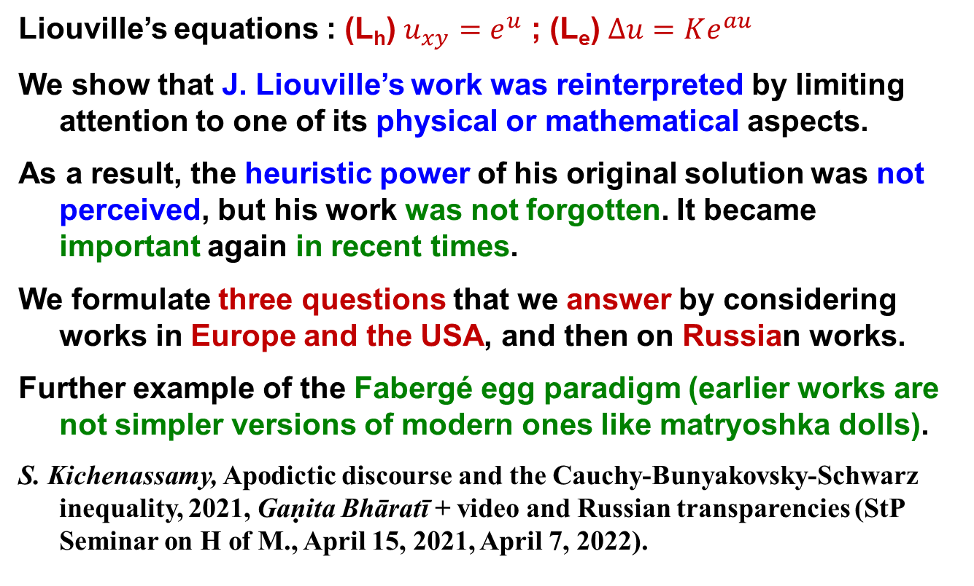
objectives
Liouville’s equations : (L_{h}) $u_{xy}=e^{u}$ ; (L_{e}) $Δu=Ke^{au}$
We show that J. Liouville’s work was reinterpreted by limiting attention to one of its physical or mathematical aspects.
As a result, the heuristic power of his original solution was not perceived, but his work was not forgotten. It became important again in recent times.
We formulate three questions that we answer by considering works in Europe and the USA, and then on Russian works.
Further example of the Fabergé egg paradigm (earlier works are not simpler versions of modern ones like matryoshka dolls).
S. Kichenassamy, Apodictic discourse and the Cauchy-Bunyakovsky-Schwarz inequality, 2021, Gaṇita Bhāratī + video and Russian transparencies (StP Seminar on H of M., April 15, 2021, April 7, 2022).

Slide 3
Outline
Liouville’s equations in Europe & the USA
The facts
Liouville’s paper and its impact in Europe & USA
Three questions & possible answers
Liouville’s equations in Russia
N.B.: Some of these results were announced in E.M.Bogatov & S.Kichenassamy, ИИЕТ РАН, 2021, pp. 81-86

Slide 4
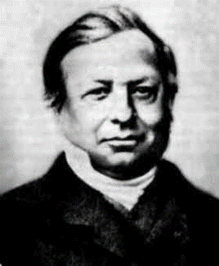
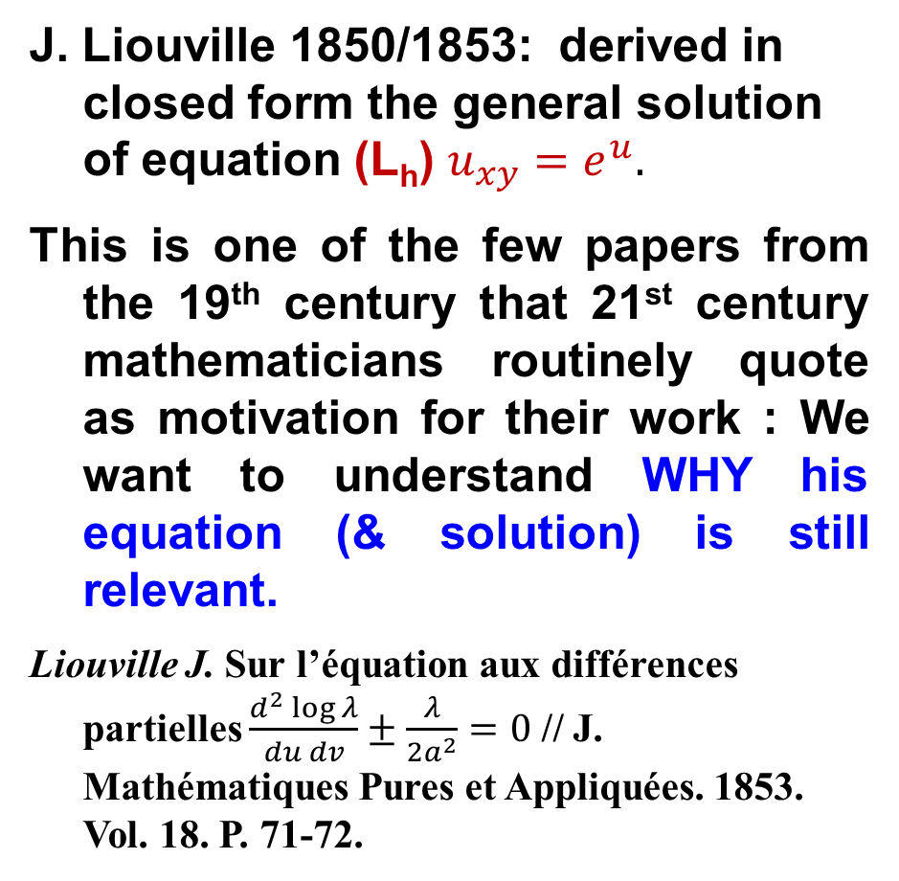
A. The facts
J. Liouville 1850/1853: derived in closed form the general solution of equation (L_{h}) $u_{xy}=e^{u}.$
This is one of the few papers from the 19th century that 21st century mathematicians routinely quote as motivation for their work : We want to understand WHY his equation (& solution) is still relevant.
Liouville J. Sur l’équation aux différences partielles $\frac{d^{2}\log{λ}}{du dv}±\frac{λ}{2a^{2}}=0$ // J. Mathématiques Pures et Appliquées. 1853. Vol. 18. P. 71-72.
Joseph Liouville

Slide 5
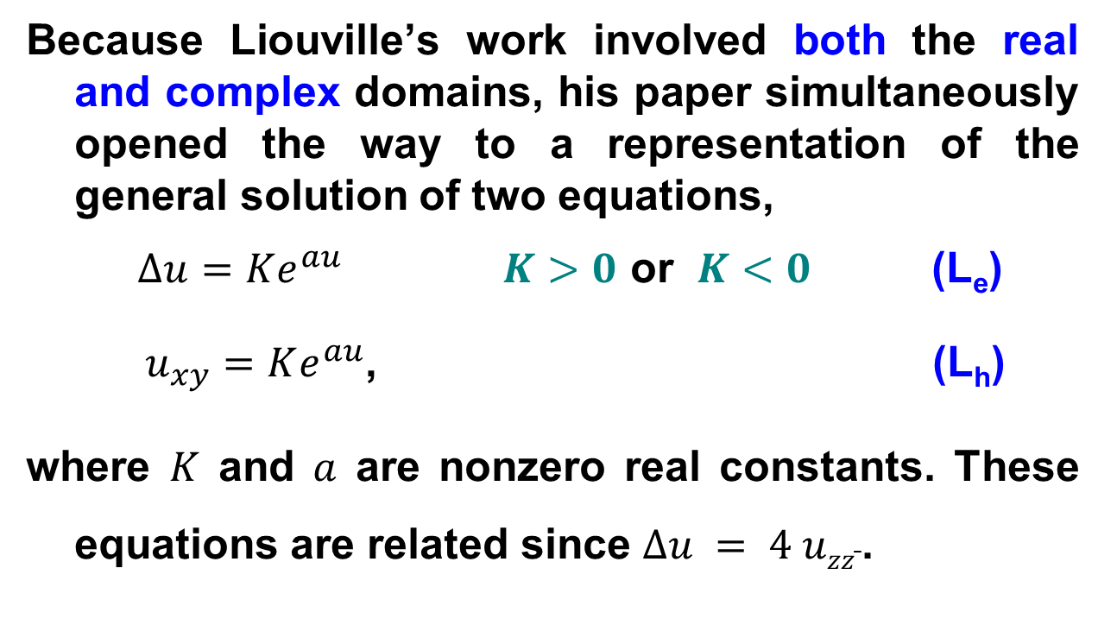
A. The facts
Because Liouville’s work involved both the real and complex domains, his paper simultaneously opened the way to a representation of the general solution of two equations,
$Δu=Ke^{au}$ $K>0$ or $K<0$ (L_{e})
$u_{xy}=Ke^{au}$, (L_{h})
where $K$ and $a$ are nonzero real constants. These equations are related since $Δu = 4 uzz ̄$.

Slide 6
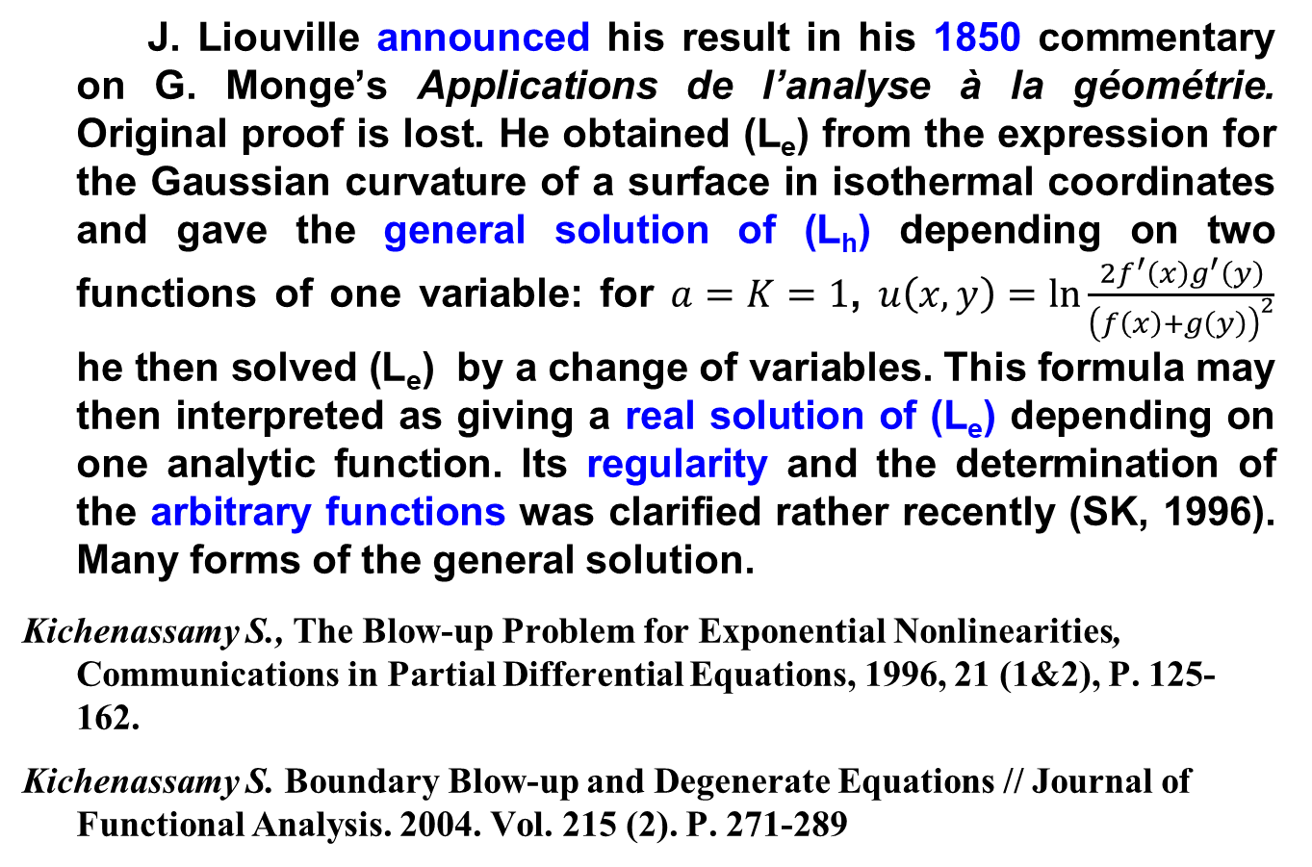
A. The facts
J. Liouville announced his result in his 1850 commentary on G. Monge’s Applications de l’analyse à la géométrie. Original proof is lost. He obtained (L_{e}) from the expression for the Gaussian curvature of a surface in isothermal coordinates and gave the general solution of (L_{h}) depending on two functions of one variable: for $a=K=1$, $u\left(x,y\right)=\ln{\frac{{2f}^{′}\left(x\right)g^{′}\left(y\right)}{{\left(f\left(x\right)+g\left(y\right)\right)}^{2}}}$ he then solved (L_{e}) by a change of variables. This formula may then interpreted as giving a real solution of (L_{e}) depending on one analytic function. Its regularity and the determination of the arbitrary functions was clarified rather recently (SK, 1996). Many forms of the general solution.
Kichenassamy S., The Blow-up Problem for Exponential Nonlinearities, Communications in Partial Differential Equations, 1996, 21 (1&2), P. 125-162.
Kichenassamy S. Boundary Blow-up and Degenerate Equations // Journal of Functional Analysis. 2004. Vol. 215 (2). P. 271-289

Slide 7
A. The facts
Nowdays: these equations are involved in at least five different mathematical problems
boundary-value pb. for (L_{e});
bifurcation for (L_{e});
boundary blow-up for (L_{e});
Cauchy pb. for (L_{h});
blow-up pb. for (L_{h}).
Liouville’s solution is the only link between these!

Slide 8
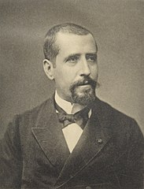
B. Liouville’s equation in Europe and the USA
G. Darboux (1870) called (L_{h}) Liouville’s equation. E. Picard (1890, etc.) gave the same name to (L_{e}).
E. Picard’s line of thought led to the boundary blow-up problem for (L_{e}), in relation to conformal mapping.
G. Darboux inserted (L_{h}) in a general theory of the solution of second-order PDEs in two variables, that was eventually reinterpreted within the theory of Bäcklund transformations.
Darboux G. Sur les équations aux dérivées partielles du second ordre // Ann. sci. de l’É.N.S., 1re série. 1870. Vol. 7. P. 163-173.
Gaston Darboux

Slide 9
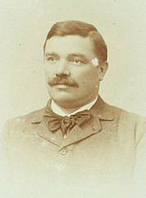
B. Liouville’s equation in Europe and the USA
Bianchi (1903) used J. Liouville’s solution to obtain a majorant series for the solution for what we now call the sine-Gordon equation. These lines of thought were apparently cut short by First World War, to be taken up again only after the birth of the theory of solitons.
Bianchi L. Lezioni di Geometria Differenziale, vol II, 2nd ed., Pisa, 1903. iv+594 p., see pp. 214-217.
Luigi Bianchi

Slide 10
Liouville’s paper: forgotten and rediscovered
Liouville’s solution was not lost because it was recorded in Bateman’s textbook (1932/1944), quoted by Witten (1977),
But the equation arose in other applications, without ref. to Liouville. Useful for hydrodynamics & astrophysics (Walker 1904,1915), thermoionic emission (von Laue, 1918; Richardson, 1921) etc.
Combustion: Frank-Kamenetski (1939) quoted by Harris (1940).
H. Bateman, P.D.E. of Math. Phys., (1923/1932/Dover, 1944) pp. 166-169.
O.W. Richardson, The Emission of Electricity from hot bodies, Longmans (1921), p. 50.
E.J. Harris, The thermal explosion of diethyl peroxide, Proc. Roy. Soc. A 175 (10 Apr. 1940) 254-261.

Slide 11
Liouville’s paper: forgotten and rediscovered
Equation (L_{e}), and its 3D counterpart arose as models for isothermal gas spheres in astrophysics, thermoionic emission, as a special model of incompressible fluid flow as well as other applications but usually without reference to Liouville.
J. Liouville’s exact solution attracted considerable interest in the late 70s as an exactly solvable model of field theory (E. Onofri, E. Witten), which seems to have led to a rediscovery of his paper (through Bateman?).
Further applications in the Russian school (part II).
Onofri E. An identity for T-ordered exponentials, with applications to Quantum Mechanics // Annals of Physics. 1976. Vol. 102. P. 371-387.
Witten E. Some exact multipseudoparticle solutions of classical Yang-Mills theory // Physical Review Letters. 1977. Vol. 38. P. 121-125.

Slide 12
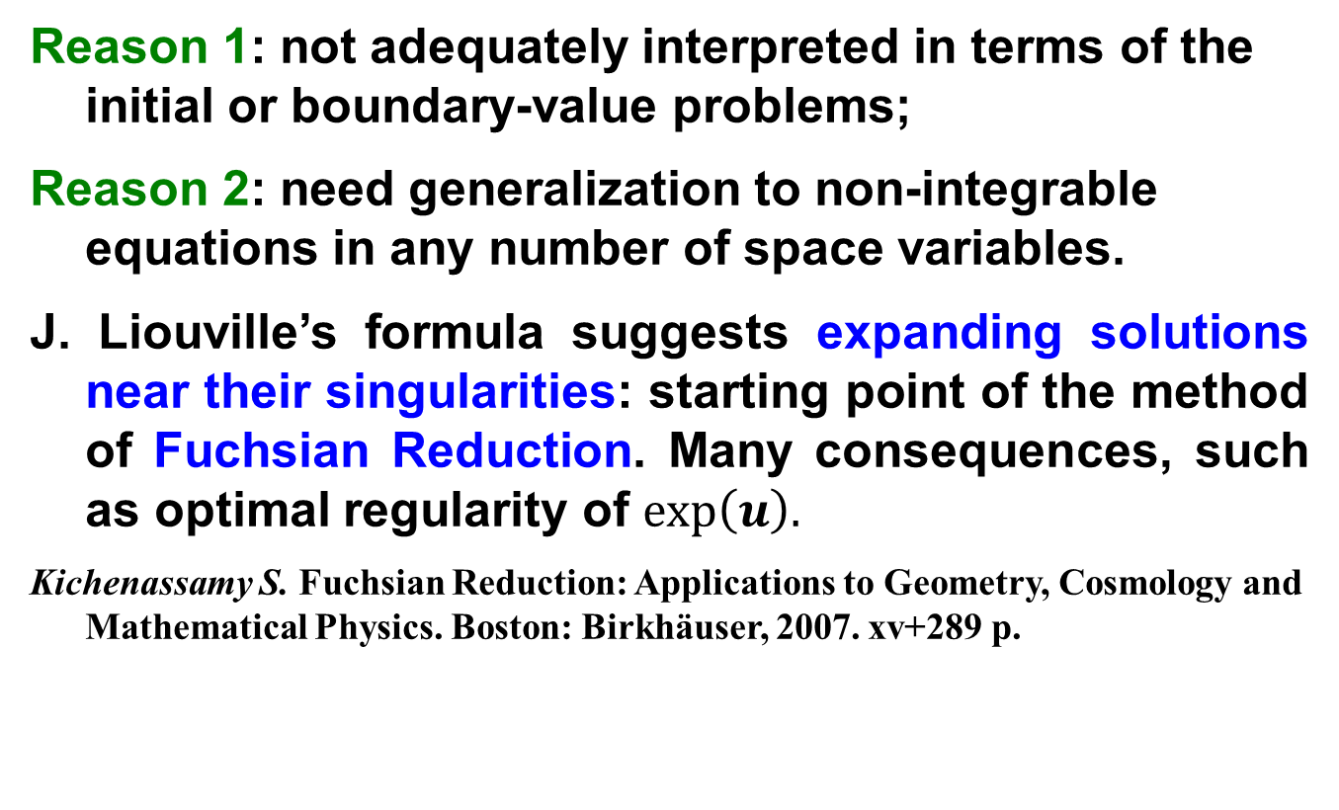
Liouville’s solution is still interesting
Reason 1: not adequately interpreted in terms of the initial or boundary-value problems;
Reason 2: need generalization to non-integrable equations in any number of space variables.
J. Liouville’s formula suggests expanding solutions near their singularities: starting point of the method of Fuchsian Reduction. Many consequences, such as optimal regularity of $exp\left(u\right).$
Kichenassamy S. Fuchsian Reduction: Applications to Geometry, Cosmology and Mathematical Physics. Boston: Birkhäuser, 2007. xv+289 p.

Slide 13
C. Three questions
First question : WHY is Liouville’s solution still relevant?
Liouville’s name was initially attached to both the hyperbolic and elliptic forms of the equation. Later, forgotten, then rediscovered.
Second question : WHY was it forgotten ?
Despite Liouville’s close relations with Russia, his equation was studied rather late in Russia.
Third question : WHY was the development in Russia/USSR different ?

Slide 14
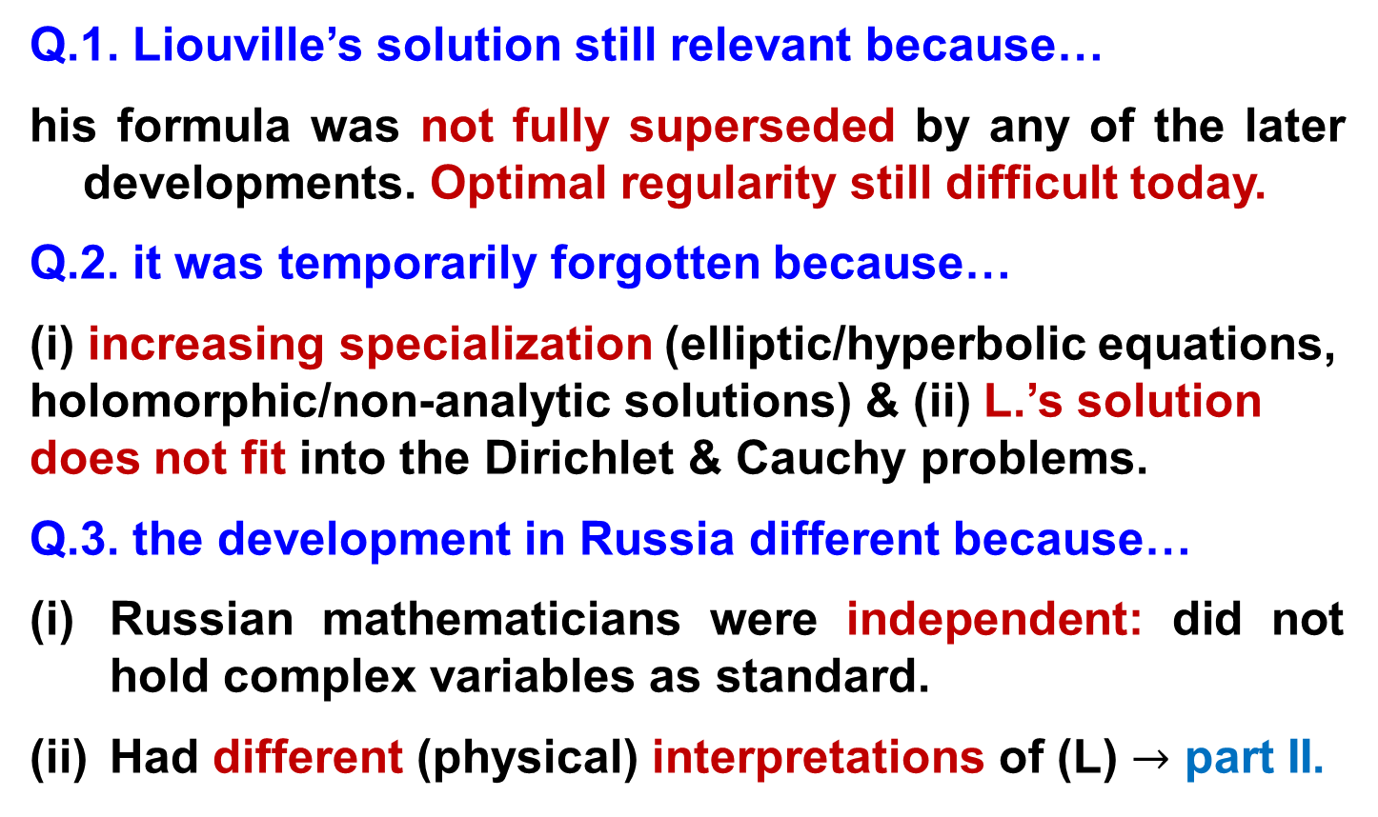
Possible answers to the three questions
Q.1. Liouville’s solution still relevant because…
his formula was not fully superseded by any of the later developments. Optimal regularity still difficult today.
Q.2. it was temporarily forgotten because…
(i) increasing specialization (elliptic/hyperbolic equations, holomorphic/non-analytic solutions) & (ii) L.’s solution does not fit into the Dirichlet & Cauchy problems.
Q.3. the development in Russia different because…
Russian mathematicians were independent: did not hold complex variables as standard.
Had different (physical) interpretations of (L) $→$ part II.

Slide 15
II. Liouville’s equation in Russia

