Slide 1
The isometrization of groups of homeomorphisms
Fredric Ancel
Moscow Geometric Topology Seminar, May 4, 2022

Slide 2
1. Definitions and Results

Slide 3
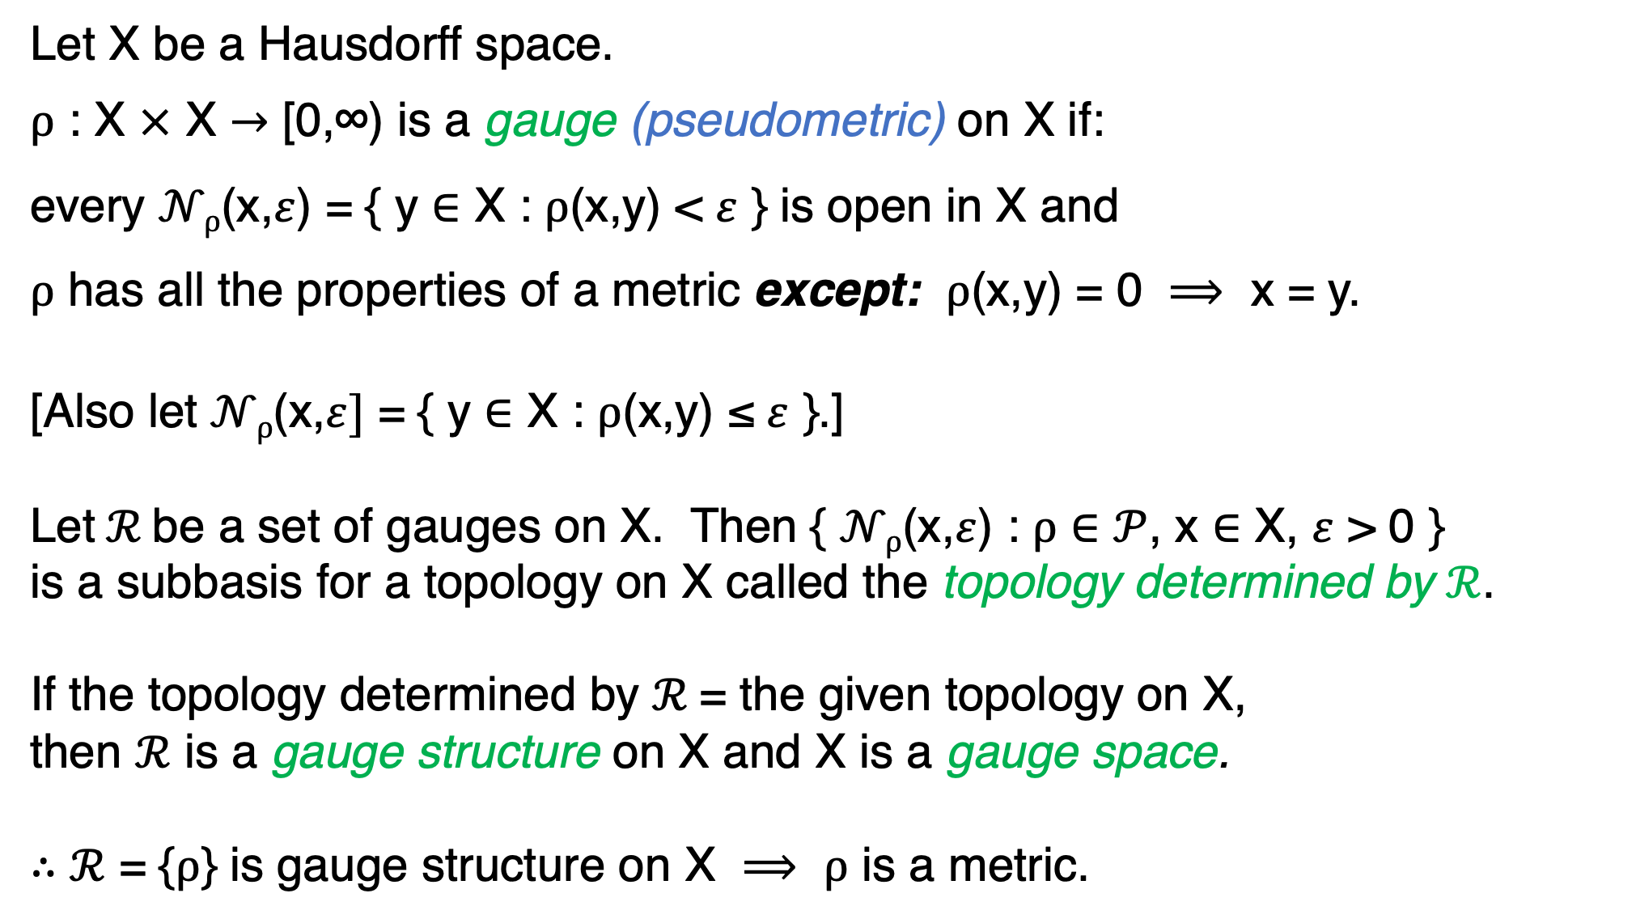
Let X be a Hausdorff space.
$ρ$ : X $×$ X $→$ [0,∞) is a gauge (pseudometric) on X if:
every $𝒩ρ$(x,$ε$) = { y $∈$ X : $ρ$(x,y) < $ε$ } is open in X and
$ρ$ has all the properties of a metric except: $ρ$(x,y) = 0 $⟹$ x = y.
[Also let $𝒩ρ$(x,$ε]$ = { y $∈$ X : $ρ$(x,y) ≤ $ε$ }.]
Let$ℛ$be a set of gauges on X. Then { $𝒩ρ$(x,$ε$) : $ρ$ $∈$ $𝒫$, x $∈$ X, $ε$ > 0 }
is a subbasis for a topology on X called the topology determined by $ℛ$.
If the topology determined by $ℛ$= the given topology on X,
then $ℛ$ is a gauge structure on X and X is a gauge space.
$∴$ $ℛ$ = {$ρ$} is gauge structure on X $⟹$ $ρ$ is a metric.

Slide 4
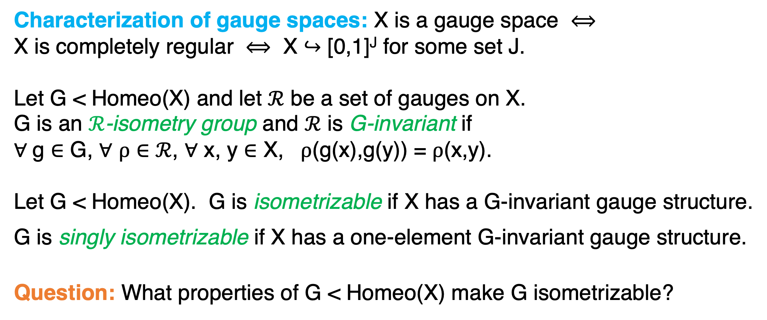
Characterization of gauge spaces: X is a gauge space $⟺$
X is completely regular $⟺$ X $↪$ [0,1]^{J} for some set J.
Let G < Homeo(X) and let $ℛ$ be a set of gauges on X.
G is an $ℛ$-isometry group and $ℛ$ is G-invariant if
$∀$ g $∈$ G, $∀$ $ρ$ $∈$ $ℛ$, $∀$ x, y $∈$ X, $ρ$(g(x),g(y)) = $ρ$(x,y).
Let G < Homeo(X). G is isometrizable if X has a G-invariant gauge structure.
G is singly isometrizable if X has a one-element G-invariant gauge structure.
Question: What properties of G < Homeo(X) make G isometrizable?

Slide 5
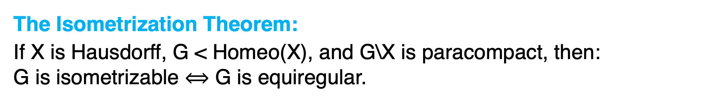
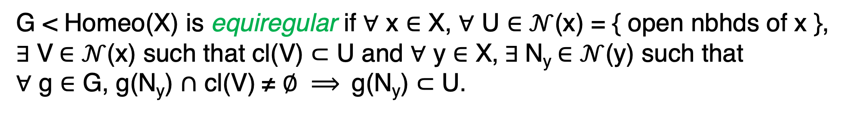
G < Homeo(X) is equiregular if $∀$ x $∈$ X, $∀$ U $∈$ $𝒩$(x) = { open nbhds of x },
$∃$ V $∈$ $𝒩$(x) such that cl(V) $⊂$ U and $∀$ y $∈$ X, $∃$ N_{y} $∈$ $𝒩$(y) such that
$∀$ g $∈$ G, g(N_{y}) $∩$ cl(V) ≠ $∅ ⟹$ g(N_{y}) $⊂$ U.
U
N_{y}
V
g(N_{y})
y
x
g′(N_{y})
The Isometrization Theorem:
If X is Hausdorff, G < Homeo(X), and G\X is paracompact, then:
G is isometrizable $⟺$ G is equiregular.

Slide 6
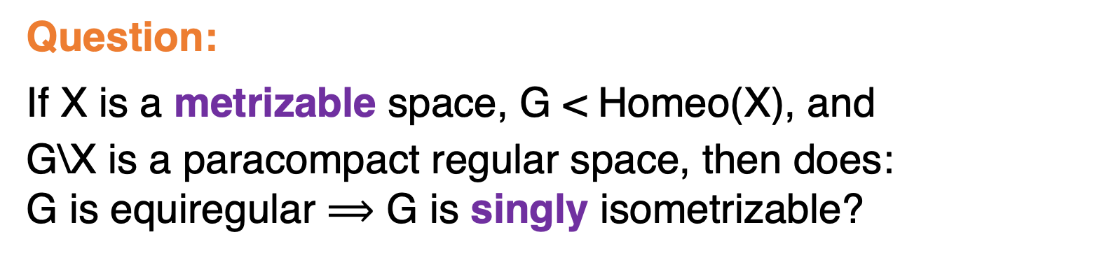
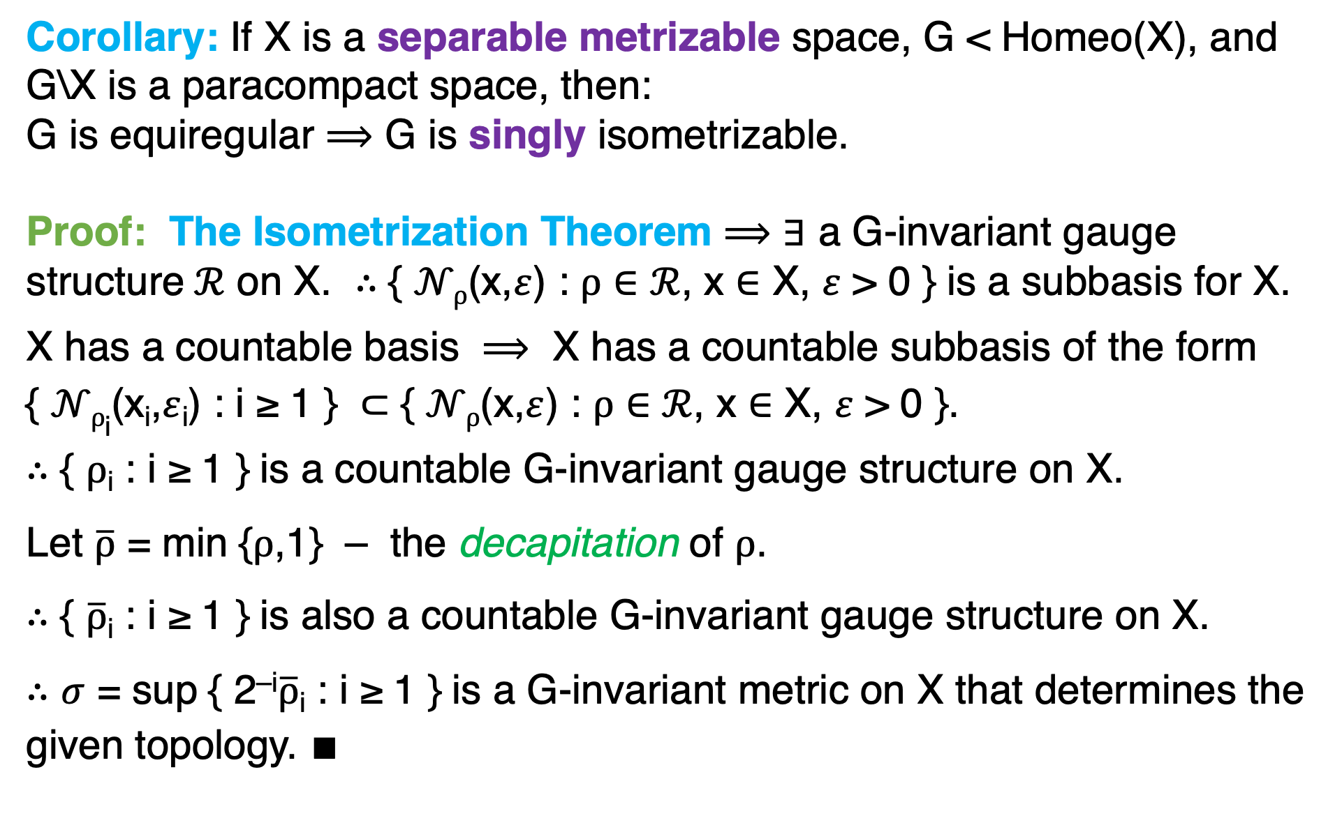
Corollary: If X is a separable metrizable space, G < Homeo(X), and
G\X is a paracompact space, then:
G is equiregular $⟹$ G is singly isometrizable.
Proof: The Isometrization Theorem $⟹$ $∃$ a G-invariant gauge
structure $ℛ$ on X. $∴$ { $𝒩ρ$(x,$ε$) : $ρ$ $∈$ $ℛ$, x $∈$ X, $ε$ > 0 } is a subbasis for X.
X has a countable basis $⟹$ X has a countable subbasis of the form
{ $𝒩ρ$_{i}(x_{i},$ε$_{i}) : i ≥ 1 } $⊂$ { $𝒩ρ$(x,$ε$) : $ρ$ $∈$ $ℛ$, x $∈$ X, $ε$ > 0 }.
$∴$ { $ρ$_{i} : i ≥ 1 } is a countable G-invariant gauge structure on X.
Let $\overline{ρ}$ = min {$ρ$,1} – the decapitation of $ρ$.
$∴$ { $\overline{ρ}$_{i} : i ≥ 1 } is also a countable G-invariant gauge structure on X.
$∴$ $σ$ = sup { 2^{–i}$\overline{ρ}$_{i} : i ≥ 1 } is a G-invariant metric on X that determines the
given topology. $∎$
Question:
If X is a metrizable space, G < Homeo(X), and
G\X is a paracompact regular space, then does:
G is equiregular $⟹$ G is singly isometrizable?

Slide 7
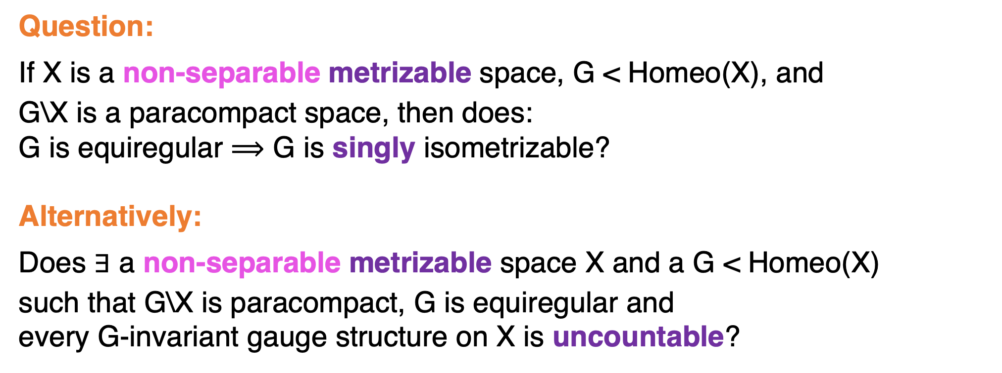
Question:
If X is a non-separable metrizable space, G < Homeo(X), and
G\X is a paracompact space, then does:
G is equiregular $⟹$ G is singly isometrizable?
Alternatively:
Does $∃$ a non-separable metrizable space X and a G < Homeo(X)
such that G\X is paracompact, G is equiregular and
every G-invariant gauge structure on X is uncountable?

Slide 8
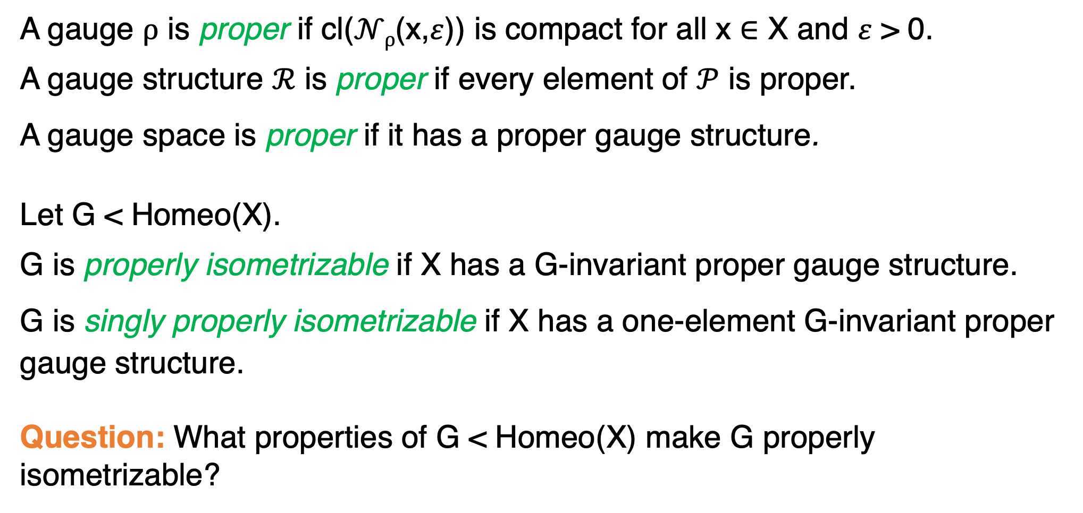
A gauge $ρ$ is proper if cl($𝒩ρ$(x,$ε$)) is compact for all x $∈$ X and $ε$ > 0.
A gauge structure $ℛ$ is proper if every element of $𝒫$ is proper.
A gauge space is proper if it has a proper gauge structure.
Let G < Homeo(X).
G is properly isometrizable if X has a G-invariant proper gauge structure.
G is singly properly isometrizable if X has a one-element G-invariant proper
gauge structure.
Question: What properties of G < Homeo(X) make G properly isometrizable?

Slide 9
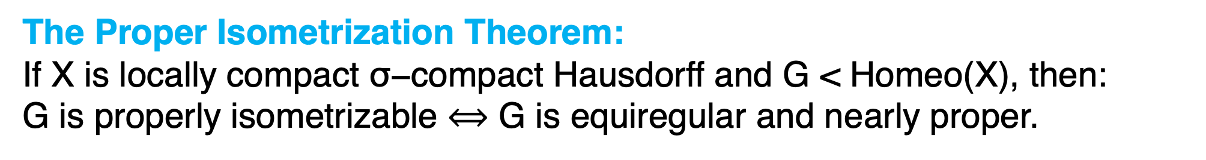
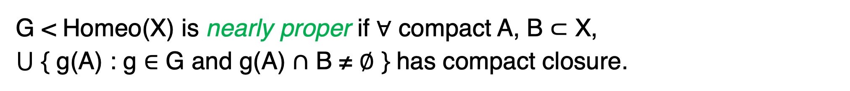
G < Homeo(X) is nearly proper if $∀$ compact A, B $⊂$ X,
$⋃$ { g(A) : g $∈$ G and g(A) $∩$ B ≠ $∅$ } has compact closure.
g(A)
g′′(A)
compact
A
B
g′(A)
The Proper Isometrization Theorem:
If X is locally compact $\text{σ}\text{−}\text{compact}$Hausdorff and G < Homeo(X), then:
G is properly isometrizable $⟺$ G is equiregular and nearly proper.

Slide 10
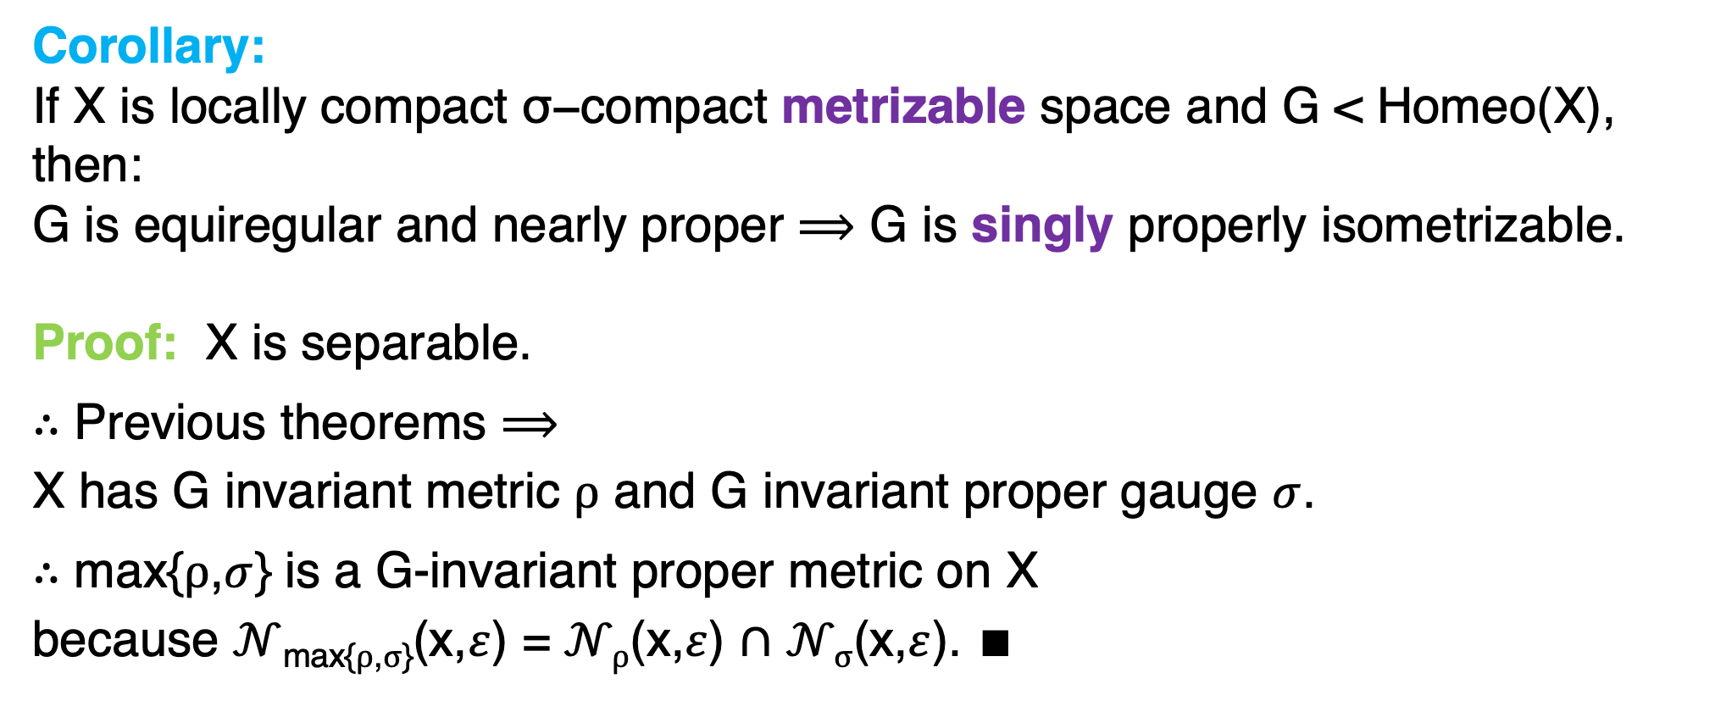
Corollary:
If X is locally compact $\text{σ}\text{−}\text{compact}$ metrizable space and G < Homeo(X), then:
G is equiregular and nearly proper $⟹$ G is singly properly isometrizable.
Proof: X is separable.
$∴$ Previous theorems $⟹$
X has G invariant metric $ρ$ and G invariant proper gauge $σ$.
$∴$ max{$ρ$,$σ$} is a G-invariant proper metric on X
because $𝒩$_{max{}$ρ$,$σ$}(x,$ε$) = $𝒩ρ$(x,$ε$) $∩$ $𝒩σ$(x,$ε$). $∎$

Slide 11
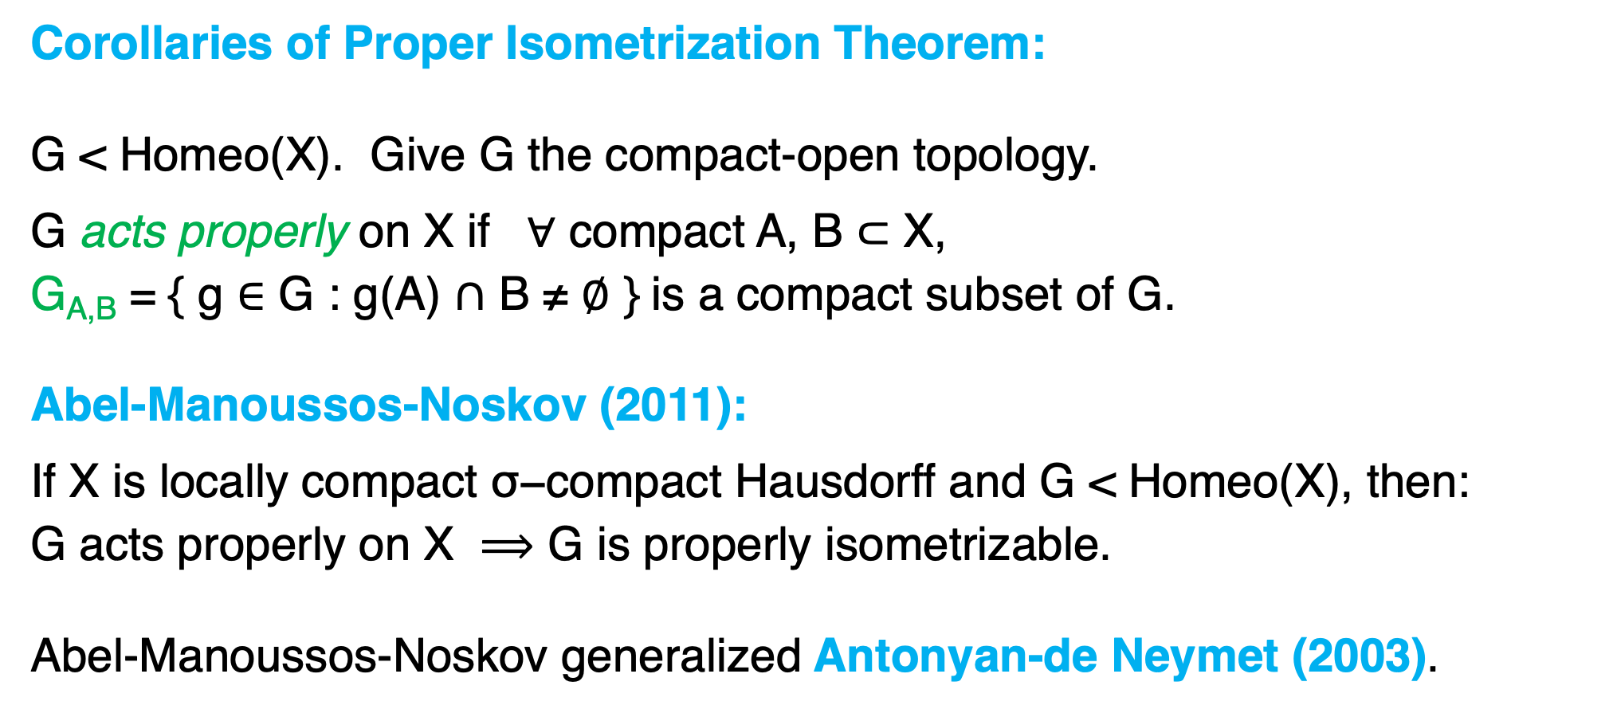
Corollaries of Proper Isometrization Theorem:
G < Homeo(X). Give G the compact-open topology.
G acts properly on X if $∀$ compact A, B $⊂$ X,
G_{A,B} = { g $∈$ G : g(A) $∩$ B ≠ $∅$ } is a compact subset of G.
Abel-Manoussos-Noskov (2011):
If X is locally compact $\text{σ}\text{−}\text{compact}$Hausdorff and G < Homeo(X), $\text{then}\text{:}$
$$\text{G} \text{acts} \text{properly} \text{on} \text{X} ⟹\text{G} \text{is} \text{properly} \text{isometrizable}\text{.}$$
Abel-Manoussos-Noskov generalized Antonyan-de Neymet (2003).

Slide 12
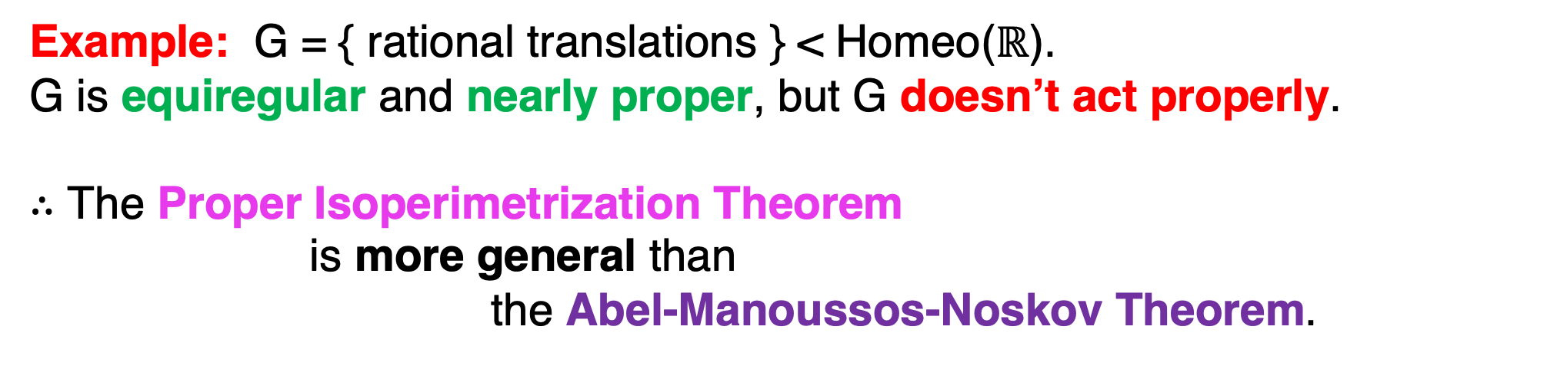
Example: G = { rational translations } < Homeo($ℝ$).
G is equiregular and nearly proper, but G doesn’t act properly.
$∴$ The Proper Isoperimetrization Theorem
is more general than
the Abel-Manoussos-Noskov Theorem.

Slide 13
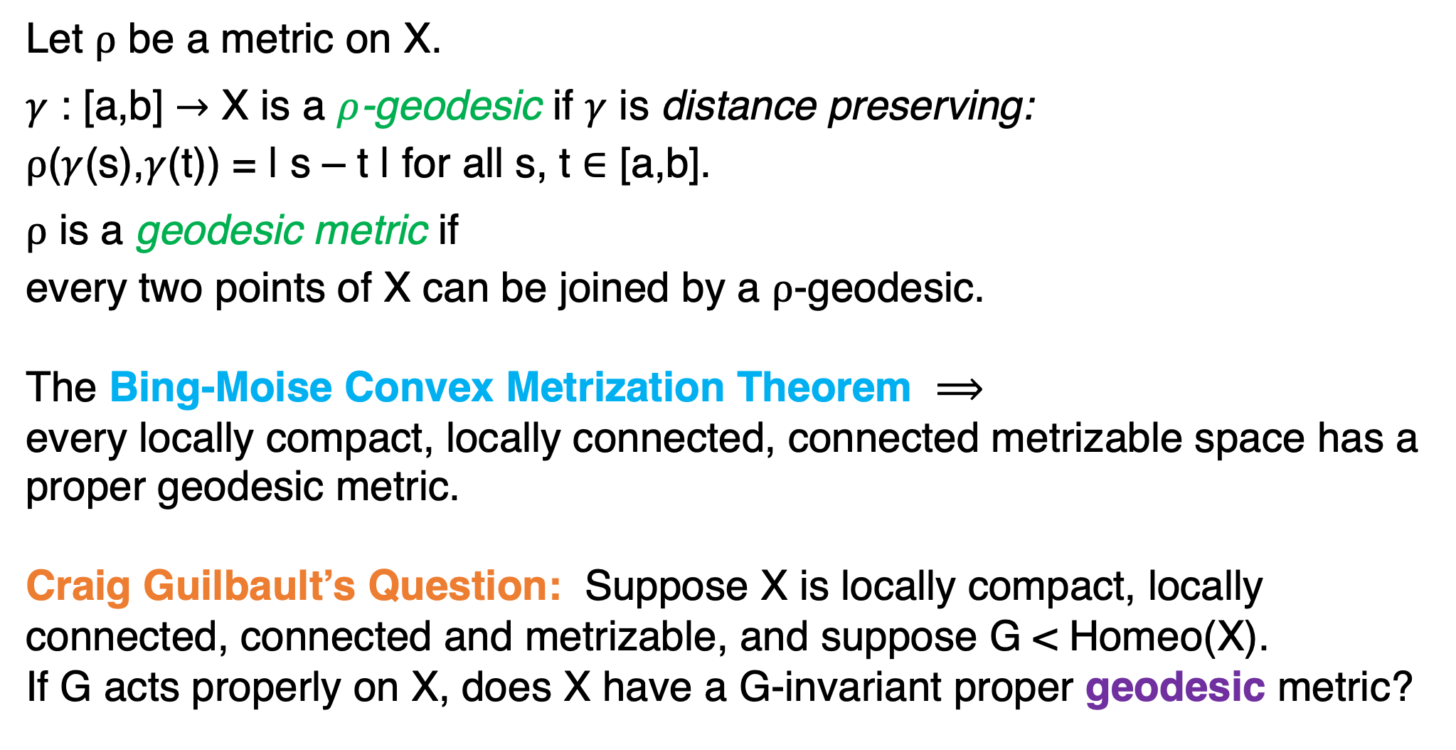
Let $ρ$ be a metric on X.
$γ$ : [a,b] $→$ X is a $ρ$-geodesic if $γ$ is distance preserving:
$ρ$($γ$(s),$γ$(t)) = | s – t | for all s, t $∈$ [a,b].
$ρ$ is a geodesic metric if
every two points of X can be joined by a $ρ$-geodesic.
The Bing-Moise Convex Metrization Theorem $⟹$
every locally compact, locally connected, connected metrizable space has a proper geodesic metric.
Craig Guilbault’s Question: Suppose X is locally compact, locally connected, connected and metrizable, and suppose G < Homeo(X).
If G acts properly on X, does X have a G-invariant proper geodesic metric?

Slide 14
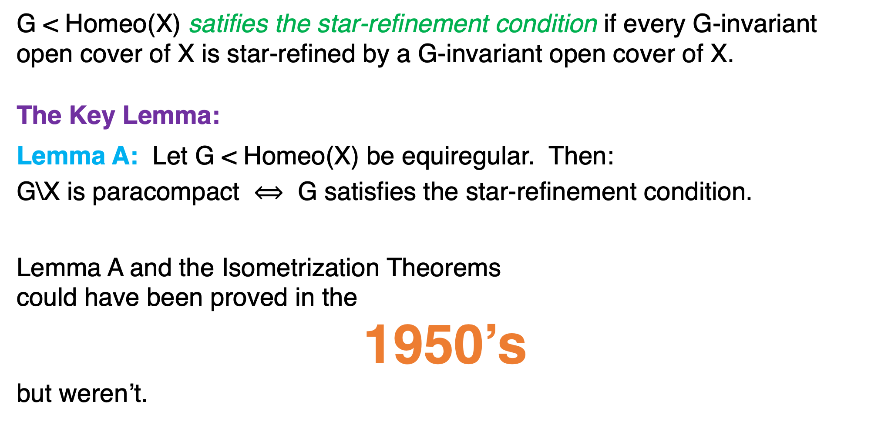
G < Homeo(X) satifies the star-refinement condition if every G-invariant
open cover of X is star-refined by a G-invariant open cover of X.
The Key Lemma:
Lemma A: Let G < Homeo(X) be equiregular. Then:
G\X is paracompact $⟺$ G satisfies the star-refinement condition.
Lemma A and the Isometrization Theorems
could have been proved in the
1950’s
but weren’t.

Slide 15
2. Metrization methods

Slide 16
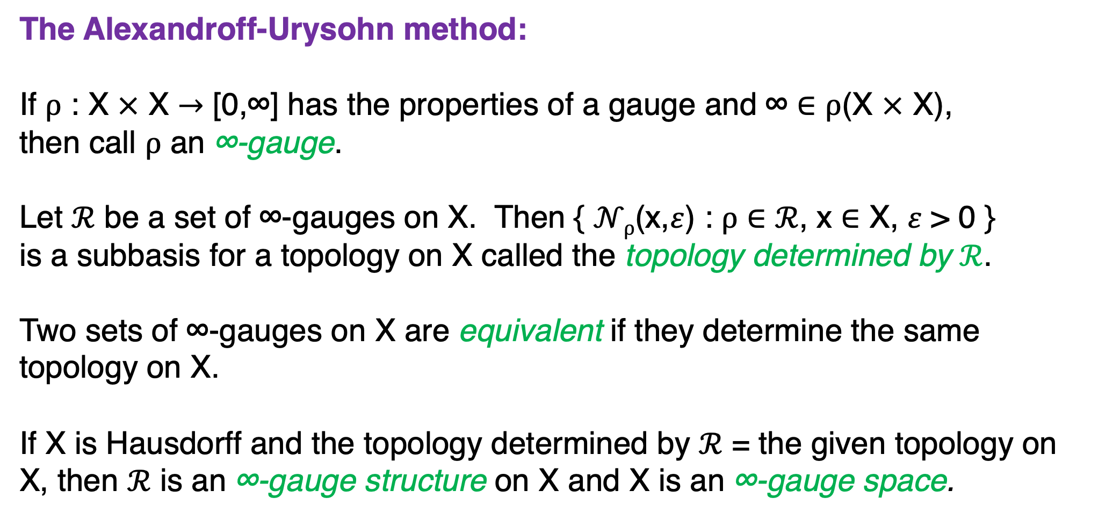
The Alexandroff-Urysohn method:
If $ρ$ : X $×$ X $→$ [0,∞] has the properties of a gauge and ∞ $∈$ $ρ$(X $×$ X),
then call $ρ$ an ∞-gauge.
Let $ℛ$ be a set of ∞-gauges on X. Then { $𝒩ρ$(x,$ε$) : $ρ$ $∈$ $ℛ$, x $∈$ X, $ε$ > 0 }
is a subbasis for a topology on X called the topology determined by $ℛ$.
Two sets of ∞-gauges on X are equivalent if they determine the same
topology on X.
If X is Hausdorff and the topology determined by $ℛ$ = the given topology on
X, then $ℛ$ is an ∞-gauge structure on X and X is an ∞-gauge space.

Slide 17

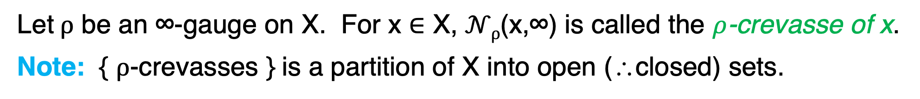
Let $ρ$ be an ∞-gauge on X. For x $∈$ X, $𝒩ρ$(x,∞) is called the $ρ$-crevasse of x.
Note: { $ρ$-crevasses } is a partition of X into open (∴closed) sets.
∞
…
0
$ρ$-crevasses (schematically)

Slide 18
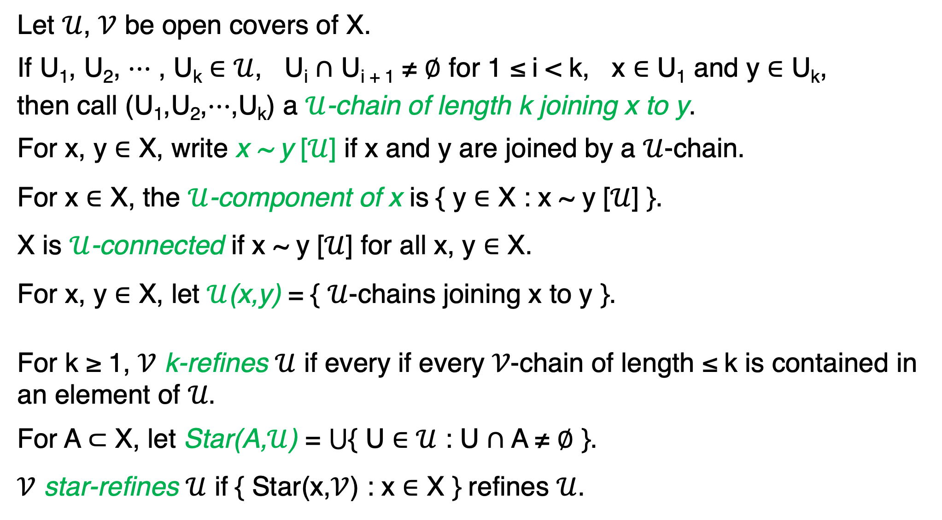
Let $𝒰$, $𝒱$ be open covers of X.
If U₁, U₂, $⋯$ , U_{k} $∈$ $𝒰$, U_{i} $∩$ U_{i + 1} ≠ $∅$ for 1 ≤ i < k, x $∈$ U₁ and y $∈$ U_{k},
then call (U₁,U₂,$⋯$,U_{k}) a $𝒰$-chain of length k joining x to y.
For x, y $∈$ X, write x ~ y [$𝒰$] if x and y are joined by a $𝒰$-chain.
For x $∈$ X, the $𝒰$-component of x is { y $∈$ X : x ~ y [$𝒰$] }.
X is $𝒰$-connected if x ~ y [$𝒰$] for all x, y $∈$ X.
For x, y $∈$ X, let $𝒰$(x,y) = { $𝒰$-chains joining x to y }.
For k ≥ 1, $𝒱$ k-refines $𝒰$ if every if every 𝒱-chain of length ≤ k is contained in
an element of 𝒰.
For A $⊂$ X, let Star(A,$𝒰$) = $⋃${ U $∈$ $𝒰$ : U $∩$ A ≠ $∅$ }.
$𝒱$ star-refines $𝒰$ if { Star(x,$𝒱$) : x $∈$ X } refines $𝒰$.

Slide 19
A sequence { 𝒰_{n} : n ≥ 1 } of open covers of X is a development in X
if { Star(x,𝒰_{n}) : x ∈ X and n ≥ 1 } is a basis for some topology on X.
This topology is called the topology determined by { 𝒰_{n} : n ≥ 1 }.
If 𝔻 is a collection of developments in a space X, then
{ Star(x,𝒰_{n}) : { 𝒰_{n} : n ≥ 1 } ∈ 𝔻, x ∈ X and n ≥ 1 } is a subbasis for a
topology on X called the topology determined by 𝔻.
Let { 𝒰_{n} : n ≥ 1 } be a development in X.
{ 𝒰_{n} : n ≥ 1 } is a k-development if 𝒰­_{n + 1} k-refines 𝒰_{n} for every n ≥ 1.
{ 𝒰_{n} : n ≥ 1 } is a star-development if 𝒰­_{n + 1} star-refines 𝒰_{n} for every n ≥ 1.

Slide 20
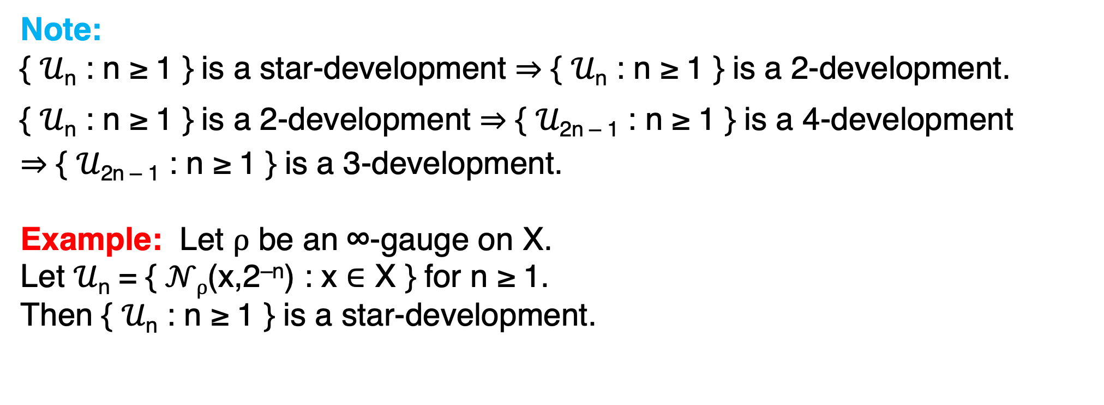
Note:
{ 𝒰_{n} : n ≥ 1 } is a star-development $⇒$ { 𝒰_{n} : n ≥ 1 } is a 2-development.
{ 𝒰_{n} : n ≥ 1 } is a 2-development $⇒$ { 𝒰_{2n – 1} : n ≥ 1 } is a 4-development
$⇒$ { 𝒰_{2n – 1} : n ≥ 1 } is a 3-development.
Example: Let $ρ$ be an ∞-gauge on X.
Let 𝒰­_{n} = { $𝒩ρ$(x,2^{–n}) : x $∈$ X } for n ≥ 1.
Then { 𝒰_{n} : n ≥ 1 } is a star-development.

Slide 21
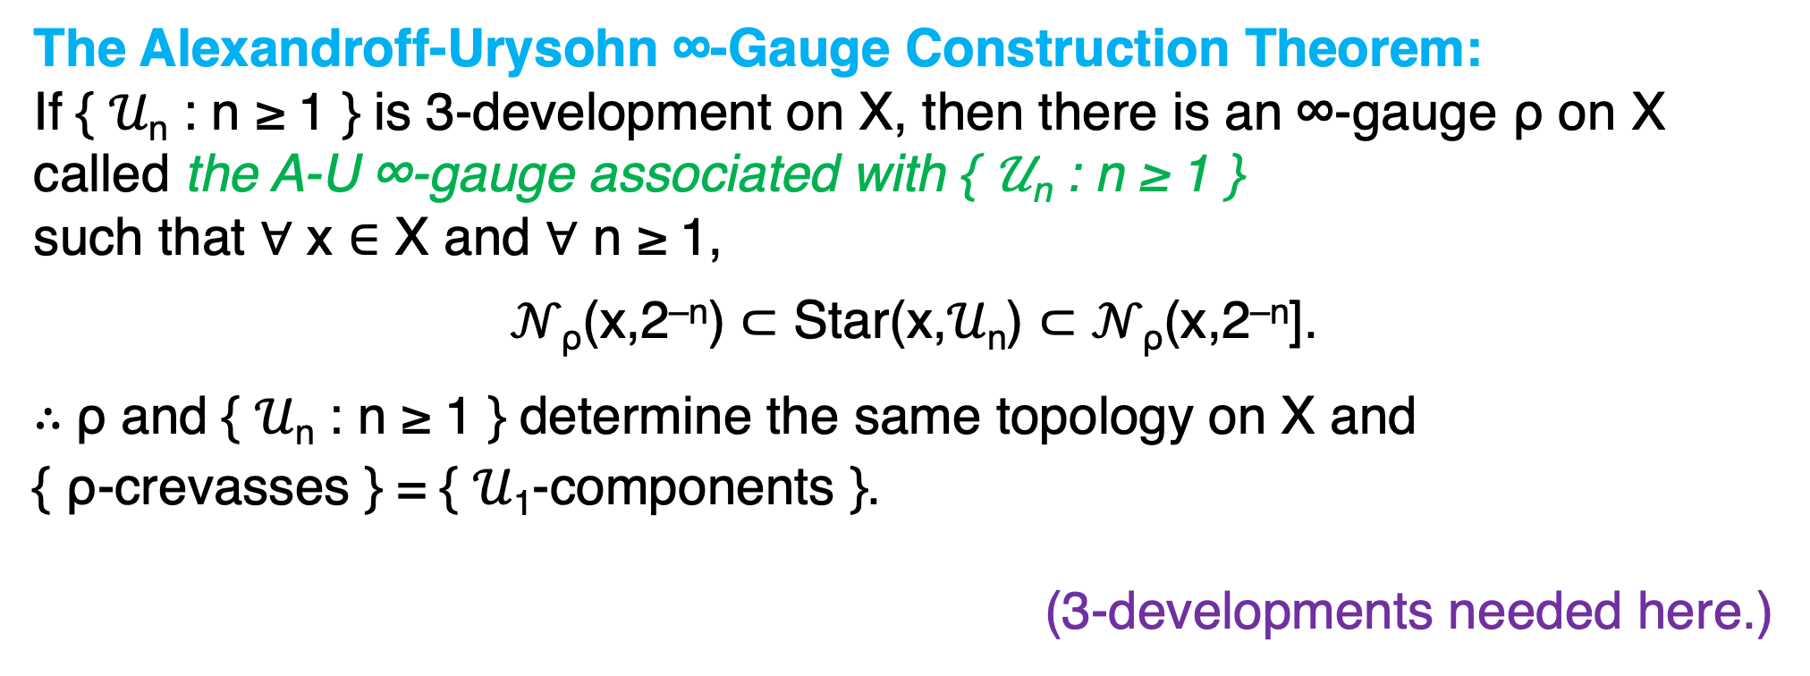
The Alexandroff-Urysohn ∞-Gauge Construction Theorem:
If { 𝒰_{n} : n ≥ 1 } is 3-development on X, then there is an ∞-gauge ρ on X called the A-U ∞-gauge associated with { 𝒰_{n} : n ≥ 1 }
such that $∀$ x ∈ X and $∀$ n ≥ 1,
𝒩_{ρ}(x,2^{–n}) ⊂ Star(x,𝒰_{n}) ⊂ 𝒩_{ρ}(x,2^{–n}].
$∴$ρ and { 𝒰_{n} : n ≥ 1 } determine the same topology on X and
{ ρ-crevasses } = { 𝒰₁-components }.
(3-developments needed here.)

Slide 22
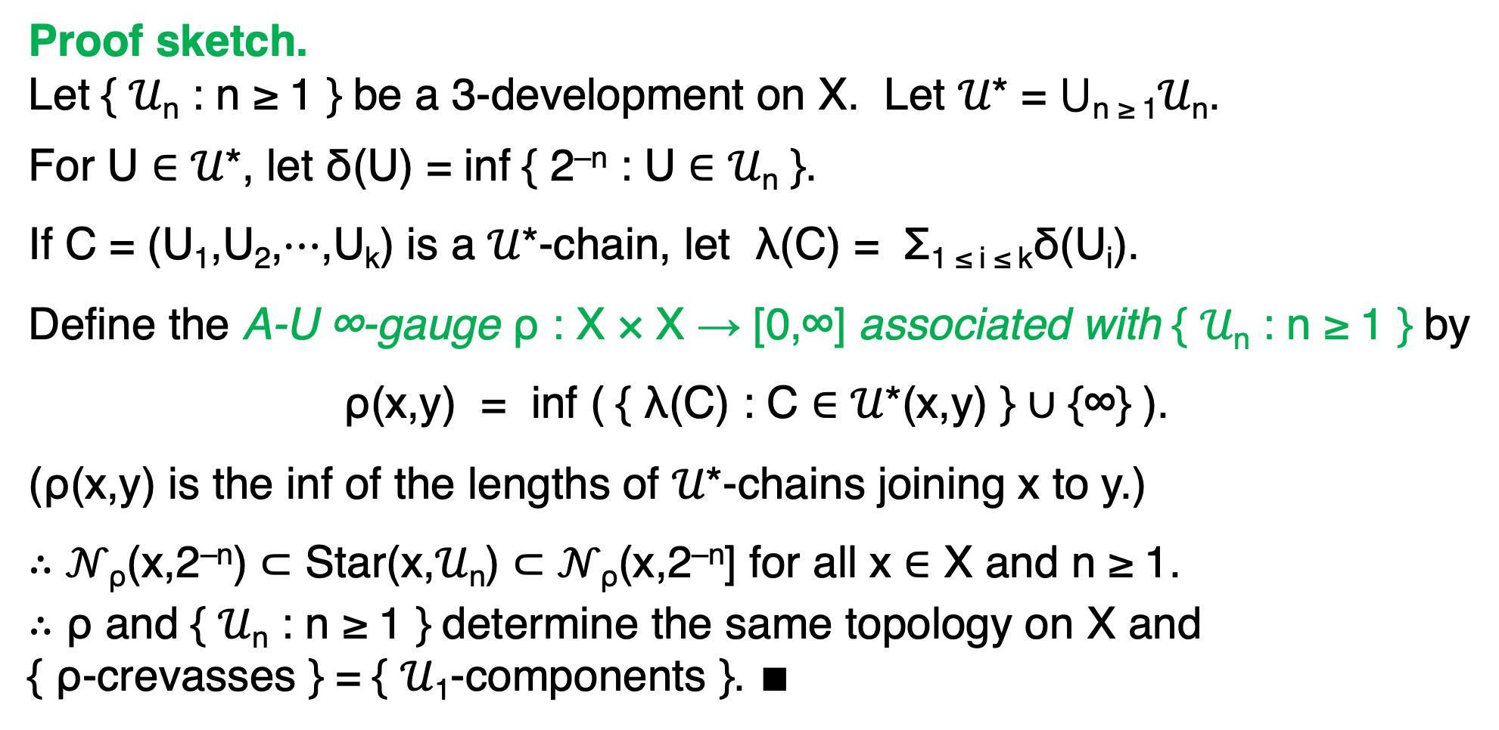
Proof sketch.
Let { 𝒰_{n} : n ≥ 1 } be a 3-development on X. Let 𝒰* = ⋃_{n ≥ 1}𝒰_{n}.
For U ∈ 𝒰*, let δ(U) = inf { 2^{–n} : U ∈ 𝒰_{n} }.
If C = (U₁,U₂,⋯,U_{k}) is a 𝒰*-chain, let λ(C) = Σ_{1 ≤ i ≤ k}δ(U_{i}).
Define the A-U ∞-gauge ρ : X × X → [0,∞] associated with { 𝒰_{n} : n ≥ 1 } by
ρ(x,y) = inf ( { λ(C) : C ∈ 𝒰*(x,y) } ∪ {∞} ).
(ρ(x,y) is the inf of the lengths of 𝒰*-chains joining x to y.)
$∴$ 𝒩_{ρ}(x,2^{–n}) ⊂ Star(x,𝒰_{n}) ⊂ 𝒩_{ρ}(x,2^{–n}] for all x $∈$ X and n ≥ 1.
$∴$ ρ and { 𝒰_{n} : n ≥ 1 } determine the same topology on X and
{ ρ-crevasses } = { 𝒰₁-components }. $∎$

Slide 23
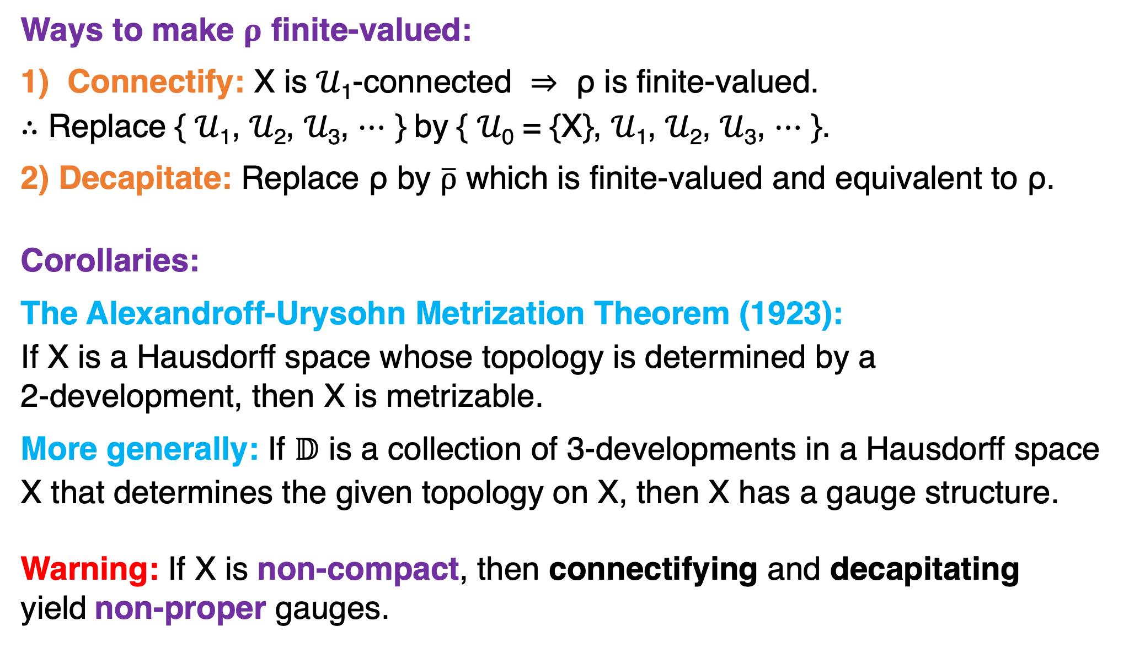
Ways to make $ρ$ finite-valued:
Connectify: X is 𝒰₁-connected $⇒$ ρ is finite-valued.
$∴$ Replace { 𝒰₁, 𝒰₂, 𝒰₃, $⋯$ } by { 𝒰₀ = {X}, 𝒰₁, 𝒰₂, 𝒰₃, $⋯$ }.
2) Decapitate: Replace ρ by $\overline{ρ}$ which is finite-valued and equivalent to ρ.
Corollaries:
The Alexandroff-Urysohn Metrization Theorem (1923):
If X is a Hausdorff space whose topology is determined by a
2-development, then X is metrizable.
More generally: If 𝔻 is a collection of 3-developments in a Hausdorff space
X that determines the given topology on X, then X has a gauge structure.
Warning: If X is non-compact, then connectifying and decapitating
yield non-proper gauges.

Slide 24
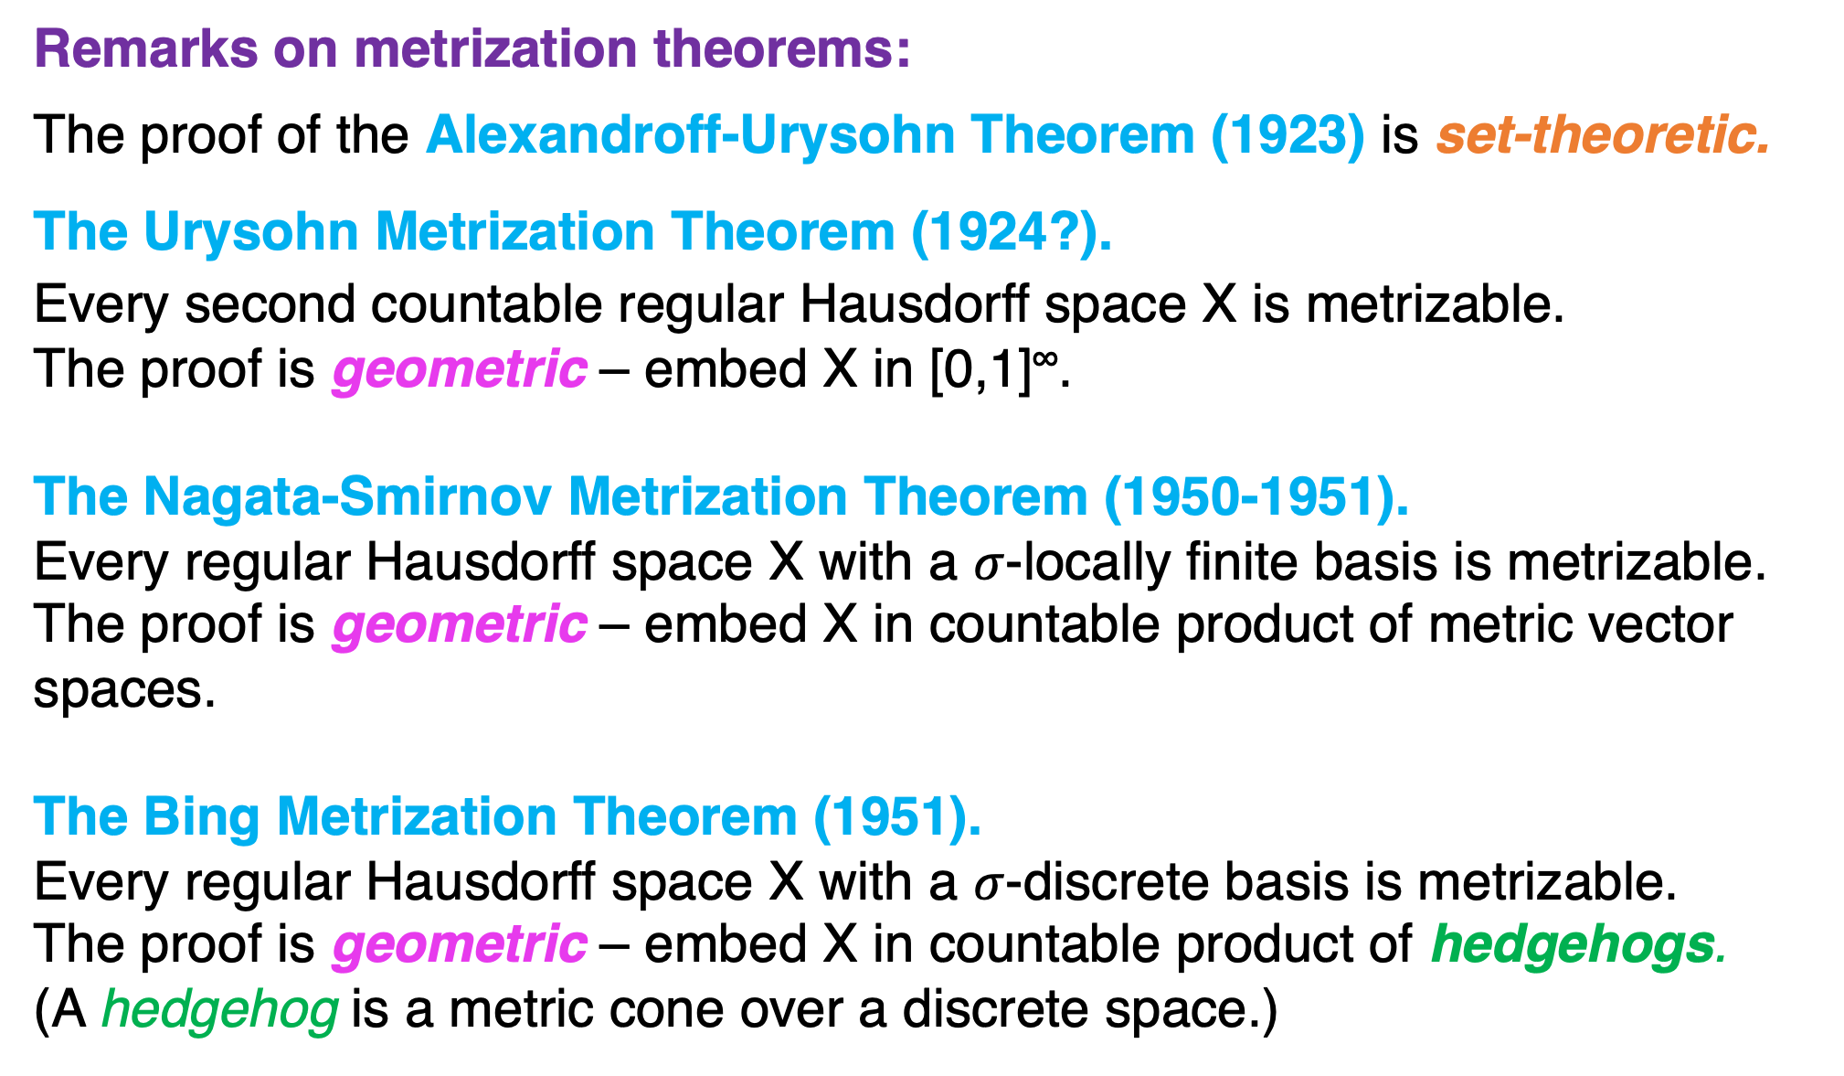
Remarks on metrization theorems:
The proof of the Alexandroff-Urysohn Theorem (1923) is set-theoretic.
The Urysohn Metrization Theorem (1924?).
Every second countable regular Hausdorff space X is metrizable.
The proof is geometric – embed X in [0,1]∞.
The Nagata-Smirnov Metrization Theorem (1950-1951).
Every regular Hausdorff space X with a $σ$-locally finite basis is metrizable.
The proof is geometric – embed X in countable product of metric vector spaces.
The Bing Metrization Theorem (1951).
Every regular Hausdorff space X with a $σ$-discrete basis is metrizable.
The proof is geometric – embed X in countable product of hedgehogs.
(A hedgehog is a metric cone over a discrete space.)

Slide 25
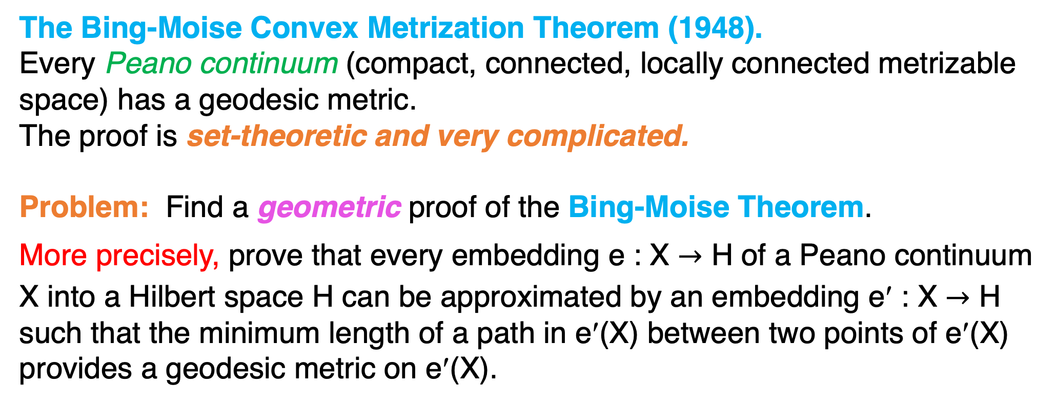
The Bing-Moise Convex Metrization Theorem (1948).
Every Peano continuum (compact, connected, locally connected metrizable
space) has a geodesic metric.
The proof is set-theoretic and very complicated.
Problem: Find a geometric proof of the Bing-Moise Theorem.
More precisely, prove that every embedding e : X $→$ H of a Peano continuum
X into a Hilbert space H can be approximated by an embedding e′ : X $→$ H
such that the minimum length of a path in e′(X) between two points of e′(X)
provides a geodesic metric on e′(X).

Slide 26
2. Tunnel systems and proper metrization methods

Slide 27
Preview:
The Alexandroff-Urysohn construction yields ∞-gauges on X.
These gauges can be finitetized by connectifying or decapitating,
but connectifying and decapitating might destroy properness.
Properness can be preserved and finiteness achieved by introducing …
bad tunnel systems.

Slide 28
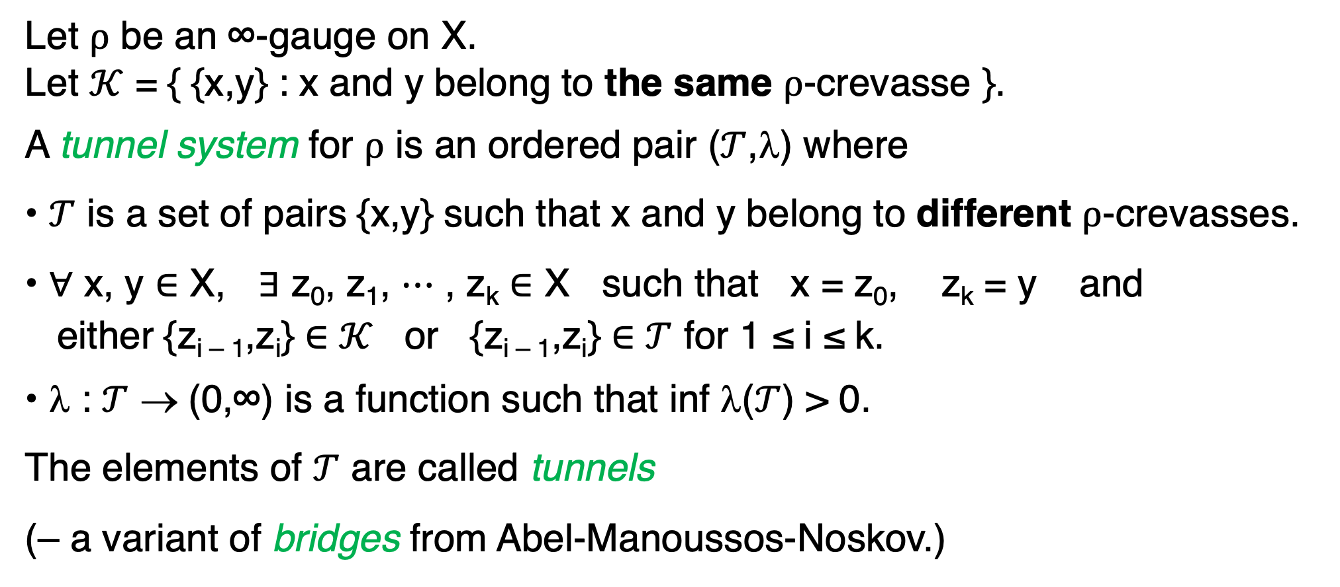
Let $ρ$ be an ∞-gauge on X.
Let $𝒦$ = { {x,y} : x and y belong to the same $ρ$-crevasse }.
A tunnel system for $ρ$ is an ordered pair ($𝒯$,λ) where
• $𝒯$ is a set of pairs {x,y} such that x and y belong to different $ρ$-crevasses.
• $∀$ x, y $∈$ X, $∃$ z₀, z₁, $⋯$ , z_{k} $∈$ X such that x = z₀, z_{k} = y and
either {z_{i – 1},z_{i}} $∈$ $𝒦$ or {z_{i – 1},z_{i}} $∈$ $𝒯$ for 1 ≤ i ≤ k.
• λ : $𝒯$ → (0,∞) is a function such that inf λ($𝒯$) > 0.
The elements of $𝒯$ are called tunnels
(– a variant of bridges from Abel-Manoussos-Noskov.)

Slide 29

A tunnel system:
∞
…
0
$ρ$-crevasses
tunnels
$λ$ : {tunnels} $→$ (0,∞) such that inf $λ$({tunnels}) > 0.

Slide 30
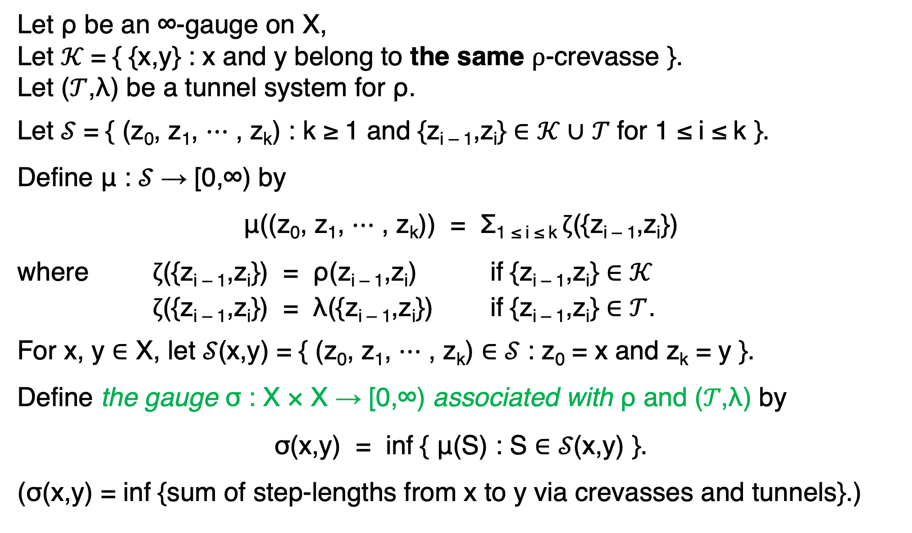
Let ρ be an ∞-gauge on X,
Let $𝒦$= { {x,y} : x and y belong to the same $ρ$-crevasse }.
Let ($𝒯$,λ) be a tunnel system for ρ.
Let 𝒮 = { (z₀, z₁, ⋯ , z_{k}) : k ≥ 1 and {z_{i – 1},z_{i}} ∈ $𝒦$∪ 𝒯 for 1 ≤ i ≤ k }.
Define μ : 𝒮 → [0,∞) by
μ((z₀, z₁, ⋯ , z_{k})) = Σ_{1 ≤ i ≤ k} $ζ$({z_{i – 1},z_{i}})
where $ζ$({z_{i – 1},z_{i}}) = ρ(z_{i – 1},z_{i}) if {z_{i – 1},z_{i}} ∈ $𝒦$
$ζ$({z_{i – 1},z_{i}}) = λ({z_{i – 1},z_{i}}) if {z_{i – 1},z_{i}} ∈ $𝒯$.
For x, y ∈ X, let 𝒮(x,y) = { (z₀, z₁, ⋯ , z_{k}) ∈ 𝒮 : z₀ = x and z_{k} = y }.
Define the gauge σ : X × X → [0,∞) associated with ρ and (𝒯,λ) by
σ(x,y) = inf { μ(S) : S ∈ 𝒮(x,y) }.
(σ(x,y) = inf {sum of step-lengths from x to y via crevasses and tunnels}.)

Slide 31
Theorem: Let ρ be an ∞-gauge on X, let (𝒯,λ) is a tunnel system for ρ,
and let σ be the gauge associated with ρ and (𝒯,λ).
Then σ is a finite-valued gauge on X that is equivalent to ρ.
Challenge: Make σ proper.

Slide 32
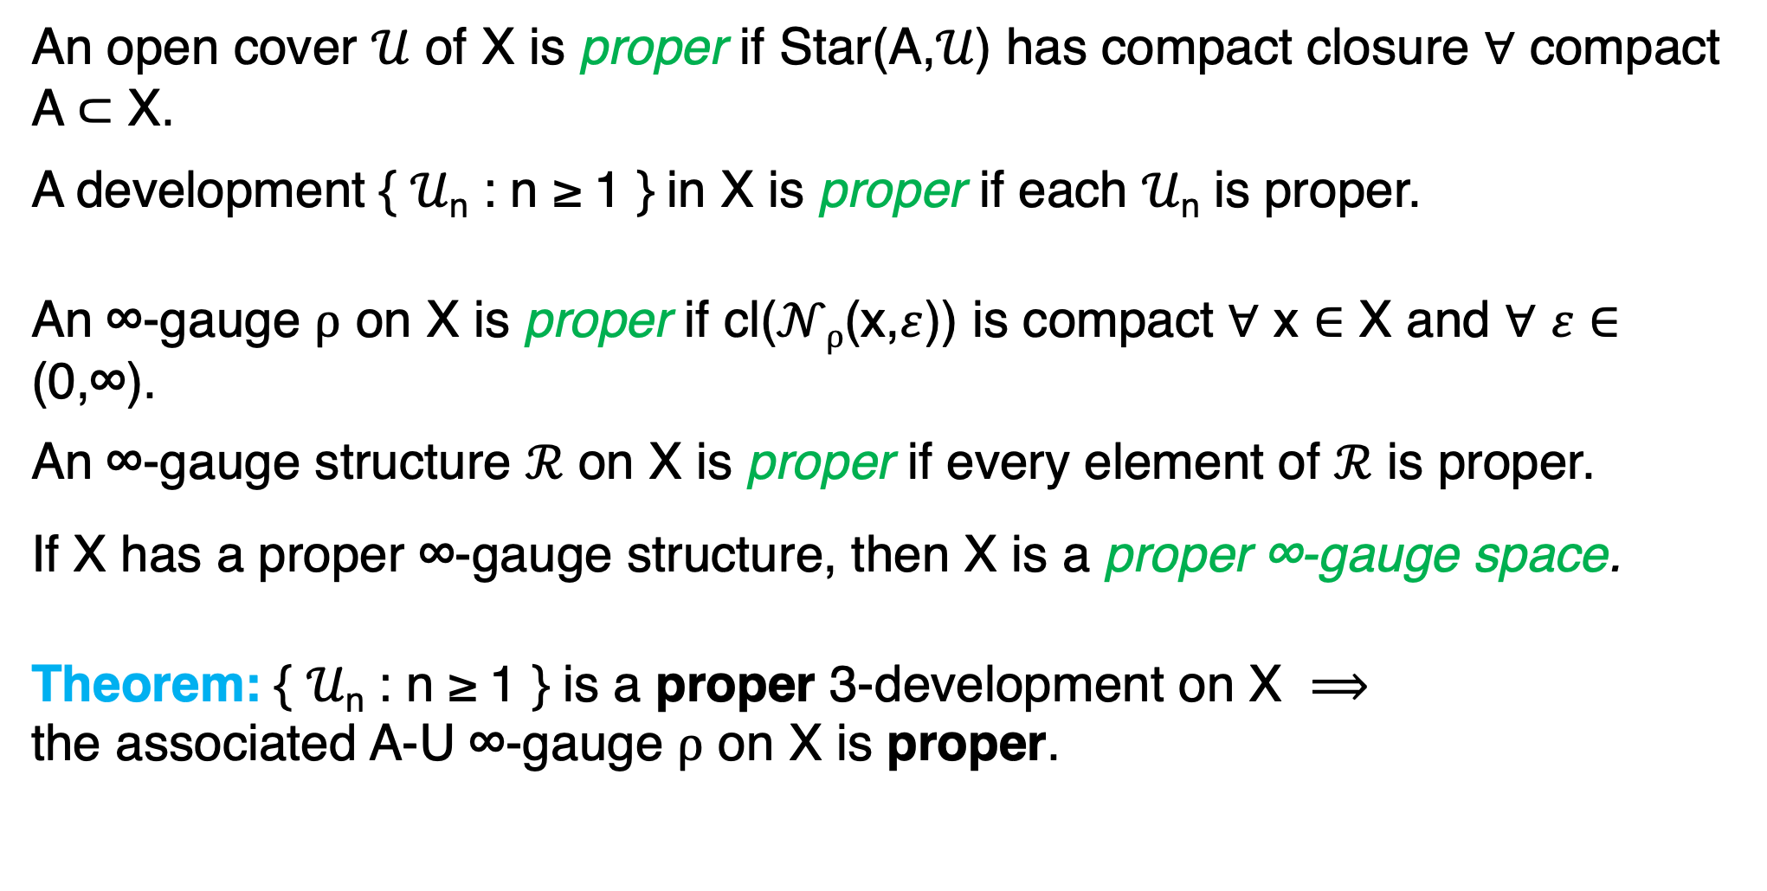
An open cover $𝒰$ of X is proper if Star(A,𝒰) has compact closure $∀$ compact A ⊂ X.
A development { 𝒰_{n} : n ≥ 1 } in X is proper if each 𝒰_{n} is proper.
An ∞-gauge $ρ$ on X is proper if cl($𝒩ρ$(x,$ε$)) is compact $∀$ x $∈$ X and $∀$ $ε$ $∈$ (0,∞).
An ∞-gauge structure $ℛ$ on X is proper if every element of $ℛ$ is proper.
If X has a proper ∞-gauge structure, then X is a proper ∞-gauge space.
Theorem: { 𝒰_{n} : n ≥ 1 } is a proper 3-development on X $⟹$
the associated A-U ∞-gauge $ρ$ on X is proper.

Slide 33
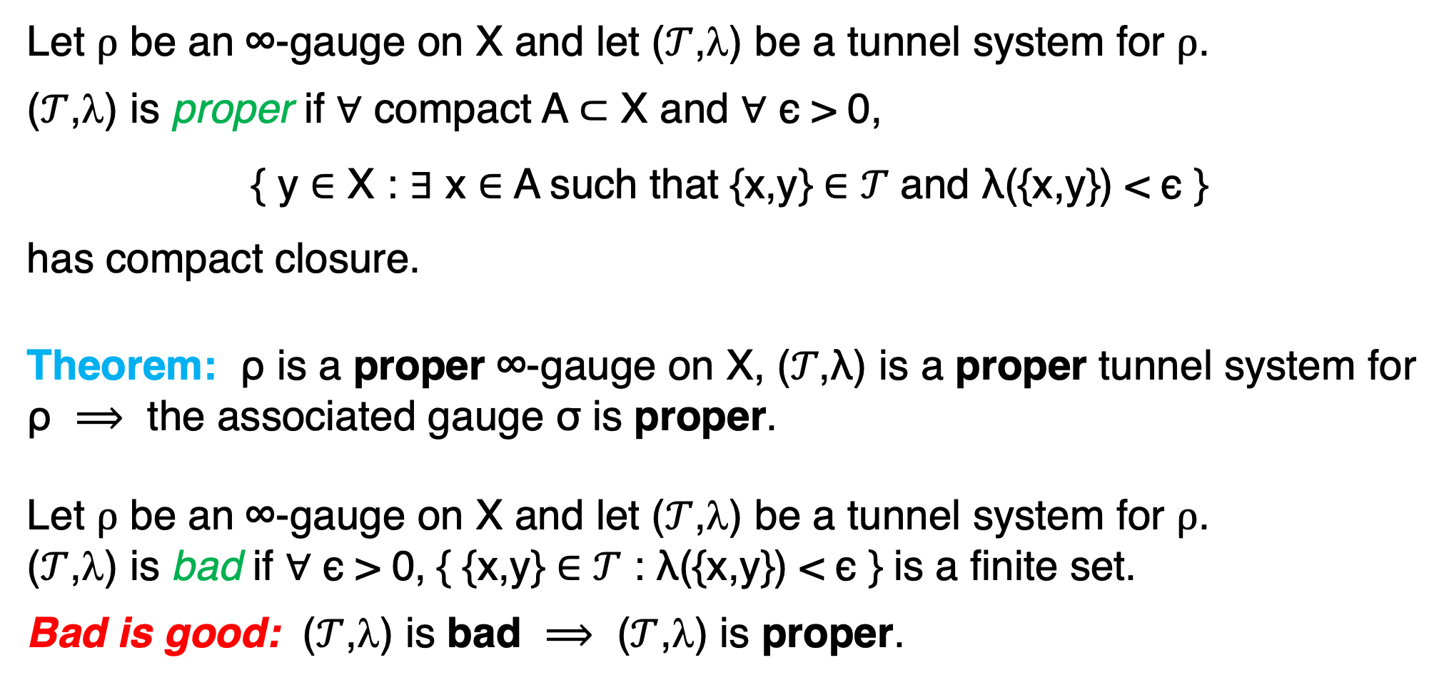
Let $ρ$ be an ∞-gauge on X and let ($𝒯$,λ) be a tunnel system for $ρ$.
($𝒯$,λ) is proper if ∀ compact A ⊂ X and ∀ ϵ > 0,
{ y ∈ X : $∃$ x ∈ A such that {x,y} ∈ 𝒯 and λ({x,y}) < ϵ }
has compact closure.
Theorem: ρ is a proper ∞-gauge on X, (𝒯,λ) is a proper tunnel system for ρ $⟹$ the associated gauge σ is proper.
Let $ρ$ be an ∞-gauge on X and let ($𝒯$,λ) be a tunnel system for $ρ$.
($𝒯$,λ) is bad if ∀ ϵ > 0, { {x,y} ∈ 𝒯 : λ({x,y}) < ϵ } is a finite set.
Bad is good: ($𝒯$,λ) is bad $⟹$ ($𝒯$,λ) is proper.

Slide 34
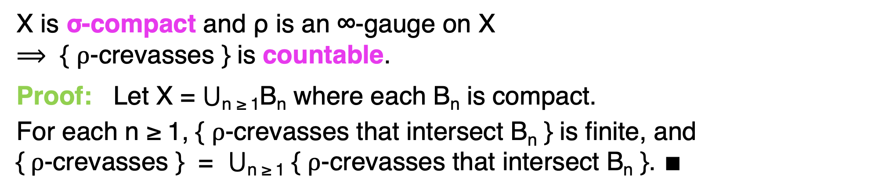
X is σ-compact and ρ is an ∞-gauge on X
$⟹$ { $ρ$-crevasses } is countable.
Proof: Let X = ⋃_{n ≥ 1}B_{n} where each B_{n} is compact.
For each n ≥ 1, { $ρ$-crevasses that intersect B_{n} } is finite, and
{$ρ$-crevasses } = ⋃_{n ≥ 1} { $ρ$-crevasses that intersect B_{n} }. ∎

Slide 35
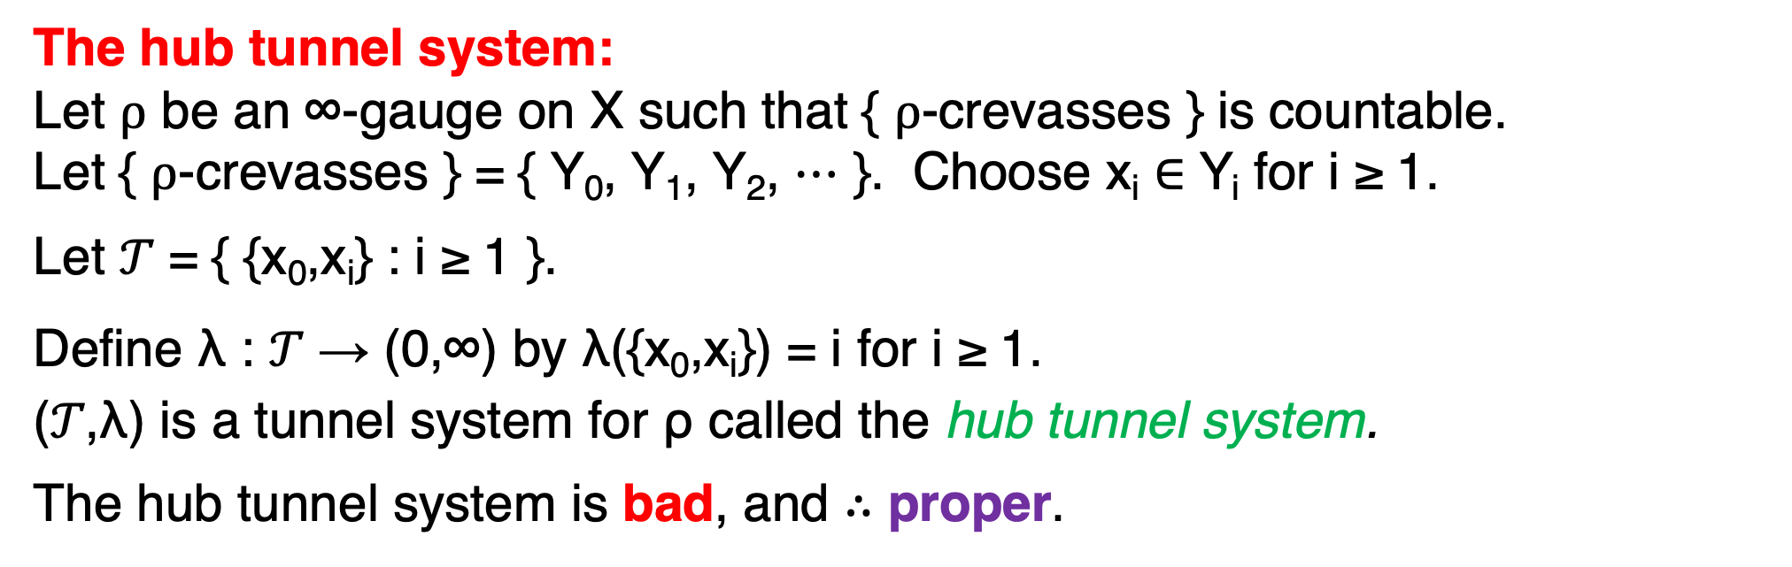
The hub tunnel system:
Let $ρ$ be an ∞-gauge on X such that { $ρ$-crevasses } is countable.
Let { $ρ$-crevasses } = { Y₀, Y­₁, Y₂, ⋯ }. Choose x_{i} ∈ Y_{i} for i ≥ 1.
Let 𝒯 = { {x₀,x_{i}} : i ≥ 1 }.
Define λ : 𝒯 → (0,∞) by λ({x₀,x_{i}}) = i for i ≥ 1.
(𝒯,λ) is a tunnel system for ρ called the hub tunnel system.
The hub tunnel system is bad, and $∴$ proper.
∞
•
•
•
•
•
Y₀
Y₁
Y₂
Y₃
Y₄
•
x₄•
…
x₃•
x₂•
x₀•
x₁•
0

Slide 36
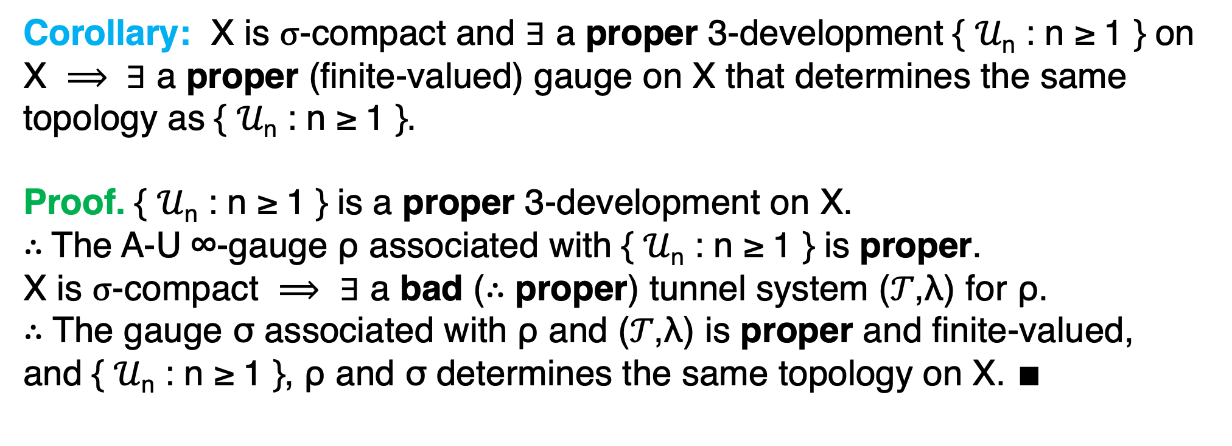
Corollary: X is $σ$-compact and $∃$ a proper 3-development { 𝒰_{n} : n ≥ 1 } on X $⟹ ∃$ a proper (finite-valued) gauge on X that determines the same
topology as { 𝒰_{n} : n ≥ 1 }.
Proof. { 𝒰_{n} : n ≥ 1 } is a proper 3-development on X.
$∴$The A-U ∞-gauge ρ associated with { 𝒰_{n} : n ≥ 1 } is proper.
X is $σ$-compact $⟹$ $∃$ a bad ($∴$ proper) tunnel system (𝒯,λ) for ρ.
$∴$ The gauge σ associated with ρ and (𝒯,λ) is proper and finite-valued,
and { 𝒰_{n} : n ≥ 1 }, ρ and σ determines the same topology on X. $∎$

Slide 37
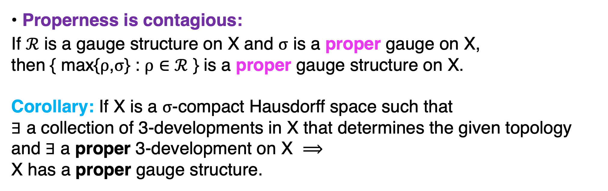
• Properness is contagious:
If $ℛ$ is a gauge structure on X and $σ$ is a proper gauge on X,
then { max{$ρ$,$σ$} : $ρ$ $∈$ $ℛ$ } is a proper gauge structure on X.
Corollary: If X is a $σ$-compact Hausdorff space such that
$∃$ a collection of 3-developments in X that determines the given topology
and $∃$ a proper 3-development on X $⟹$
X has a proper gauge structure.

Slide 38
III. Invariant gauge construction methods

Slide 39
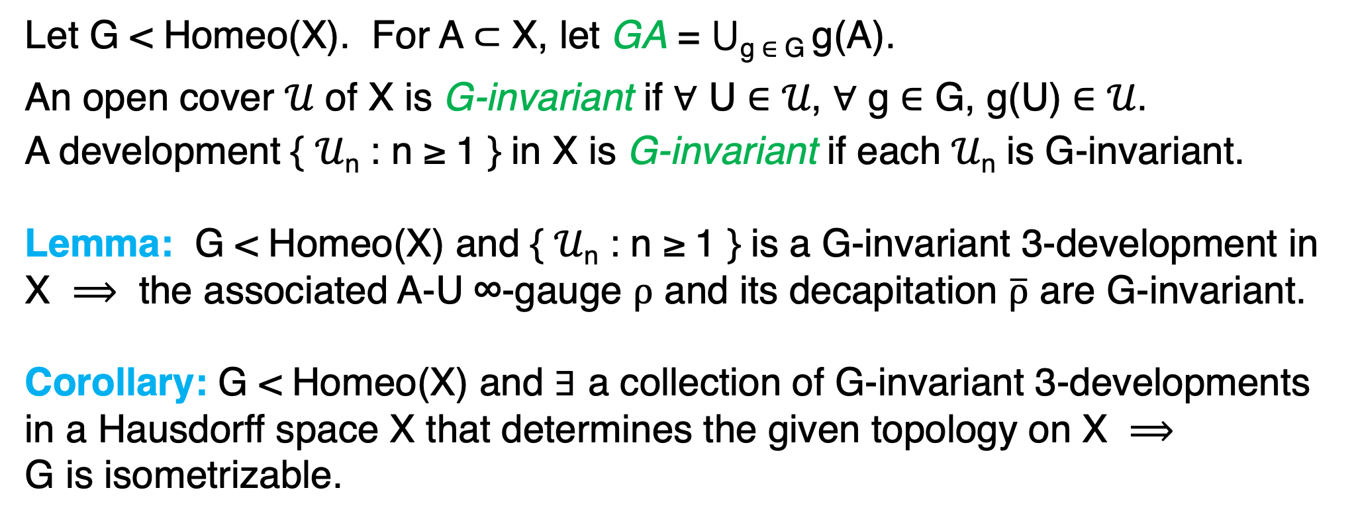
Let G < Homeo(X). For A $⊂$ X, let GA = $⋃$_{g} $∈$ _{G} g(A).
An open cover 𝒰 of X is G-invariant if ∀ U ∈ 𝒰, ∀ g ∈ G, g(U) ∈ 𝒰.
A development { 𝒰_{n} : n ≥ 1 } in X is G-invariant if each 𝒰_{n} is G-invariant.
Lemma: G < Homeo(X) and { 𝒰_{n} : n ≥ 1 } is a G-invariant 3-development in X $⟹$ the associated A-U ∞-gauge $ρ$ and its decapitation $\overline{ρ}$ are G-invariant.
Corollary: G < Homeo(X) and $∃$ a collection of G-invariant 3-developments
in a Hausdorff space X that determines the given topology on X $⟹$
G is isometrizable.

Slide 40
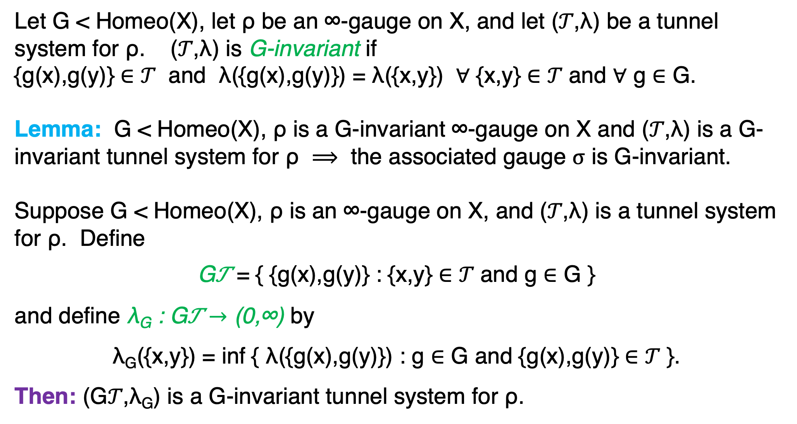
Let G < Homeo(X), let ρ be an ∞-gauge on X, and let (𝒯,λ) be a tunnel system for ρ. (𝒯,λ) is G-invariant if
{g(x),g(y)} ∈ 𝒯 and λ({g(x),g(y)}) = λ({x,y}) ∀ {x,y} ∈ 𝒯 and ∀ g ∈ G.
Lemma: G < Homeo(X), ρ is a G-invariant ∞-gauge on X and (𝒯,λ) is a G-invariant tunnel system for ρ $⟹$ the associated gauge $σ$ is G-invariant.
Suppose G < Homeo(X), ρ is an ∞-gauge on X, and (𝒯,λ) is a tunnel system
for ρ. Define
G𝒯 = { {g(x),g(y)} : {x,y} $∈$ 𝒯 and g $∈$ G }
and define λ_{G} : G𝒯 $→$ (0,∞) by
λ_{G}({x,y}) = inf { λ({g(x),g(y)}) : g $∈$ G and {g(x),g(y)} $∈$ 𝒯 }.
Then: (G𝒯,λ_{G}) is a G-invariant tunnel system for ρ.

Slide 41
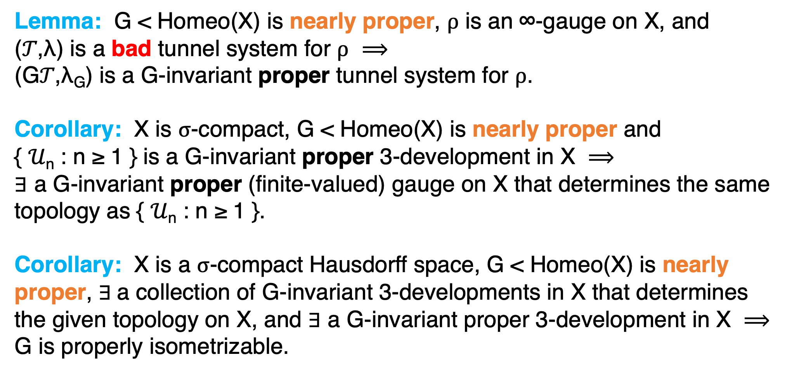
Lemma: G < Homeo(X) is nearly proper, $ρ$ is an ∞-gauge on X, and
(𝒯,λ) is a bad tunnel system for $ρ$ $⟹$
(G𝒯,λ_{G}) is a G-invariant proper tunnel system for $ρ$.
Corollary: X is $σ$-compact, G < Homeo(X) is nearly proper and
{ 𝒰_{n} : n ≥ 1 } is a G-invariant proper 3-development in X $⟹$
$∃$ a G-invariant proper (finite-valued) gauge on X that determines the same topology as { 𝒰_{n} : n ≥ 1 }.
Corollary: X is a $σ$-compact Hausdorff space, G < Homeo(X) is nearly proper, $∃$a collection of G-invariant 3-developments in X that determines
the given topology on X, and $∃$ a G-invariant proper 3-development in X $⟹$
G is properly isometrizable.

Slide 42
IV. Proofs of isometrization theorems

Slide 43
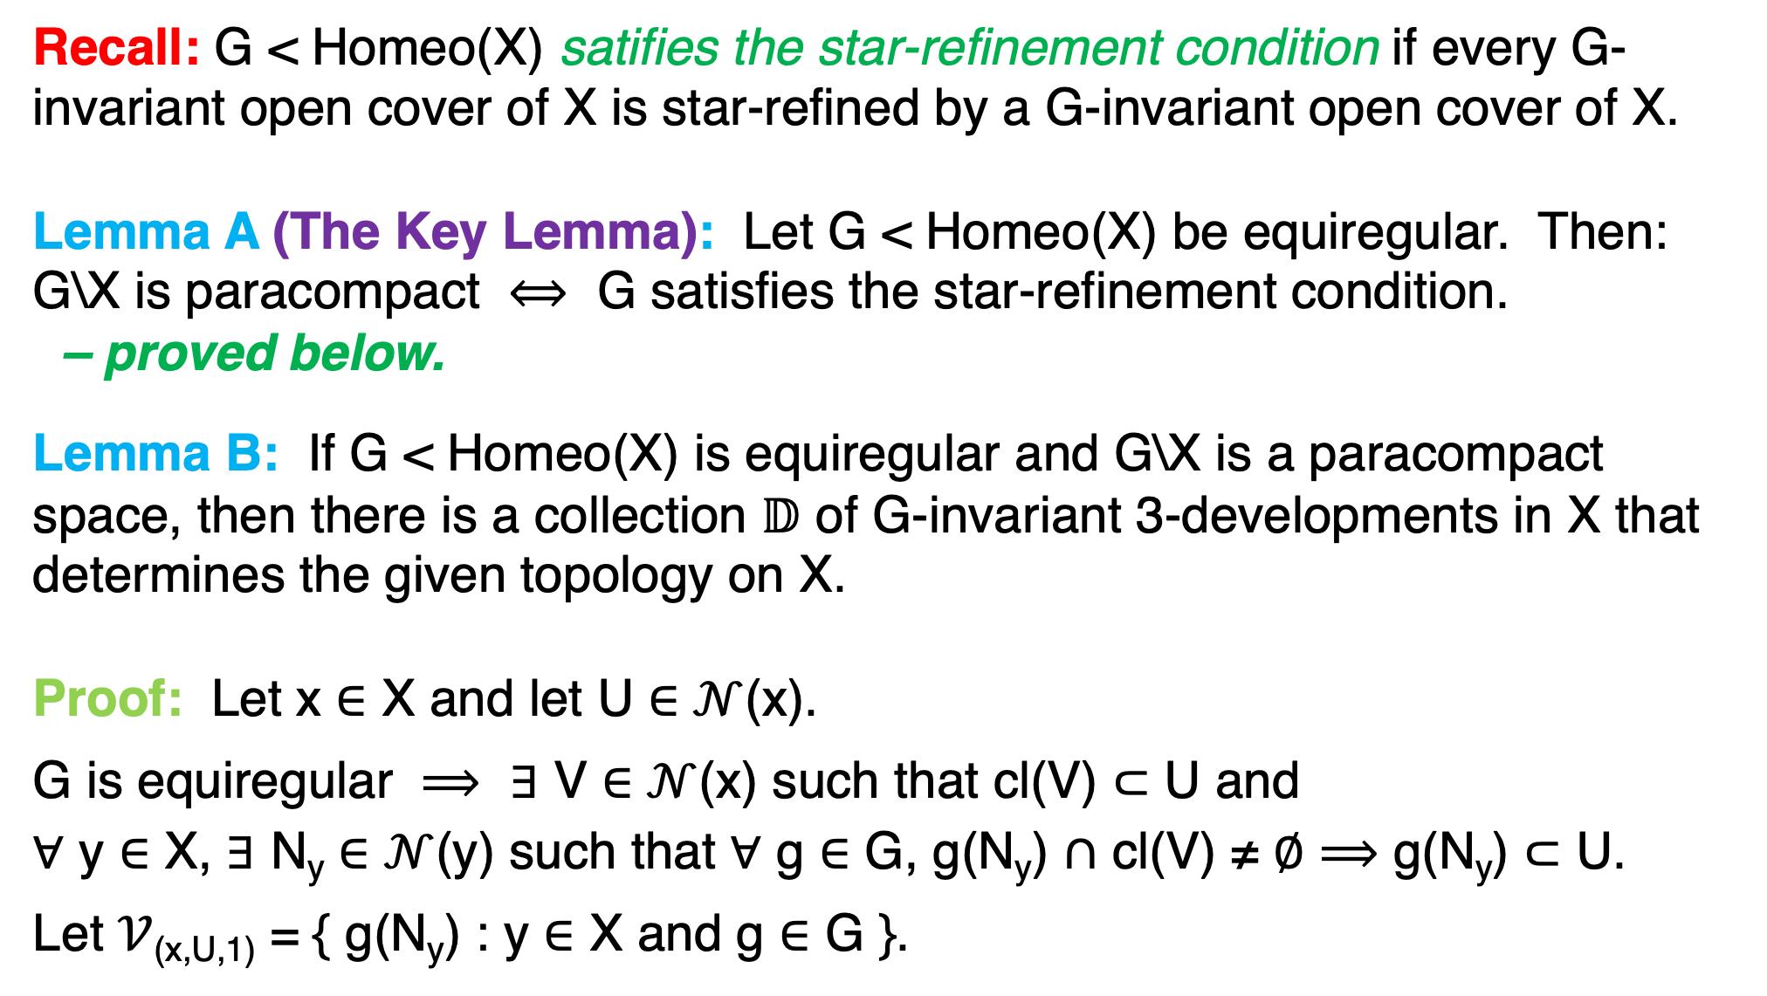
Recall: G < Homeo(X) satifies the star-refinement condition if every G-invariant open cover of X is star-refined by a G-invariant open cover of X.
Lemma A (The Key Lemma): Let G < Homeo(X) be equiregular. Then:
G\X is paracompact $⟺$ G satisfies the star-refinement condition.
– proved below.
Lemma B: If G < Homeo(X) is equiregular and G\X is a paracompact space, then there is a collection 𝔻 of G-invariant 3-developments in X that determines the given topology on X.
Proof: Let x ∈ X and let U ∈ $𝒩$(x).
G is equiregular $⟹$ $∃$ V ∈ $𝒩$(x) such that cl(V) $⊂$ U and
$∀$ y ∈ X, $∃$ N_{y} ∈ $𝒩$(y) such that $∀$ g ∈ G, g(N_{y}) $∩$ cl(V) ≠ $∅$ $⟹$ g(N_{y}) $⊂$ U.
Let $𝒱$_{(x,U,1)} = { g(N_{y}) : y ∈ X and g ∈ G }.

Slide 44
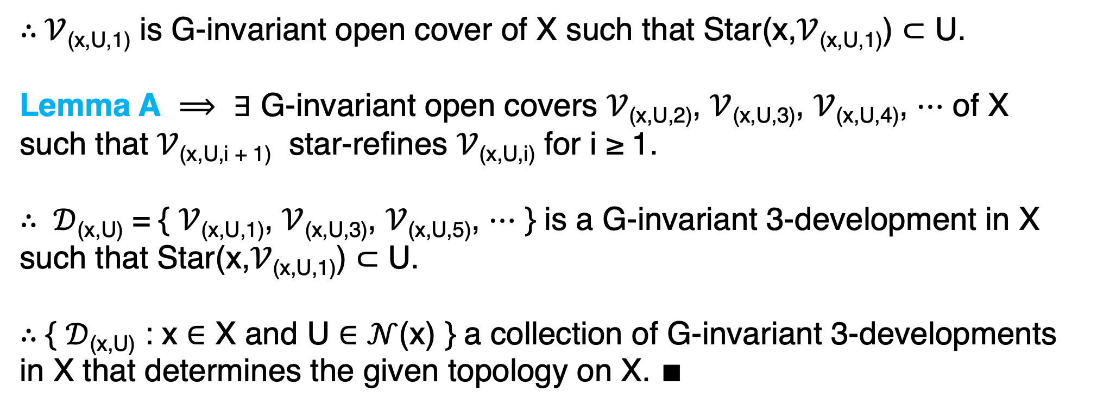
$∴$ $𝒱$_{(x,U,1)} is G-invariant open cover of X such that Star(x,$𝒱$_{(x,U,1)}) $⊂$ U.
Lemma A $⟹$ $∃$ G-invariant open covers $𝒱$_{(x,U,2)}, $𝒱$_{(x,U,3)}, $𝒱$_{(x,U,4)}, $⋯$ of X
such that $𝒱$_{(x,U,i + 1)} star-refines $𝒱$_{(x,U,i)} for i ≥ 1.
$∴ 𝒟$_{(x,U)} = { $𝒱$_{(x,U,1)}, $𝒱$_{(x,U,3)}, $𝒱$_{(x,U,5)}, $⋯$ } is a G-invariant 3-development in X
such that Star(x,$𝒱$_{(x,U,1)}) $⊂$ U.
$∴$ { $𝒟$_{(x,U)} : x ∈ X and U ∈ $𝒩$(x) } a collection of G-invariant 3-developments
in X that determines the given topology on X. $∎$

Slide 45
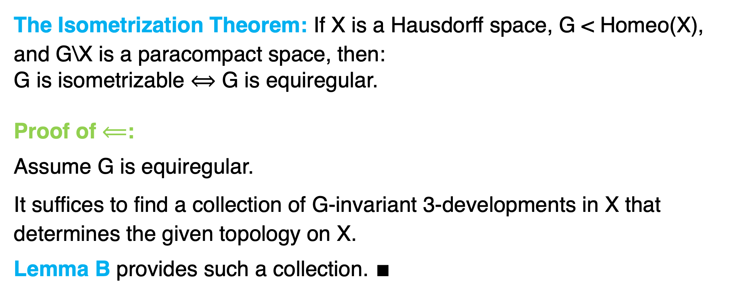
The Isometrization Theorem: If X is a Hausdorff space, G < Homeo(X),
and G\X is a paracompact space, then:
G is isometrizable $⟺$ G is equiregular.
Proof of $⟸$:
Assume G is equiregular.
It suffices to find a collection of G-invariant 3-developments in X that
determines the given topology on X.
Lemma B provides such a collection. $∎$

Slide 46
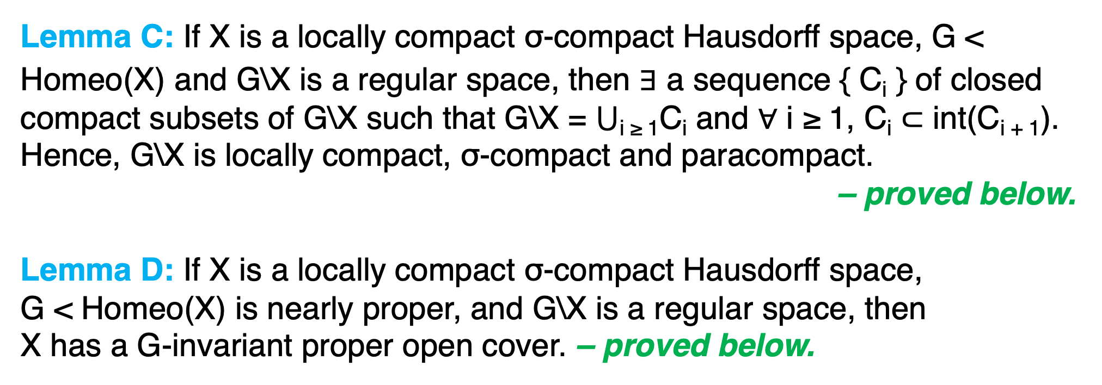
Lemma C: If X is a locally compact σ-compact Hausdorff space, G <
Homeo(X) and G\X is a regular space, then $∃$ a sequence { C_{i} } of closed compact subsets of G\X such that G\X = $⋃$_{i ≥ 1}C_{i} and $∀$ i ≥ 1, C_{i} $⊂$ int(C_{i + 1}).
Hence, G\X is locally compact, σ-compact and paracompact.
– proved below.
Lemma D: If X is a locally compact σ-compact Hausdorff space,
G < Homeo(X) is nearly proper, and G\X is a regular space, then
X has a G-invariant proper open cover. – proved below.

Slide 47
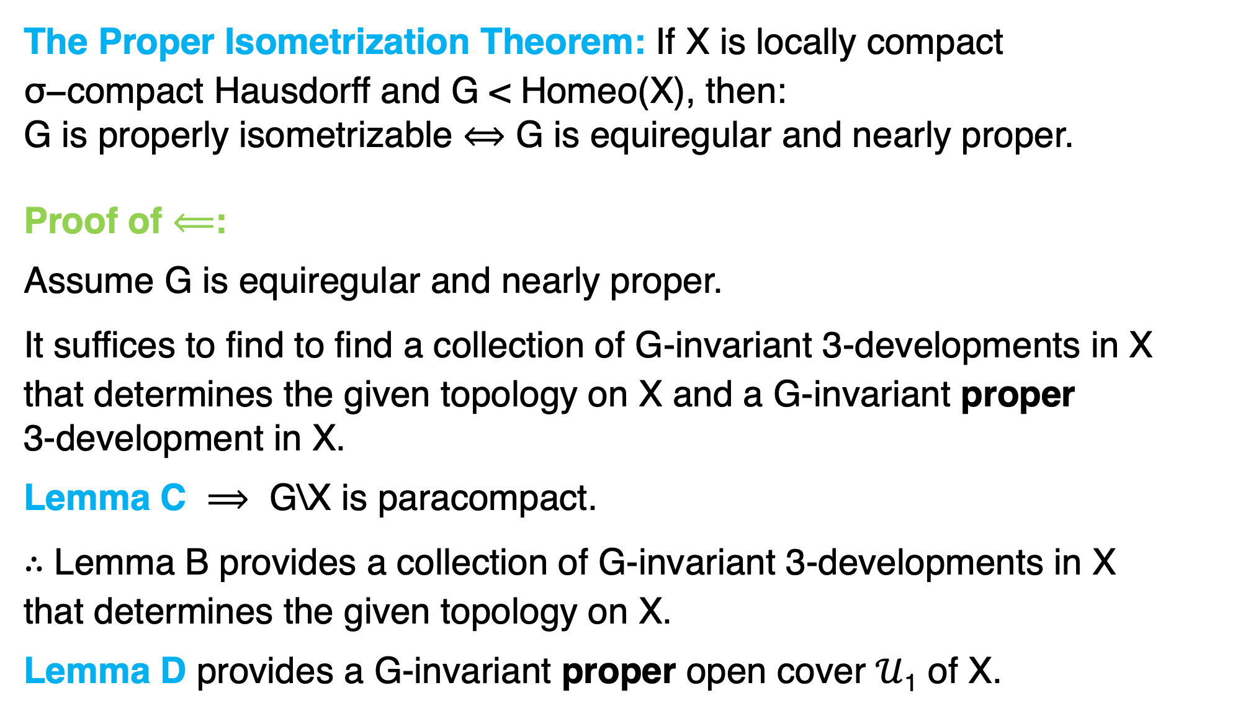
The Proper Isometrization Theorem: If X is locally compact
$\text{σ}\text{−}\text{compact}$Hausdorff and G < Homeo(X), then:
G is properly isometrizable $⟺$ G is equiregular and nearly proper.
Proof of $⟸$:
Assume G is equiregular and nearly proper.
It suffices to find to find a collection of G-invariant 3-developments in X
that determines the given topology on X and a G-invariant proper
3-development in X.
Lemma C $⟹$ G\X is paracompact.
$∴$ Lemma B provides a collection of G-invariant 3-developments in X
that determines the given topology on X.
Lemma D provides a G-invariant proper open cover $𝒰$₁ of X.

Slide 48
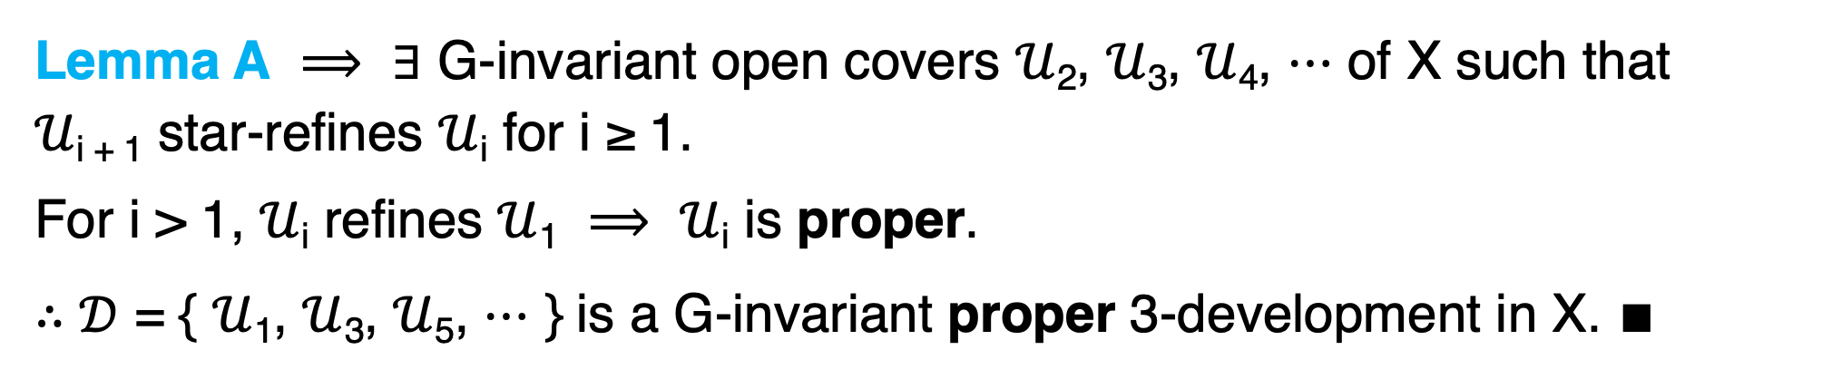
Lemma A $⟹$ $∃$ G-invariant open covers $𝒰$₂, $𝒰$₃, $𝒰$₄, $⋯$ of X such that
$𝒰$_{i + 1} star-refines $𝒰$_{i} for i ≥ 1.
For i > 1, $𝒰$_{i} refines $𝒰$₁ $⟹$ $𝒰$_{i} is proper.
$∴𝒟$ = { $𝒰$₁, $𝒰$₃, $𝒰$₅, $⋯$ } is a G-invariant proper 3-development in X. $∎$

Slide 49
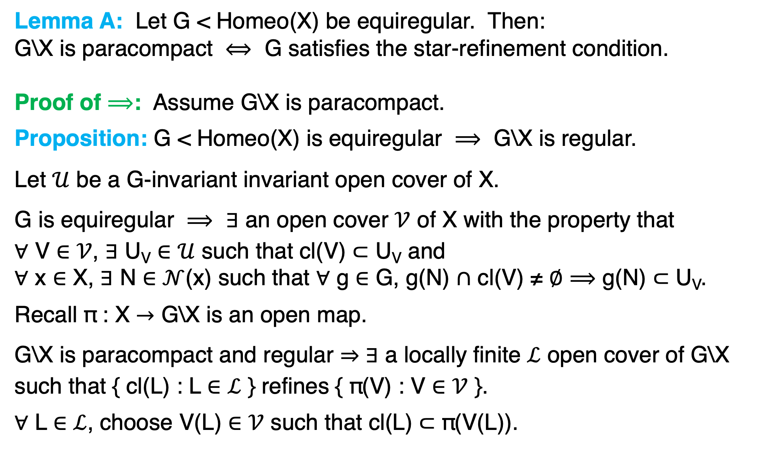
Lemma A: Let G < Homeo(X) be equiregular. Then:
G\X is paracompact $⟺$ G satisfies the star-refinement condition.
Proof of $⟹$: Assume G\X is paracompact.
Proposition: G < Homeo(X) is equiregular $⟹$ G\X is regular.
Let $𝒰$ be a G-invariant invariant open cover of X.
G is equiregular $⟹$ $∃$ an open cover $𝒱$ of X with the property that
$∀$ V $∈$ $𝒱$, $∃$ U_{V} $∈$ $𝒰$ such that cl(V) $⊂$ U_{V} and
$∀$ x $∈$ X, $∃$ N $∈$ $𝒩$(x) such that $∀$ g $∈$ G, g(N) $∩$ cl(V) ≠ $∅$ $⟹$ g(N) $⊂$ U_{V}.
Recall π : X $→$ G\X is an open map.
G\X is paracompact and regular ⇒ $∃$ a locally finite $ℒ$ open cover of G\X
such that { cl(L) : L $∈$ $ℒ$ } refines { π(V) : V $∈$ $𝒱$ }.
$∀$ L $∈$ $ℒ$, choose V(L) $∈$ $𝒱$ such that cl(L) $⊂$ π(V(L)).

Slide 50
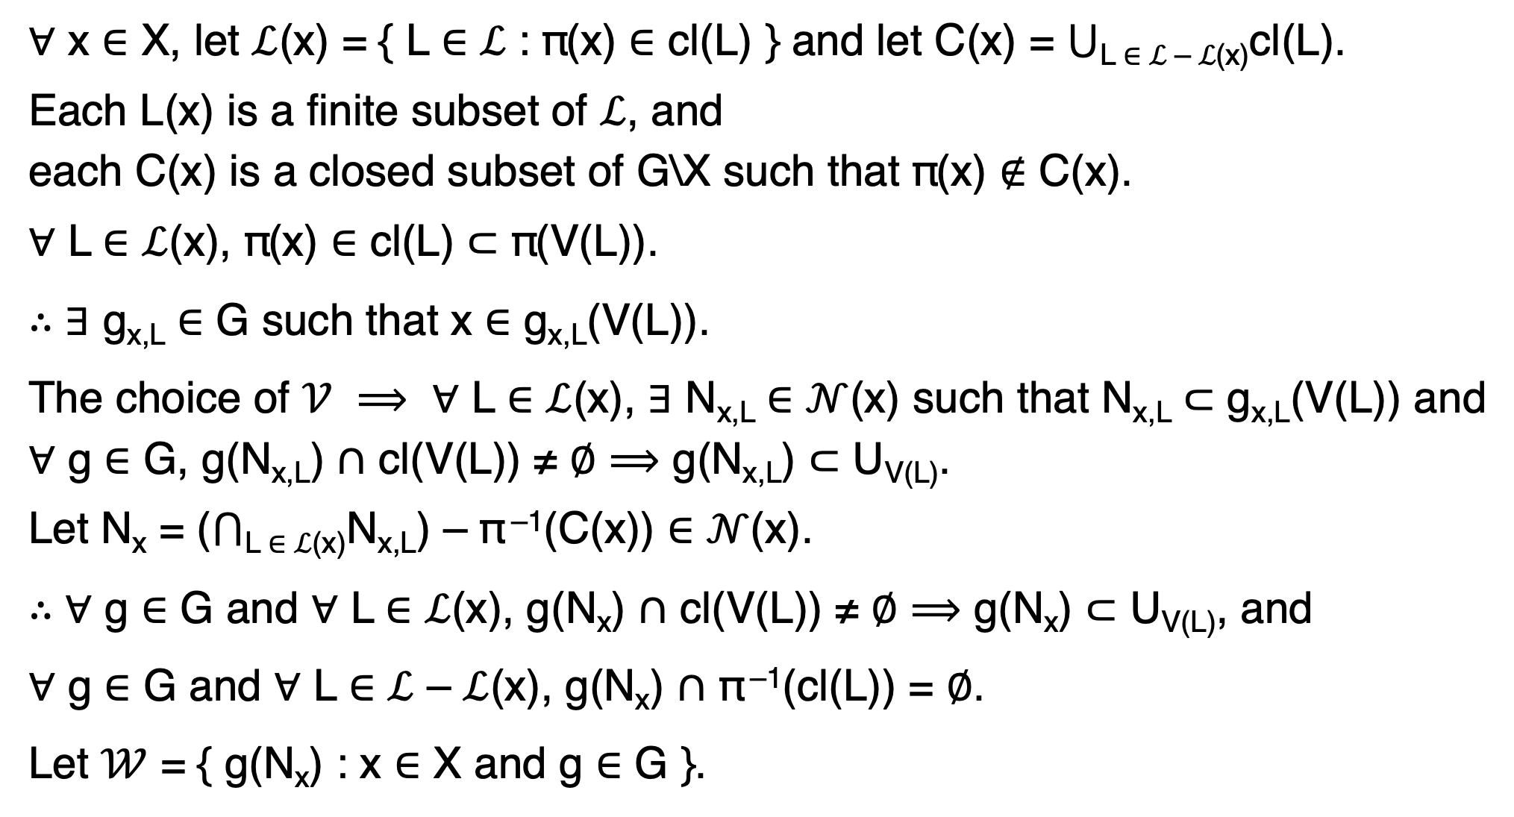
$∀$ x $∈$ X, let $ℒ$(x) = { L ∈ ℒ : π(x) ∈ cl(L) } and let C(x) = ⋃_{L ∈ ℒ – ℒ(x)}cl(L).
Each L(x) is a finite subset of $ℒ$, and
each C(x) is a closed subset of G\X such that π(x) $∉$ C(x).
$∀$ L $∈$ $ℒ$(x), π(x) $∈$ cl(L) $⊂$ π(V(L)).
$∴∃$ g_{x,L} $∈$ G such that x $∈$ g_{x,L}(V(L)).
The choice of $𝒱$ $⟹$ $∀$ L $∈$ $ℒ$(x), $∃$ N_{x,L} $∈$ $𝒩$(x) such that N_{x,L} $⊂$ g_{x,L}(V(L)) and
$∀$ g $∈$ G, g(N_{x,L}) $∩$ cl(V(L)) ≠ $∅$ $⟹$ g(N_{x,L}) $⊂$ U_{V(L)}.
Let N_{x} = ($⋂$_{L} $∈$ $ℒ$_{(x)}N_{x,L}) – π ^{–1}(C(x)) $∈$ $𝒩$(x).
$∴$ $∀$ g $∈$ G and $∀$ L $∈$ $ℒ$(x), g(N_{x}) $∩$ cl(V(L)) ≠ $∅$ $⟹$ g(N_{x}) $⊂$ U_{V(L)}, and
$∀$ g $∈$ G and $∀$ L $∈$ $ℒ$ – $ℒ$(x), g(N_{x}) $∩$ π ^{–1}(cl(L)) = $∅$.
Let $𝒲$ = { g(N_{x}) : x $∈$ X and g $∈$ G }.

Slide 51
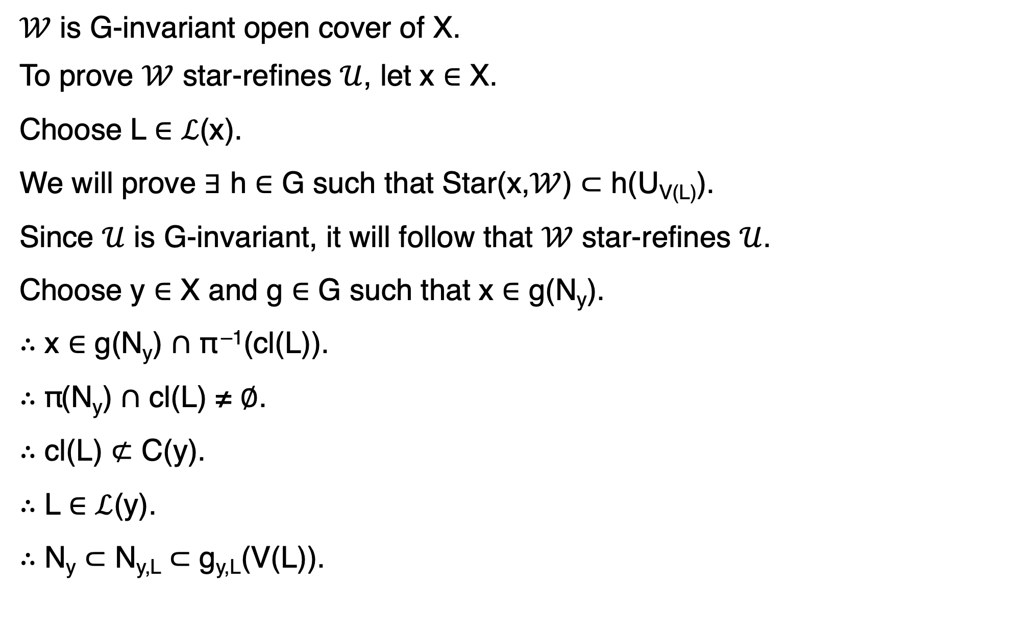
$𝒲$ is G-invariant open cover of X.
To prove $𝒲$ star-refines $𝒰$, let x $∈$ X.
Choose L $∈$ $ℒ$(x).
We will prove $∃$ h $∈$ G such that Star(x,$𝒲$) $⊂$ h(U_{V(L)}).
Since $𝒰$ is G-invariant, it will follow that $𝒲$ star-refines $𝒰$.
Choose y $∈$ X and g $∈$ G such that x $∈$ g(N_{y}).
$∴$ x $∈$ g(N_{y}) $∩$ π ^{–1}(cl(L)).
$∴$ π(N_{y}) $∩$ cl(L) ≠ $∅$.
$∴$ cl(L) $⊄$ C(y).
$∴$ L $∈$ $ℒ$(y).
$∴$ N_{y} $⊂$ N_{y,L} $⊂$ g_{y,L}(V(L)).

Slide 52
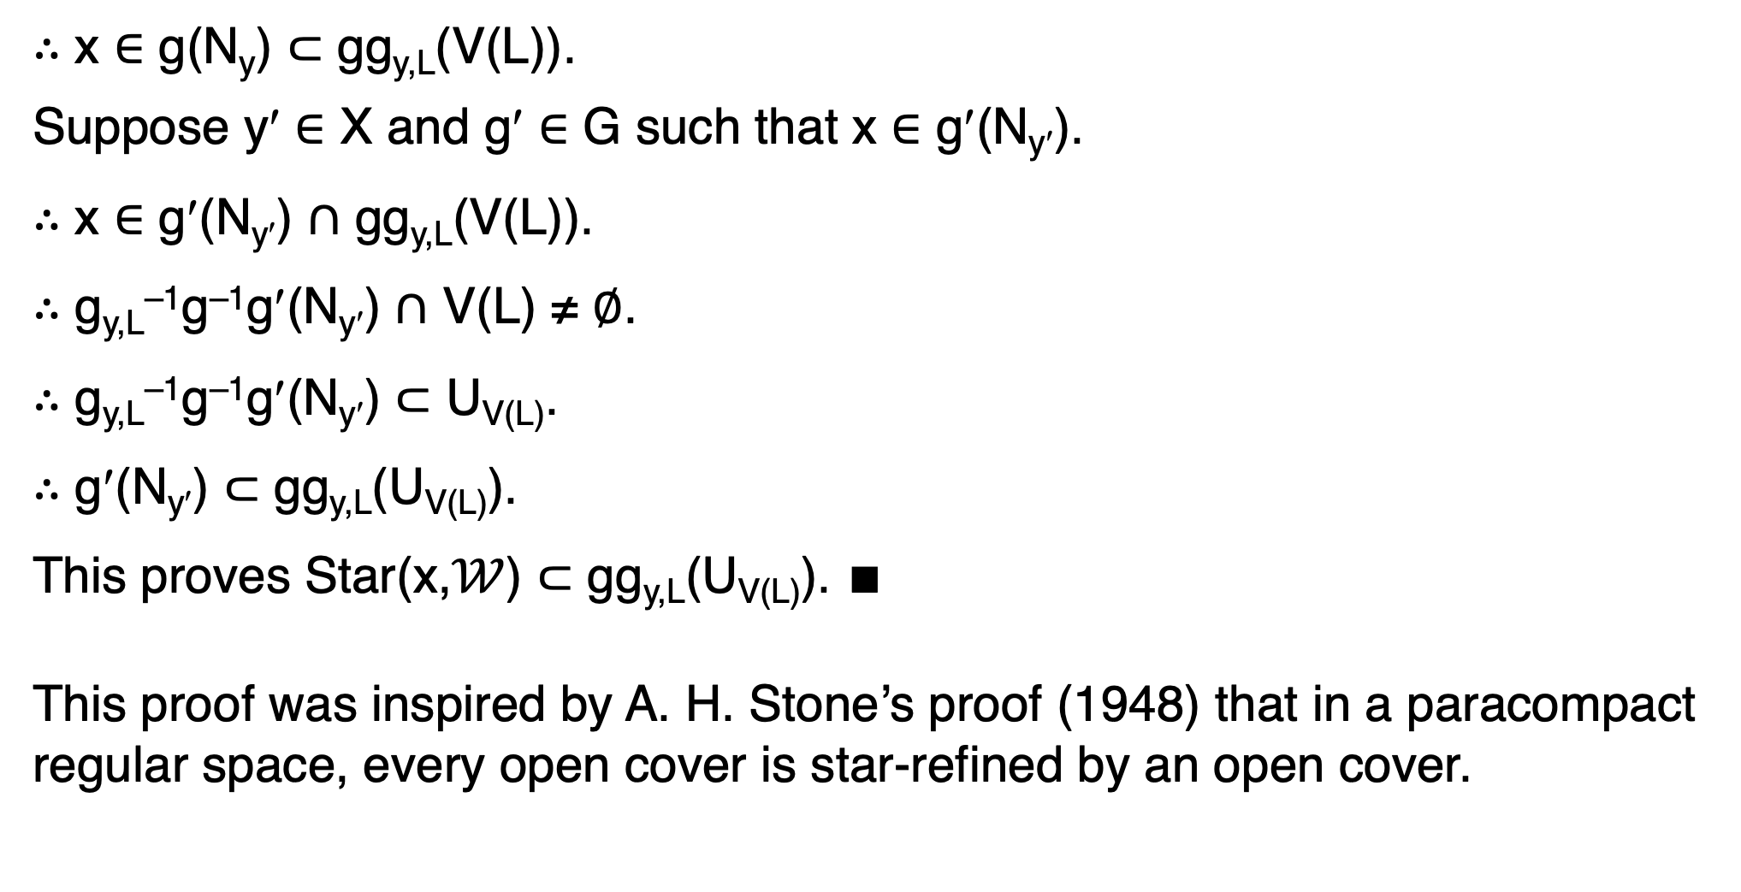
$∴$ x $∈$ g(N_{y}) $⊂$ gg_{y,L}(V(L)).
Suppose y′ $∈$ X and g′ $∈$ G such that x $∈$ g′(N_{y′}).
$∴$ x $∈$ g′(N_{y′}) $∩$ gg_{y,L}(V(L)).
$∴$ g_{y,L}^{–1}g^{–1}g′(N_{y′}) $∩$ V(L) ≠ $∅$.
$∴$ g_{y,L}^{–1}g^{–1}g′(N_{y′}) $⊂$ U_{V(L)}.
$∴$ g′(N_{y′}) $⊂$ gg_{y,L}(U_{V(L)}).
This proves Star(x,$𝒲$) $⊂$ gg_{y,L}(U_{V(L)}). ∎
This proof was inspired by A. H. Stone’s proof (1948) that in a paracompact regular space, every open cover is star-refined by an open cover.

Slide 53
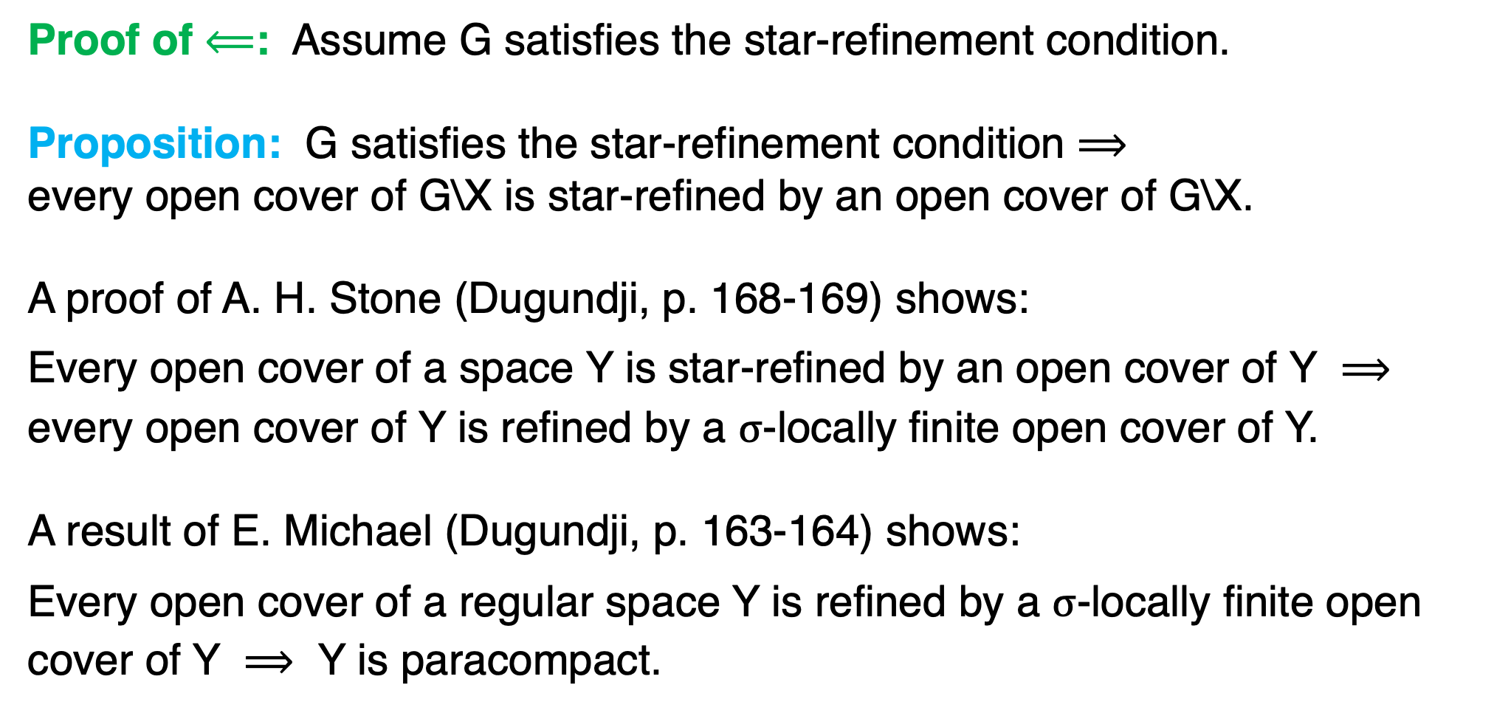
Proof of $⟸$: Assume G satisfies the star-refinement condition.
Proposition: G satisfies the star-refinement condition $⟹$
every open cover of G\X is star-refined by an open cover of G\X.
A proof of A. H. Stone (Dugundji, p. 168-169) shows:
Every open cover of a space Y is star-refined by an open cover of Y $⟹$
every open cover of Y is refined by a $σ$-locally finite open cover of Y.
A result of E. Michael (Dugundji, p. 163-164) shows:
Every open cover of a regular space Y is refined by a $σ$-locally finite open
cover of Y $⟹$ Y is paracompact.

Slide 54
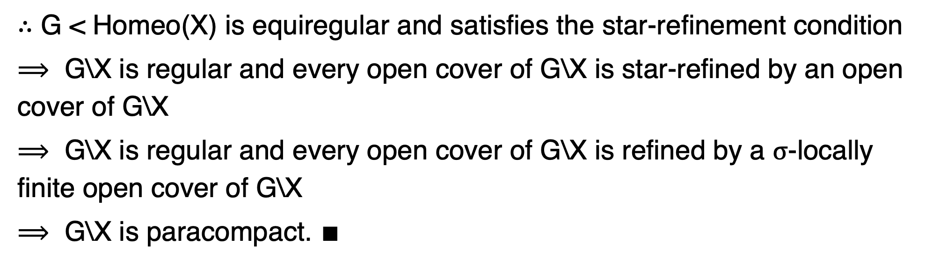
$∴$ G < Homeo(X) is equiregular and satisfies the star-refinement condition
$⟹$ G\X is regular and every open cover of G\X is star-refined by an open
cover of G\X
$⟹$ G\X is regular and every open cover of G\X is refined by a $σ$-locally
finite open cover of G\X
$⟹$ G\X is paracompact. $∎$

Slide 55
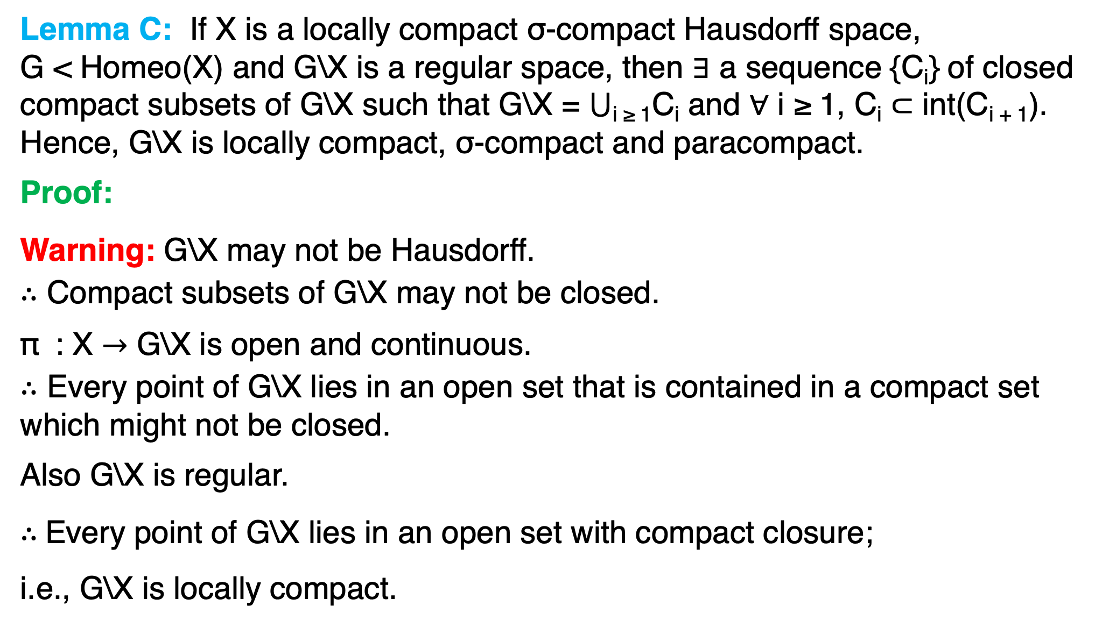
Lemma C: If X is a locally compact σ-compact Hausdorff space,
G < Homeo(X) and G\X is a regular space, then $∃$ a sequence {C_{i}} of closed compact subsets of G\X such that G\X = $⋃$_{i ≥ 1}C_{i} and $∀$ i ≥ 1, C_{i} $⊂$ int(C_{i + 1}).
Hence, G\X is locally compact, σ-compact and paracompact.
Proof:
Warning: G\X may not be Hausdorff.
$∴$ Compact subsets of G\X may not be closed.
π : X $→$ G\X is open and continuous.
$∴$ Every point of G\X lies in an open set that is contained in a compact set which might not be closed.
Also G\X is regular.
$∴$Every point of G\X lies in an open set with compact closure;
i.e., G\X is locally compact.

Slide 56
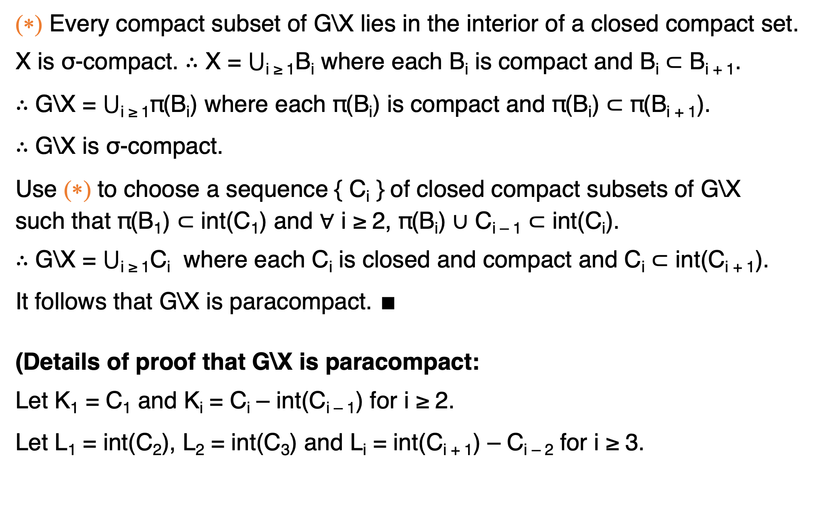
(∗) Every compact subset of G\X lies in the interior of a closed compact set.
X is σ-compact. $∴$ X = $⋃$_{i ≥ 1}B_{i} where each B_{i} is compact and B_{i} $⊂$ B_{i + 1}.
$∴$ G\X = $⋃$_{i ≥ 1}π(B_{i}) where each π(B_{i}) is compact and π(B_{i}) $⊂$ π(B_{i + 1}).
$∴$ G\X is σ-compact.
Use (∗) to choose a sequence { C_{i} } of closed compact subsets of G\X
such that π(B₁) $⊂$ int(C₁) and $∀$ i ≥ 2, π(B_{i}) $∪$ C_{i – 1} $⊂$ int(C_{i}).
$∴$ G\X = $⋃$_{i ≥ 1}C_{i} where each C_{i} is closed and compact and C_{i} $⊂$ int(C_{i + 1}).
It follows that G\X is paracompact. ∎
(Details of proof that G\X is paracompact:
Let K₁ = C₁ and K_{i} = C_{i} – int(C_{i – 1}) for i ≥ 2.
Let L₁ = int(C₂), L₂ = int(C₃) and L_{i} = int(C_{i + 1}) – C_{i – 2} for i ≥ 3.

Slide 57
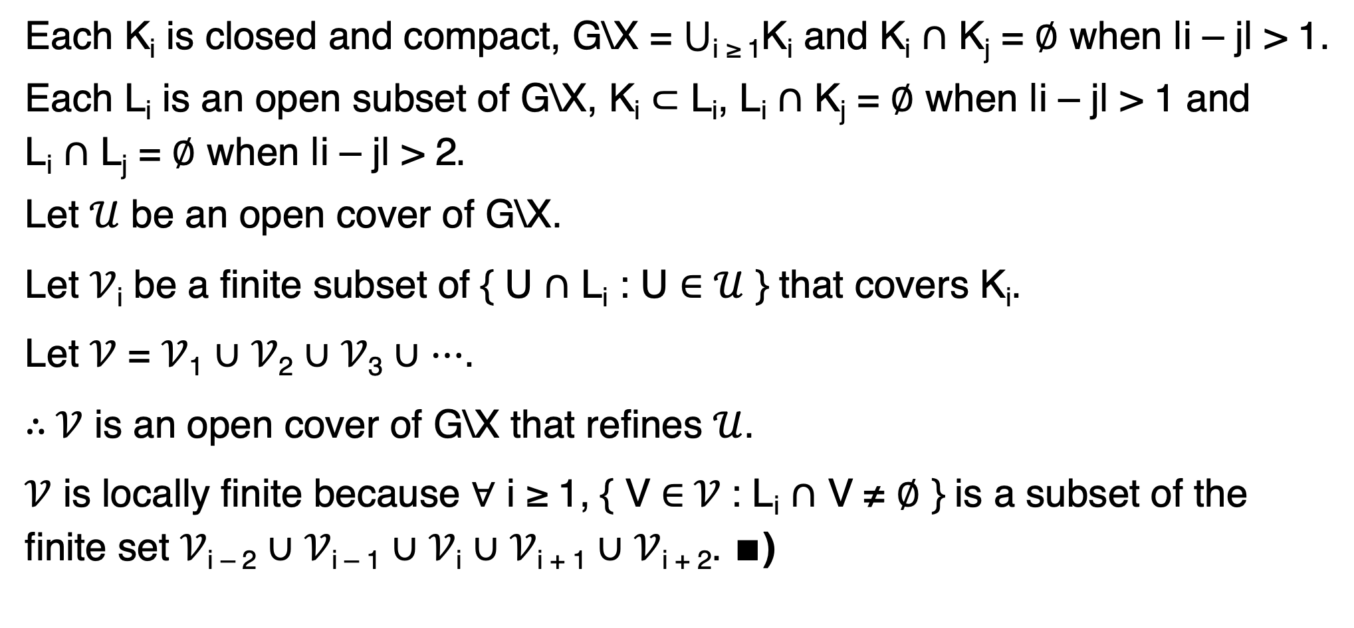
Each K_{i} is closed and compact, G\X = $⋃$_{i ≥ 1}K_{i} and K_{i} $∩$ K_{j} = $∅$ when |i – j| > 1.
Each L_{i} is an open subset of G\X, K_{i} $⊂$ L_{i}, L_{i} $∩$ K_{j} = $∅$ when |i – j| > 1 and
L_{i} $∩$ L_{j} = $∅$ when |i – j| > 2$.$
Let $𝒰$ be an open cover of G\X.
Let $𝒱$_{i} be a finite subset of { U $∩$ L_{i} : U $∈$ $𝒰$ } that covers K_{i}.
Let $𝒱$ = $𝒱$₁ $∪$ $𝒱$₂ $∪$ $𝒱$₃ $∪$ $⋯$.
$∴$ $𝒱$ is an open cover of G\X that refines $𝒰$.
$𝒱$ is locally finite because $∀$ i ≥ 1, { V $∈$ $𝒱$ : L_{i} $∩$ V ≠ $∅$ } is a subset of the
finite set $𝒱$_{i – 2} $∪$ $𝒱$_{i – 1} $∪$ $𝒱$_{i} $∪$ $𝒱$_{i + 1} $∪$ $𝒱$_{i + 2}. ∎)

Slide 58

Lemma D: If X is a locally compact σ-compact Hausdorff space,
G < Homeo(X) is nearly proper, and G\X is a regular space, then
X has a G-invariant proper open cover.
Proof:
Lemma C $⟹$ $∃$ a sequence { C_{i} } of closed compact subsets of G\X such
that G\X = $⋃$_{i ≥ 1}C_{i} and $∀$ i ≥ 1, C_{i} $⊂$ int(C_{i + 1}).
Again let K₁ = C₁, let K_{i} = C_{i} – int(C_{i – 1}) for i ≥ 2,
let L₁ = int(C₂), L₂ = int(C₃) and let L_{i} = int(C_{i + 1}) – C_{i – 2} for i ≥ 3.
$∀$ i ≥ 1, $∃$ a collection $𝒰$_{i} of open subsets of X with compact closure such
that K_{i} $⊂$ $⋃${ π(U) : U $∈$ $𝒰$_{i} } $⊂$ L_{i}.
K_{i} is compact $⟹$ $∃$ a finite $ℱ$_{i} $⊂$ $𝒰$_{i} such that K_{i} $⊂$ $⋃${ π(U) : U $∈$ $ℱ$_{i} }.
Let $ℱ$= $ℱ$₁ $∪$ $ℱ$₂ $∪$ $ℱ$₃ $∪$ $⋯$.

Slide 59

$∴$ { π(U) : U $∈$ $ℱ$ } covers G\X.
Let $𝒱$ = { g(U) : U $∈$ $ℱ$ and g $∈$ G }.
$∴$ $𝒱$ is a G-invariant open cover of X.
To prove $𝒱$ is proper, let B $⊂$ X be compact.
$∃$ k ≥ 1 such that i > k $⟹$ π(B) $∩$ L_{i} = $∅$.
$∴$ i > k and U $∈$ $ℱ$_{i} $⟹$ π(B) $∩$ π(U) = $∅$.
$∴$ U $∈$ $ℱ$_{i}, g $∈$ G and B $∩$ g(U) ≠ $∅$ ⇒ i ≤ k.
$∴$ { U $∈$ $ℱ$ : $∃$ g $∈$ G such that B $∩$ g(U) ≠ $∅$ } $⊂$ $ℱ$₁ $∪$ $ℱ$₂ $∪$ $⋯$ $∪$ $ℱ$_{k}.
Let A = $⋃${ cl(U) : U $∈$ $ℱ$₁ $∪$ $ℱ$₂ $∪$ $⋯$ $∪$ $ℱ$_{k} }.
$∴$ A is compact.
Also U $∈$ $ℱ$, g $∈$ G and B $∩$ g(U) ≠ $∅$ $⟹$ U $⊂$ A.

Slide 60

$∴$ Star(B,$𝒱$) $⊂$ $⋃${ g(A) : g $∈$ G and g(A) $∩$ B ≠ $∅$ }.
G is nearly proper $⟹$ cl($⋃${ g(A) : g $∈$ G and g(A) $∩$ B ≠ $∅$ }) is compact.
$∴$ cl(Star(B,$𝒱$)) is compact.
$∴$ This proves $𝒱$ is proper. ∎

Slide 61

Remark on the hypothesis: G\X is paracompact:
Our proof requires that G satisfy the star-refinement condition.
Lemma A implies:
G satisfies the star-refinement condition $⟺$ G\X is paracompact.
$∴$ The hypothesis that G\X is paracompact is necessary for our proof.
However, $∃$ isometrizable G < Homeo(X) such that G\X is not paracompact.
Example: Let X = ({countable ordinals} with order topology) $×$ $ℤ$₂.
X is Haudorff completely regular but not paracompact.
Let G = $ℤ$₂ act on X by g(y,h) = (y,gh).
G < Homeo(X) is equiregular and isometrizable,
G\X $≈$ {countable ordinals} is not paracompact.
$∴$ G does not satisfy the star-refinement property.

Slide 62

Note: X completely regular Hausdorff and G < Homeo(X) isometrizable $⟹$
G is equiregular.
Conjecture: X completely regular Hausdorff and G < Homeo(X) equiregular $⟹$ G is isometrizable.

Slide 63

An example showing equiregular $⟹$ nearly proper.
Let X = { 0, 1, 2, $⋯$ } with the discrete metric $ρ$.
$∴$ X is a locally compact $σ$-compact non-compact metrizable space.
Let G = Homeo(X). $∴$ $ρ$ is G-invariant.
$∴$ G is singly isometrizable. $∴$ G is equiregular.
For n ≥ 1, define g_{n} $∈$ G by: g_{n}(1) = n, g_{n}(n) = 1 and g_{n}(k) = k for k $∉$ {1,n}.
Let C = {0,1}. $∴$ $∀$ n ≥ 1, 1 $∈$ C $∩$ g_{n}(C) and $⋃$_{n ≥ 1}g_{n}(C) = X.
$∴$ G is not nearly proper.
$∴$ G is equiregular but not nearly proper.
Also G is singly metrizable but not properly isometrizable.

