Slide 1
Pyotr Lavrovich Lavrov
(1823-1900) is the first Russian author of the cycle of lectures on the history of physical and mathematical sciences. To the bicentenary of the birth
G.I. Sinkevich
St. Petersburg State University of Architecture and Civil Engineering
gsinkevich@gmail.com

Slide 2
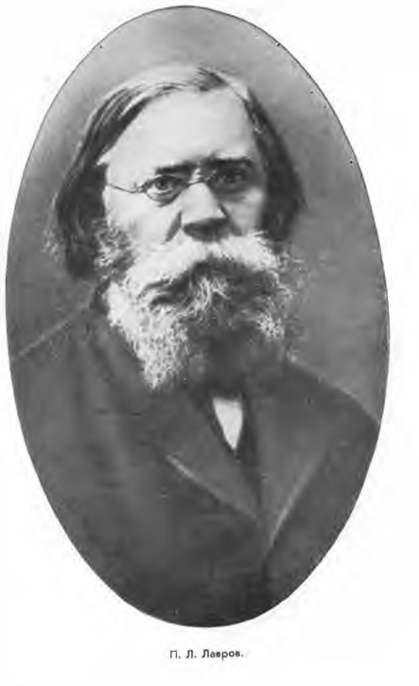

Slide 3
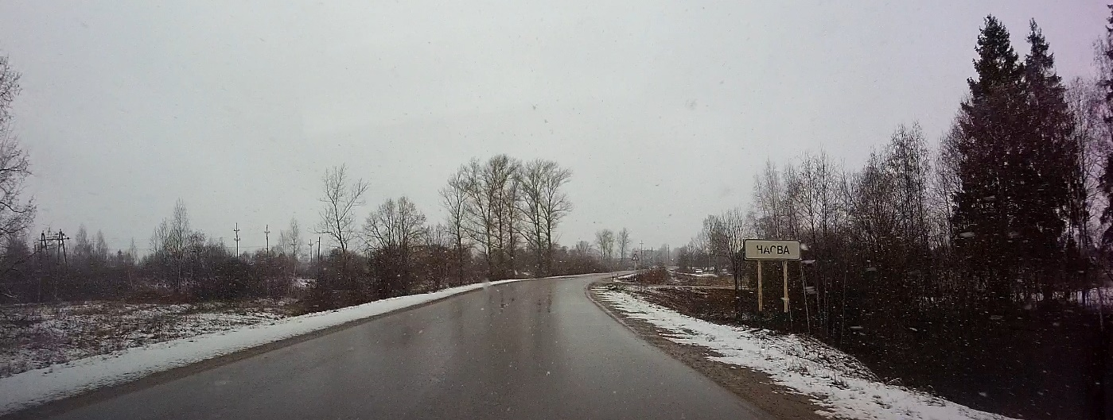
Nasva village, Novosokolnichesky district, Pskov region. The former estate of the Lavrovs - Melikhovo. 19th century In 1823, the theorist of revolutionary populism, a member of the Paris Commune, the author of the song Worker's Marseillaise (Let's Renounce the Old Worl) P. L. Lavrov (1823-1900) was born here. Old linden trees, traces of a pond in the form of a question mark, remains of foundations have been preserved.

Slide 4
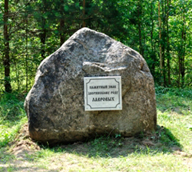
A visitor to the former estate of the Lavrovs will see only the remains of the park, fragments of the foundation and a memorial sign

Slide 5
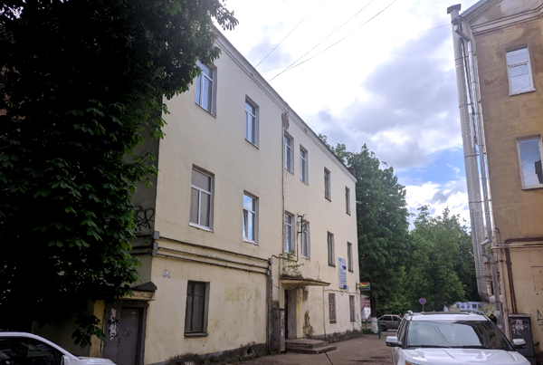
House of the Lavrovs in Velikiye Luki - Nekrasova street, 10

Slide 6
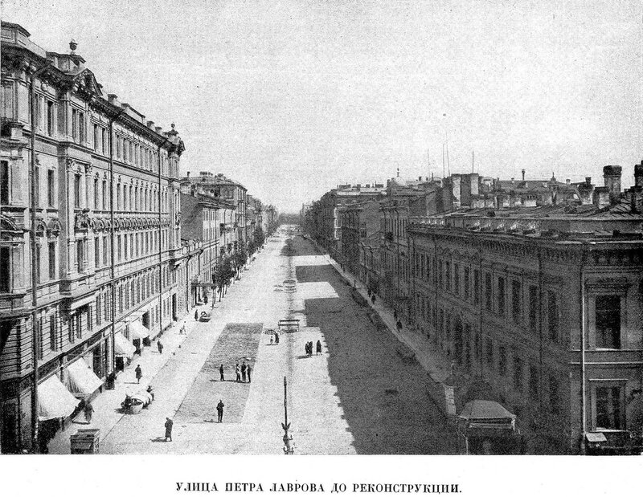
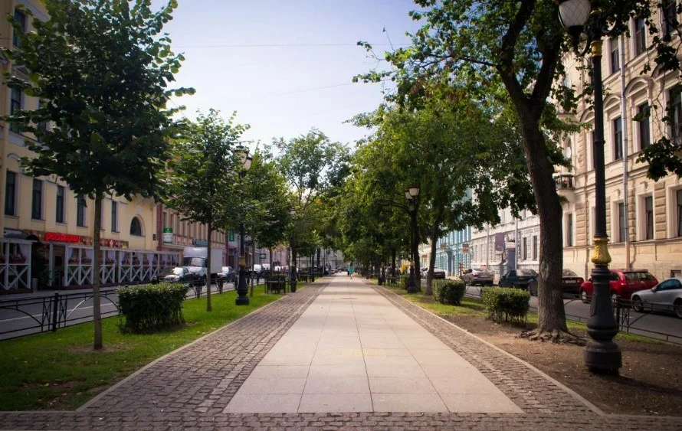
Furshtadtskaya (Furshtatskaya) street in St. Petersburg

Slide 7
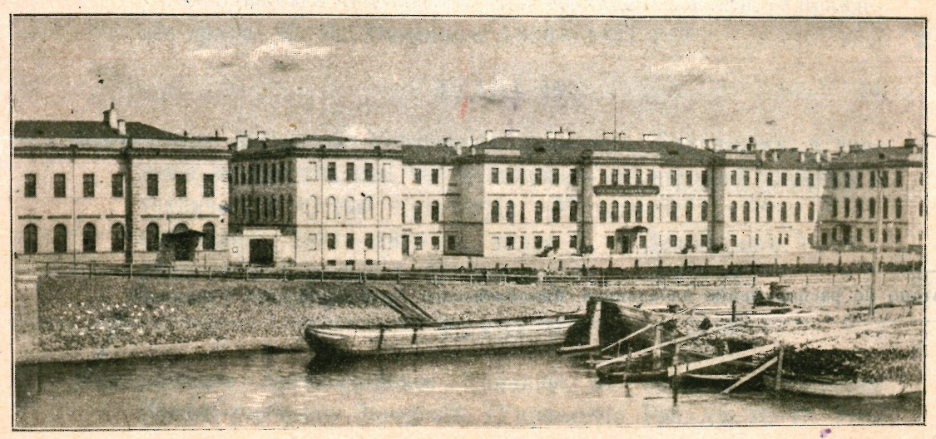
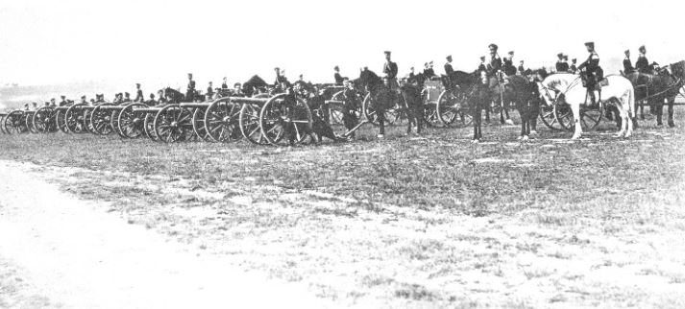
Mikhailovskaya Artillery Academy

Slide 8
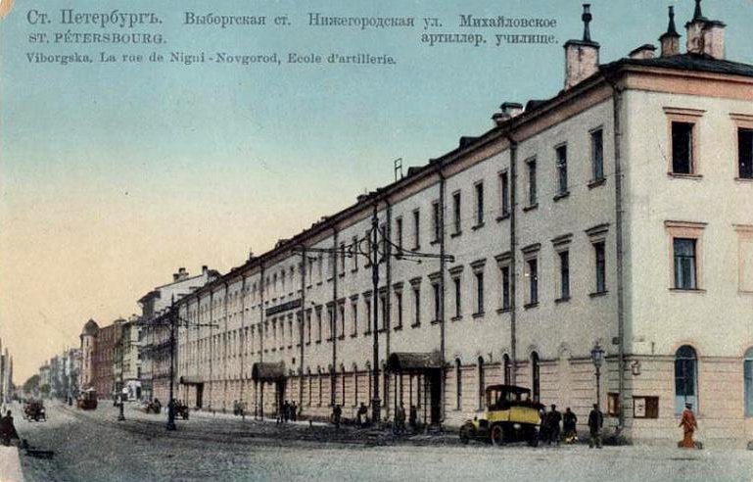
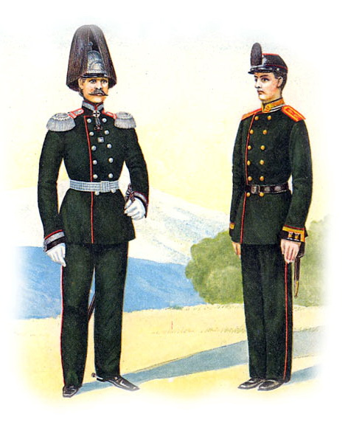

Slide 9
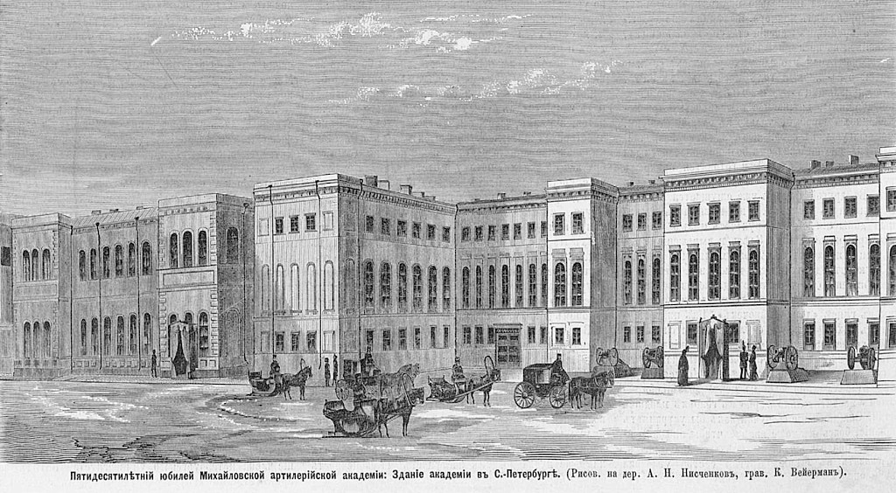
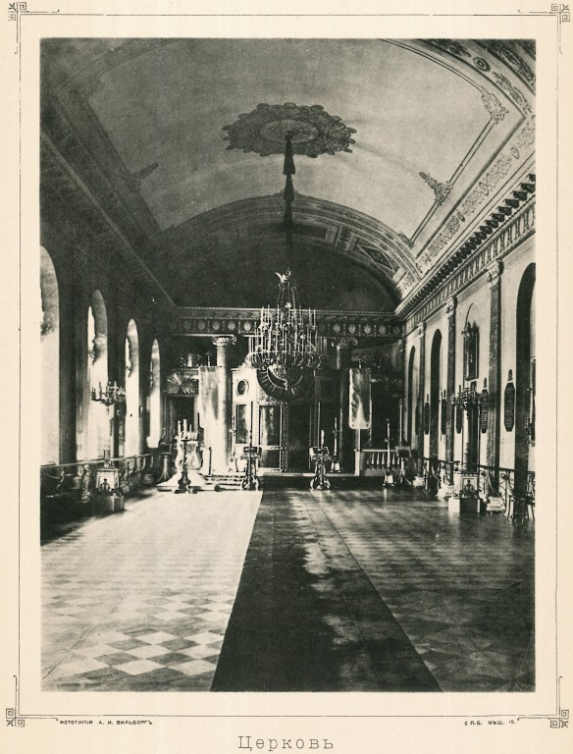
Mikhailovskaya Artillery Academy

Slide 10
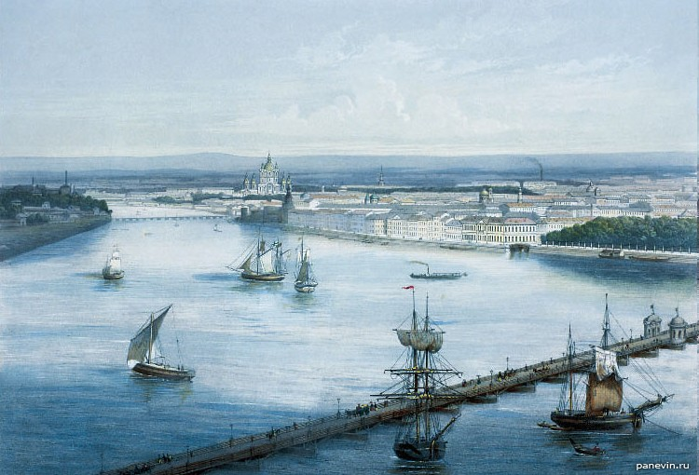
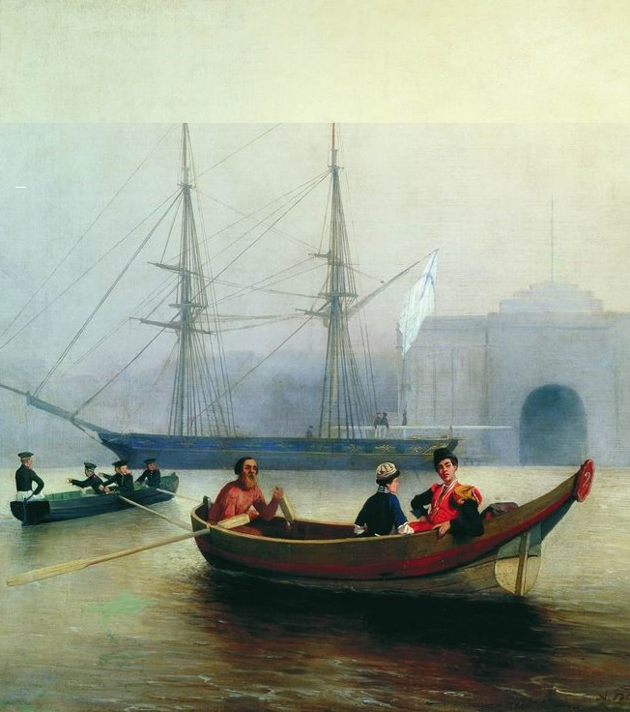
Voskresensky floating bridge

Slide 11
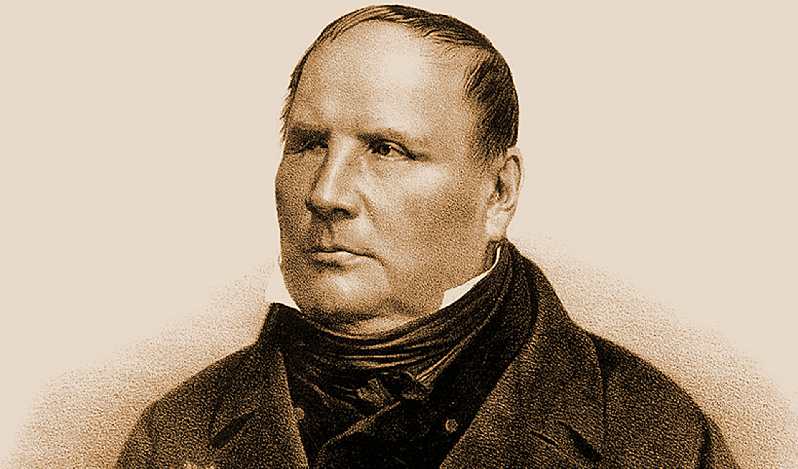
M.V. Ostrogradsky

Slide 12
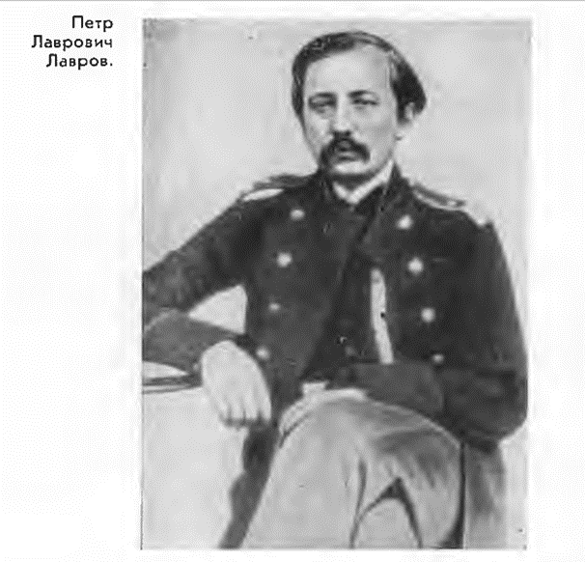
Petr Lavrovich Lavrov

Slide 13
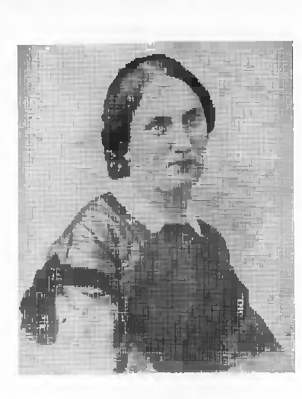
Antonina-Cecilia Khristoforovna Lavrova, nee. Loveiko, wife of P.L. Lavrov

Slide 14
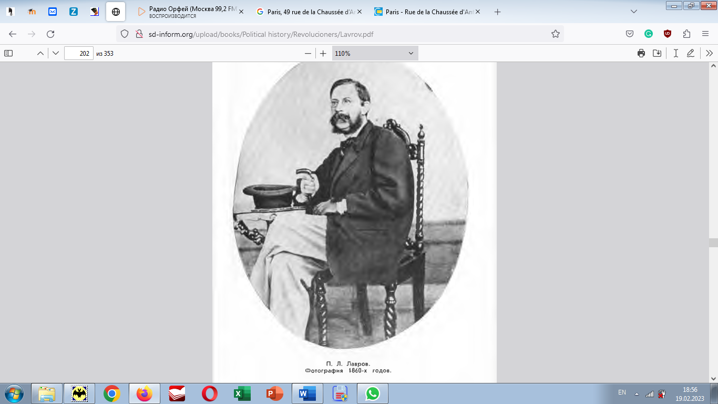


Slide 15
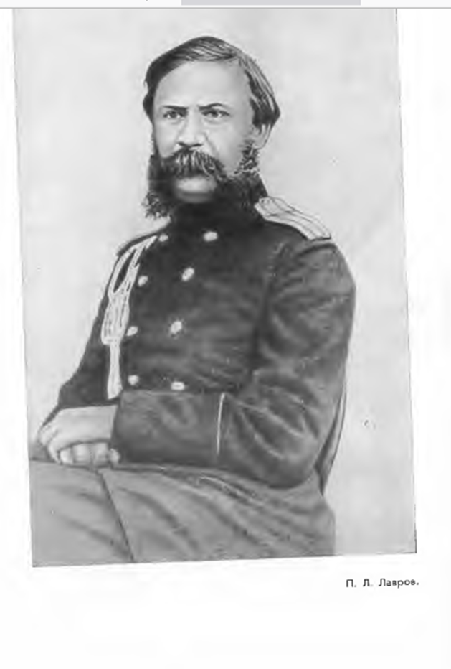
Petr Lavrovich Lavrov

Slide 16
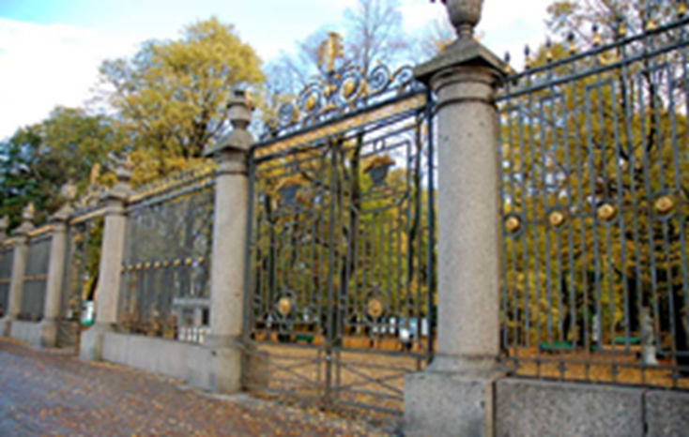
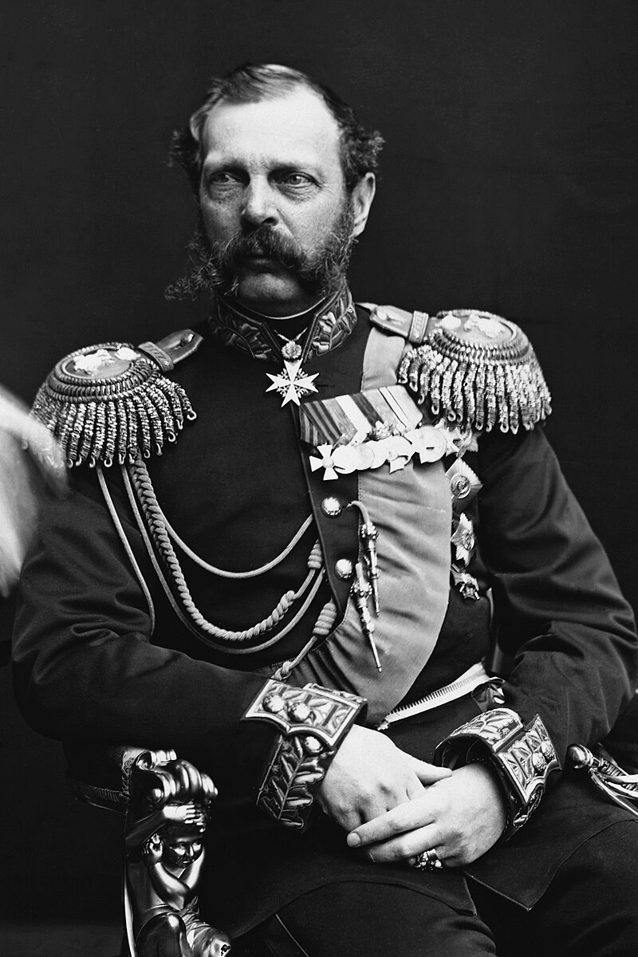
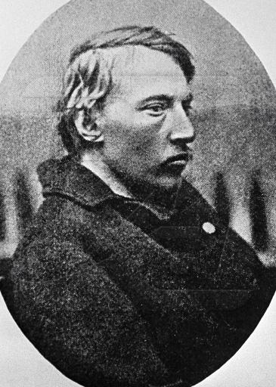
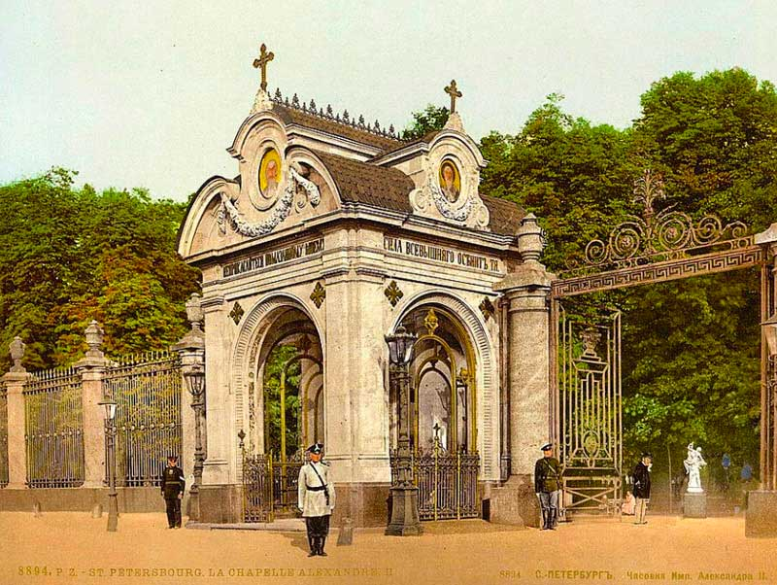
April 4, 1866, Dm. Karakozov tries to shoot at
Emperor Alexander II

Slide 17

Totma, Vologda province

Slide 18
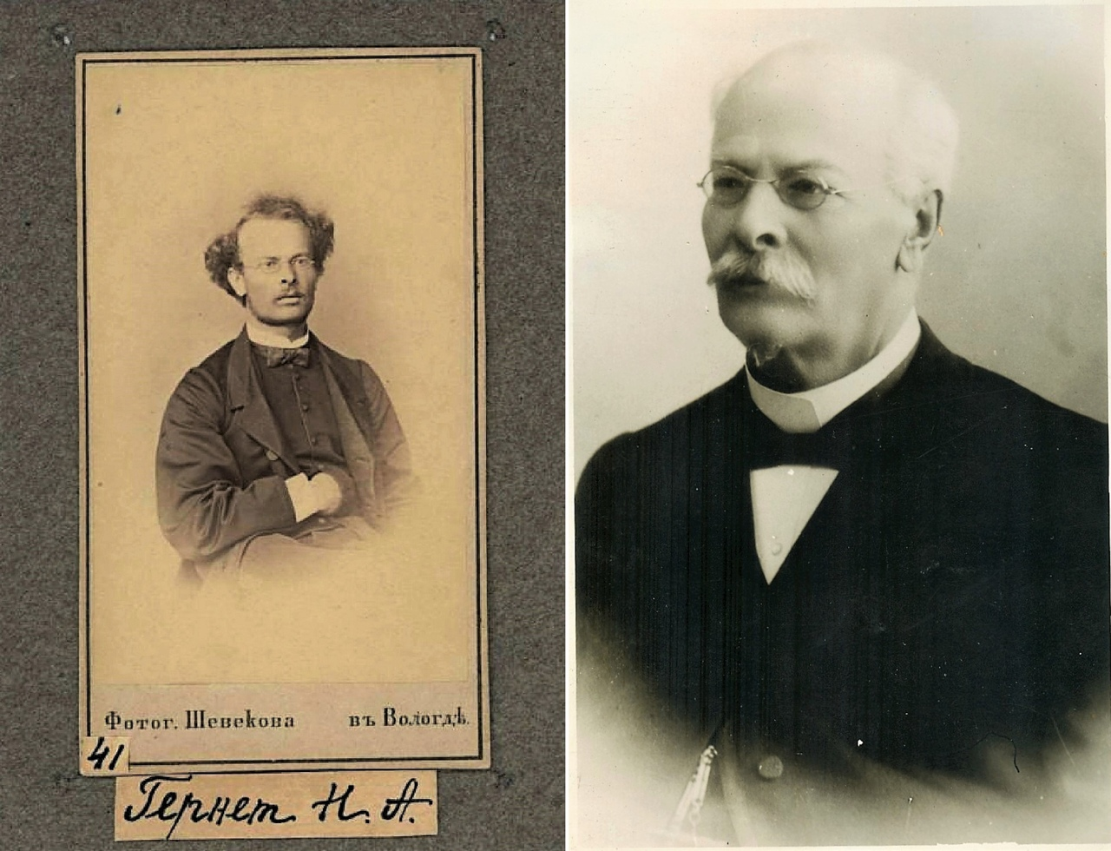
N.A. Gernet

Slide 19
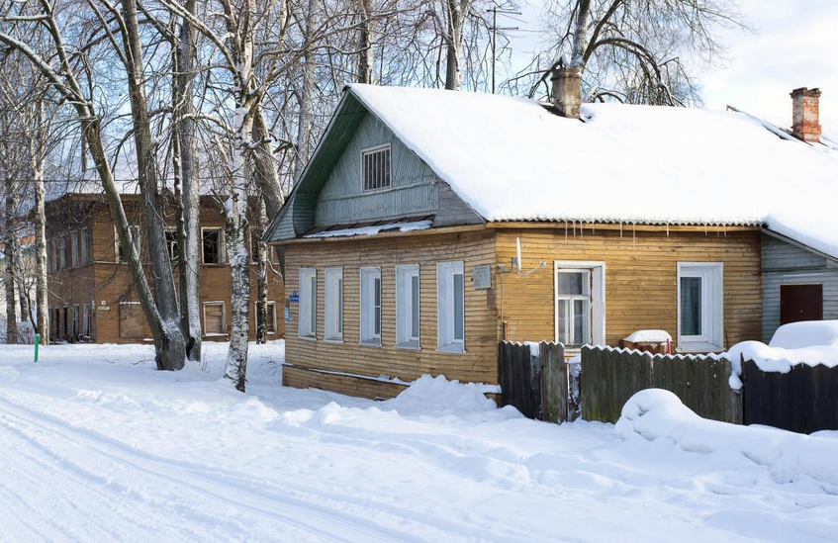
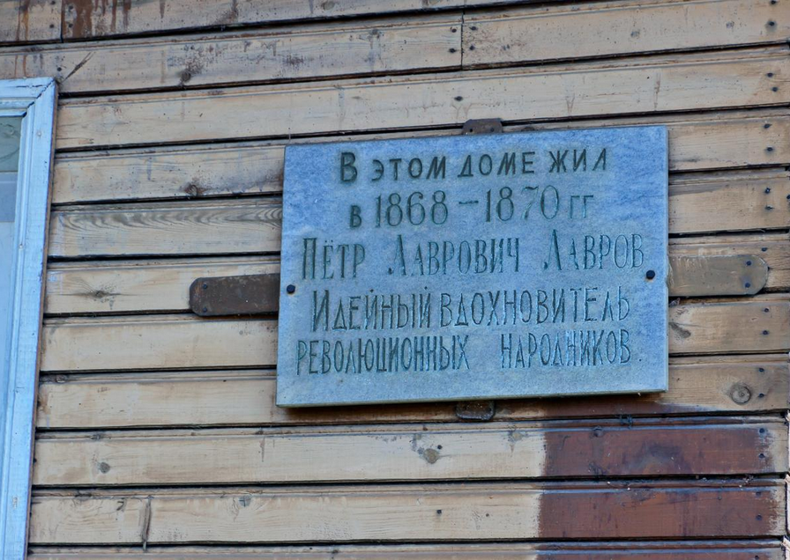
The house in Kadnikovo, where P. L. Lavrov lived, is one-story, wooden, chopped, sheathed with boards, the foundation is on rubble pillars. The layout of the house has been preserved. The room in which P. L. Lavrov lived has not been established. In 1963, a marble memorial plaque was opened on the house with the text: "Pyotr Lavrovich Lavrov, the ideological inspirer of the revolutionary Narodniks, lived in this house in 1868-1870."

Slide 20
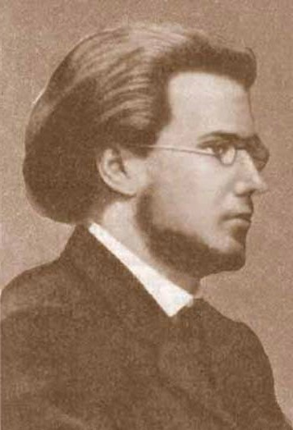
German Alexandrovich Lopatin

Slide 21
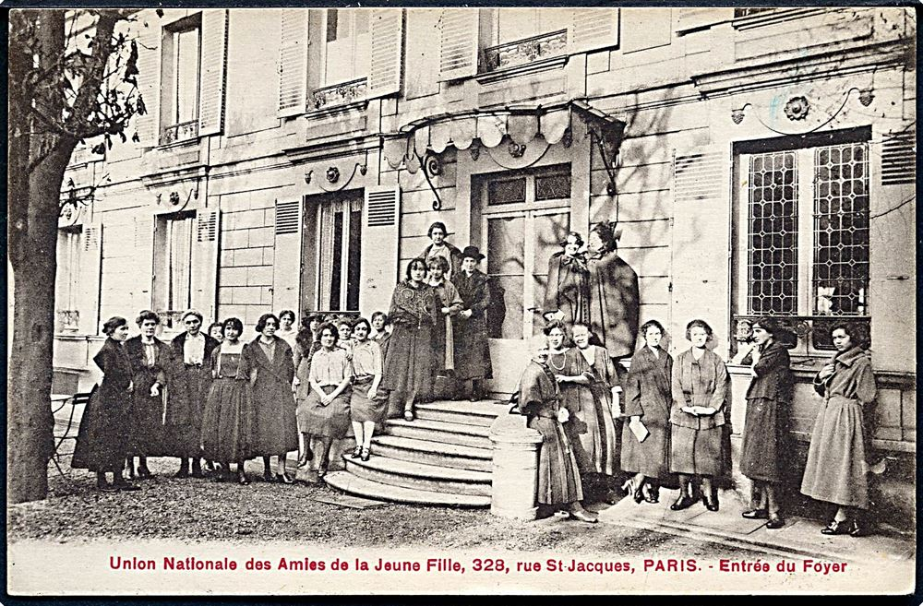
The house where Lavrov lived in Paris

Slide 22
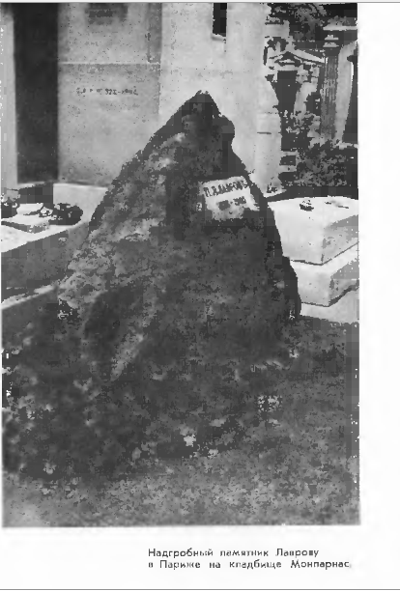
Lavrov's tombstone at the Montparnasse cemetery

Slide 23
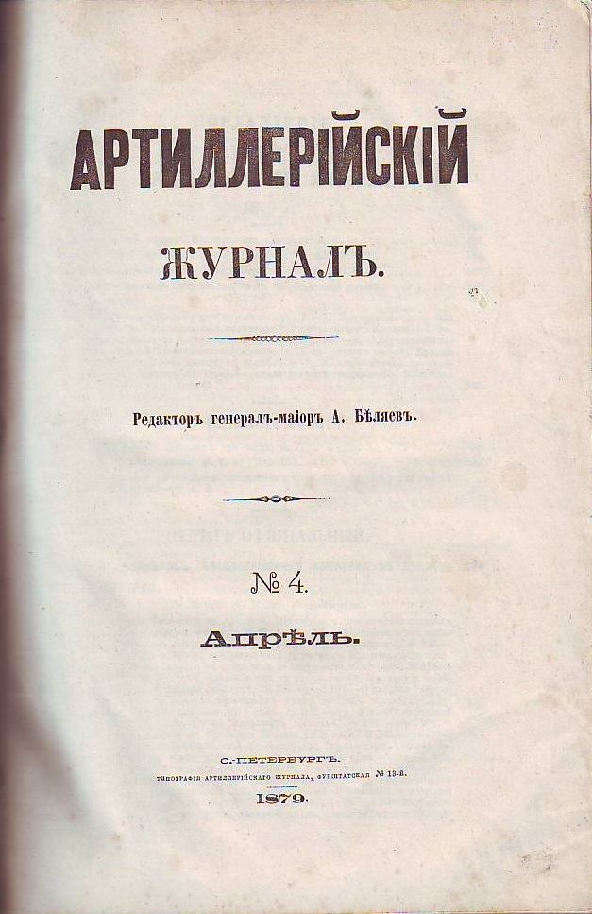
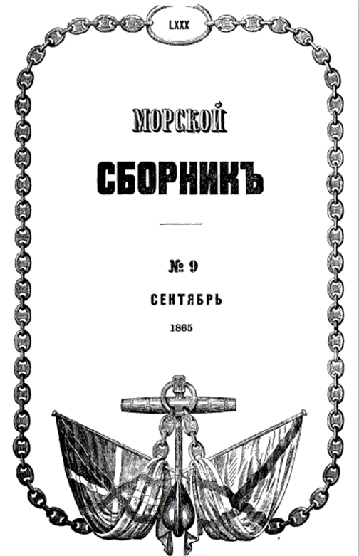
Essay on the history of physical and mathematical sciences
Compiled from lectures given in the laboratory of the Artillery Academy, P. Lavrov.
Artilleryjournal and Marine collection, 1865-1866

Slide 24
Contents of Lavrov's 12 lectures on the history of physical and mathematical sciences
Article one. Introduction. Forewarning. §1. Significance of the history of sciences. Its limits are in the history of human thought in general. Limits of the history of physical and mathematical sciences. The purpose of this story. §2. Prior knowledge. Metallurgy. Three periods of primitive culture. Metals known in antiquity. §3. Numeral systems. Mechanical calculations. §4. Written reckoning [Морской сборник, 1865. Т. LXXVI, №1, c.1-36], [Артиллерийский журнал, 1865, 4, c. 1-58]
Article two. Chapter I. Greece VII-IV centuries. BC §5. The first scientific information. Measures. Mathematics. Astronomy. §6. China. Dispute about the science of the ancient East. India. §7. Babylon; ancient information about his science and Nabataean literature. Egypt. The position of the dispute about his science. Phoenicians. Jews. Etruscans [Морской сборник, 1865. Т. LXVII. №3, c. 37-68], [Артиллерийский журнал, 1865, 5, c. 59-120].

Slide 25
Article three. Chapter I. Greece. §8. Secular sciences in Greece. The original state of Greek knowledge. Asia Minor cities. The question of the composition of the world. Greek thinkers of the first era. The fallacy of their method in matters of natural science. Advances in mathematics and astronomy. §9. The question of the possibility of knowledge. Sophists. Greece in the middle of the 5th century. Protagoras. Socrates. Plato. planetary astronomy. Analysis. geometric places. Conic sections. Other curved lines. geometric questions. Eudox. Theory of spheres. Callippus. The rotation of the earth about its axis. Ctesias and Xenophon[Морской сборник, 1865. Т. LXVII. №4, c. 69-115], [Артиллерийский журнал, 1865, 6, c. 121-152].
Article four. Chapter I. Greece. Continuation. §11 (sic!). Aristotle. His life. the fate of his doctrine. The influence of the campaigns of Alexander the Great on Greek thought. The difference between Aristotle and his predecessors and his works on logic. §12. Guidance. observation and experience. scientific method. Striving to understand the world. Disadvantages of Aristotle's method [Морской сборник, 1865. Т. LXXVIII, №5, c.125-154].
Article five. Chapter I. Greece. Continuation. § 13. Mathematical works of Aristotle. A group of his writings on inorganic nature. Movement. quality changes. Mechanical knowledge of Aristotle. Heavenly and earthly phenomena. Four forces. The phenomenon of gravity. Elemental changes. Meteorology and physics of the earth. Astronomy of Aristotle [Морской сборник, 1865. Т.LXXIX, №7, С. 155-170].

Slide 26
Article six. Greece. §14. Aristotle's work on organisms. Works on botany. Aristotle's own experience in anatomy and physiology. His mistakes. His merit. His writings on anatomy and physiology. His classification. Psychology. Meaning of Aristotle. §15. School of Aristotle. Θeophrast. Mineralogy. Botany. Evdem. Aristoxenus. Dikearch. Strato. Autolycus [Морской сборник, 1865. Т.LXXIX, №8, c. 171-214].
Article seven. Alexandria. 3rd century BC – V c. AD §16. Alexander the Great and the Diadochi. Alexandria of Egypt. Ptolemies. Library of Alexandria and Museum of Alexandria. §17. Euclid of Alexandria [Морской сборник, 1865. Т. LXXX. №9, С. 215-254].
Article eight. Chapter II. Alexandria. 3rd century BC - V с. AD Continued. §18. Astronomical observations. Armillary spheres. Aristillus and Timocharis. Conon. Dositheus. Aristarchus of Samos. Poems of Arat. §19. Eratosthenes of Cyrene. §20. Archimedes of Syracuse[Морской сборник, 1865. Т. LXXX. №10, c. 255-297].
Article nine. Chapter II. Alexandria. §21. Apollonius of Perga. On conic sections. §22. Relationships between mathematicians of the late 3rd and early 2nd centuries. Nycomed. Ipsicle. Seleucus. Technological advances. Ctesibius. Heron. Philo. §23. Hipparchus of Nicaea [Морской сборник, 1865. Т. LXXXI, №11, c. 298-342].

Slide 27
Article ten. Alexandria. Ending. §24. Medical anatomists. Skepticism and empiricism. Nicander of Colophon [Морской сборник, 1865. Т. LXXXI. № 12, c. 343-355].
Article eleven. Chapter II. Alexandria. §25. Rome until the middle of the II century BC. §26. The time of the decline of scientific studies. Ptolemy Everget II. Pergamon. Apocryphal literature. Attalus III and Mithridates of Pontus. Epicureanism. Lucretius. Seneca's predictions. §27. Posidonius. Geminus. Cleomedes. Theodosius. Menelaus. Varro. Agrimensors. Vitruvius. Frontin. Seneca. didactic poets. Julian calendar. Description of the empire. Travelers and geographic compilers. Strabo. Geographers, contemporary to him. Pomponius Mela. Medics. The state of chemical knowledge in the 1st century after our era. Nikolai Damaskin. Celsus. Columella. Dioscorides. Pliny. The state of chemical knowledge in the 1st century of our era [Морской сборник, 1866. Т. LXXXII. №2, c. 357-408].
Article twelve. Chapter II. Alexandria. 2nd century BC – V c. AD. Continuation. §28. Attempts to revive science. Nicomachus. Leon of Smyrna. Some mathematicians and astronomers of this time. Cl. Ptolemy. Astronomical collection. §28. Medical anatomists of the 2nd century. Marin. Soran. Ruf. Claudius Galen. Some zoological materials [Морской сборник, 1866. Т. LXXXIII, №3, c. 409-452].
This is where the publication ends, because. in April 1866, Lavrov was arrested, followed by his deportation to the Vologda province.

Slide 28
Influence of the development of the exact sciences on the successes of military affairs and, in particular, artillery
Lectures given by Colonel Lavrov for artillery officers
Artillery journal1865 № 4, 6, 7.
First lecture. Proudhon's fable about Hercules and the opposition between science and military affairs. This opposition really exists in other social circles. Historical proof of the need for this connection. Science and Poliorcetics of Ancient Babylon and Nineveh. Durot de la Malle's thesis. Greece in the 5th and 3rd centuries BC Siege of Plataea. Nicias before Syracuse. The era of the successors of Alexander. Demetrius Poliorketes and his helepolis. Works of Heron of Alexandria and Philo of Byzantium. Polyorketics in the 3rd century BC, explanation of its success. Plato, Euclid, Apollonius of Perga; progress in mathematics. Aristotle, physicians; successes in natural science; Ctesibius, Heron; advances in technology. Archimedes. Defense of Syracuse. The scientific significance of Archimedes. He is the first scientific artilleryman.
Second lecture. The use of gunpowder as a propelling force. Antiquity of gunpowder. Artillery in the 15th century and in the 17th. Successes of mathematical sciences in Italy in the 16th century. Leonardo da Vinci, Maurolicus, Ferro, Tartaglia, Cardano. The occupations of scientists by military affairs. The dangerous situation of France at the end of the 18th century. Scientists defending the fatherland: Guyton de Morveau, Berthollet, Fourcroy, Monge. What has science done? Modern Artillery Improvements. Political and economic issues.
Third lecture. The result of a historical review. Should every artilleryman be a great scientist? Theory and practice. Every practice is based on theory. Every theory must be practical. An example of the theory of artillery actions in the field. The need for the development of sciences for the success of artillery. To what extent should the gunners themselves participate in this development? What should an artilleryman learn? What does an artillery technician need? What does an artillery theorist need? What is more expensive: to prepare scientists or to take ready-made results of scientific investigations from foreigners? What does a combat artilleryman need? He needs no less a technician and a theoretician, but something else. The need for academic courses for line officers, but courses other than those for technicians. Courses of political economy and theory of administration. Science and education. necessary and desirable. The duty of the state and the responsibility of the individual. Descartes and Faulhaber.

Slide 29
Literature in Russian used by Lavrov
Арат из Сол. Аристофан, Архимед. Псаммит / пер. Ницце (?- пер. Ф. Петрушевского). 1824. Архимед в различных переводах (в частности, Дж. Борелли). Borelli, G. A. Rome, Mascardi, 1679. Elementa Conica'et Archimedis Opera Nova & breviora methodo demonstrata.), Афиней, Бокль Г.Т. История цивилизации в Англии / Пер. К. Бестужева-Рюмина и Н. Тиблена. 2-е, испр. изд. Т. 1-2. СПб., 1864-1865, Буняковский В.Я. Арифметика // Энциклопедический словарь. V. Буняковский В.Я. Архит Тарентский. Энциклопедический словарь, составленный русскими учёными и литераторами. СПб. 1862. Валлис о Паппе и Аполлонии. Витрувий. Ворсо И.И.А. (Worsaae). Северные древности Королевского музея в Копенгагене, отобранные и объясненные профессором копенгагенского университета И. И. А. Ворсо (Worsaae). с совместным предисловием. К.М. Бэра и А.А. Шифнера. СПб., 1861. Гейльброннер. Геродот. Евтерпа. 1862. Гесиод. Диоген Лаэртский. Х.Л. Иделер (нем. Chr. L. Ideler). Заграничный вестник (СПб журнал). 1864 № 9. Н.М. Карамзин. История государства российского. VII (см.о сорока и девяносто в русском счете). Ксенофонт. Лейбниц об Архимеде в письме к Валлису 29 дек. 1698 г., цит. у Бертрана. J.Bertrand. Traité de calcul différentiel et de calcul intégral. I. 1864. Preface. II, пример. Paris. 1864.

Slide 30
Лукреций. О природе вещей (De rerum natura). Милль Дж. С. - Система логики. Том 1. СПб. 1865. Одиссея. Папп. Математическое собрание // M. Chasles. Платон. Диалоги. Плиний. Натуральная история, кн. XXVIII. Плутарх. Полибий. Всеобщая история. Т. V. 1861. Порфирий. Пипер // в журнале Zeitschrift der Deutschen Morgenländischen ... Прокл. Кл. Птолемей. Великий синтаксис XII.I. в издании Гальма (Composition mathematique de Claude Ptolémée. I-II. Paris:Halma. 1816). Г. Саллюстий. О заговоре Катилины. Сомов О.И. Архимед // Энциклопедический словарь, составленный русскими учёными и литераторами. СПб. 1862. Сомов О.И. Евклид // Энциклопедический словарь, составленный русскими учёными и литераторами. СПб. 1863. Т.VI. 39-40. Страбон. Теофраст. Г.П. Успенский. Опыт повествования о древностях русских. Харьков. Ч. II. 1818. Филострат старший. Жизнь Аполлония Тианского – нем пер. Якобса, 1829. Фукидид. Д.А. Хвольсон Д.А. Новооткрытые памятники древневавилонской литературы // Русский вестник. 1859. № 9 (С. 5-37); № 10 (С. 181-218) и № 11 (С. 406-428). Цензорин. П.Л. Чебышев. Теория сравнений. СПб. 1849. Энциклопедический лексикон (Плюшара). III., 69. (Ленин, употребление этого числа как особой единицы счета). Ямвлих. Мифология, авторы: Кун, Шварц, Велькер, Гримм, Мори, Мангардт. Journal des savants. 1821.

Slide 31
Sources in foreign languages, used by Lavrov
F. Arago. Astronomie populare Astronomie populaire de François Arago. 1864.
F. Arago. Éloge historique de James Watt // Oeuvres. 1854.
F. Arago. Biographies des principaux astronomes. Hipparque // Oeuvres. 1854.
Aristarque de Samos. Traité d'Aristarque de Samos sur les grandeurs et les distances / par M. le Comte de Fortia d'Urban. Paris. 1823.
J.S. Bailly. Lettres sur L'Origine des Sciences et sur celle des Peuples. Paris. 1777.
J.S. Bailly. Lettres [by J.S. Bailly] Sur l'Atlantide de Platon Et Sur l'Ancienne Histoire de l'Asie, Pour Servir de Suite aux Lettres Su R l'Origine des Sciences. 1779.
H. Balsam. Des Apollonius von Perga sieben Bücher über Kegelschnitte. Berlin. 1861.
J.C. Barchusen. De Medicinæ Origine et Progressu Dissertationes. Amstelodami. 1723.
A. Bastian. Der Mensch in der Geschichte. Leipzig. 1860.
Th. Benfey. Indien // Allgemeine Encyclopädie der Wissenschaften und Künste. Т. 17. 1828.
G.Bernhardy. Eratosthenica. Berlin.1822.
G.Bernhardy. Grundriss der römischen Litteratur. 1862/63.
J.Bertrand. Traité de calcul différentiel et de calcul intégral. I. 1864. Preface. II, пример. Paris. 1864.
Ed. Biot. Mémoire sur la Constitution politique de la Chine au XIIe siecle avant notre ère. Mémoires des savants étrangers, publiés par l’Académie des inscriptions et belles-lettres, t. II. 1845.

Slide 32
J.W. Blakesley. A Life of Aristotle: Including a Critical Discussion of Some Questions of Literary ... With His Works. London. 1839.
H. M. D. de Blainville. Histoire des sciences de l’organisation et de leurs progrès, comme base de la philosophie. Paris-Lyon.1845.
J. Blancanus. Aristotelis loca mathematica... Bononiae. 1615.
Borelli, G.A. Apollonius Pergaeus / Archimedes. Elementa Conica'et Archimedis Opera Nova & breviora methodo demonstrata. Rome. 1679.
Chr. Aug. Brandis. Aristoteles, seine akademischen Zeitgenossen und nächsten Nachfolger. Berlin. 1853.
Chr. Aug. Brandis. Übersicht über die Aristotelische Lehrgebäude. Berlin.1860.
P.Breton. Recherches nouvelles sur les porismes d’Euclide // Journal de Liouville, 1855.20.1. – P. 209-304.
P.Breton. Observation sur le Mémoire de M. Housel, intitulé: Les Porismes d'Euclide; par M. Breton (de Champ). Premier supplément aux recherches nouvelles // Journal de Liouville. 1857. 2 Ser. T. 2. P. 185-206.
P.Breton. Deuxième supplément aux Recherches nouvelles sur les Porismes d'Euclide. Examen et réfutation de l'interprétation donnée par M. Vincent des textes de Pappus et de Proclus relatifs aux Porismes // Journal de Liouville, 1858. T. 3. S.2. P. 89-142.
H. Brugsch. Numerorum apud veteres aegyptios demoticorum doctrina Cum V Tabulis Ex papyris et inscriptionibus nunc primum illustrata auctore Henrico Brugsch. 1849.
H. Brugsch. Geographische Inschriften altägyptischer Denkmäler. Leipzig. 1860.
G.-L. Buffon. Oeuvres complétes. Paris. 1837.
I. Bullialdius (Boulliau). Expositio rerum mathematicarum ad legendum Platonem utilium, translation of Theon of Smyrna. Paris. 1644.
J. Bunsen. Aegyptens Stelle in der Weltgeschichte // Rheinisches Museum für Philologie. 1857. Neue Folge, 12. – P. 1-45.
Burja. Mémoires I et II sur les connaissances mathématiques d'Aristote // Mém. de l'Acad. de Berlin 1790.
E. Burnouf. Introduction à l'histoire du buddhisme indien. Paris. 1844.

Slide 33
J.W. Camerer. Apollonius von Perga ebene Oerter, wiedesherg von Rob. Simson, aus d. Latein. Leizig. 1796.
M. Cantor. Mathematische Beiträge zum Kulturleben der Völker. Halle. 1863.
M. Cantor. Archimedes. ( ?)
M. Cantor. Mathematische Beiträge zum Kulturleben der Völker. Halle.1863.
L.N.Carnot. Reflexions sur la metaphysique du calcul infinitesimal. Paris. 1815 (? -1797).
Celsus. Proscemium // H. Haeser. Lehrbuch.. 1861.
M.Cicero. De Natura Deorum
M. Chasles. Aperçu historique sur l'origine et le développement des méthodes en géométrie. Paris. 1843.
M. Chasles. Traité de géométrie supérieure. Paris. 1852.
M. Chasles. Eclaircissements sur le Traité De numero L'Arénaire d’Archimèdes // CR XIV. 1842. 547-559.
M. Chasles. Traité de sections coniques I. Paris. 1865. (J.D. Gergonne, H. G. Grassmann, J.Plücker)
A. Chassang. Histoire Du Roman Et De Ses Rapports Avec L'histoire Dans L'antiquité Grecque Et Latine. Paris. 1862.
L. Choulant. Bibliotheca medico-historica sive Catalogus librorum historicorum de re medica et scientia naturali systematicus. Leipzig 1842.
D. Le Clerc. Histoire de la medecine. Amsterdam.1702. (Tertullianus, Galenus).
A. Cocchi. Discorso intorno l'anatomia. Milano.1824.
F.Commandino. Archimedis De iis quae vehuntur in aqua. Bologna. 1565.
G.Fr. Creuzer. Symbolik und Mythologie der alten Völker, besonders der Griechen: in Vorträgen und Entwürfen. Leipzig, Darmstadt.1810.
E. Curtius. Griechische Geschichte. V. 1-3. Berlin. 1857-1861.
J. L. N. F. Cuvier, Magdeleine de Saint-Agy. Histoire des sciences naturelles depuis leur origine jusqu'à nos jours, chez tous les peuples connus, professée au Collège de France. 5 v. 1841-1845.

Slide 34
J. Dard. Dictionnaire français-wolof et français-bambara, suivi du dictionnaire wolof-français. 1824.
Ch. V. Daremberg. Exposition des connaissances de Galien sur l'anatomie, la physiologie et la pathologie du système nerveux. Paris. 1841.
Ch. V. Daremberg. Hippocrate. Paris. 1843.
Ch. V. Daremberg. Oeuvres médicales et philosophiques de Galien. Paris. 1854.
Ch. V. Daremberg. De Galien et ses doctrines philosophiques // La médecine: histoire et doctrines. Paris. 1865.. – P. 59-98.
J.-B. Delambre. Histoire de l'astronomie ancienne. Paris. 1817.
J.-B. Delambre. Ptolémée // Biogr. Univers
W.A. Diesterweg. Die Bücher des Apollonius von Perga " De Sectione Rationis " nach dem lateinischen des Edm. Halley frey bearbeitet. Berlin. 1824.
Diogen Laérte. Vies et doctrines des philosophes de l'antiquité. Paris. 1847.
Dioscorides // Complete Dictionary of Scientific Biography.
Donkin. Aristarchus // The Dictionary of Greek and Roman Biography and Mythology. 1849.
J.W. Draper. History of the intellectual development of Europe. New-York. 1864.
J. G. Droysen. Geschichte des Hellenismus. Gamburg. 1836.
G.H. Dufour. Mémoire sur l’Artillerie des Anciens et sur celle du Moyen-Age. Paris.1840.
M. Duncker. Geschichte des Alterthums. Leipzig. 1855.
C.F. Dupius. Origine de tous les cultes ou religion universelle.1795
H. Ewald. Geschichte des Volkes Israel bis Christus. Göttingen. 1864.
Fée. Dioscorides // Nouv. Biogr gen.
P. Fermat. Porismatum Euclideorum renovata doctrina et sub forma Isagoges recentioribus Geometris exhibita // Chales
L. Figuier. Vies des savants illustres depuis l'antiquité jusqu'au dix-neuvième siècle, avec l'appréciation sommaire de leurs travaux. Paris. 1866.
A. Franzius. Aristoteles, Vier Biicher ueber die Theile der Thiere. Leipzig. 1853.
J. Frei. Beiträge zur Geschichte der griechischen Sophistik // Rheinisches Museum für Philologie:l N.F. VII (1850), VIII (1858).
J.B. Friedreich. Die Weltkörper in ihrer mythisch-symbolischen Bedeutung. Stahel, Würzburg 1864.
A. Forbiger. Handbuch der alten Geographie. Leipzig, 1842.

Slide 35
Cl. Galenius. // D. Le Clerc. Histoire de la medecine. Amsterdam.1702.
Geminus. Elementa Astronomiae
I.Geoffroy Saint-Hilaire. Histoire naturelle générale des règnes organiques. Paris. 1854
M.Gosselin. Géographie des Grecs analysée. Paris.1790.
J. Grimm. Deutsche Mythologie.1854.
G. Grote. A History of Greece; from the Earliest Period to the Close of the Generation Contemporary with Alexander the Great. 12 vols. London. 1846–1856.
J.M. Guardia. La Médecine a Travers les Siècles. Histoire - Philosophie. Paris. 1865.
J.M. Guardia. La légende hippocratique // La Médecine a Travers les Siècles. Histoire - Philosophie. 1865.
H. Haeser. Lehrbuch der Geschichte der Medicin. 1853, 1861.
G. Hager. Memoria sulle cifre arabiche, attribuite fino a'giorni nostri agl'Indiani, ma inventate in un paese più rimoto dell'India. (mail). 1813.
Abbé Halma. Composition mathematique de Claude Ptolémée. I-II. Paris. 1813-1816.
N. Halma. Almageste, ou Composition mathématique de Claude Ptolémée, ou Astronomie ancienne, traduit pour la première fois du grec en français, suivie des Notes de Delambre/ Paris. 1813.
N. Halma. Traité de géographie de Claude Ptolémée. Paris. 1828.
C.F. Harles. Geschichte der Hirn- und Nervenlehre im Alterthume. Erlangen.1801.
H. Hecquard. Reise An Die Küste Und In Das Innere Von West-afrika. 1854.
G.W. Fr. Hegel. Werke. XIV. Berlin.1833.
J. Chr. Heilbronner. Historia matheseos universae a mundo condito ad seculum P.C.N. XVI. Praecipuorum mathematicorum vitas, dogmata, scripta et manuscripta complexa. Accedit recensio elementorum, compendiorum et operum mathematicorum atque historia arithmetices ad nostra tempora. 1742.

Slide 36
J. Herschel. A Preliminary Discourse on the Study of Natural Philosophy. London. 1831.
Ph. De La Hire. Les sections coniques. Paris. 1672 ( ?).
B. Hirshel. Compendium der Geschichte der Medicin von den Urzeiten bis auf die Gegenwart. Wien1862.
J. Hoefer. Ptolémée // Nouvelle Biographie Générale.
Al. von Humboldt. Über die bei verschiedenen Völkern üblichen Systeme von Zahlzeichen und über den Ursprung des Stellenwerthes in indischen Zahlen // Crelle’s journal (Journal für die reine und angewandte Mathematik). 1829. IV. Bd.3. 205-231.
Al. von Humboldt. Kosmos. Stüttgart. 1845-1862.
Al. von Humboldt. Kritische Untersuchungen Über Die Historische Entwickelung Der Geographischen Kenntnisse Von Der Neuen Welt Und Die Fortschritte Der Nautischen. Berlin. 1852.
Al. von Humboldt. Asie centrale. Paris. 1843.
J.J.N. Huot. Nouveau cours élémentaire de géologie. 1837.
L. Ideler. Handbuch der mathematischen und technischen Chronologie. Bd. 1. Berlin: 1825.
L. Ideler. Über die Zeitrechnung der Chinesen. Berlin. 1839.
L. Joubert. Eratosthene // N. Biographen, 217.

Slide 37
A. Jourdain. Recherches critiques sur l'age et l'origine des traductions latines d'Aristote et sur des commentaires grecs ou arabes employes par les docteurs scolastiques par Amable Jourdain. Paris.1843.
D. L. G. Karsten (Д. Карстен). Museum Leskeanum: Regnum Minerale : quod ordine systematico disposuit atque descripsit. 1789.
A.G. Kästner. Geschichte der Mathematik. Göttingen. 1797.
J. E. R. Käuffer. Geschichte von Ost-Asien.1858.
C. Kissel. A. Cornelius Celsus. Giessen. 1844.
G. Klemm. Allgemeine Culturgeschichte der Menschheit. I. Leipzig. 1943.
G.S. Klügel. Mathematisches Wörterbuch oder Erklärung der Begriffe, Lehrsätze, Aufgaben und Methoden der Mathematik. 1803.
H. Kopp. Geschichte der Chemie. I. 1843.
Ad. Kuhn. Die Herabkunft des Feuers und des Göttertranks. 1859.
Ad.Kuhn. Sagen, Gebräuche und Märchen aus Westfalen und einigen andern, besonders den angrenzenden Gegenden Norddeutschlands 1-2. Leipzig: Brockhaus, 1859.
Chr. Lassen. Indische Alterthumskunde. Bonn. 1847.
Th.Lauth. Histoire de l'anatomie. Strasbourg.1815.
Gothofredi Guillelmi Leibnitii ... opera omnia. 6 v. Genevae. 1768.

Slide 38
J.-A. Letronne. Recherches pour servir à l’histoire de l’Egypte pendant la domination des Grecs et Romains. Paris. 1823.
J.-A. Letronne. Observations Critiques Et Archeologiques Sur L'Objet Des Representations Zodiacales Qui Nous Restent De L'Antiquite. Paris. 1824.
J.-A. Letronne. Sur les écrits et les travaux d'Eudoxe de Cnide // Mélanges d'érudition et de critique historique. Paris. 1850 (2-ed. 1860).
G.C. Lewis. An history survey of the astronomy of the ancients. London.1862.
G.C. Lewis. Aristotle. 1864.
K. R. Lepsius. Cronologie die Aegyptes (Denkmäler Aus Aegypten Und Aethiopien). 1849-1859.
G. Libri. Histoire des sciences mathématiques en Italie. 1838-1841.
Lipsius. Urkundenbuch (?).
Lichtenstedt. Erasistratus // Litterarische Annalen der gesammten Heilkunde / in Verbindung mit mehreren Gelehrten herausgegeben von Justus Friedrich Carl Hecker. XVII.
É, M. P. Littré о Плинии.
J.-A.-M. de M, de Mailla. Histoire générale de la Chine. 13 vol. Paris. 1777-1785.
K. Fr. H. Marx. Die Karikatur und Satire in der Medizin. Leipzig. 1838.
M. Matter. Une histoire de l'école d'Alexandrie. Paris. (2 ed. 1840).
Alfr. Maury. Ciffres // l'Encyclopédie moderne (1846-1851).
Alfr. Maury. Histoire des religious de la Grèce antique. T. 3. Paris. 1859.
E.H.F. Meyer. Geschichte der Botanik. Königsberg. 1854.
E.H.F. Meyer. Botanische Erläuterungen zu Strabons Geographie und einem Fragment des Dikäarchos, ein Versuch. Königsberg. 1852.
J.B. Meyer. Aristoteles Thierkunde. Berlin.1855.

Slide 39
J.St. Mill. A System of Logic, Ratiocinative and Inductive. London. 1862.
T.Mommsen. Römische Geschichte. Berlin.1857.
B. de Montfaucon. L'antiquité expliquée et représentée en figures, t. 1-5.Paris, 1719.
J.-E. Montucla. Histoire des Mathématiques. Paris. 1758.
J.-E. Montucla. Histoire des Recherches sur la Quadratur du Cercle. Paris.1754. 2-nd. ed. 1831.
F.M. Müller. Lectures on the science of language, London. 1861.
F.M. Müller. A History Of Ancient Sanskrit Literature. London. 1860.
A. Neander. Allgemeine Geschichte der christlichen Religion und Kirche. 1856.
G.H.F. Nesselmann. Die Algebra der Griechen. Berlin. 1842.
M. Nicolas. Essais de Philosophie Et d'Histoire Religieuse. Paris. 1863.
S. Nilssen. Die Ureinwohner des skandinavischen Nordens. 1863.
P.C. Pantl. Geschichte der Logik im Abendlande. Leipzig.1855.
G. Parthey. Das Alexandrinische Museum. Berlin. 1838.
G. Paucker. Geometrische Analysis enthaltend: des Apollonius von Perga Sectio rationis, spatii und determinata. Leipzig.1837.
Paulys Real-Encyclopädie der Klassischen Altertumswissenschaft. III. Stuttgard.1844.
M.G. Pauthier. L'univers. , Chine moderne ou Description historique, géographique et littéraire de ce vaste empire, d'après des documents chinois.... Paris. 1853.
F. Peyrard. Les oeures d’Euclide. 3 v. Paris. 1814-1818.
Pinoff J. Herophilus: Ein Beitrag zur Geschichte der Geburtshilfe // Janus. 1847. II. – P. 739–743.
J. Playfair. On the origin and investigation of Porismes // Transactions of the Royal Society of Edinburgh. 1794, vol. iii. – P. 154-205.
Plinius. Natur Hist. II. Natural History of Gaius Plinius Secundus.

Slide 40
J.Chr. Poggendorff. Biographisch-literarisches Handwörterbuch zur Geschichte der exacten Wissenschaften (A-L). Leipzig. 1863.
J.V. Poncelet. Traité des propriétés projectives des figures. Paris. 1822.
A.Portal. Histoire de l'anatomie et de la chirurgie. Paris. 1770.
Posidonii Rhodii reliquiae doctrinae // Collegit atque illustravit Janus Bake. Lugduni Batavorum. 1810.
Pott. Die quin u vigesim. Zählm (?)
F.-A. Pouchet. Histoire des sciences naturelles au moyen âge. Paris. 1853.
C. von Prantl. Abhandlungen der philosophisch-philologischen Classe der Königlich... Ueber die probleme des Aristoteles. 1850.
J. Pristley. Geschichte und gegenwärtiger Zustand der Optik, vorzüglich in Absicht auf den physikalischen Theil dieser Wissenschaft. Aus dem Englischen übersetzt und mit Anmerkungen und Zusätzen gegleitet von Georg Simon Klügel. Leipzig. 1775.
Cl. Ptolémée. Almageste. Composition mathématique. (пер. Nicholas Halma) 1813.
N.Th. Reimer. Historia problematis de cubu duplicatione. Göttingen. 1798.
J.T. Reinaud. Mémoire géographique, historique et scientifique sur l'Inde. Paris. 1849.
J.T.Reinaud et I.Favé. Histoire de l'artillerie, t. 1 : Du feu grégeois, des feux de guerre et des origines de la poudre à canon chez les Arabes, les Persans et les Chinois, Paris, J. Dumaine, 1845, 1 vol.
S. Reinisch. Asty // Real-Encyclopädie der classischen Altertumswissenschaft. 1864.
E. Renan. Histoire générale et système comparée des langues sémitiques. Paris. I. 1858.
E. Renan. Averroès et l'averroïsme: essai historique. Paris.1861.
F.W. Ritschl. Die Alexandrinischen Bibliotheken unter den ersten Ptolemäern. Breslau. 1838.

Slide 41
C. Ritter. Asien // Allgemeine Encyclopädie der Wissenschaften und Künste. Т. 17. 1828.
V. Rose. De Aristotelis librorum ordine et auctoritate commentatio. Berlin.1854.
U. Rosenbaum. Additamenta ad lud Choulanti bibliothecam medico-historicam. Halle. 1842.
J. P. Rossignol. Les métaux dans l'antiquité : origines religieuses de la métallurgie, ou les Dieux de la Samothrace représen. Paris. 1863.
E.M. Röth. Geschichte unserer abendländischen Philosophie. Mannheim.1846-1858.
J.K. Schaubach. Geschichte der griechischen Astronomie bis auf Eratosthenes. Göttingen, 1802.
M.J. Schleiden. Grundzüge der wissenschaftlichen Botanik. Leipzig. 1842-1843.
K.C.G. Schmidt. Über den alten Mathematiker Kleomedes. Naumburg, 1828.
H.R. Schoolcraft. Information, respecting the History, Conditions and Prospects of the Indian Tribes of the United States. 1859 (1851?).
H. Schreiber. Geschichte und Beschreibung des Münsters zu Freiburg im Breisgau. Freiburg im Breisgau. 1820.
F.L.W. Schwartz. Der Ursprung der Mythologie. Berlin. 1860.
F.L.W. Schwartz. Sonne, Mond und Sterne: Ein Beitrag zur Mythologie und Kulturgeschichte der Urzeit. Hertz, 1864.
Ann. Seneca. Naturales Quaestiones.
Ann. Seneca. Medea // Nisard. Lucrêce, Virgile, Valerius Flaccus: Oeuvres complètes. 1850

Slide 42
R. Simson. VI. Pappi alexandrini propositiones duæ generales quibus plura ex euclidis porismatis complexus est // Philosophical Transactions. 1723. June. – P. 330-340
R. Simson. De porismatibus tractatus.Glasgow. 1776.
S. Sharpe. Geschichte Ägyptens: von der ältesten Zeit bis zur Eroberung durch die Araber 640 n. Chr. 1846. auf Deutsch ab der 3. Auflage. (1852) von Jolowicz, überarbeitet von Von Gutschmid, Leipzig, 1862, 2 Bände.
K. Sprengel. Geschichte der Arzneikunde. 1792, 1821.
K. Sprengel. Histoire De La Médecine. Paris.1825.
J. Steiner. Systematische Entwickelung der Abhängigkeit geometrischer Gestalten von einander. Berlin. 1832.
Strabons Erdbeschreibung in siebenzehn Büchern. Verd von C.G. Grosskurd. München. 1831-1834.
J. Struve and K.L. Struve. Altes Griechisches Epigramm mathematischen Inhalts. Altona.1821.
Theonis Smyrnaei Platonici Liber de Astronomia. Paris. 1849.
O. Terquem. Notice bibliographique sur Apollonius. // Nouvelles Annales de Mathématiques. III. 1844.
F.Ad. Trendelenburg. Logische Untersuchungen. Leipzig.1862.
F.A. Ukert. Geographie der Griechen und Römer von den frühesten Zeiten bis auf Ptolemäus. Weimar, 1816–1846, 3 vol.
H. C. Usener. Analecta Theophrastea. Bohn. 1858.
A-J.-H.Vinsent. Considérations sur les Porismes en général et sur ceux d’Euclide en particulier. Examen et réfutation de l’interprétation donnée par M. Breton (de Champ) aux textes de Pappus et de Proclus relatifs aux Porismes // Journal de Mathématiques Pures et Appliquées. 1859. S. 2 . T. 4.- P. 9-46.
Th. Waitz. Antropologie. 1859.
Th. Waitz. Anthropologie der Naturvölker. 1864.
A.Weber. Akademische Vorlesungen über indische Literaturgeschichte. Berlin.1852.
A.Weber. Indische Studien. 1849-1864.
Th. Wechniakoff. Recherches sur les conditions anthropologiques. St.-Petersburg. 1865.
Weisser. E. Weiß, History Bilder-Atlas. 1860. L. Weisser. Bilder-Atlas Zur Weltgeschichte. 1860.

Slide 43
W. Whewell. History of the inductive sciences. London. 1837.
Fr. Wimmer. Phytologiae Aristotelicae fragmenta. Vratislaviae.1838.
N. Witsen. Noord еп Oost-Tartarye 1692, 1705.
J.W. Wolf. Beiträge zur deutschen Mythologie. II. 1851.
J. J. A. Worsaae. The Primeval Antiquities of Denmark. London. 1849.
F.Wöpcke. Essai d’une restitution des travaux perdus d’Apollonius sur les quantités irrationelles, d’après des indications tirées d’un manuscrit arabe. In: Mémoires présentées par divers savants à l’Académie des Sciences de l’Institut de France. Sciences mathématiques er physiques 14 (1856), 658-720.
C.A. Wunderlich. Geschichte der Medicine. Stuttgart. 1859.
W.Wundt. Vorlesungen über Menschen- und Thierseele. Leipzig. 1863.
E. Zeller. Die philosophie der Griechen in ihrer geschichtlichen entwicklung dargestellt. 1856? 1860.
F.X.M. Zippe. Geschichte der Metalle. 1857.

Slide 44
Lavrov on the methodology of the history of mathematics
The methodology of the history of mathematics, especially in lecture form, has not yet been formed; there is no work in Europe that fully satisfies the task set by him.
The biographical element necessarily enters into the history of the sciences.
The successes of the sciences were made with the help of writings, and therefore the bibliography of science cannot be excluded from its history. It is also necessary to tell the history of finds and translations of books.
The first scientific investigations in the field of geometry and pure mathematics belong to a later time, and they cannot be placed at the beginning of any science. It is also in accordance with the laws of the development of the human spirit: in order for a person to be interested in the abstract properties of numbers or extensions, so that he tries to understand them or ask himself questions about them, his mind must be sufficiently exercised in understanding and in posing questions from other areas of knowledge. more accessible to the human senses.

Slide 45
The history of physical and mathematical sciences should show:
how historical circumstances in a given era prepared the ground for this step in science;
what impulses from other areas of life hastened this step; what previous scientific advances made it possible;
what obstacles the epoch put up for a clear understanding of the revealed truth and the consequences flowing from it;
what obstacles this truth had to contend with in order to take root first in the mind of the scientist, then in the sphere of recognized science, finally in society;
how the circumstances of the life of a given person and her mental development allowed this particular person to grasp this truth and assert her place in science, but at the same time allowed the scientist to understand the truth discovered by him and its consequences only to a certain extent.
Further, it would be necessary to indicate in what forms the truth, discovered by a given era, had appeared to the minds of previous periods;
how it manifested itself now in the form of conjecture, now in connection with errors that distorted it in the writings of the past;
how it gradually became clear to the very who finally mastered it; what conclusions from it belong to him, and which - to his successors in the field of science;
finally, what influence did this discovery have on subsequent events in the history of thought and in history in general.

Slide 46
Sources
1. Артиллерийский журнал. Артиллерiйский журналъ, издаваемый Артиллерiйским комитетом. СПб. 1865.
2. Васильев А.В. Лавров – историк и философ математики // П.Л. Лавров. Сборник статей. Петербург: Колос. 1922. – С. 373-384.
3. Володин А.И. Б.С. Итенберг Б.С. Лавров /ЖЗЛ. Вып. 11. М.: Молодая гвардия. 1981.
4. Переписка П.Л. Лаврова с В.Н. Никитиной //Литературное наследство. Т. 87. М.: Наука, 1977. – С. 508-602.
5. Морской сборник. 1865-1866. СПб: в типографии Морского ведомства. Раздельная пагинация.
6. Синкевич Г.И. Иоганн Альбрехт Эйлер и его неопубликованная рукопись по истории геометрии // Чебышевcкий сборник, 2022, т. 23, вып. 1, с. 236-268.
7. Воспоминания Льва Тихомирова / предисл. В. Невского, вст. ст. В. Фигнер. М.; Л.: Госиздат, 1927 (1-е изд.). 2-е изд. Тени прошлого. Воспоминания / сост. М.Б. Смолин. М.: Изд-во журнала «Москва», 2000 (2-е изд.). Электронный ресурс https://biography.wikireading.ru/hq5ZFTnaKG
8. Hermann J. Oratio de ortu et progressu geometriae. Quaestio circa telescopiorum perfectionem. (17 Aug. 1726). J. Hermann. De ortu et progressu Geometriae. Sermones in secundo solenni Academiae Scientiarum imperialis conventu die 1 augusti anni MDCCXXVI publice recitati. Petropoli, 1728.
9. Добровольский В.А. Первый курс по истории физико-математических наук в России П.Л. Лаврова // Вопросы истории естествознания и техники. 1971. Вып. 1 (34). – С.47–49.

Slide 47
Thank you for attention

