Slide 1

A copy of geometry-astronomy treatise “Commentary on the Almagest”, by Nasir al-Din al-Tusi in Ottoman Sultan Fatih Sultan Mehmet’s library
Yagub Aliyev
School of IT and Engineering
ADA University
yaliyev@ada.edu.az
Seminar on the History of Mathematics
June 1, 2023 18:00, St. Peterburg, online

Slide 2

Fateh’s Library
https://www.yenisafak.com/hayat/fatihin-kutuphanesinden-bize-ne-kaldi-2407853?p=1

Slide 3
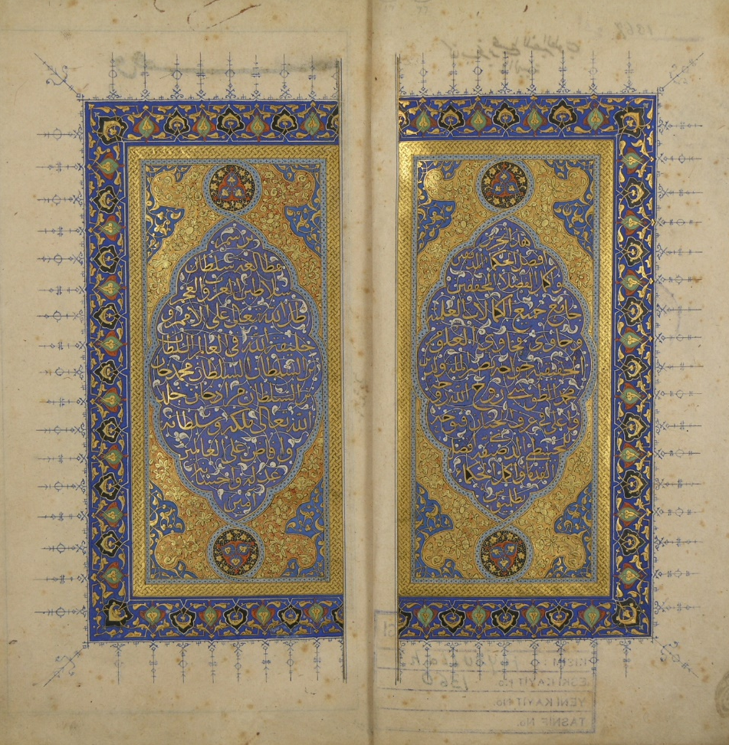
Nasireddin Tusi’s 1. Tahriri Majisti 2. Tahriru-Usulil-Hendese vel-Hisab

Slide 4
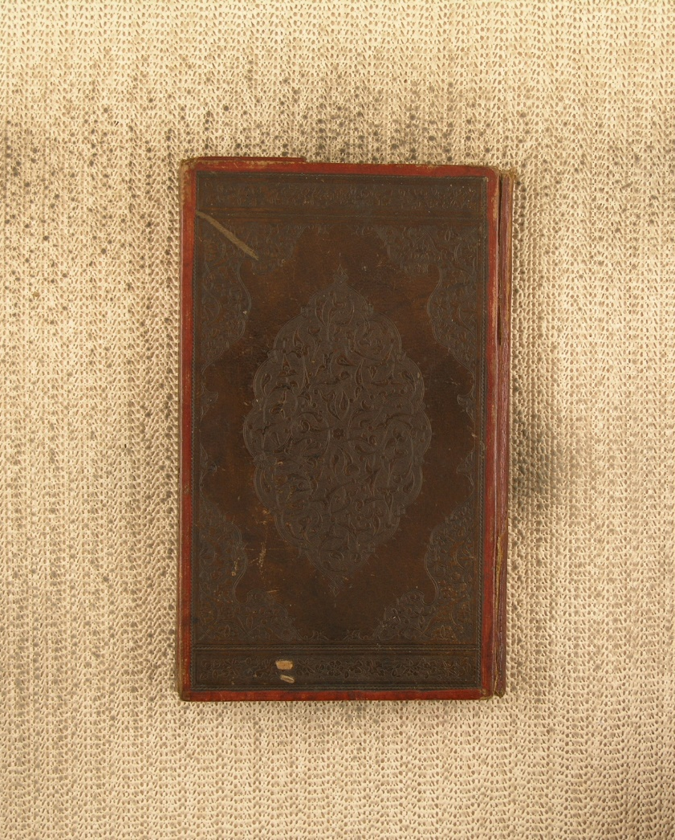
There are many books in this library designed in the same way

Slide 5
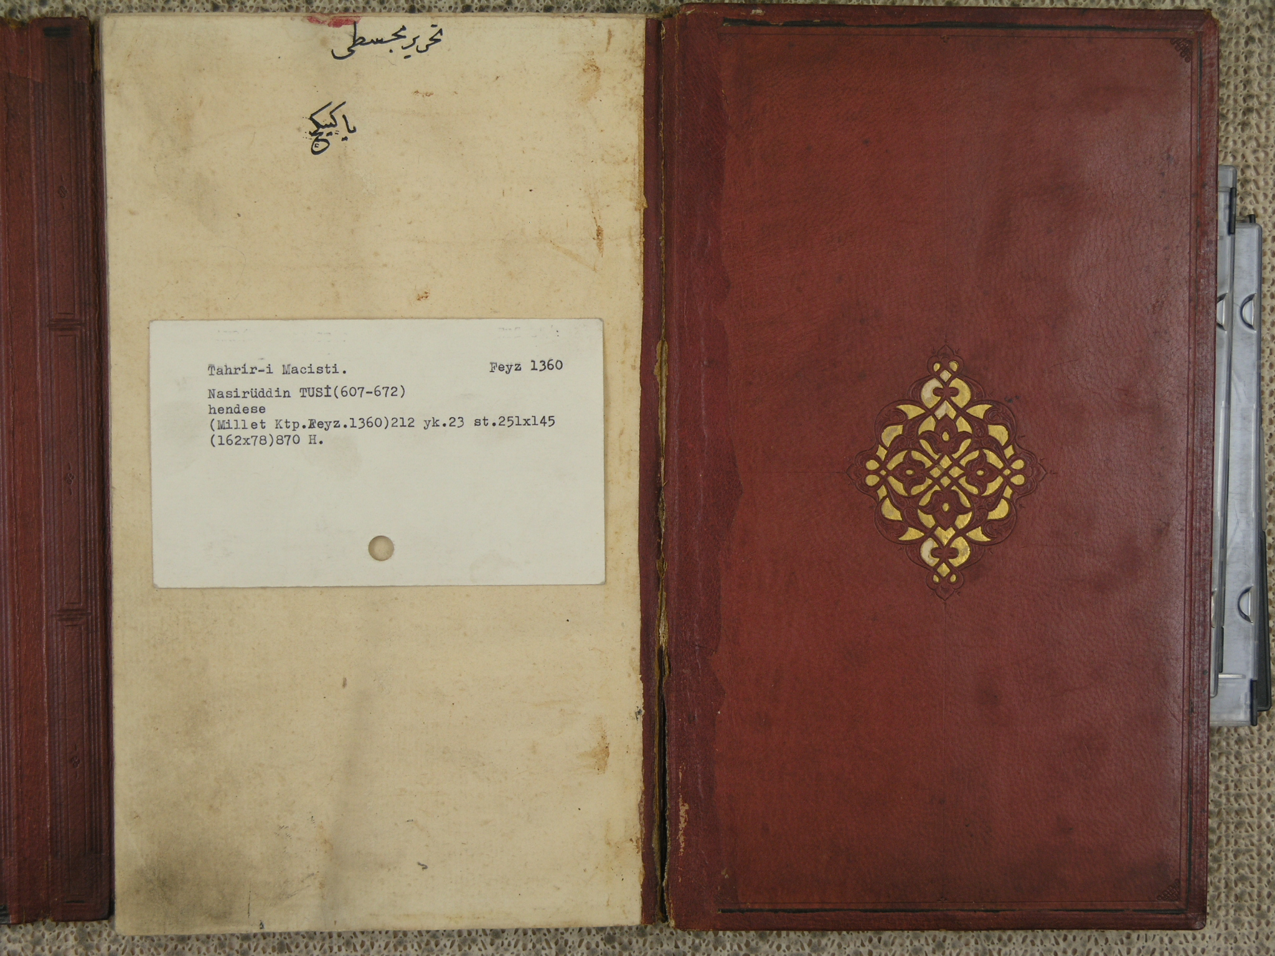
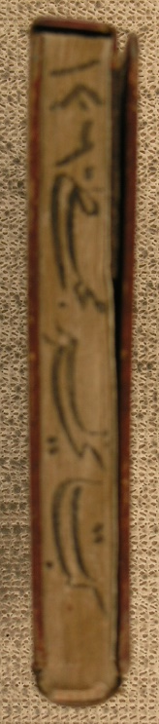

Slide 6
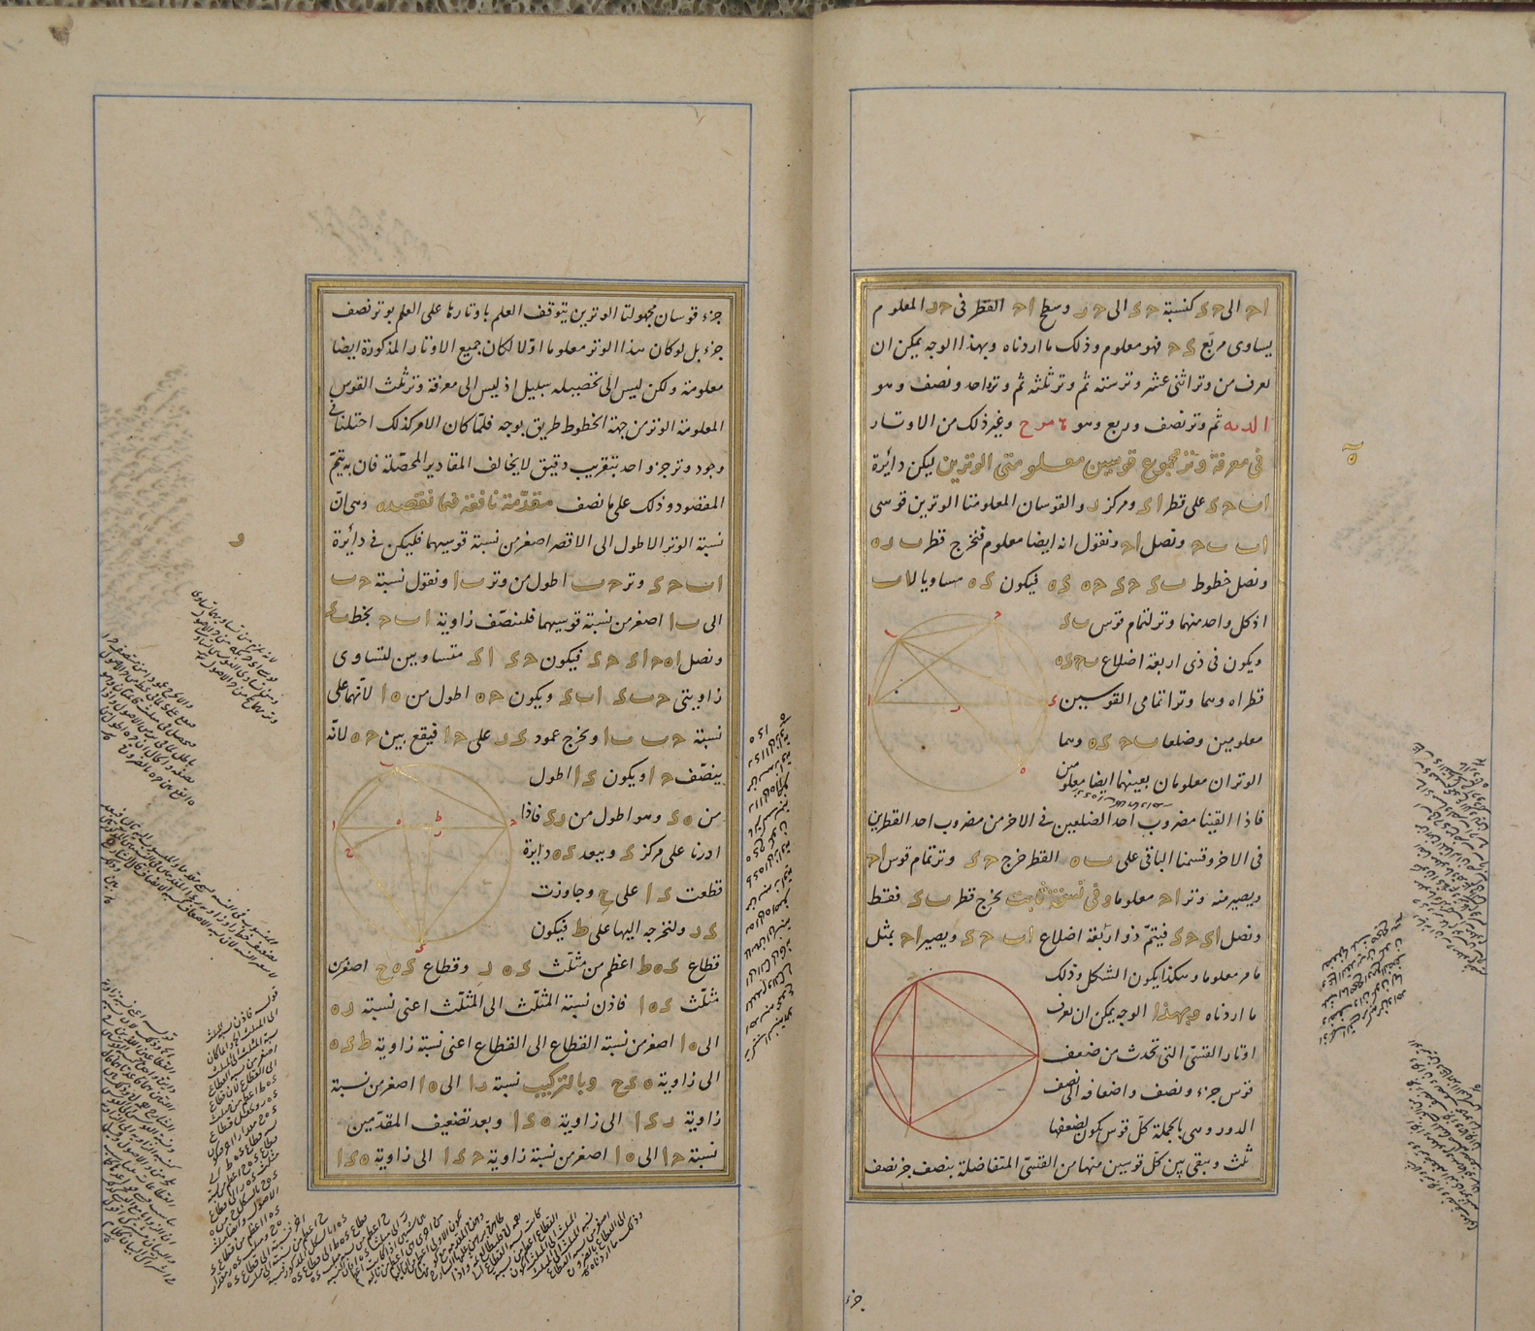
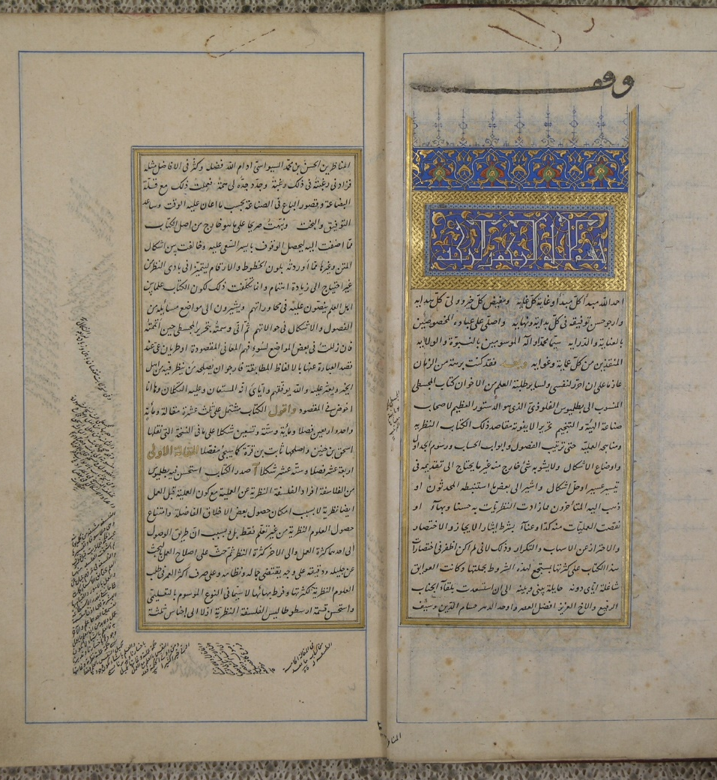

Slide 7
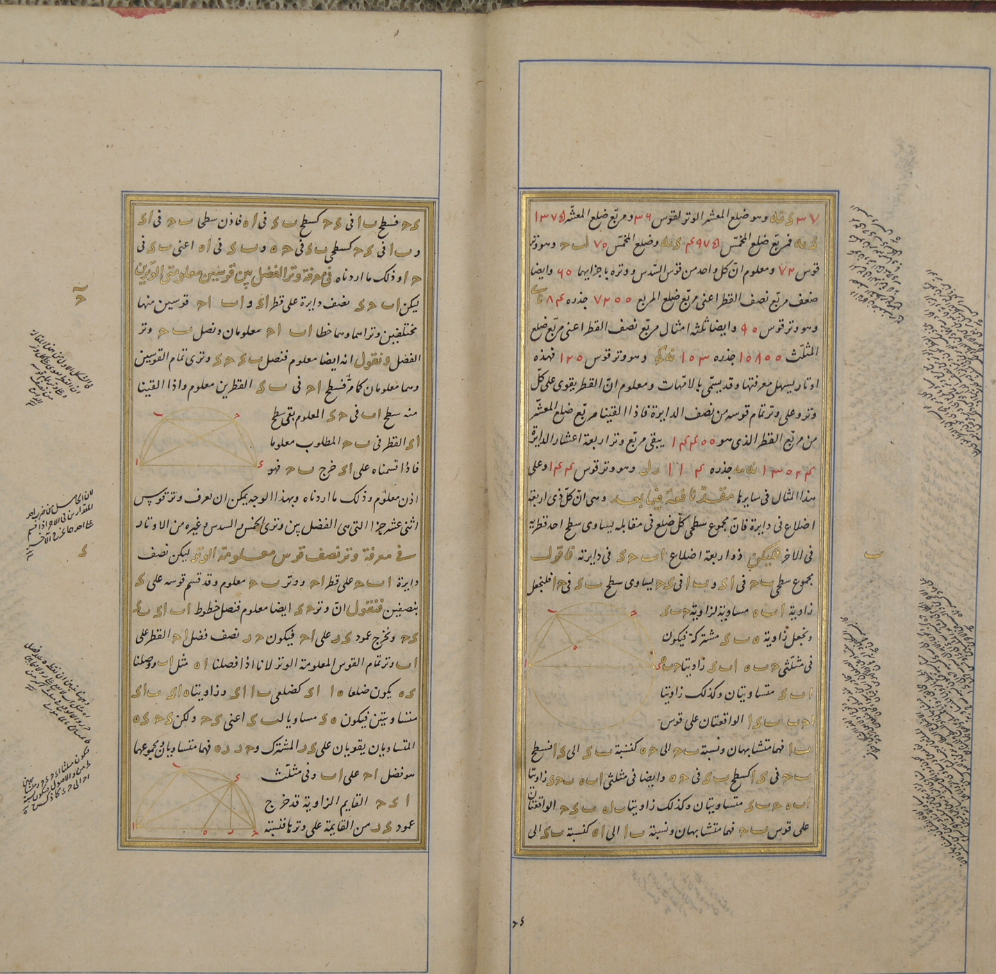
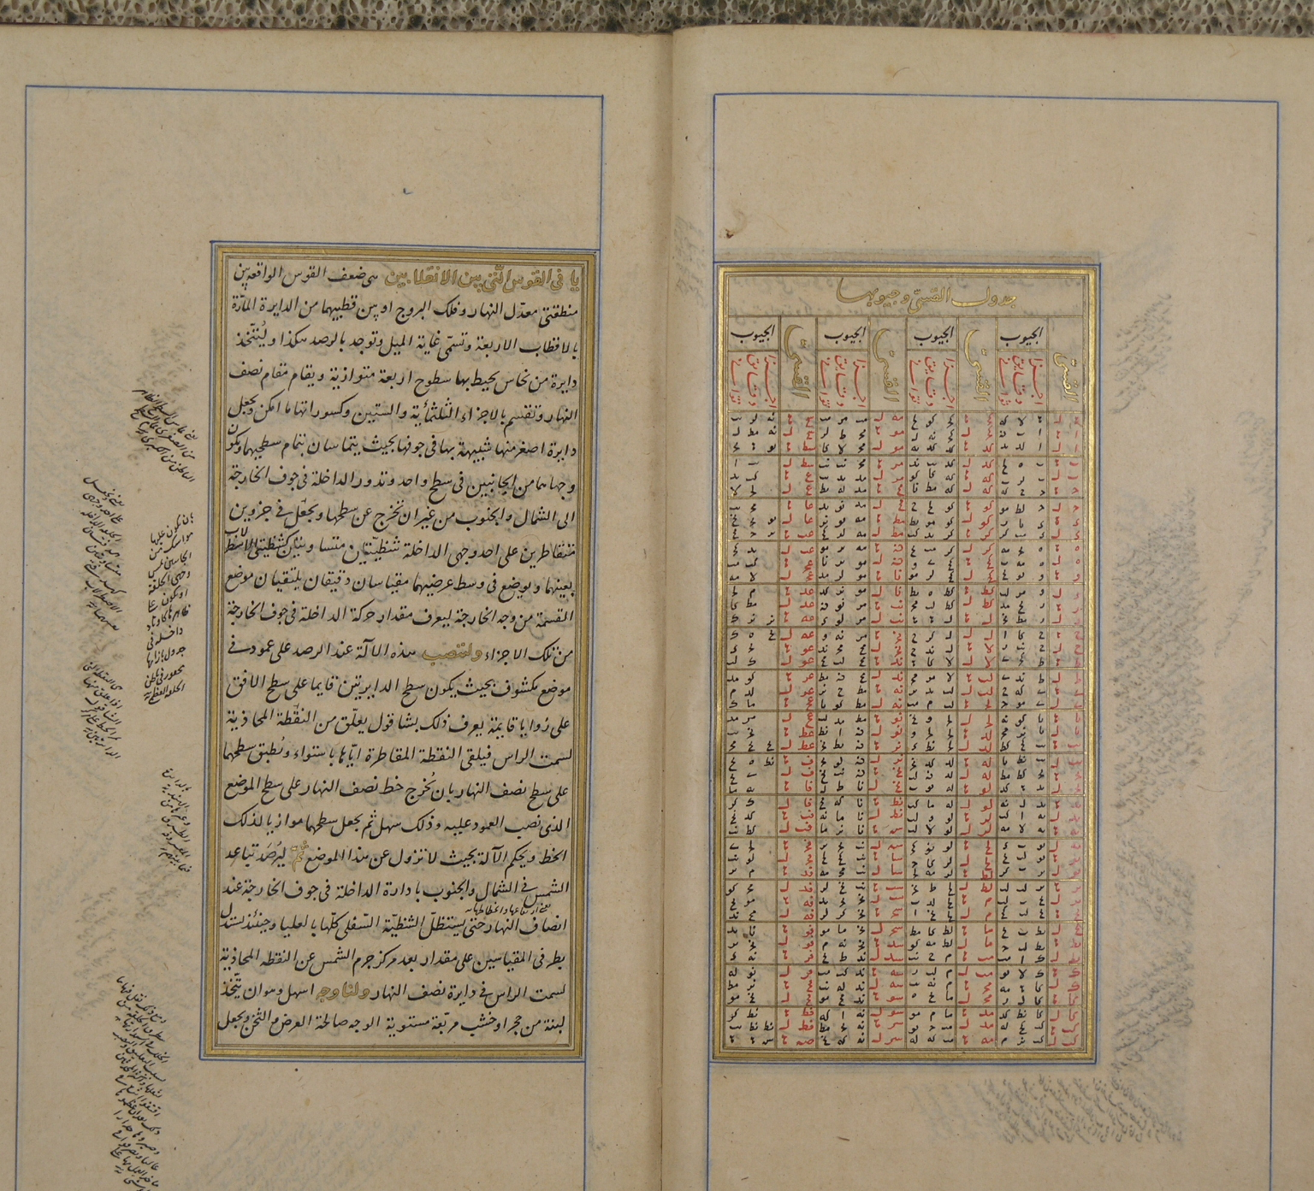

Slide 8
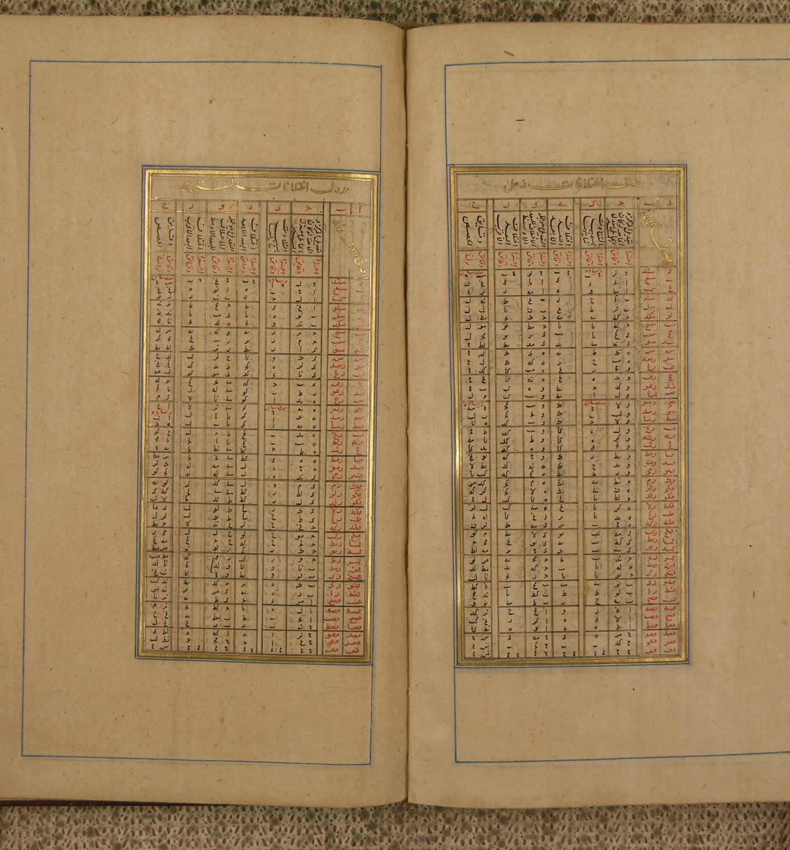
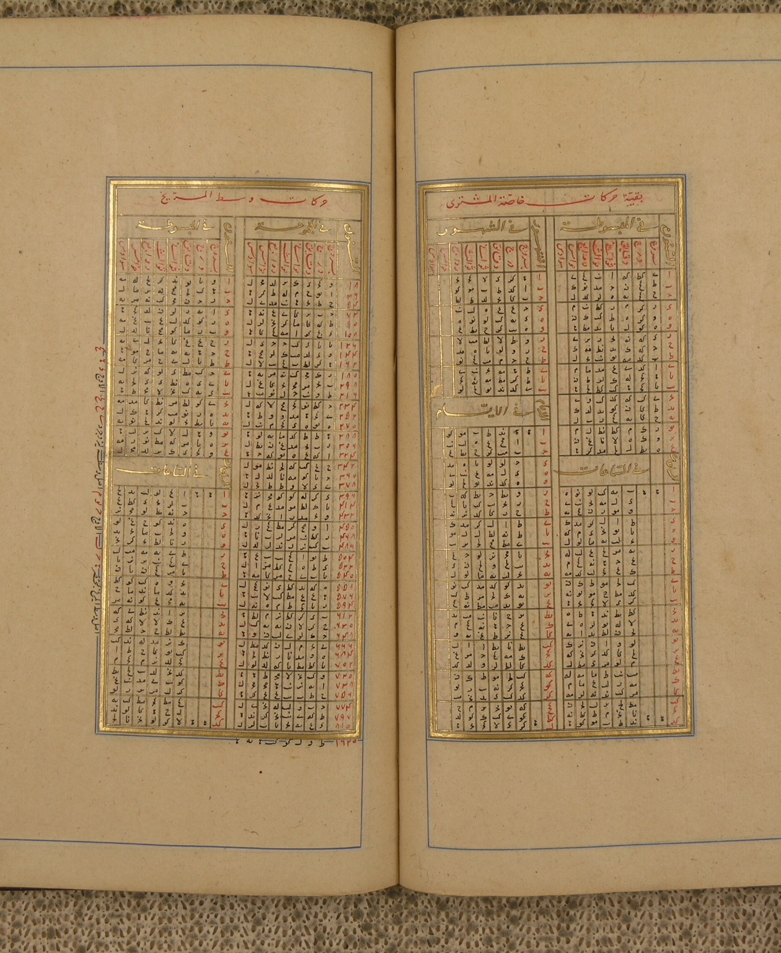

Slide 9
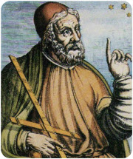
Ptolomeus (127 – 145 AD Alexandria, Egypt)
We follow Paul Kunitzsch’s
entry about Almagest in this collection
https://www.mathopenref.com/ptolemy.html

Slide 10
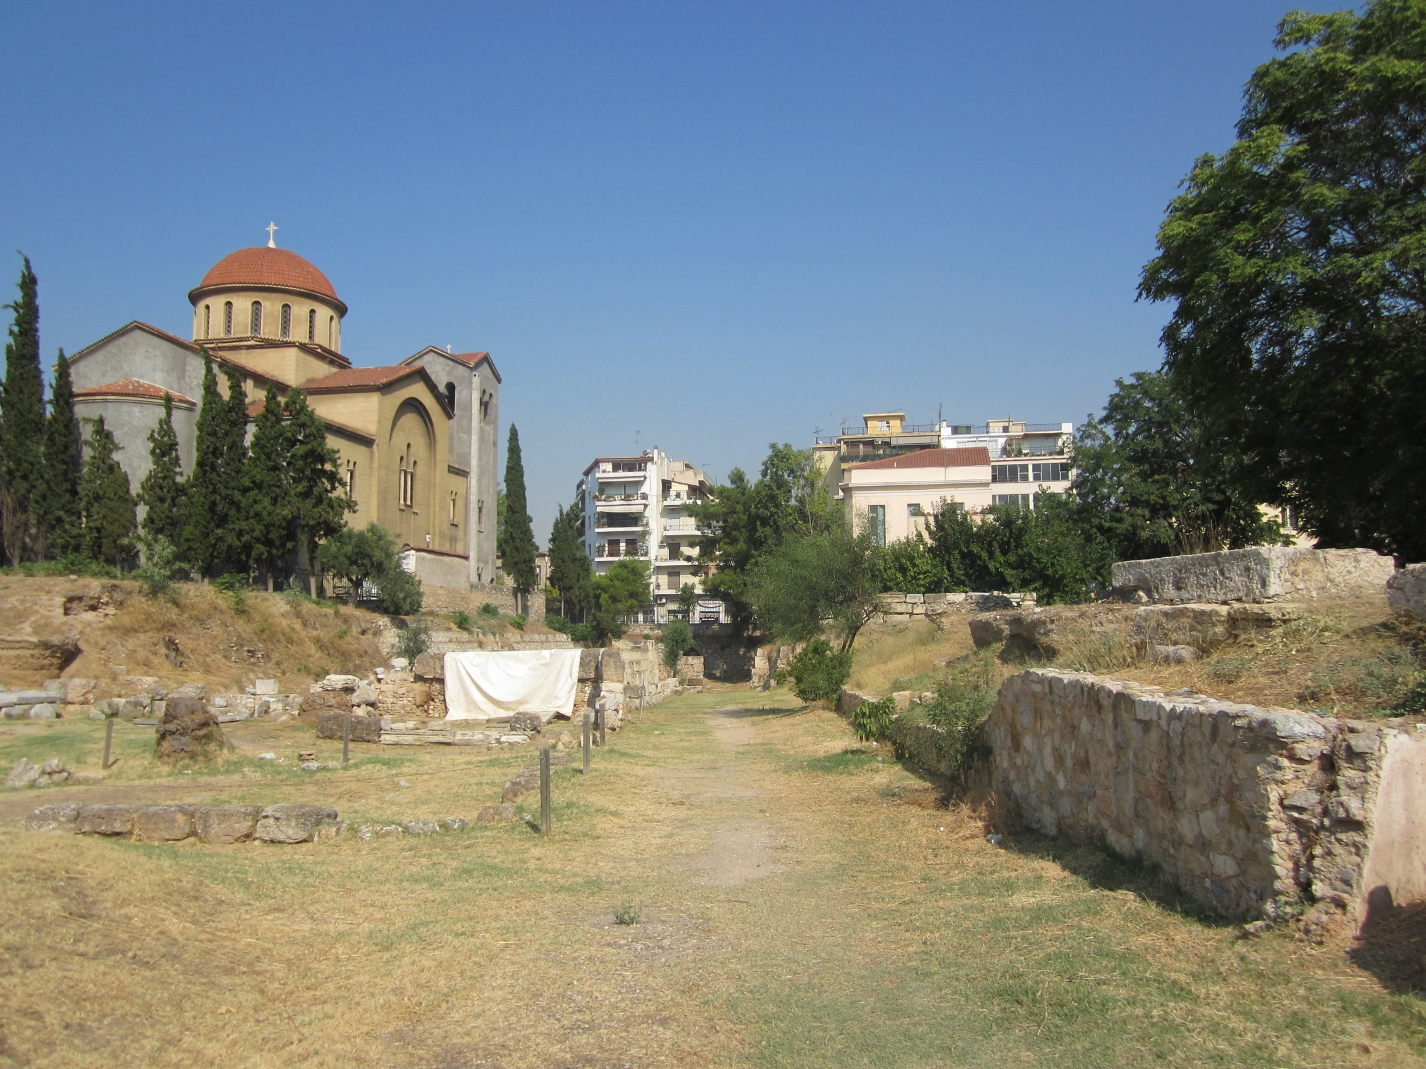
Ancient road to Plato’s Academy
wikimedia.org

Slide 11
Around AD 150, Ptolemy wrote his great handbook of astronomy called Mathematike Syntaxis (The Mathematical Composition) in the original Greek. Because of its importance, it soon received wide attention throughout the Hellenistic world. Its fame seems to have radiated into the Middle East, because there are hints that the work was known, and perhaps even translated partially or completely, into Middle-Persian (Pahlavi) under the Sassanian ruler Shahpur I (reigned AD 241 - 272).

Slide 12
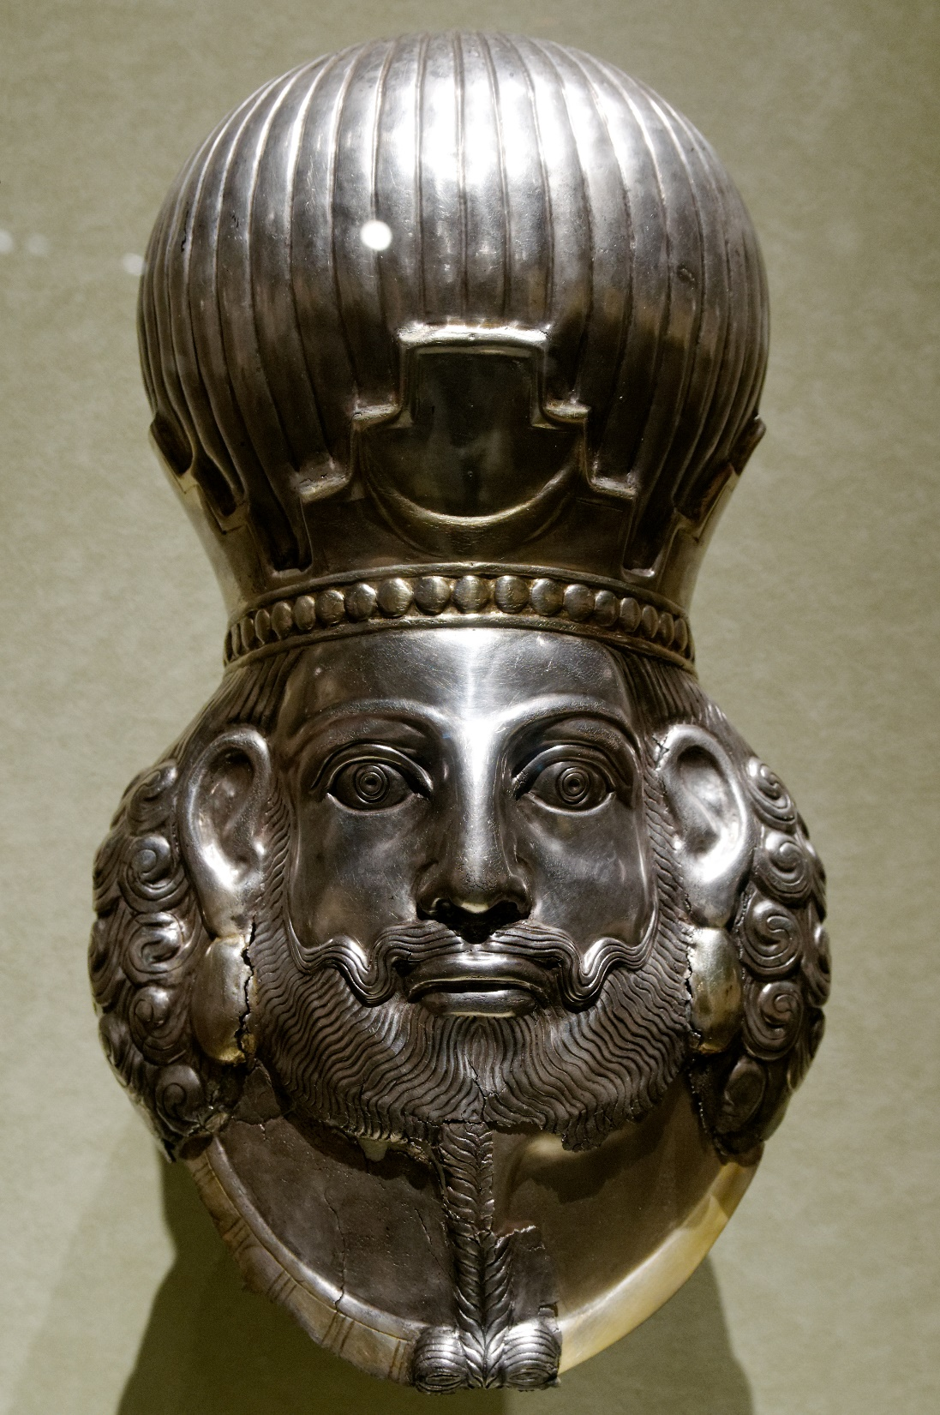
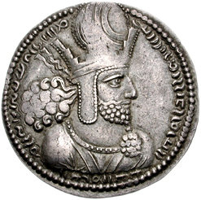
Shapur I Sasanid Ruler (240-270 AD)

Slide 13
A second period of intensive contact of the Persians with Greek science was in the middle of the sixth century, after the closing of the Academy in Athens (AD 529), when several Greek scholars sought refuge in Persia. At this point Ptolemy's work may again have been brought to the attention of Persian scholars.

Slide 14
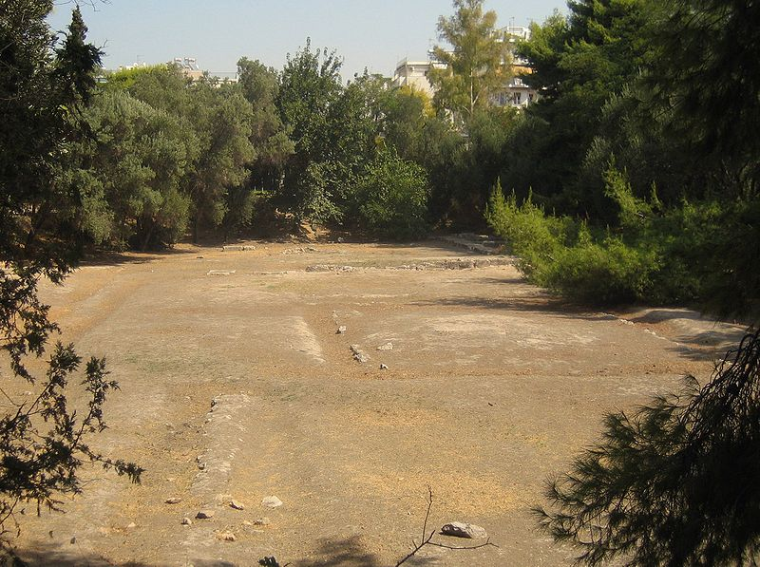
Remains of Academy of Athens
wikimedia.org

Slide 15
This was, the first knowledge of the Arabs about Ptolemy.
The Arabs first knew Ptolemy's astronomical handbook under
the title Kitab al-majasti (The Book Almagest), which
evidently derives from a Greek superlative (Megiste
Syntaxis, The Greatest Composition). Under this title the
book was already known in Arabic- Islamic circles before the
translations proper.

Slide 16
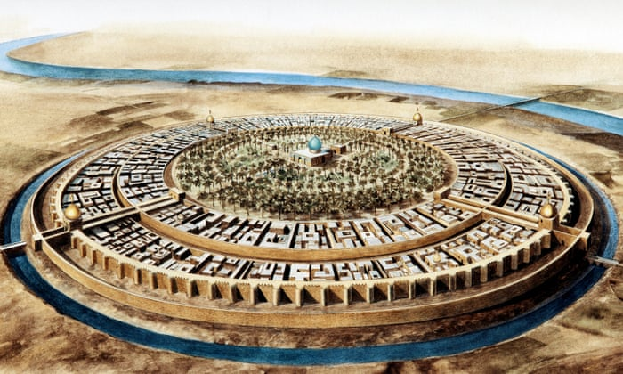
Bagdad X century
https://www.theguardian.com/

Slide 17
Direct knowledge of the text of the Almagest in Arabic-Islamic
science developed through a series of translations
from Greek into Arabic. Before the Arabic translations, a
translation was made into Syriac, the language common
among Christian monks and scholars who later played the
main role in the translation of Greek scientific works into
Arabic . It is not known when and by whom this Syriac translation
was made, but it is probable that the first translators of
the work into Arabic knew and used the Syriac version. Still,
in the twelfth century Ibn al-Salah had the Syriac version to
hand.

Slide 18
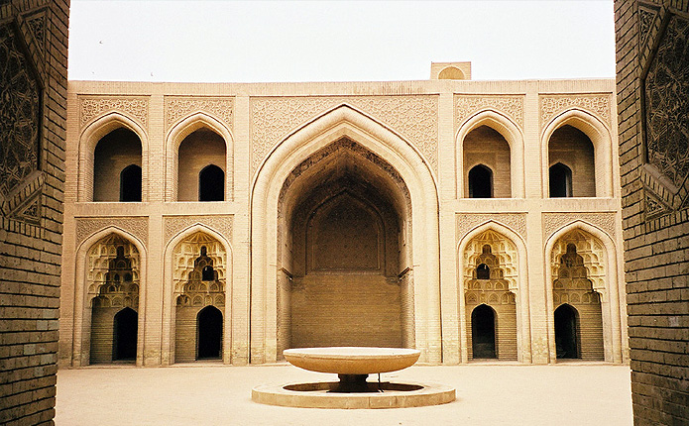
Abbasid palace, Bagdad
https://www.1001inventions.com/

Slide 19
A first Arabic translation of the Almagest was made some time around AD 800, its text is now lost, but it was often
cited by Arabic-Islamic astronomers and bibliographers
as "the first" or ''the old" or "the ma'munian" translation,
after the caliph al-Ma’mun, who patronized translations and
scientific work in general. Traces of it are found in the astronomical
work of al-Battani (d. 929) and in Ibn al-Salah.

Slide 20
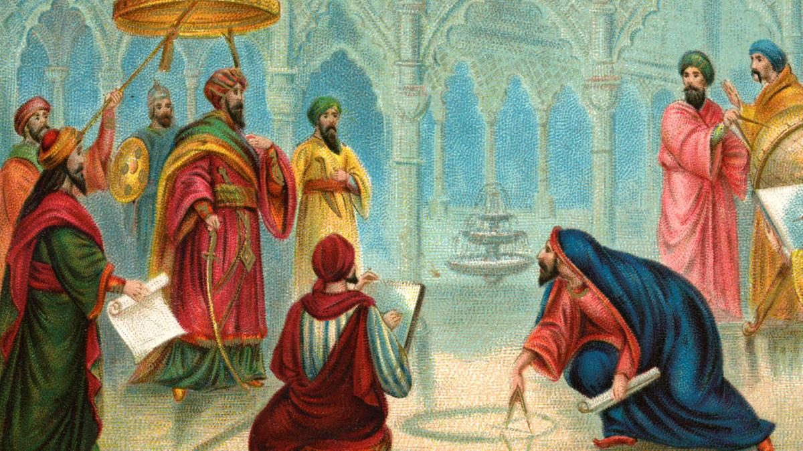
Al Ma’mun (813-833) first translation is made
https://www.thenational.ae/

Slide 21
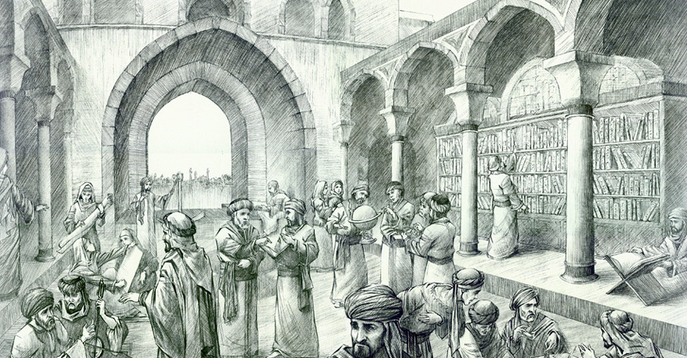
House of Wisdom (Bagdad, X century)
https://www.1001inventions.com/

Slide 22
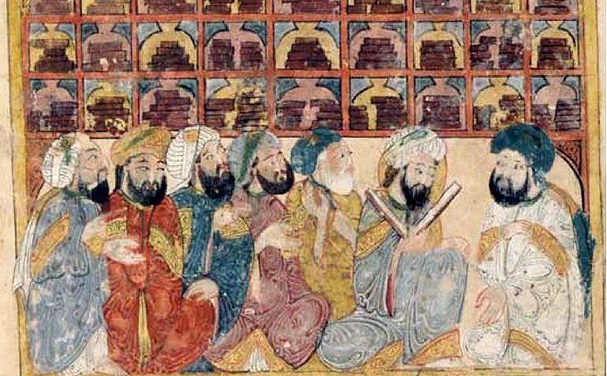
A Library in Bagdad. from Hariri’s book XIII century
https://www.1001inventions.com/

Slide 23
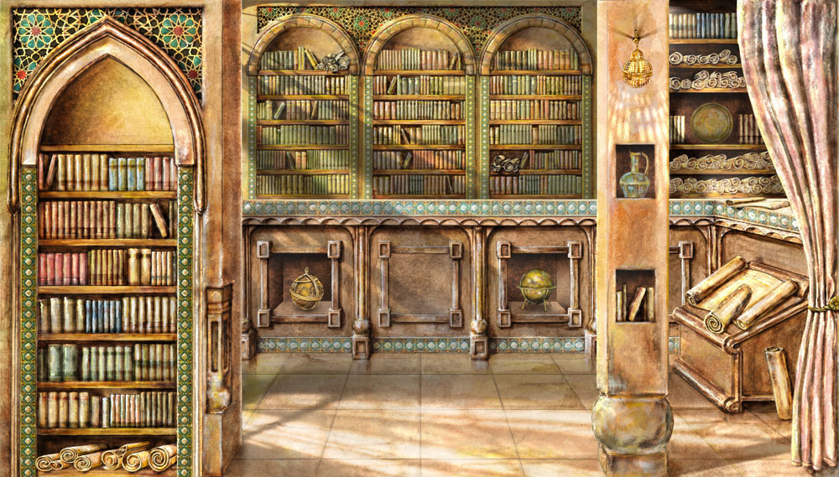
https://www.1001inventions.com/

Slide 24
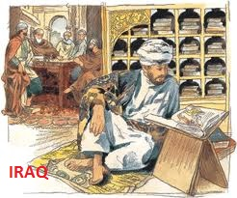
Almajisti’s 2-nd translation was done by Al-Ḥajjac ibn Yusuf ibn Matar (d. 833)

Slide 25
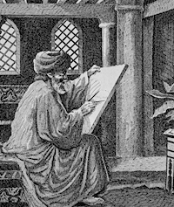
He was assisted by Elias the son of Serjius (christian scholar) Of it two manuscripts have survived until our times: one complete and the other fragmentary.

Slide 26
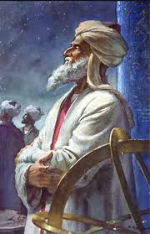
3rd translation of Almajisti was done by İshaq ibn Hunayn About fifty to sixty years later, a third translation was made by lshaq ibn Hunayn (830-910). It was soon afterwards revised by Thabit ibn Qurra (836-901) of this revised version, nine manuscripts are still extant today.
http://www.mathyards.com/

Slide 27
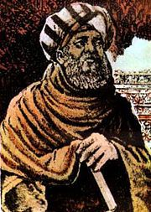
Sabit ibn Kurra (826-901) reviewed the 3rd translation and made corrections
https://www.pinterest.com/

Slide 28
The two versions of al-Hajjaj and of Ishaq revised by
Thabit were received in Muslim Spain - they were both
used by Gerard of Cremona for his translation of the Almagest
into Latin (Toledo, ca. 1150--1180). Gerard's Arabo-Latin
version then remained the standard version of the Almagest
in Europe until Renaissance times.

Slide 29
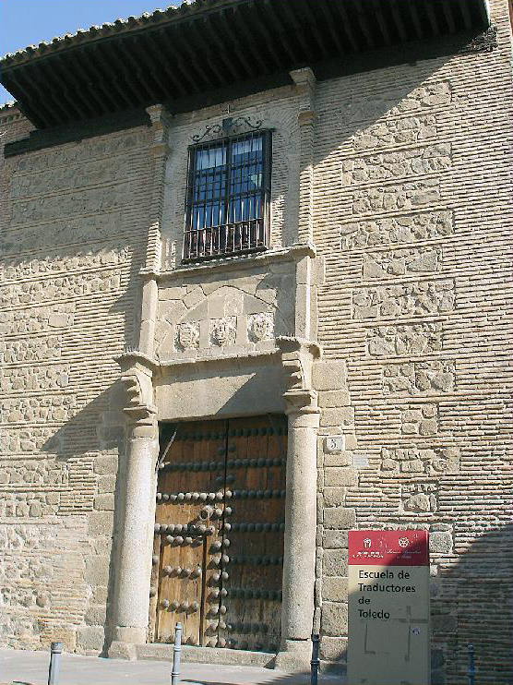
Spain, Toledo city, as 800 years ago, this place is still a translation center.
https://www.1001inventions.com/

Slide 30
In the following centuries Arabic- Islamic astronomers
not only studied the Almagest as their main source in astronomy,
but they also wrote commentaries on the entire book
or on problems of detail. Fuat Sezgin lists more than thirty
commentaries, several of which were afterwards commented
upon themselves.

Slide 31
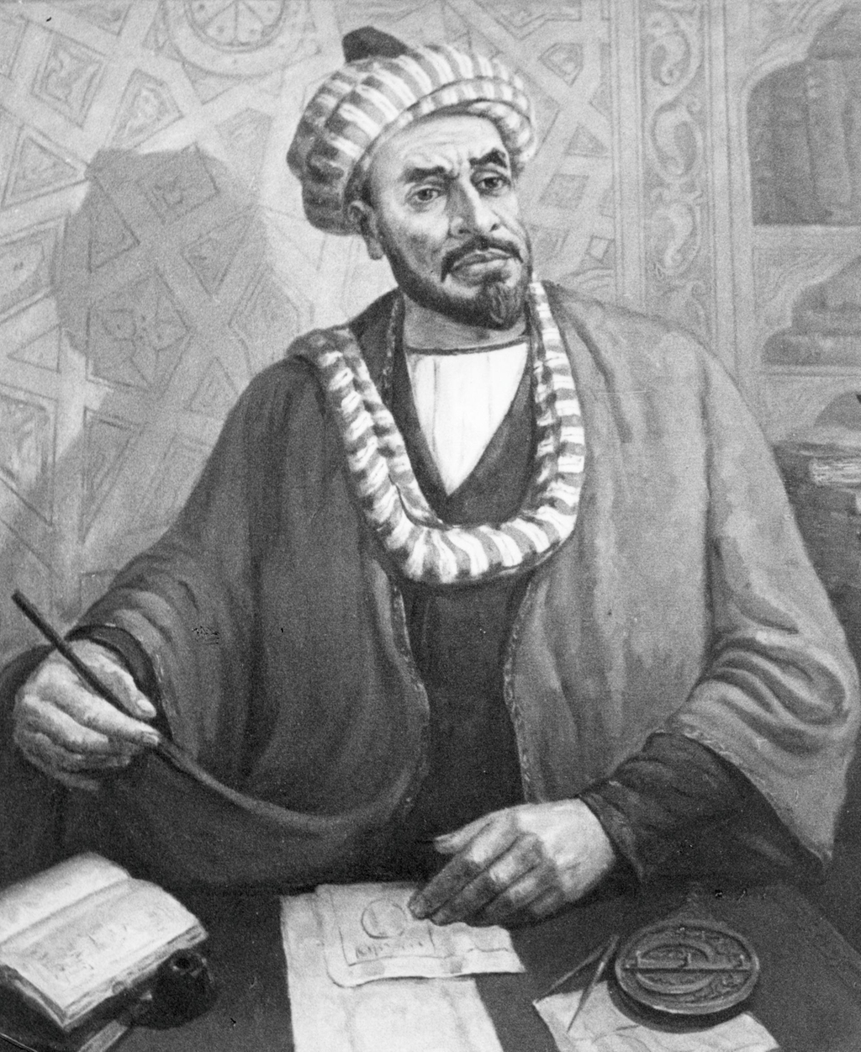
Among the numerous commentators two shall be named here. Ibn al-Salah (d. 1154) is important, because he had to hand five versions of the Almagest (the Syriac version, the "old" version, the version of al-Hajjaj, the original of lshaq's version, and Ishaq's version as revised by Thabit) from all of which he tried by comparing the texts and by observing the stars to establish the best values in longitude and latitude for a selected number of stars from the star catalog in the Almagest.

Slide 32
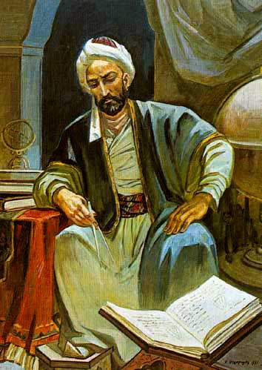
Another famous commentator was Nasir ad-Din al-Tusi (1201- 1274) who wrote revisions of many translated Greek mathematical and astronomical texts, which included the Almagest - his tahrir (based on the version of Ishaq as revised by Thabit) survives in numerous manuscripts but is still unedited.
https://az.wikipedia.org/

Slide 33
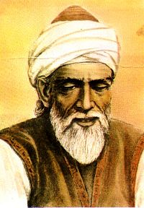
The title al-majasti (Almagest) became so famous that other authors freely used the name for their own works, both in the East and in Europe, e.g., the Kitab al-majast (The Book Almagest) of the mathematician Abu'l-Wafa al-Buzjani (940-987 or 998);
https://en.wikipedia.org/

Slide 34
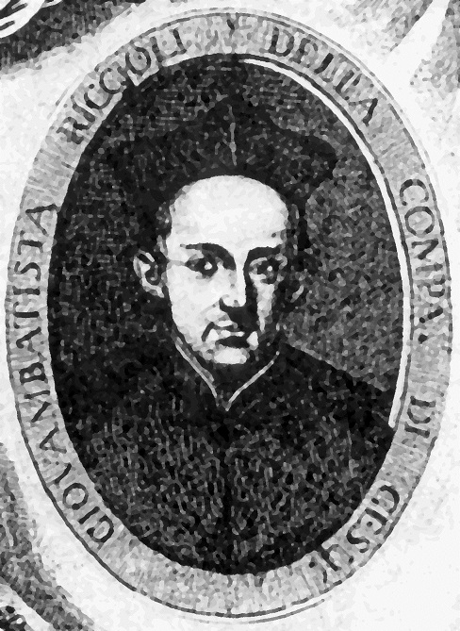
Giovanni Battista Riccioli (1598 –1671) the Almagestum novum of the astronomer Giovanni Riccioli (Bologna, 1651 ), or even the Almagestum Botanicum of Leonard Plukenet (1696).
https://en.wikipedia.org/

Slide 35
The Link of free copy of the book
https://drive.google.com/file/d/1Dfydm27cRHpyhPjg9zfH9bF1_V_aV3Jn/view?usp=sharing

