Slide 1
On the history of scientific Arabic studies in Russia
Mahmoud Al-Hamza, Prof. of Mathematics,
IHST RAS (formerly)
(Syria-Russia) alhamza.mahmoud@gmail.com
Moscow-2024

Slide 2
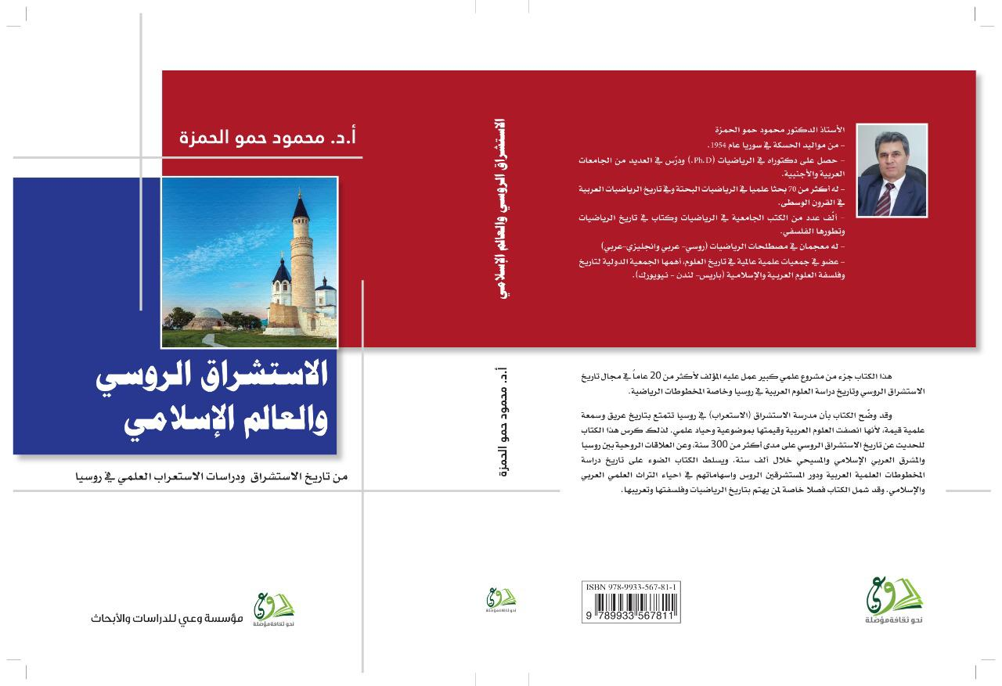
FROM THE HISTORY OF RUSSIAN ORIENTALIZM AND THE ISLAMIC WORLD - 2022.

Slide 3
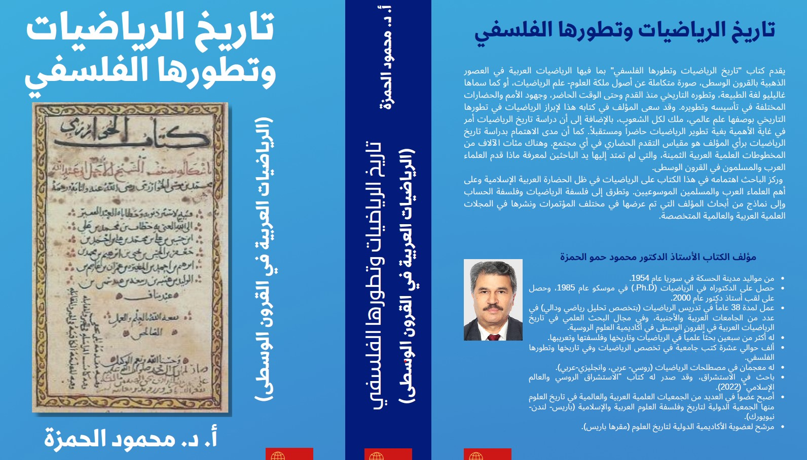
The History of Mathematics and its Philosophical Development (Arabic Mathematics in the Middle Ages - 2024)

Slide 4
The School of Scientific Arabic Studies in Russia
The 1st Arabic mathematical manuscript was translated into Russian in 1867 in St. Petersburg. (Mathematical collection) (Academician Chebyshev): “The Book of Reduction of the Arab geometer Ibn al-Banna”.
In the middle of the 19th century, the famous Arabist N. Khanikov translated the manuscript of Al-Khazini's “The Book of the Scales of Wisdom” (12th century).
Similarly, the Russian mathematician Victor Bobynin (d. 1919) presented the history of medieval Arabic mathematics in a series of lectures on the history of mathematics at the Moscow State University in the last quarter of the 19th century
. He was one of the authors of the Encyclopedic Dictionary of Brockhaus and Efron. He defended in March 1882 his master's thesis “Mathematics among the ancient Egyptians” (on the Rinde papyrus).

Slide 5
Russian studies of Arabic scientific manuscripts, especially in the field of mathematics, began in the mid-twentieth century, although some were published in 1867, when a manuscript entitled "A Summary of Arithmetic operations” by Ibn al-Banna al-Marrakshi was translated from French (R. Marr) into Russian and published in the journal Mathematical Collection of Moscow Mathematical Society.
The Russian translation of the French version was incomplete and contained a number of errors. Neither the name of the translator nor the name of the author of the manuscript article was known.

Slide 6
In 2005, the author of this report, together with M. M. Rozhanskaya, fully translated Ibn al-Banna's manuscript “Talkhys” or “Summary” into Russian from an Arabic manuscript found in the library of St. Petersburg University. Then the author, together with Rozhanskaya, published several articles about this manuscript and its first publication in French, and we placed our historical and scientific study of the manuscript in the journal “Historical and Mathematical Studies”, which was published in the Mathematics Sector of the Institute of History of Science and Technology (named after S. Vavilov) of the Russian Academy of Sciences, where the author worked as a senior researcher for about 16 years.
We will present an overview of the study of many Arabic mathematical manuscripts in Russia and the contribution of Russian Arabists in their fair and objective evaluation of these manuscripts, as well as highlight the main new ideas in those manuscripts that were translated into Russian.
Important scientific encyclopedic works on the history of Arabic science in Russian were prepared by Yushkevich, Rosenfeld, Matvievskaya, and Rozhanskaya.

Slide 7
On Scientific Arabistics in Russia in the mid-20th century, the historian of mathematics Adolf Yushkevich (d. 1993) founded the School of History of Mathematics in Russia and distinguished himself by his objective view of the role of Arab and Islamic sciences. He emphasized that Arab and Islamic culture is an essential part of world culture. Arab scientists not only transferred ancient scientific works from Greece, India and other countries and preserved them from loss, but also created new theories.
Yushkevich himself conducted important studies on the history of Arabic mathematics, which became famous and popular in the world. The systematic study of Arabic scientific manuscripts in Russia began exactly more than eighty years ago, with the publication of Yushkevich's first in-depth study of the algebra of Omar Khayyam (1948).

Slide 8
An entire (Soviet) school for the study of the history of Arabic mathematics was established, with branches in Moscow, Leningrad (now St. Petersburg), Kazan, Tashkent, Baku, Dushanbe, and other cities of the Soviet Union. Dozens of Soviet linguists and specialists in exact sciences worked on translating rare Arabic manuscripts preserved in the libraries of these cities on mathematics, physics, medicine, astronomy, engineering, pharmacy, and others.
Russian Arabists have also conducted extensive and in-depth studies of the works of many Arab and Muslim scholars in the fields of mathematics, mechanics, and astronomy, such as al-Khwarizmi, al-Biruni, Thabit Ibn Kurra, Ibn Sina, Omar Khayyam, Abd al-Rahman al-Khazni, Nasireddin al-Tusi, Abu Kamil al-Masri, Abu al-Wafa al-Buzzjani, Jamshid al-Kashi, Baha al-Din al-Amili, Ibn Iraqi, Ibn al-Baghdadi and Abd al-Rahman al-Sufi, al-Farabi, Kushyar Ibn Laban al-Jilani and many others.

Slide 9
Among the most prominent Russian Arabists who have left their mark on the study of the history of medieval Arabic mathematics, we note A. Yushkevich, B. Rosenfeld, G. Matvievskaya, M. Rozhanskaya, G. Mammadbeyli, G. Jalalov, M. Medovoy, A. Kubesov, P. Bulgakov, A. Akhmedov, and others.
Many scholarly Arabic manuscripts saw the light of day for the first time in Russian translations or commentaries after they had been forgotten for hundreds of years.
All this led to the growth of knowledge of Arabic mathematics and the role of the peoples of Islamic countries, especially in Central Asia, and helped in the late fifties and early sixties of the twentieth century to make generalizations of the works studied. This was reflected in a number of articles by Yushkevich (1951, 1958, 1959), the most important of which was his famous book “History of Mathematics in the Middle Ages” (1961). as well as a 3-volume book on the history of mathematics from ancient times to the new time written by Yushkevich, Rosenfeld and E. Berezkina et al (1970).

Slide 10
The main results of research on Arabic mathematics:
Yushkevich restored the contents of the arithmetic manuscript of al-Khwarizmi, which is partially preserved in a twelfth-century Latin translation.
Medovoy studied practical methods of calculation using ordinary fractions mentioned in Abu al-Wafa as well as in al-Nasawi (1963).
The theory of ratio was studied by Sabit ibn Qurra and developed the concept of positive real number during the study of Khayyam's manuscripts.
The theory of relation and the accumulated research on the concept of number were comprehensively outlined in Matvievskaya‘s book on number (1967).
In her research Matvievskaya paid special attention to the study of the theory of irrational numbers (Book 10 of Euclid) in the commentaries of Arab scholars of the 9th-13th centuries.
In particular in the manuscript of Ibn al-Baghdadi (10th-11th c.), a predecessor of Descartes. Soviet scholars studied the history of the appearance of the binomial theory in Arabic literature by at-Tusi, al-Kashi, and others.

Slide 11
They wrote about methods of extracting roots with positive integers (Yushkevich, Rosenfeld, Akhmedov). The studies of Rushdi Rashid (Paris) made it possible to study this question at early stages. The use of geometric methods in solving cubic equations according to Khayyam and the geometric constructions of Abu al-Wafa and al-Farabi were studied by Yushkevich and Rosenfeld.
Soviet historians of mathematics prepared deep and comprehensive studies on the development of the theory of parallels (Euclid's fifth axiom), as manifested in attempts to prove Euclid's axiom or to replace it with a clearer proposition (hypothesis). Ibn Qurra, Ibn al-Haysam, Omar Khayyam, at-Tusi and others (Yushkevich, Rosenfeld, Mammedabeyli, etc.). An important discussion of parallel lines related to the fifth postulate, which were considered by Al-Biruni in his book “Masudi's Law” (B. Bulgakov, A. Akhmedov). These studies proved that Arab mathematicians were ahead of the 18th century scientists in some basic ideas and methods. Orientalist Mirza Muhammad Ali Kazembek translated at-Tusi's manuscript on Euclid's fifth axiom (the “complete quadrilateral”) of at-Tusi for N. Lobachewski in the early 19th century.

Slide 12
The history of plane and spherical triangles, which were essential for astronomy, was also investigated. Regarding the study of the manuscript of the “complete quadrilateral” of at-Tusi and the unknown author's “Treatise on the Determination of Chord in a Circle” and chapters from al-Biruni's “Canon of al-Masudi” preceding it in chronological order, “Almagest” by al-Farabi and the trigonometric manuscripts of al-Kashi and Rumi allowed us to interpret some issues of the addition and history of trigonometry (especially the theorem on sines and cosines and methods of determining trigonometric functions), as well as methods of calculating trigonometric quantities and compiling tables in the medieval East (Yushkevich, Rosenfeld, Rozhanskaya et al.).
Work has been done on the history of trigonometry and a number of studies related to the emergence of the concept of functional relation and its general properties, as well as methods of its study (Rosenfeld, Rozhanskaya, etc.).

Slide 13
Special attention was also given to the study of ideas and methods of infinitesimals in Arabic mathematics. The manuscripts of Thabit bin Qurra and Ibn Sinan on the square of a parabola and the cube of a parabola were studied. The manuscripts of Ibn al-Haytham on measuring the volume of sphere and regular shapes were also studied, as well as at-Tusi's ideas on infinitesimals, who developed Archimedes' method on the methods of infinitesimals (Rosenfeld, Kubesov, Jamal al-Dabbagh, etc.).
In addition, there were other tendencies in Arabic mathematics to develop the methods of infinitesimals related to the study of properties of functional dependencies (Ibn Kurra, al-Biruni), which were successfully applied at that time in the study of celestial mechanics.

Slide 14
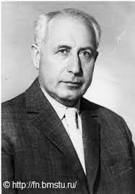
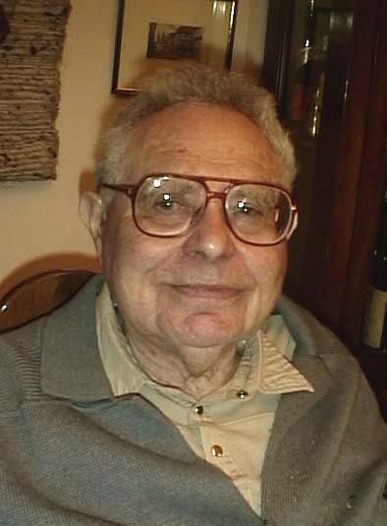
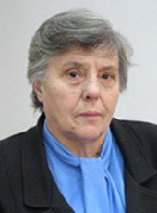
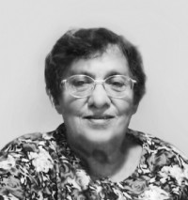
A.P. Yushkevich B.A. Rosenfeld G.P. Matvievskaya M.M. Rozhanskaya

Slide 15
The main works of Russian scientists on the history of mathematics:
G. P. Matvievskaya, B. Rosenfeld: Mathematicians and astronomers of the Muslim Middle Ages and their works (VIII-XVII cc.). 3 vols. 1983.
А. Yushkevich: The history of mathematics in the Middle Ages -1961.
G. Matvievskaya:The studies of number in the medieval Near and Middle East. 1967.
https://www.youtube.com/watch?v=4AGUnYSsHXg
Galina Pavlovna Matvievskaya interviewed Mahmoud Al-Hamza about her many years of work on the study of Arabic mathematical manuscripts (Orenburg - 2019).
М. Rozhanskaya (u. 2014)- Mechanics in the Medieval East. 2010.

Slide 16
Adolf (Andrey) Pavlovich Yushkevich (July 15, 1906, Odessa, July 17, 1993, Moscow).Doctor of Physical and Mathematical Sciences, Honored Scientist of the RSFSR. 1940 - Professor of Moscow State University А. P. Yushkevich - author of more than 200 scientific papers on the history of mathematics. 1965-1968 - President of the International Academy of History of Science
Areas of research: history of mathematics in the Middle Ages, including in the East; history of mathematics in Russia; history of mathematical analysis.
He was a member of the editorial board of the series “Scientific and Biographical Literature” in the publishing house “Nauka”.
Since 1945 and until the end of his life - Institute for the History of Science and Technology, RAS (IHET)
1948 - Founder (together with G. F. Rybkin) and executive editor of issues of the collection “Historical and Mathematical Research”.

Slide 17
1967 - Corresponding Member of the Leibniz Scientific Society, Leibniz Silver Medal. G. W. Leibniz of the Leibniz Scientific Society.
1971 - G. W. Leibniz Medal of the Leibniz Scientific Society. A. Coire Medal of the International Academy of the History of Science
1976 - Corresponding Member of the German Society of Historians of Natural Science, Technology and Medicine, Leibniz Medal. G. W. Leibniz Medal of the Academy of Sciences of the GDR.
1978 - G. W. Leibniz Medal of the G. W. Leibniz Academy of Sciences of the GDR. J. Sarton Medal of the American Society of Historians of Science
1979 - Honorary Member of the Czechoslovak Society of Historians of Science. Honorary Member of the Czechoslovak Society of Historians of Science and Technology 1982 - Member of the French Mathematical Society. French Mathematical Society
1982 - Duasto-Blutel Prize of the Paris Academy of Sciences
1983 - 2nd Euler Medal. L. Euler Medal of the Academy of Sciences of the GDR.

Slide 18

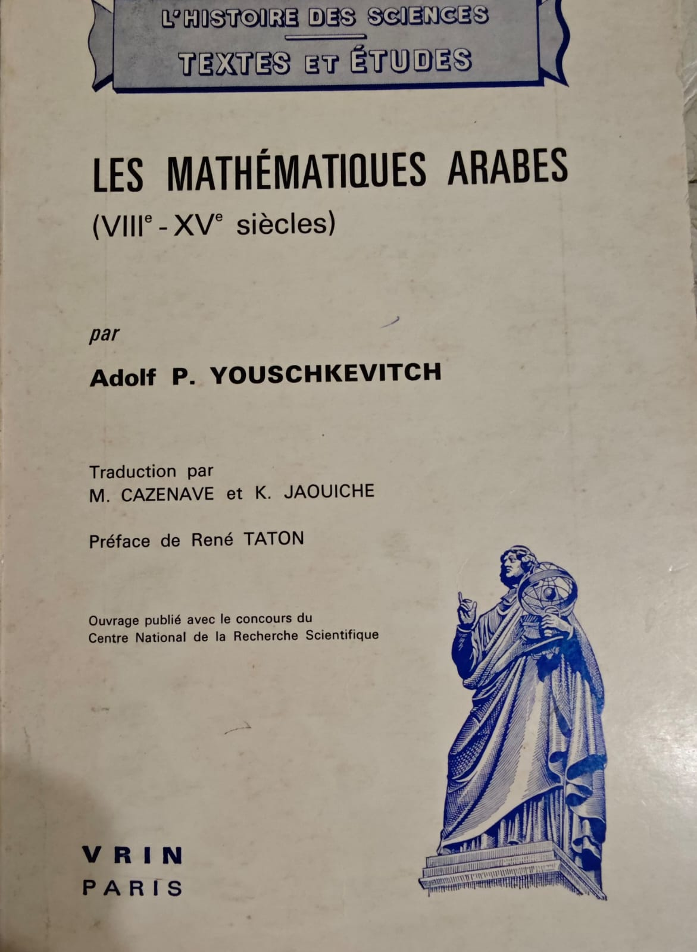

Slide 19
Yushkevich on mathematics in Islamic countries
Yushkevich's book History of Mathematics in the Middle Ages (1961) is considered a true encyclopedia on the history of medieval mathematics in China, India, Islamic countries, and Europe.
The book includes a large chapter on the history of medieval Arabic mathematics. Because of its importance, this chapter was translated into a separate book in French, German, and other languages.
In the introduction to his book, Yushkevich provided historical information about the development of economic, social, and political conditions, as well as the development of mathematics in Arab and Islamic countries during the Middle Ages. The introduction discussed the situation of mathematicians during that period and their suffering as a result of power struggles between different forces.
Yushkevich considered the broad and deep development of mathematics in the East and West of the Islamic world, including Andalusia.
He wrote in his introduction that the term Arab or Islamic mathematics is flawed. Mathematical theories are the result of the genius of scholars of different nationalities and religions, but they wrote in Arabic and lived and worked under the Arab Islamic state. This justifies the different names.

Slide 20
Contents of the book (Mathematics in the Countries of Islam)
General information
The spread of positional decimal numbering.
Fractions.
Algebraic treatise of al-Khwarizmi.
Rule of three
Rule of two false positions
Geometry in the works of al-Khwarizmi.
Treatises on algebra by Abu Kamil and al-Karaji.
Questions of number theory
Development of positional numbering system, decimal fractions
Extraction of roots and Newton's binomial Irrational numbers (dummy numbers) and theory of relations. Geometric problems and cubic equations.

Slide 21
Omar Khayyam's geometric theory of cubic equations.
Al-Qalasadi's algebraic symbolism.
Questions of geometry Abu -l-Wafa
The Theory of parallels Conic sections.
New cubatures of Ibn al-Haytham.
Development of trigonometry.
Spherical trigonometry.
Treatise on the Complete Quadrilateral by Nasir al-Din at-Tusi.
Trigonometric tables.
Measurement of the circle by Giyathddin al-Kashi.
Algebraic solution of the angle trisection equation.
Influence of mathematics of the countries of Islam on the science of Western Europe

Slide 22
Main remarks on Yushkevich's book:
The book contains an important claim made by Yushkevich, which is that medieval mathematics, including Arabic mathematics, is considered to be a basic and essential part of the development of world mathematics.
Yushkevich paid tribute to Arabic mathematics and believed that it was creative and contained new theories, and that Arab scholars were not just translators and transmitters of ancient sciences, but rather creators of new sciences that set the stage for the European Renaissance.
Yushkevich reached important conclusions by examining the history of mathematics from the third to the sixteenth century A.D. in the Eastern countries, China, India, Greece, the Islamic world, and Europe.
He emphasized the unity of the mathematical topics discussed and the similarity of mathematical methods despite the diversity of geographical locations.

Slide 23
Yushkevich explains the reasons for this phenomenon by the similarity of economic, social and political conditions in the countries of the East, as well as the close connection and intersection of the countries of the East in various fields.
Yushkevich proved that mathematics in the Eastern countries in the Middle Ages was distinguished by its originality and high level, and emphasized the special importance of this in the development of science in general.
In 1966 Yushkevich presented at the International Conference on Mathematics held in Moscow a report entitled “Studies on the History of Mathematics in the Eastern Countries in the Middle Ages: Results and Prospects”.
Reading the book we can make conclusion about Yushkevich's successful choice of topics, which are the main themes representing the main stages of the development of Arabic mathematics author is deep, very intellectual and comprehensive.
For this reason, most researchers all over the world cite Yushkevich's book because of the distinct coverage of the stages of development of mathematics and reflection on the most important works of Arab scholars.

Slide 24
Important and new conclusions concerning the development of mathematics and specifically the role of Arab scholars. Yushkevich used a large number of references in preparing the book. His extensive knowledge of European languages such as French, German and others helped him in this. It should be noted that Yushkevich's book was published more than eighty years ago, so some of its information is outdated. For example: a major historian of mathematics Rushdi Rashid (France-Egypt) and his students published an important new study that clarifies the history of the discovery of decimal fractions, proving that they were introduced by al-Samuwal al-Maghribi (12th century), not al-Kashi (16th century).
The history of the origin of algebraic symbolism was also leaked in the studies of Muhammad Ablagh (Morocco) and Ahmed Jabbar (France-Algeria), showing that the first to use algebraic symbolism was Ibn al-Yasamin (12th century) and not al-Kalasadi of (16th century).
The great importance of the book can be judged from the fact that most researchers in different countries of the world relied on this book as the main reference book on the history of Arabic science in the Middle Ages. Note that the preface to the French translation was written by the French historian of science René Taton and published under the title: “Arab Mathematics” (8th-15th centuries).

Slide 25
The main attention in Russia was paid to the study of mathematics in the Arab East, and there was almost no coverage of mathematics in the Western Arabian area, i.e. in the Maghreb and Andalusia. This was primarily due to the scarcity of Maghrebian and Andalusian manuscripts in Russian libraries. On the other hand, there were extensive ties between Russian Arabists and colleagues from the Arab East. As for the study of mathematics in the Maghreb and Andalusia, it began for the first time in Russia in 2002 by the author of this study in collaboration with the Russian historian of Arabic science Maryam Rozhanskaya. It began with the discovery of an important Arabic mathematical manuscript “A Summary of Arithmetic Operations” (Talkhys) by Ibn al-Banna al-Marrakshi in the library of the Institute of Oriental Manuscripts of the Russian Academy of Sciences in St. Petersburg and the manuscript “Unlocking the Mysteries of the Science of the Numeral of Ghubar” by al-Kalasadi in the Scientific Library of the Faculty of Oriental Languages at St. Petersburg State University.

Slide 26
The manuscript “Talhis” by Ibn al-Banna was fully translated into Russian with historical and mathematical commentary. Translations from Arabic into Russian, together with historical and mathematical commentary of manuscripts by a number of Western Arab authors such as al-Hassar, Ibn al-Yasmin, Ibn Ghazi al-Fasi, al-Kalasadi, Yaysh al-Omawi, Ibn al-Haim, and others have also been completed and published.
Studies by Soviet and Russian scholars on the history of Arabic mathematics indicate its abundance and depth.
They have objectively assessed the contribution of Arab and Islamic science to the development of world science and its influence on the scientific renaissance in Europe. Unfortunately, these scientific studies and the valuable results achieved by Russian Arabists are still largely unknown to many Arab and European readers.

Slide 27
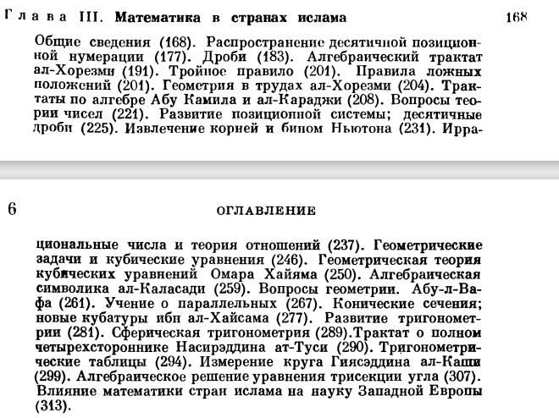

Slide 28
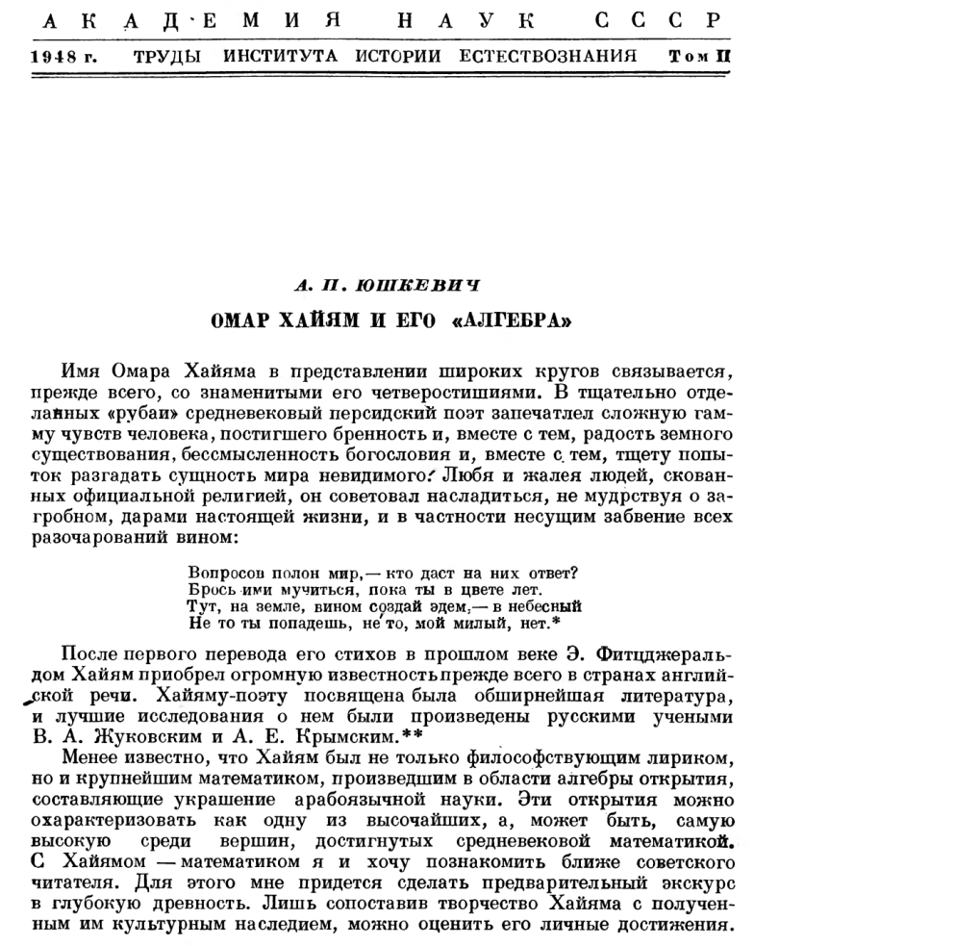

Slide 29
Some major works of A. P. Yushkevich and literature about him:
Tokareva T. A., Volodarsky A. I. List of published works of A. P. Yushkevich, reviews of his books and literature about him. // Historical and Mathematical Studies. - Moscow: Janus-K, 2006. - № 46 (11).
The History of Mathematics in the Middle Ages. 1961.
Mathematics before the Renaissance / Edited by B. A. Rosenfeld; Academy of Sciences of the USSR. Institute of the History of Natural Science and Technology. - Moscow: Fizmatgiz, 1961. - 448 с. - 15 (Romanian translation - 1963; revised and supplemented German translation - 1964; Polish translation - 1969; Japanese translation - 1971)
The History of Mathematics in Russia up to 1917. - M.: Nauka, 1968.
The History of Mathematics from the Most Ancient Times to the Beginning of the XIX Century.
Volume 1. From the Most Ancient Times to the Beginning of the New Time. - Moscow: Nauka, 1970 (edited and co-authored the preface and five chapters with E. I. Beryozkina and B. A. Rosenfeld).
Vol. 2. Mathematics of the Seventeenth Century. - Moscow: Nauka, 1970 (edited and authored six chapters, partly with B. A. Rosenfeld and M. V. Chirikov).
Volume 3: Mathematics of the XVIII century. - M.: Nauka, 1972 (edited and authored five chapters and the conclusion, partly in collaboration with I. G. Bashmakova, B. A. Rosenfeld, and E. P. Ozhigova).

Slide 30
Kolmogorov A. N., Yushkevich A. P. (eds.) Mathematics of the XIX century. Moscow: Nauka.
Vol. 1. Mathematical logic. Algebra. Number theory. Probability theory. (Unavailable link) 1978.
Volume 2. Geometry. Theory of analytic functions. (Unavailable link) 1981.
Vol. 3. The Chebyshev direction in the theory of functions. Ordinary differential equations. Calculus of variations. Finite difference theory. 1987.
Textbook on the History of Mathematics / Edited by A. P. Yushkevich. - Moscow: Enlightenment.
Arithmetic and algebra. Theory of numbers. Geometry. 1976, 318 с.
Mathematical analysis. Probability theory. 1977, 224 с.
Yushkevich A. P. Mathematics in its history. Selected Works. Moscow: Janus, 1996, 413 p. ISBN 5-88929-018-5.

Slide 31
The first steps of the school of the history of Arabic mathematics.
The beginning of A.P. Yushkevich's studies of medieval Arabic mathematics was laid by an article on the algebra of O.Khayyam, written before the war, but which saw the light of day only in 1948.
Its publication was welcomed by the famous Russian orientalist I.Yu. Krachkovsky. Although Krachkovsky's wish that the author learn Arabic and undertake a serious study of Arabic-language mathematics was only partially fulfilled (the author never started to study the language), Yushkevich did much more than that - he organized research on medieval Arabic mathematics in the country.
He persuaded B.A. Rosenfeld to learn the Arabic language and begin research on this subject. Subsequently, Boris Rosenfeld became one of the world's greatest specialists in this field and educated numerous students.
In 1959, in Tashkent, G.P. Matvievskaya began to study medieval Arabic mathematical culture.

Slide 32
Thus, in the 1960, a school of the history of Arabic mathematics had already been established in the country, with representatives working in various cities of Russia, Central Asia and Transcaucasia. The center of this research was Moscow, where, in addition to Yushkevich and Rosenfeld, a whole group of their students were involved in research, including M.M. Rozhanskaya, who published a book on mechanics in the medieval East in 1976. In the late 1980, I.O. Luther and J. Adabbach joined this research group.
In 2002, the author of this paper came to IHST RAS and worked with M. Rozhanskaya on the history of Arabic mathematics in the Middle Ages in Morocco and Andalusia until 2016.
Yushkevich carried out many works in co-authorship with B. Rosenfeld. One such work is devoted to the development of the theory of parallel in the medieval Arab East (Arabic translation (Aleppo-1989)).
The History of Mathematics Seminar at Moscow State University played an extremely important role in the formation of the Soviet Historical Mathematical School. In 1944, M.Y. Vygodsky and S.A. Yanovskaya attracted A. Yushkevich to lead the seminar. With his efforts, the seminar acquired the status of the leading seminar in the country

Slide 33
Boris Abramovich Rosenfeld (30.08.1917, Petrograd - 5.04.2008, State College, Pennsylvania) was a Soviet mathematician, historian of mathematics, and teacher.
After graduating from high school he entered the Moscow Power Engineering Institute in 1935, and from September 1936, in addition, began to study at the 3rd year of the Moscow State University Faculty of Mechanics and Mathematics.
In 1940, he completed four and a half courses at the Moscow Power Engineering Institute.
Earlier, in 1939, he graduated with an external degree from the Moscow State University's Faculty of Mechanics and was admitted to the postgraduate program at the Department of Differential Geometry. There, under the supervision of P.K. Rashevsky, he studied the theory of Lie groups, multivariate differential geometry, and the geometry of symmetric spaces.
The third year of postgraduate studies was spent in Tashkent and Ashkabat, where MSU was evacuated. In 1942 he defended his Ph.D. thesis “Manifolds of spheres geometry”

Slide 34
1947 defended his doctoral dissertation “Families of subspaces theory”.
Working in 1950 - 1955 as a professor at the Geometry Department of Azerbaijan University in Baku, he began research on the history of mathematics in the medieval East. He translated into Russian from Arabic and Persian treatises of at-Tusi, Omar Khayyam, al-Kashi, al-Khwarizmi, al-Farghani, Thabit ibn Korra, Ibn al-Haitham, al-Biruni, Ulugbek.
In 1964 - 1990 he worked as a senior and leading researcher at the Institute for the History of Natural History and Technology of the USSR Academy of Sciences in Moscow.
Together with A.P. Yushkevich, he wrote sections on the history of mathematics in the Middle Ages and the Renaissance and on the history of geometry in the three-volume “History of Mathematics from the Most Ancient Times to the Beginning of the XIX Century” (1970-1972) published by this Institute under the editorship of A.P. Yushkevich, as well as on the history of geometry (with B.L. Laptev) in the book “Mathematics of the XIX Century: Geometry. Theory of Analytic Functions” edited by A.N. Kolmogorov and A.P. Yushkevich (1981).
In 1990 - 1995 he worked as a professor at the University of Pennsylvania (USA), lecturing on geometry and history of mathematics. He published 450 scientific papers. Under his supervision, 82 Ph.D. theses were defended; 8 of his students became doctors of sciences and professors.

Slide 35
Rosenfeld B. A. Non-Euclidean geometries. - Moscow: State Publishing House of Technical and Theoretical Literature, 1955. - 744 с. - 3000 copies (in per.)- Yushkevich A. P. History of Mathematics in the Middle Ages / Edited by B. A. Rosenfeld. - Moscow: (Fizmatgiz), 1961. - 448 с. - 15 000 copies (in per.).
Rosenfeld B. A., Yushkevich A. P. Omar Khayyam. - Moscow: Nauka, 1965. - 192 с.
Rosenfeld B. A. Multidimensional spaces. - Moscow: Nauka. Main Editorial Office of Physical and Mathematical Literature, 1966. - 648 с. - 8000 copies (in per.).
Rosenfeld B. A. Non-Euclidean spaces. - Moscow: Nauka. Main Editorial Office of Physical and Mathematical Literature, 1969. - 548 с. (in per.)
Kedrov B. M., Rosenfeld B. A. Abu Rayhan Biruni. - Moscow: Nauka. Main Editorial Office of Oriental Literature, 1973. - 56 с. - 2700 copies (obl.)
Rosenfeld B. A., Rozhanskaya M. M., Sokolovskaya Z. K. Abu-r-R-Rayhan al-Biruni. - Moscow: Nauka, 1973. - 272 с. (obl.)

Slide 36
Rosenfeld B. A. History of non-Euclidean geometry: Development of the concept of geometric space. - Moscow: Nauka, 1976. - 416 с. (in per.)
Bulgakov P. G., Rosenfeld B. A., Akhmedov A. A. Muhammad al-Khwarizmi, c. 783 - c. 850. 783 - c. 850. - Moscow: Nauka, 1983. - 240 с. - (Biographical series). - 3600 copies (in per.).
Rosenfeld B. A., Yushkevich A. P. Theory of Parallel Lines in the Medieval East IX - XIV centuries. - Moscow: Nauka, 1983. - 128 с. (obl.)
Rosenfeld B. A., Zamakhovsky M. P. Geometry of Lie groups: Symmetric, parabolic and periodic spaces. - M.: MCNMO, 2003. - 560 с. - 1000 copies. - ISBN 5-94057-032-1.
Rosenfeld B. A. Apollonius of Perga. - M.: MTSNMO, 2004. - 176 с. - 2000 copies. - ISBN 5-94057-132-8, ISBN 978-5-94057-132-2. (obl.)
Akivis M. A., Rosenfeld B. A. Eli Kartan. - M.: MTSNMO, 2007. - 328 с. - 1000 ex. - ISBN 978-5-94057-208-4. (obl.)

Slide 37
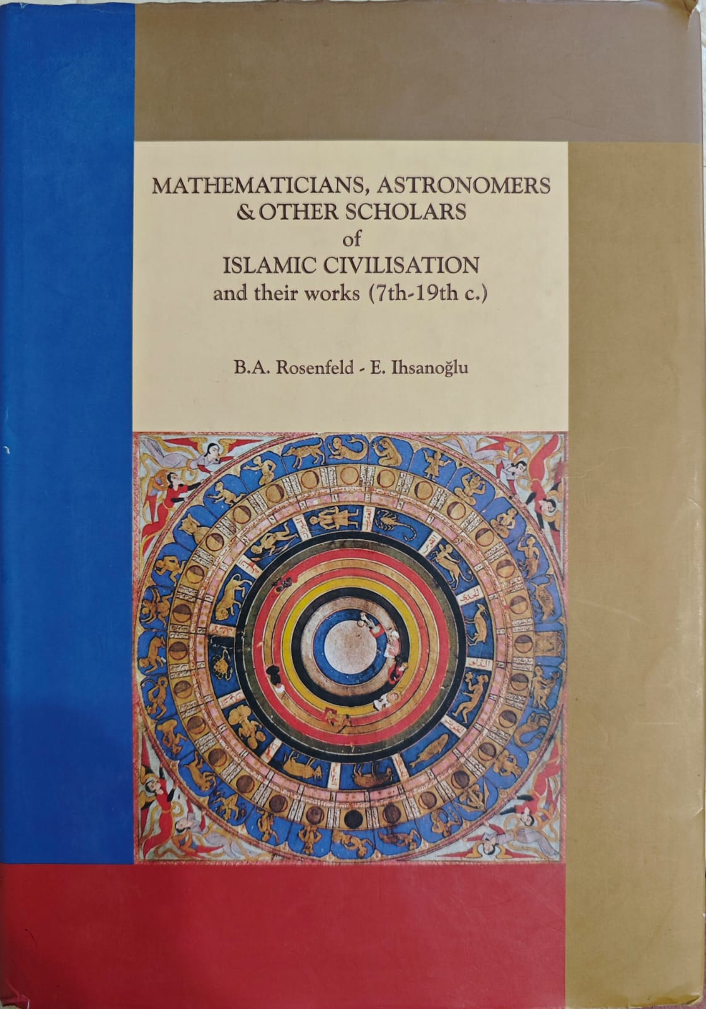
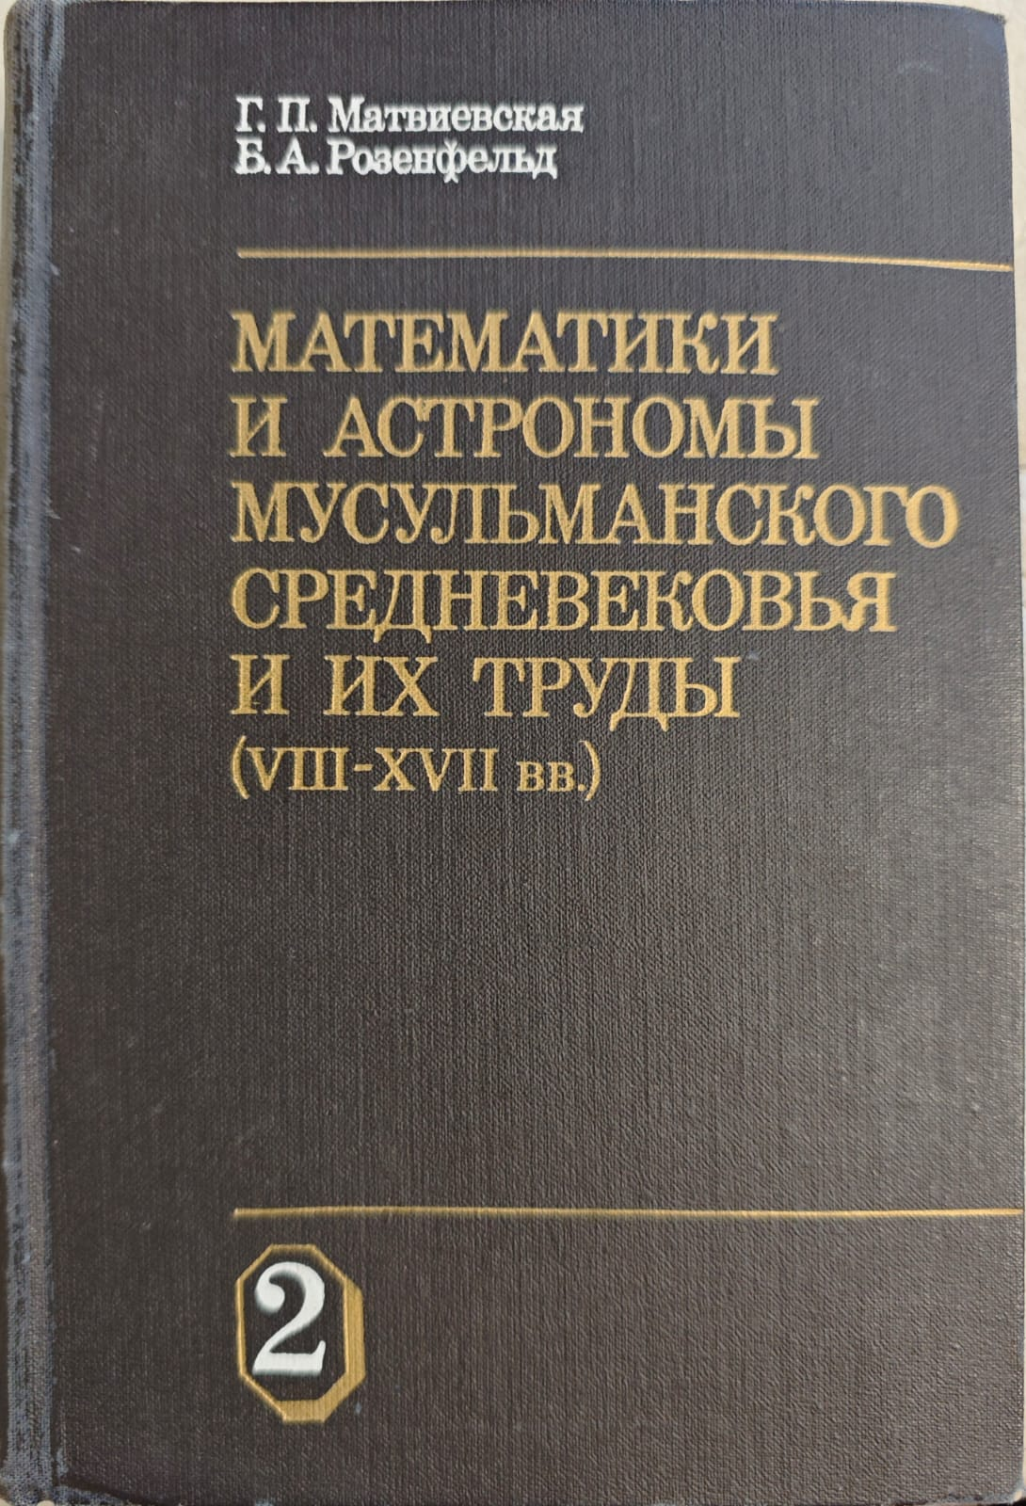

Slide 38
Galina Pavlovna Matvievskaya (July 13, 1930, Dnepropetrovsk) was a Soviet and Russian historian of mathematics, orientalist, local historian, and literary critic. Doctor of Physical and Mathematical Sciences (1969). Honored Scientist of the Uzbek SSR (1980). Academician of the Academy of Sciences of the Uzbek SSR. Full member of the International Academy of History of Science (1993). Member of the Union of Writers of Russia. Winner of the Abu Rayhon Beruni State Prize of the Uzbek SSR.
Laureate of the Orenburg Lyre Prize and the All-Russian Captain's Daughter Prize.
In 1954 she graduated from Leningrad State University.
In 1954-59 worked at the Leningrad branch of the Institute for the History of Sciences and Technology of the USSR Academy of Sciences.
Since 1959, she has been a member of the Institute of Mathematics of the Academy of Sciences of the Uzbek SSR. Since 1994, she has been a professor at the Orenburg Pedagogical University.

Slide 39

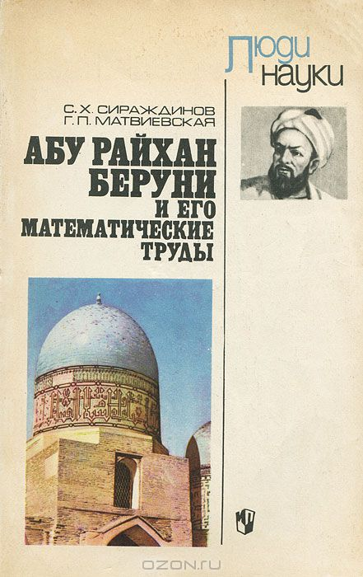
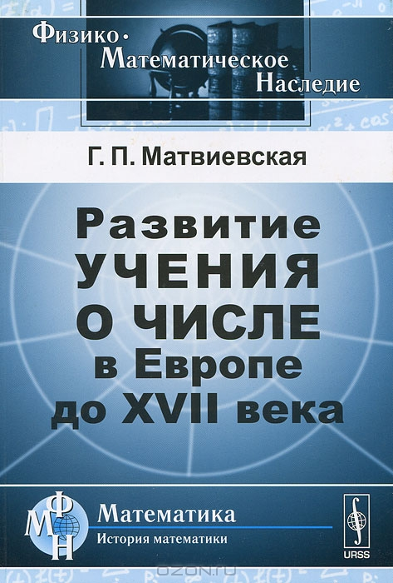
The main areas of Matvievskaya's research include the history of mathematics and mathematical astronomy in the countries of the medieval East, the history of number theory, L. Euler's manuscripts, and the cultural history of the Orenburg region. Author of more than 250 scientific works, including 20 monographs. She has trained three doctors and ten candidates of physical and mathematical sciences.

Slide 40
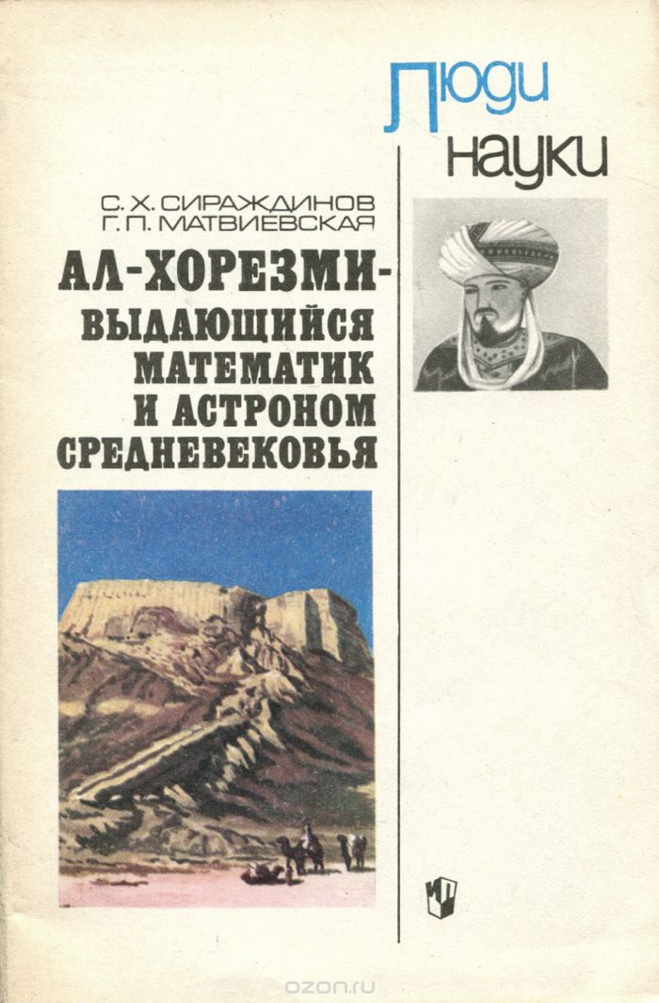
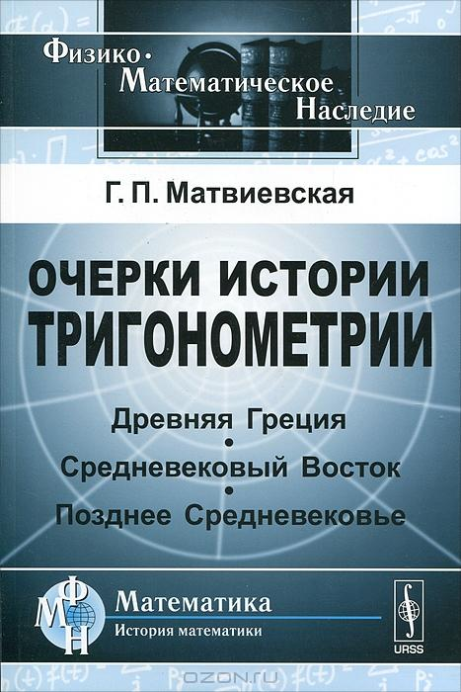

Slide 41
G. P. Matvievskaya, B. Rosenfeld (eds. 2008): Mathematicians and astronomers of the Muslim Middle Ages and their works (8th-17th centuries). 3 vols. 1983.
B.A. Rozenfeld, E. Ihsanoglu, Mathematicians, Astronomers & other Scholars of Islamic Civilization and their works (7th-19th c.), IRCICA, Istanbul, (2003).
G. P. Matvievskaya. The Theory of Number in the Medieval East. Tashkent: Fan, 1967. - 344 с. - 2000 copies.
Rene Descartes. G. P. Matvievskaya. - Moscow: Nauka, 1976. - 272 с. - (Scientific and biographical series). - 31,500 copies (obl.)
Abu Rayhan Beruni and his mathematical works: Manual for students . S. Kh. Sirazhdinov, G. P. Matvievskaya. - Moscow: Prosveshchenie, 1978. - 96 с. - (People of Science). - 95 000 copies (obl.)
Ramus. 1515-1572 . G. P. Matvievskaya. - Moscow: Nauka, 1981. - 152 с. - (Scientific and biographical series). - 21 700 copies (obl.)
Al-Khwarizmi - an outstanding mathematician and astronomer of the Middle Ages: Manual for students / S. Kh. Sirazhdinov, G. P. Matvievskaya. - Moscow: Prosveshchenie, 1983. - 80 с. - (People of Science).

Slide 42
Albrecht Dürer - scientist. 1471-1528. G. P. Matvievskaya; Ed. by Cand. Phys.-Math. sciences - Y. A. Bely; Reviewers: Acad. Academy of Sciences of the UzSSR V. P. Shcheglov, Dr. Phys.-Math. sciences B. A. Rosenfeld; Academy of Sciences of the USSR. - Moscow: Nauka, 1987. - 240, [8] с. - (Scientific and biographical literature). - 34 000 copies (in per.).
Essays on the History of Trigonometry. Tashkent: Fan, 1990.
Ulugbek. 1394-1449 . G. P. Matvievskaya, Z. K. Sokolovskaya. - Moscow: Nauka, 1997. - 152 с. - ISBN 5-02-003674-9.
Vsevolod Ivanovich Romanovsky. 1879-1954. A. N. Bogolyubov, G. P. Matvievskaya. - Moscow: Nauka, 1997. - ISBN 5-02-003644-7.
Abd al-Rahman al-Sufi. M.: Nauka, 1999.
Vladimir Ivanovich Dal / G. P. Matvievskaya, I. K. Zubova; Edited by E. N. Mirzoyan. - Moscow: Nauka, 2002. - 224 с. - (Scientific and biographical literature). - 530 copies. - ISBN 5-02-022726-9. (in per.)
Yakov Vladimirovich Khanykov. 1818-1862 . G. P. Matvievskaya; Edited by Dr. A. V. Postnikov; Reviewers: Dr. V. V. Glushkov, Acad. V. S. Myasnikov; Russian Academy of Sciences. - Moscow: Nauka, 2006. - 200 с. - (Scientific and biographical literature). - ISBN 5-02-033232-1. (in per.)

Slide 43
https://www.youtube.com/watch?v=4AGUnYSsHXg
Interview
Galina Pavlovna Matvievskaya -Soviet and Russian historian of mathematics, orientalist, local historian, and literary critic. Doctor of Physical and Mathematical Sciences (1969). Honored Scientist of the Uzbek SSR (1980). Corresponding member of the Academy of Sciences of the Uzbek SSR (1984). Full member of the International Academy of History of Science (1993). Member of the Union of Writers of Russia. Winner of the Abu Rayhon Beruni State Prize of the Uzbek SSR. Laureate of the “Orenburg Lyre” prize and the All-Russian “Captain's Daughter” prize.
Interviewed by: Mahmoud Al-Hamza - Professor of Mathematics and specialist in the history of Arabic mathematics in the Middle Ages2019- Orenburg- Russia.

Slide 44
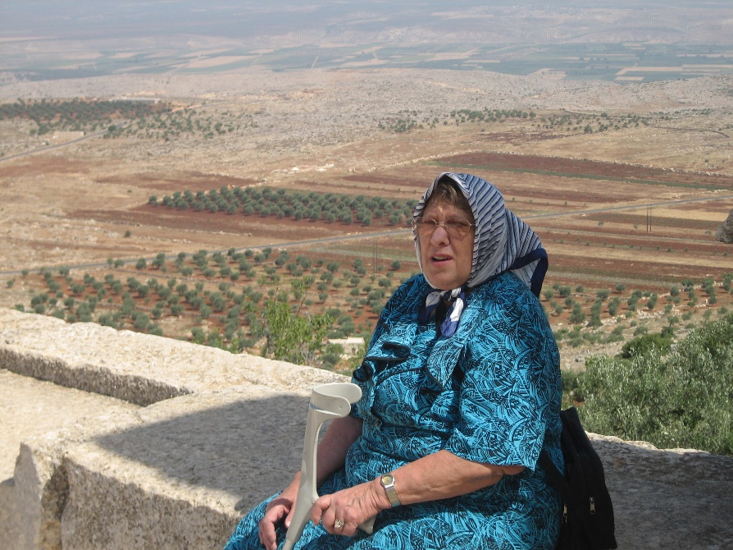
Mariam Mikhailovna Rozhanskaya (25.07.1928, Shchigry, Kursk obl. - 25.11.2014) - historian of mathematics and mechanics, a world-renowned expert in the history of science in the medieval East; doctor of physics and mathematics, doctor of historical sciences.
- Graduated with honors from the Faculty of History of Lomonosov Moscow State University, and Faculty of Mechanics and Mathematics.
She was a student of the Soviet historian S.P. Tolstov, who discovered the ancient Khorezmian civilization.
Since 1950 she worked for more than 30 years in the Khorezm archaeological and ethnographic expedition.
From 1959 to 1967 she worked at the Institute of Ethnography of the USSR Academy of Sciences.
Since 1967 - at the Institute of History of Science and Technology of the USSR Academy of Sciences, in the group of researchers on the history of mathematical sciences in the medieval East, which included historians of science - A.P. Yushkevich and B.A. Rosenfeld; I.N. Veselovsky, G.P. Matvievskaya.

Slide 45
Working with Khorezmian materials, M.M. Rozhanskaya became interested in medieval Arabic mathematics, one of the centers of which was ancient Khorezm.
The results obtained by her constituted the content of the dissertation “Functional dependencies in al-Biruni” for the degree doctor of physics and mathematics1967.
The dissertation “Mechanics in Khorasan and Maverannahr in the Middle Ages (IX - XV)” for the degree of Doctor of Historical Sciences was defended in 1986.
These works, as well as scientific biographies of great scientists, participation in the publications (translator and commentator) of the works of the classics created her reputation as one of the major modern specialists in the history of ancient and medieval science.
She was the author of more than 150 scientific works.
Full member of the International Academy of the History of Science.
She was a member of different scientific societies for the history of science in Europe.

Slide 46
Rozhanskaya M. M. Mechanics in the Medieval East. 2010
Rozhanskaya M. M. On some Arabic mathematical manuscripts in the libraries of St. Petersburg. 2009‍
Rozhanskaya M. M. About some Arabic mathematical manuscripts in the libraries of St. Petersburg // Proceedings of VII Kolmogorov Readings.Yaroslavl, 2009.С. 341-346.
Rozhanskaya M. M. M. M. About some problems of development of medieval algebra- Proceedings of IX Kolmogorov Readings. - Yaroslavl, 2011. - С. 43-45.
Rozhanskaya M. M. On the reconstruction of the full text of al-Biruni's treatise on specific weights // Historical and Mathematical Studies. Moscow: Janus-K, 2002.7(42). С. 223-243.
Rozhanskaya M. M. Translations of mathematical and astronomical works of scientists of VIII-XIV centuries and their role in the history of science // Proceedings of V Kolmogorov Readings. - Yaroslavl, 2007. С. 294-298.

Slide 47
Joint work of Mahmoud Al-Hamza with M.M. Rozhanskaya (2002-2014) at the IIET RAS.
During this period we were engaged in mathematics of Andalusian and Maghreb countries. The mathematical manuscripts of Al-Hassar (12th century), Ibn Al-Banna (14th century) and Al-Kalasadi (15th century) were translated into Russian, studied and published in the journal “Historical and Mathematical Studies” at the IHST RAS.
The ways and forms of penetration of algebra ideas through these countries into medieval Europe were also investigated. The pattern of development and origin of Arabic algebra from weighing problems and also the development of the problem of “two false positions” into the problem of “Cup of Weights” was found.
Al-Hamza Mahmud studied the works of Arab mathematicians of Andalusia and Maghreb such as: Ibn Al-Banna (14th century), Yaysh Al-Umawi (14th century), Al-Kalasadi (15th century), Ibn Al-Haim Al-Maqdisi (15th century), Ibn Ghazi Al-Fasi (16th century) and others.

Slide 48
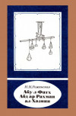
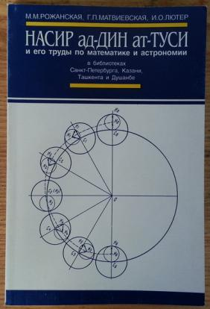
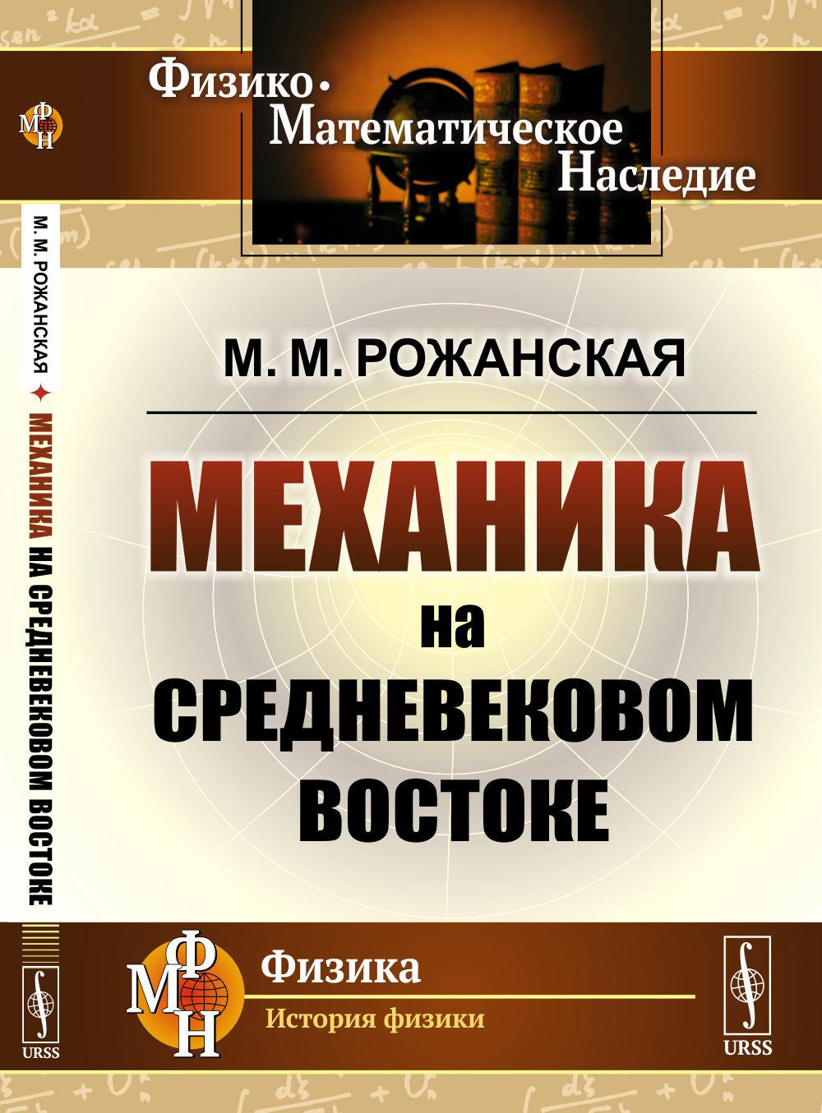
'Abd al-Rahman al-Khazini. XII c.

Slide 49
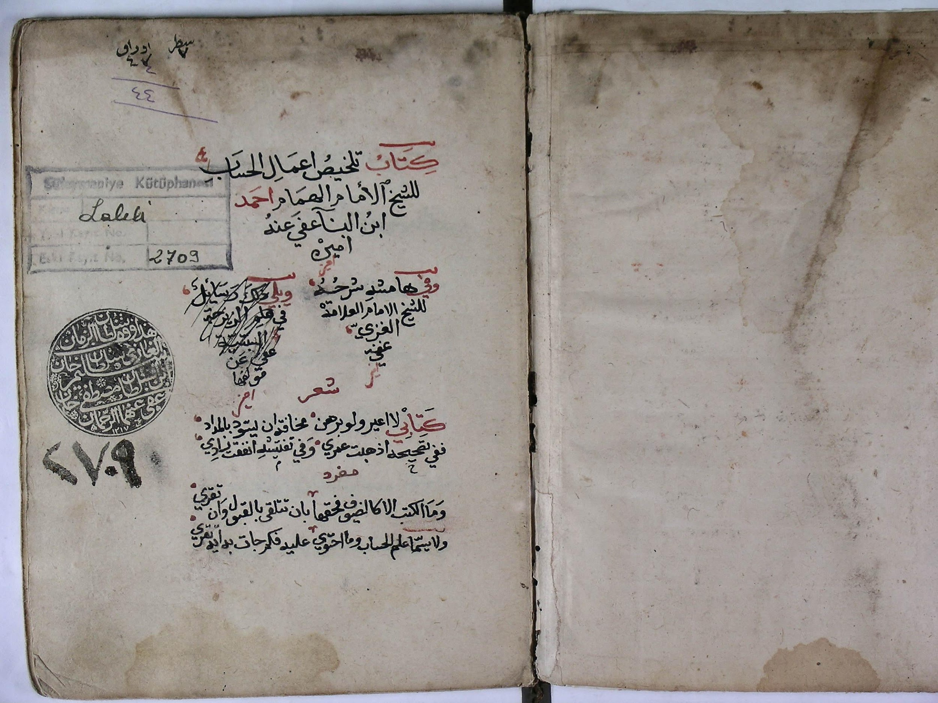
manuscript “A Summary of Arithmetic Operations” (Talkhys) by Ibn al-Banna al-Marrakshi- Istanbul- Suleymaniye Library

Slide 50
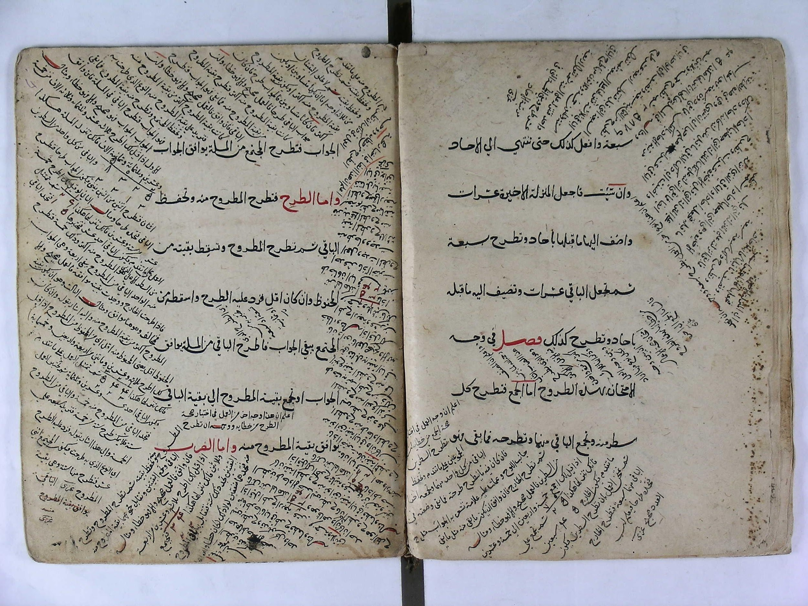

Slide 51
Transition of science from the Muslim world to Europe:
From the 12th century a major Arabic-to-Latin translation campaign began (via Andalusia-Sicily-Byzantium-Crusaders).
Modern research (2023): there were translations of the manuscript from Arabic into Greek (Byzantium).
Creation of European universities on the experience of Arab universities as:
University of Zetoun (Tunis-737)
Al-Qairovan University (Morocco-Fas-859)
Al-Azhar University (Egypt-Cairo-970)
House of wisdom (9th century)
University of Cordoba (10th century)
First European University: University of Bologna,1088 (11th c.)

Slide 52
Conclusion
Positive and objective attitude of Russian Arabists towards the Arab-Muslim heritage. (while the position of many orientalists in the West is biased and negative).
Russian historians of Arab science in the Middle Ages have done a great work and left hundreds of works on Arab and Muslim scholars such as: Al-Khwarizmi, Al-Biruni, Al-Khayam, Thabit ibn Kura, Al-Buzdjani, Nasirdin At-Tusi, Ibn Sina, Al-Khazin, Ibn Al-Haytham, Al-Farabi, Ibn Al-Baghdadi and others.
Encyclopedic works on the history of Arabic mathematics have been written.

Slide 53
СПАСИБО ЗА ВНИМАНИЕ
THANK YOU FOR LISTENING
شكرا على حسن الاستماع

