Slide 1
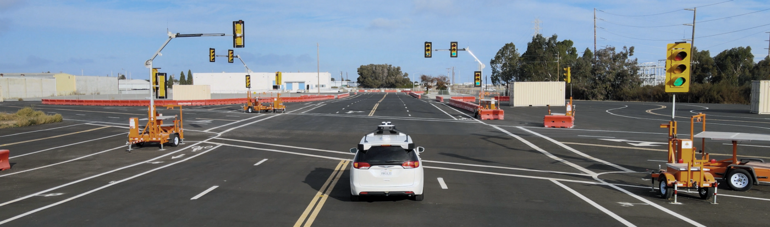
Transformers in Autonomous driving
Sergey Zagoruyko

Slide 2
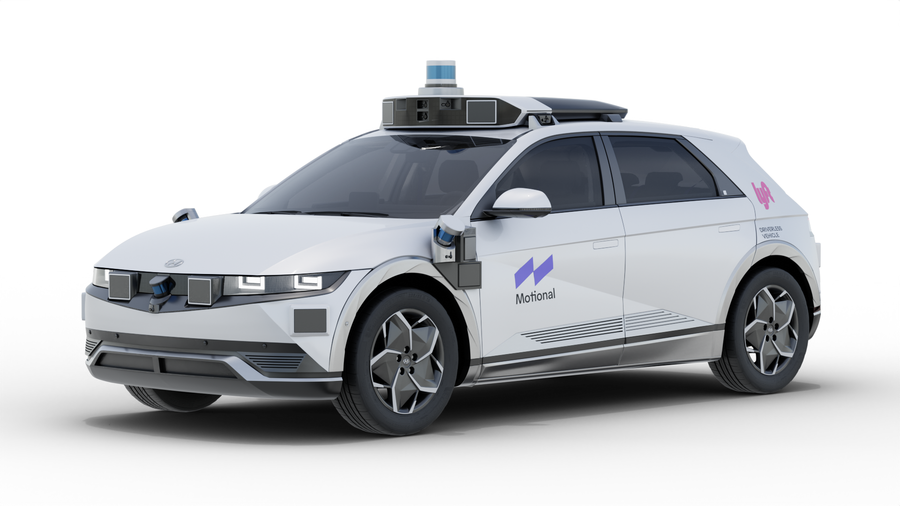
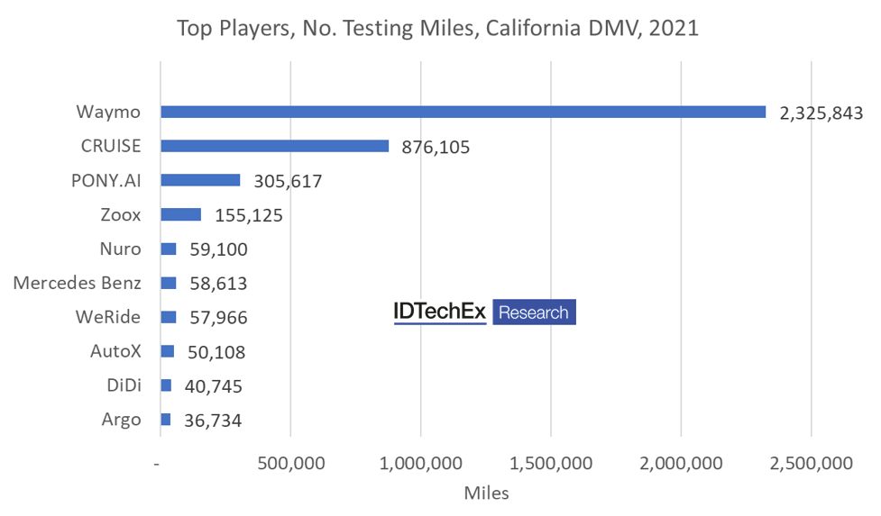
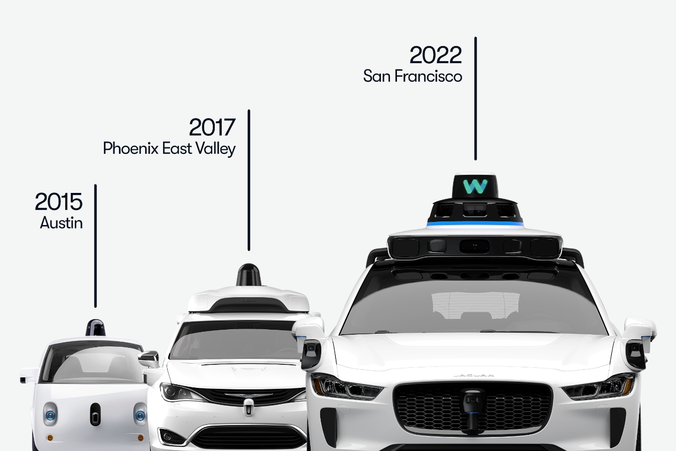
AV companies: the US

Slide 3
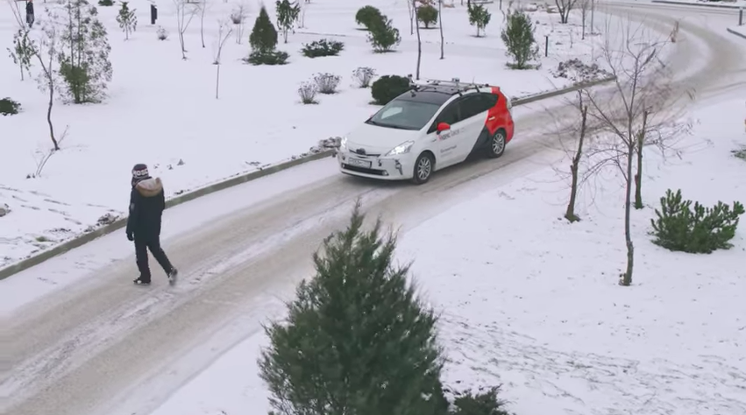
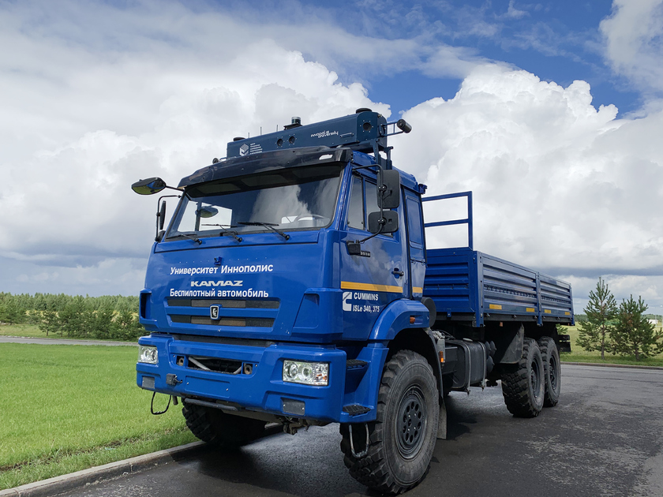
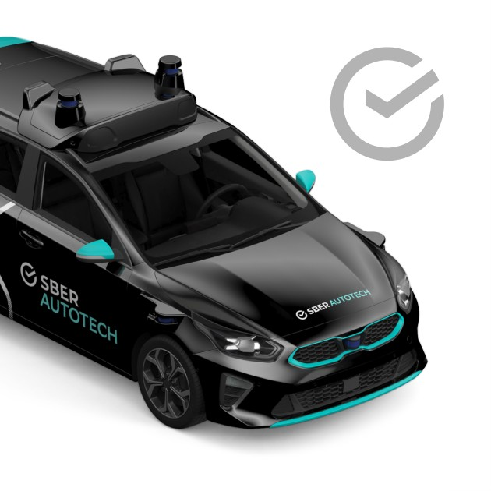
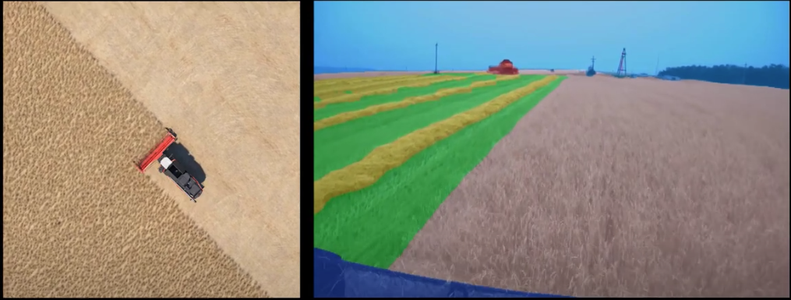
AV companies: Russia
Yandex's autonomous cars have driven over six million miles in 'challenging conditions'
https://www.youtube.com/watch?v=q-ekm7uqeq8

Slide 4
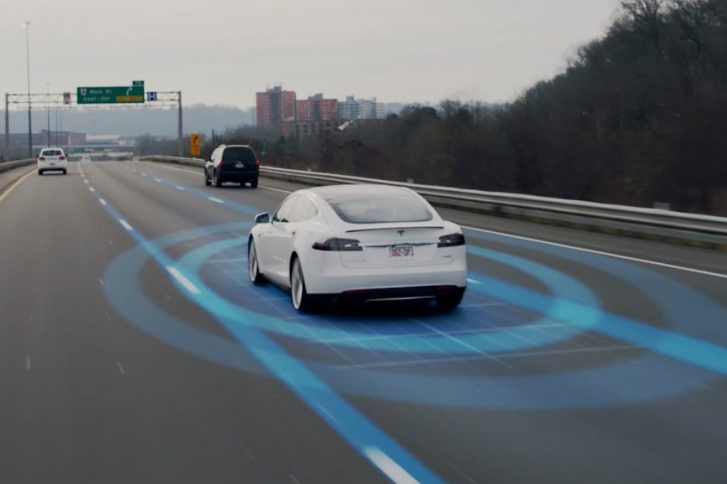
When did first autonomous vehicle was developed?
https://youtu.be/YZ6nPhUG2i0
In 1980s Ernst Dickmanns developed a system which was able to drive more than 1000 kms autonomously!

Slide 5
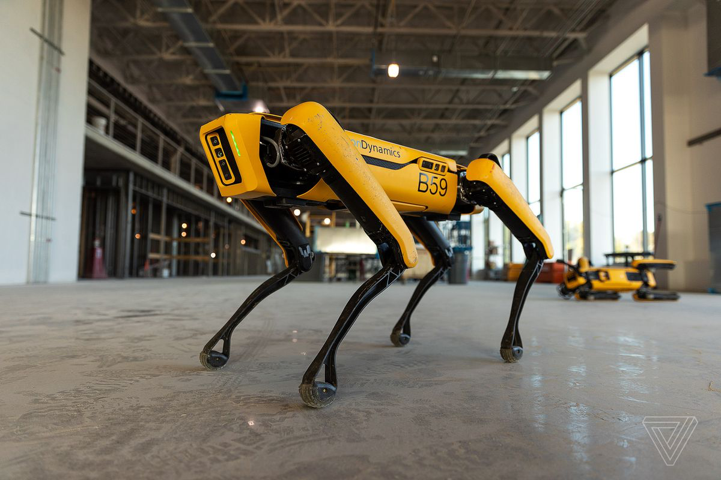
What kind of machine learning is used in robots?
None.

Slide 6
Autonomous Driving stack

Slide 7


Slide 8
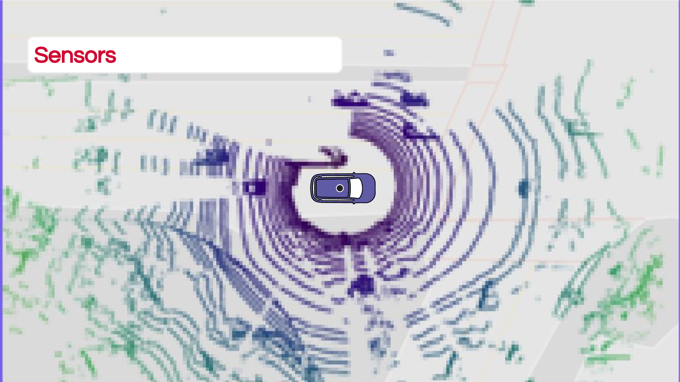

Slide 9
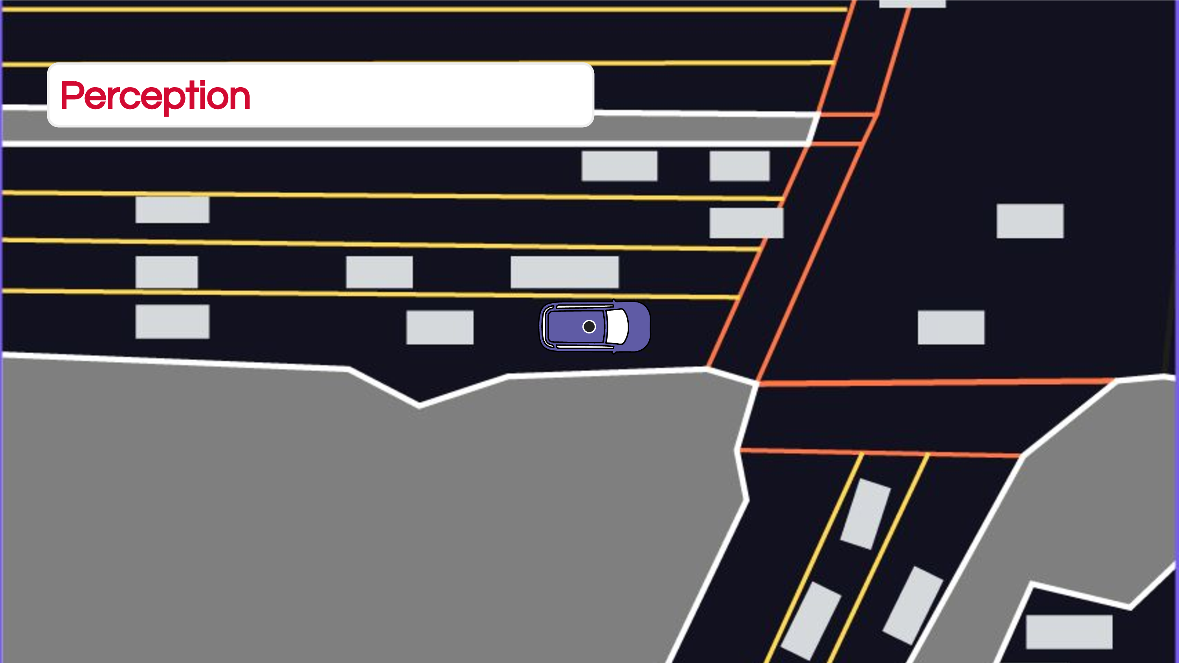

Slide 10
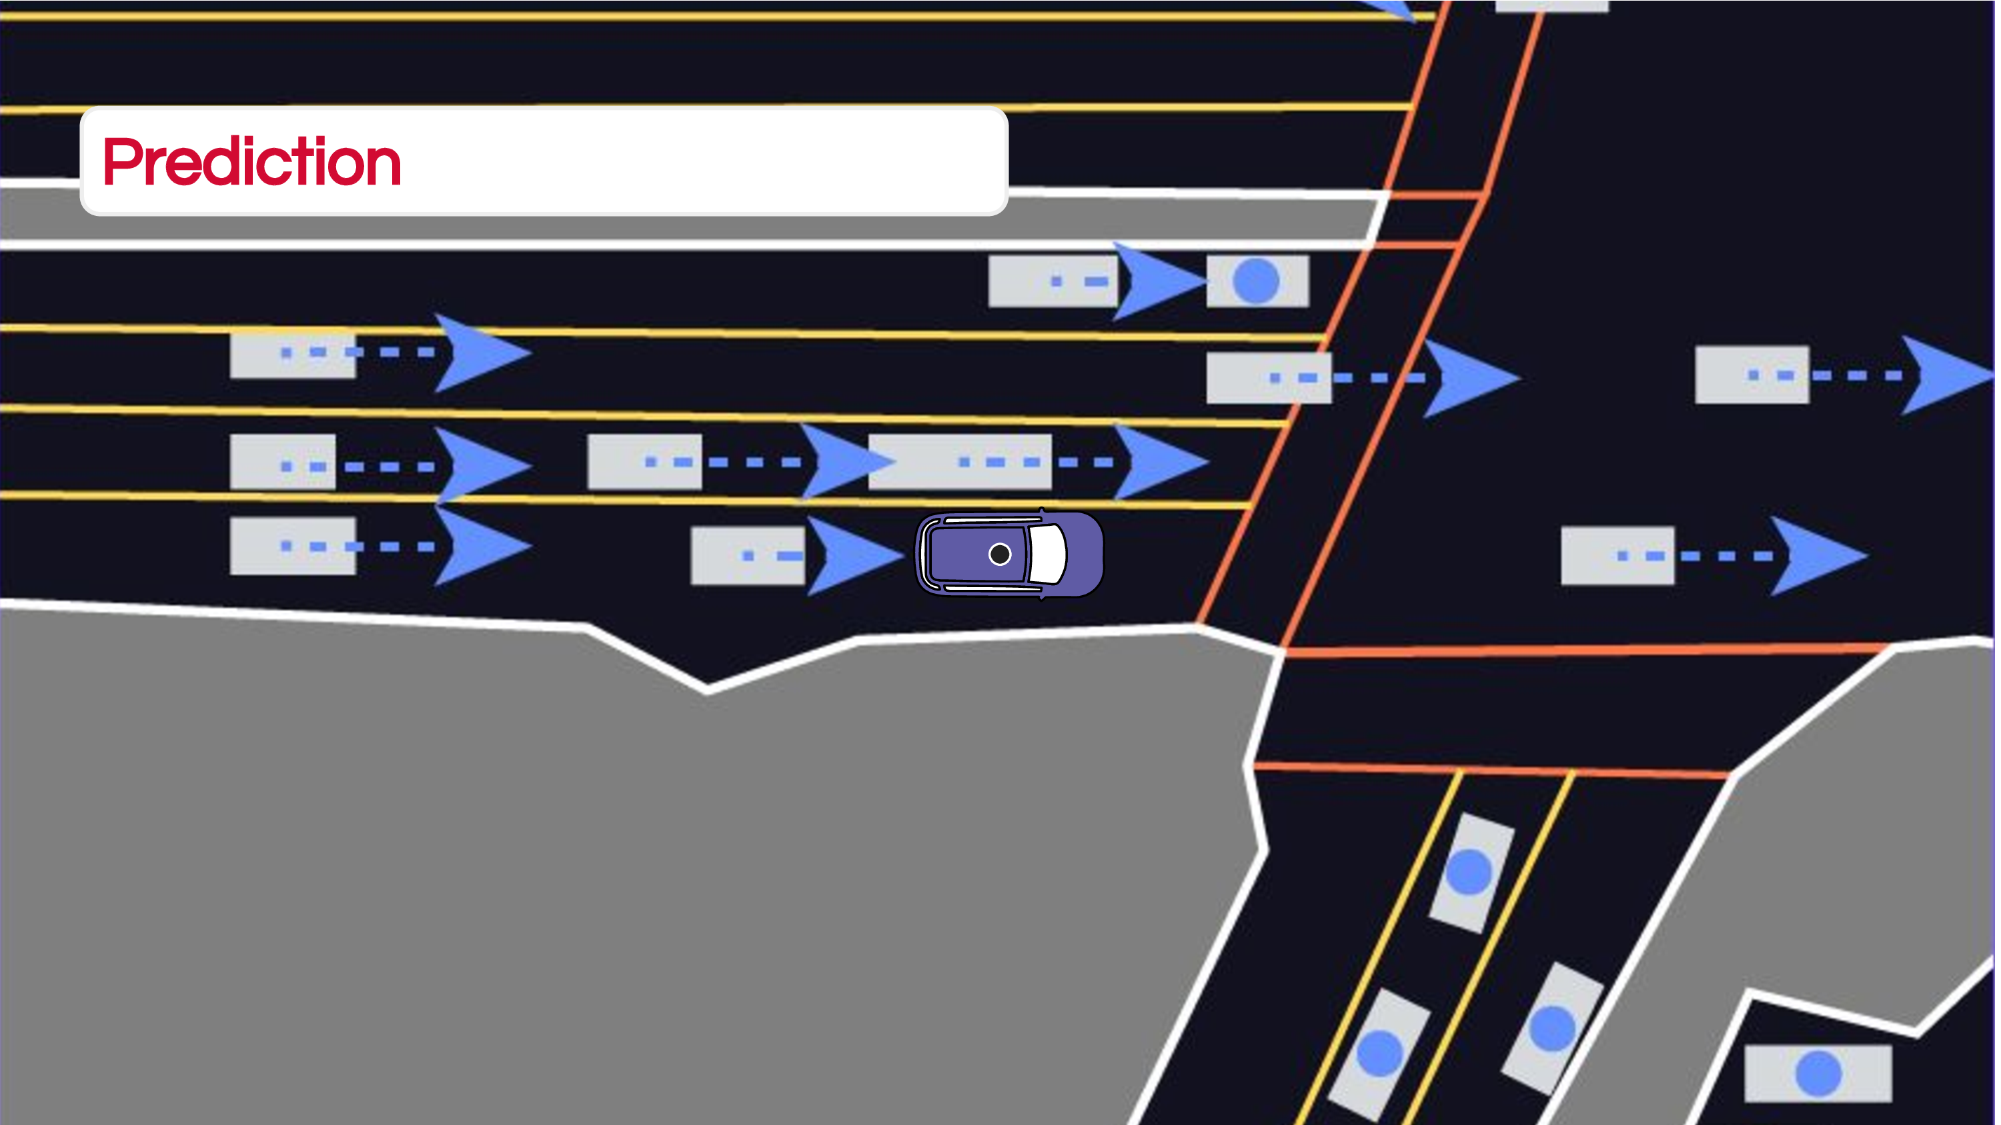

Slide 11
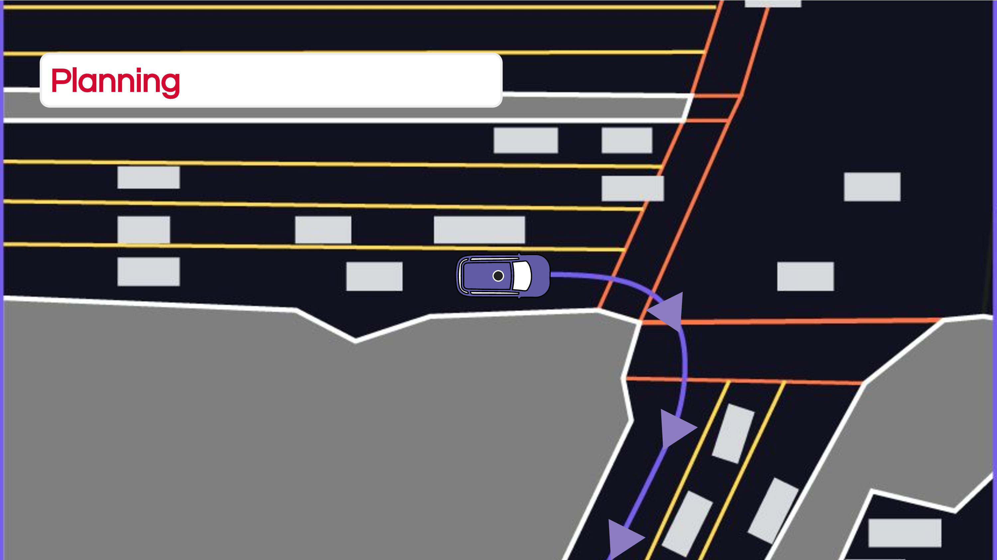

Slide 12
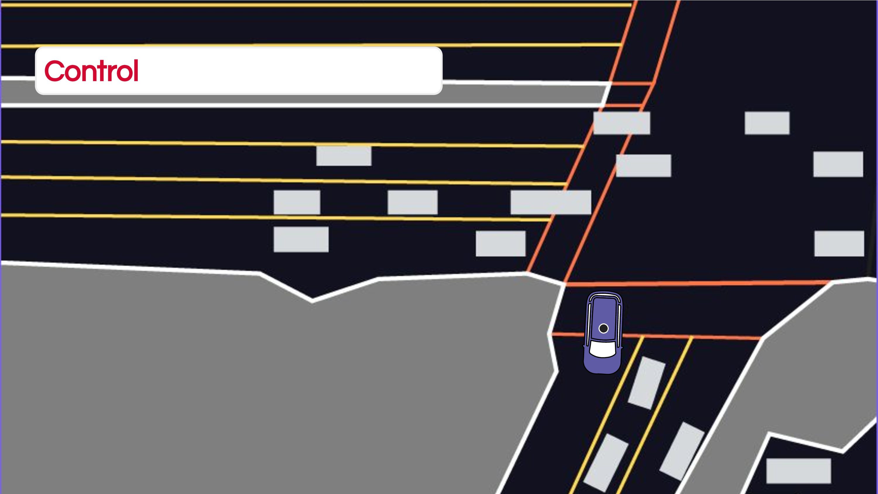

Slide 13
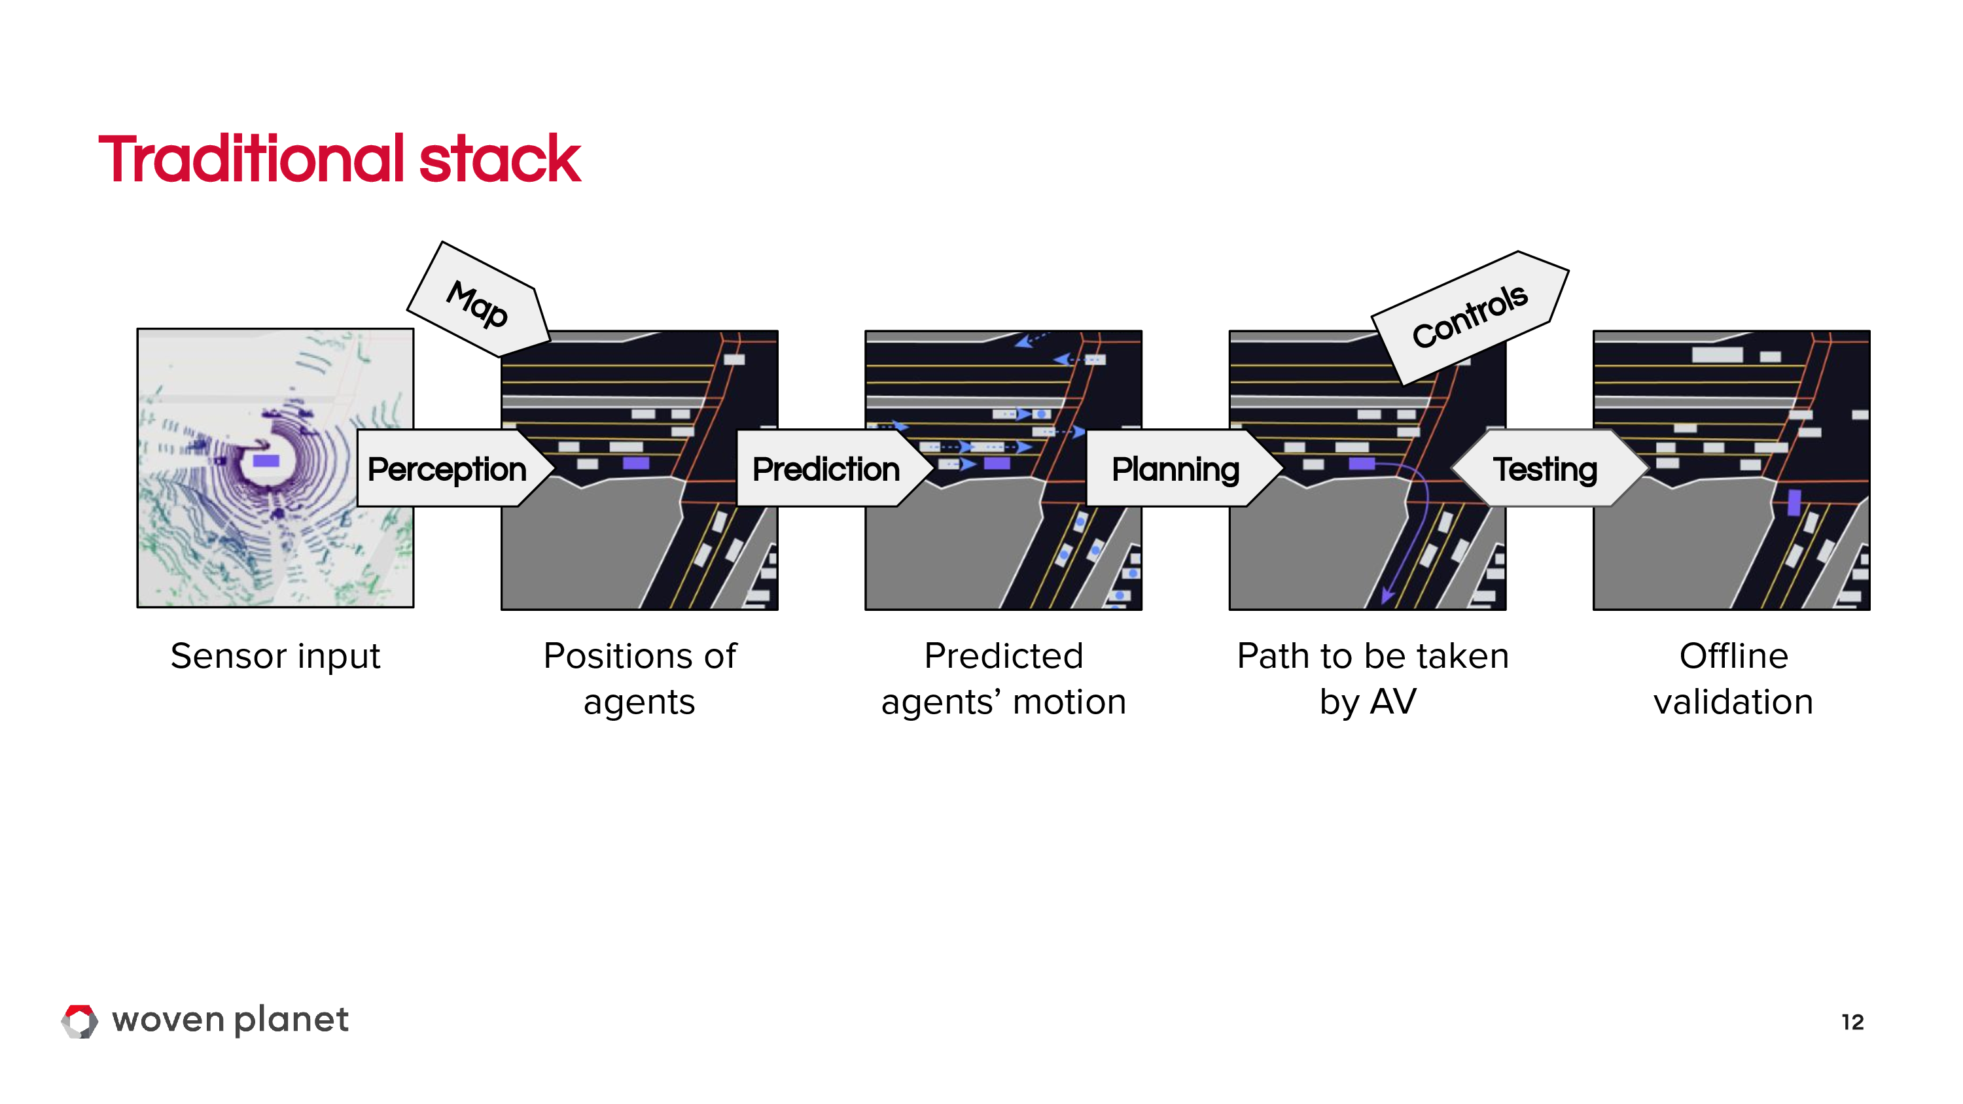
Slide credit: Ana Ferreira and Christian Perone

Slide 14
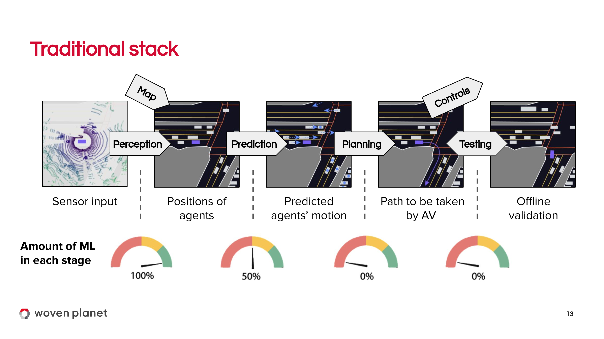

Slide 15
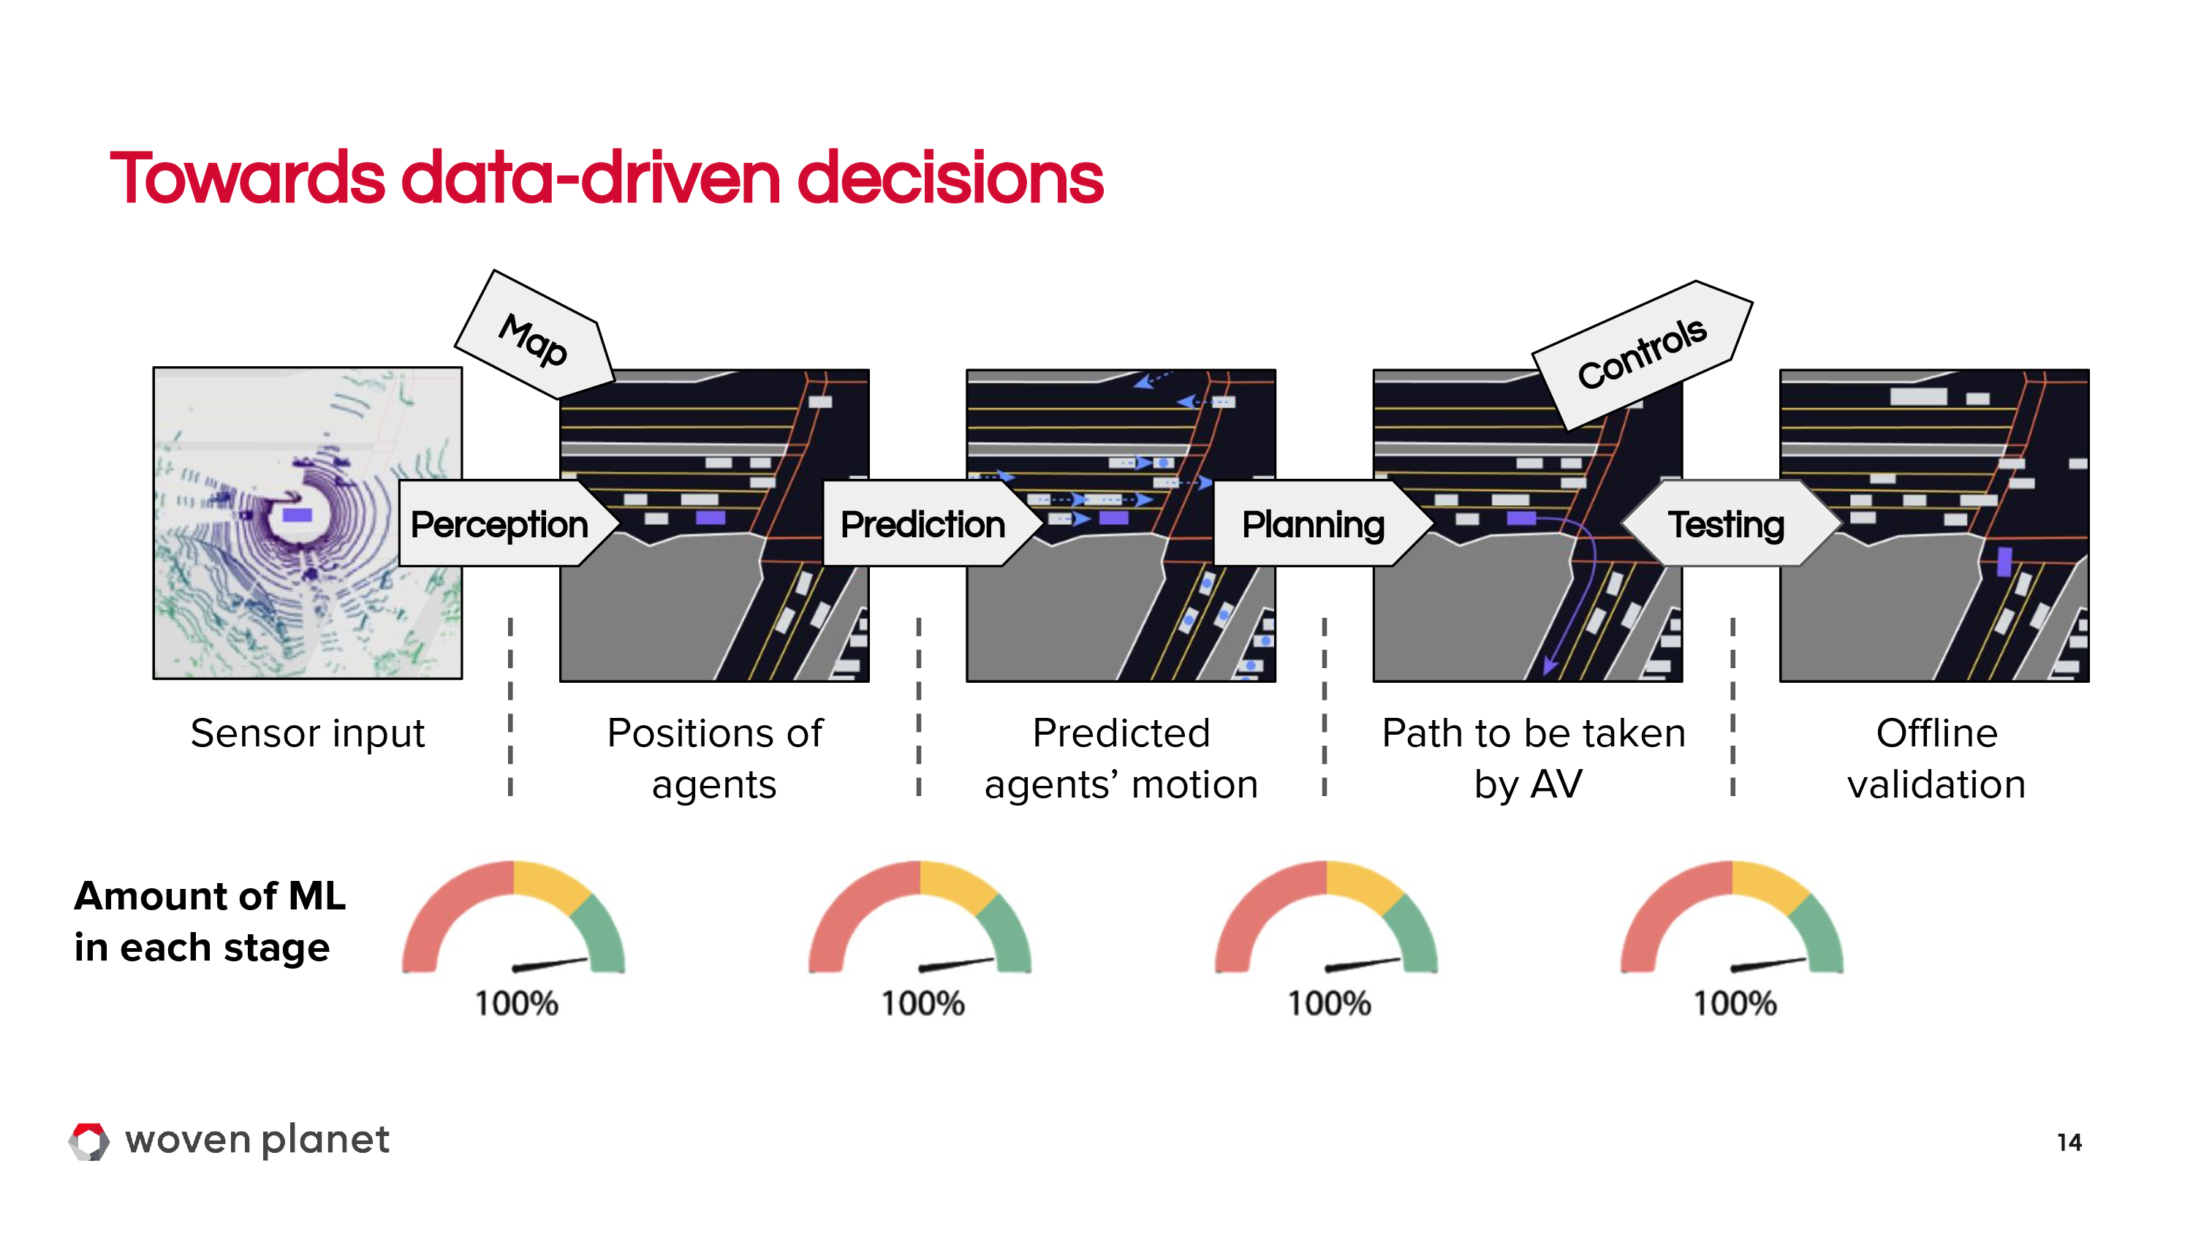
Slide credit: Ana Ferreira and Christian Perone

Slide 16
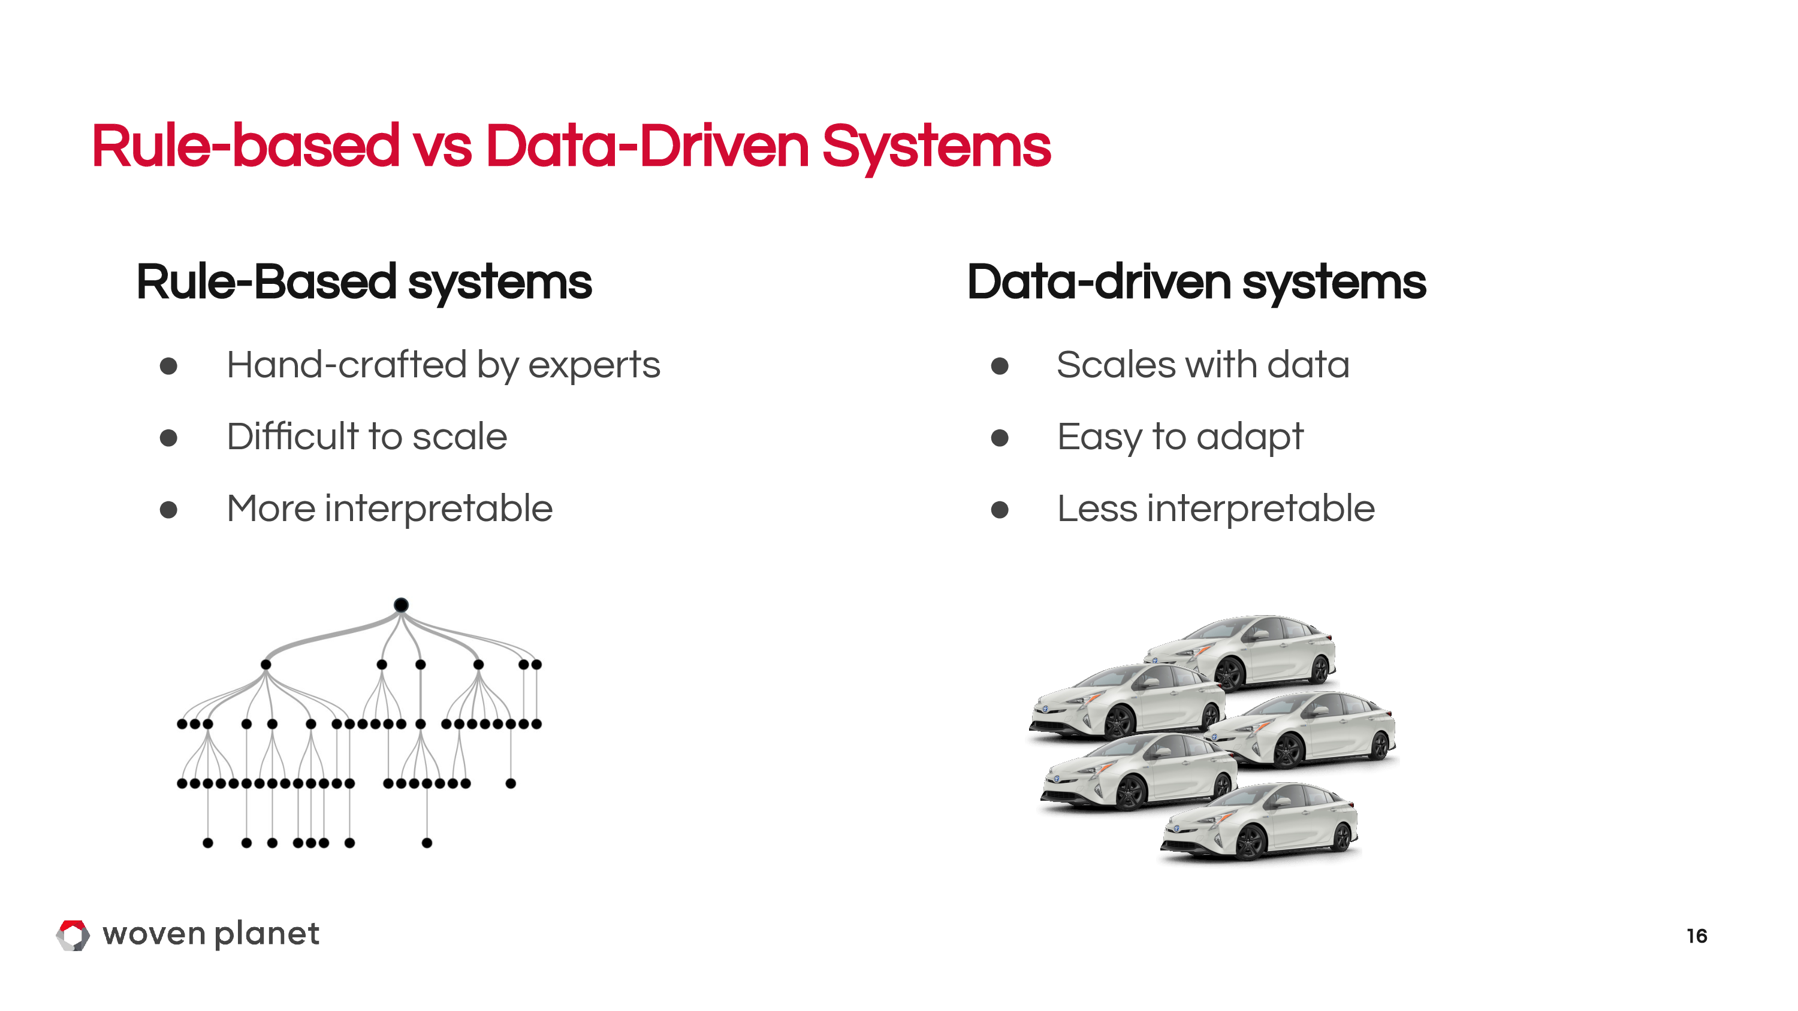
Slide credit: Ana Ferreira and Christian Perone

Slide 17
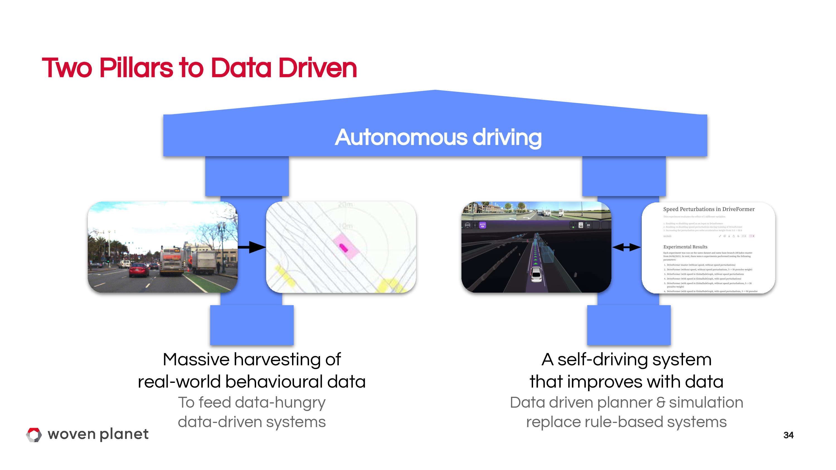
Slide credit: Ana Ferreira and Christian Perone

Slide 18
Imitation learning

Slide 19
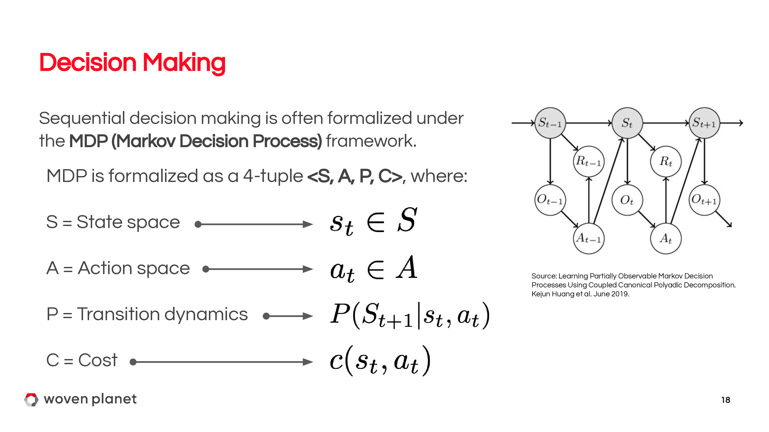

Slide 20
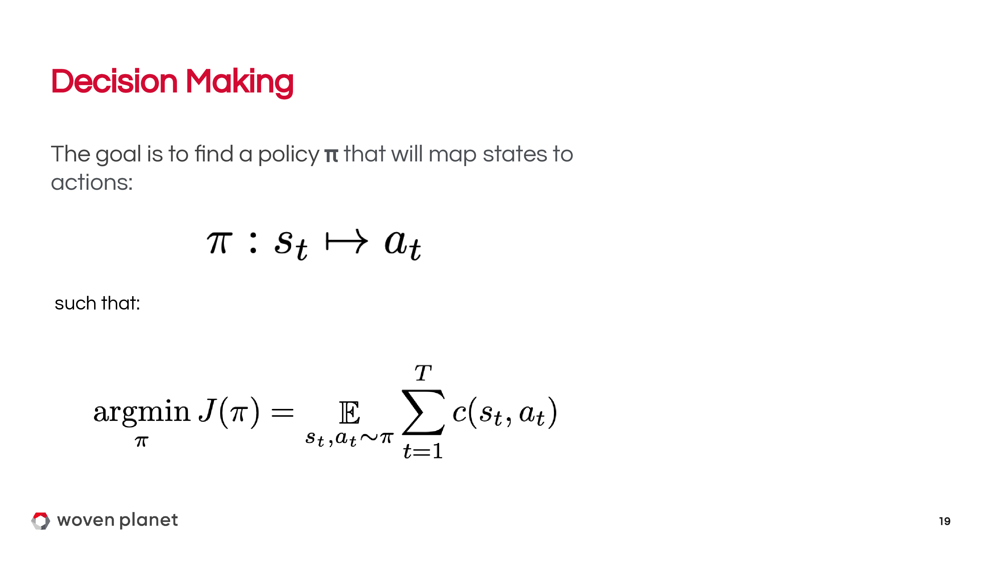

Slide 21
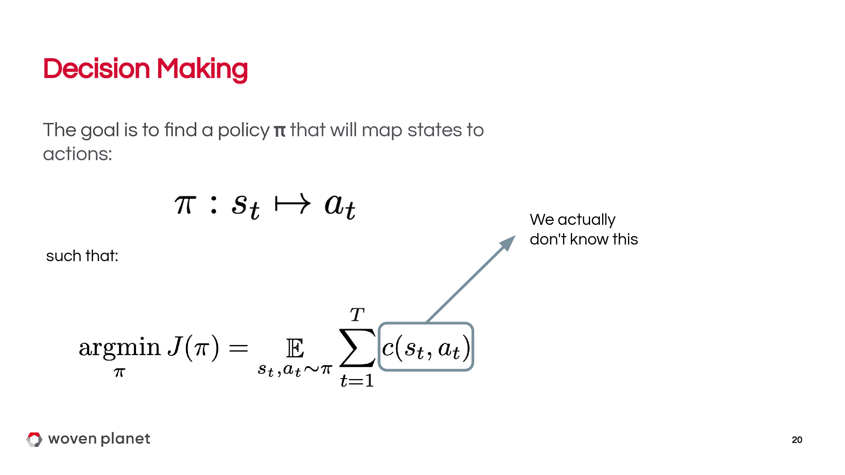

Slide 22
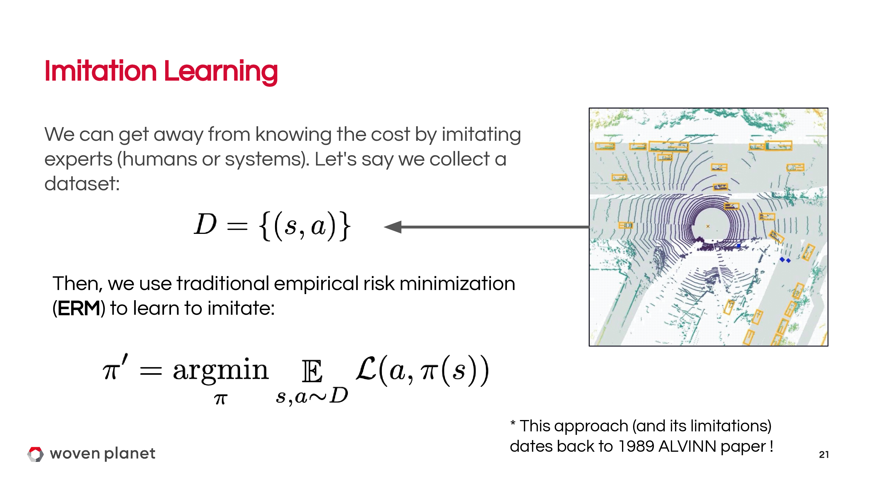

Slide 23
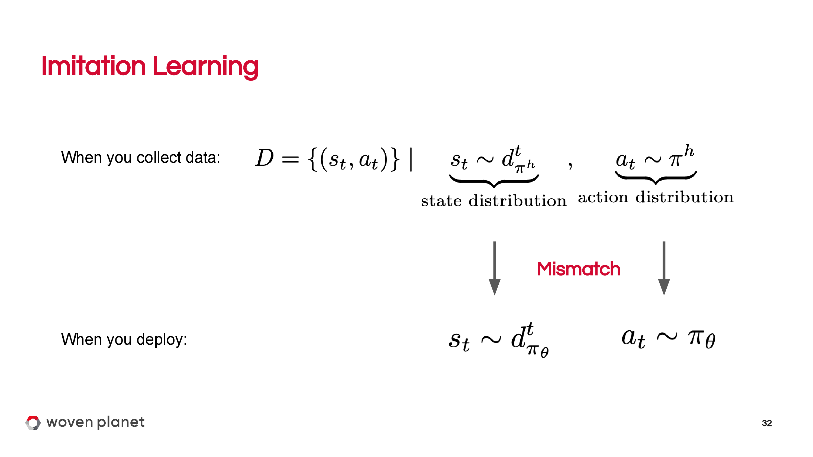

Slide 24
Does not work out of the box for AV planning
One way to make it work is to add perturbations
ChauffeurNet: Learning to Drive by Imitating the Best and Synthesizing the Worst
Mayank Bansal, Alex Krizhevsky, Abhijit Ogale

Slide 25
Transformers in Perception

Slide 26
Autonomous Driving datasets
KITTI
Waymo Open Dataset
nuScenes / nuPlan / nuImages
Lyft prediction / perception datasets
Yandex Vehicle Motion Prediction
…
Many more

Slide 27
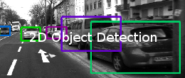

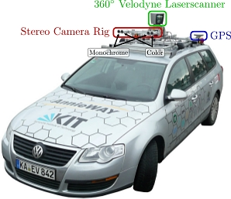
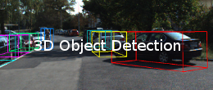
Autonomous Driving datasets
KITTI: detection

Slide 28
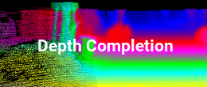
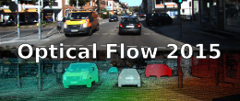
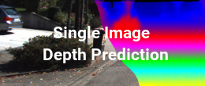
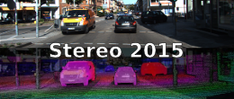
Autonomous Driving datasets
KITTI: stereo

Slide 29
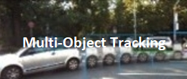
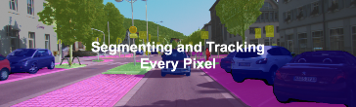
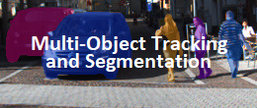
Autonomous Driving datasets
KITTI: tracking

Slide 30
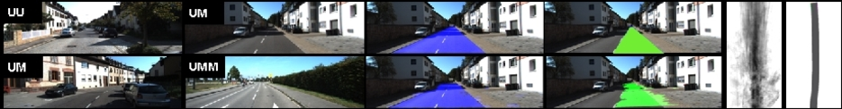
Autonomous Driving datasets
KITTI: road lane detection

Slide 31
Autonomous Driving datasets
KITTI: road lane detection

Slide 32
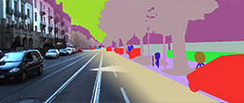
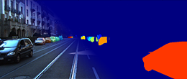
Autonomous Driving datasets
KITTI: segmentation

Slide 33
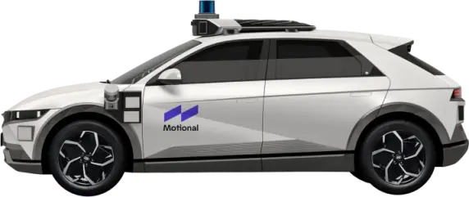
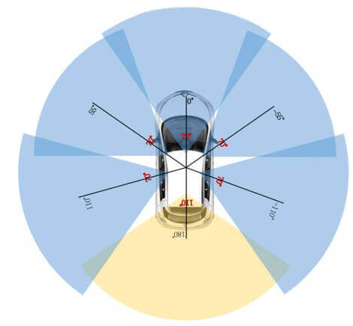
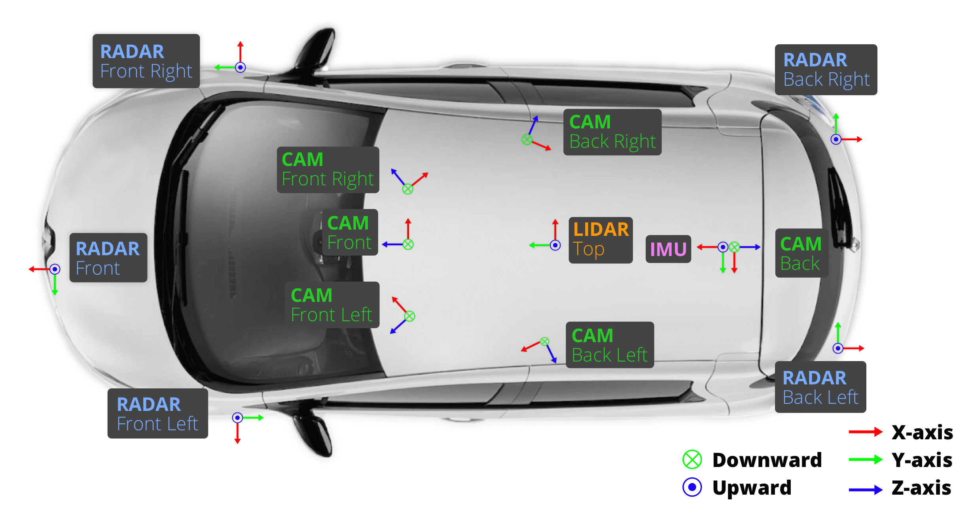
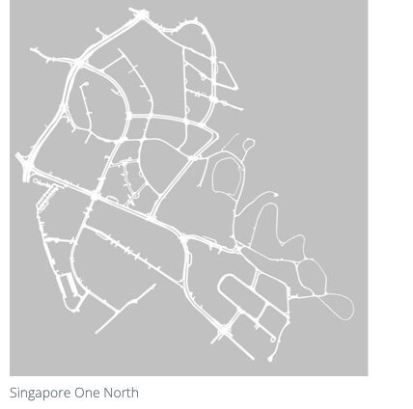
Autonomous Driving datasets
nuScenes
nuPlan
nuImages

Slide 34
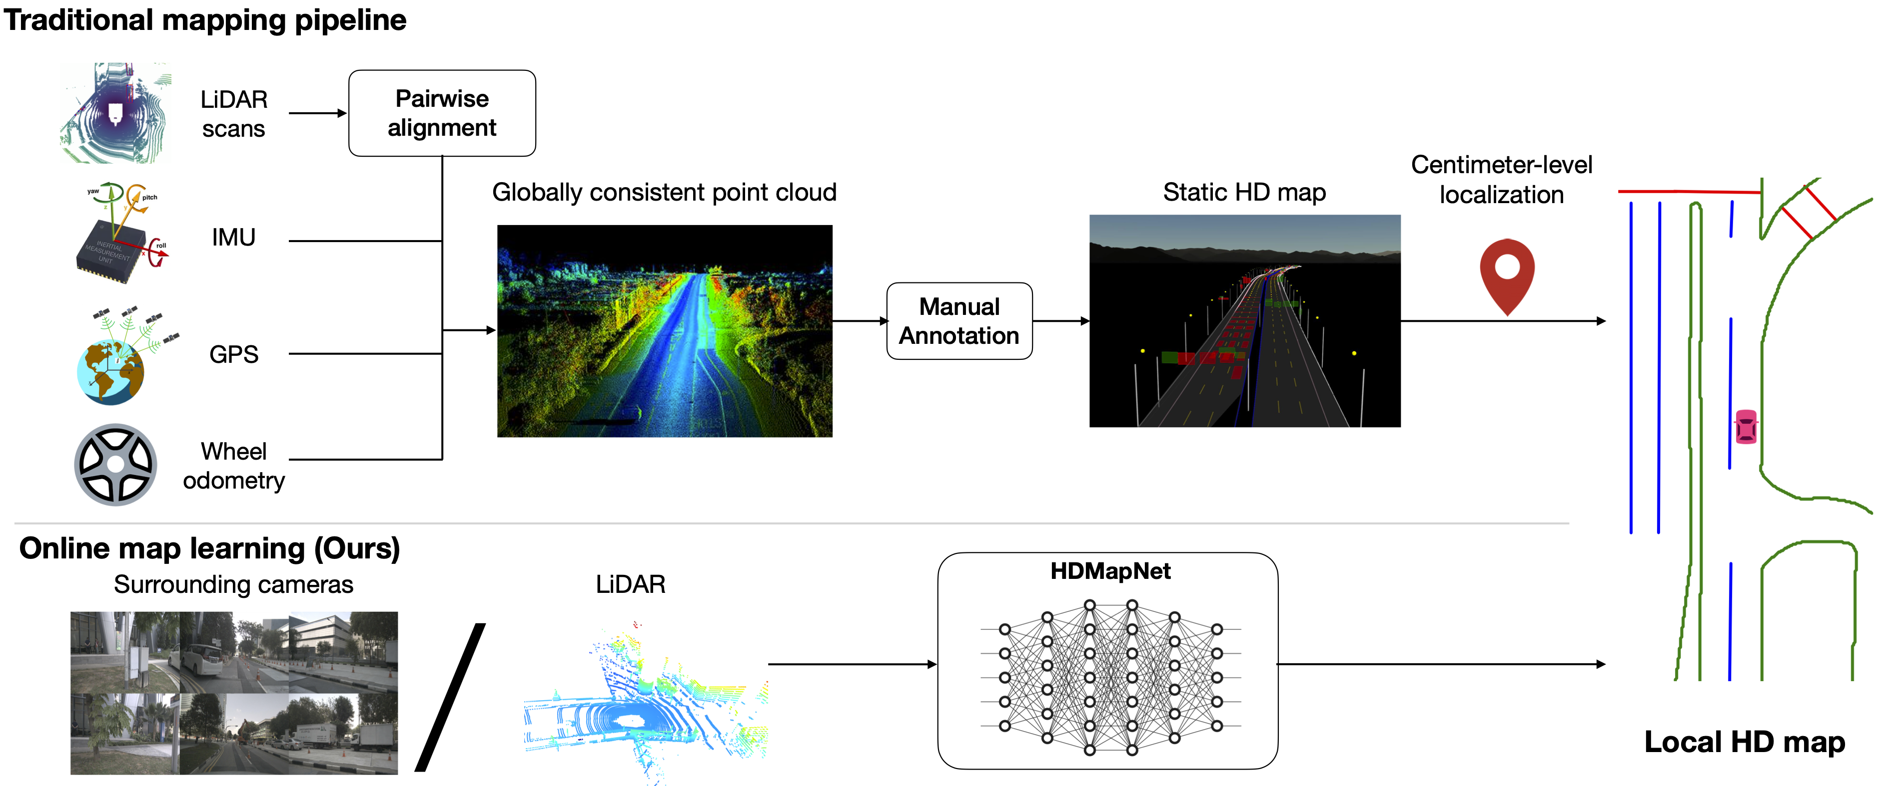
HDMapNet

Slide 35
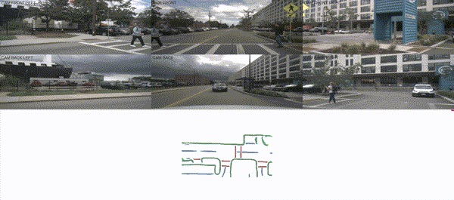
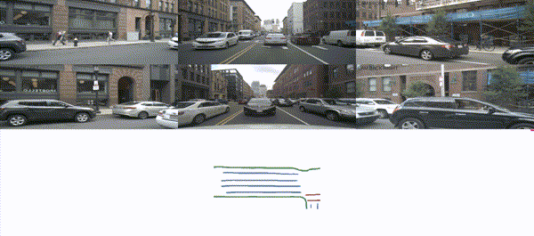
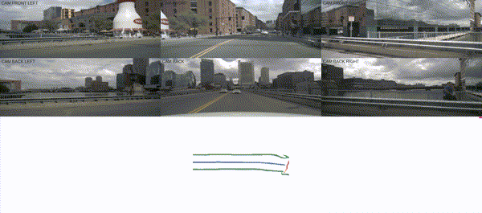
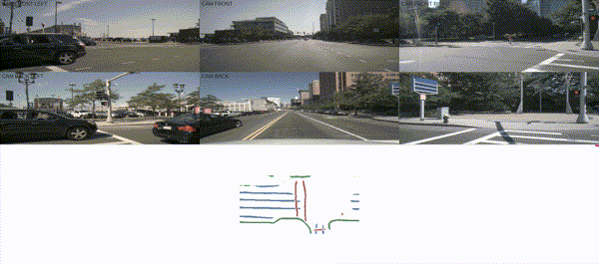
HDMapNet

Slide 36
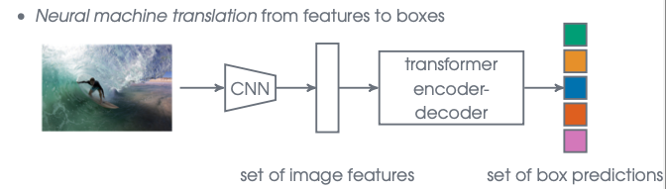
DETR: End-to-end Object Detection
Applying NMT to translate CNN features to detections:

Slide 37
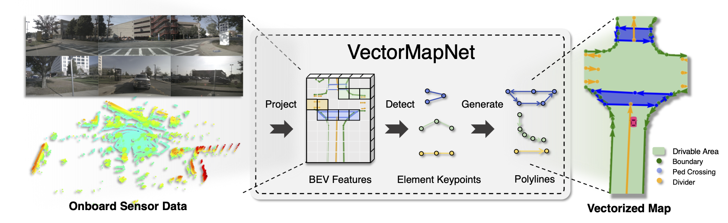
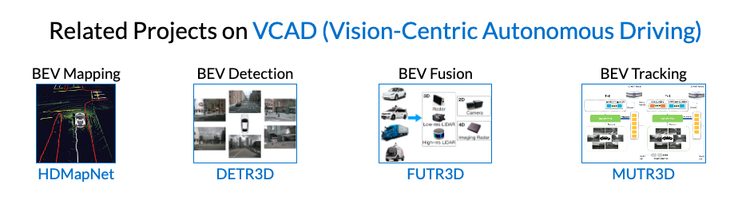
VectorMapNet and MapTR
Liu et al, VectorMapNet: End-to-end Vectorized HD Map Learning

Slide 38



PointPillars

Slide 39

End-to-end multi-camera 3D MOT
Pang et al., Standing Between Past and Future: Spatio-Temporal Modeling for Multi-Camera 3D Multi-Object Tracking

Slide 40
Perception problems
Planning and simulation uncover perception problems:
Long tail
Data collection and annotation are expensive
Offline perception is computationally heavy
Requires storing large amounts of data
Creating high-definition maps is difficult, become obsolete with time

Slide 41

Anecdotal cases: trucks
Problem for simulation and planning

Slide 42

Anecdotal cases: trucks

Slide 43

Anecdotal cases: animals

Slide 44
Transformers in Motion Planning

Slide 45


Slide 46


Slide 47


Slide 48


Slide 49


Slide 50


Slide 51
Ensuring safety

Slide 52

Notes:
2 problems: Mode switching and difficulty of creating fallback

Slide 53

SafePathNet
Pick safest trajectory according to predictions
Safe Real-World Autonomous Driving by Learning to Predict and Plan with a Mixture of Experts (Pini, 2022)

Slide 54

SafePathNet
Learns multiple futures in unsupervised way
Similar to DETR

Slide 55


SafePathNet

Slide 56


