Slide 1
Efficient Video Classification on Mobile Devices
Andrey Savchenko
Dr. of Sci, Prof.
Sber AI Lab, Scientific director
HSE University, Nizhny Novgorod

Slide 2
Motivation
Deep neural networks for image recognition
Model | Top-1 Accuracy | # Params | Depth | Inference time (ms) (CPU)
VGG16 | 71.3% | 138.4M | 16 | 69.5
ResNet50 | 74.9% | 25.6M | 107 | 58.2
ResNet152 | 76.6% | 60.4M | 311 | 127.4
InceptionV3 | 77.9% | 23.9M | 189 | 42.2
InceptionResNetV2 | 80.3% | 55.9M | 449 | 130.2
DenseNet121 | 75.0% | 8.1M | 242 | 77.1
DenseNet201 | 77.3% | 20.2M | 402 | 127.2
NASNetMobile | 74.4% | 5.3M | 389 | 27.0
NASNetLarge | 82.5% | 88.9M | 533 | 344.5
Deep models are accurate but have many parameters:
long training and inference!
Main problem:
How to obtain a neural network that better fits the concrete device?

Slide 3
Agenda
Background
AutoML and Neural Architecture Search (NAS)
AutoFace framework
Other efficient classifiers

Slide 4
Background

Slide 5
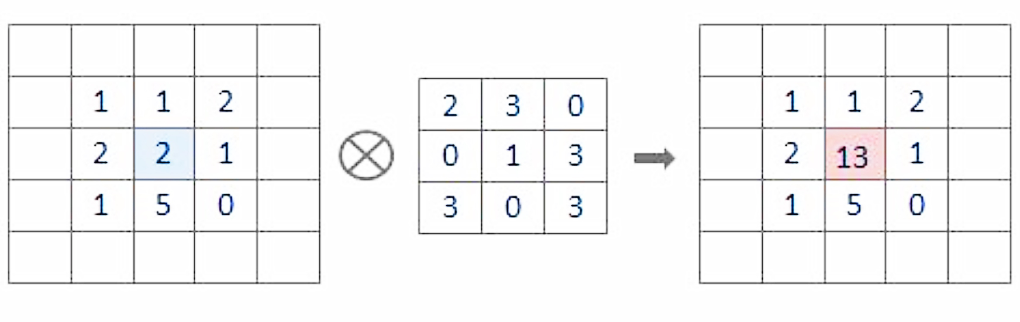
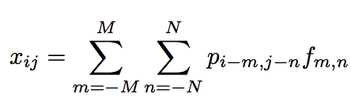
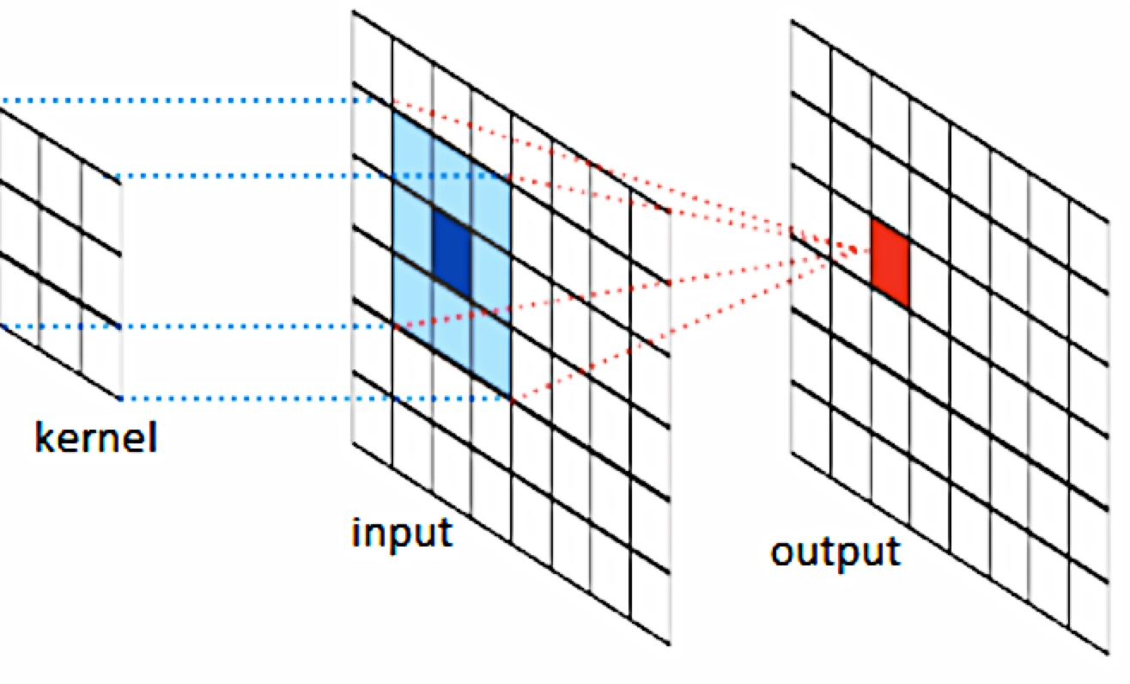
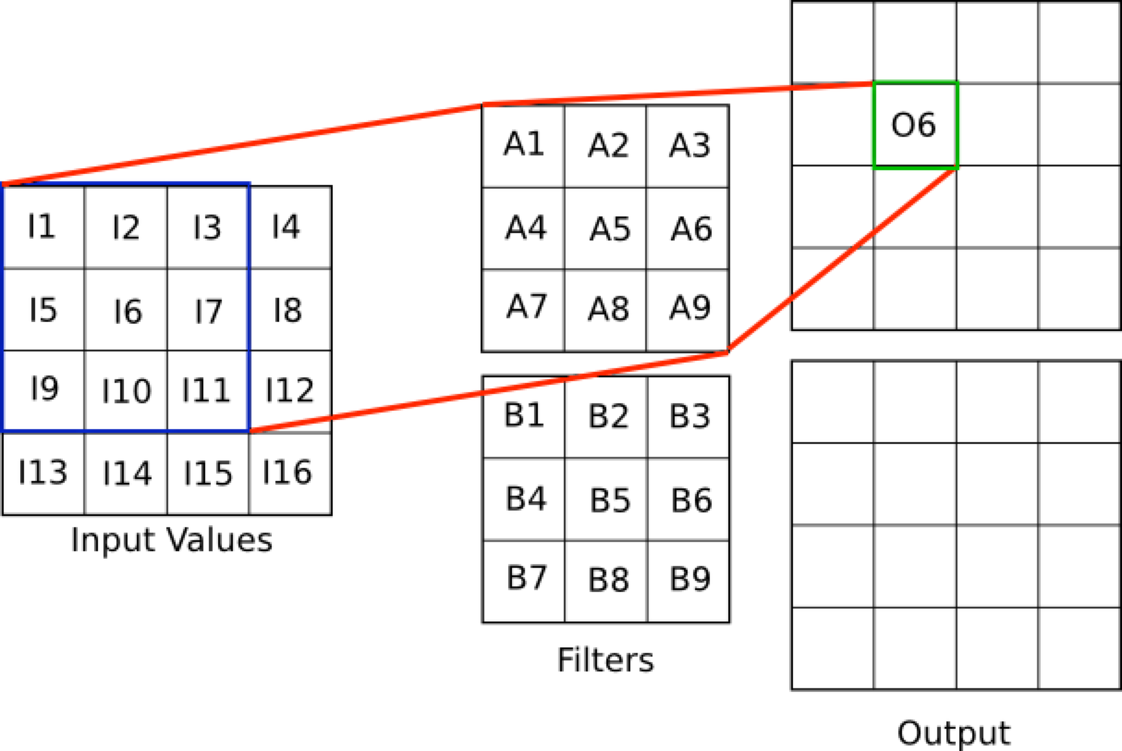
2D Convolution (1)
http://intellabs.github.io/RiverTrail/tutorial/

Slide 6
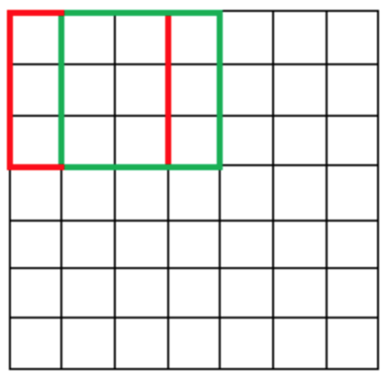
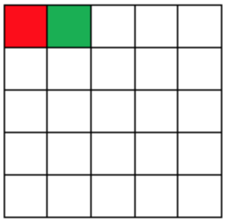

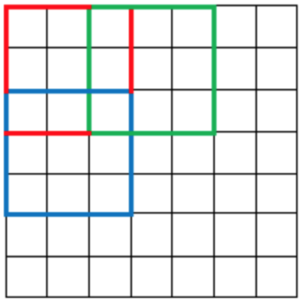
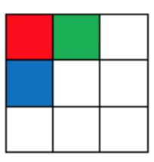


2D Convolution (2)
Parameters: stride
s=1
s=2 (strided convolution)
https://adeshpande3.github.io/A-Beginner%27s-Guide-To-Understanding-Convolutional-Neural-Networks-Part-2/

Slide 7
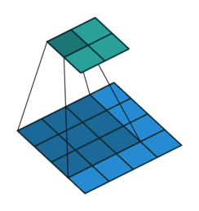
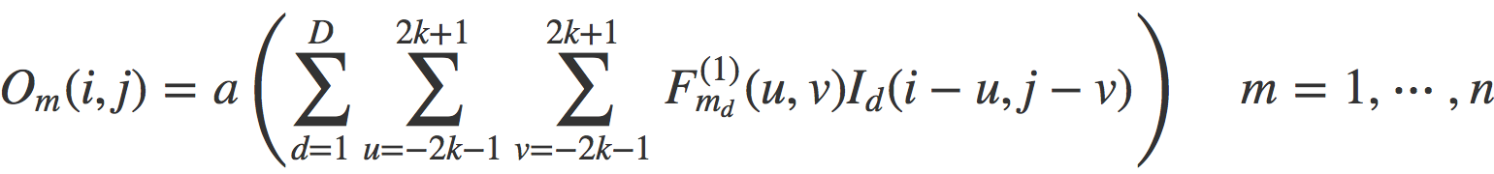
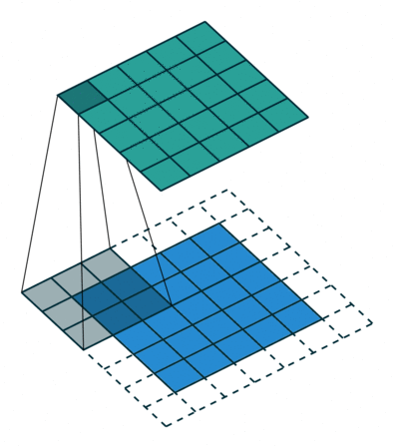
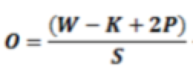
2D Convolution (3)
p=0
All parameters
Kernel size K
Number of filters (feature map), depth D
Stride S
Zero padding P
P=1
Output width/height
https://gist.github.com/akiross/754c7b87a2af8603da78b46cdaaa5598

Slide 8
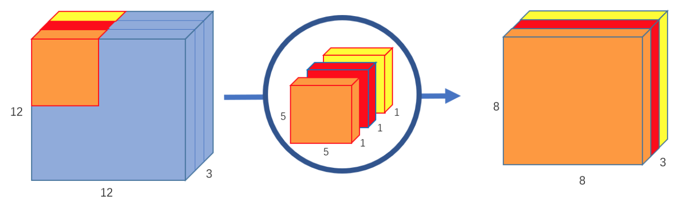
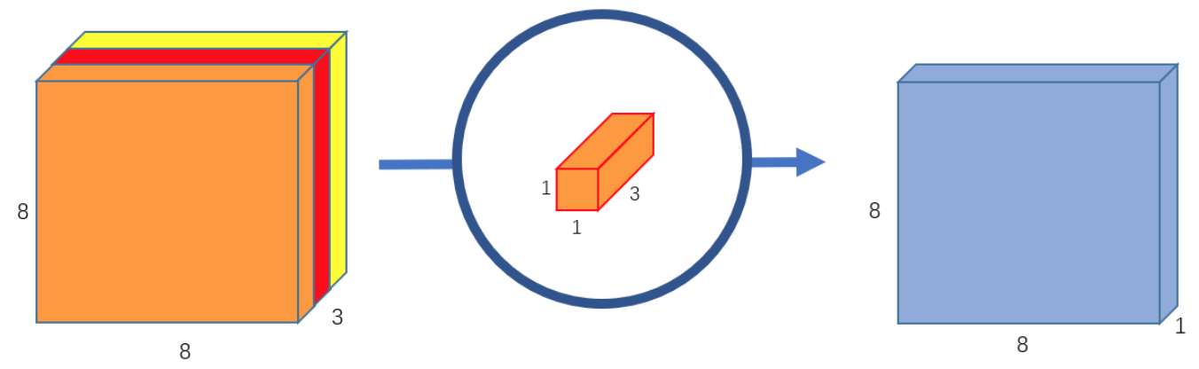
Depthwise separable convolution
Depthwise convolution
Convolution
256 kernels 5x5x3, 8x8 shifts. Totally, 256x3x5x5x8x8 = 1,228,800 multiplications
Separable convolution
Depthwise: 3 kernels 5x5x1 and 3x5x5x8x8 = 4,800 multiplications
Pointwise: 256 kernels 1x1x3, 256x1x1x3x8x8 = 49,152 multiplications
Totally: 53,952 multiplications
Pointwise convolution
Example: MobileNet v1
28 layers (Depthwise + ConvLayer with stride 2 instead of max-pooling)
ImageNet Top-5 Error rate: 12.81%
4.2M weights
Chi-Feng Wnag/ towardsdatascience.com

Slide 9
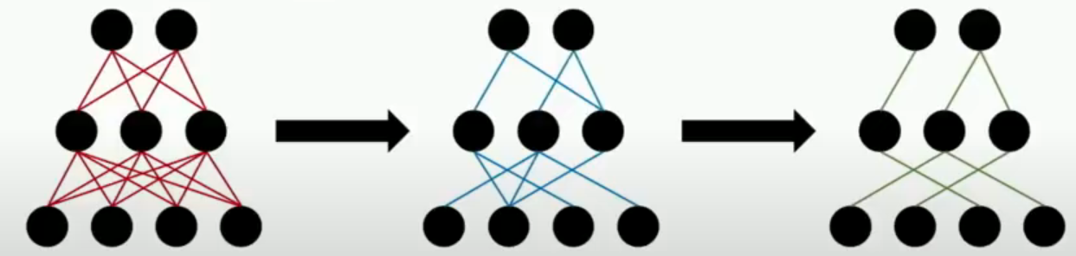
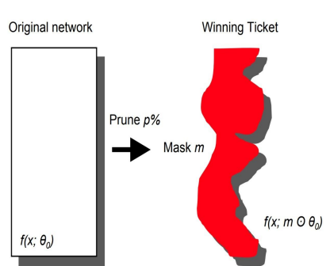
Lottery Ticket Hypothesis
Network pruning
Train the network
Remove superfluous structure
Fine-tune the network
(Optionally) repeat steps 2 and 3
Training pruned networks
“A randomly-initialized, dense neural network contains a subnetwork that is initialized such that—when trained in isolation—it can match the test accuracy of the original network after training for at most the same number of iterations”
“We designate these trainable subnetworks, winning tickets, since these subnetworks have won the initialization lottery with a combination of weights and connections capable of learning”
J. Frankle and M. Carbin, ICLR 2019

Slide 10
AutoML and Neural Architecture Search (NAS)

Slide 11
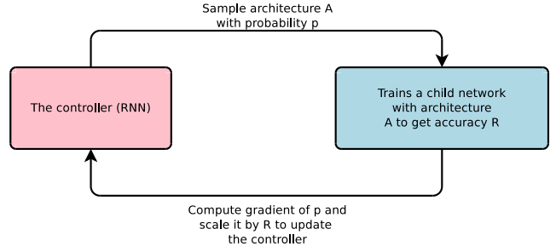

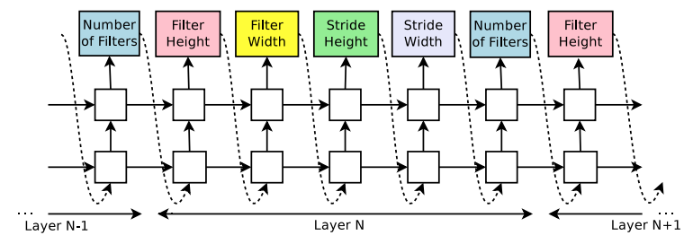
NAS with Reinforcement Learning
Structure and connectivity of a neural network can be typically specified by a variable-length string”
A RNN– the controller – is used to generate such string.
Training the network specified by the string – the “child network” – on the real data will result in an accuracy on a validation set.
Using this accuracy as the reward, we can compute the policy gradient to update the controller (REINFORCE):
RNN controller
General AutoML framework
Search space defines possible models
Search algorithm defines algorithm to look for the best model on a search space
Model evaluator estimates the quality of a candidate model (the most computationally complex part)
B. Zoph and Quoc V. Le (Google Brain), ICLR 2018

Slide 12
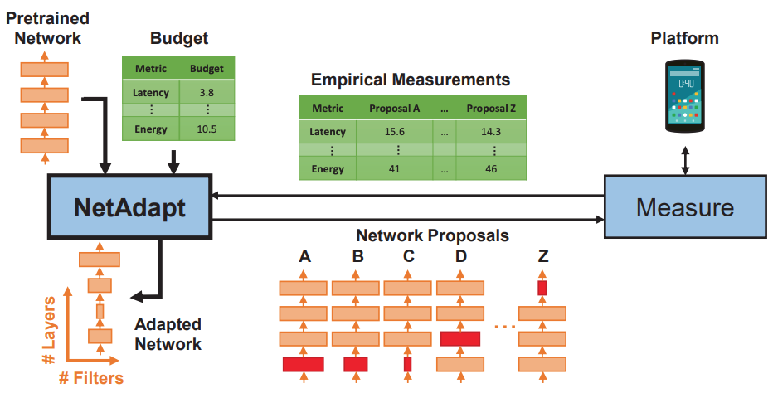
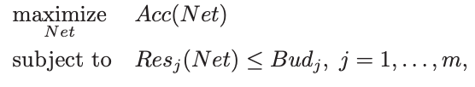
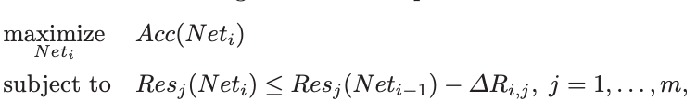
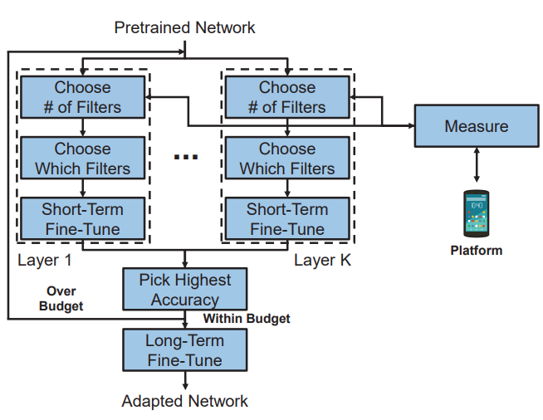
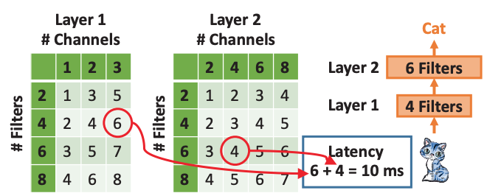
NetAdapt
Fast resource consumption estimation
Tien-Ju Yang et al, ECCV 2018

Slide 13
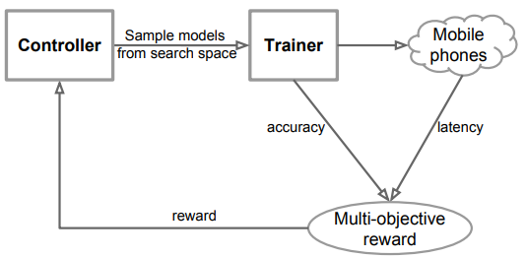
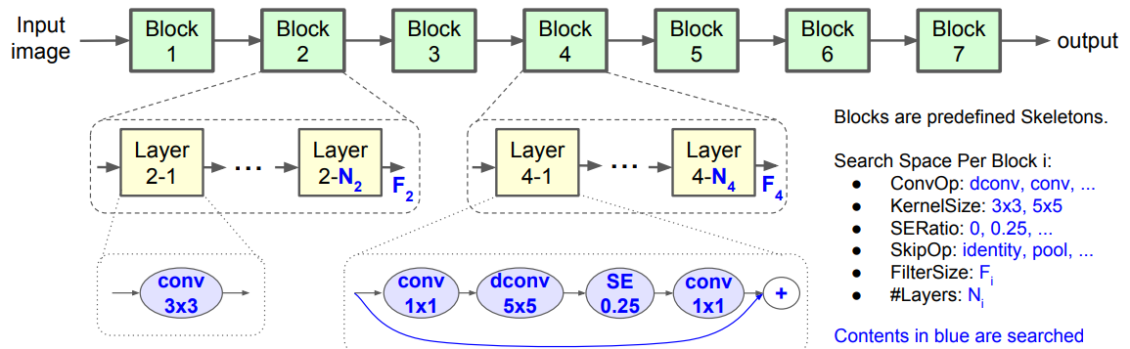
MnasNet
Platform-aware NAS
max Acc(Net)
subject to Lat(Net)<T
Reward:
max Acc(Net) x (Lat(Net)/T)^{w}
Factorized Hierarchical Search Space
“Network layers are grouped into a number of predefined skeletons, called blocks, based on their input resolutions and filter sizes. Each block contains a variable number of repeated identical layers. For each block, we search for the operations and connections for a single layer and the number of layers N, then the same layer is repeated N times”
Mingxing Tan et al., CVPR 2019

Slide 14
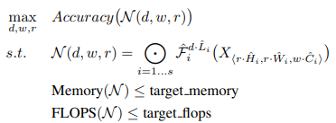
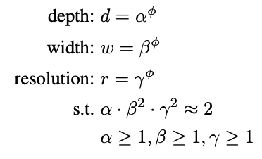
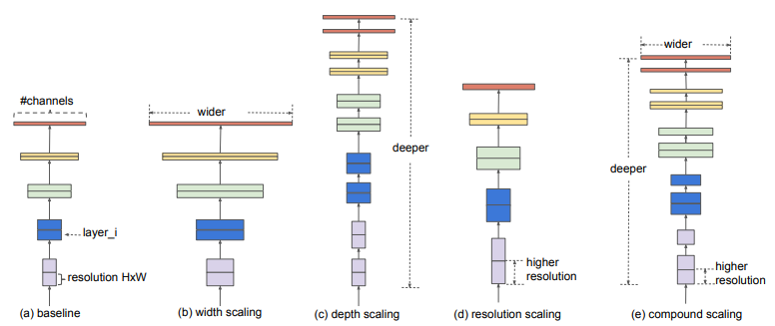
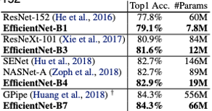
EfficientNet
Platform-aware NAS + NetAdapt for layer-wise search AutoML (MnasNet), but optimize FLOPS instead of latency
MBConv - mobile inverted bottleneck
Compound scaling: uniformly scales all three dimensions with a fixed ratio
EfficientNet-B7: top-1 accuracy on ImageNet 84.3%, 8.4x smaller and 6.1x faster on inference than the best existing ConvNet
EfficientNets transfer well to other dataset
Tan and Le, ICML 2019

Slide 15
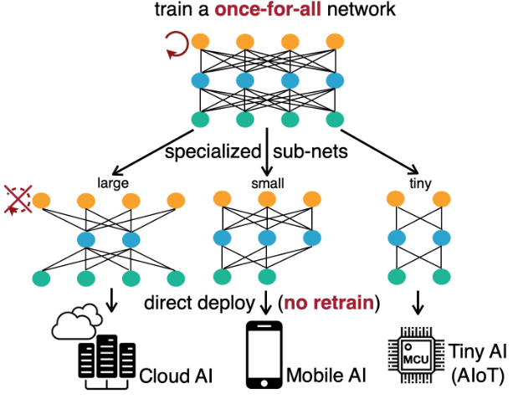
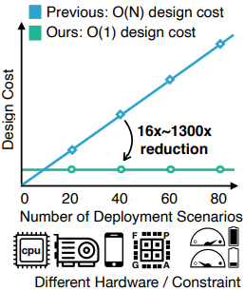
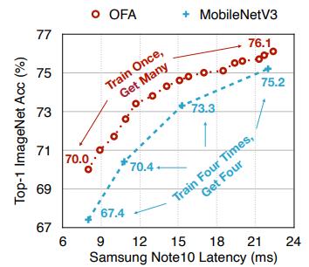
One-shot NAS
Once-for-All (OFA) SuperNet
Han Cui et al., ICLR 2020

Slide 16


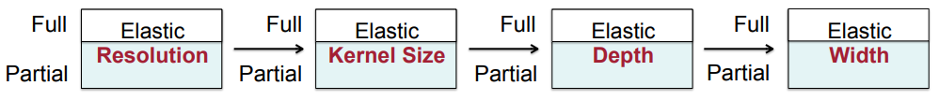
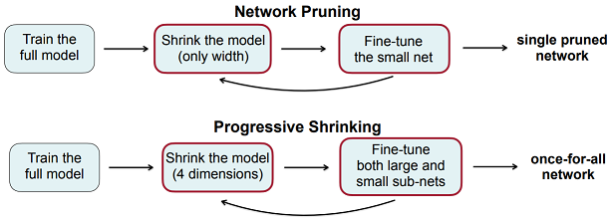
Training OFA SuperNet (1)
Progressive shrinking
SN(W_{s},a) - subnetwork with architecture a extracted from the SuperNet
supports different depth D, width W, kernel size K and resolution R
leads to a large space comprising diverse sub-networks
Progressive shrinking can be viewed as a generalized network pruning technique with much higher flexibility. Compared to network pruning, it shrinks more dimensions (not only width) and provides a much more powerful once-for-all network that can fit different deployment scenarios rather than a single pruned network

Slide 17
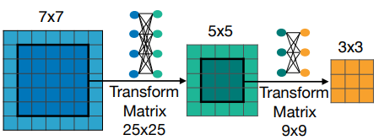
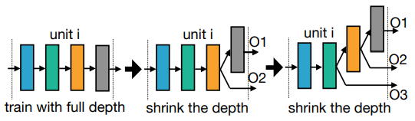
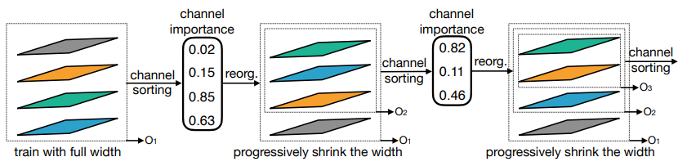
Training OFA SuperNet (2)
Kernel transformation matrix for elastic kernel size
Progressive shrinking for elastic depth
Instead of skipping each layer independently, we keep the first D layers and skip the last (4 − D) layers. The weights of the early layers are shared
Progressive shrinking for elastic width
“In this example, we progressively support 4, 3, and 2 channel settings. We perform channel sorting and pick the most important channels (with large L1 norm) to initialize the smaller channel settings. The important channels’ weights are shared”

Slide 18
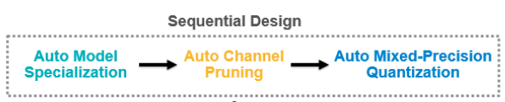
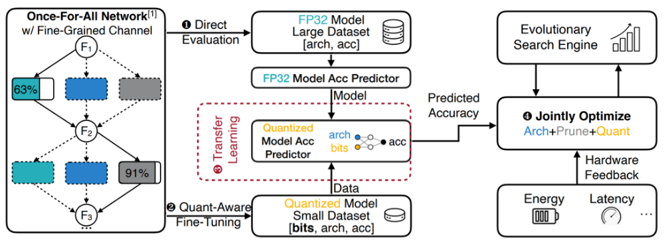
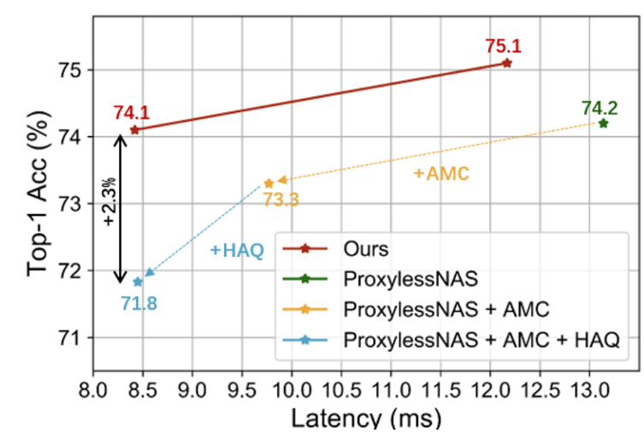
NAS and quantization
APQ: Joint Search for Architecture, Pruning and Quantization
APQ
Better performance compared to sequential design
Han Cui et al., CVPR 2020

Slide 19
AutoFace framework

Slide 20
Problem formulation: subnetwork extraction
How to sample sub-network?
For each block b ∈ {1, . . . , 5}, the number of layers (depth) d_{b} is sampled from {2, 3, 4} with uniform distribution
For each convolution layer l ∈ {1, . . . , d_{b}}, the kernel size ks_{b;l} and the expand ratio for the number of filters (elastic width) e_{b;l} are uniformly sampled from sets {3, 5, 7} and {3, 4, 6}, respectively.
Specialized model deployment
Build a latency lookup table on each target hardware platform to predict the latency
Sample sub-networks with different architectures and input image sizes, estimate their validation accuracy
Train accuracy predictor – a neural network for regression
Conduct an evolutionary search
Challenges
Architecture of a subnet is described by parameters (d_{b}, ks_{b;l}, e_{b;l}, b ∈ {1, . . . , 5}, l ∈ {1, . . . , d_{b}}): each Conv layer is encoded by 3×3 = 9 parameters, and there may be two, three, or four Conv layers in each of the five blocks. As a result, the search space is huge: we can encode (9² + 9³ + 9⁴ )⁵ = 7374⁵ = 21, 758, 655, 492, 572, 485, 851 subnetworks
It is impossible to achieve high accuracy of accuracy predictor
How to win the lottery?

Slide 21

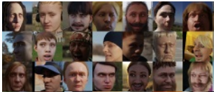
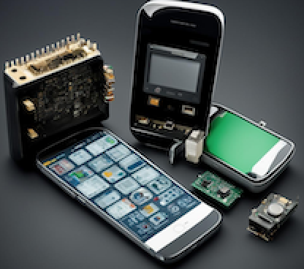
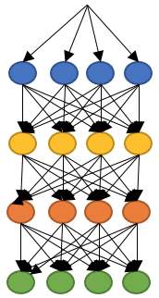
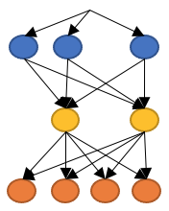


Our framework
Large dataset
User’s device
Generate training set with pairs of subnetworks
Train SuperNet
Train gradient boosting classifier
Surrogate accuracy comparator
Measure running time for all layers
SuperNet
Quick search of an optimal subnetwork
LookUp Table
PyTorch FP32 subnetwork
Remove classification layer
Device-specific descriptor
Savchenko et al., Device-Specific Facial Descriptors: Winning a Lottery with a SuperNet, ECAI 2024
Savchenko, AutoFace: How to Obtain Mobile Neural Network-Based Facial Feature Extractor in Less Than 10 Minutes? IEEE Access, 2024

Slide 22
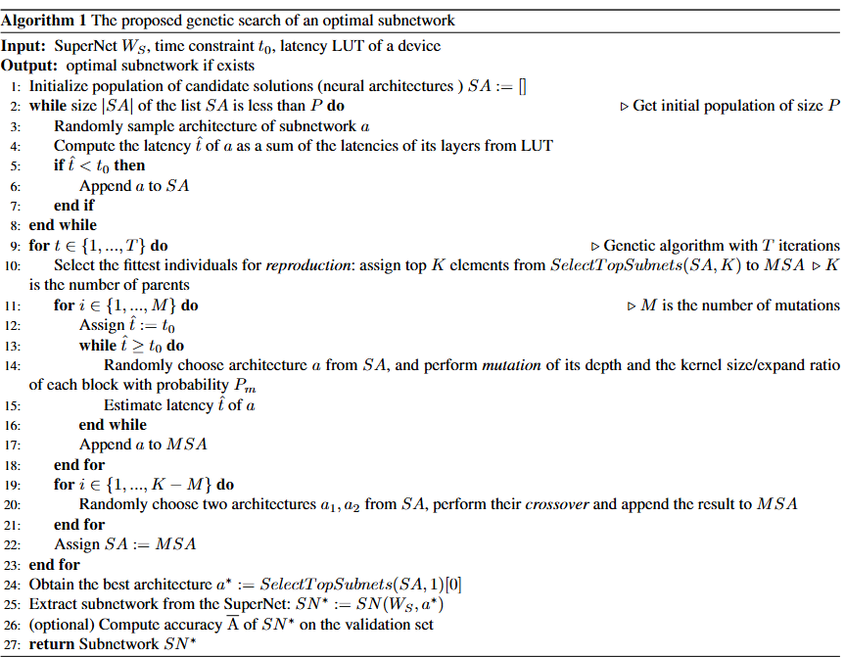
Main algorithms (1)
Evolutionary Search of Optimal Subnetwork

Slide 23
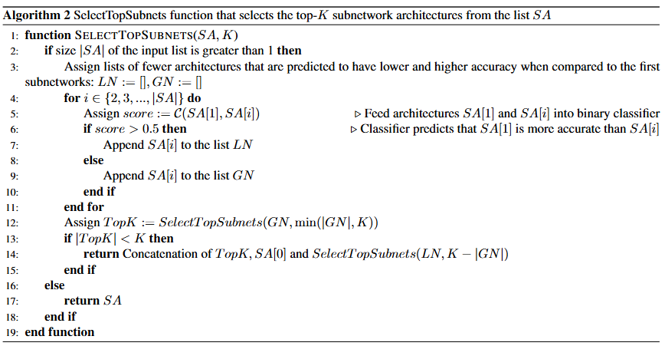
Main algorithms (2)
SelectTopSubnets
selecting the Top-K Subnetwork architectures from the list SA

Slide 24
Implementation of the framework
generate_acc_predictor_dataset.py
prepare_tflite_lut_assets.py
GBDTLightGBMClassification.py
LookUp Table (measured on-device)
Surrogate accuracy comparator
transform_raw_lut.py
generate_subnet.py
PyTorch FP32 subnetwork
torch2keras_conversion.py
Device-specific descriptor
https://github.com/av-savchenko/mobile-face-recognition

Slide 25
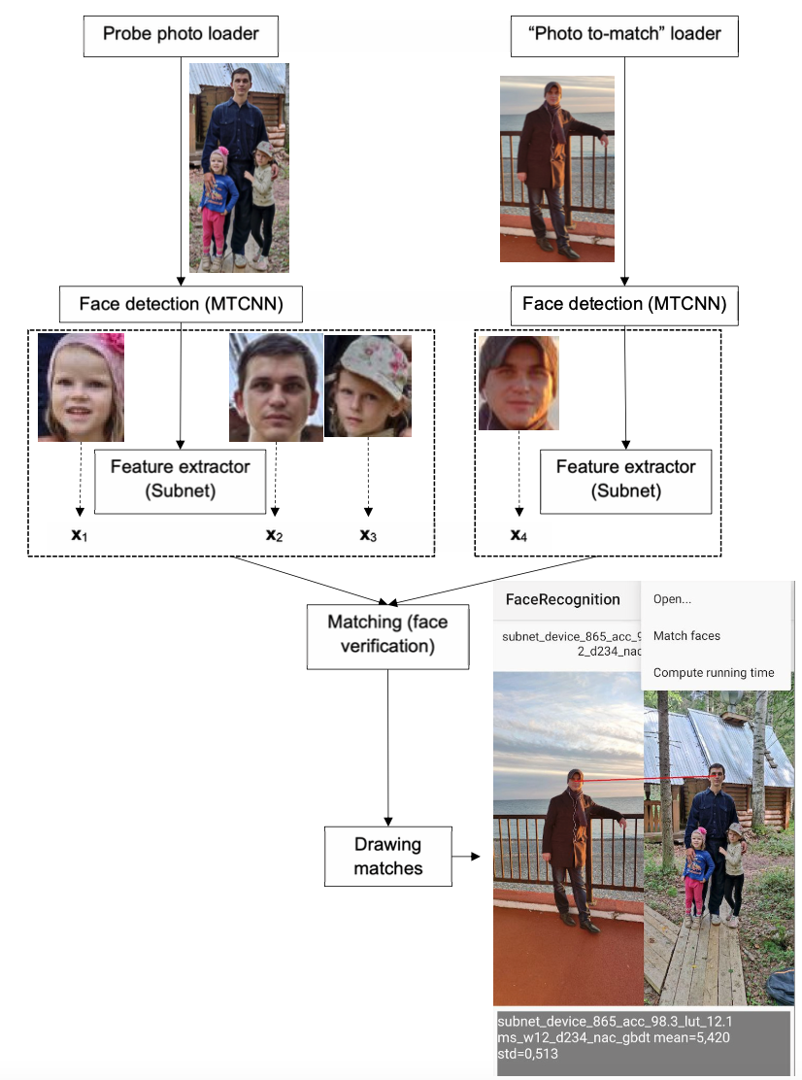
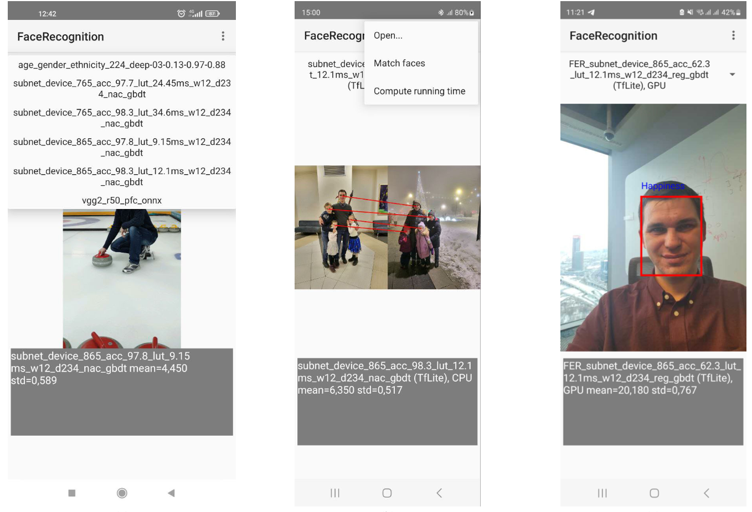
Mobile demo application
https://github.com/av-savchenko/mobile-face-recognition/tree/main/mobile/FaceMatcher

Slide 26
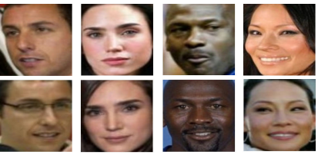
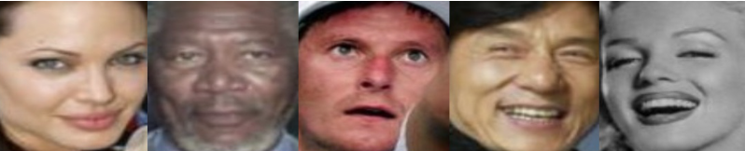


Experimental Datasets
LFW dataset
AffectNet dataset
Cropped by RetinaFace without margins
Cropped and aligned

Slide 27


Experimental Results
Face recognition
Face identification accuracy (%)
Inference time (ms) per one face

Slide 28

Experimental Results
Ablation Study

Slide 29


Experimental Results
Facial expression recognition
Confusion matrix, Subnet 1

Slide 30

Demo application

Slide 31


GigaDoc

Slide 32
Other efficient classifiers

Slide 33


Fast video classification (1)
Input video
Frame selection
Feature extraction (EmotiEffNet)
Compute class-level scores
Refine granularity (choose other frames)
Accept class for maximal score?
Smooth predicted scores
Final decision
The ideas of statistical sequential analysis by A. Wald are used: video is processed at most L = ⌈log_{k} T ⌉ steps.
Deterministic policy of frame sampling with fixed frames skip rate: frames rate ratio k^{L−l} is used at the l-th step (l = 1,2,..., L)
Sequence of frames at the l-th step is a subset of frames at the (l + 1)-th step
Decision reliability at the l-th step is tested by using the confidence scores at the output of video classifier

Slide 34




Fast video classification (2)
How to choose thresholds?
Train classifier on part of the training set, feed at its input the remaining M videos
Fix false acceptance rate (FAR) 𝛼_{l}
Threshold is chosen as the 𝛼_{l} –quantile of the maximal inter-class scores
How to choose FAR for every l-th step, if the confidence level of the whole procedure is given? It is important to choose an appropriate correction, e.g.:

Slide 35
Experimental results: Facial expression recognition
Efficient video classifiers, EmotiEffNet-B0 facial embeddings

Slide 36



Fourier PNN (Probabilistic Neural Network)
Orthogonal density expansions to speed up classification
R(c) – number of examples for class c
N – number of training examples
C – number of classes
D – dimensionality
J – hyperparameter
Advantages
Converges to Bayesian solution
Very high training speed
Classification is (N/C)^{2/3}–times father than instance-based learning (PNN, k-NN).
Savchenko, A.V. IEEE Transactions on Neural Networks and Learning Systems, 2020
Savchenko A.V., IEEE ICPR 2018

Slide 37






Sequential Fourier PNN
Pdf (probability density function) can be estimated sequentially
Degree of reliability is estimated by using the likelihood ratio
Best runtime complexity (m=D/L): O(mN^{1/3}C^{2/3})
Average runtime complexity:
Savchenko A.V., Belova N. Expert Systems with Applications, 2022

Slide 38
Experimental results
Stanford dogs dataset

Slide 39




Approximate nearest neighbor search
The next reference example (instance) to check is chosen based on the maximal likelihood of distances
KL divergence is asymptotically distributed as non-central chi-squared, normal approximation
Savchenko A.V., Pattern Recognition, 2017,2012
Savchenko A.V., Optimization Letters, 2017
Savchenko A.V. Automation and Remote Control, 2016

Slide 40
Experimental results
Face identification in LFW
Error rate, %
 | VGGNet, L2 | VGGNet, chi-squared | LCNN, L2
SVM | 49.6 | - | 28.9
1-NN (Brute force) | 10.7 | 10.2 | 9.6
Randomized KD tree | 11.0 | 10.6 | 9.9
Perm-sort | 10.9 | 10.6 | 9.9
ML-ANN | 10.9 | 10.6 | 10.5
Proposed algorithm | 10.9 | 10.5 | 9.9

Slide 41


AI Lab – strategic Sber’s department in artificial intelligence
Main principles
Selecting projects based on their scientific novelty and potential business impact
Results: publications, open-source libraries
Maintenance of new technologies during their implementation in business
“We work at the intersection of business and science. We create science-intensive technologies that benefit not only our company, but the world as a whole. We publish scientific articles at key international conferences, help businesses implement new technologies and move science forward together with them”.
~60
Technology
Researchers
and
13
12
Research
=
Papers accepted at A* conferences in 2024
Papers accepted at A conferences in 2024
Open Source
and
10
Scientific paper
Open-source products
Recent results and future work
Automated Machine Learning: LAMA (LightAutoML) wins 2024 AutoML Grand Prix (Kaggle)
AIDA (AI Diagnostic Assistant): in every Moscow’s policlinic for adults
RePlay: the main Sber’s framework for building recommender systems
PyTorch-Lifestream: embeddings of event sequences
Reasoning in LLMs, math tutor

Slide 42


Thanks for your attention!
Contacts: avsavchenko@hse.ru
Sber AI Lab
GitHub
sb-ai-lab

