Slide 1

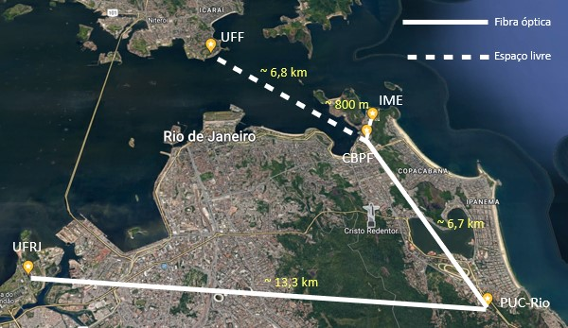
Recognition of light orbital angular momentum superpositions for quantum communication
Antonio Zelaquett Khoury
QOART – January 21st, 2025

Slide 2
Structured light and applications

Slide 3
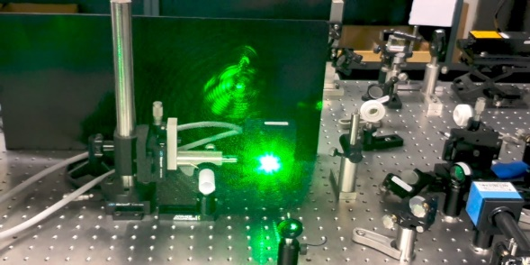

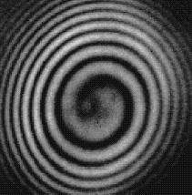
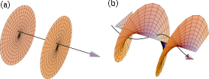
Light Orbital Angular Momentum
Twisted wavefront
Angular momentum
SPIN + ORBITAL
pol
wavefront
kz=0
kz+lφ=0
l = -1
l = 0
l = 1
Spatial Light Modulator
l = 0

Slide 4
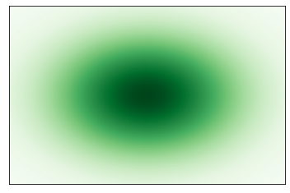
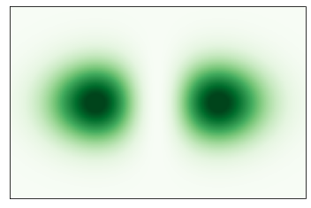
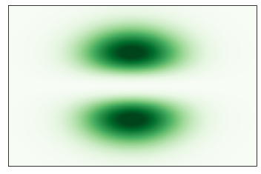
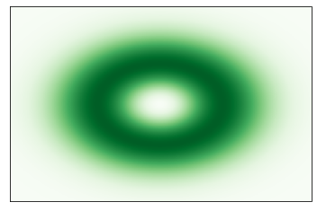
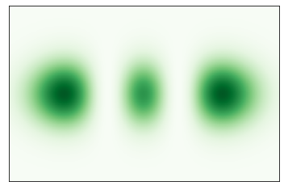
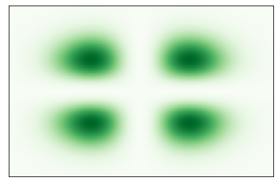
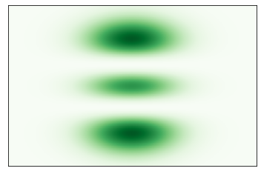
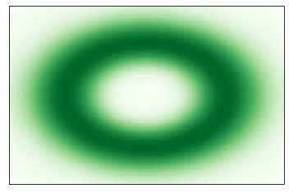
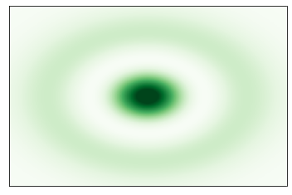
General Paraxial Modes
Paraxial Equation‏
Hermite-Gauss (HG)‏
Laguerre-Gauss (LG)‏
(0,0)
Rectangular
Cylindrical
(0,0)
HG_{nm}(x,y)
LG_{pl}(ρ,φ)
(1,0)
(0,1)
(0,+1)
(0,-1)
(2,0)
(1,1)
(0,2)
(0,+2)
(1,0)
(0,-2)

Slide 5
Hermite-Gaussian Modes
Gouy phase
N=m+n
y
Orthonormal
N=0
x
(0,0)
N=1
Complete
(1,0)
(0,1)
N=2
(2,0)
(1,1)
(0,2)

Slide 6
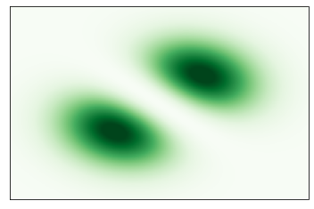
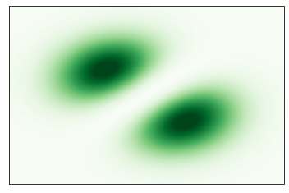
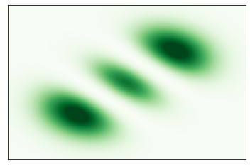
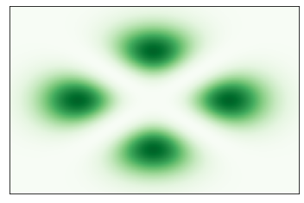
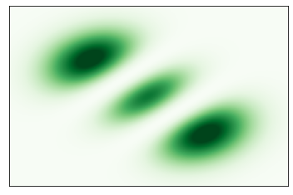
Hermite-Gaussian Modes
Gouy phase
N=m+n
y'
x'
N=0
Orthonormal
(0,0)
N=1
Complete
(1,0)
(0,1)
N=2
(2,0)
(1,1)
(0,2)

Slide 7
Laguerre-Gaussian Modes
Gouy phase
N=2p+|l|
Orthonormal
N=0
(0,0)
N=1
Complete
(0,+1)
(0,-1)
N=2
(0,+2)
(1,0)
(0,-2)

Slide 8
Algebraic structure of paraxial wave functions
E. Abramochkin and V. Volostnikov,
Opt. Commun. 83, 123 (1991)
LG-HG Unitary transformation
Hermite-Gauss (HG)‏
Laguerre-Gauss (LG)‏
← SU(1) →
(0,0)
(0,0)
← SU(2) →
(1,0)
(0,1)
(0,+1)
(0,-1)
← SU(3) →
(2,0)
(1,1)
(0,2)
(0,+2)
(1,0)
(0,-2)

Slide 9
Astigmatic mode transformations
HG-LG
HG-HG
Mode Converter
cylindrical lenses at 45º
MC eingenvectors

Slide 10
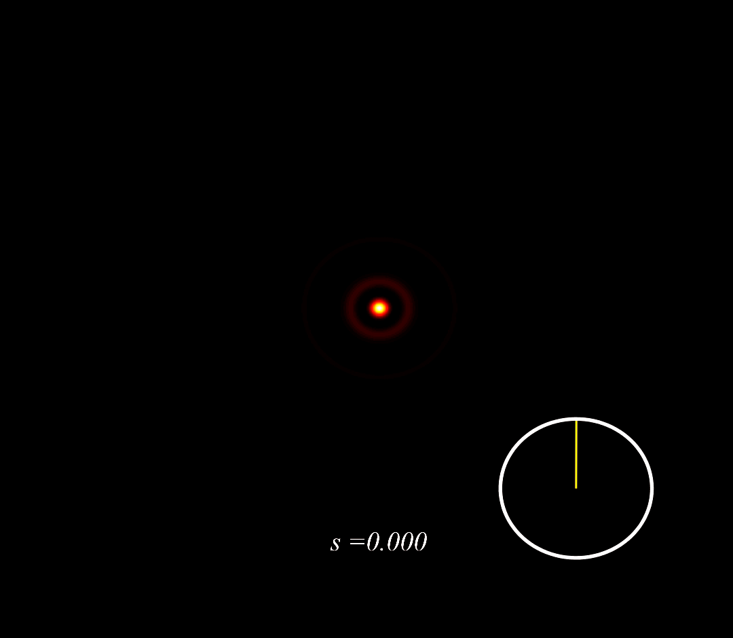
Self-Restoring Spot
Gouy phase
Synchronisation

Slide 11
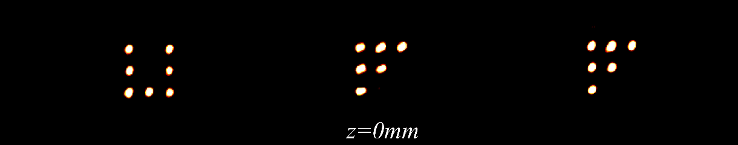
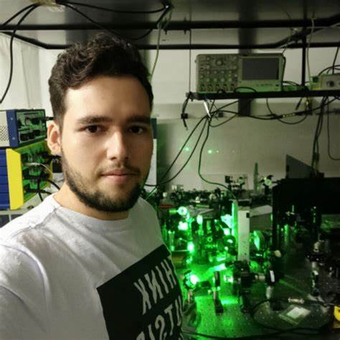
Self-Restoring Spot Array
B. Pinheiro da Silva et al,
Phys. Rev. Lett. 124, 033902 (2020)
Application
Dark Optical Tweezer (PUC-UFF)
Phys. Rev. Lett. 131, 163601 (2023)

Slide 12

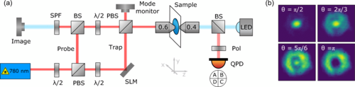
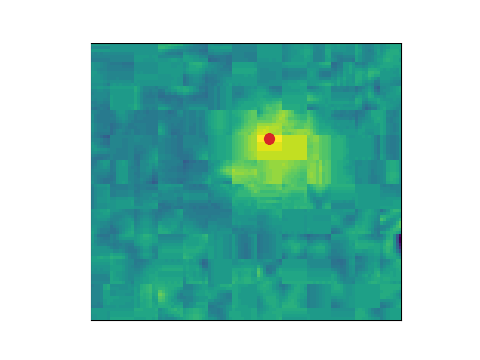
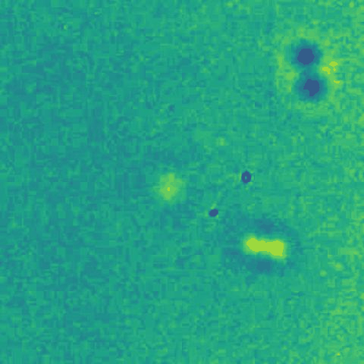
Trapping in a dark focus
Phys. Rev. Lett. 131, 163601 (2023)
Thiago Guerreiro
PUC-Rio

Slide 13
Spin-Orbit non separability

Slide 14
Algebraic structure of paraxial wave functions
E. Abramochkin and V. Volostnikov,
Opt. Commun. 83, 123 (1991)
LG-HG Unitary transformation
Hermite-Gauss (HG)‏
Laguerre-Gauss (LG)‏
← SU(1) →
(0,0)
(0,0)
← SU(2) →
(1,0)
(0,1)
(0,+1)
(0,-1)
← SU(3) →
(2,0)
(1,1)
(0,2)
(0,+2)
(1,0)
(0,-2)

Slide 15
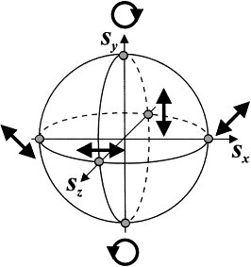
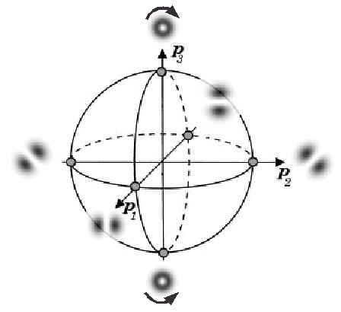




Spin-orbit nonseparable modes
Poincaré spheres
$$ψ_{+}\left(r\right)$$
$$ψ_{V}\left(r\right)$$
POLARIZATION
SPATIAL
$$ψ_{H}\left(r\right)$$
$$ψ_{−}\left(r\right)$$
Tensor product in CO
Bell modes

Slide 16
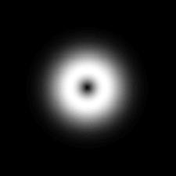
Polarization vortices
Spin-orbit coupling in liquid crystals
S-Plate
L. Marrucci, C. Manzo, and D. Paparo,
Phys. Rev. Lett. 96, 163905 (2006)

Slide 17


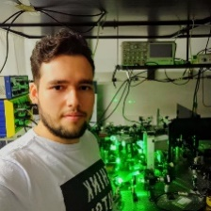
Structured nonlinear optics
m
W. T. Buono et al, New J. Phys. 16, 093041 (2014)
TYPE II
m+n, 2m, 2n
SHG
ω
2ω
n
HWP
Polarization controlled OAM operations
Spin-to-OAM transfer
NLC
W. T. Buono et al, Opt. Lett. 43, 1439 (2018)
B. Pinheiro da Silva et al, Nanophot. 11, 771 (2022)

Slide 18
Structured Light Tomography

Slide 19
Statement of the problem
Given an arbitrary superposition of fixed order
We wish to determine α_{pl} from intensity distribution only
Problem:

Slide 20
Symmetry lift by astigmatic transformation

Slide 21
Tomography of transverse mode superpositions
Tilted lens
B. Pinheiro da Silva et al, Phys. Rev. A 103, 063704 (2021)

Slide 22
Partially coherent beams
More generally, given a coherence function
We wish to determine ρ_{ij}
Gell-Mann matrices
High dimensional tomography
Far too difficult at high d

Slide 23
Intensity measurements
R_{m}
Position POVM
y
x
Transverse plane
If T is injective, then the POVM is informationally complete

Slide 24
Tomography from intensity measurements
High dimensional tomography
One equation for each pixel information! However…

Slide 25
Informationally complete POVM
Astigmatic transformation

Slide 26
Experimental results in the photocount regime
128
2048
Theory
d = 4

Slide 27
Tomography with partial information
IRIS
BLADE

Slide 28
The Rio Quantum Network

Slide 29
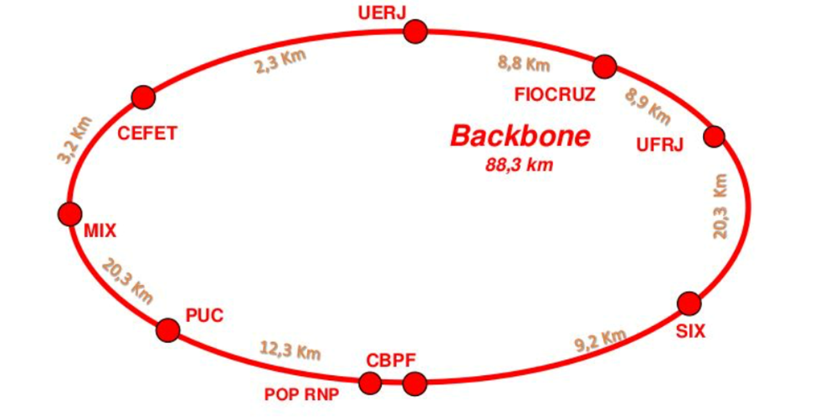

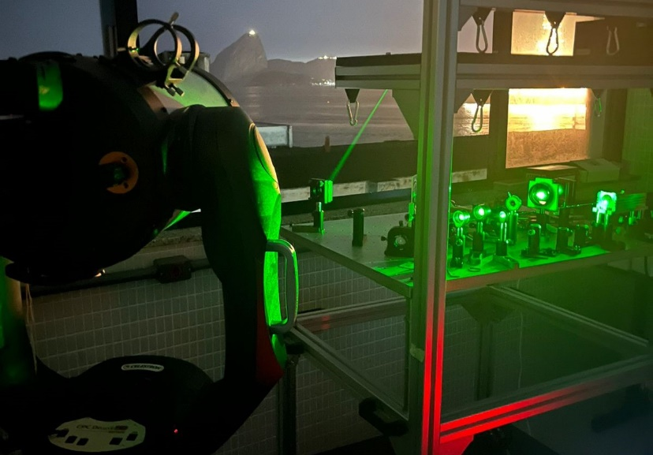




Arquitecture

Slide 30
Objectives
Establishment of a QKD network connecting 5 institutions
Development of new devices for quantum communication
Promote scientific exchange
Testbed for new technologies in q-comm.
Integration with other national and international networks

Slide 31

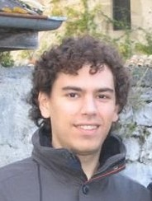



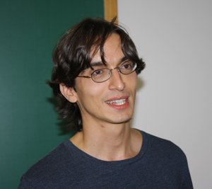

Participants
UFF
PUC
IME
UFRJ
Antonio Z. Khoury
Guilherme P. Temporão
Victor Andrezo
Gabriel Aguillar
Ivan Oliveira
Fernando de Melo
Nilton Alves Jr.
CBPF
CBPF
CBPF

Slide 32
Conclusions
Quantum tomography in high dimension is a difficult task
Intensity measurement is an easy task and provide a lot of information
Reconstruction of structured light state in high dimension with position POVM
Problem: informational completeness
Solution: astigmatic transformation

Slide 33

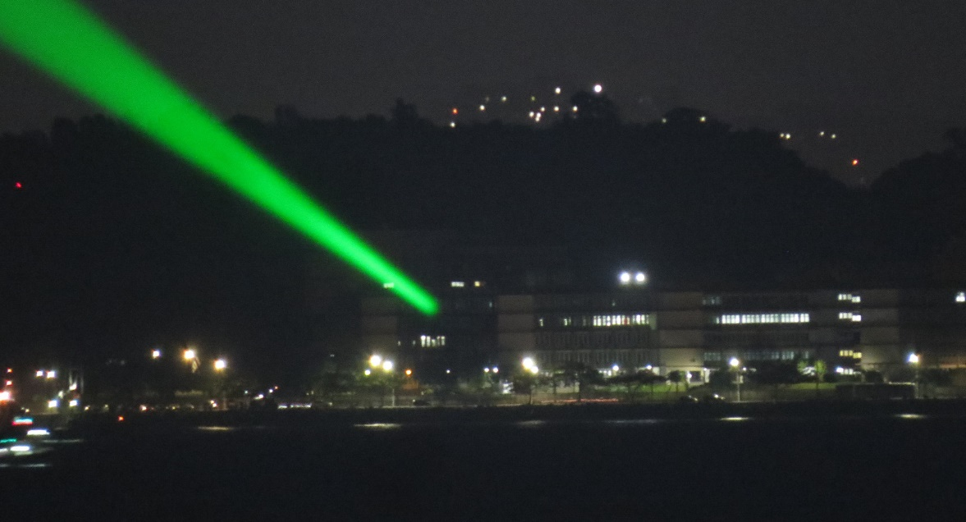
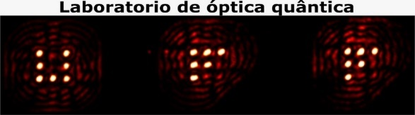

T H A N K Y O U !!!
T H A N K Y O U !!!

