Slide 1
On the stability of solutions of certain systems of two nonlinear differential equations perturbed by white noise
Magomet M. Shumafov
Vyacheslav B. Tlyachev
Adyghe State University
ICSM-10, Divnomorskoe, Russia
01 – 06 June, 2025

Slide 2
Content
Motivation
  Stochastic Differential Equations (SDE)
  Stability of SDE

Slide 3


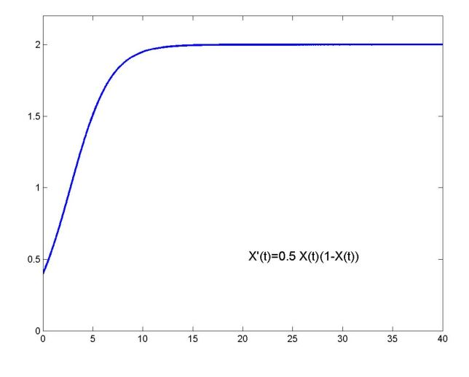
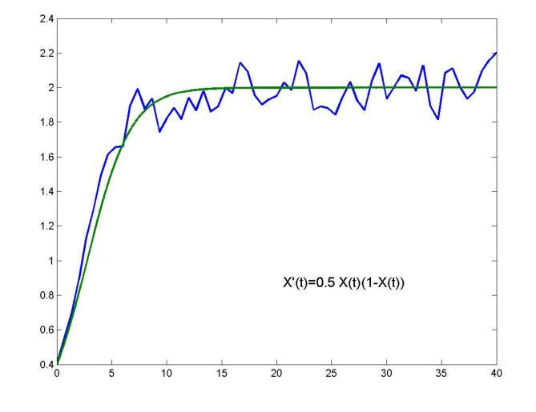



Motivation
Problem 2 (Ecology). Consider Verhulst model, logistic growth for single species
, (1)
where , is growth parameter, is carring capacity,
is birth per capita rate.
Problem 1 (Ecology). Consider Verhulst model, logistic growth for single species
(1’)
is average
(The pictures is taken from Stochastic Differential Equations, Part I (Evelyn Buckwar))
How to solve (1), (1’) ?

Slide 4


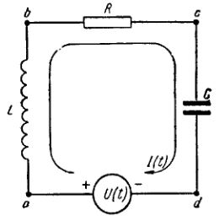


Motivation
(2)
where is inductance, is resistance, is capacitance, is potential source (voltage tension).
A situation where some of the coefficients,
say , are not deterministic, i.e.
where is nonrandom.
Problem 2 (Electric circuits). The charge satisfies the differential equation
(2’)
How to solve (2), (2’) ?

Slide 5

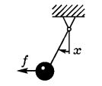
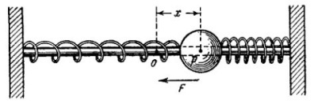

Motivation
Problem 3 (Harmonic oscillator). Consider a linear equation
(3)
where , is eigenfrequency,
is coefficient of friction.
In fact, is mean value of the coefficient of friction, while its true value is a stochastic process with small correlation interval:
(3’)
How to determine the bifurcation value of noise intensity to be stable (3), (3’) ?

Slide 6
Motivation
Langevin Equation (describes Brownian motion)
Here x(t) is the position of the Brownian particle, x(t) is its damping coefficient, m is its mass and ϕ(x) is an external force. The noise term η(t) (random force) represents the effect of the collisions with the molecules of the fluid.

Slide 7
Motivation
Other problems arise from
  Theory of filtration (for example, Kalman – Bucy filter)
  Marketing management (optimal stopping problem)
  Stochastic control (an optimal portfolio selection problem)
  Mathematical Finance
  Stabilization of Stochastic Systems

Slide 8

Background: Stochastic differential equations
Louis Bachelier (1900) is the first person to model the stochastic process – Brownian motion, as part of his doctoral thesis «The Theory of Speculation» (Theorie de la speculation) [defended in 1900, instructor Henri Poincaré].
Bachelier’s Ph.D. thesis introduced the first mathematical model of Brownian motion. It was the first paper to use advanced mathematics in the study of finance. His Bachelier model has been influential in the development of other widely used models, including the Black-Scholes model.
Paul Langevin (1908) introduced a stochastic differential equation describing how a system evolves when subjected to a combination of deterministic and fluctuating ("random") forces [ The paper ‘‘On the Theory of Brownian Motion’’ [‘‘Sur la the´orie du mouvement brownien,’’ C. R. Acad. Sci. (Paris) 146, 530–533 (1908)].
where m is mass, μ is viscosity, is radius of particle, X is random force.
In terms of velocity the equation (L) can be rewritten as

Slide 9
Background: Stochastic differential equations: Papers
First: Bachelier L. (1900) PhD Thesis
Langevin P. (1908) Acad. Sci. Paris, 146,530-533.
Mathematical papers on Stoch. Diff. Eqs had only begun to appear in 1930s.
Kolmogoroff A.N. (1931) (Math. Ann. 104, 415–458)
Pontryagin L.S., Andronov A.A., Vitt A.A. (1933) (J.exp.&theor. phys., 3(3), 165-180)
Bernstein S.N. (1934) (Trudy fiz.-mat. Inst. Steklov, No 5, 95-124)
Bogolubov N.N., Krylov N.M. (1939) (Zapiski kaf. Mat. Fiz. AN USSR, No 4, 5-158)
Wolfgang Döblin (known as Vincent Doblin) (1940) (Sur L'équation de Kolmogoroff)
Gikhman I.I. (1941)(Nauchn. Zapiski Kievskogo univ-ta, No 5, 119-132; 141-149)
Ito K. (1942) Diff. eqs. det. Markoff proc. (J. Pan-Japan Math. Coll. (1077): 1352–1400)
Gikhman I.I. (1947) Doklady Akad. Nauk SSSR, 58, 961-964)
Gikhman I.I. (1950) On some diff. eqs. with rand. funct-s (Ukraine Math. J., 2(3), 45-69)
Gikhman I.I. (1950) On theory of diff. eqs. stoch. proc. (Ukraine Math. J., 2(4), 37-63)
Gikhman I.I. (1951) )On theory of diff. eqs. stoch. proc (Ukrain. Math. J. 3(3), 317-339)
Ito K. (1951) On Stochastic Diff. Equations (Memories of Amer. Math. Soc. 4. 1-51)

Slide 10
Background: Ito SDE, Stratonovich SDE
K. Ito independently constructed the theory of SDE, based on stochastic integral
Ito K. (1942) Diff. eqs. det. Markoff pr. (J. Pan-Japan Math. Coll. (1077): 1352–1400)
Ito K. (1946) On a Stochastic Integral Equation (Proc. Jap. Acad., 22:2, 32-35)
Ito K. (1950) Stochastic Diff. Eqs. in a Differ. Manifold (Nagoya Math. J., 1, 35-47)
Ito K. (1951) On Stochastic Diff. Equations (Memories of Amer. Math. Soc. 4. 1-51)
In 1964 R.L. Stratonovich defined stochastic integral and SDE in a different way:
Stratonovich R.L. A new form of writing stochastic integrals and equations //Bulletin of the Moscow University. Ser. 1. Mathematics, mechanics. 1964. Vol. 1. P. 3–12.
Contributions to the theory of SDE :
Smoluchowski M., Ornstein L.S., Uhlenbeck G.E., Kolmogorov A.N., Chapman S.,
Wiener N., Wonham W.M., Stratonovich R.L., Skorokhod A.V., Shiryaev A.N. and other authors

Slide 11
Background: Books and Monographs on SDE
Gikhman I.I., Skorokhod A.V. (1968) Stochastic Differential Equations.
Arnold L. (1974). Stochastic Differential Equations and Applications.
Friedman A. (1975) Stochastic Differential Equations and Applications.
Okcendal B. (2000). Stochastic Differential Equations.
Mao X. (2007) Stochastic Differential Equations and Applications.
Levakov A.A. (2009). Stochastic Differential Equations (in Russian).
Bulinsky A.V., Shiryaev A.N. (2005) Theory of Random Processes (Chapter VIII) (in Russian).
Gikhman I.I., Skorokhod A.V. (1977) Introduction in Theory of Random Processes (Chapter VIII) (in Russian).
Venttsel A.B. (1975). Course on the Theory of Random Processes (Chapter 12) (in Russian).
Rozanov Yu.A. (1985). Theory of Probability, Random Processes and Mathematical Statistics (Chapter V, §5) (in Russian).

Slide 12
Stability of Stochastic Differential Equations: Main Papers
* Bertram J. E., Carachik P.E. (1959) (IRE Trans. on InformationTheory. 5(5))
* Katz I.Ya., Krasovsky N.N. (1960) (Prikl. Math. Mech. 24(5), 809-823)
* Kushner H. (1964) (Proc. Nat. Acad. Sci., USA, 53(1), 8-12)
* Gihman I.I., Dorogovtsev A.Ya. (1965) (Ukraine math. journ., 17(6),3-21)
* Khasminskii R.Z. (1966) (Prikl. Mat. Meh. 30(5), 915–921)
* Khasminskii R.Z. (1967) (Teor. Veroyatnost. i Primenen., 12(1), 167–172)
* Levit M.V. (1972) (Uspekhi Matem. Nauk, 27(4), 215-216)
* Pakshin P.V. (1977) (Automation and Remote Control, 38(4),474–481)
* Shumafov M.M. (1981) (Differ. Uravn., 17(6),1143–1145)
* Mao X. (2001) (J. of Math. Analysis and Applications 260,325–340)
* Shumafov M.M. (2010) (Differential Equations,46(6), 901–905)
* Asylgareev A.S., Nasyrov F.S. (2016) (Sib. Math. J. Vol. 57(5), 754–761)
* Sultanov O. (2017) (Mathematical Notes, 101(1–2),149–156)
* Shumafov M.M., Tlyachev V.B. (2018) (Itogi Nauki i Tekhniki., 149, 118–128)
  * Korenevskii D. G. (1986). D AN SSSR V. 290 №5, 1041 – 1044; №6, 1294 – 1298.
  * Korenevskii D. G. (2001). Math. Notes, V. 70, №2, 213 – 229.
  * Kadiev R.I., Ponosov A. V. (2017). Appl. math. and problems of contr. №2, 32 –47
* Sandrić N. (2018). Journ. of Mathem. Analysis and Appl., № 467, 734–750.
* Shumafov M.M., Tlyachev V.B. (2021). arxiv.org arXiv:2104.01637.

Slide 13
Stability of Stochastic Differential Equations: Books, Surveys
Books:
* Kushner H. (1967) Stochastic Stability and Control. Academic Press, N-Y.-London.
* Khas'minskii R.Z. (1969) Ustojchivost differencialnyh sistem pri sluchajnyh vozmusheniyah ih parametrov.
* Gihman I.I., Skorokhod A.V. (1968) Stohasticheskie differencialnye uravneniya (P. 2, Gl. 3).
* Arnold L. (1974) Stochastic Differential Equations. Theory and Applications (Ch. 11).
* Mao X. (2007) Stochastic Differential Equations and Applications. 2nd Edition (Ch. 4).
* Levakov A.A. (2009) Stohasticheskie differencialnye uravneniya (Glava 3) .
Surveys:
* Thygesen U.H. (1997) A Survey of Lyapunov techniques for SDE. IMM Tech. Report.
* Pakshin P.V. , Ugrinovskii V.A. (2006) Stochastic problems for absolute stability
(Autom. Remote Control. 67 (11), 1811–1846).
* Visentin F. (2013) A Survey on Stability for Stochastic Differential Equations.
(Scientiae Mathematicae Japonicae, 76(1), 147–152).

Slide 14
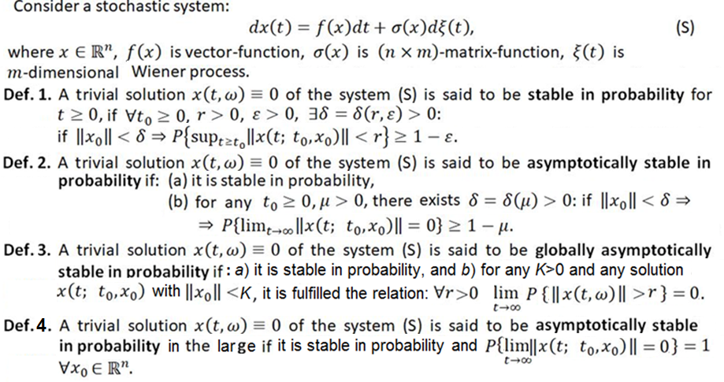
Stochastic stability: Definitions

Slide 15
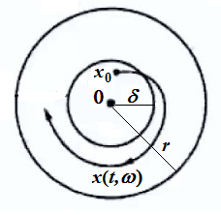
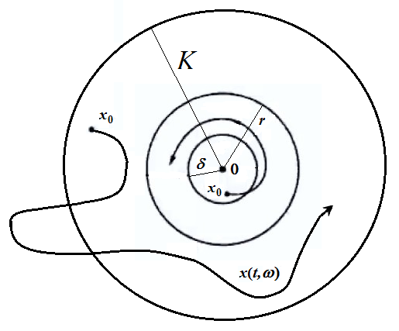


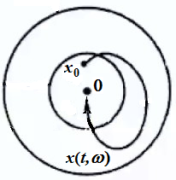
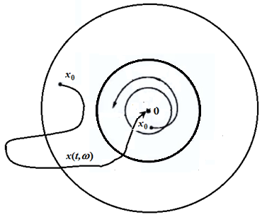
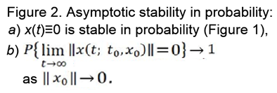

Illustrations of Stochastic Stability

Slide 16
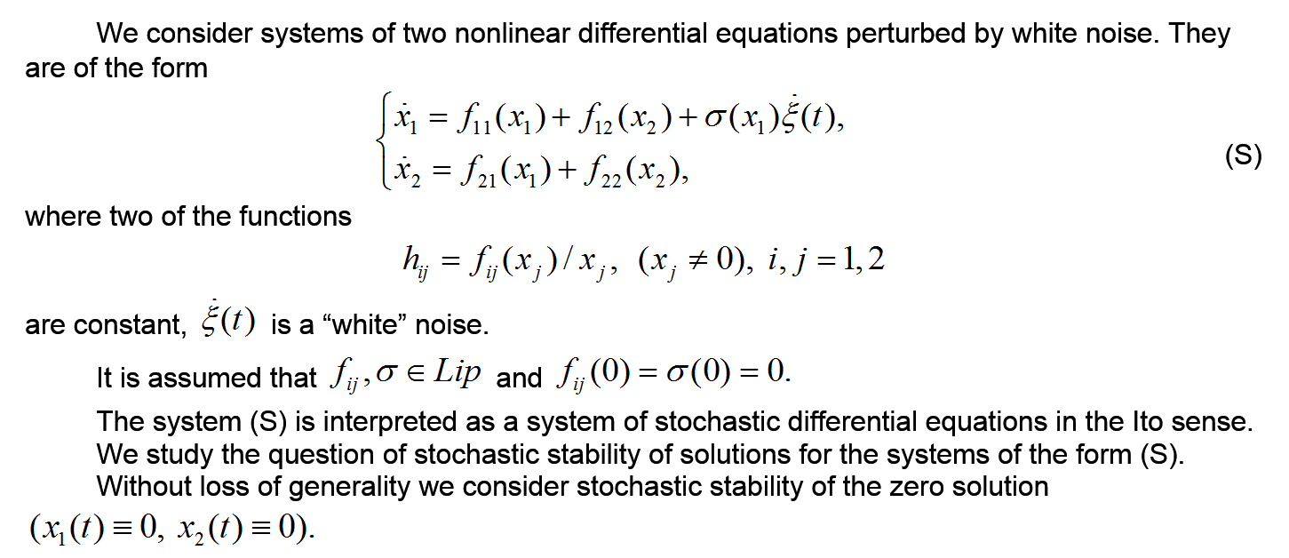
The Subject of the Study

Slide 17
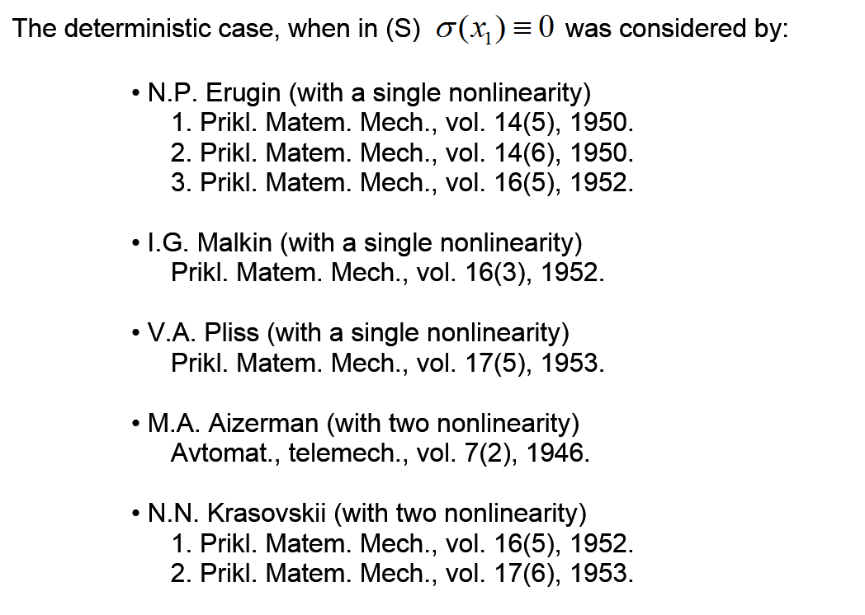
The Subject of the Study

Slide 18
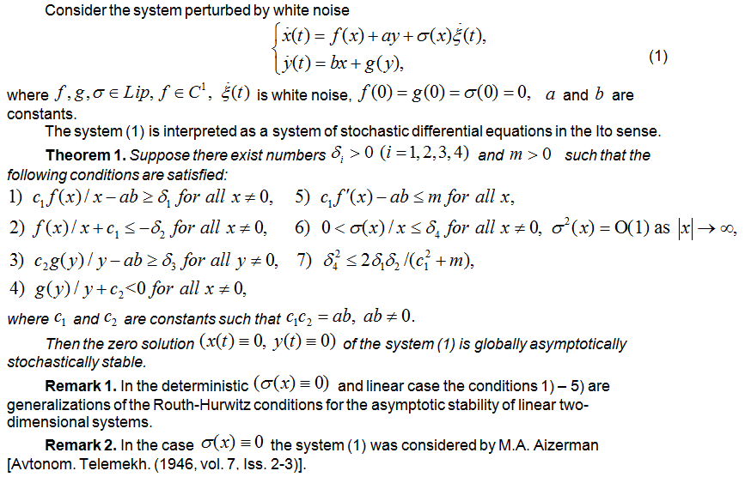
Stochastic stability of systems (dim=2)

Slide 19
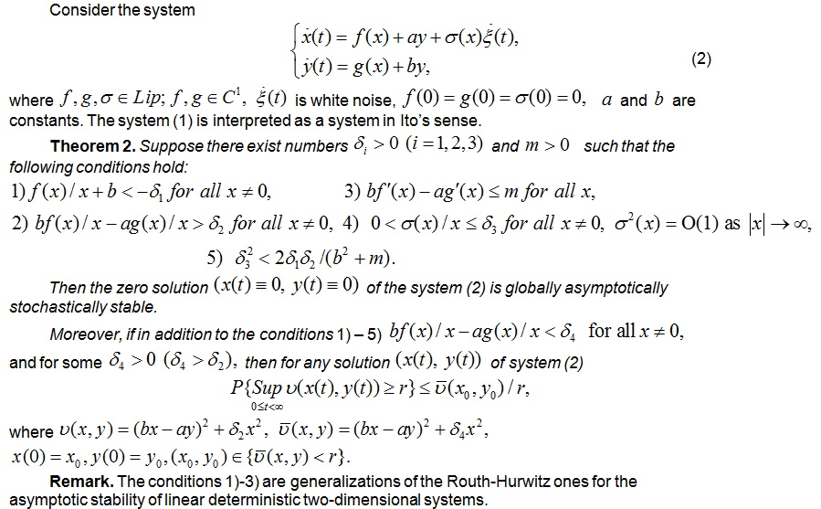
Stochastic stability of systems (dim=2)

Slide 20
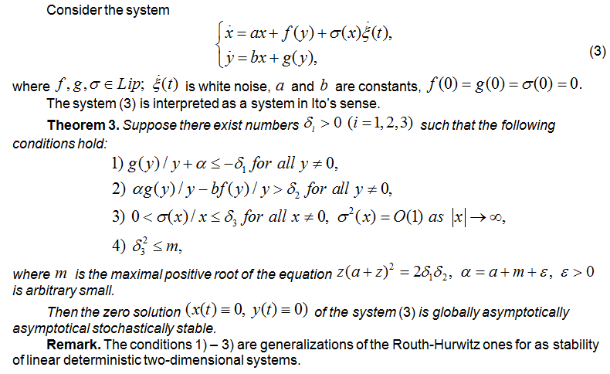
Stochastic stability of systems (dim=2)

Slide 21
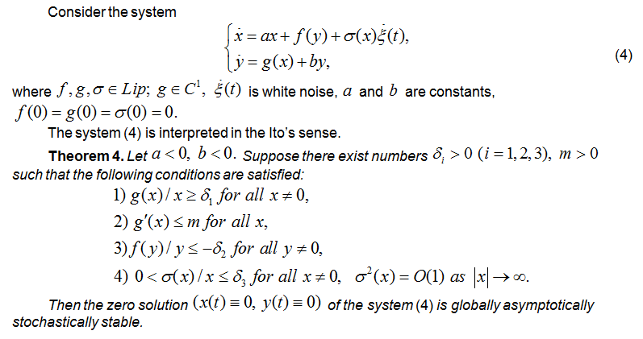
Stochastic stability of systems (dim=2)

Slide 22
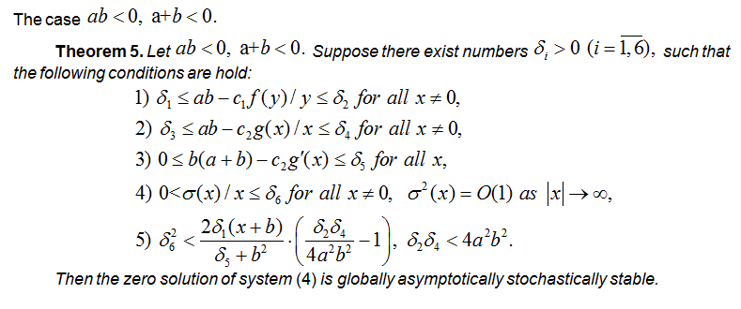
Stochastic stability of systems (dim=2)

Slide 23
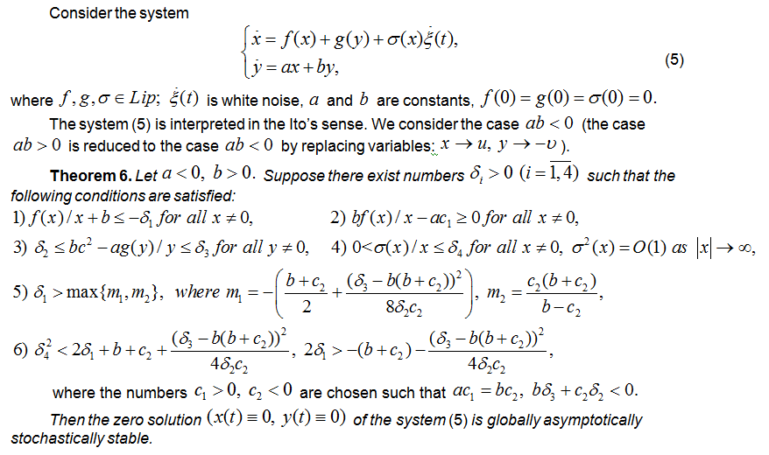
Stochastic stability of systems (dim=2)

Slide 24
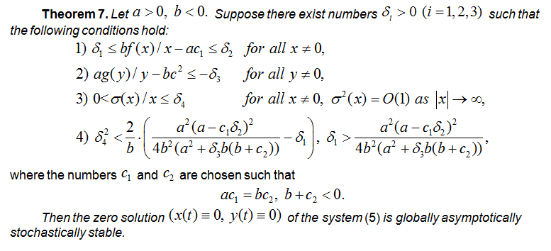
Stochastic stability of systems (dim=2)

Slide 25
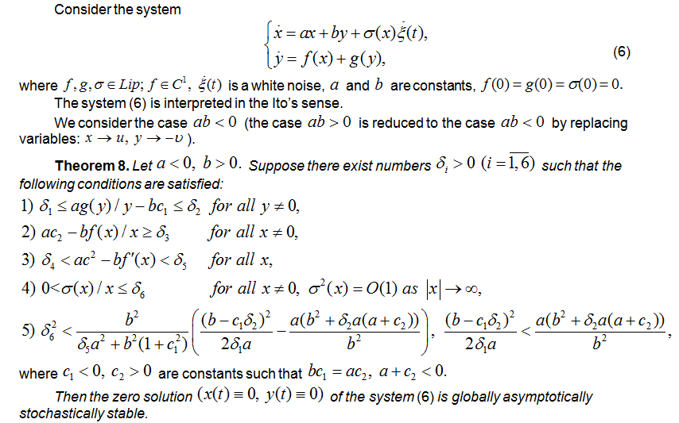
Stochastic stability of systems (dim=2)

Slide 26
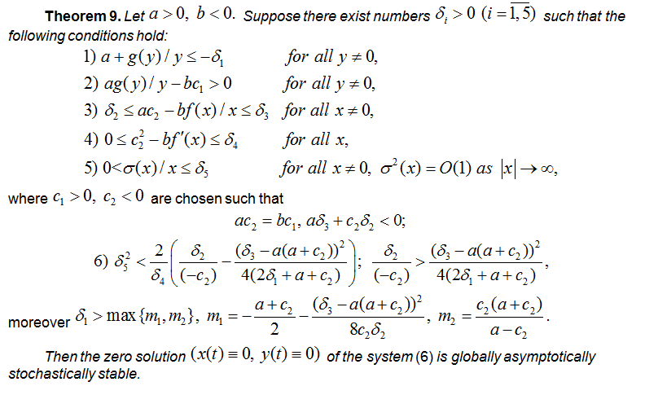
Stochastic stability of systems (dim=2)

Slide 27
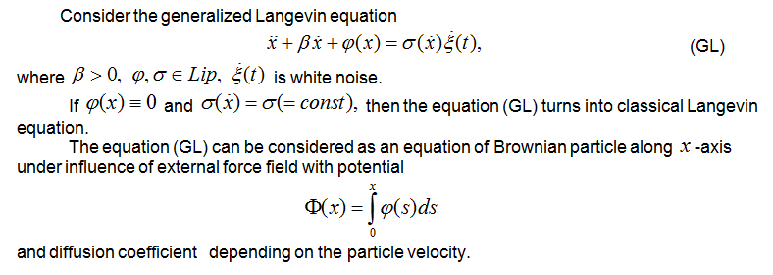
Generalized Langevin Equation

Slide 28
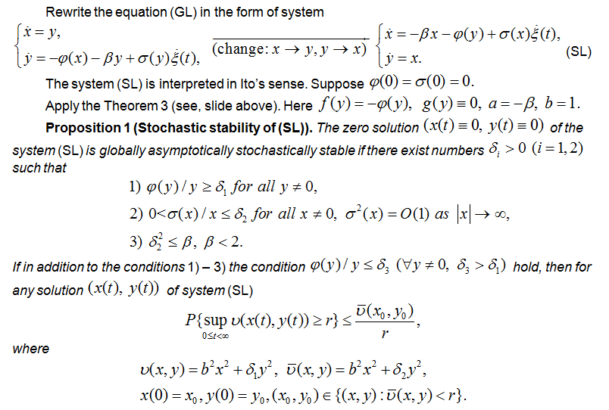
Stochastic stability of generalized Langevin equation

Slide 29
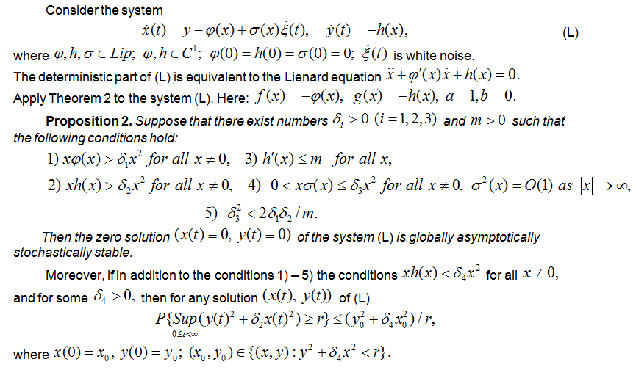
Stochastic stability of Lienard stochastic system

Slide 30
Active area of research
The problems of the stochastic stability and related questions are active area of research and the flow of publications in this topics does not decrease.

Slide 31
Thank You for Your Attention!

