Slide 1
Comparative analysis of books 1) G.P. Matviyevskaya, B.A. Rosenfeld. Mathematicians and astronomers of the Muslim Middle Ages and their works (8th–17th centuries) in three volumes (books). Moscow: Nauka, 1983. 2) B.A. Rosenfeld. Mathematicians, astronomers, and other scholars of Islamic civilization and their works (7th‒I9th c.) by Rosenfeld B.A. and Ekmeieddin İhsanoğlu. Istanbul: Research Center for Islamic History, Art and Culture, 2003.
G.I. Sinkevich
galina.sinkevich@gmail.com

Slide 2
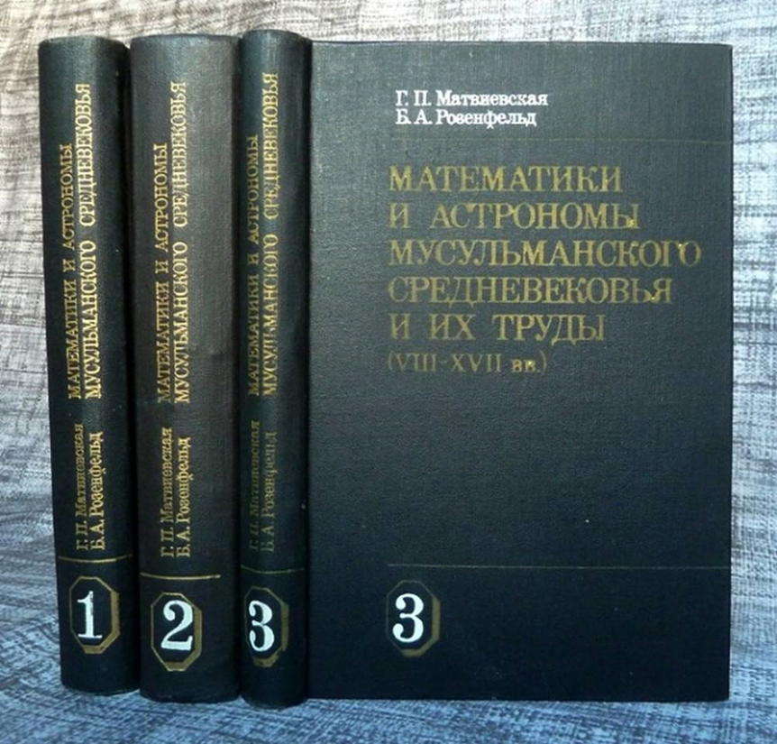
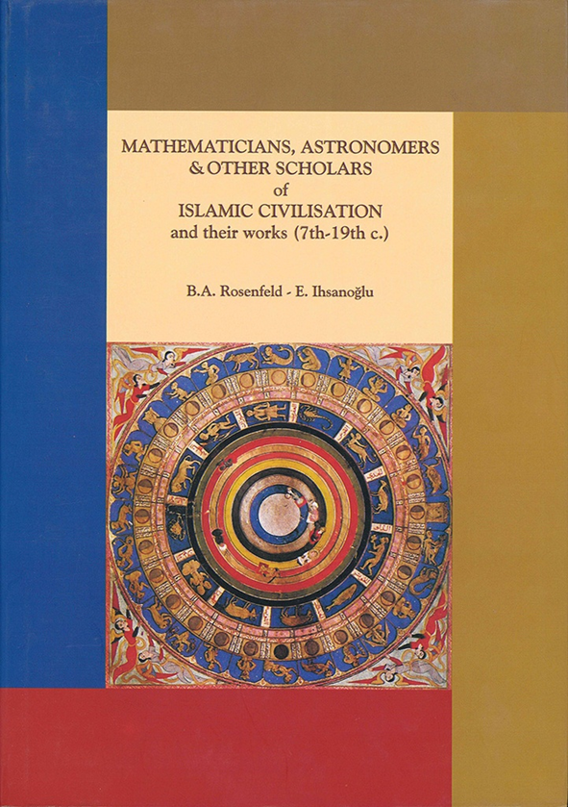
1) G.P. Matviyevskaya, B.A. Rosenfeld. Mathematicians and Astronomers of the Muslim Middle Ages and Their Works (8th‒17th Centuries) in Three Volumes (Books). Moscow: Nauka, 1983. 2) B.A. Rosenfeld. Mathematicians, Astronomers, and Other Scholars of Islamic Civilization and Their Works (7th‒19th Centuries) by Rosenfeld B.A. and Ekmeieddin İhsanoğlu. Istanbul: Research Center for Islamic History, Art and Culture, 2003. 833 p.

Slide 3
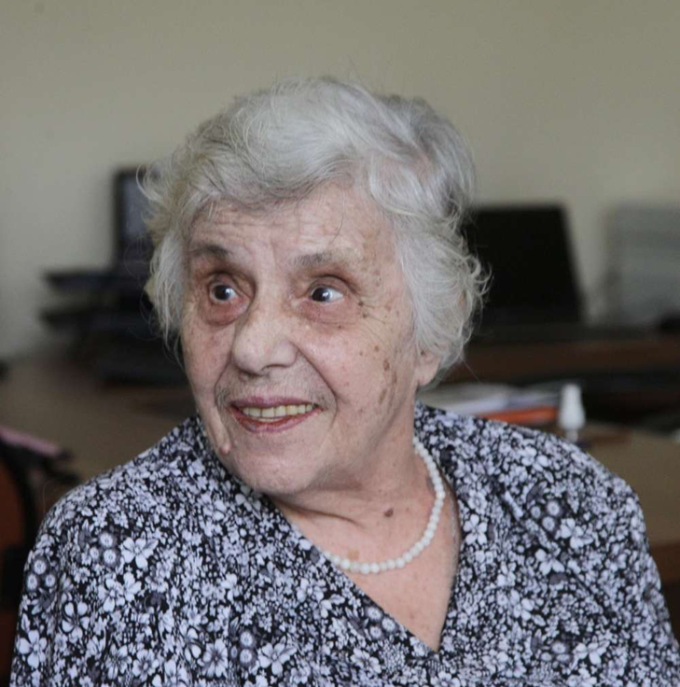
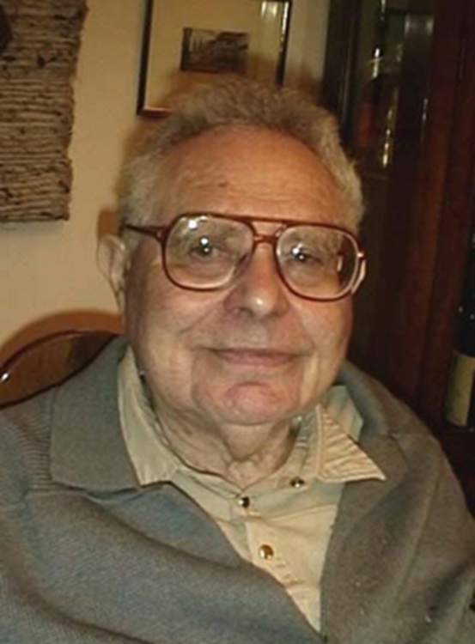
G.P. Matviyevskaya (1930‒2025) and B.A. Rosenfeld (1917‒2008)

Slide 4
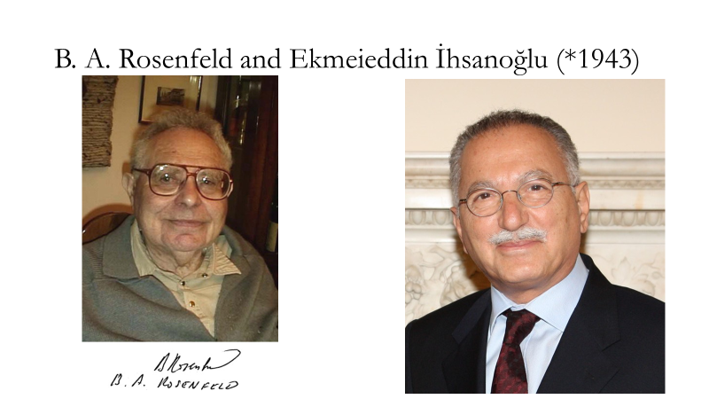

Slide 5
Ekmeleddin İHSANOĞLU
Biography. Prof. Dr. Ekmeleddin İhsanoğlu is a Turkish Scholar, Diplomat, former Member of Turkish Parliament and Member of Parliamentary Assembly of the Council of Europe (PACE).
İhsanoğlu is Founder and Chair of the first Department of History of Science in Turkey, University of Istanbul, 1984-2000. Taught at Ankara, Exeter, Istanbul and Munich Universities and lectured in leading universities in Europe and in the USA. Founder and Honorary President of Turkish Society for History of Science (TBTK) 1989, and ISAR Foundation 1990. Former president of IUHPS, member of Academie Europea and International Academy of History of Science, and member of numerous international academic institutions. Holder of UNESCO Avicenna Medal (2004); Alexandre Koyré Medal of the International Academy of History of Science (2008) and numerous honorary academic titles. Holder of distinguished medals from different countries. Founding Director General of OIC Research Centre for Islamic History, Art and Culture (IRCICA) 1980-2004 and the 9th Secretary General of the Organization of Islamic Cooperation (OIC) 2005-2013.
Editor and co-author of the 18 volume Series of History of Ottoman Scientific Literature, IRCICA; editor and co-author of the 2 volume History of the Ottoman State and Civilization, IRCICA, 2000 (Turkish, English, Arabic, Russian, Bosnian, Albanian and Persian); editor and co-author of Culture and Learning in Islam, UNESCO, 2003; author of Science Technology and Learning in the Ottoman Empire, Ashgate U.K., 2003; author of Turks in Egypt and their Cultural Heritage (Turkish, Arabic, English), IRCICA, 2006, (Arabic edition won the King Abdullah Prize in 2008); History of the Ottoman University-Darülfünun (Turkish), IRCICA, 2010; The Islamic World in the New Century: the Organisation of the Islamic Conference, 1969-2009 (English, Turkish, Arabic, Russian, Urdu, Bengali), Hurst U.K. & Columbia Univ. Press, 2010. Author of two volume Osmanlı Bilim Mirası-Ottoman Scientific Legacy (Turkish) Yapı Kredi Yayınları, 2017.
Research Interests. Islamic History and Muslim CivilizationIslamic ArtIslamic CultureIslamic StudiesOttoman StudiesIslamic HistoryHistory of ScienceRecreation & Leisure StudiesUluslararası İlişkilerOttoman HistoryWomen and Gender Issues in IslamHistory of Turkish RepublicArt History.
Affiliations. Istanbul University, History of Science, Emeritus.
Source. https://ekmeleddinihsanoglu.academia.edu/

Slide 6
Book 1 (G.P. Matvievskaya, B.A. Rosenfeld) Book structure
This publication is a biographical and bibliographical reference book on mathematicians and astronomers of Muslim countries who lived in the 8th–17th centuries. It consists of three books.
The first book includes an introductory article and a reference section, which presents an extensive bibliography. After the “Introduction” (pp. 1–10), comes the substantial historical and analytical section, which is not included in book (2): “Mathematical Sciences” (pp. 11–78), “Natural Sciences” (pp. 79–91), “Philosophical Issues in Mathematics and Natural Science” (pp. 92–99), “Reference Section,” “Manuscript Libraries,” and a bibliography (pp. 122–479).
The second book (650 pp.) contains information on 1,044 scientists whose lifetimes are known.
The third book (372 pp.) contains information about 350 scientists whose lifetime is unknown (pp. 4-47), anonymous works (with an indication of their storage locations by country, pp. 48-119), and indexes (systematic and alphabetical indexes of works, index of authors (pp. 120-332), systematic index of works (pp. 120-160), alphabetical index of works transcribed into Russian (pp. 161-273), alphabetical index of names (pp. 274-332), as well as an “Appendix” (“Mathematical Sciences”, “Natural Sciences”, pp. 333-335), a Bibliography by authors (pp. 335-361) and by persons, incl. by anonymous authors (pp. 362-370), indication of catalogues of manuscripts and publications with translations and their research (pp. 370-372).

Slide 7
Book 2 (Rosenfeid B.A., İhsanoğlu, E.) Book structure
The book contains brief information and bibliographies on 1,423 medieval Muslim scholars whose lifetimes are known (pp. 13–420), as well as on 288 scholars whose lifetimes are unknown (pp. 421–449). It is followed by a list of anonymous works in libraries around the world (by country, pp. 450–497); An index of libraries with manuscripts (by country, pp. 499‒512. Next comes an index of review works by topic (pp. 513‒516). Next comes a list of references (pp. 517‒739, including 40 works by G.P. Matviyevskaya, where she is the sole author, are listed on pp. 640‒641, and 11 of her co-authored works are also listed in this section, pp. 641‒642). Next comes an index of authors (pp. 741‒758). Next comes an index of titles of works in English transcription (pp. 759‒833).

Slide 8
Book (2). Introduction, (pp.3-5)
One hundred years ago, in 1900, Swiss historian of mathematics and astronomy, Heinrich Suter, published the bio-bibliographical survey "Mathematicians and Astronomers of Arabs and Their Works" (Mathematiker und Astronomers der Araber und ihre Werke - MAA). Suler's book contained information on scholars not only in the Arab countries but in all the Islamic countries from the 8'1' to the 17lh centuries. MAA contains information on approximately 500 scholars whose time of life was known and 100 with unknown dates.
In 1983 G.P. Matviyevskaya and B.A. Rosenfeld in Moscow published the work "Mathematicians and Astronomers of Medieval Islam and Their Works" (Malematiki i astronomy musul'manskogo srednevekov’ya i ikh trudy - MAMS) in three volumes which comprise 1000 authors whose lime of life was known and about 300 authors with unknown dates. These items have (he same numbers as in MAA, except those that were newly added.

Slide 9
This work titled Mathematicians, Astronomers and other Scholars of Islamic Civilization and their Works (7th-I9th c.) is based on earlier publications among which MAMS takes the first place. The data taken from MAMS is enriched with the information taken from numerous publications and other relevant sources. Altogether this book comprises the names of 1423 authors whose time of life is known and 288 scholars whose lime of life is unknown. As will be seen, new names that were not in the above-mentioned reference books are added to die list, while some others who were among unknown authors, were identified and included in the list of known authors.
The present work contains English translations of all the material in MAMS with numerous additions, corrections and elaborations. Thus, G. Matviyevskaya's contribution to the present work is very substantial since the relationship between MAMS and the present work is similar to the relationship between Suter's MAA and MAMS. This work also includes new material based on other sources which are listed below. The following are among the most important reference books that appeared in the last twenty years and they are extensively used in this work.
End of quote.

Slide 10
G.I. Sinkevich conclusion
Having carefully studied both books, I come to the following conclusion.The authors of book (2) cite book (1) as their primary source. They abbreviate book (1) with the acronym MAMS, which stands for the joint work of G.P. Matviyevskaya and B.A. Rosenfeld (Mathematicians and Astronomers of the Muslim Middle Ages and Their Works).
Book (2) contains 831 references to MAMS.
On page 499, MAMS is listed among the general catalogs.
Book (2) contains 99 references to G.P. Matviyevskaya works, including a list of 40 of her solo works, as well as a list of 11 of her co-authored works with other researchers (pp. 640-642).

Slide 11
Book (2) has a different structure than Book (1). It doesn't contain the same broad overview and in-depth analysis of mathematicians' work as Book (1), but it significantly expands the number of individuals covered. Book (2) includes many scientific results that have emerged since Book (1), namely:

Slide 12
"A Catalogue of the Scientific manuscripts in the Egyptian National Library" (Fihris al-MakhtOtat al-'ilrniyya al-mahiuza bi-Dar al-kutub al-Misnyya ‒ FMI), 1981.
"A Survey of the Scientific Manuscripts in the Egyptian National Library" (SSM), 1983. "Mathematical Astronomy in Medieval Yemen" (MAY) of D.A. King.1986.
"Science and Technology in Medieval India. A Bio-bibliographical Source Malerial in Sanskrit, Arabic and Persian" (STMI) of Abdur Rahman, M.A.AIvi, S.A.Khan Ghori and K.V. Samba Murthy. 1982.
"Arabic Manuscripts of the Institute of Oriental Studies of the Academy of Sciences of the USSR" (Arabskiye rukopisi Instiluta Voslokovedeniya Akademii nauk SSSR - ARIV) - the catalogue of Arabic manuscripts in the St.Pctersburg branch of ihe Institute of Oriental Studies of the Russian Academy of Sciences that came out in 1986.
"Encyclopaedia of History of Arabic Science" (EHAS) ed. by Rushdi Rashed. 1996.

Slide 13
The works that brought new life to this field are the scientific literature surveys which are edited by E. İhsanoğlu under the series of "History of Ottoman Scientific Literature" and published by Research Centre for Islamic History, Art and Culture (1RCICA) in Istanbul. These are: "History of Astronomy Literature During the Ottoman Period" (Osmanh Astronomi Lileraturu Tarihi - OALT) 2 vols; "History of Mathematical Literature During the Ottoman Period" (Osmanli Matematik Lileraturu Tarihi - OMLT) 2 vols; and "History of Geographical Literature During the Ottoman Period" (Osmanh Cografya Lileraturu" Tarihi - OCLT) 2 vols., and "History of Music Literature During the Ottoman Period" (Osmanh Muzik Literalurii Tarihi - OMULT) published in 1997, 1999, 2000 and 2003 respectively.
These four books comprise surveys of astronomical, mathematical, geographical and musical works of scholars in Turkey and in all the provinces of the Ottoman Empire, stretching from Europe, Asia Minor, the Middle East to North Africa. Alltogether ihey contain a total of 1588 names from15th to 20th centuries.

Slide 14
The natural development of biobibliographical reference works involves building on previous literature and gradually expanding the number of individuals covered.
Thus, it can be concluded that Book (2), although a significantly revised expansion of previous editions, including Book (1), is nonetheless an independent scholarly study, with accurate references to the literature used.

Slide 15
Thank you for your attention

