Slide 1
Market-Triggered Changes in Capital Structure:
Equilibrium Price Dynamics
Paul Glasserman
Columbia Business School
Joint work with Behzad Nouri
Advanced Finance and Stochastics Conference
Steklov Institute – Moscow
June 24-28, 2013

Slide 2
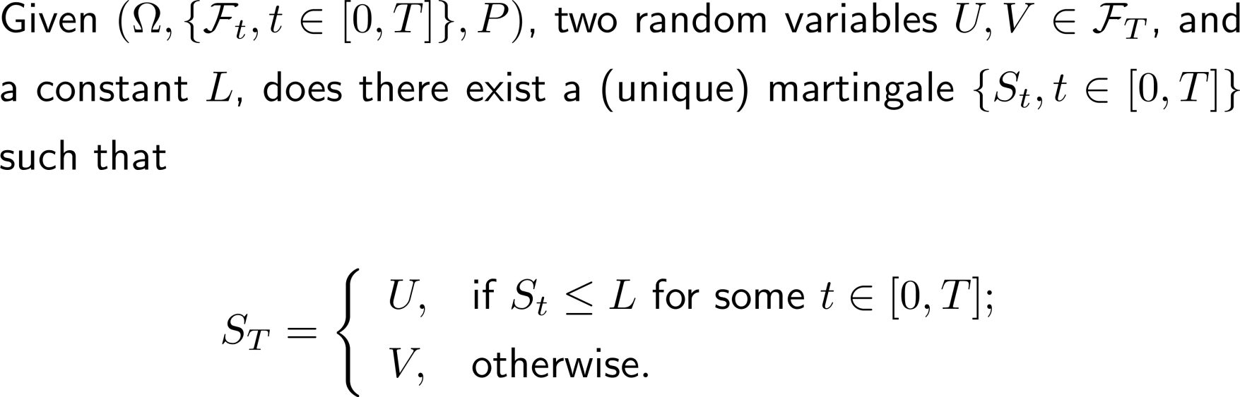
Before the Finance, Some Stochastics…

Slide 3
Motivation: Contingent Capital for Banks
Contingent convertible debt (“Cocos” ) is debt that converts to equity when a bank gets in trouble, avoiding bankruptcy or a government bail-out – possible solution to too-big-to-fail
  Major issuances to date by Lloyds, Credit Suisse, BBVA
  Recent conversion by Co-Operative Bank in UK
  On-going consideration by Basel Committee on Banking Supervision
  More interest in Europe than in the US
Big question: How to define the trigger for conversion?
  So far, all actual issuances and regulatory proposals use a regulatory capital ratio: accounting-based, slow to react, subject to discretion
  Flannery (2005) proposed a market-based trigger (bank’s stock price): quick to react and may provide a better measure of a bank’s condition

Slide 4
Regulatory Versus Market Signals

Slide 5
The Problem of Internal Consistency
Sundaresan and Wang (2010) point out a problem with a market trigger
  Conversion from debt to equity is triggered by the stock price
  But the stock price depends on whether the debt converts
  Is the mechanism consistent? Is there a unique equilibrium?
  Their two-period binomial examples show the possibility of multiple equilibria or no equilibrium
  They suggest that this can lead to market manipulation or excess volatility

Slide 6
The Problem of Internal Consistency
Sundaresan and Wang (2010) point out a problem with a market trigger
  Conversion from debt to equity is triggered by the stock price
  But the stock price depends on whether the debt converts
  Is the mechanism consistent? Is there a unique equilibrium?
  Their two-period binomial examples show the possibility of multiple equilibria or no equilibrium
  They suggest that this can lead to market manipulation or excess volatility
We
  Look at the problem in continuous time – price adjustments make a big difference
  Develop a general framework beyond contingent capital
  Show that multiple equilibria can mostly be ruled out in continuous time (i.e., if the triggering security is sufficiently liquid)
  Give sufficient conditions for existence of an equilibrium (and construct it explicitly): effect of conversion should move in the same direction as trigger

Slide 7
Outline
Static case
  0, 1, infinitely many equilibria all possible and easy to describe
Dynamic model
  Continuous price processes, no coupons or dividends
  Applications
  Continuous coupons and dividends
  Infinite horizon
  Jumps and discrete dividends

Slide 8
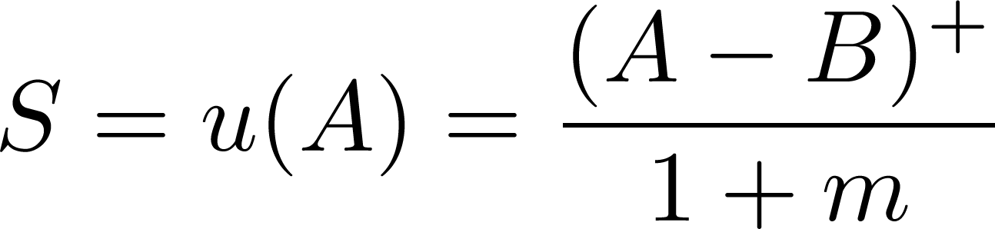
Static Case
Firm has
  Assets = A
  Straight debt = B
  Contingent capital = C
Without conversion, the stock price is
Conversion produces m additional shares and a stock price of
v(A) without conversion
u(A) with conversion
A
B
B+C

Slide 9
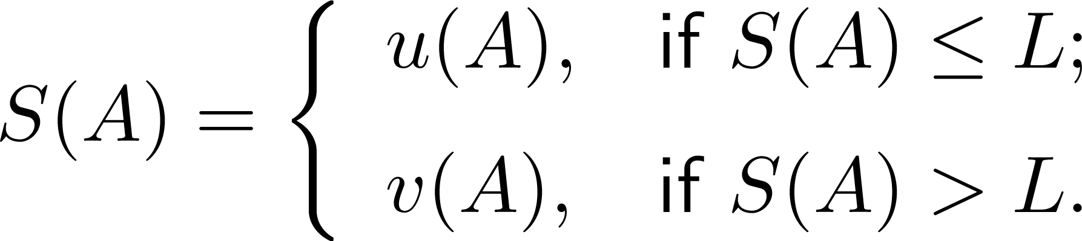
Stock Price and Trigger
Suppose we want the contingent capital to convert if the stock price is at or below a trigger level of L
Define an equilibrium stock price to be a mapping from [0,∞) to [0,∞) satisfying
Does such a mapping exist? If so, is there is more than one?

Slide 10
Nice Case: Unique Equilibrium
Need
v(A) without conversion
u(A) with conversion
L=C/m

Slide 11
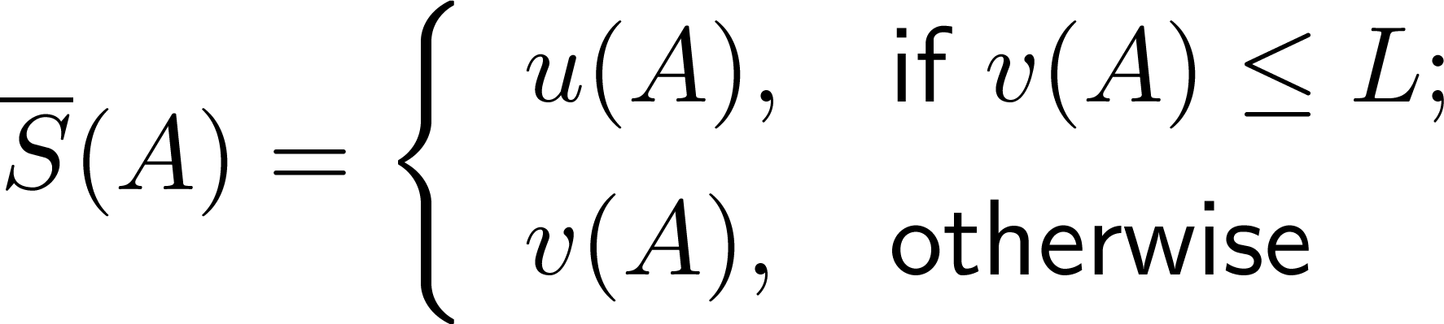
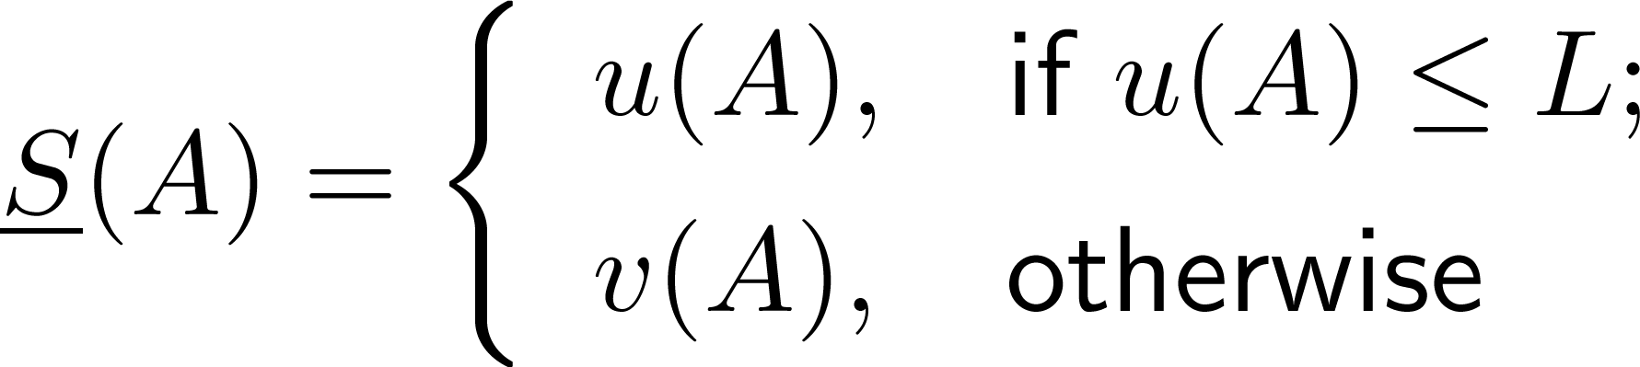
Less Nice Case: Multiple Equilibria
Need
v(A)
v(A)
L>C/m
u(A)
u(A)

Slide 12
The Cretan Case:
Conversion Implies Non-Conversion and Vice Versa
Need
v(A)
u(A)
L<C/m

Slide 13
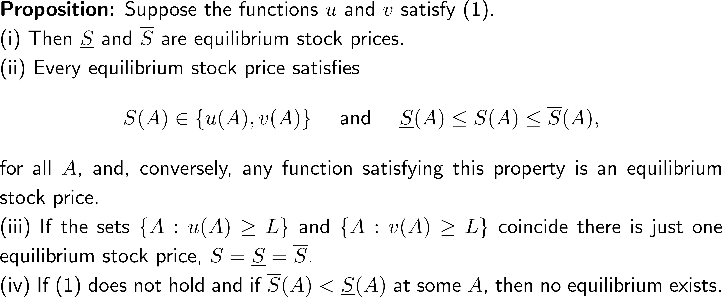
More Generally…
Key property is

Slide 14
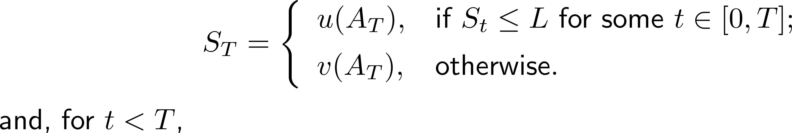
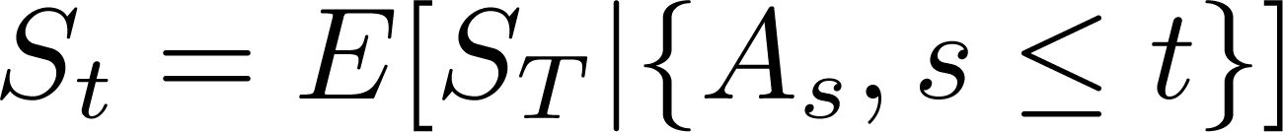
From Static Case to Dynamic Model
Special case: Contingent capital in a Merton model
  Assets A_{t} follow GBM
  At maturity T, stock price is either u(A_{T}) or v(A_{T}), with u, v as in the static case, depending on whether trigger was reached
  Trigger at L is in effect throughout [0,T]
Does there exist a process S satisfying

Slide 15
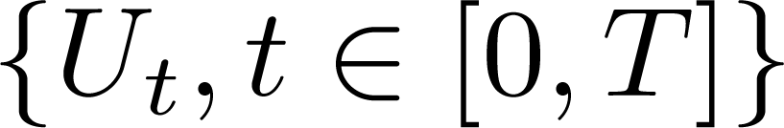
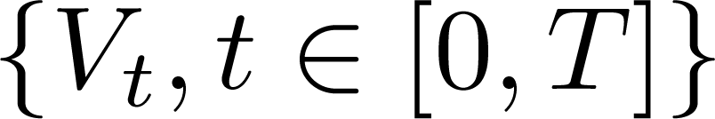
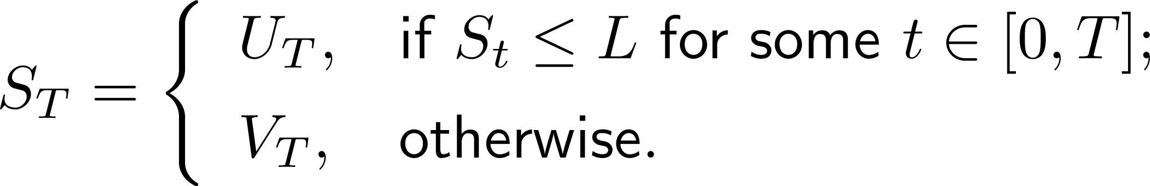
Dynamic Setting: Abstract Formulation
Given two martingales and does there exist (just) one martingale S satisfying
We assume
  Investors are risk-neutral and interest rates are zero (for notational convenience only)
  No dividends or coupons, so price processes are martingales
  A Brownian filtration, so all martingales are continuous (for now)

Slide 16
Dynamic Setting: Interpretation
Given two martingales and does there exist (just) one martingale S satisfying
V_{t} is the stock price in a “no-conversion” firm
  E.g., debt cannot convert to equity
U_{t} is the stock price in a “post-conversion” firm
  E.g., debt has already converted to equity

Slide 17
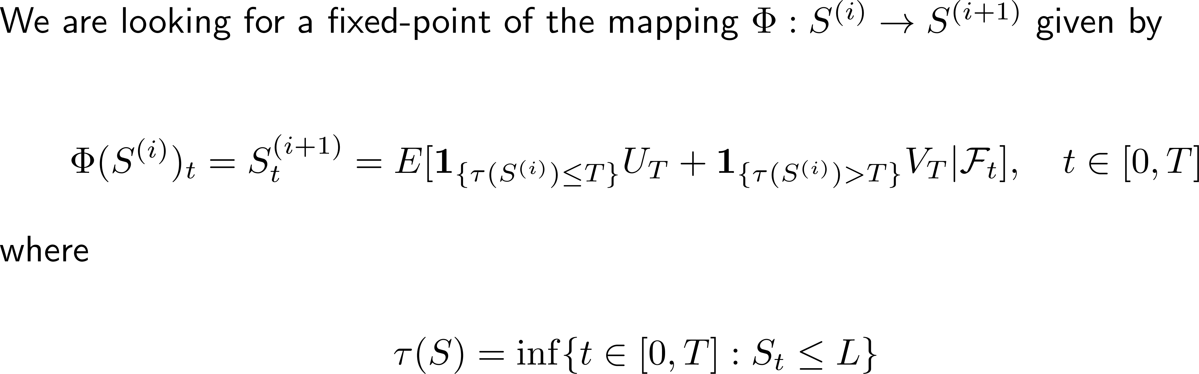
Fixed-Point Formulation

Slide 18
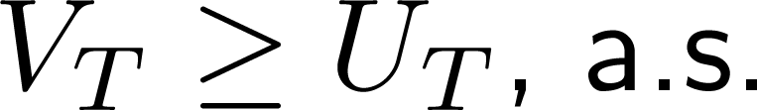
Existence
Main condition
Interpretation: At high asset levels, conversion is bad for shareholders, and trigger should be high enough that conversion occurs in this range
Easier case:
Implies
Theorem (Existence): Under condition (1), there exists at least one equilibrium stock price process.
First prove easier case, then reduce general case to easier case.

Slide 19
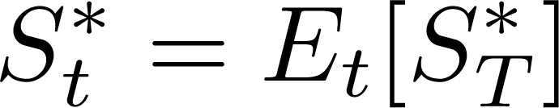
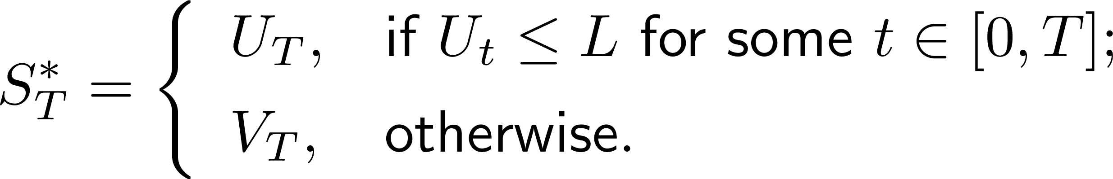
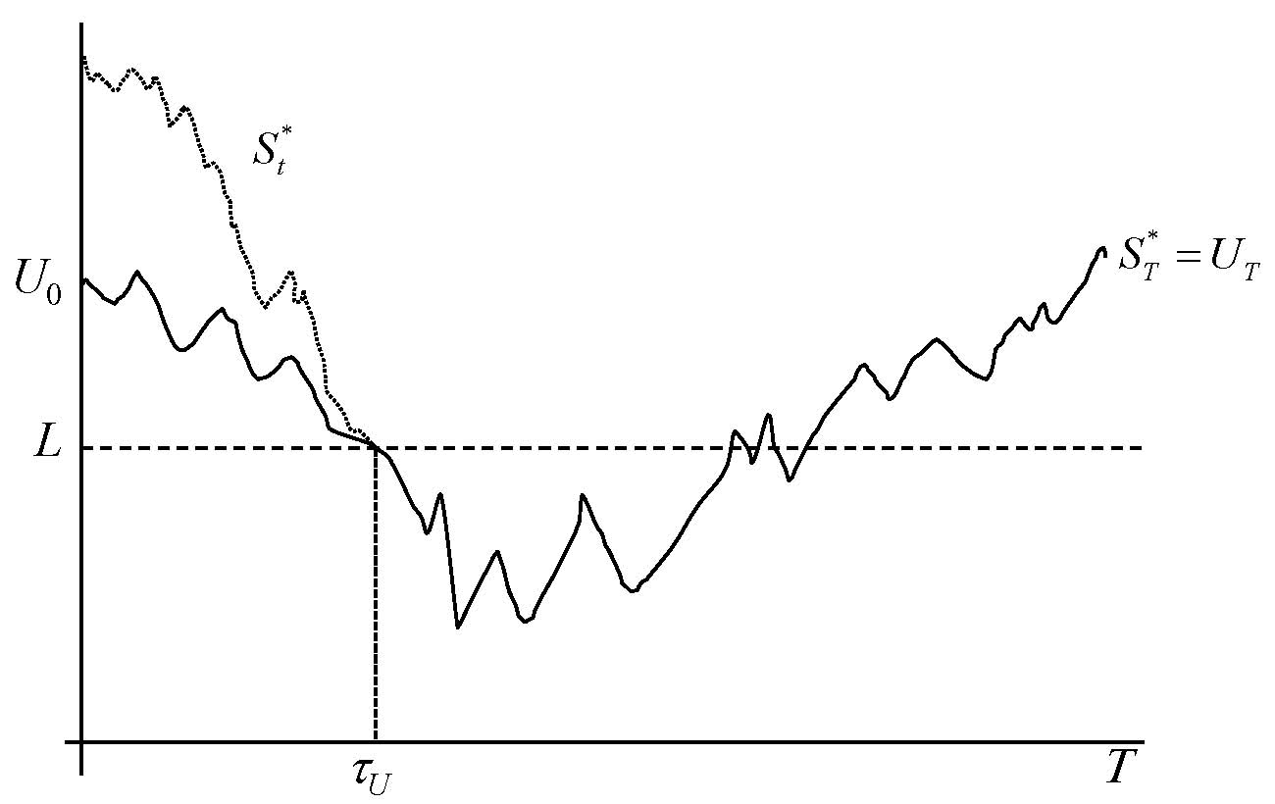
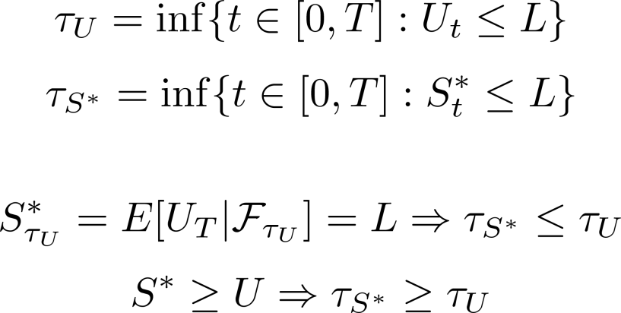
Existence Proof: By Construction
Define with
This equilibrium converts the first time the post-conversion price is at or below the trigger

Slide 20
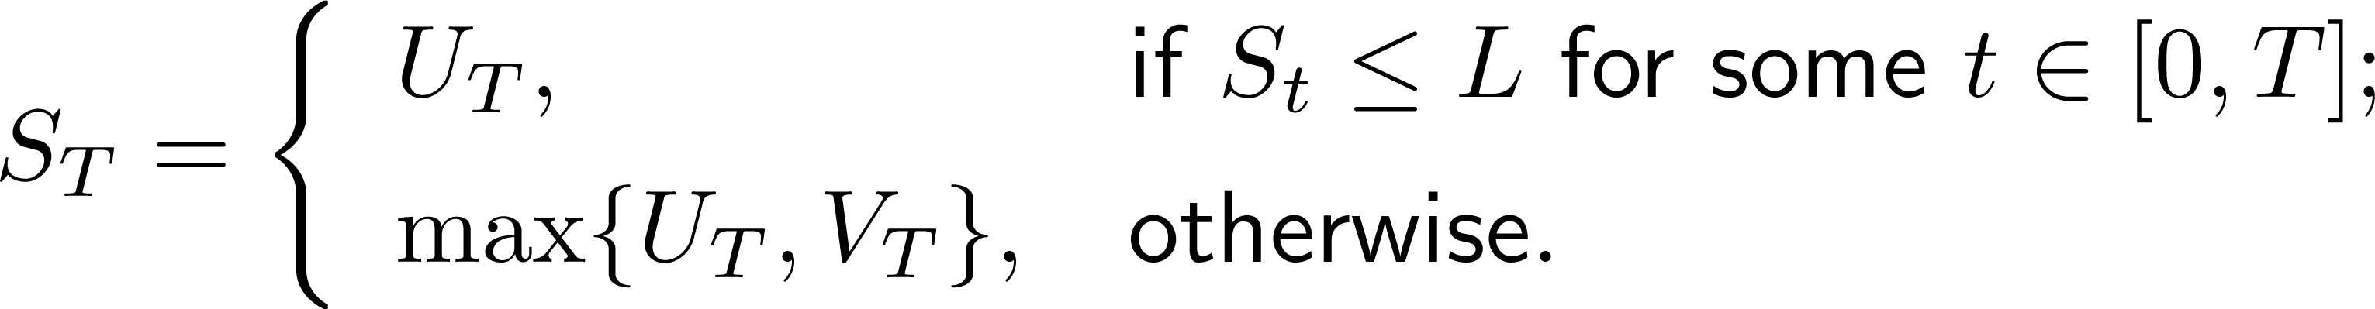
Reduction To Easy Case
If we have
then S satisfies
If and only if

Slide 21
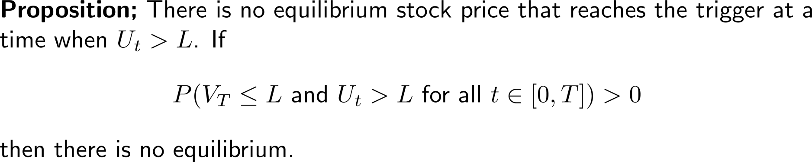
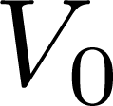
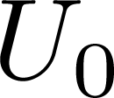
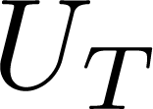
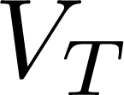
Partial Converse
Cretan case:

Slide 22
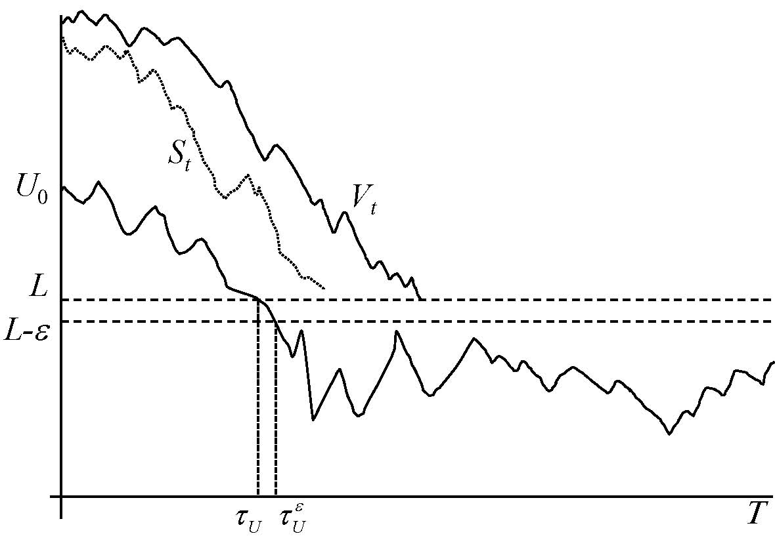
Uniqueness: Sketch of Argument
Conversion cannot cause a jump because
  Brownian martingales are continuous
  Stock price adjusts to anticipate the effect of conversion

Slide 23
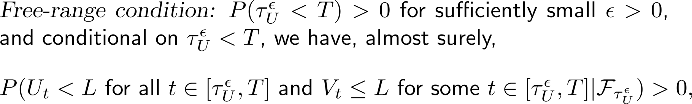
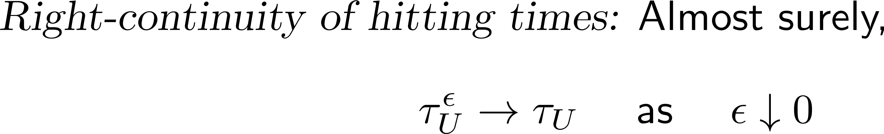
Two Conditions

Slide 24
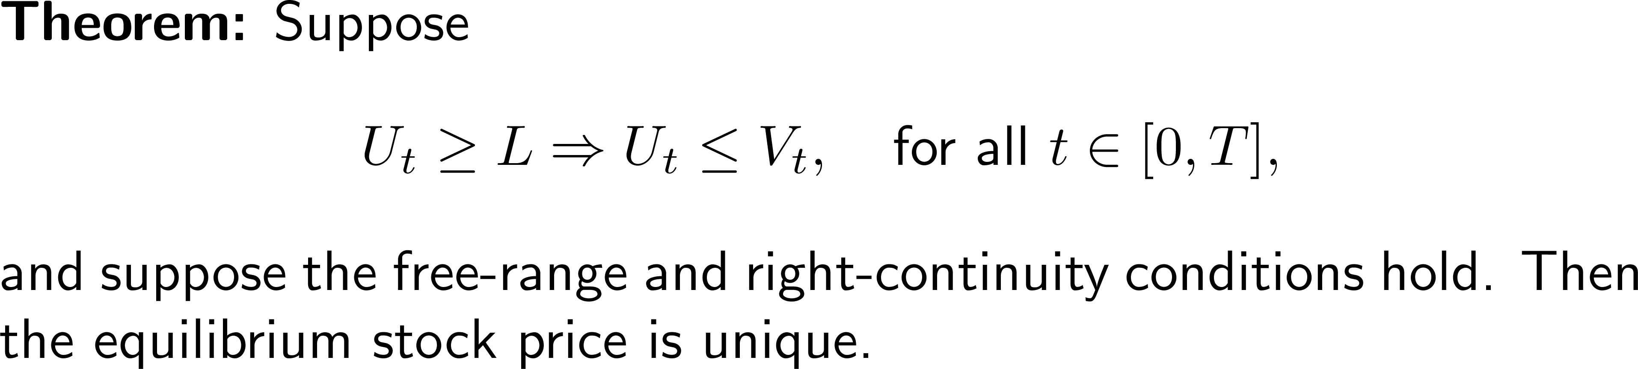
Uniqueness

Slide 25
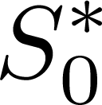

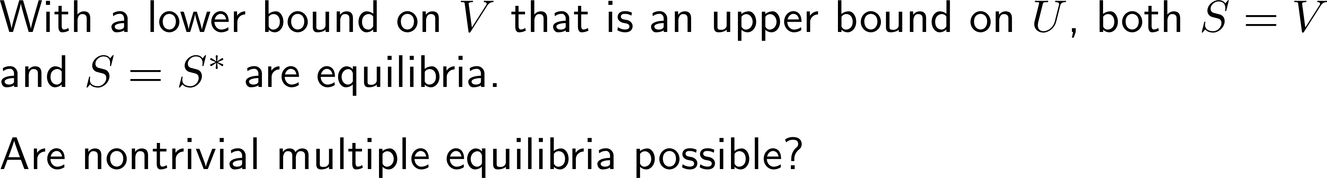
Counterexample: Dropping Free-Range Condition

Slide 26
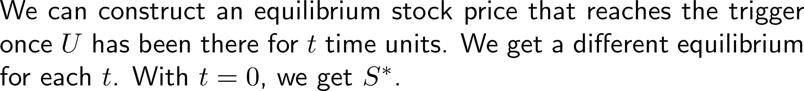
Counterexample: Dropping Right-Continuity of Hitting Times

Slide 27
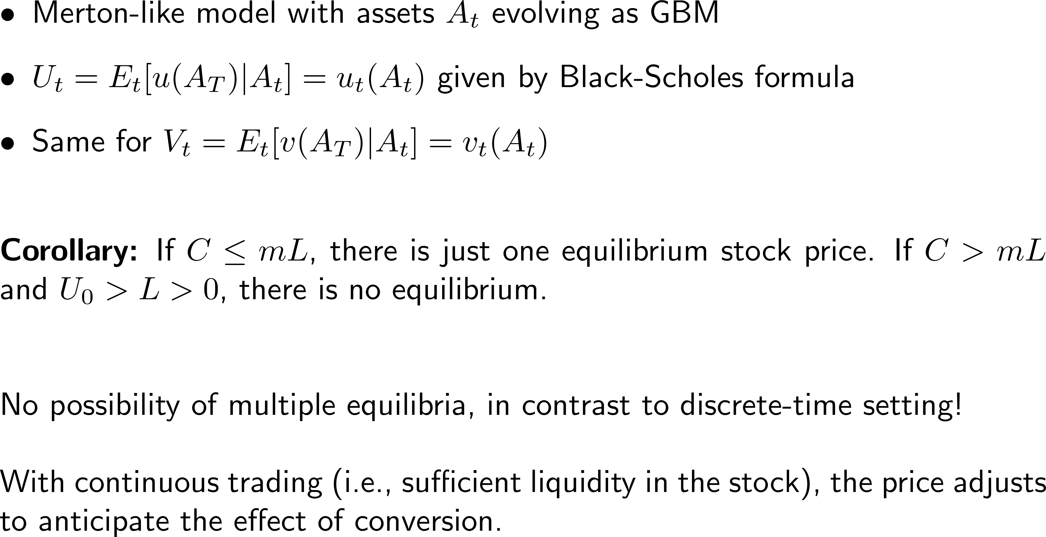
Application: Contingent Capital Revisited

Slide 28
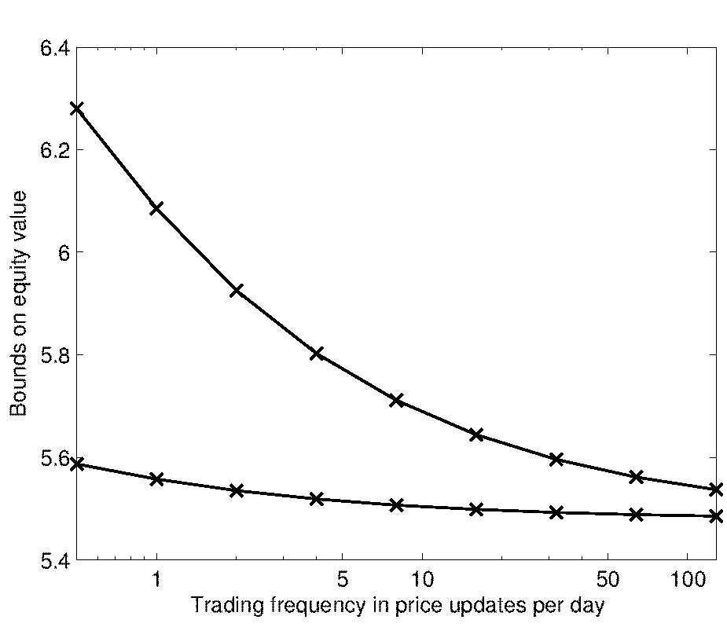
From Discrete to Continuous Time (Binomial Model)
Unique continuous-time equilibrium is the minimal discrete-time equilibrium: earlier conversion = lower stock price
Apparent convergence appears to O(1/sqrt(n))
A₀=B=100, C=6, L=1, T=5, asset volatility = 6%

Slide 29
Binomial Bounds
Terminal condition
Terminal condition
A_{u}
A_{u}
A
A
A_{d}
A_{d}
Convert when you can
Convert when you must

Slide 30
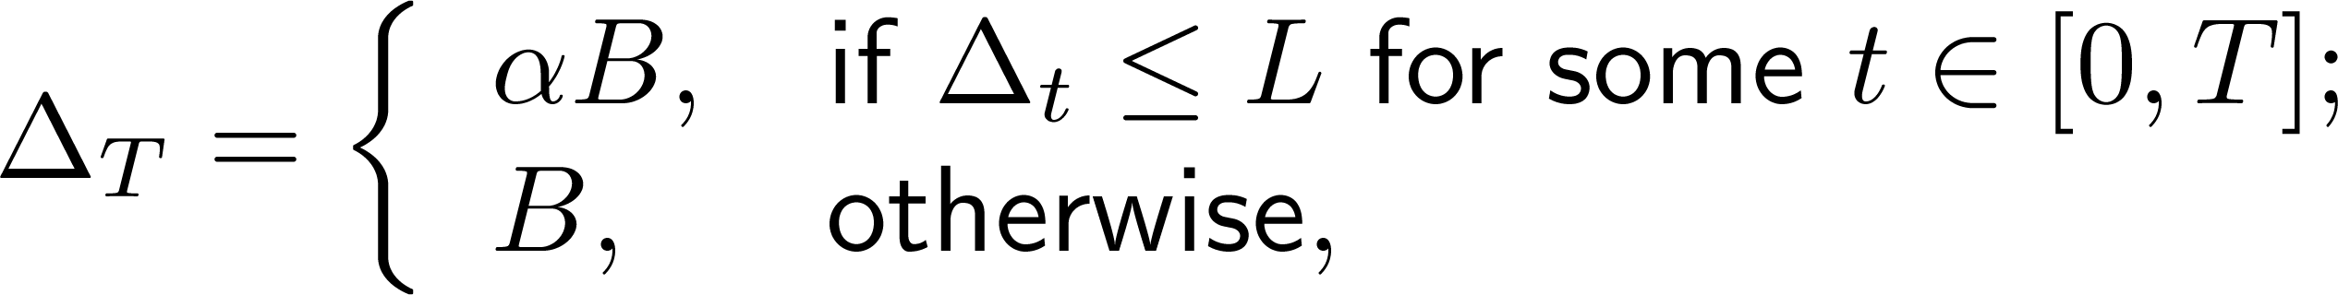
Application: Debt Write-Down
Rabobank issued contingent capital in 2010 in the form of bonds that get written down to 25% of par if a capital ratio falls below 7%
What about a market trigger?
Consider a bond price trigger (or a CDS trigger)
Debt price Δ_{t}
Post-conversion and no-conversion prices
This is the easy case U≤V so converting when the bond price falls is ok

Slide 31
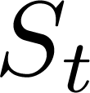

Application: Debt Write-Down
What about a stock price trigger?
Post-conversion and no-conversion prices
This is a bad case U≥V; converting when the stock price falls is not ok
It would appear that the only possible equilibrium is one that never hits the trigger

Slide 32
Application: Debt Write-Down
If we set the trigger to be approached from below, we’re ok
Post-conversion and no-conversion prices
This is an easy case U≥V with a trigger defined by S_{t}≥L
However, having a rise in the stock price trigger a debt write-down wouldn’t go over well
Better example: performance-sensitive coupons

Slide 33
Other Applications
We need the effect of conversion to “move” in the same direction in which the triggering security approaches the trigger
  If the trigger is a decline in the stock price, we need the post-conversion price lower than the no-conversion price when both are above the trigger
Forced deleveraging: Sell assets to pay down debt when stock falls (good)
Automatic share repurchase: Issue debt to buy back shares when stock price falls (bad)
Triggered consolidation: Bank consolidates a subsidiary to improve its capital ratio (good if trigger is based on a linear combination of the two stock prices)

Slide 34
Continuous Dividends, Infinite Horizon, Jumps, Discrete Dividends

Slide 35
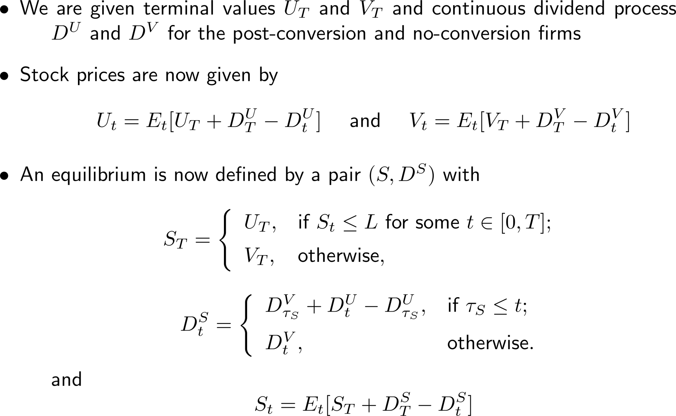
Dividends: Continuous Case

Slide 36
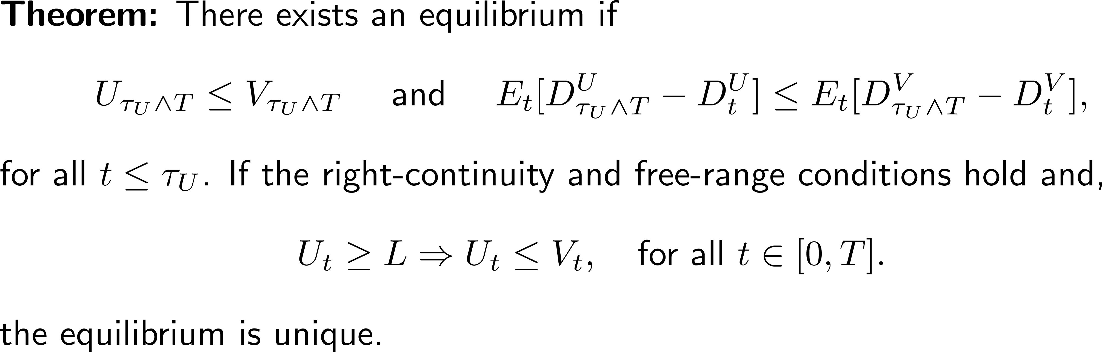
Dividends: Continuous Case
Essentially the same argument as before

Slide 37
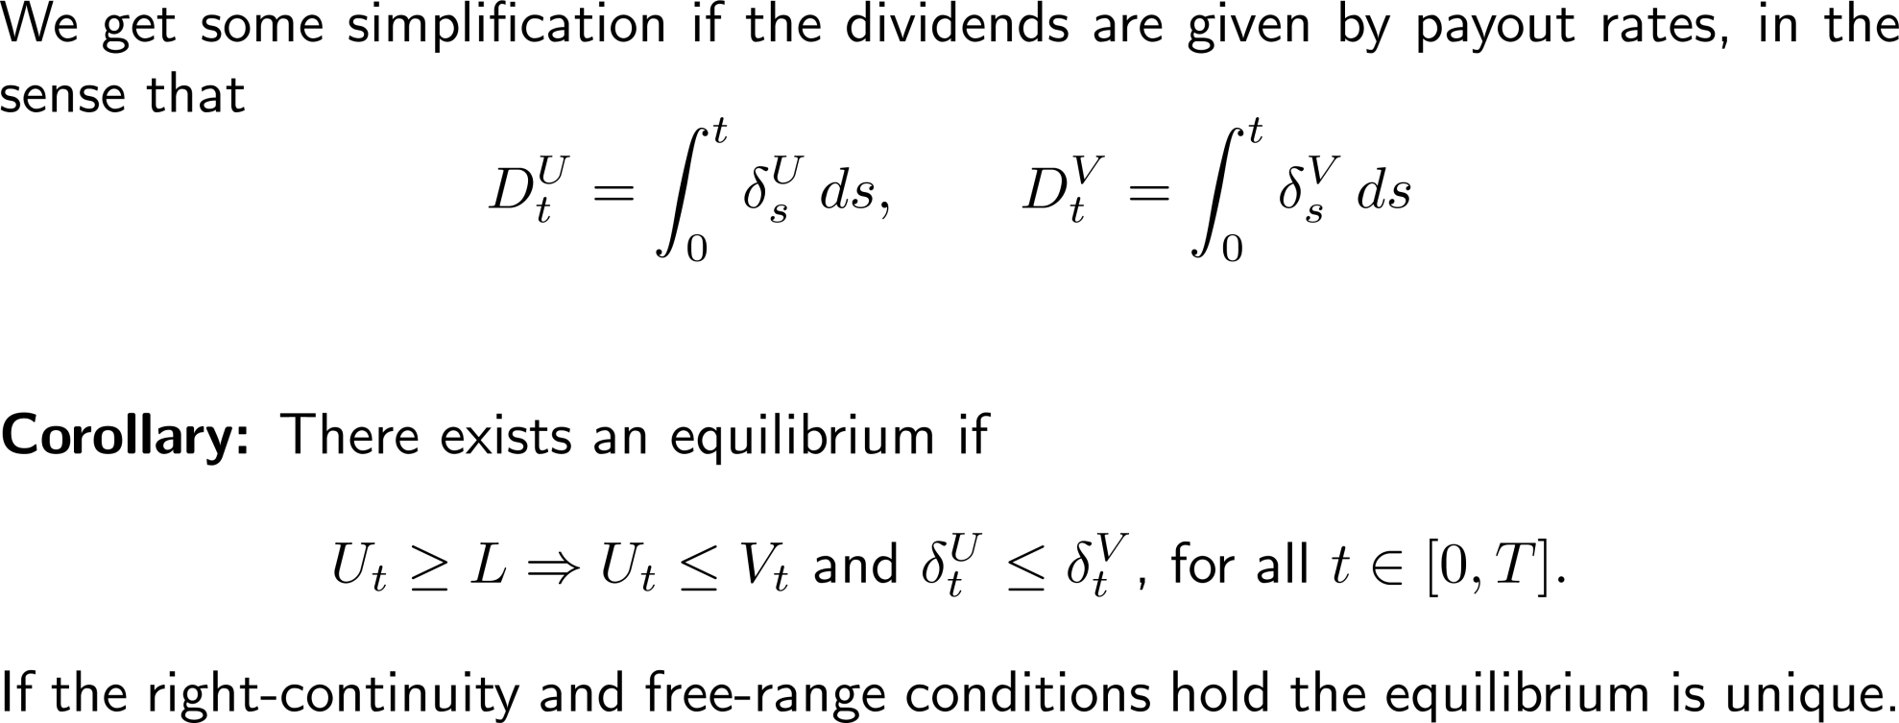
Dividends, continued
In a structural model, assets generate cash used to pay (continuous) coupon on debt, and residual is paid as dividends to equity.

Slide 38
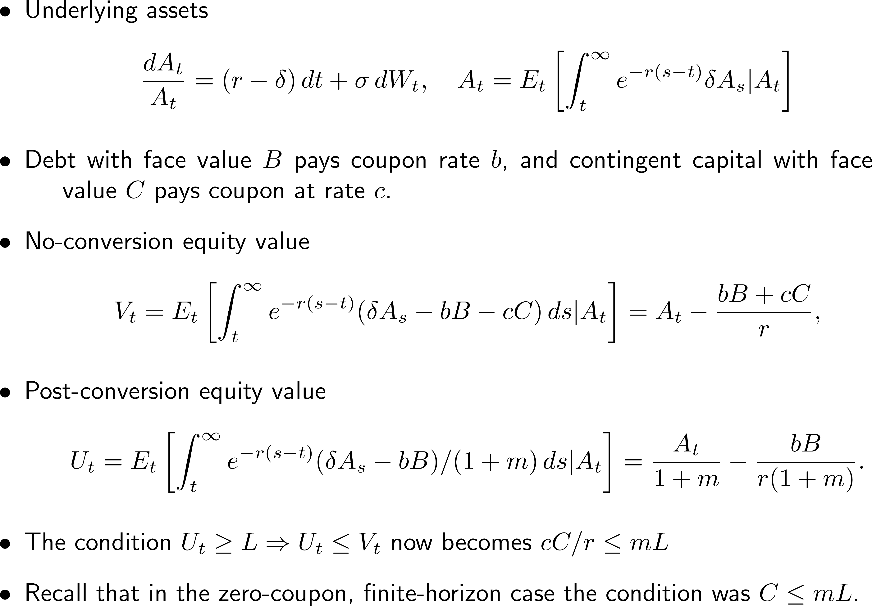
Dividends: Infinite Horizon Example

Slide 39
Jumps
Introduce a compound Poisson process (right-continuous), independent of underlying Brownian motion
Price processes adapted to the history generated jointly
Martingales no longer need to be continuous, but
Representation theorem (as in Jacod and Shiryaev 2003) implies that jumps can occur only at points of the Poisson process
A jump can cause conversion, but conversion can’t cause a jump

Slide 40
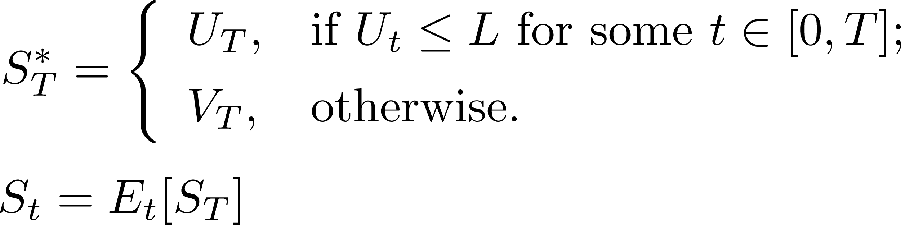
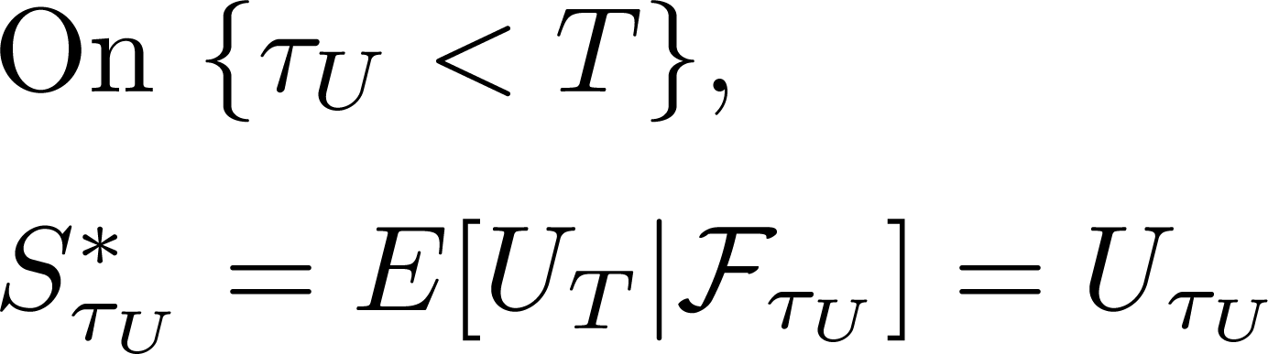
Jumps: Existence
For simplicity, omit dividends
Recall construction of S* (doesn’t use continuity)

Slide 41
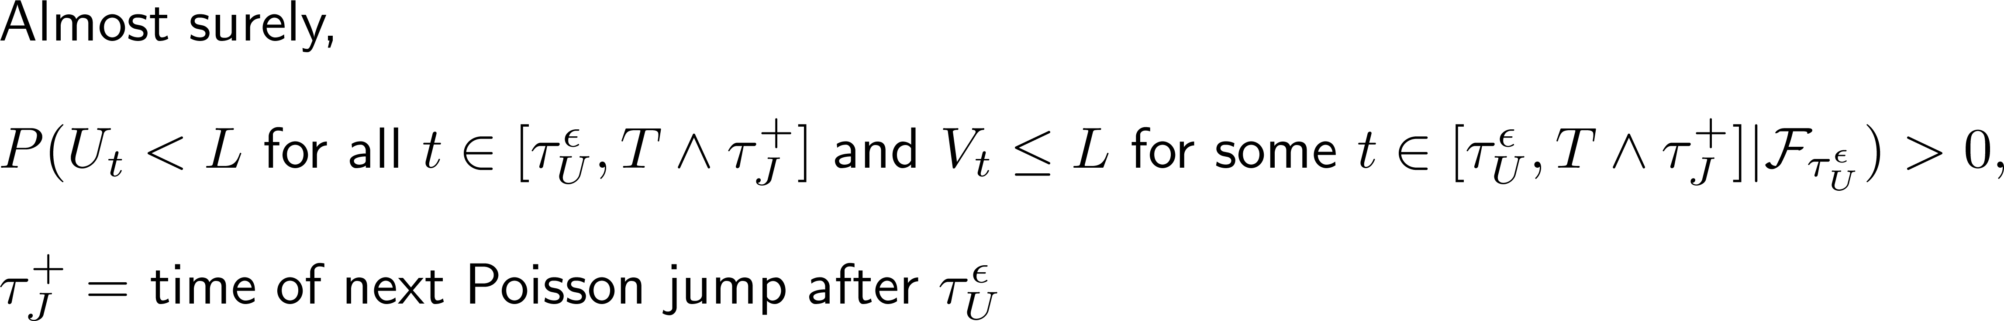
Jumps: Uniqueness
The uniqueness argument did use continuity: conversion could happen only when U_{t}=L
But this remains true if there are no jumps
Modify the free-range condition:
No jumps

Slide 42
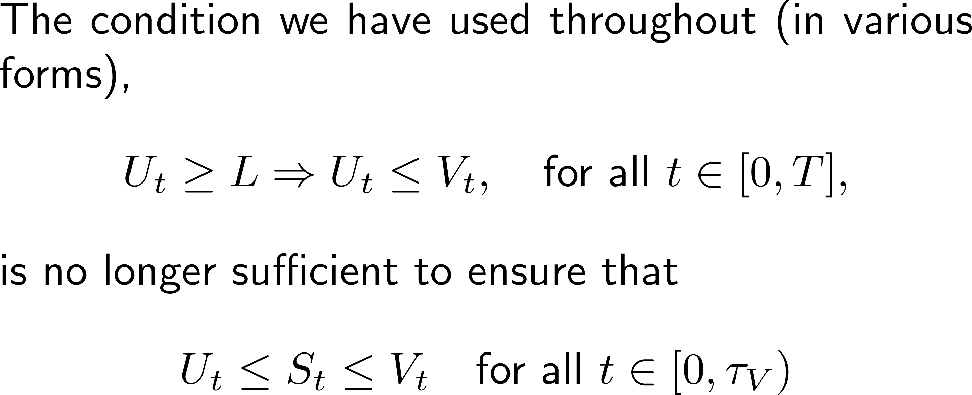
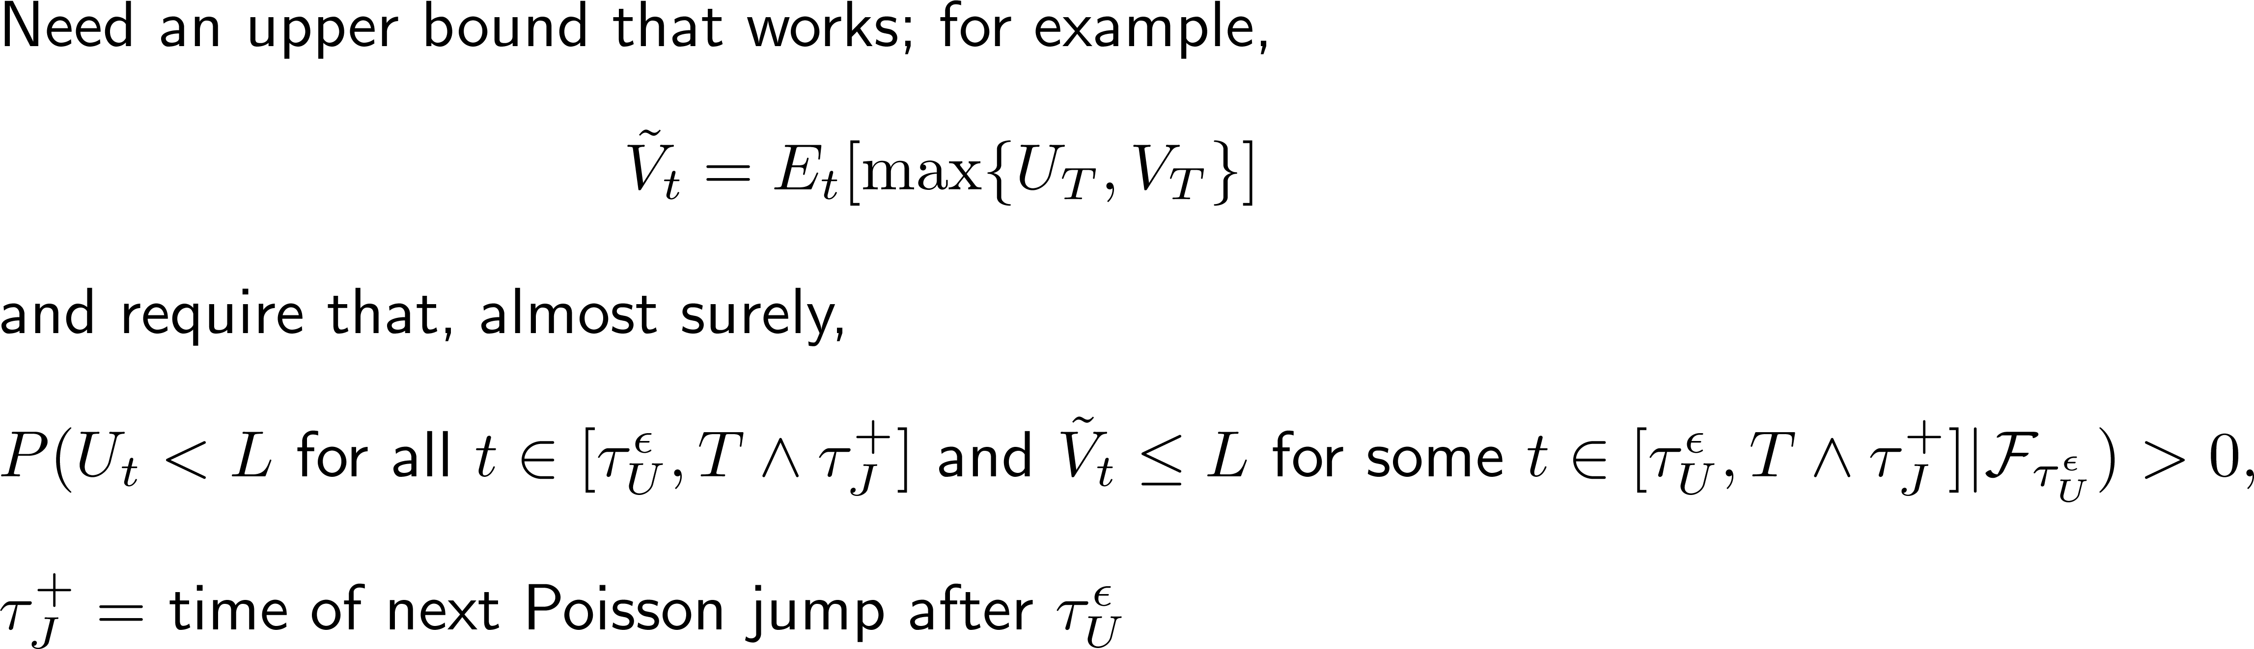
Jump: Uniqueness, continued

Slide 43
Last Case: Discrete Dividends
These introduce jumps at fixed dates
This gets tricky: If the no-conversion and post-conversion firms pay a dividend at the same time, which does the “real” firm follow?
  What if the no-conversion dividend triggers conversion but the post-conversion doesn’t?
  But we don’t want a dividend to trigger conversion ever
  We’ll assume the post-conversion firm pays no dividends; this is consistent with the idea that conversion is punitive to shareholders
V’s dividends are restricted to fixed dates

Slide 44
Discrete Dividends: Existence and Uniqueness
Existence construction is the same as before
For uniqueness, we need an upper bound; for example
No jumps and no dividends

Slide 45
Wrapping Up: Open Problems
Key point: continuous trading mostly rules out multiple equilibria; price adjusts to anticipate effect of conversion
Are there interesting cases of multiple equilibria in continuous time?
  “Interesting” requires that more than one can reach the trigger
  In the continuous case, we know all conversion times are in {t:U_{t}=L}
If the direction at conversion goes the “wrong” way, when is V (never convert) an equilibrium?
How to bound the range of equilibria in discrete time?
What if the trigger is defined by an average price over some window?
What happens if a security yielding multiple or no equilibrium is actually issued?

Slide 46
Thank You

